Slide 1

Realtime Face recognition using Opencv and numpy
Project members:
Amul Neupane
Suja Basnet
Ramina Rajbhandari

Slide 2
Objectives
1. To detect a face in an image.
2. Generate the labels for the training data and training our classifier.
3. Predict image

Slide 3
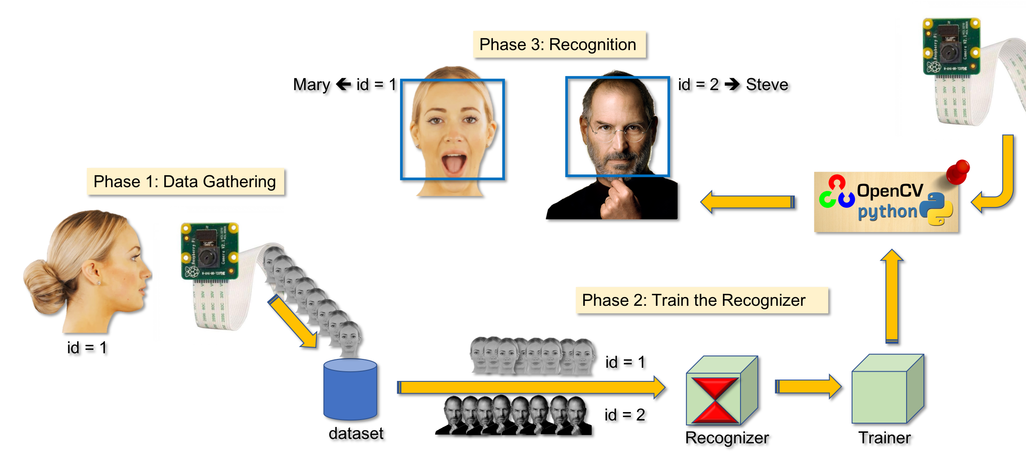
Steps

Slide 4
Technology Used
Numpy
It contains a powerful implementation of N-dimensional arrays which we will use for feeding data as input to our functions.
Opencv
Opencv is used for object detection classifiers.
In our project we are using Haar cascade classifiers and LBPH for feature extraction.
Haar Cascade Classifiers
It is an effective way for object detection.
Lots of features are in coded here to detect face.

Slide 5
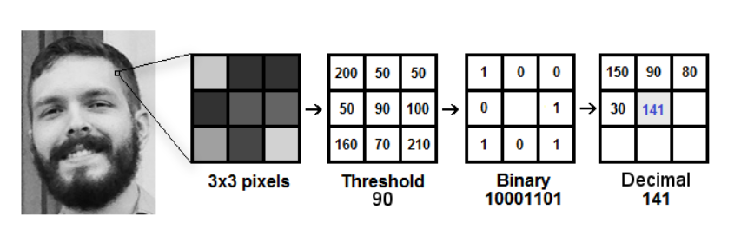
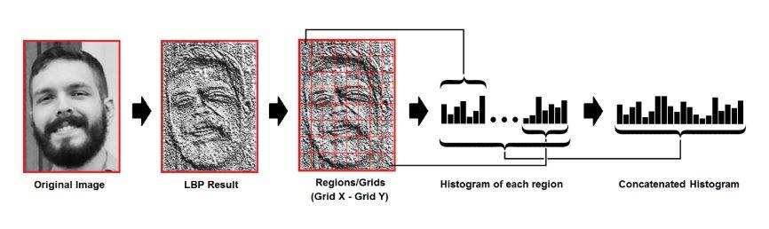
It is used to extract features from an input test image and match them with the faces in system's database. It labels the pixels of an image by thresholding the neighborhood of each pixel and considers the result as a binary number.
LBPH
(Local Binary Pattern Histogram)

Slide 6
DEMO

Slide 7
Conclusion & Future Work
The videoTester.py provided us with 40-50% confidence score and detected and recognized face almost every time with very small error.
Implementing the recognition and prediction part using Neural network can be one of the future work that we couldn’t implement due to various reasons.

Slide 8
References
https://towardsdatascience.com/face-recognition-how-lbph-works-90ec258c3d6b
https://docs.opencv.org/3.4/db/d28/tutorial_cascade_classifier.html
https://pythonprogramming.net/haar-cascade-face-eye-detection-python-opencv-tutorial/
https://www.geeksforgeeks.org/face-detection-using-python-and-opencv-with-webcam/?fbclid=IwAR1npStCZVv21nTZvE_kE8fhXz7vgW_lt-rn9Ilf_fCRXHqLkxZSpOTAGK0

