Slide 1
A Network and Device Aware QoS Approach for Cloud-Based Mobile Streaming
A.PREMALATHA
V.PRABHAVATHI
S.RATHIKA
S.SATHYA

Slide 2
Abstract
Multimedia information can be obtained easily using mobile, allowing users to enjoy network services devices.
Considering the limited bandwidth available for mobile streaming and different device requirements, this study presented a network and device-aware Quality of Service (QoS) approach that provides multimedia data suitable for a terminal unit environment.

Slide 3
Introduction
In recent years, as mobile devices have developed rapidly, users have been able to access network services anywhere and at any time with the development of 3G and 4G networks.
It realizes multimedia computing, storage space configuration, and sharing services based on the powerful arithmetic capability of cloud computing .

Slide 4
Existing System
Scholars have done numerous researches toward conventional platform (CDN) to store different movie formats in a multimedia server, to choose the right video stream according to the current network situation or the hardware calculation capabilities.
To solve this problem, many researchers have attempted dynamic encoding to transfer media content, but still cannot offer the best video quality.

Slide 5
Proposed System
When a mobile device requests a multimedia streaming service, it transmits its hardware and network environment parameters to the profile agent.
Then transmits them to the Network and Device-Aware Multi-layer Management (NDAMM).
The NDAMM determines the most suitable SVC code.

Slide 6
Architecture
Mapper
Reducer
Output
Media Content Provider
Mobile
Phone
Media Data
SVC
Data Format
User-Generated Content
NDAMM
User
Profile
Module
Mobile Phone
Cloud Content Management Services

Slide 7
Algorithm
SVC is an improvement over traditional H.264/MPEG-4 AVC coding, as it has higher coding flexibility.
This study investigated how to determine an appropriate multimedia video streaming service according to these three major characteristics.

Slide 8
Data Flow Diagram

Slide 9
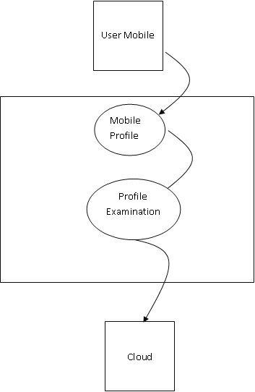
Level 0 DFD

Slide 10
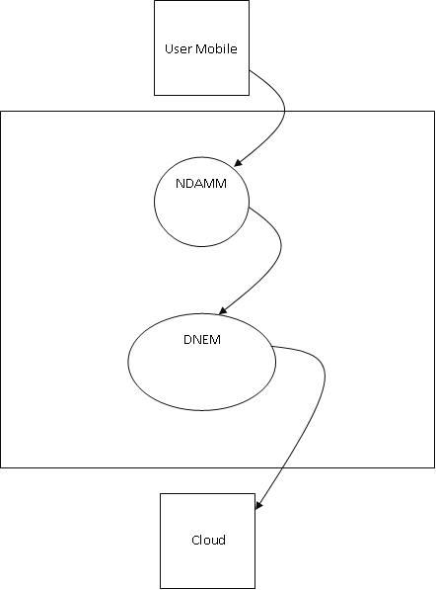
Level 1 DFD

Slide 11
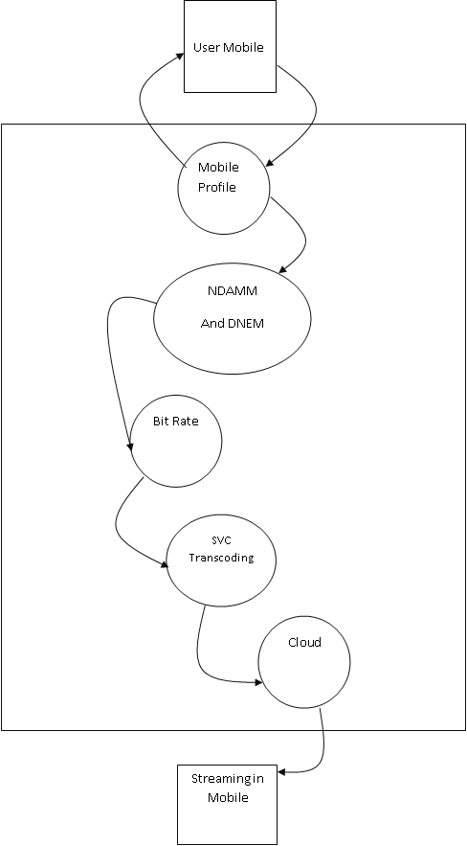
Level 2 DFD

Slide 12
Use Case Diagram

Slide 13
ER Diagram

Slide 14
Codings
//NEW WEB SERVICE
@WebService(serviceName = "NewWebService")
public class NewWebService {
@WebMethod(operationName = "signin")
public String signin(@WebParam(name = "username") String username, @WebParam(name = "password") String password) {
try {
Common_DB cd=new Common_DB();
ResultSetrs=Common_DB.LoginCheck("psjav05", "login","username","password", username, password);
if(rs.next()) {
return "success";
}
else {
return "username or password is invalid";
}
} catch (Exception ex) {
Logger.getLogger(NewWebService.class.getName()).log(Level.SEVERE, null, ex);
return "server temporarily not available";
} }

Slide 15
Codings
@WebMethod(operationName = "signup")
public String signup(@WebParam(name = "username") String username, @WebParam(name = "password") String password, @WebParam(name = "email") String email) {
try {
Common_DB cd=new Common_DB();
intrs=Common_DB.InsertTable("psjav05", "INSERT INTO login(username,password,email) VALUES('"+username+"','"+password+"','"+email+"')");
if(rs>0) {
return "success";
}
else {
return "username is already available";
}
} catch (Exception ex) {
Logger.getLogger(NewWebService.class.getName()).log(Level.SEVERE, null, ex);
return "server temporarily not available";
} }

Slide 16
Codings
//CALL SERVICES
public static String getVideosFromMobileInfo(String bandwidth,Stringphonetype,Stringnetworkname,Stringsimstate,Stringnetworktype,Stringosversion,Stringusername,String method) {
String list = null;
SoapObject soap=new SoapObject(NAMESPACE,method);
soap.addProperty("bandwidth",bandwidth);
soap.addProperty("networkname",networkname);
soap.addProperty("phonetype",phonetype);
soap.addProperty("simstate",simstate);
soap.addProperty("networktype",networktype);
soap.addProperty("osversion",osversion);
soap.addProperty("username",username);
SoapSerializationEnvelope envelope=new SoapSerializationEnvelope(SoapEnvelope.VER11);
envelope.setOutputSoapObject(soap);
HttpTransportSE http=new HttpTransportSE(URL);

Slide 17
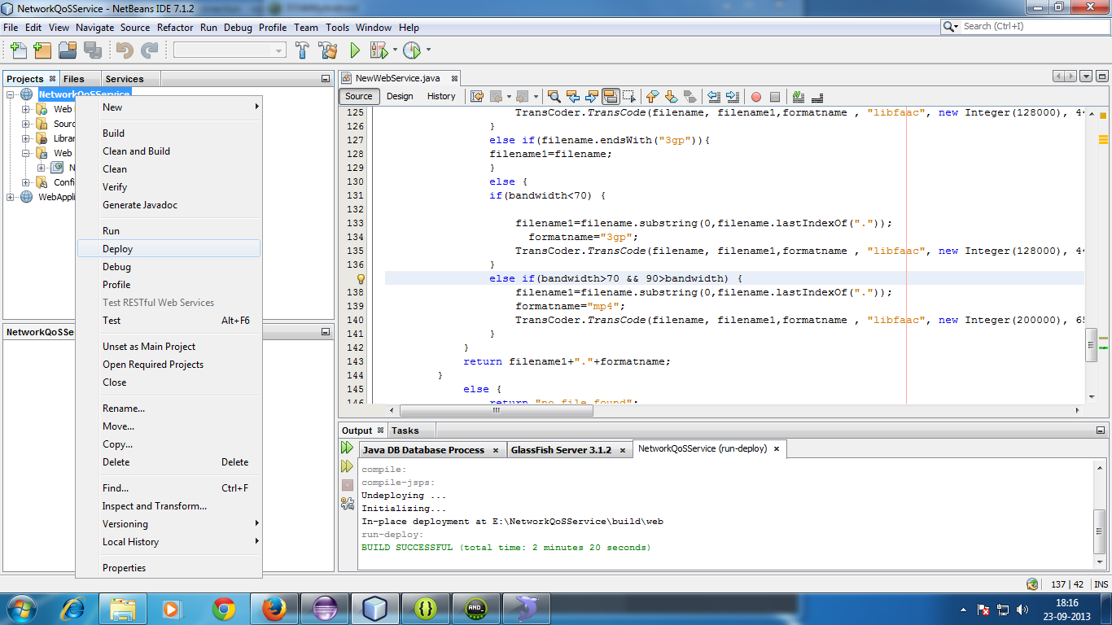
Experimental results

Slide 18
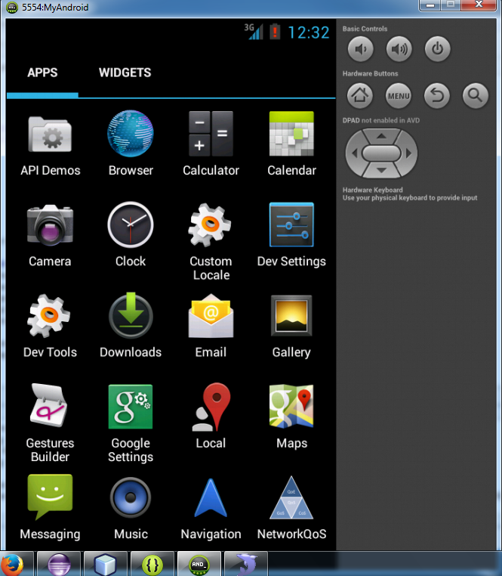
Experimental results

Slide 19
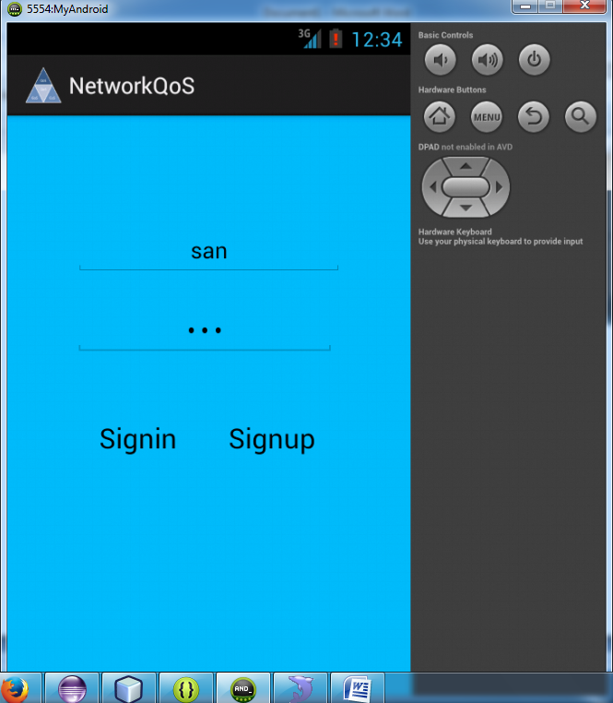
Experimental results

Slide 20
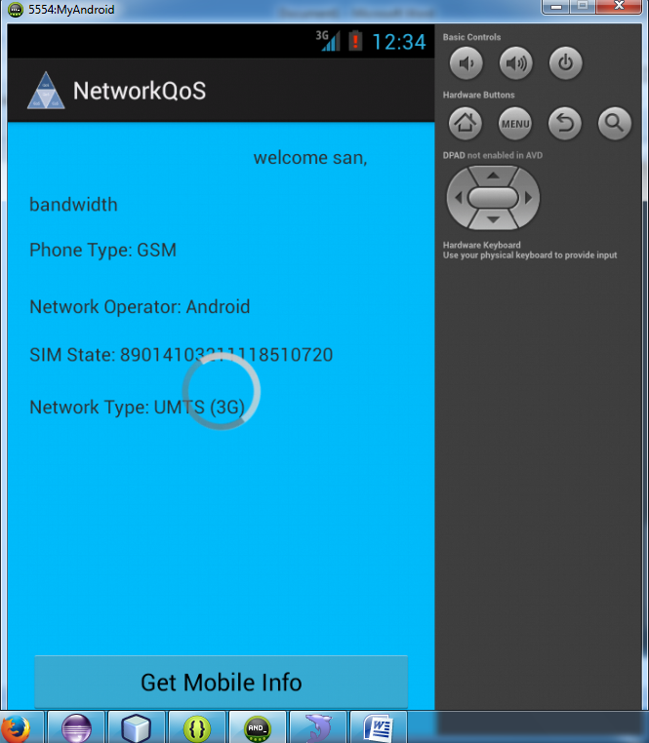
Experimental results

Slide 21
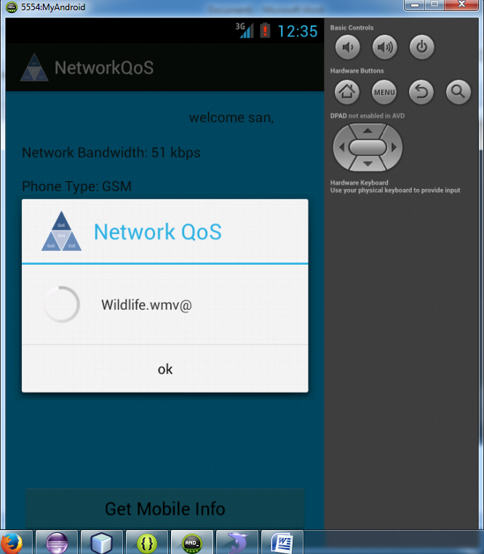
Experimental results

Slide 22
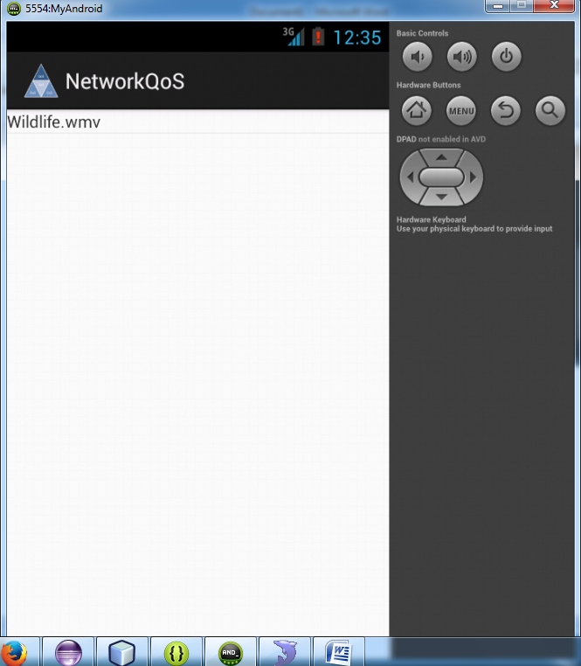
Experimental results

Slide 23
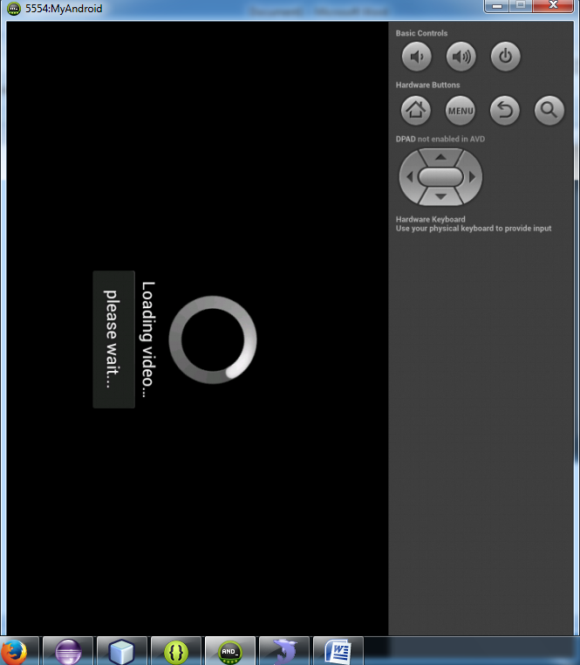
Experimental results

Slide 24
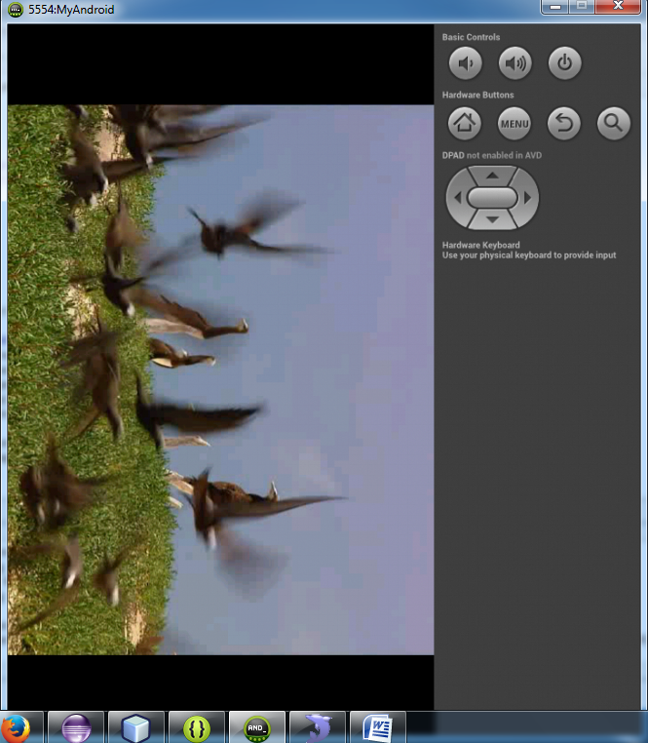
Experimental results

Slide 25

Than(Q)ueries

