Slide 1
QR Code Based Billing System For Shops Using Android Smartphone

Slide 2
Abstract
The objective is to propose a real time capturing system for consumer using Quick Response (QR) code.
Vision-based automatic identification technology.
Standard image codes like one-dimensional and two-dimensional barcodes with black and white patterns.
It verifies products by capturing it through the smart phone.
Then decodes and sends it to the server for authentication.

Slide 3
INTRODUCTION
QR Code is a type of 2-dimensional bar code in the form of Matrix Code.
QR Code is composed of black and white modules.
It contains information both in the vertical and horizontal direction.
It can hold information more than other bar codes.

Slide 4
LITERATURE SURVEY (Paper 1) Use Multiplexing to Increase Information in QR Code, Chulalongkorn University,Bangkok,Thailand.
This technique can increase the amount of data.
The original data for encoding is divided into smaller parts, each part will form QR Code pattern in its standard form.
It represented each module in QR Code with black and white special symbols.
At the receiving end it decodes to give back QR Code patterns.

Slide 5
Identifying QR Code (Paper 2) Chanon Skawattananon, Mahasak Ketcham and Sartid Vongpradhip.
It contains information in both the vertical and horizontal
directions.
The interesting characteristic of QR Code is error correction.
Reed-Solomon error correction.

Slide 6
Data Hiding Method for QR Code (Paper 3) Mahasak Ketcham, Virutt Kosolvijak.
The 2D Barcode with a digital watermark is a widely interesting research in security field.
The invisible watermark can prevent information hiding text in QR Code.
QR Code embedded technique for invisible watermarking by using DCT compare with DFT.

Slide 7
Existing System
The consumer can take an image of a barcode on a product.
The barcode must be read using computer vision techniques.
It can hold information, and vision task in consumer scenarios is challenging.
It gives the vision algorithm feedback, and develop a progressive strategy of the product.

Slide 8
Disadvantages
System software failure may cost more delays .
Durability and cost.
Scratches cannot be readen.
Obstacle between the reader cannot readed.

Slide 9
Proposed System
In the proposed system, we are using QR code in products.
It verifies product by capturing it through the smart phone.
Then decodes and sends it to the server for authentication.
The customer forwards the selected product list to the server and get response.

Slide 10
Advantages
A simple scan captures the desired information.
The Decode information are stored in server.
High accuracy in image capturing.
Easily detectable.

Slide 11
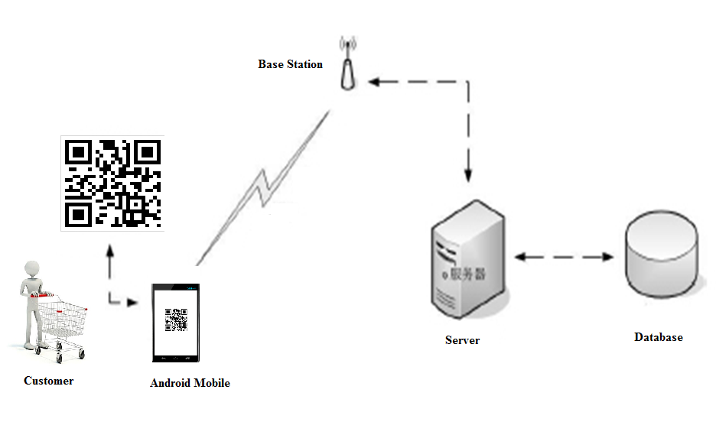
ARCHITECTURE

Slide 12
Algorithm and technique
Multiplexing:
The original information is divided, to form a string of characters into n parts.
Each part form QR code pattern.
The module correspond to the same position in each QR Code.
The Finder Pattern and Timing Pattern are multiplexed by using a special black and white symbol .

Slide 13
Algorithm and technique
Demultiplexing:
This process decode the information from single QR Code with special symbols.
Split the data back to their QR Code pattern where these QR Code pattern can be read by ordinary QR Code reader.
The data in each QR Code pattern were recognized and concatenated back to form its original information.

Slide 14
Use case diagram

Slide 15
DATA FLOW DIAGRAM
USER
SCANNER
SERVER
Customer
CHECKING
Details With
PROCESS BY
Selected
SALES
Products
EXECUTIVE
DATABASE

Slide 16
Modules Description
Generating QR code image
Mobile Authentication Module
QR Code Scanner Module
Web service client module

Slide 17
Modules Description GENERATING QR CODE IMAGE
In this module we are creating QR code for encoding the information about the products.
The product contains name, code, quantity and price.
Each pattern is encoded and represented each module in QR code with black and white special symbols.
The positioning of the symbol, size and inclination are located.

Slide 18
Modules Description MOBILE AUTHENTICATION MODULE
This module represents the authentication.
The customer to login their details for the shopping processes
Authentication provides privilege and granted to a particular user or process.
The validation process are done on the webserver.

Slide 19
Modules Description QR CODE SCANNER MODULE
This module is used to scan the QR code and read the value of the QR code inside the mobile.
QR code is a matrix bar code designed to be read by Smartphone.
The code contains of black modules arranged in a square pattern on a white background.
The information encoded may be text, a URL, or other data.

Slide 20
Modules Description WEB SERVICE CLIENT MODULE
This module has the process of storing the selected product’s information from the client.
All these informations will be stored in the database.
We are maintaining a centralized server to receive list from the customer through internet.
In this module the merchant see the ordered items from the client.

Slide 21
GENERATE QR CODE
protected void doGet(HttpServletRequest request, HttpServletResponse response) throws ServletException, IOException {
String qrtext = request.getParameter("qrtext");
String result = pname+";"+pdate+";"+pquants+";"+pprice;
ByteArrayOutputStream out = QRCode.from(qrtext).to(
ImageType.PNG).stream();
response.setContentType("image/png"); response.setContentLength(out.size());

Slide 22
LOGIN CHECKER
protected void processRequest(HttpServletRequest request,
HttpServletResponse response) throws ServletException, IOException,
SQLException {
response.setContentType("text/html;charset=UTF-8");
PrintWriter out = response.getWriter();
try {
String user = request.getParameter("user");
String pass = request.getParameter("pass");

Slide 23
Cont……………
protected void doPost(HttpServletRequest request,
HttpServletResponse response) throws ServletException, IOException {
try {
processRequest(request, response);
} catch (SQLException ex) {
Logger.getLogger(LoginChecker.class.getName()).log(Level.SEVERE,
null, ex);

Slide 24
PAY SERVLET
protected void doGet(HttpServletRequest request, HttpServletResponse response) throws ServletException, IOException {
}
protected void doPost(HttpServletRequest request,HttpServletResponse response) throws ServletException, IOException
{
String billno = request.getParameter("billno").toString();
System.out.println(billno);
request.getRequestDispatcher("CustomerLogs.html").forward(request, response);}}

Slide 25
QR CODE SERVER
public static Connection getConnection() {
try {
Class.forName("com.mysql.jdbc.Driver");
String username = "root";
String password = "root";
conn = DriverManager.getConnection(url, username, password);
} catch (ClassNotFoundException e) {
e.printStackTrace();
} catch (SQLException e) {
e.printStackTrace();

Slide 26
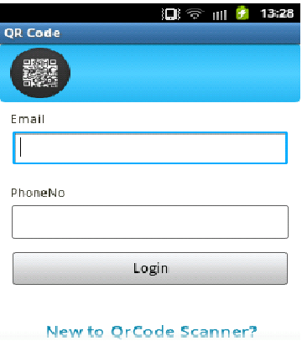
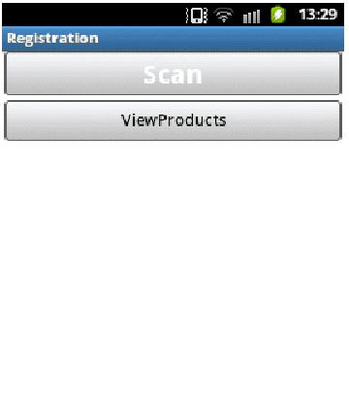
Results Obtained
Customer Mobile Module:

Slide 27
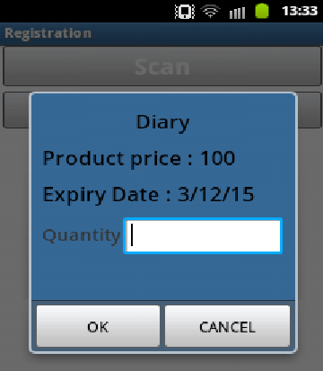
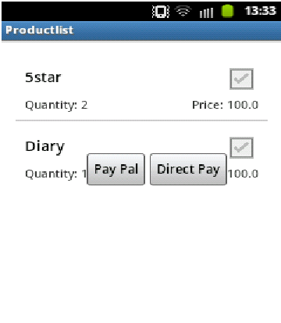
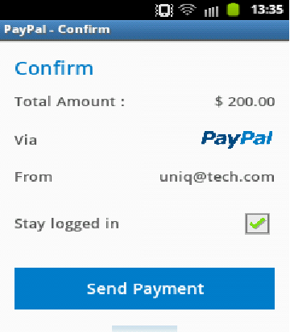
PAYMENT SYSTEM

Slide 28
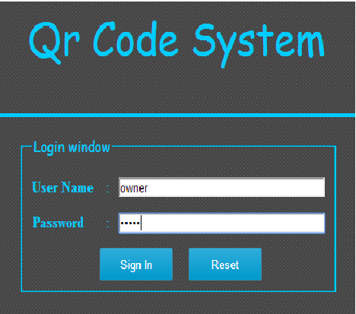
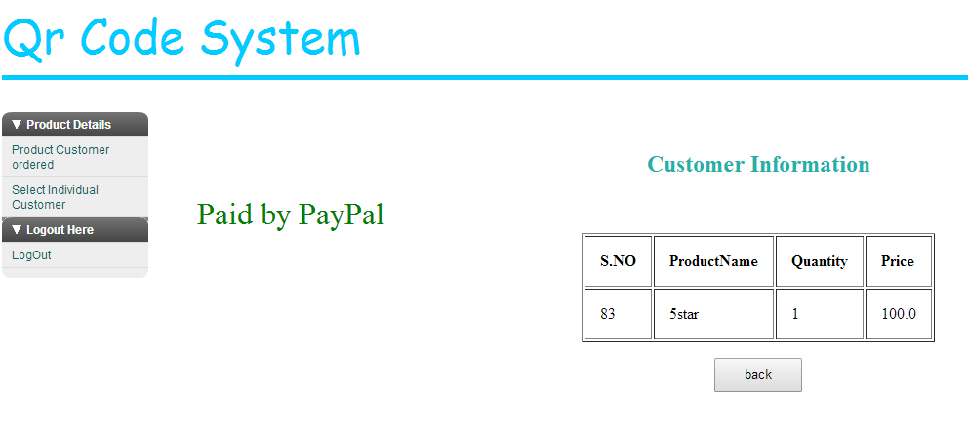
OWNER PAGE

Slide 29
PERFORMANCE EVALUATION
High Security.
Reliable transaction.
Easy to access.

Slide 30
REFERENCE
[1] R. T. Azuma, “A Survey of Augmented Reality,” vol. 4, no. August, pp. 355–385, 1997.
[2] T. Kan, C. Teng, and W. Chou, “Applying QR code in augmented reality applications,” … Realit Continuum and its Applications in …, vol. 1, no.212, pp. 253–258, 2009.
[3] J. Rouillard, “Contextual QR Codes,” 2008 TheThird International Multi-Conference on Computing in the Global Information Technology (iccgi 2008), pp. 50–55, Jul. 2008.
[4] D. Schmalstieg, T. Langlotz, and M. Billinghurst,“Augmented Reality 2.0,” pp. 13–38, 2011.
[5] D. Shin, J. Jung, and B. Chang, "The psychologybehind QR codes: User experience perspective",;presented at Computers in Human Behavior, 2012,
pp.1417-1426.
[6] L. Madden, Professional Augmented Reality Browsers for Smartphones. John Wiley & Sons,2011, p. 360.

Slide 31
BATCH MEMBERS
P.SENTHIL KUMAR
M.PRASANTH
M.NALENDRAN
J.SURESH
GUIDE
Mr.R.MANIKANDAN Asst.prof/IT

