Slide 1


Image Restoration Using SADNet
EE5179- DL for Imaging- Course Project
Sujay - ED20B065
Devansh - EE21B037
Navneet - EE21B094
Sujal - EE21B144

Slide 2
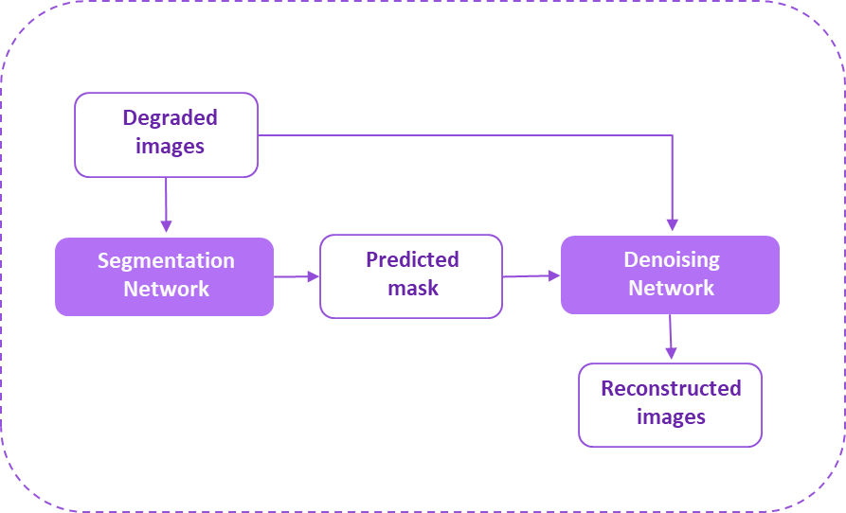
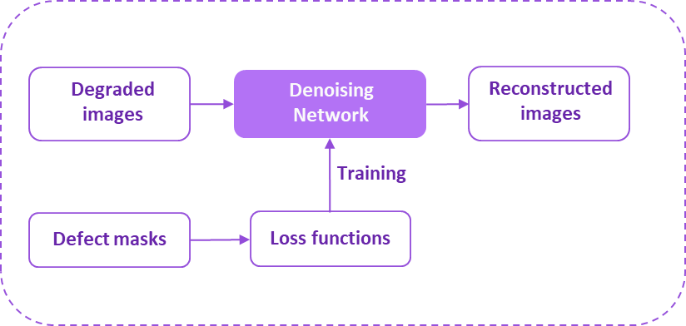
Approach
Pipeline 1:
Mask Prediction -> Denoising
Pipeline 2:
Mask aware fine-tuning (Custom loss functions)
DnCNN, RIDNET: Subpar validation set PSNR values of 24-25 dB.
Restormers: Very complex and computationally expensive to train.
Final Model: SADNET, a balance between complexity and computation.

Slide 3
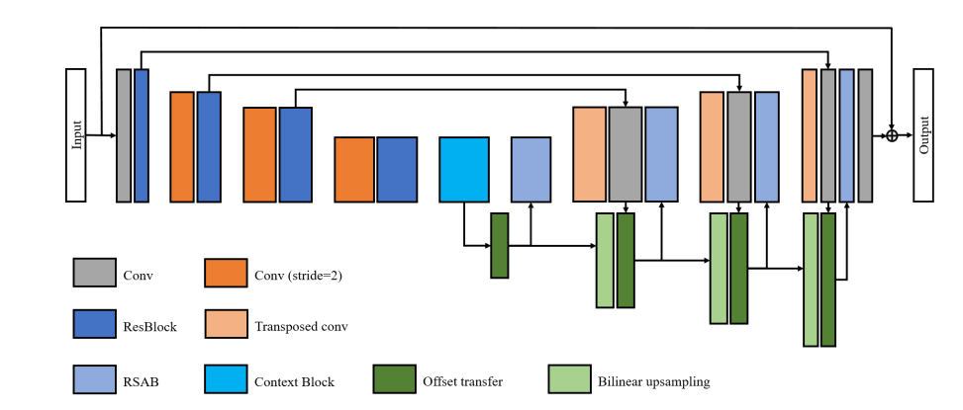
SADNet - Spatial-Adaptive Denoising Network
Multi-scale, spatially adaptive approach that captures noise patterns across different resolutions
Preserves fine textures and edges in denoised images through the RSAB block and offset learning
Benchmark model for Kodak 24 dataset
Model Architecture

Slide 4
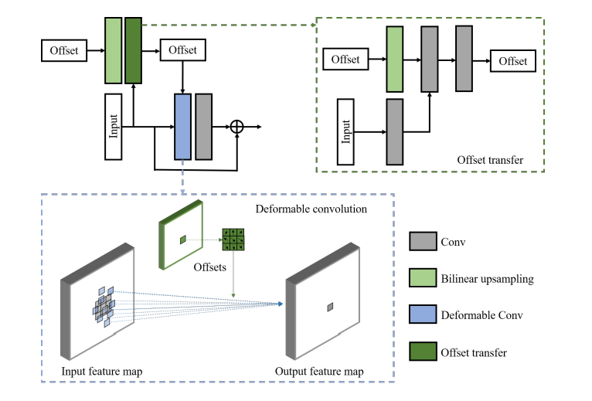
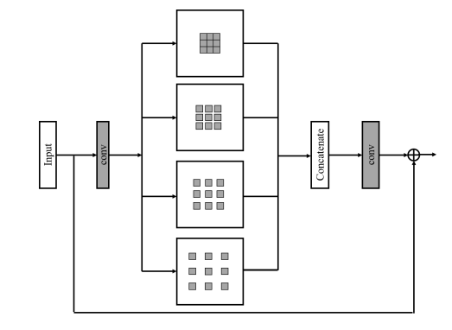
Residual Spatial-Adaptive Blocks (RSABs):
Incorporating deformable convolutions to adapt to spatial textures and edges, reducing over-smoothing
Offset Transfer Mechanism:
Transfers offsets from coarse to fine scales, improving alignment of feature locations across resolutions.
RSAB Block
Context Block:
Uses dilated convolutions (instead of downsampling) to capture multi-scale features without losing structural details.
Context Block

Slide 5
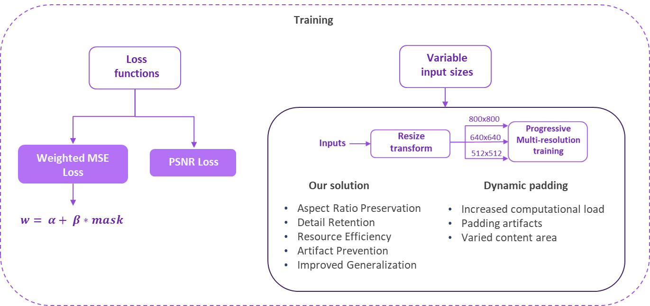
Training

Slide 6
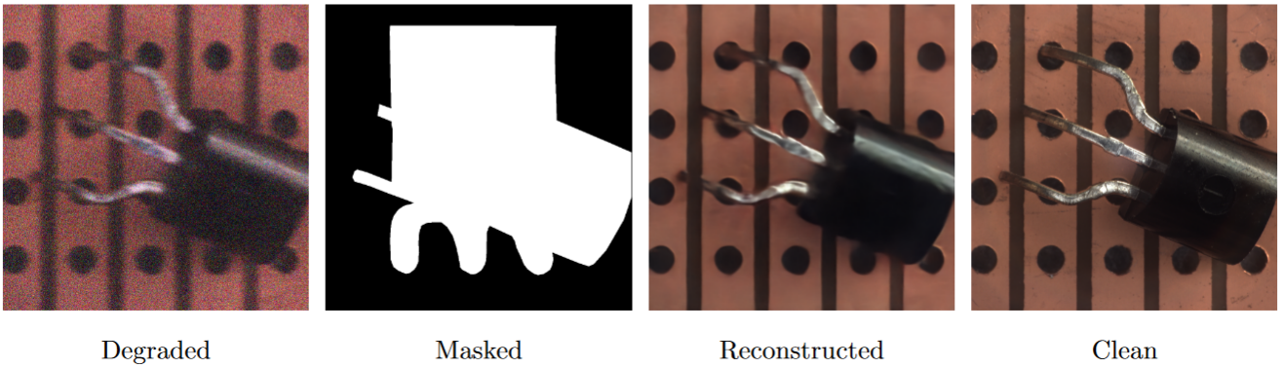
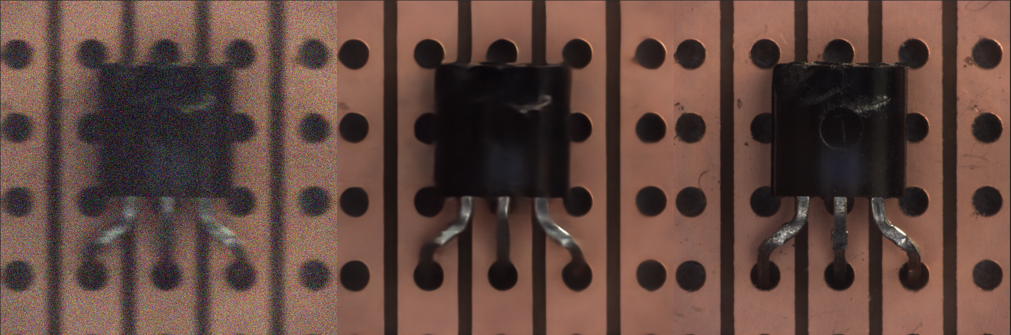
Qualitative Evaluation
Training Results
Testing Results
Degraded
Reconstructed
Ground Truth

Slide 7
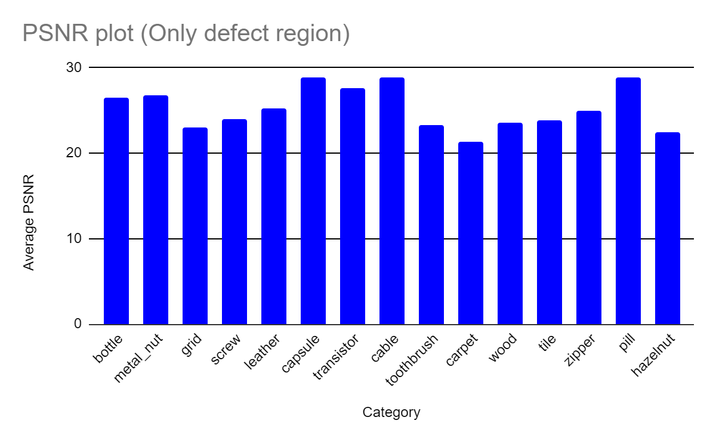
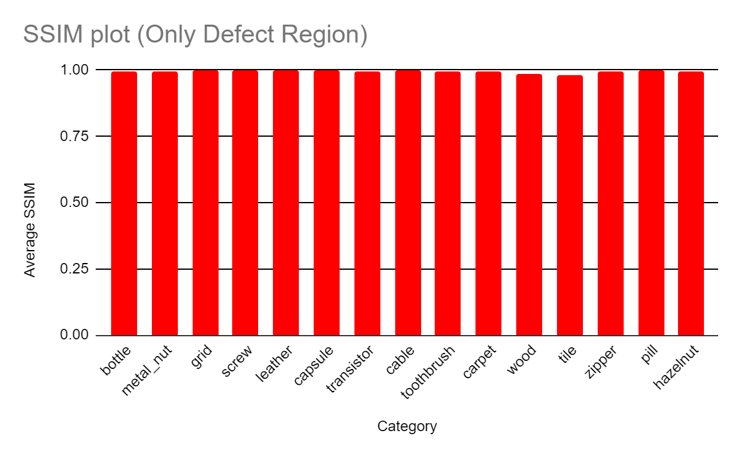
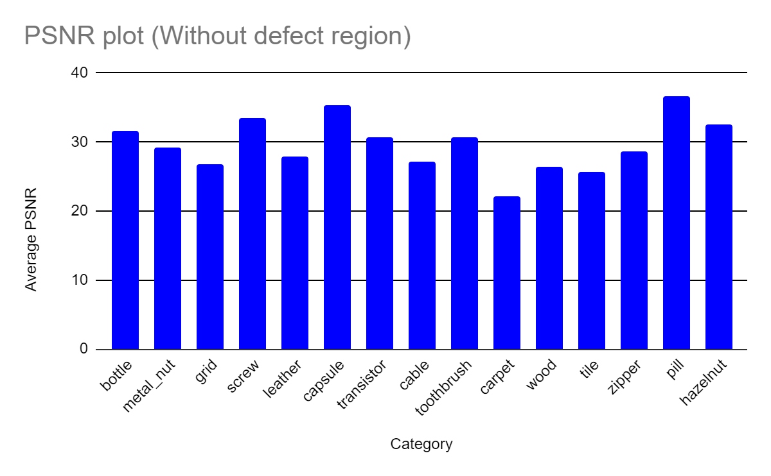
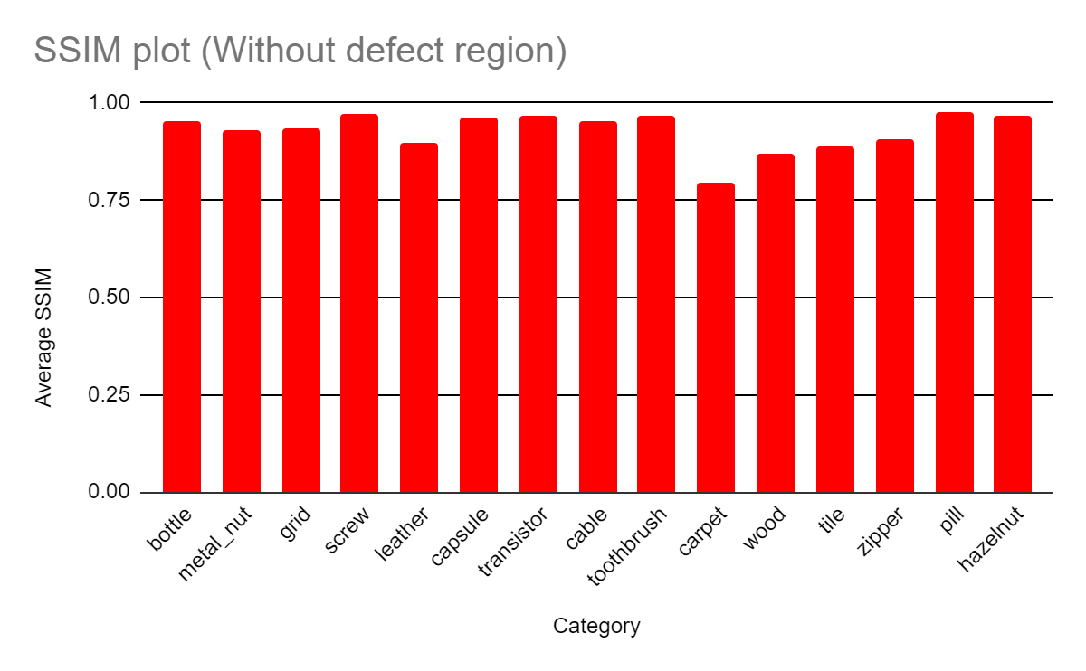
Quantitative Results : Testing

Slide 8
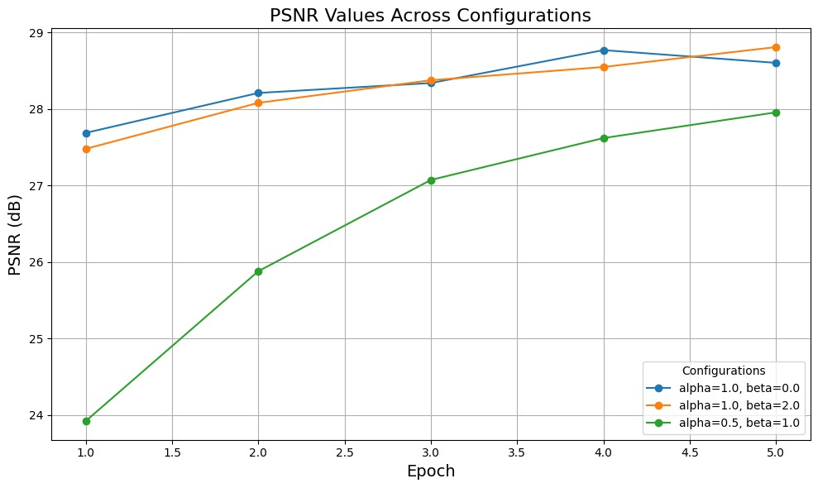
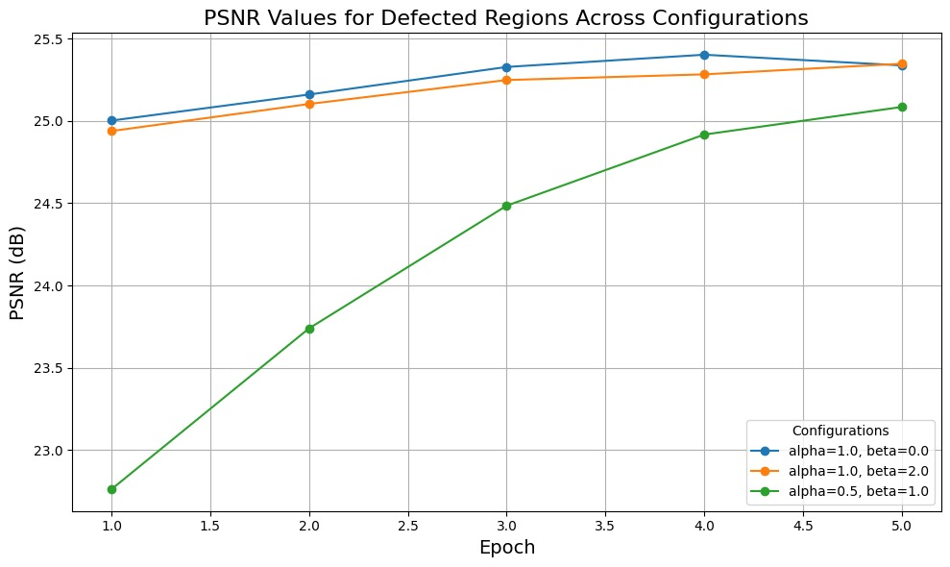
Quantitative Results
Ablation Study
Condition (TRAINING)​ | Total Average PSNR​ | Total Average SSIM​
Without Defect​ | 30.0076​ | 0.8212​
Only Defect​ | 25.5591​ | 0.9892​
Condition (TESTING)​ | Total Average PSNR​ | Total Average SSIM​
Without Defect​ | 29.6485​ | 0.9294​
Only Defect​ | 25.2784​ | 0.9953​

Slide 9
Conclusion
This solution involved using the SADNet, a former state-of-the-art architecture, to solve the problem of reconstructing degraded images with preserving the critical defects of interests
SADNet gave us the best result given computational limitations
Future works:
Utilizing the Restormer, current state-of-the-art architecture
Training on higher resolution images (1024 x 1024)
Experimenting with diverse loss functions to include the SSIM metric also

