Slide 1

D.Y. Patil College of Engineering, Akurdi, Pune
DEPARTMENT OF COMPUTER ENGINEERING
PBL PROJECT:- BROWSER
GROUP: B6
By:-
SUJAL JOSHI (COMPSEB1405)
AKSHAY WAGH (COMPSEB1325)
PUSHPAK VEER (COMPSEB1402)
TEJAS THORAT (COMPSEB1309)
SARANG PHALAK (COMPSEB1364)
SUBHOD JADHAV (COMPSEB1332)
Guided by:-Mrs. Dhanshree Phalke

Slide 2

M.O.B
BROWSER

Slide 3
ABOUT BROWSER--
This is the a simple browser made with python language and its libraries providing us the same basic features which are there in other browsers like navigation bar buttons and to open many tabs at a time in browsing window.

Slide 4
LIBRARIES AND PACKAGES:-
PYQT5 (LIB)
Modules
QT core
QT GUI
QT Widgets
QT WebEngineWidgets

Slide 5
Speech_recognition
Pyttsx 3
Datetime
wikipedia

Slide 6
PyQt5:-
PyQt5 is a set of Python bindings for Qt5 application framework from Digia. Qt library is one of the most powerful GUI libraries.

Slide 7
Qt: It combines all the classes/modules mentioned below into a single module. It considerably increases the memory used by the application. However, it's easier to manage the framework by only importing one module.
QtCore: Contains the core non-graphical classes used by other modules. This is where the Qt event loop, signals, and slot-connectivity, etc. are implemented
QtWidgets: Contains most of the widgets available in Pyqt5.
Qt WebEngine Widgets :- for creating widget-based web applications
QtGui: Contains GUI components and extends the QtCore module .

Slide 8
Speech_recognition:Library for performing speech recognition, with support for several engines and APIs, online and offline.
Pyttsx 3:text-to-speech conversion library in Python.
Datetime: module related to dates.
Wikipedia: makes it easy to access and parse data from Wikipedia.
PyAudio:PyAudio provides Python bindings for PortAudio, the cross-platform audio I/O library. With PyAudio, you can easily use Python to play and record audio on a variety of platforms.

Slide 9
FEATURES:-
1) NAVIGATION BAR:- BACK BTN
FORWARD BTN
RELOAD BTN
HOME BTN
STOP BTN
2) BOOKMARKS
3) NEW TABs.
4) DIRECTED SEARCH ENGINE--microsoft bing.
5)ADVANCE FEATURES:- VOICE SEARCH for BROWSER.

Slide 10
Module-1
Created Browser View
Default search engine as Bing
Navigation Tools

Slide 11
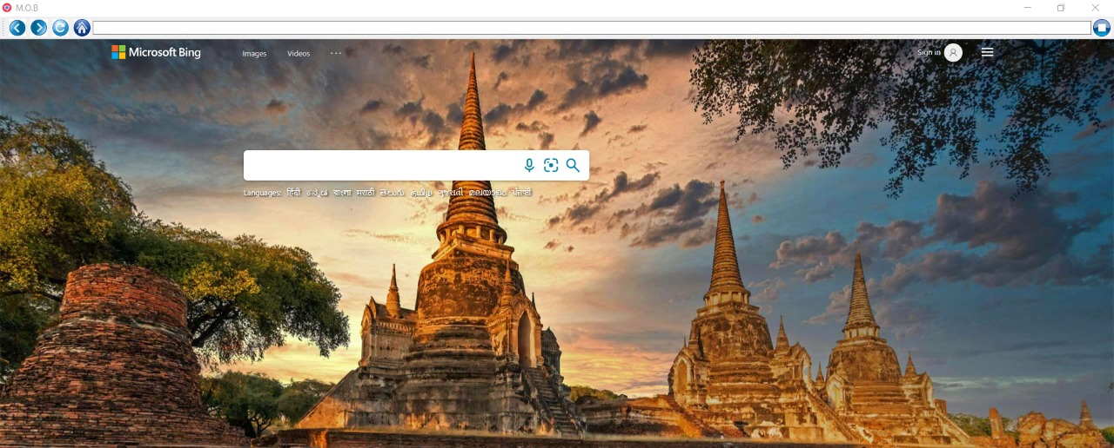

Slide 12
Module-2
Adding Functionality to Navbar tools

Slide 13
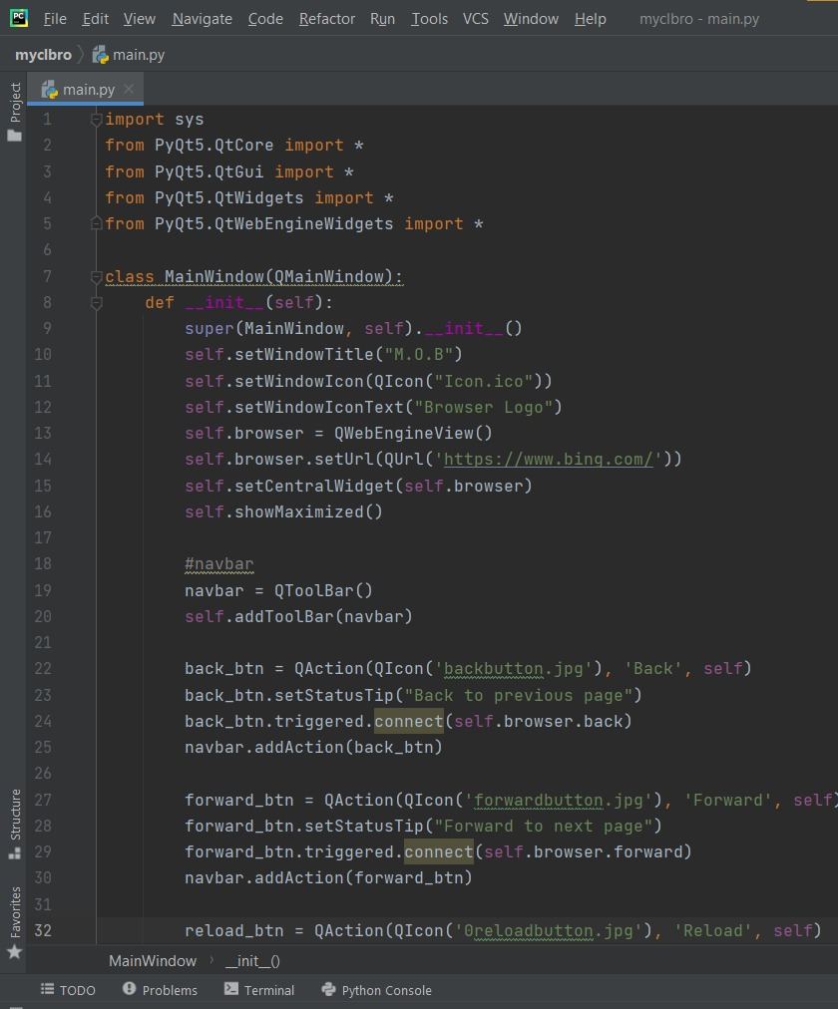

Slide 14
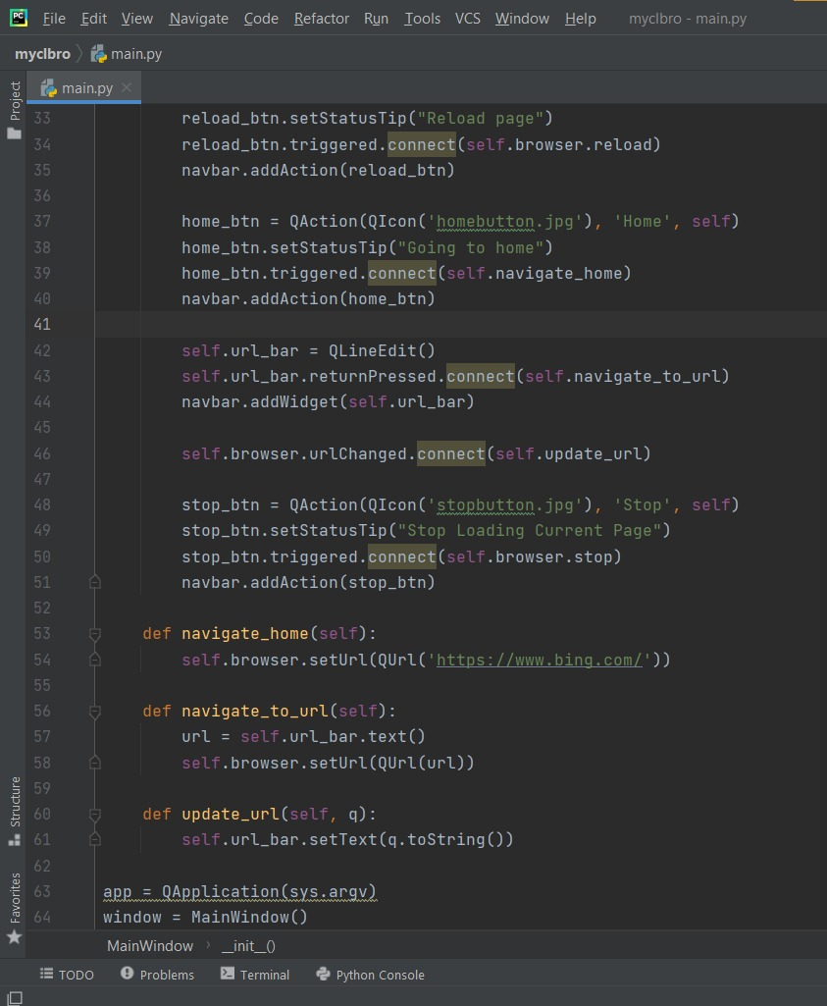

Slide 15
Module-3
Bookmark Tool
Bookmark your favourite tabs using this tool.

Slide 16
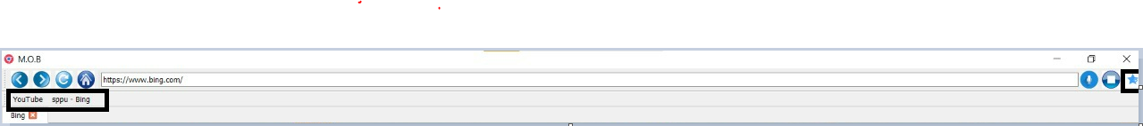
Bookmark tool
Bookmarked tabs

Slide 17
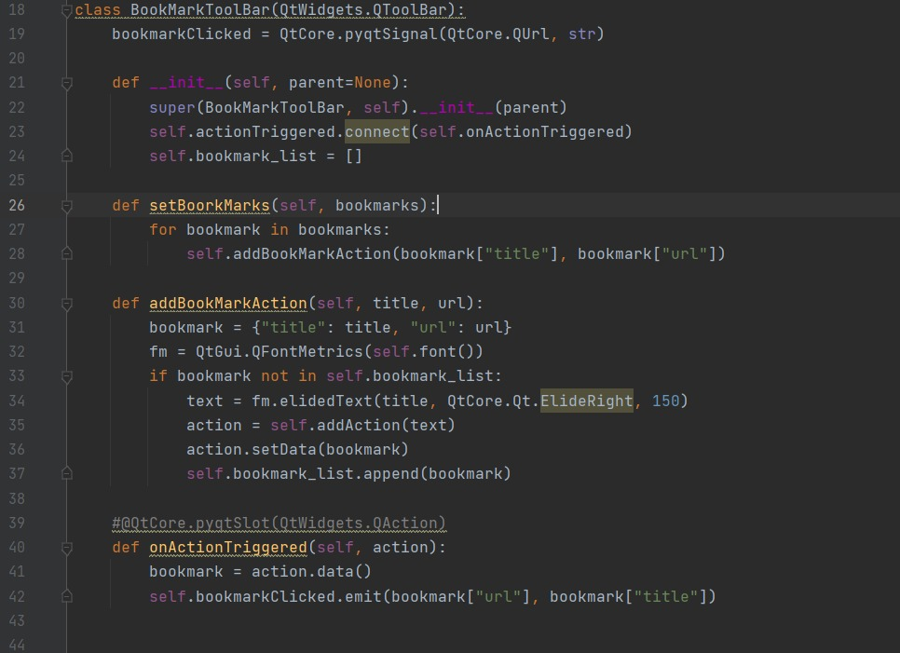

Slide 18
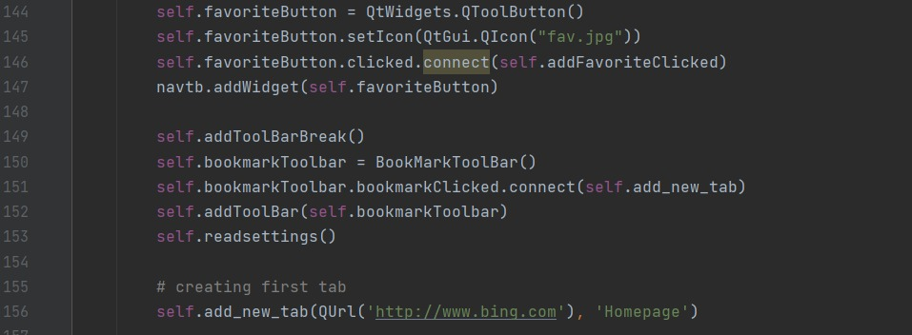

Slide 19
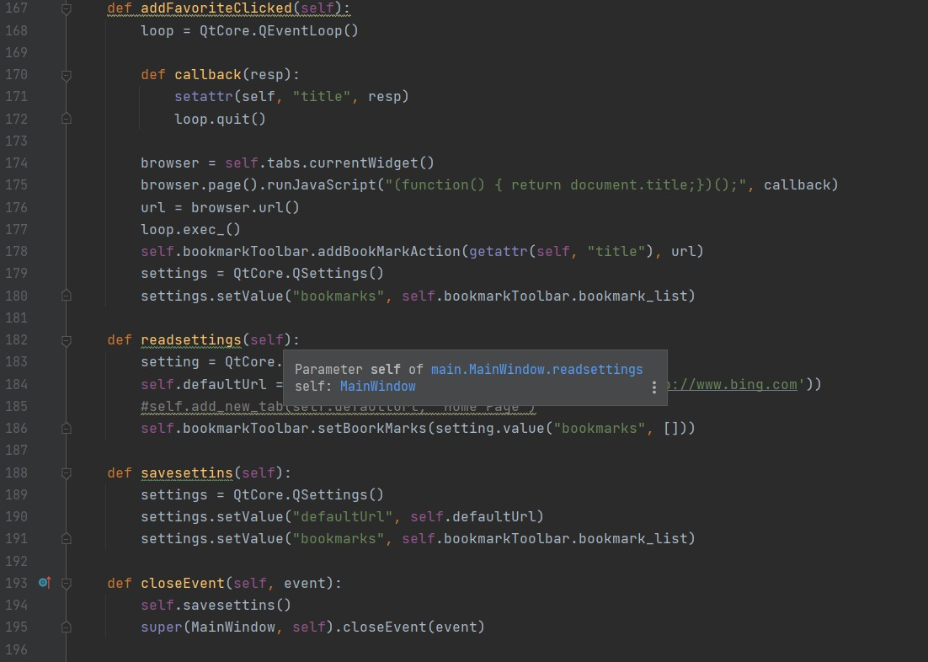

Slide 20
Module-4
Adding Tabs
We can Open multiple tabs at same time.

Slide 21
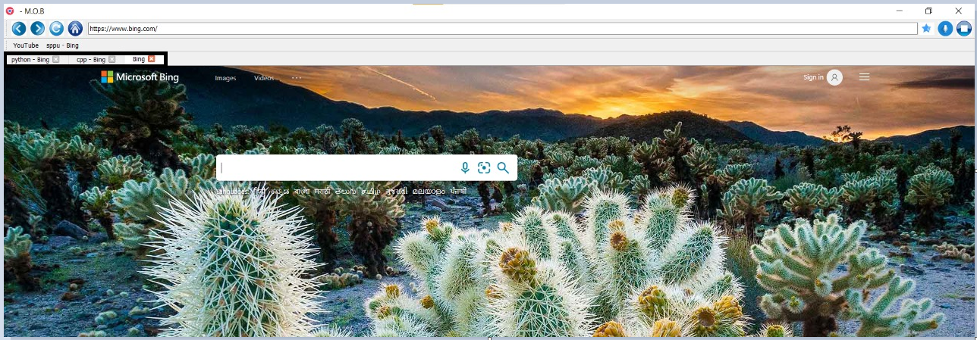
Multiple Tabs

Slide 22
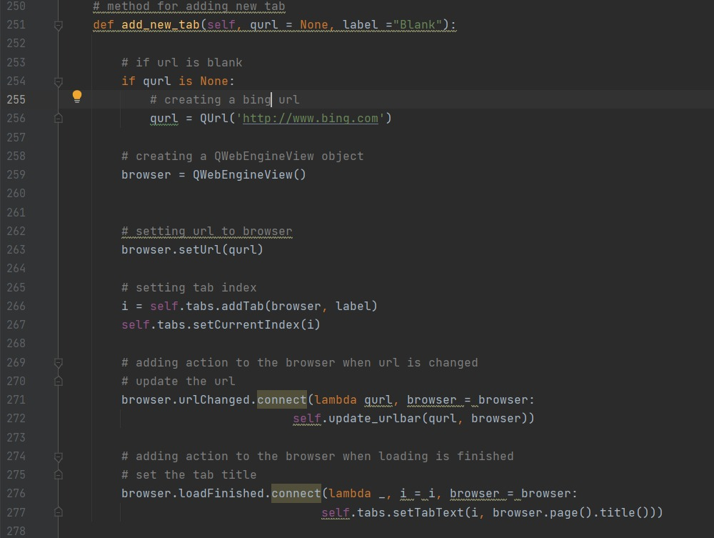

Slide 23
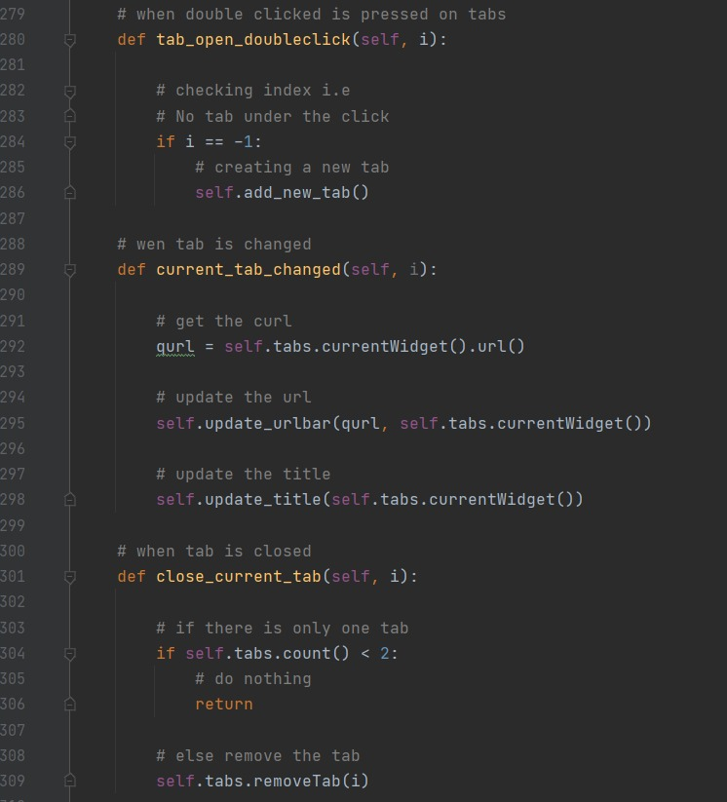

Slide 24
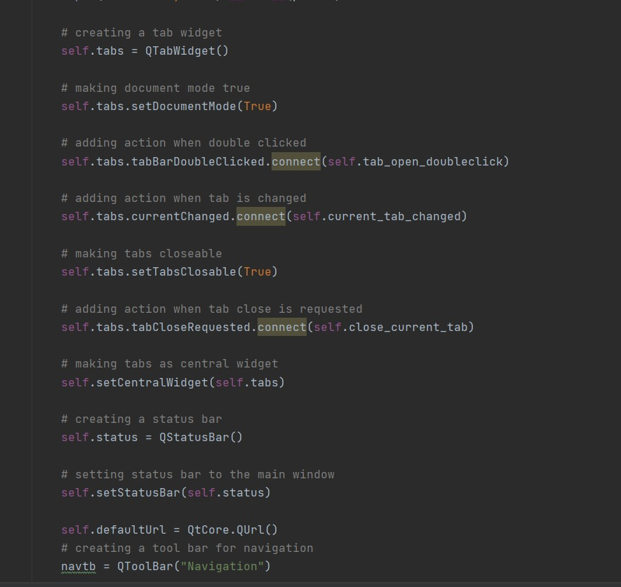

Slide 25
Module-5
Voice Search
Browser can search using speech to txt conversion

Slide 26
Voice search

Slide 27

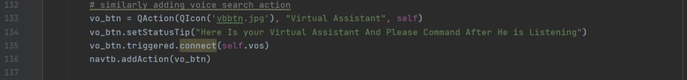

Slide 28
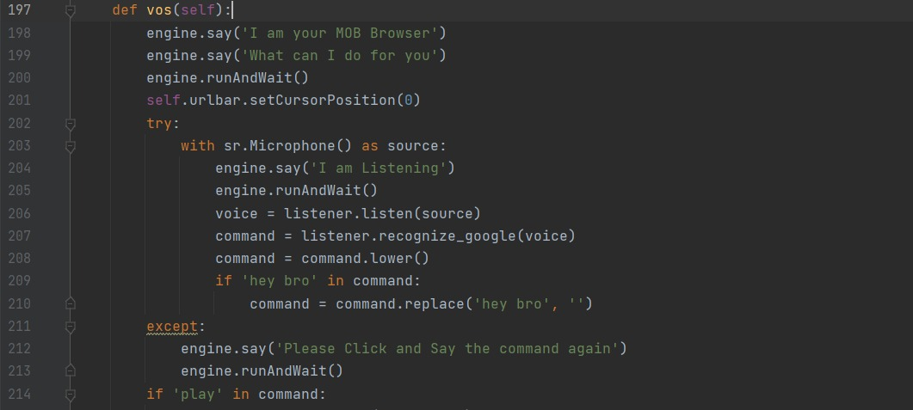

Slide 29
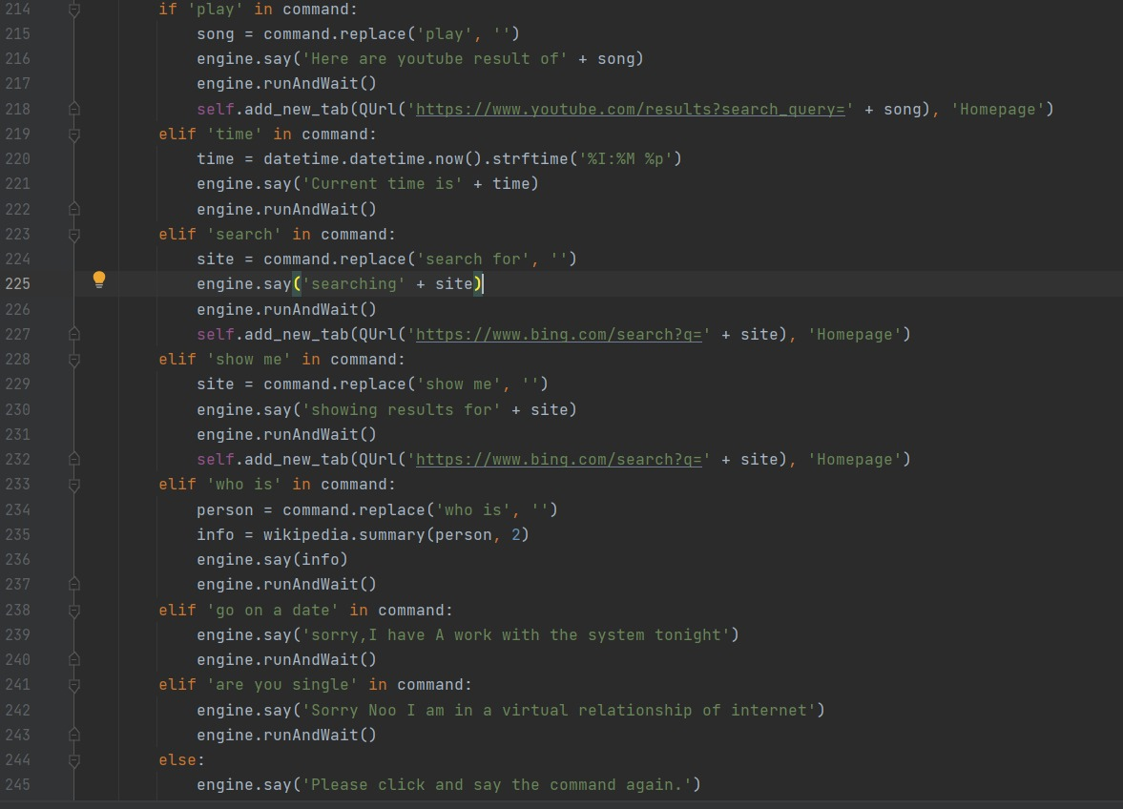

Slide 30
CONCLUSION:
Implementing various python libraries with a voice search feature a basic functional browser was achieved.

