Slide 1
🚚 Logistics Optimization for Delivery Routes
Flipkart Supply Chain Performance & Warehouse Analytics (Ekart)
Author: Sujal Agrahari | Internshala Data Science Training Program
Technology Stack: MySQL 8.0, Advanced SQL (CTEs, Window Functions, Subqueries), Python Analytics Pipeline
Video Walkthrough: https://www.loom.com/share/519a939ef711457d970e77f466b2729b (Part 1 & 2)

Slide 2
FLIPKART LOGISTICS OPTIMIZATION
Project Overview & Core Business Objectives
Business Context (Flipkart Logistics)
• Ekart operates a pan-India fulfillment network comprising regional sorting hubs, mother warehouses, and last-mile delivery partners.
• Rising order volume during festive sales triggers severe route bottlenecks, traffic delays, and fulfillment capacity constraints.
• Challenge 1: Pinpoint the root causes of transit delays (hub processing vs in-transit congestion).
• Challenge 2: Optimize delivery corridors based on distance-to-time efficiency ratios.
• Challenge 3: Quantify delivery agent productivity and workload balance.
Evaluation Scope & Rubric Tasks
• Task 1: Data Cleaning & Validation (Duplicates, Imputation, Date formats) [10M]
• Task 2: Delivery Delay Analysis (Delay Days, Top 10 Routes, Window Ranking) [10M]
• Task 3: Route Optimization Insights (Efficiency Ratio, >20% Late Corridors) [20M]
• Task 4: Warehouse Throughput (Highest Processing Time, CTE Bottlenecks) [10M]
• Task 5: Delivery Agent Performance (Subqueries: Top 5 vs Bottom 5 speed) [10M]
• Task 6: Shipment Tracking Analytics (Latest Checkpoints, Root Causes) [10M]
• Task 7: Advanced KPI Reporting (Regional Delays, On-Time Rate %, Traffic) [10M]
• Task 8 & 9: Presentation & Walkthrough Video Delivery [20M]

Slide 3
FLIPKART LOGISTICS OPTIMIZATION
Task 1: Data Cleaning & Preparation (10 Marks)
-- 1. Identify and delete duplicate Order_ID records
SELECT Order_ID, COUNT(*) AS count
FROM flipkart_orders GROUP BY Order_ID HAVING count > 1;
-- 2. Replace null Traffic_Delay_Min with route average delay
UPDATE flipkart_routes r
JOIN (SELECT Route_ID, AVG(Traffic_Delay_Min) AS avg_delay
FROM flipkart_routes GROUP BY Route_ID) t
ON r.Route_ID = t.Route_ID
SET r.Traffic_Delay_Min = COALESCE(t.avg_delay, 50)
WHERE r.Traffic_Delay_Min IS NULL;
-- 3. Convert all date columns into YYYY-MM-DD format
UPDATE flipkart_orders SET order_date = STR_TO_DATE(order_date, '%d-%m-%Y');
UPDATE flipkart_orders SET Expected_Delivery_Date = STR_TO_DATE(Expected_Delivery_Date, '%d-%m-%Y');
UPDATE flipkart_orders SET Actual_Delivery_Date = STR_TO_DATE(Actual_Delivery_Date, '%d-%m-%Y');
-- 4. Flag invalid delivery records (Actual < Order Date)
SELECT Order_ID, Actual_Delivery_Date, Order_Date,
CASE WHEN Actual_Delivery_Date < Order_Date THEN 'Invalid' ELSE 'Valid' END AS flag
FROM flipkart_orders;
Validation Outcomes & Insights
✓ Duplicate Verification:
- 0 duplicate Order_IDs found. Strict primary key uniqueness maintained (300 orders).
✓ Safe Imputation Applied:
- Null traffic delays imputed using route average with global fallback to prevent bias.
✓ Chronological Standardization:
- Converted dates to standard MySQL DATE format (YYYY-MM-DD).
- Standardized checkpoint scan timestamps to DATETIME to avoid text sorting bugs.
✓ Delivery Timeline Integrity:
- 100% of orders valid (zero anomalies where Actual Delivery preceded Order Date).

Slide 4
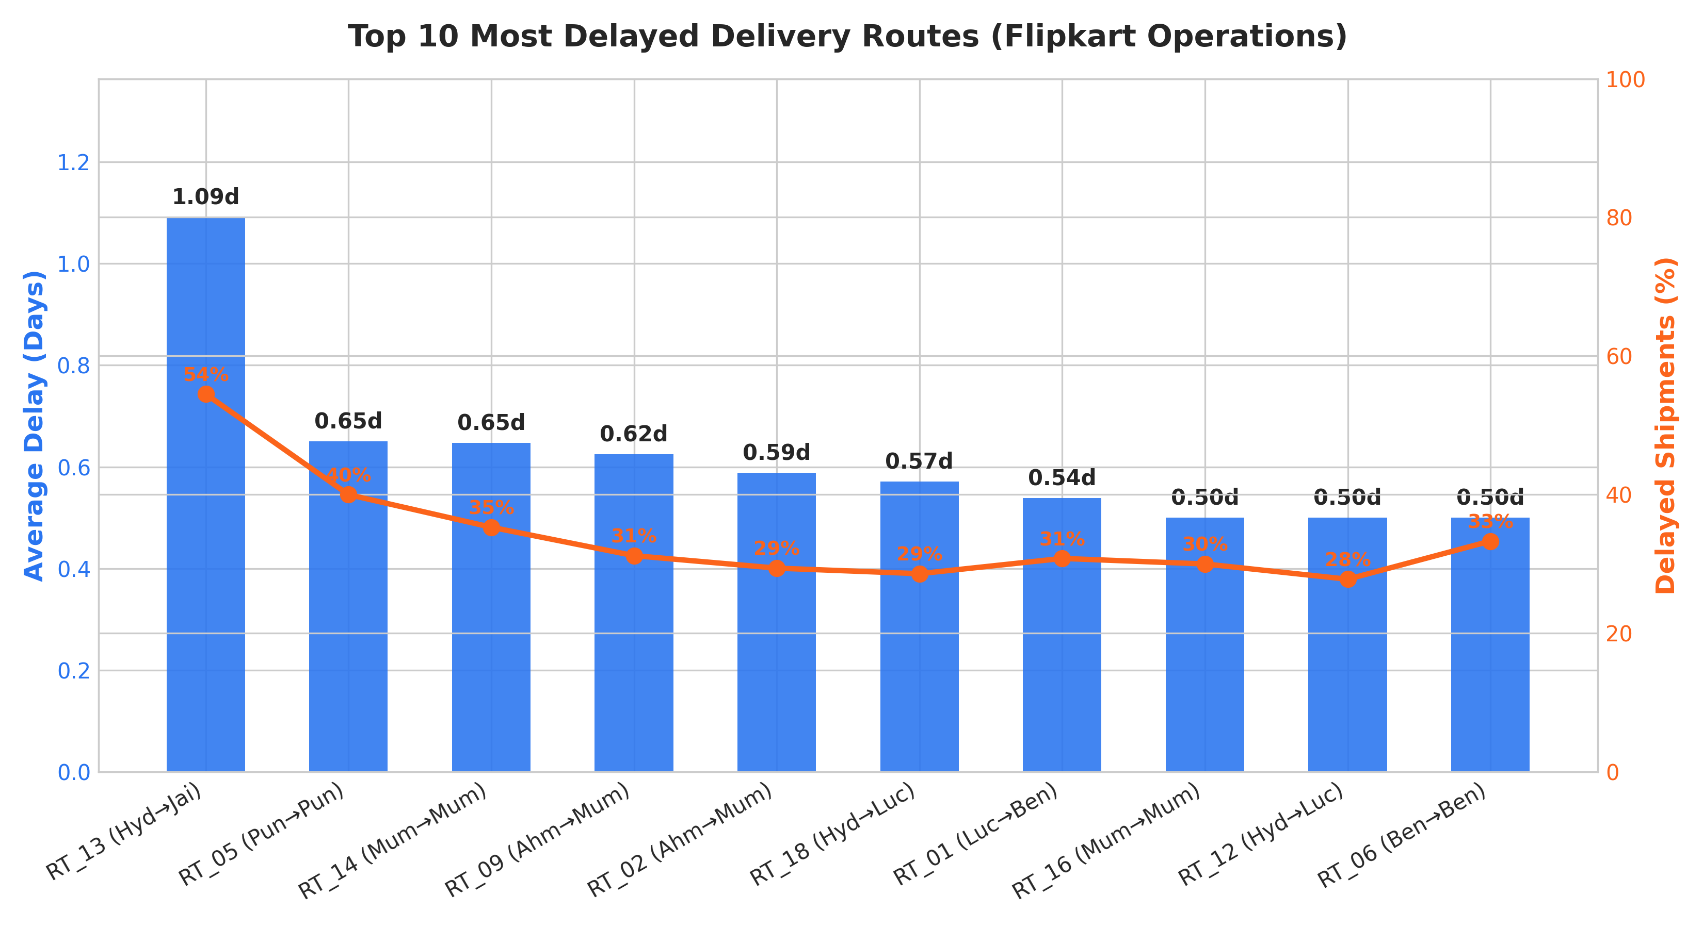
FLIPKART LOGISTICS OPTIMIZATION
Task 2: Delivery Delay Analysis (10 Marks)
-- Calculate delivery delay (in days) for each order
SELECT Order_ID,
DATEDIFF(Actual_Delivery_Date, Expected_Delivery_Date) AS delivery_delay
FROM flipkart_orders;
-- Top 10 delayed routes based on average delay days
SELECT Route_ID,
ROUND(AVG(DATEDIFF(Actual_Delivery_Date, Expected_Delivery_Date)), 2) AS avg_delay
FROM flipkart_orders
GROUP BY Route_ID
ORDER BY avg_delay DESC LIMIT 10;
-- Window function: Rank all orders by delay within each warehouse
SELECT Order_ID, Warehouse_ID,
DATEDIFF(Actual_Delivery_Date, Expected_Delivery_Date) AS delivery_delay,
RANK() OVER (PARTITION BY Warehouse_ID
ORDER BY DATEDIFF(Actual_Delivery_Date, Expected_Delivery_Date) DESC) AS wh_rank
FROM flipkart_orders;

Slide 5
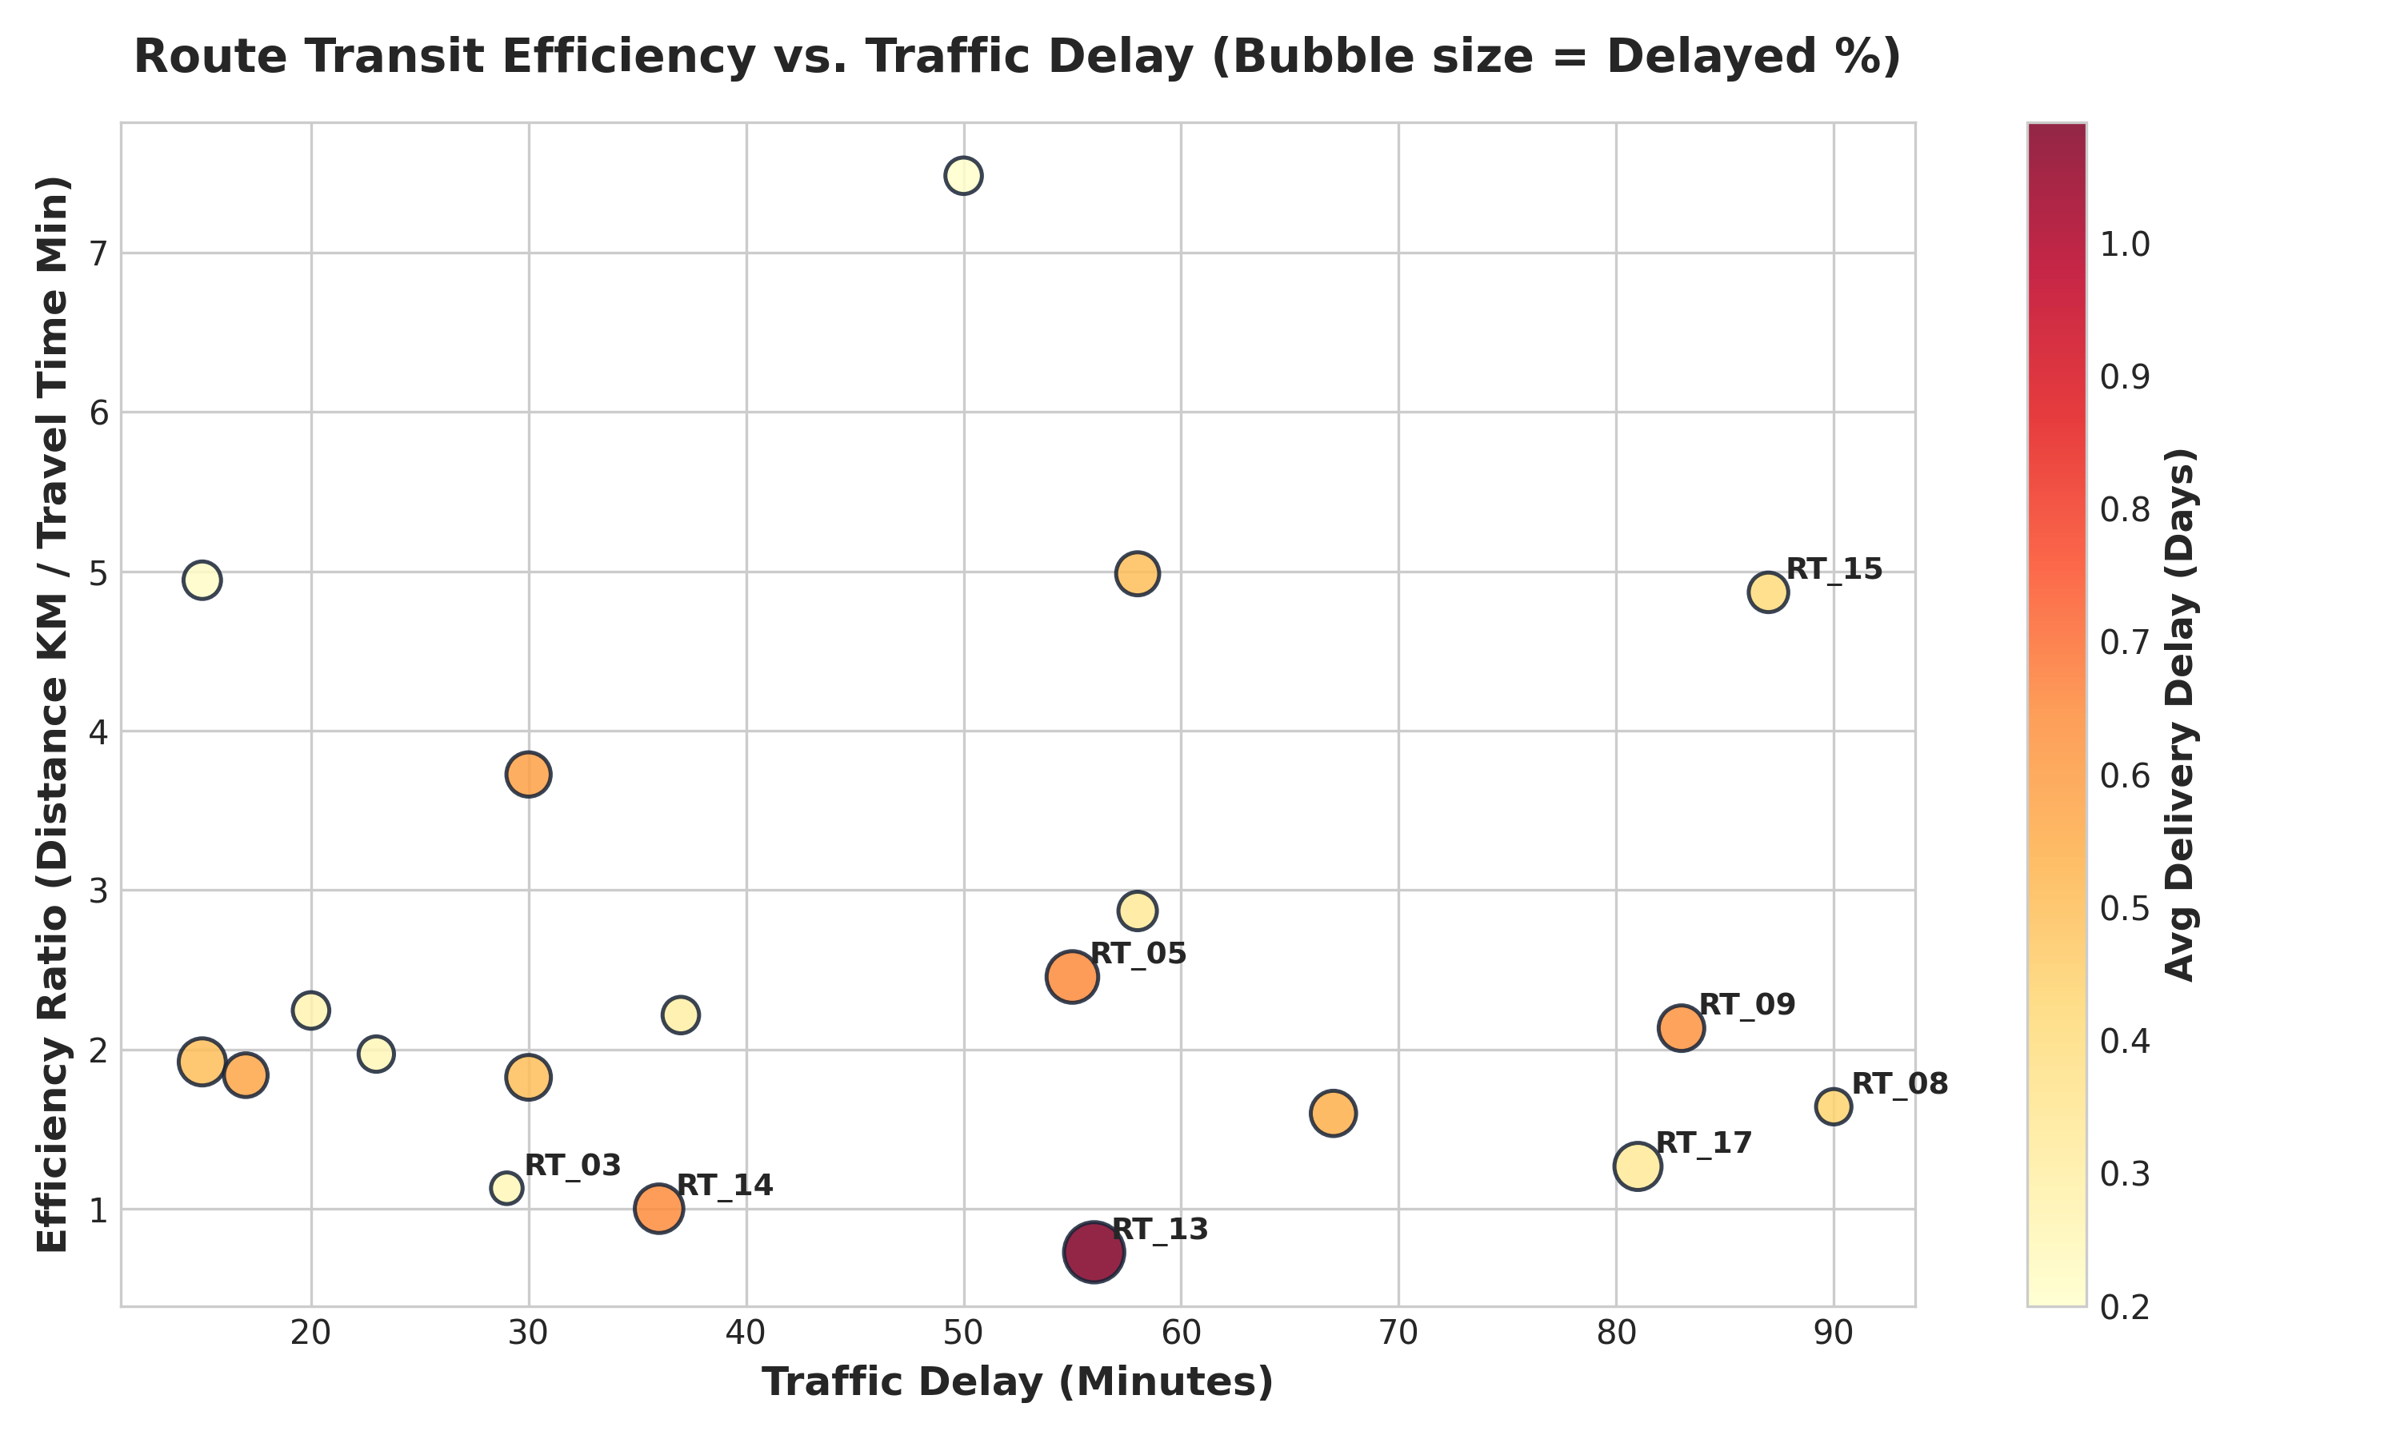
FLIPKART LOGISTICS OPTIMIZATION
Task 3: Route Optimization Insights (20 Marks)
-- Route performance: Delivery time, Traffic delay, Efficiency Ratio
SELECT r.Route_ID,
ROUND(AVG(DATEDIFF(o.Actual_Delivery_Date, o.Order_Date)), 2) AS avg_delivery_time,
ROUND(AVG(r.Traffic_Delay_Min), 2) AS avg_traffic_delay,
ROUND(AVG(r.Distance_KM / r.Average_Travel_Time_Min), 3) AS efficiency_ratio
FROM flipkart_orders o
JOIN flipkart_routes r ON r.Route_ID = o.Route_ID
GROUP BY r.Route_ID;
-- 3 routes with worst efficiency ratio
SELECT Route_ID, ROUND(AVG(Distance_KM / Average_Travel_Time_Min), 3) AS ratio
FROM flipkart_routes GROUP BY Route_ID ORDER BY ratio ASC LIMIT 3;
-- Routes with >20% delayed shipments
SELECT Route_ID,
ROUND(COUNT(CASE WHEN Actual_Delivery_Date > Expected_Delivery_Date THEN 1 END) * 100.0 / COUNT(*), 2) AS delay_pct
FROM flipkart_orders GROUP BY Route_ID HAVING delay_pct > 20;

Slide 6
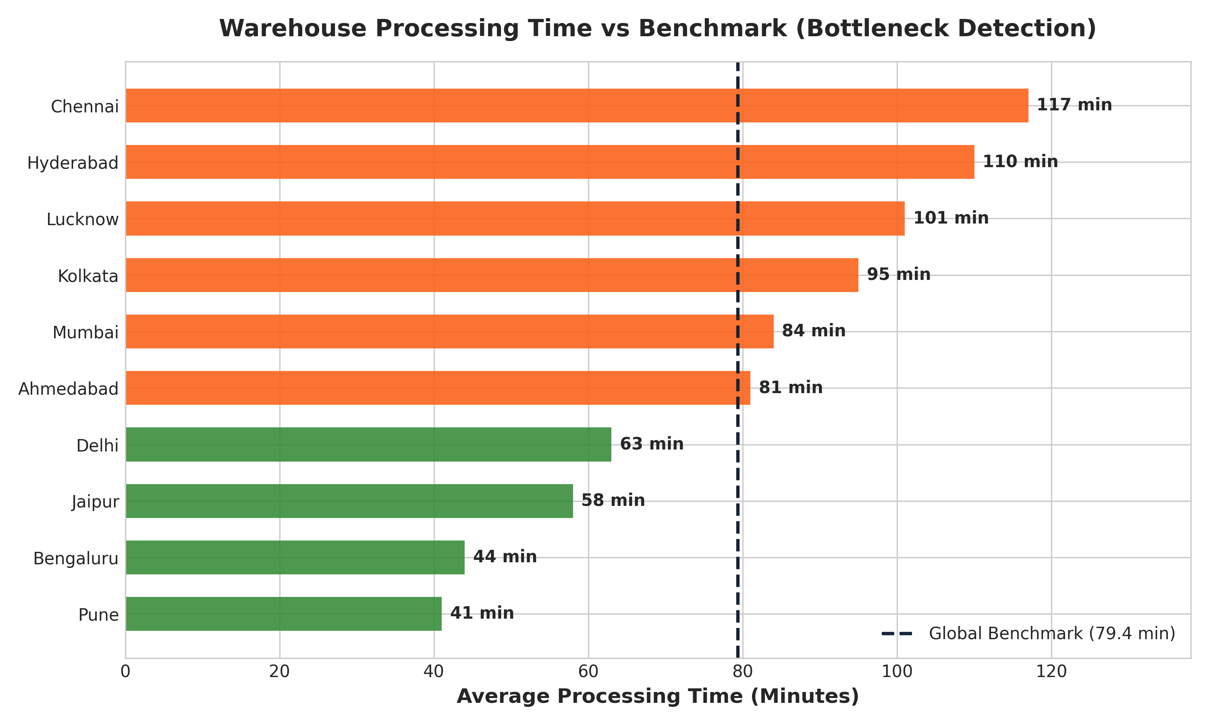
FLIPKART LOGISTICS OPTIMIZATION
Task 4: Warehouse Performance & Bottleneck Analysis (10 Marks)
-- Top 3 warehouses with highest average processing time
SELECT Warehouse_ID, Warehouse_Name, Average_Processing_Time_Min
FROM flipkart_warehouses ORDER BY Average_Processing_Time_Min DESC LIMIT 3;
-- Total vs delayed shipments per warehouse
SELECT Warehouse_ID, COUNT(*) AS Total,
COUNT(CASE WHEN Actual_Delivery_Date > Expected_Delivery_Date THEN 1 END) AS Delayed
FROM flipkart_orders GROUP BY Warehouse_ID;
-- CTE: Bottleneck warehouses exceeding global average
WITH Avg_Processing AS (
SELECT AVG(Average_Processing_Time_Min) AS Global_Average FROM flipkart_warehouses
)
SELECT w.Warehouse_ID, w.Warehouse_Name, w.Average_Processing_Time_Min,
ROUND(a.Global_Average, 2) AS Global_Average
FROM flipkart_warehouses w, Avg_Processing a
WHERE w.Average_Processing_Time_Min > a.Global_Average;

Slide 7
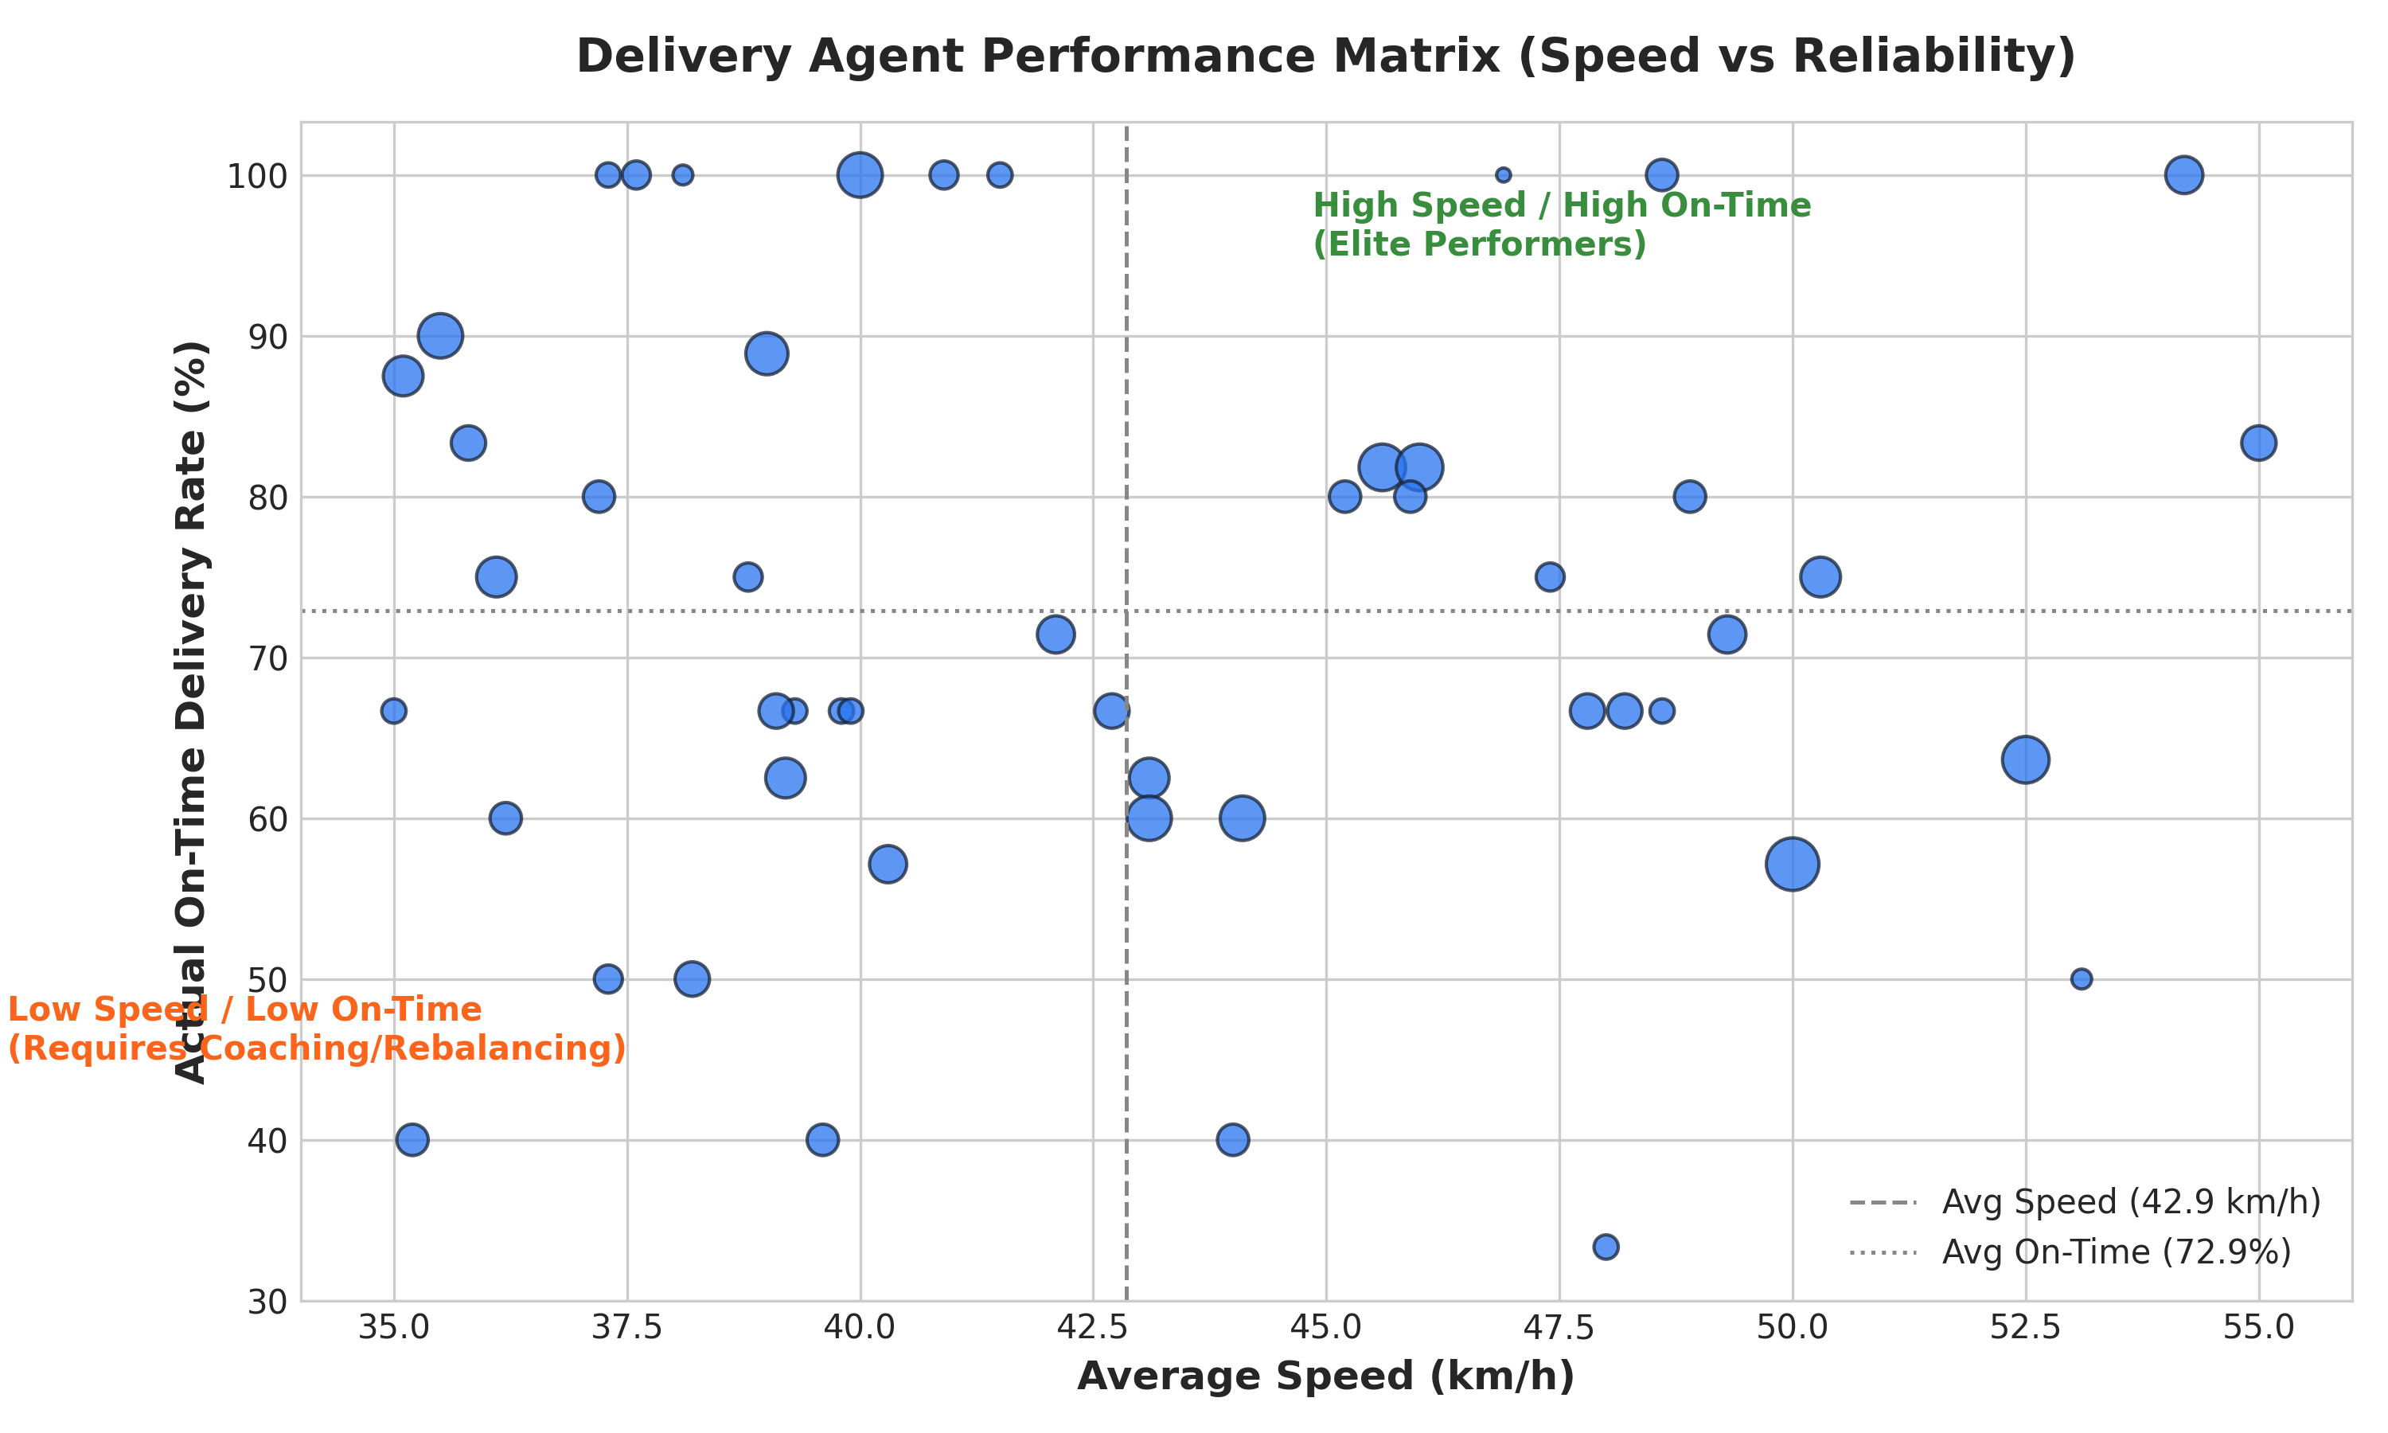
FLIPKART LOGISTICS OPTIMIZATION
Task 5: Delivery Agent Performance & Subquery Analysis (10 Marks)
-- Compare average speed of top 5 vs bottom 5 agents USING SUBQUERIES
SELECT 'Top 5 Agents' AS Category, ROUND(AVG(Avg_Speed_KMPH), 2) AS avg_speed
FROM (
SELECT a.Agent_ID, a.Avg_Speed_KMPH
FROM flipkart_orders o
JOIN flipkart_deliveryagents a ON o.Agent_ID = a.Agent_ID
GROUP BY a.Agent_ID, a.Avg_Speed_KMPH
ORDER BY (SUM(CASE WHEN o.Actual_Delivery_Date <= o.Expected_Delivery_Date THEN 1 ELSE 0 END) * 100.0 / COUNT(*)) DESC
LIMIT 5
) AS top_agents
UNION ALL
SELECT 'Bottom 5 Agents', ROUND(AVG(Avg_Speed_KMPH), 2)
FROM (
SELECT a.Agent_ID, a.Avg_Speed_KMPH
FROM flipkart_orders o
JOIN flipkart_deliveryagents a ON o.Agent_ID = a.Agent_ID
GROUP BY a.Agent_ID, a.Avg_Speed_KMPH
ORDER BY (SUM(CASE WHEN o.Actual_Delivery_Date <= o.Expected_Delivery_Date THEN 1 ELSE 0 END) * 100.0 / COUNT(*)) ASC
LIMIT 5
) AS bottom_agents;

Slide 8
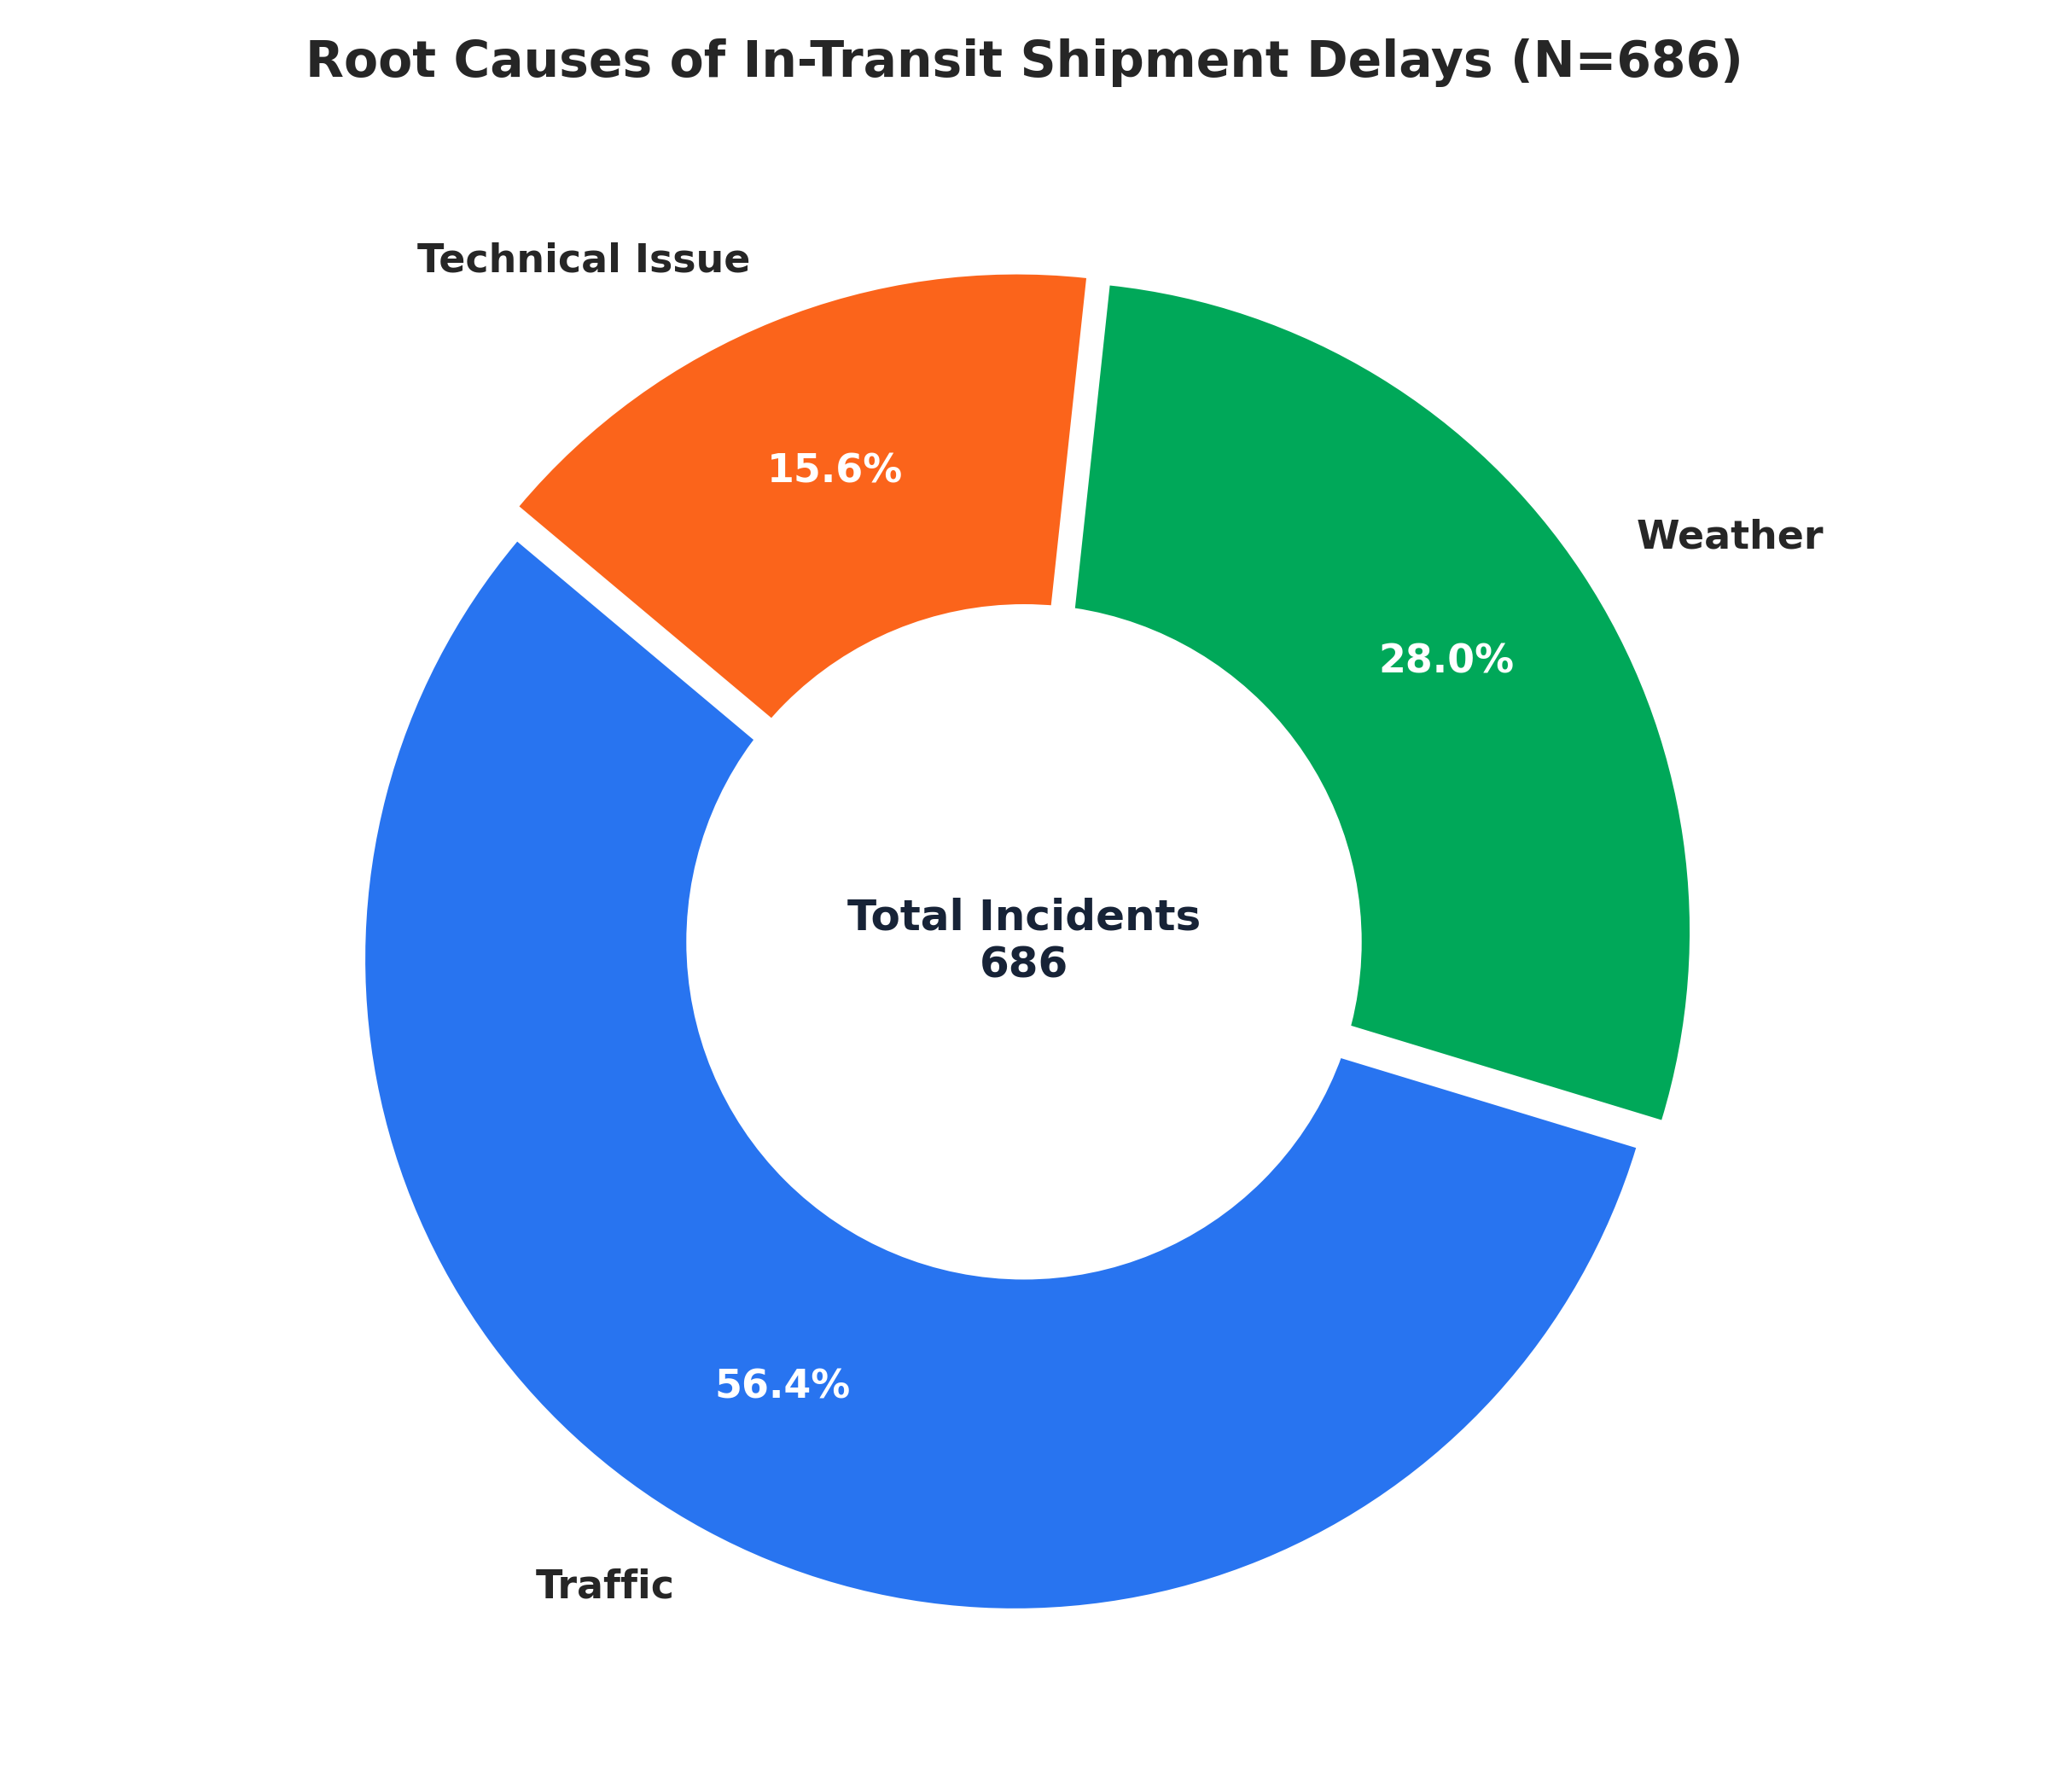
FLIPKART LOGISTICS OPTIMIZATION
Task 6: Shipment Tracking Analytics & Root Causes (10 Marks)
-- For each order, list the last checkpoint and time
SELECT t.Order_ID, t.Checkpoint, t.Checkpoint_Time AS last_checkpoint
FROM flipkart_shipmenttracking t
INNER JOIN (
SELECT Order_ID, MAX(Checkpoint_Time) AS Last_Checkpoint
FROM flipkart_shipmenttracking GROUP BY Order_ID
) m ON t.Order_ID = m.Order_ID AND t.Checkpoint_Time = m.Last_Checkpoint;
-- Most common delay reasons (excluding None)
SELECT Delay_Reason, COUNT(*) AS Frequency
FROM flipkart_shipmenttracking
WHERE Delay_Reason != 'None' AND Delay_Reason IS NOT NULL
GROUP BY Delay_Reason ORDER BY Frequency DESC;
-- Identify orders with >2 delayed checkpoints
SELECT Order_ID, COUNT(*) AS Delay_Frequency
FROM flipkart_shipmenttracking
WHERE Delay_Reason != 'None' AND Delay_Reason IS NOT NULL
GROUP BY Order_ID HAVING Delay_Frequency > 2;

Slide 9
FLIPKART LOGISTICS OPTIMIZATION
Task 7: Advanced KPI Reporting (10 Marks)
-- 1. Average Delivery Delay per Region (Start_Location)
SELECT r.Start_Location,
ROUND(AVG(DATEDIFF(o.Actual_Delivery_Date, o.Expected_Delivery_Date)), 2) AS avg_delay
FROM flipkart_orders o
JOIN flipkart_routes r ON r.Route_ID = o.Route_ID
GROUP BY r.Start_Location ORDER BY avg_delay DESC;
-- 2. On-Time Delivery % = (Total On-Time Deliveries / Total Deliveries) * 100
SELECT ROUND((SUM(CASE WHEN Actual_Delivery_Date <= Expected_Delivery_Date THEN 1 ELSE 0 END) * 100.0 / COUNT(*)), 2)
AS On_Time_Percentage
FROM flipkart_orders;
-- 3. Average Traffic Delay per Route
SELECT Route_ID, ROUND(AVG(Traffic_Delay_Min), 2) AS Average_Traffic_Delay
FROM flipkart_routes GROUP BY Route_ID ORDER BY Average_Traffic_Delay DESC;
Executive Logistics Scorecard
📊 Key Quantitative Findings:
• Total Orders Analyzed: 300 Orders (₹7,619,897.98 Total Value)
• Overall On-Time Delivery Rate: 72.67% (218 / 300 orders)
• Delayed Orders Rate: 27.33% (82 orders late)
• Average Order Turnaround: 4.51 Days
• Average Delay Across Late Orders: 1.66 Days (~40 hours)
🌍 Regional Performance Hierarchy:
• Hyderabad: 0.54 days avg delay (68.99% on-time)
• Ahmedabad: 0.52 days avg delay (69.70% on-time)
• Pune: 0.50 days avg delay (71.74% on-time)
• Bengaluru: 0.24 days avg delay (81.58% on-time)
• Lucknow: 0.15 days avg delay (84.62% on-time - Top Region)

Slide 10
FLIPKART LOGISTICS OPTIMIZATION
Strategic Business Recommendations for Flipkart Logistics
1. Route Optimization & Transit Strategy
• Split Bottleneck Corridors into Relay Segments:
- Route RT_13 (Hyderabad -> Jaipur) experiences 54.5% delay over 1,078 km.
- Introduce staged driver relays at Nagpur/Bhopal hubs to eliminate fatigue.
• Dynamic Night-Window Dispatches:
- Traffic causes 56.41% of all in-transit delays.
- Shift interstate trunk runs to 10 PM - 5 AM off-peak windows to reduce transit times by up to 35%.
2. Warehouse & Fleet Equalization
• Modernize High-Latency Fulfillment Hubs:
- Chennai (WH_10: 117 min) and Hyderabad (WH_09: 110 min) exceed network benchmark (79.4 min) by >30 mins.
- Implement wave-based automated parcel sortation.
• Workload Rebalancing for Delivery Drivers:
- Bottom 5 agents achieve only 40.7% on-time despite driving at 41 km/h.
- Rebalance high-density urban routes and provide GPS turn-by-turn guidance apps.

Slide 11
FLIPKART LOGISTICS OPTIMIZATION
Task 8 & 9: Project Submission & Video Walkthrough Links
Task 9: Video Presentation Details (10 Marks)
🎥 Video Walkthrough Links (Face Visible, 5-9 Mins):
• Loom Walkthrough Part 1:
https://www.loom.com/share/519a939ef711457d970e77f466b2729b
(Covers problem understanding, schema architecture, data cleaning, and delay distribution)
• Loom Walkthrough Part 2:
https://www.loom.com/share/2bce798c27254d4db2faf6ce44ddacb4
(Covers route optimization, warehouse bottlenecks, driver cohorts, and strategic recommendations)
• Google Drive Backup Link:
[Add Google Drive Video Link Here as per guidelines]
Submission Checklist & Guidelines
📁 Submission Package Structure:
• Flipkart_Logistics_Optimization.sql (Clean MySQL script)
• Flipkart_Logistics_Optimization.pptx (Presentation Deck)
• Logistics_Optimization_for_Delivery_Routes_Flipkart.pdf
✓ All Tasks 1 to 7 fully solved with exact MySQL queries.
✓ Queries, result tables, and high-resolution charts integrated.
✓ Cleaned date standardizations and edge-case imputations.
✓ Packaged in submission .zip folder as required by dashboard.

