Slide 1

Customer Shopping Behavior Analysis
Uncovering insights from transactional data to guide strategic business decisions.

Slide 2


Project Overview & Dataset Summary
Project Goal
Dataset at a Glance
Analyze 3,900 purchases to optimize operations, reduce costs, and improve energy forecasting.
Rows: 3,900
Columns: 18
Key Features: Demographics, Purchase Details, Shopping Behavior
Missing Data: 37 values in Review Rating

Slide 3
Exploratory Data Analysis (Python)
1
2
Data Loading & Exploration
Missing Data Handling
Imported dataset using pandas. Checked structure and summary statistics.
Imputed missing Review Rating values using median by product category.
3
4
Column Standardization
Feature Engineering
Renamed columns to snake_case for readability.
Created age_group and purchase_frequency_days.
5
6
Data Consistency
Database Integration
Dropped redundant promo_code_used column.
Loaded cleaned data into PostgreSQL for SQL analysis.

Slide 4


Data Analysis using SQL: Key Insights
Revenue by Gender
High-Spending Discount Users
Male: $157,890
Female: $75,191
839 customers used discounts but spent above average.
Top 5 Products by Rating
Gloves (3.86), Sandals (3.84), Boots (3.82), Hat (3.80), Skirt (3.78)

Slide 5


SQL Analysis: Shipping & Subscriptions
Shipping Type Comparison
Subscribers vs. Non-Subscribers
Average Purchase Amount:
Subscribers (1053): Avg Spend $59.49, Total Revenue $62,645
Standard: $58.46
Non-Subscribers (2847): Avg Spend $59.87, Total Revenue $170,436
Express: $60.48

Slide 6

SQL Analysis: Product & Customer Focus
Discount-Dependent Products
Customer Segmentation
Hat (50%), Sneakers (49.66%), Coat (49.07%), Sweater (48.17%), Pants (47.37%)
Loyal (3116), Returning (701), New (83)
Repeat Buyers & Subscriptions
958 repeat buyers are subscribers, 2518 are not.

Slide 7
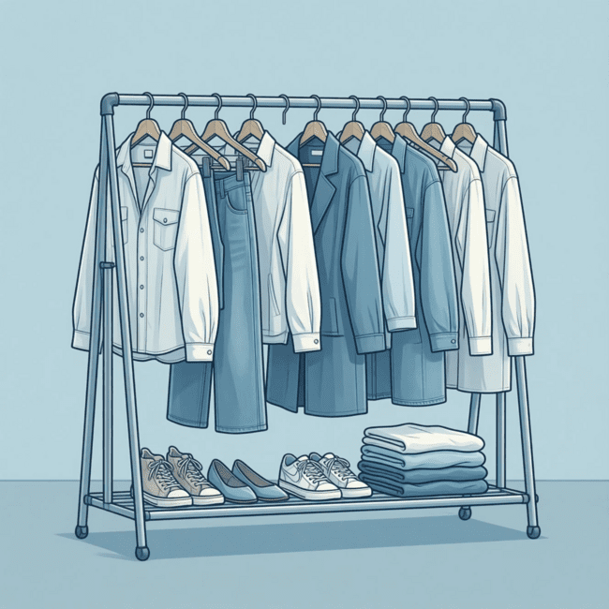

SQL Analysis: Top Products & Age Groups
Top 3 Products per Category
Revenue by Age Group
Accessories: Jewelry, Sunglasses, Belt
Young Adult: $62,143
Clothing: Blouse, Pants, Shirt
Middle-aged: $59,197
Footwear: Sandals, Shoes, Sneakers
Adult: $55,978
Outerwear: Jacket, Coat
Senior: $55,763

Slide 8

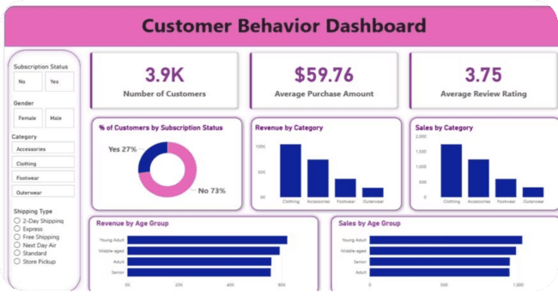
Interactive Dashboard in Power BI
Visualizing key insights for strategic decision-making.

Slide 9




Dashboard Highlights
Customers
Avg. Purchase
3.9K
$59.76
% Subscribers
Avg. Review
27% Yes, 73% No
3.75

Slide 10
Business Recommendations
Boost Subscriptions
Promote exclusive benefits.
Customer Loyalty Programs
Reward repeat buyers.
Review Discount Policy
Balance sales with margin control.
Product Positioning
Highlight top-rated and best-selling items.
Targeted Marketing
Focus on high-revenue age groups and express-shipping users.

