Slide 1

Movie Recommendation System
Sujal Agarwal Btech IT
5th Semester Section : IT
University Roll No. : 2015555 Class Roll No. : 38
Contact No : 8533814475
E-mail: sujalagarwal0007@gmail.com

Slide 2
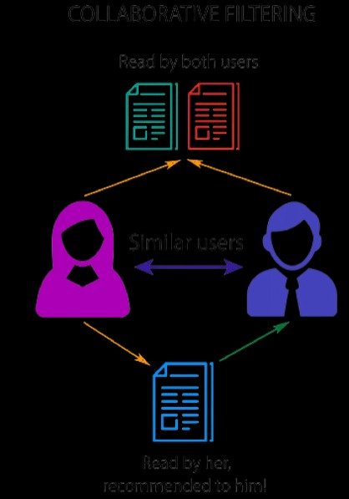
What is a Recommendation system?
Recommender System is a system that seeks to predict or filter preferences according to the user's choices. Recommender systems are utilized in a variety of areas including movies, music, news, books, research articles, search queries, social tags, and products in general..

Slide 3
Types of recommendation system
Collaborative/Social-filtering system – aggregation of consumers’ preferences and recommendations to other users based on similarity in behavioral patterns
Content-based system – supervised machine learning used to induce a classifier to discriminate between interesting and uninteresting items for the user.
Hybrid recommender systems- combine two or more recommendation strategies in different ways to benefit from their complementary advantages.

Slide 4
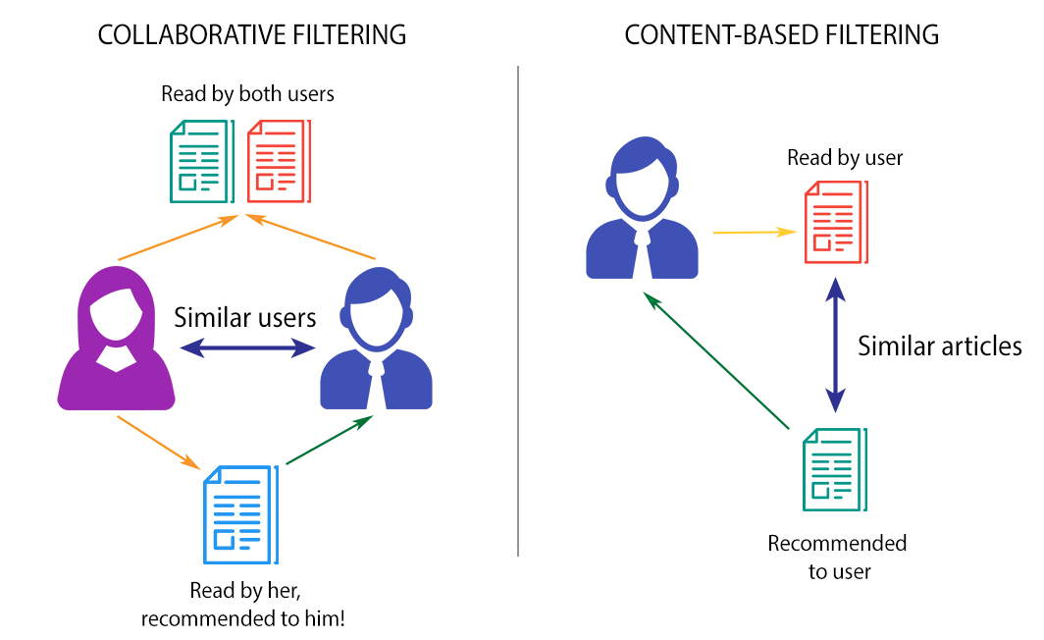

Slide 5
Libraries Used
NLTK
Pandas
Scikit learn
NLTK(Natural Language Toolkit) is a standard python library that provides a set of diverse algorithms for NLP. It is one of the most used libraries for NLP and Computational Linguistics..
Pandas is a Python library for data analysis. ... Pandas is built on top of two core Python libraries—matplotlib for data visualization and NumPy for mathematical operations. Pandas acts as a wrapper over these libraries, allowing you to access many of matplotlib's and NumPy's methods with less code.
Scikit-learn is a free machine learning library for Python. It features various algorithms like support vector machine, random forests, and k-neighbours, and it also supports Python numerical and scientific libraries like NumPy and SciPy.
NumPy
OS
NumPy is a library for the Python programming language, adding support for large, multi-dimensional arrays and matrices, along with a large collection of high-level mathematical
functions to operate on these arrays.
This module provides a portable way of using operating system dependent functionality.

Slide 6

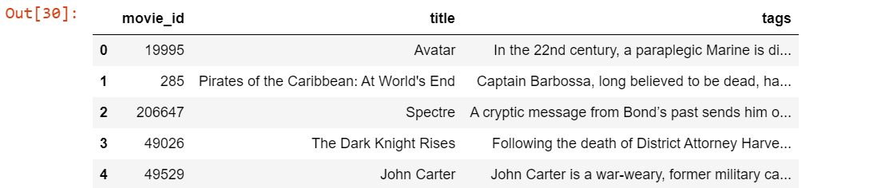
Data Preprocessing
Data preprocessing is the process of transforming raw data into an understandable format. ... The quality of the data should be checked before applying machine learning.

Slide 7
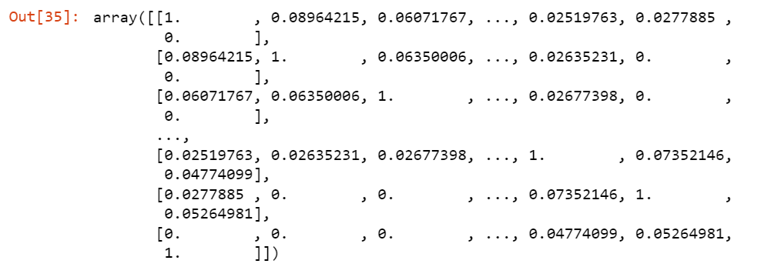
Using CountVectorizer to Extracting Features from Text
CountVectorizer is a great tool provided by the scikit-learn library in Python. It is used to transform a given text into a vector on the basis of the frequency (count) of each word that occurs in the entire text. This is helpful when we have multiple such texts, and we wish to convert each word in each text into vectors (for using in further text analysis).
CountVectorizer creates a matrix in which each unique word is represented by a column of the matrix, and each text sample from the document is a row in the matrix. The value of each cell is nothing but the count of the word in that particular text sample.
.

Slide 8
Key Observations:
There are 12 unique words in the document, represented as columns of the table.
There are 3 text samples in the document, each represented as rows of the table.
Every cell contains a number, that represents the count of the word in that particular text.
All words have been converted to lowercase.
The words in columns have been arranged alphabetically.
.

Slide 9
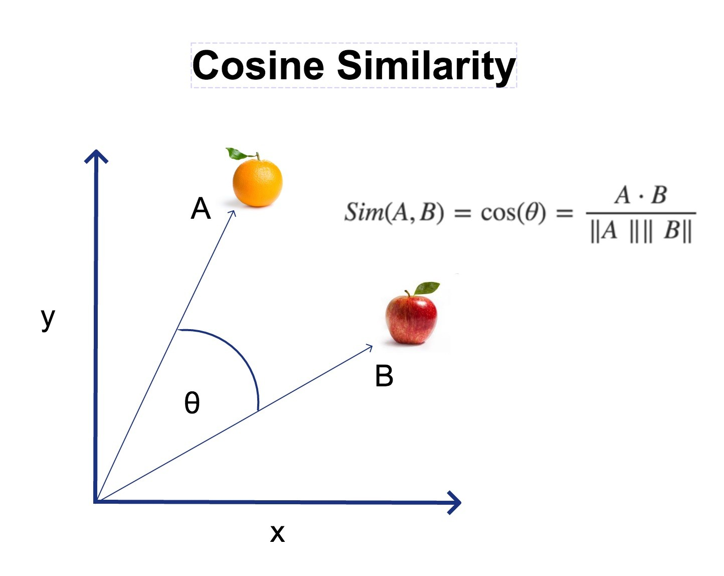
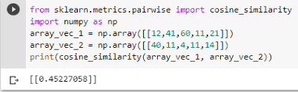
Cosine similarity
Cosine similarity is one of the metric to measure the text-similarity between two documents irrespective of their size in Natural language Processing. ... If the Cosine similarity score is 1, it means two vectors have the same orientation. The value closer to 0 indicates that the two documents have less similarity

Slide 10


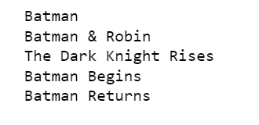
Final Results

Slide 11
Conclusion
Recommender system actually unsupervised Machine learning algorithm it’s a very powerful technique in term of business because Google , Amazon all the big giants Organization actually use powerful Recommended system in order to Expand their business.

Slide 12


Reference
www.kaggle.com www.stakoverflow.com www.youtube.com www.wikipedia.com www.medium.com https://docs.python.org

Slide 13
Thank you

