Slide 1

CourseCraft
Connecting Education.

Slide 2
Project Profile
Type | Description
Project Name | CourseCraft
Group No. | 26
Group Members | B65 Sujal Thakor B50 Alex Rana B71 Darshan Vithalani B29 Prince Khandavi B41 Pruthvi Parekh
Platform | Web Application
Institute | GLS(S.R Parikh) Institute Of Computer Technology

Slide 3
Introduction
The course craft is an learning management system which provides a medium between Faculties and Students.
The simple workflow allows teachers to create, review, and grade assignments quickly, sharing of resources, polling facilities and Continuous Evaluation Component, all in one place.
Teachers( Class Authors ) can add students( Class Members ) via sharing a code with their class to join. It takes just minutes to set up.

Slide 4

Project Definition
CourseCraft is a user-friendly Learning Management System (LMS) that simplifies education by offering a centralized platform for educators and students to interact, share resources, manage assignments, and track progress. It supports paperless workflows, continuous evaluation, and easy classroom setup via code sharing.

Slide 5




Tools and Technology
Bootstrap5
Front-End Technologies
Back-End
Database
Server | Django Deployment Server

Slide 6
Modules
Class Management Module: This focuses on the structure and organization of classes themselves (creation, deletion, enrollment, class details, etc.).
Assignment Module: This module would handle all aspects of assignments - creation, distribution, submission, review, grading, and feedback.
Resource Sharing Module: This module would facilitate the sharing of learning materials like documents, videos, links, etc., between teachers and students.

Slide 7
Modules
Polling Module: This module would enable teachers to conduct polls or quizzes within the platform for quick assessments or feedback.
Continuous Evaluation Module: This module might handle features related to ongoing assessments, progress tracking, and perhaps gradebook functionalities.
User Management Module: This module would handle user accounts, roles (teacher/student), class joining, and user profiles. .

Slide 8
Entities
Teachers (Class Authors): Educators who create classes, upload resources, create and grade assignments, conduct polls, and manage their virtual classrooms. Their primary goal is to teach and manage their courses online.
Students (Class Members): Students who join classes, access resources, submit assignments, participate in polls within the platform. Their primary goal is to learn and engage with the course material.
Admin: Admins manage the platform meaning users, system settings, modules, data, and maintenance. They ensure everything runs smoothly

Slide 9
Use Case Diagrams

Slide 10
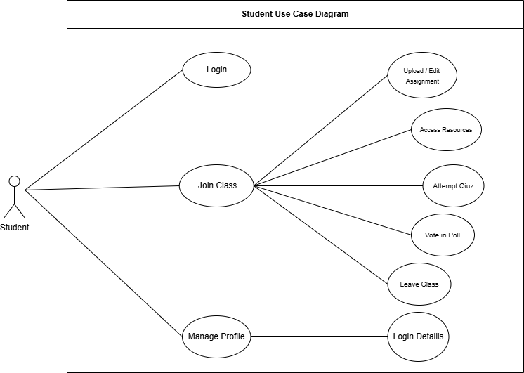

Slide 11
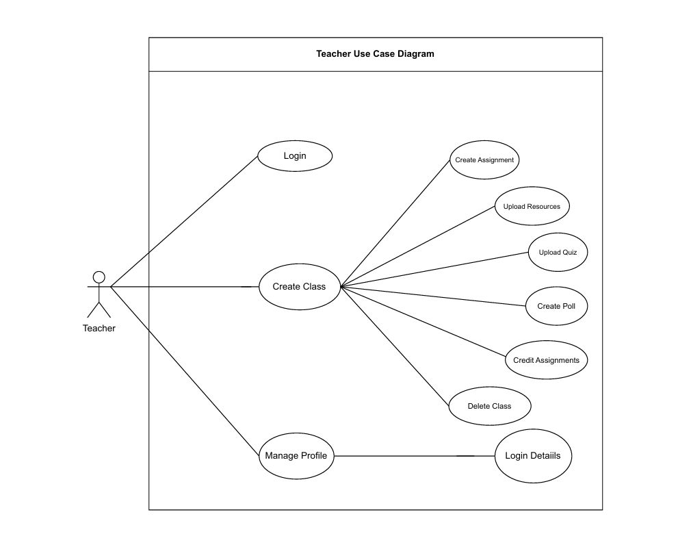

Slide 12
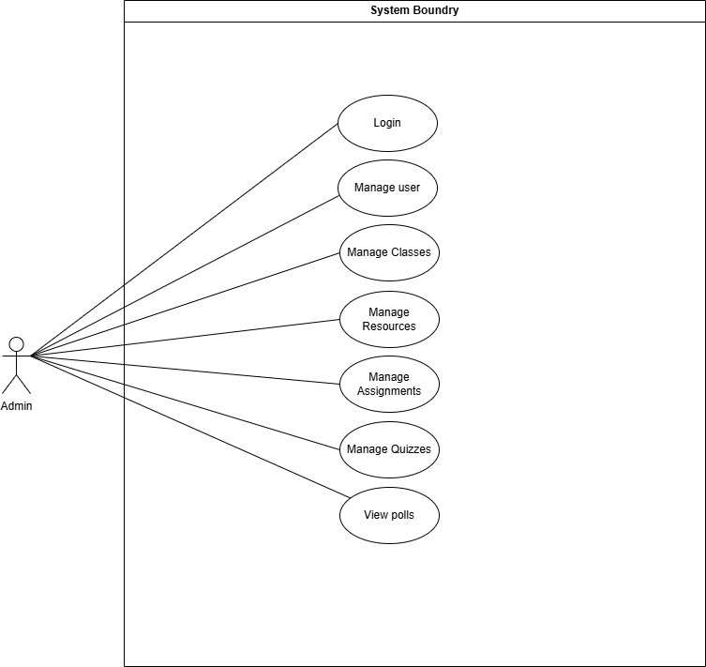

Slide 13
Architecture Diagram

Slide 14
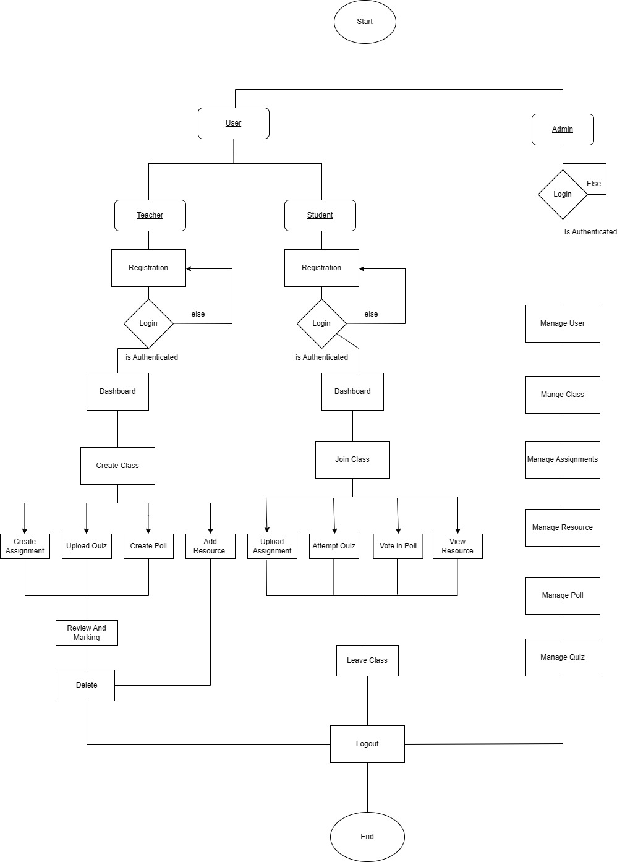

Slide 15
Sequence Diagram

Slide 16
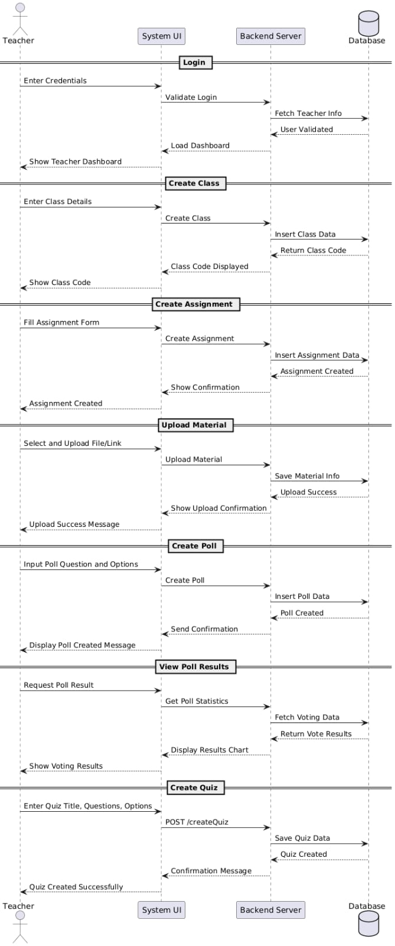
Teacher Sequence diagram

Slide 17
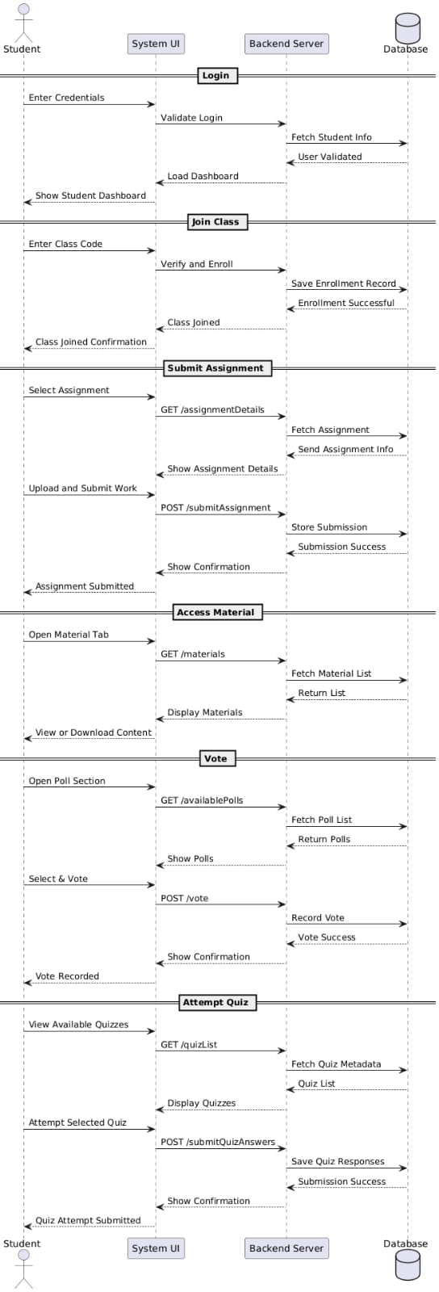
Student sequence Diagram

Slide 18
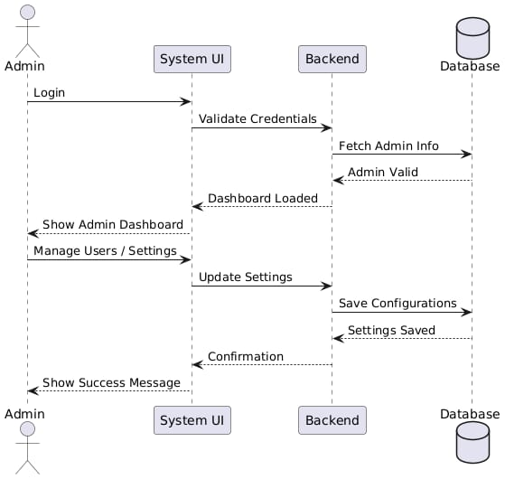
Admin Sequence

Slide 19
Activity Diagram

Slide 20
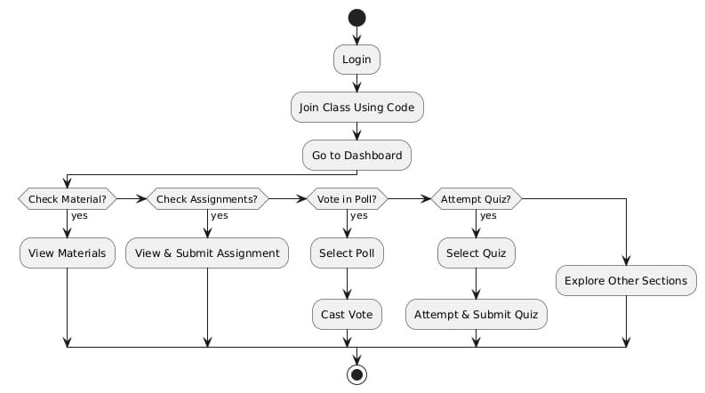
Student Activity

Slide 21
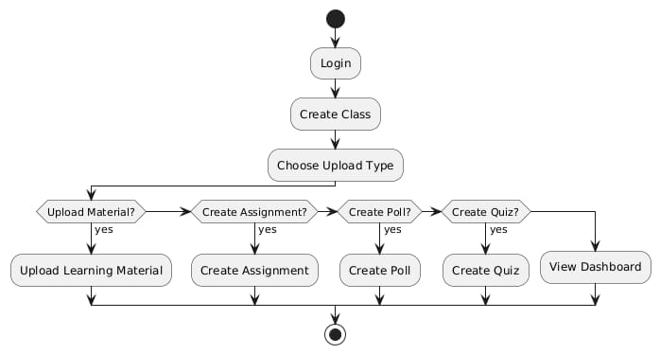
Teacher Activity

Slide 22
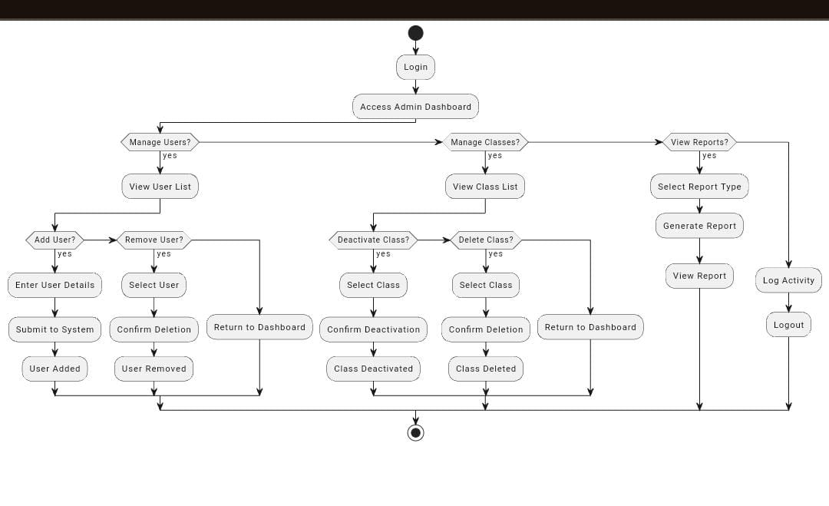
Admin Activity

Slide 23
class diagram

Slide 24
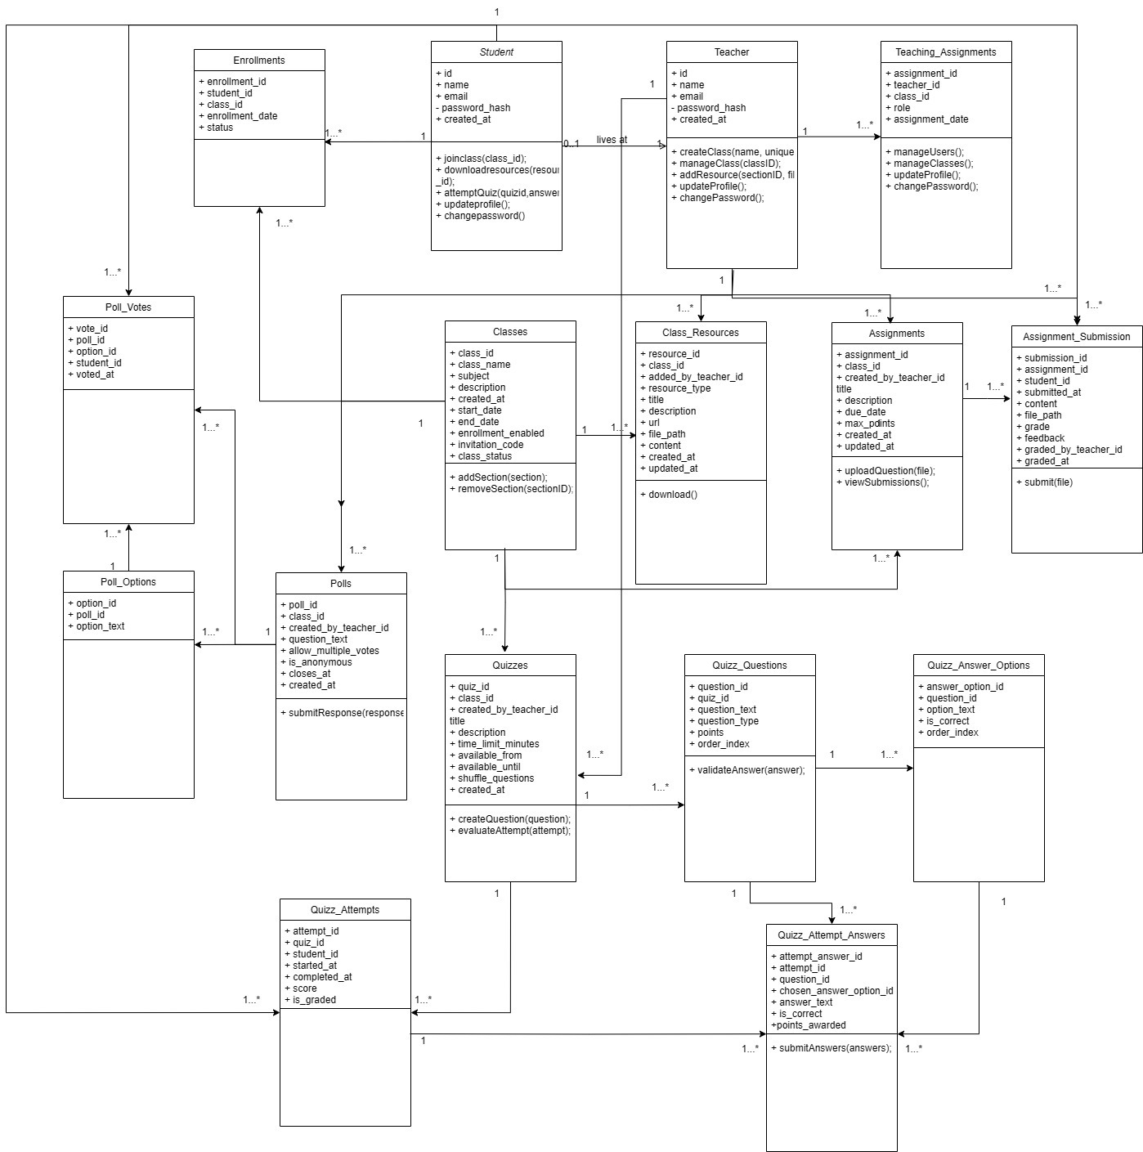

Slide 25
data dictionary

Slide 26
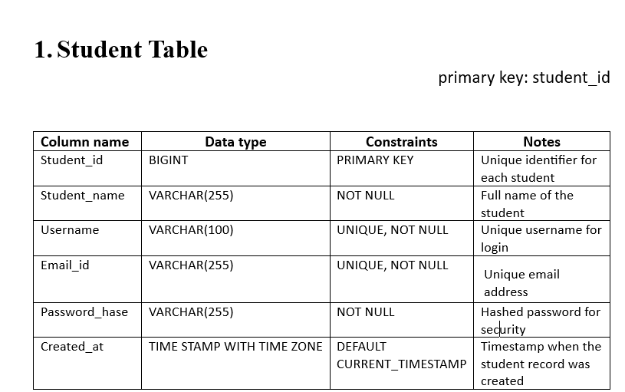

Slide 27
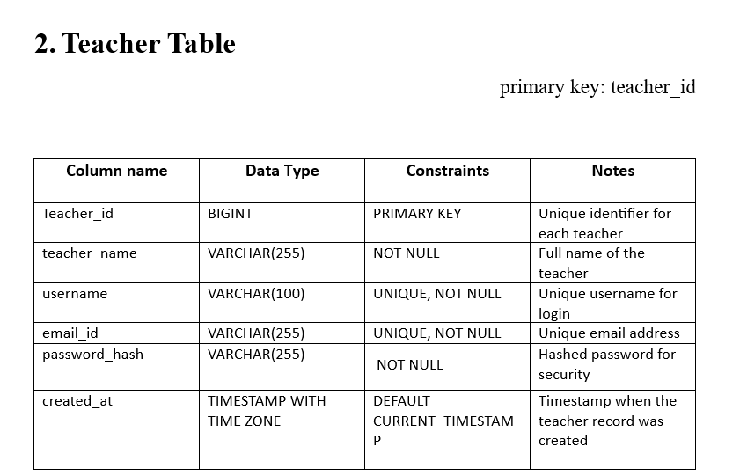

Slide 28
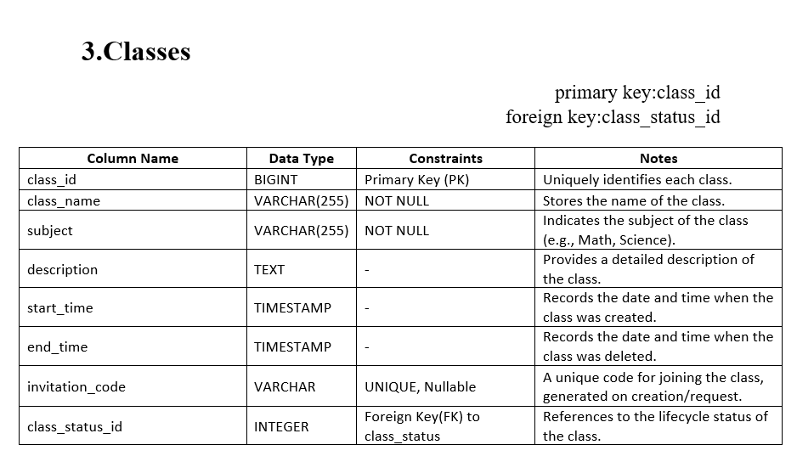

Slide 29
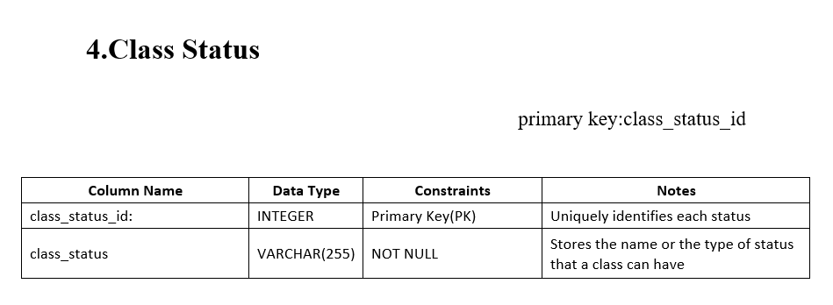

Slide 30
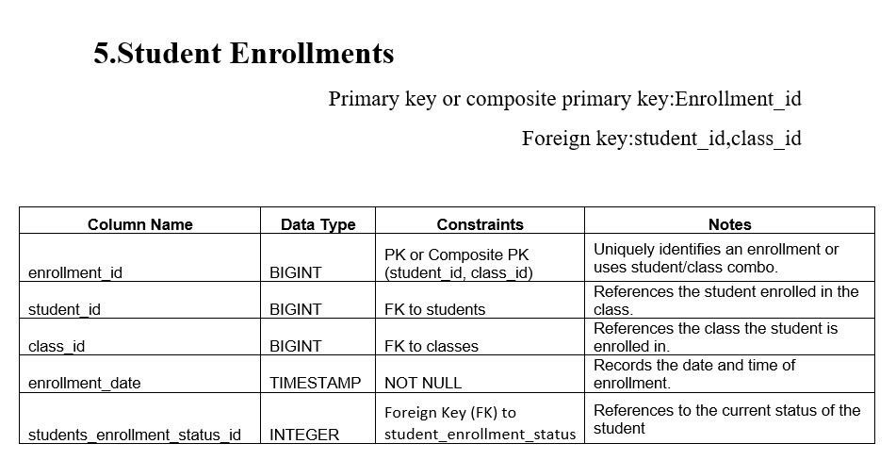

Slide 31
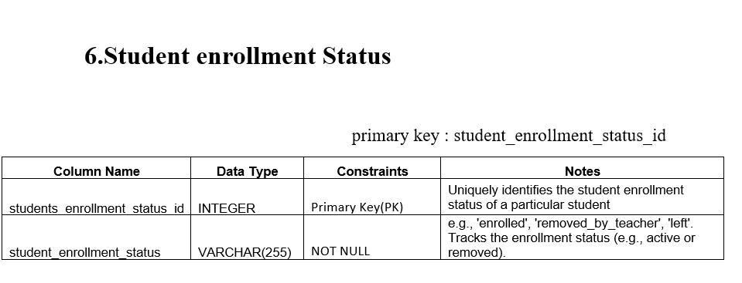

Slide 32
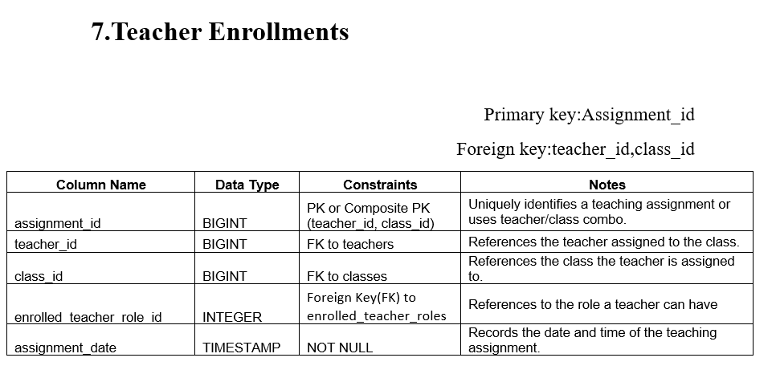

Slide 33
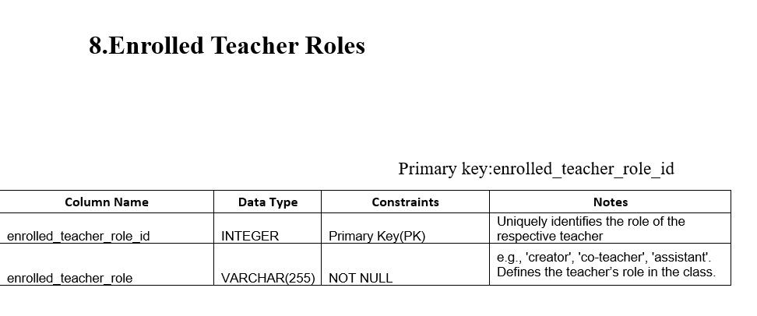

Slide 34
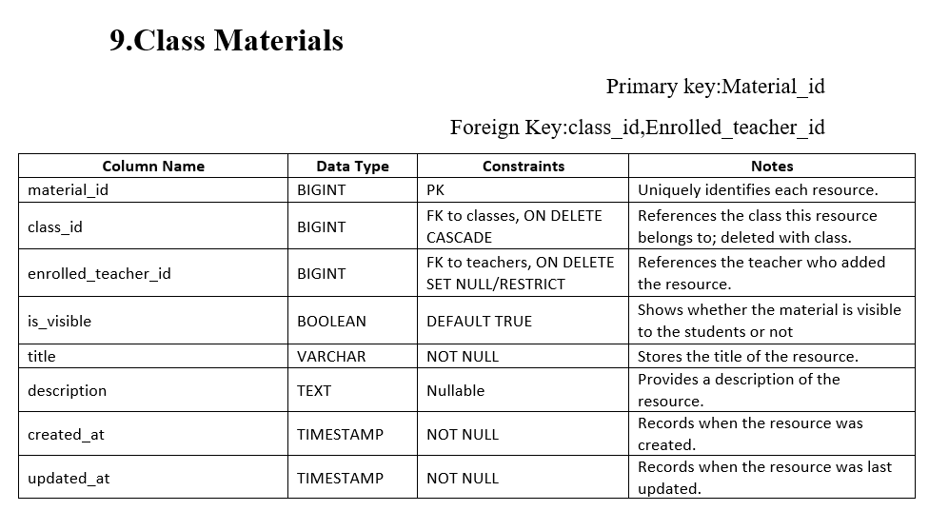

Slide 35
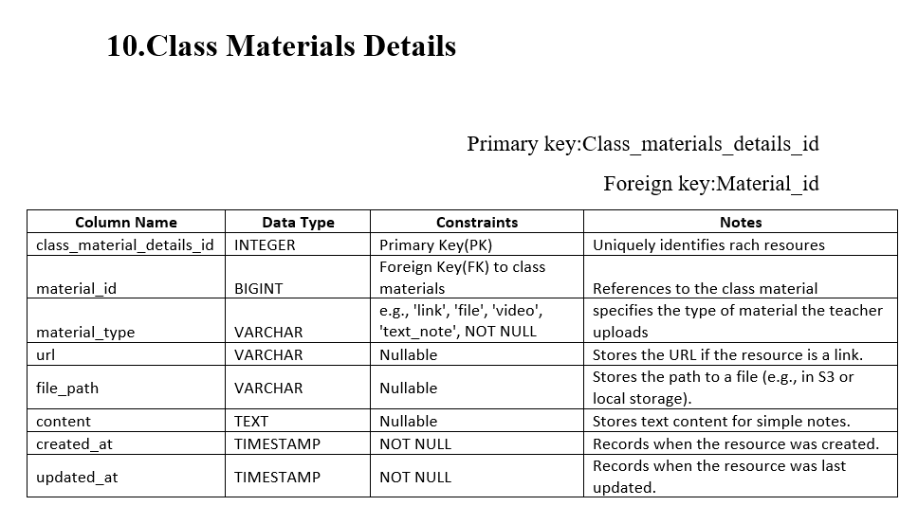

Slide 36
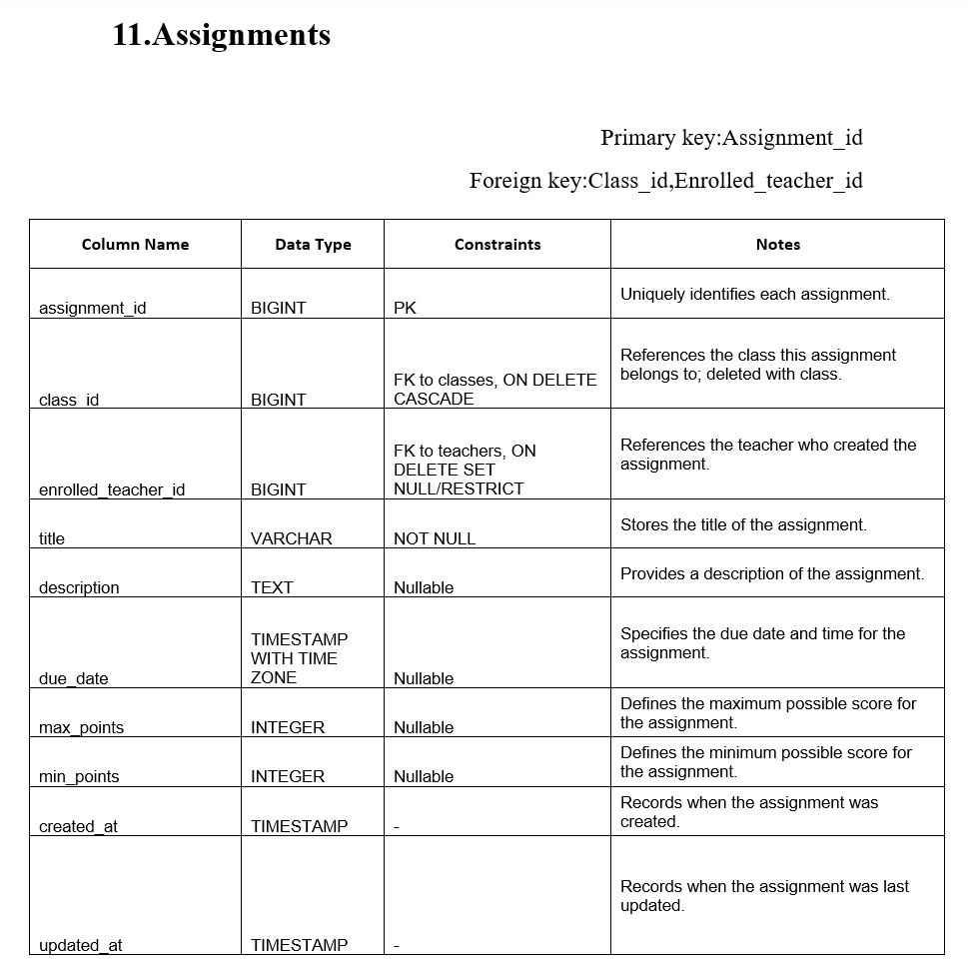

Slide 37
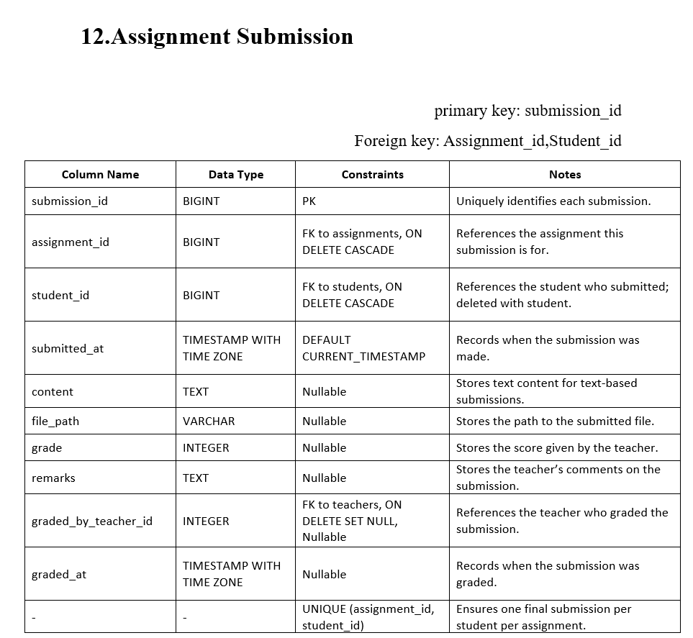

Slide 38
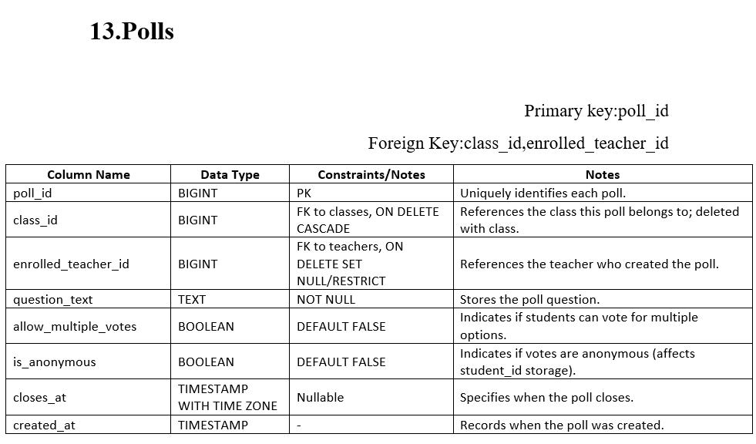

Slide 39
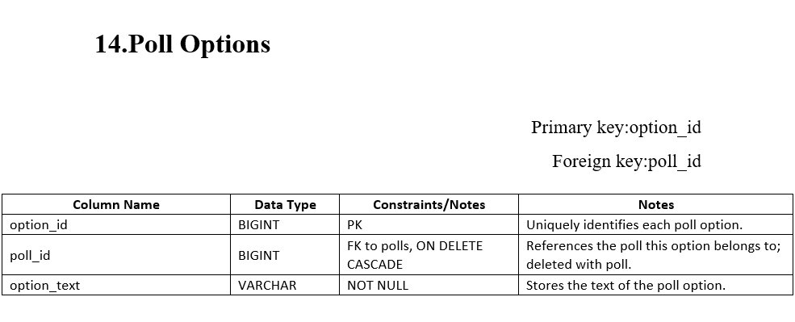

Slide 40
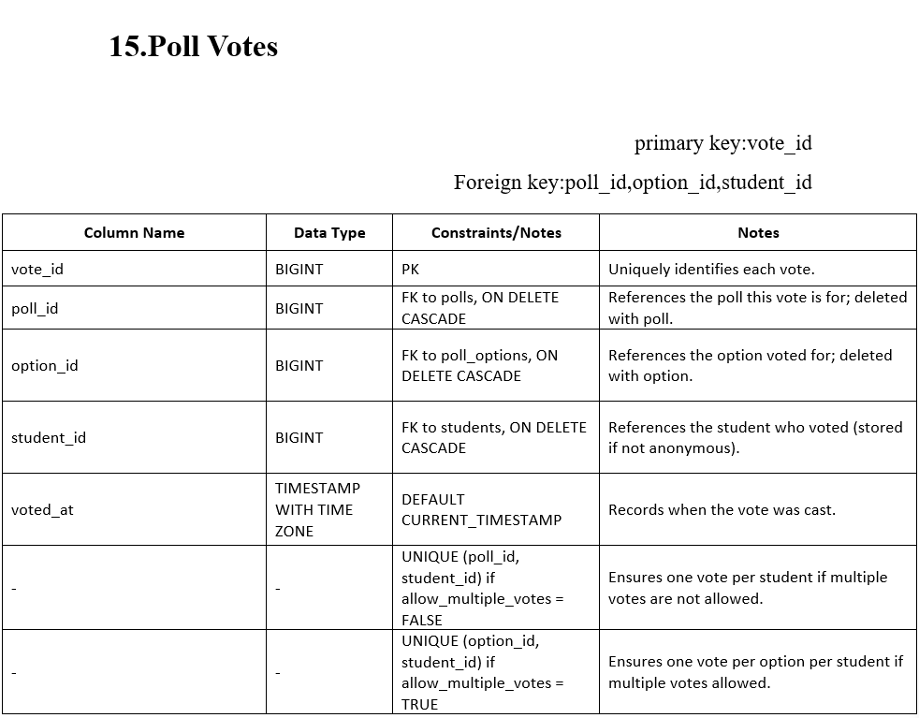

Slide 41
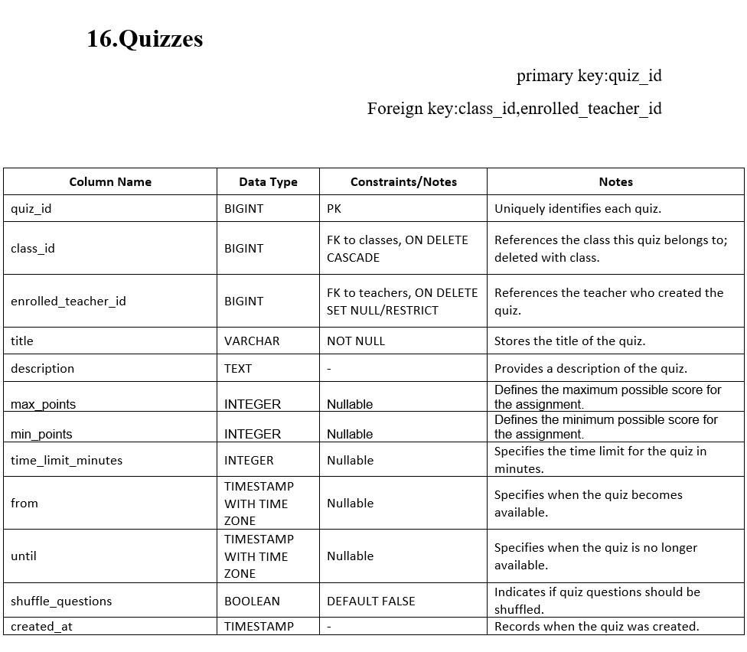

Slide 42
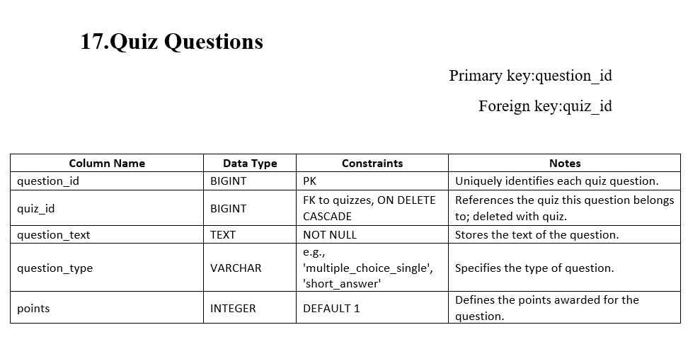

Slide 43
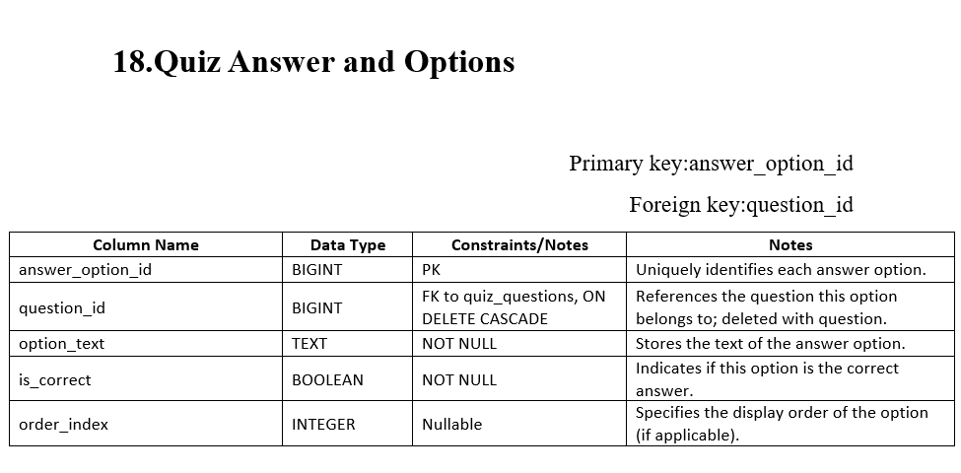

Slide 44
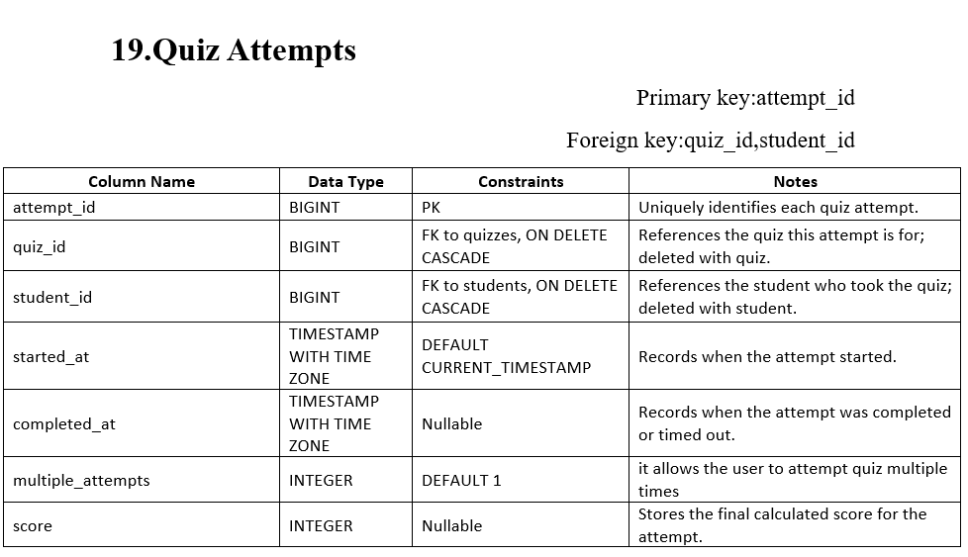

Slide 45
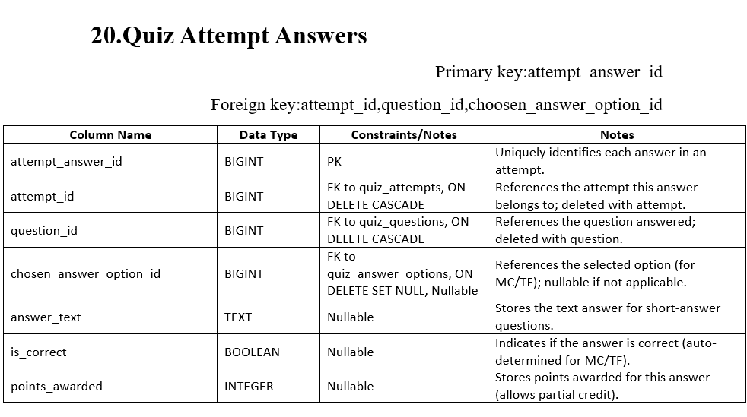

Slide 46
GUI Screen(Wireframes)

Slide 47
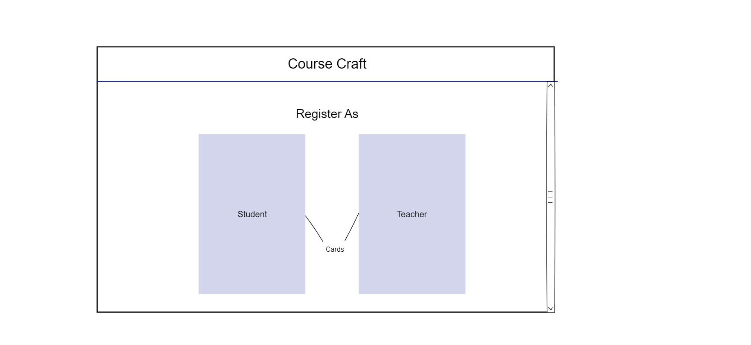
Index Page

Slide 48
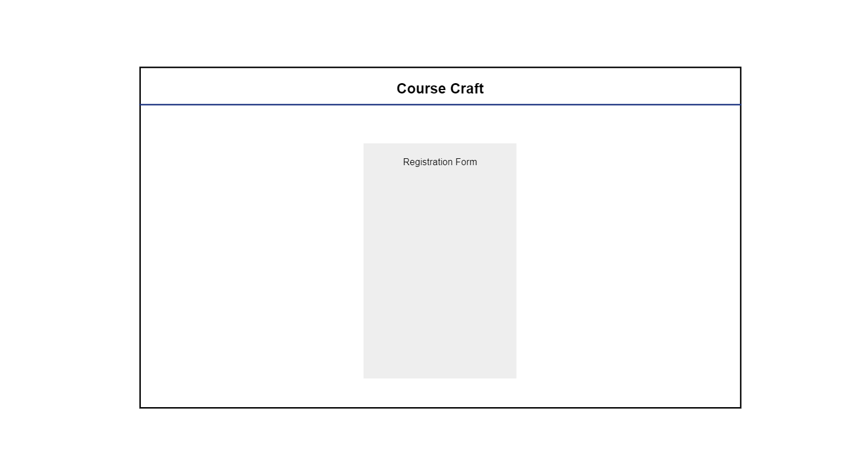
Registration page

Slide 49
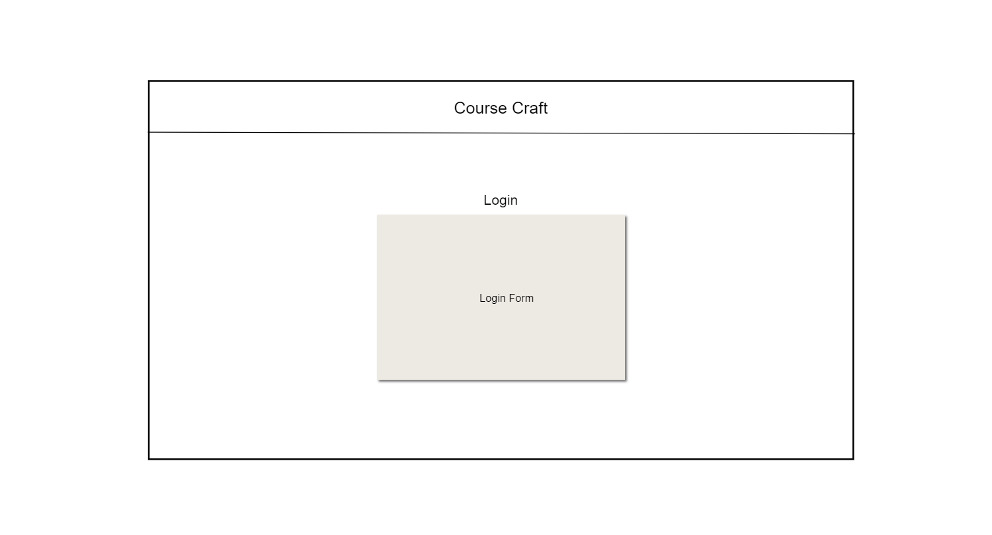
Login Page

Slide 50
Student Side GUI

Slide 51
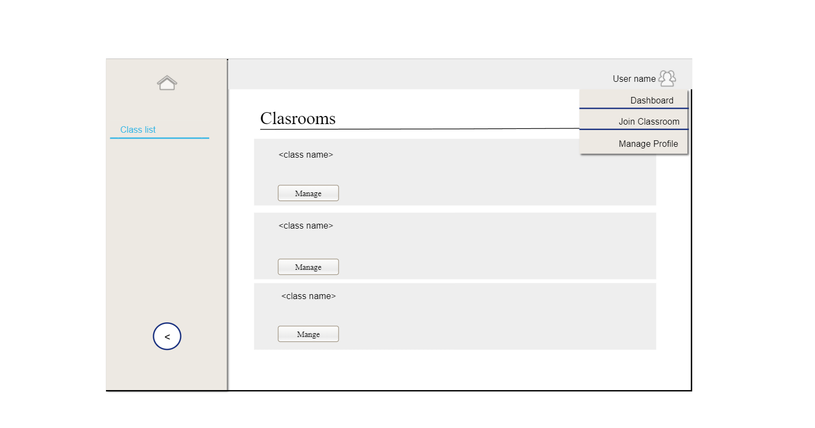
Student Dashboard

Slide 52
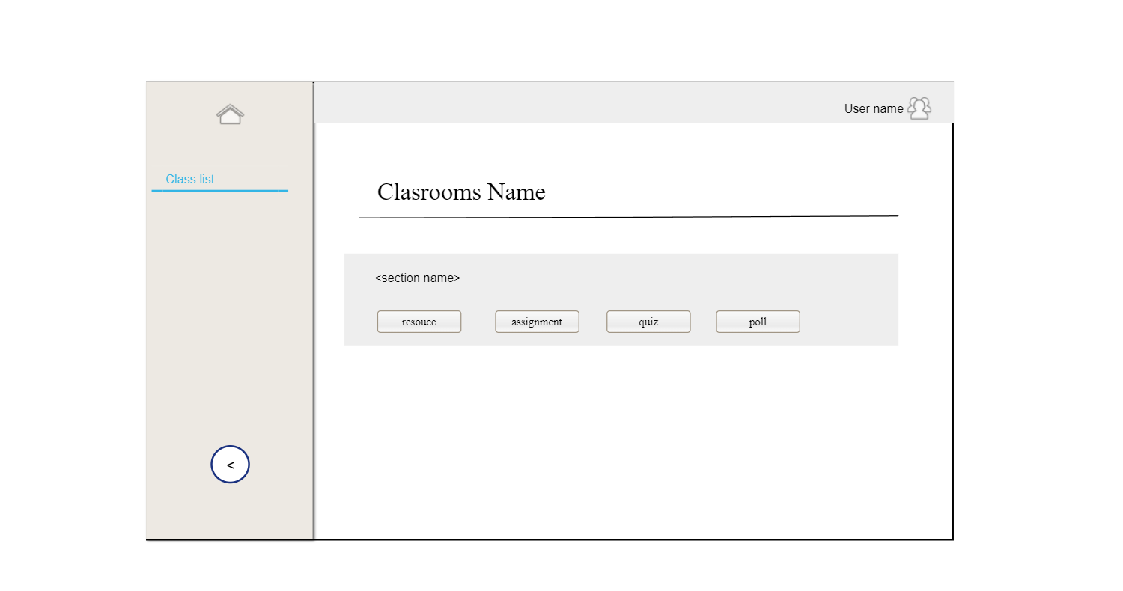
Student InnerClass

Slide 53
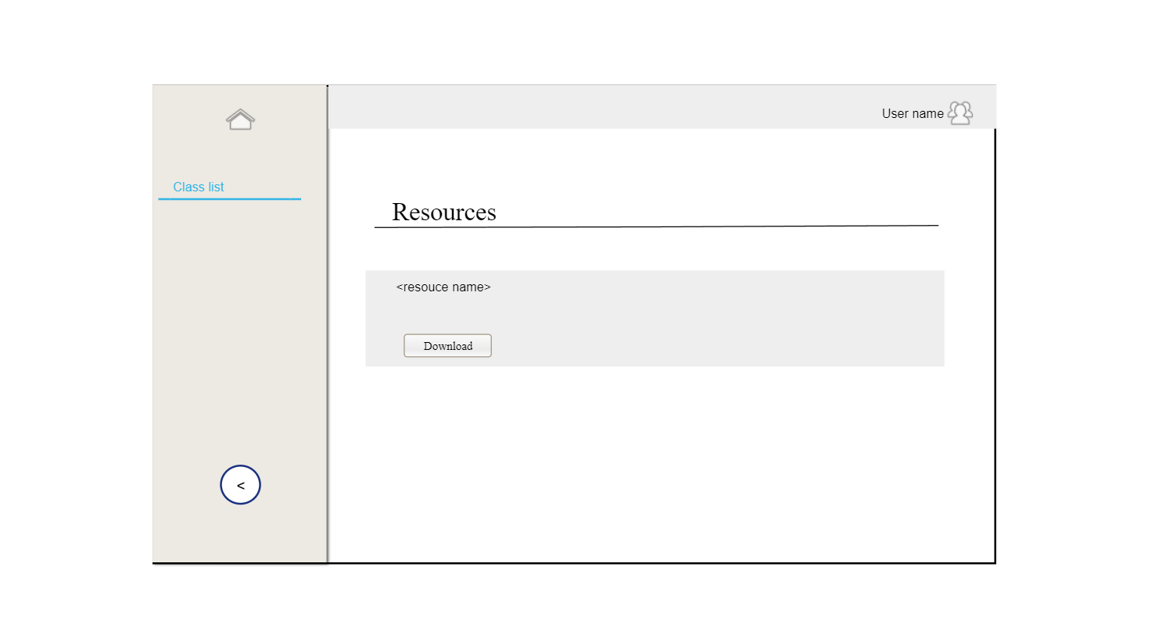
Student Resource

Slide 54
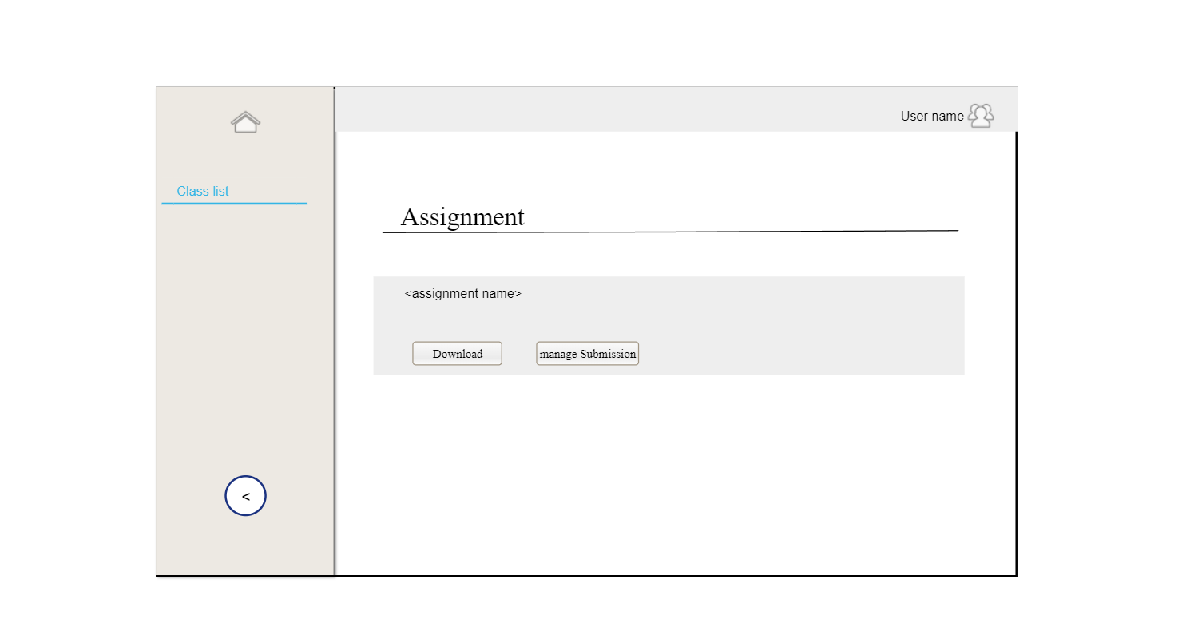
Student Assignment

Slide 55

Student Quiz

Slide 56
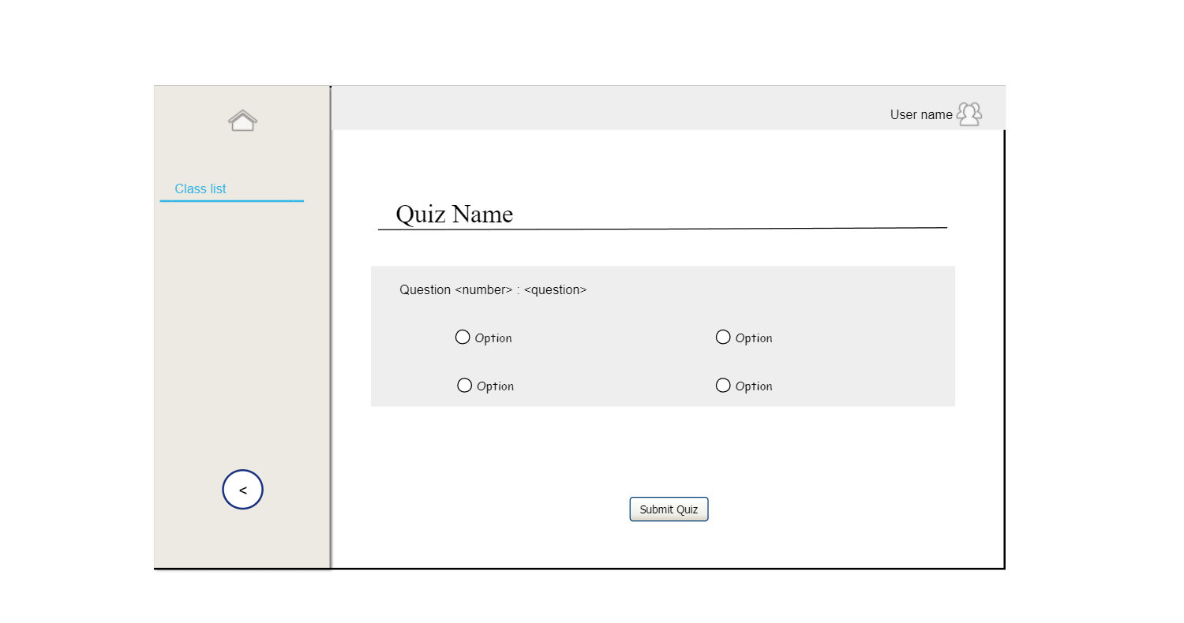
Attempt Question Student

Slide 57
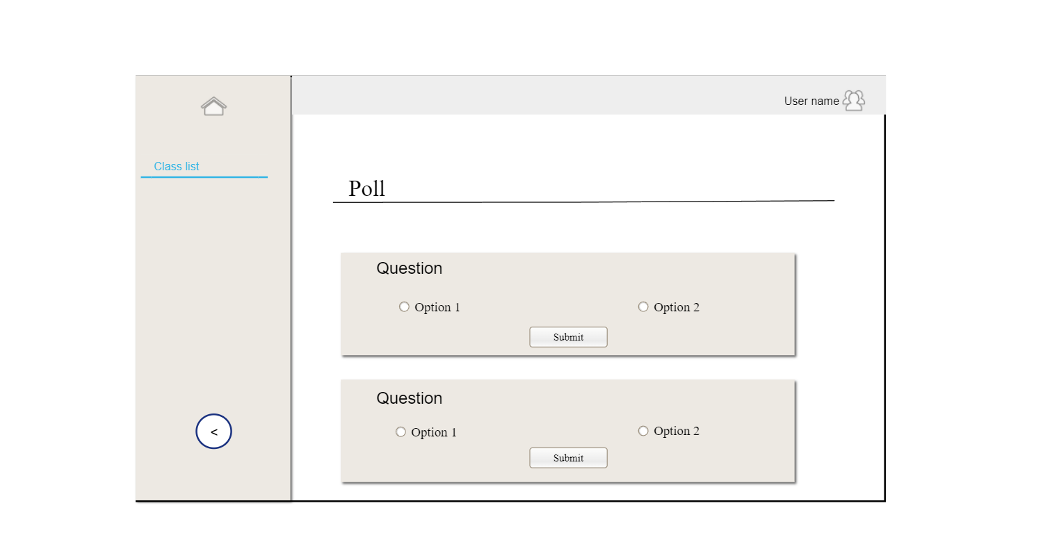
Poll Student

Slide 58
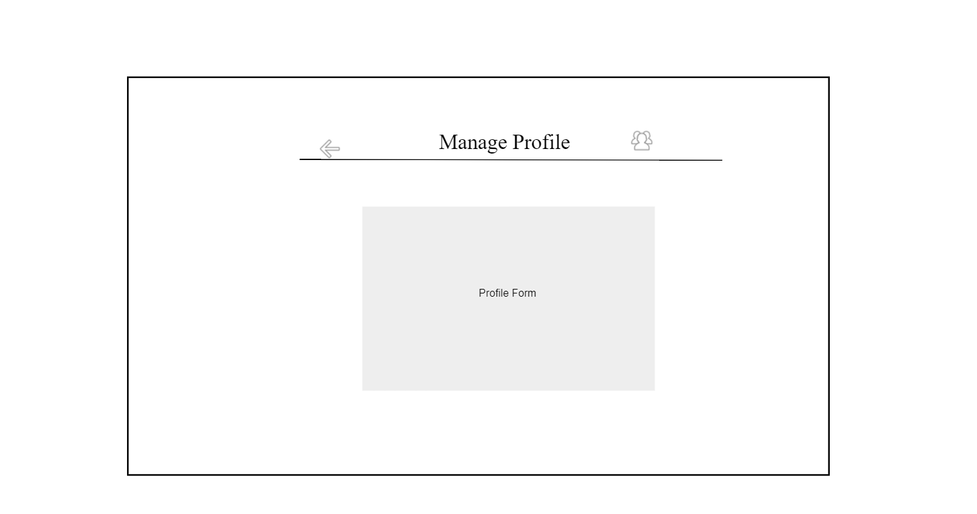
Manage Profile

Slide 59
Teacher Side GUI

Slide 60

Teacher Dashboard

Slide 61
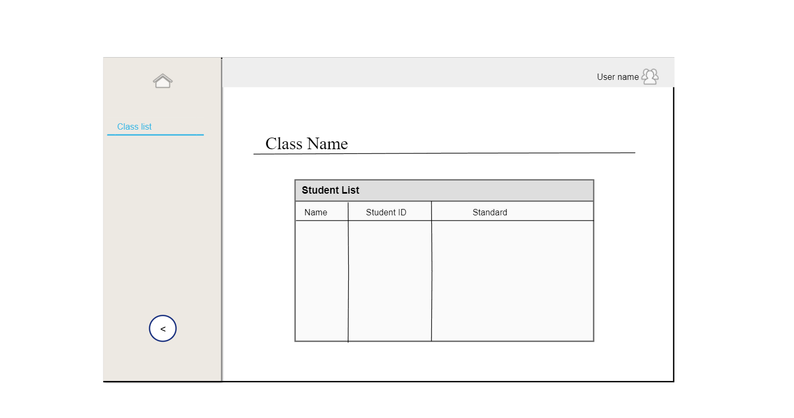
Student List

Slide 62
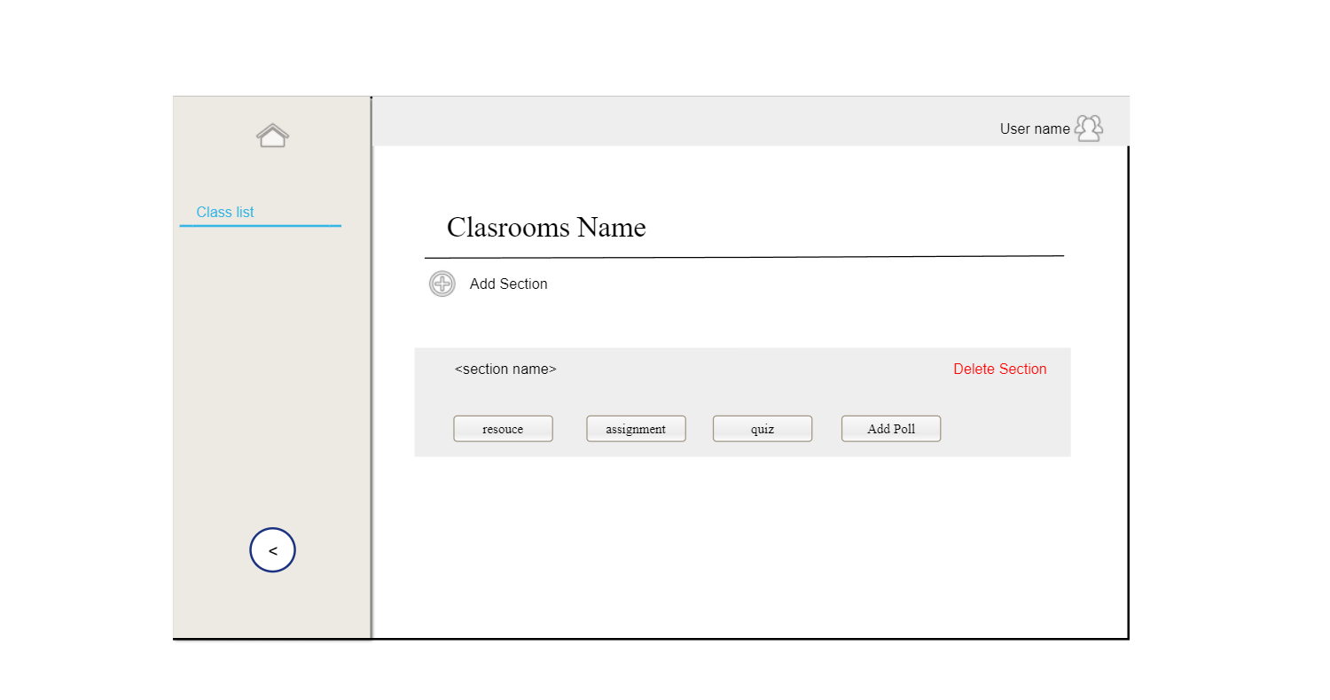
Teacher InnerClass

Slide 63
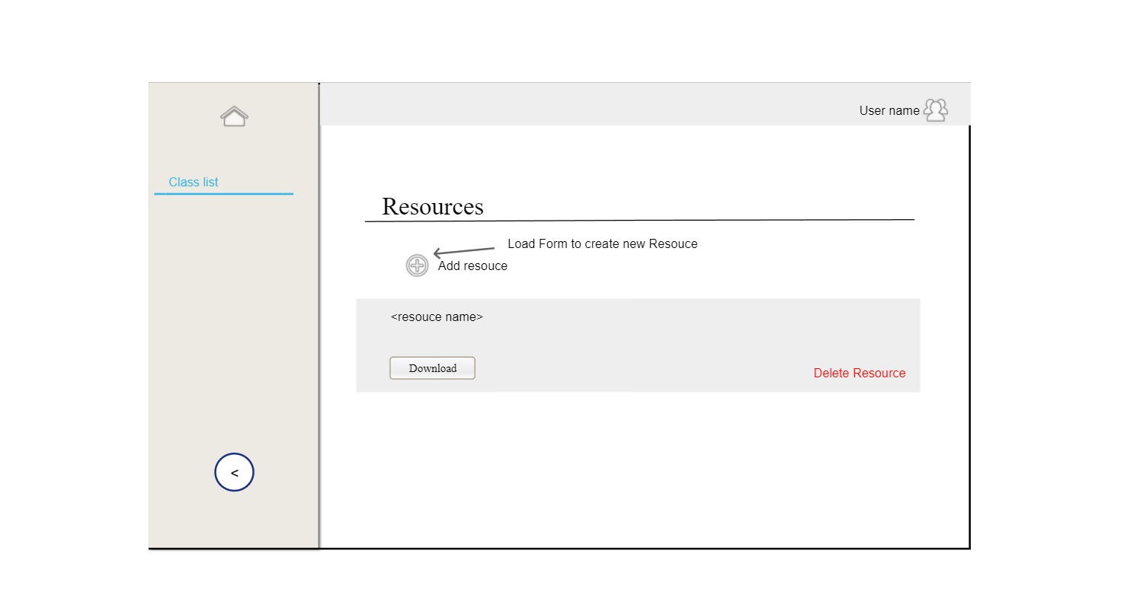
Teacher Resource

Slide 64

Teacher Assignment

Slide 65
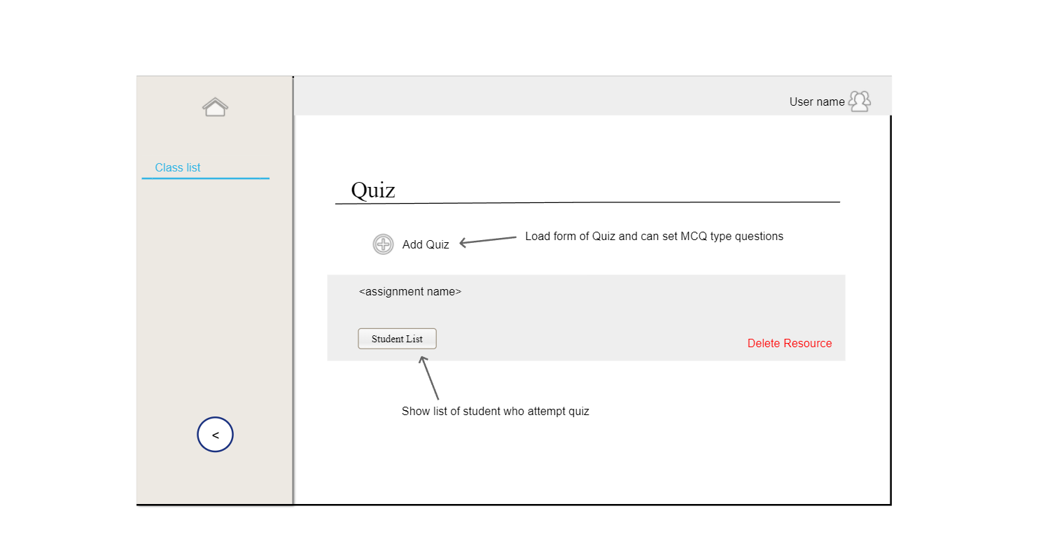
Teacher Quiz

Slide 66
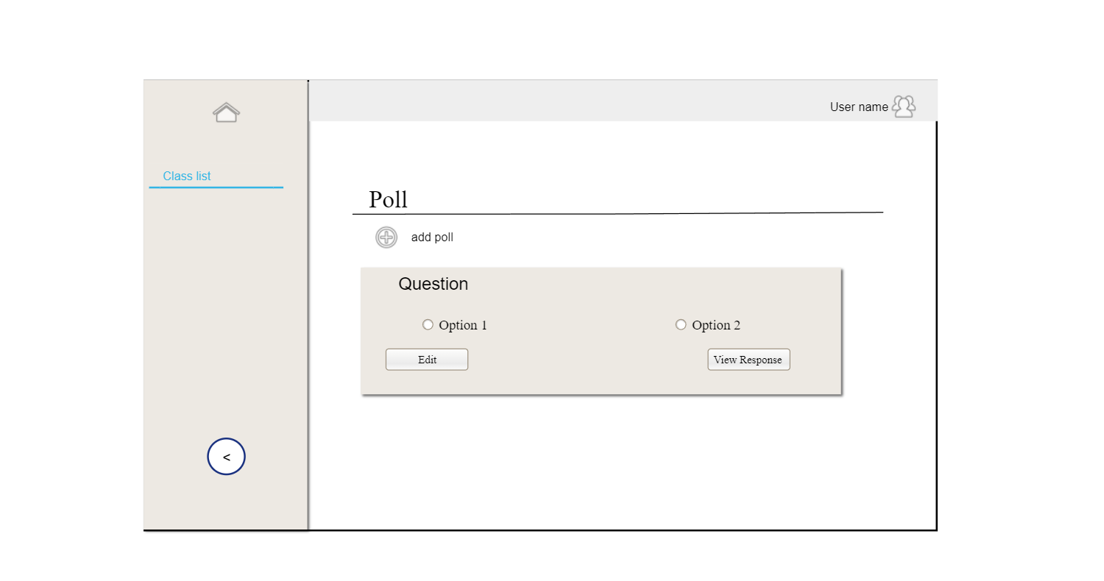
Teacher Poll

Slide 67
Appreciate Your Time and Attention
Thank you.

