Slide 1
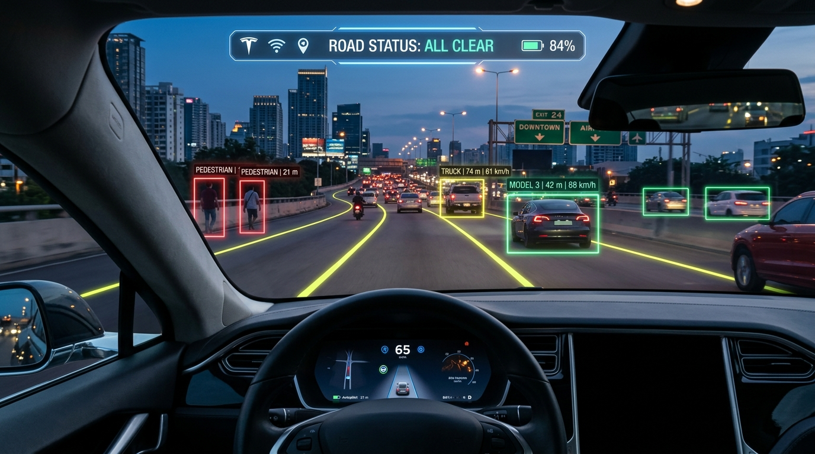
EDGE COMPUTER VISION ADAS
AI Dashcam
Object Detection
& Road Risk System
A Tesla-Inspired Real-Time Vision Pipeline
⚡ YOLOv8 & ByteTrack MOT
🛣️ Hough Lane Departure Warning
📐 Monocular 3D Distance
🚨 Dynamic Collision Threat Engine

Slide 2
THE PROBLEM & MISSION
From Passive Recording to Active Edge AI
❌ Conventional Dashcam (Passive)
• Purely Forensics: Records video to SD card for post-crash claims
• Zero Real-Time Warnings: Silent during lane drifts or tailgating
• Human Blindspots: Fatalities caused by momentary distraction
• Expensive Upgrades: OEM ADAS locked into $50,000+ luxury vehicles
✅ Our AI Dashcam (Active ADAS)
• Proactive Warning: Alerts driver before collisions occur (DANGER / CAUTION)
• Active Lane Centering: Flags dangerous road drift in real time (±25px)
• Pure Camera Vision: Zero expensive LiDAR or stereo radar sensors needed
• Low-Cost Universal: Runs on commodity CPUs (15 FPS) and edge GPUs (60+ FPS)
AI Dashcam ADAS & Road Risk System • Slide 2 / 10

Slide 3
HIGH-THROUGHPUT MODULAR ARCHITECTURE
End-to-End Vision Pipeline
1. INGESTION
Webcam / MP4 / RTSP
Resolution: 640×640
RGB Normalization
2. DETECTION
YOLOv8 Nano
9 Road Classes
Fast Anchor-Free
3. TRACKING
ByteTrack MOT
Persistent IDs
Motion IoU Matching
4. GEOMETRY
Hough Lane Lines
Pinhole Distance
Corridor Alignment
5. TELEMETRY
Dynamic Risk Engine
Tesla-Style Overlay
FPS & Lane Badges
AI Dashcam ADAS & Road Risk System • Slide 3 / 10

Slide 4
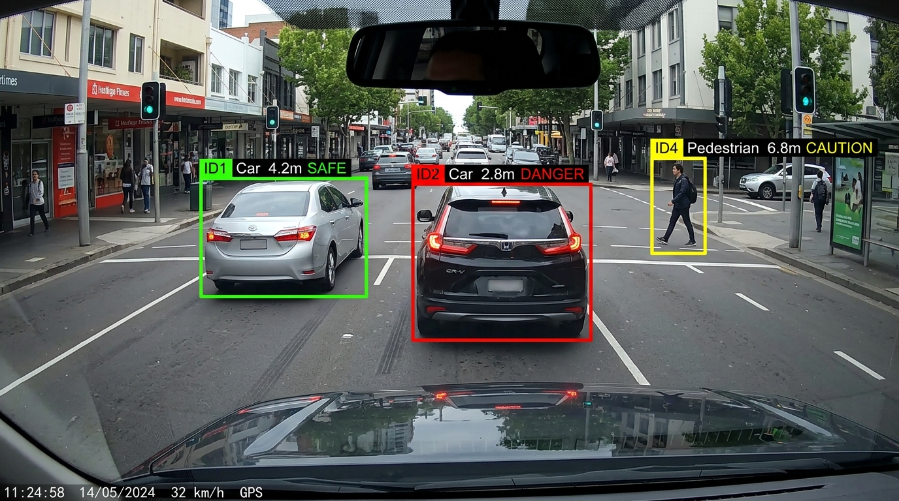
YOLOV8 & BYTETRACK MOT
Object Detection & Multi-Object Tracking
Key Perception Metrics
🎯 YOLOv8 Nano: Only 3.2M parameters (~6MB file size)
🏎️ 9 Road Classes: Cars, trucks, buses, bikes, pedestrians, signs
🔄 ByteTrack IDs: Prevents ID switching during vehicle occlusion
⏱️ Tracking Latency: < 1.0 ms execution overhead on CPU
💡 Low-Score Matching: Recovers detections hidden by road glare
AI Dashcam ADAS & Road Risk System • Slide 4 / 10

Slide 5
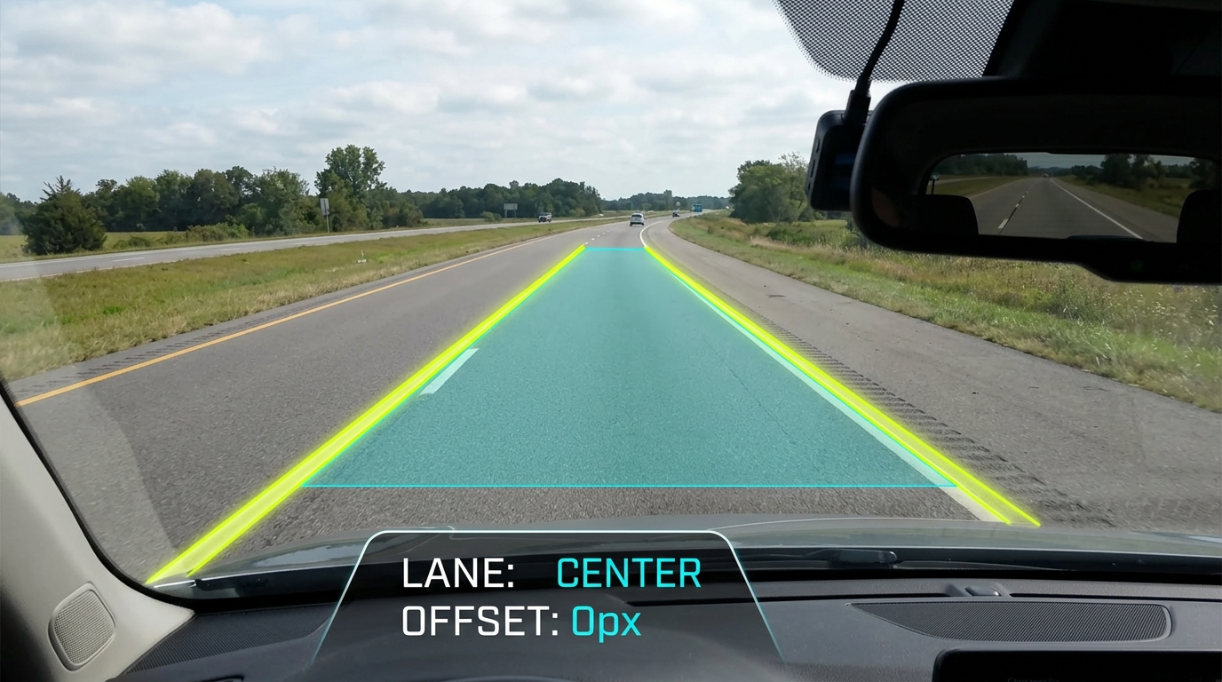
GEOMETRIC OPENCV HORIZON ANALYSIS
Computer Vision Lane Detection & Drift Alert
Lane Centering Mathematics
📐 ROI Trapezoid: Discards 60% of frame (sky and vehicle hood)
🔍 Canny + Hough: Isolates painted lines with |slope| > 0.3
🎯 Lateral Offset Formula:
Offset = Lane_Center - (Frame_Width / 2)
🟢 nominal: |Offset| ≤ 25 px → LANE: CENTER
⚠️ Drift Warnings:
Offset > +25 px → DRIFT RIGHT
Offset < -25 px → DRIFT LEFT
AI Dashcam ADAS & Road Risk System • Slide 5 / 10

Slide 6
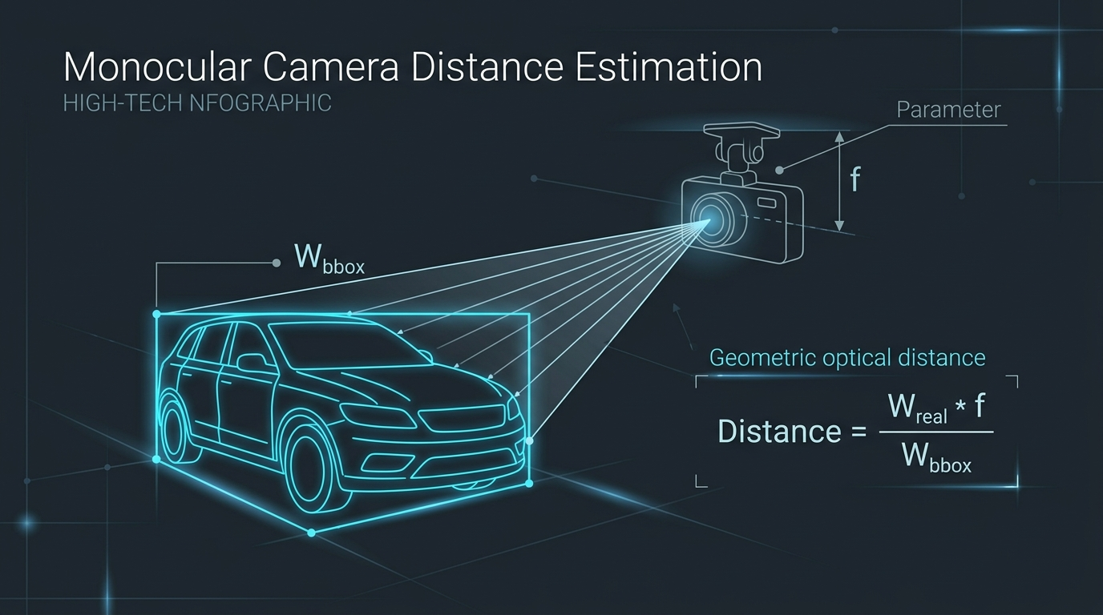
3D SPATIAL RANGE WITHOUT LIDAR
Monocular Distance Estimation (Pinhole Model)
Optical Projection Math
📐 Triangular Similarity:
Distance (m) = (Real_Width * f) / BBox_Width_px
⚙️ Calibrated Focal Length:
f = 700 pixels (adjustable per lens)
🚗 Real-World Prior Widths:
• Car: 1.8m | Truck/Bus: 2.5m
• Bike: 0.6m | Pedestrian: 0.5m
✨ Zero Sensor Cost: No LiDAR, no stereo cameras, 0 extra watts
AI Dashcam ADAS & Road Risk System • Slide 6 / 10

Slide 7
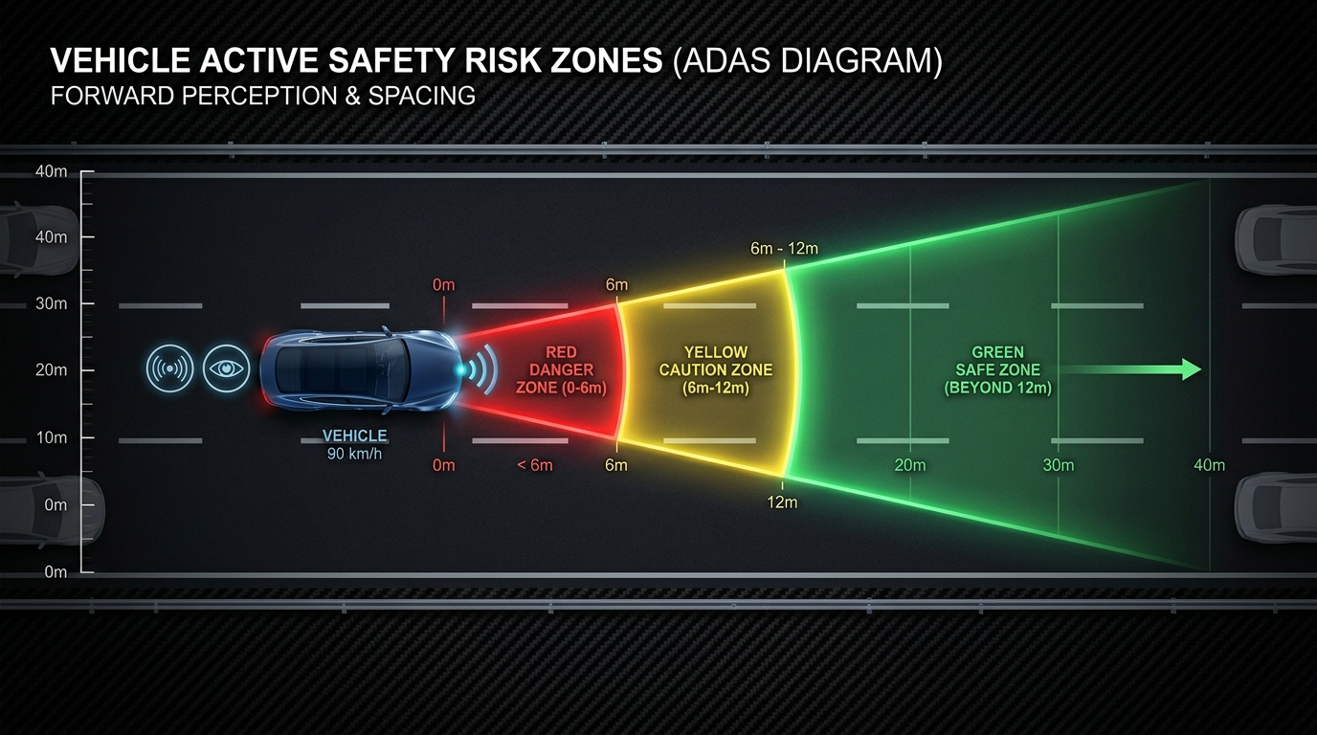
CLASS-AWARE SPATIAL THREAT MATRIX
Dynamic Collision Risk Zones
Active Risk Thresholds
🟢 SAFE (Green):
Distance ≥ 12m (Vehicles) / ≥ 15m (Pedestrians)
Or outside 30%-70% travel corridor
🟡 CAUTION (Amber):
Distance 6m - 12m (Vehicles) / 8m - 15m (Pedestrians)
Near-field uncalibrated objects
🔴 DANGER (Crimson):
Distance < 6m (Cars) / < 8m (Pedestrians)
AND positioned inside forward path
AI Dashcam ADAS & Road Risk System • Slide 7 / 10

Slide 8
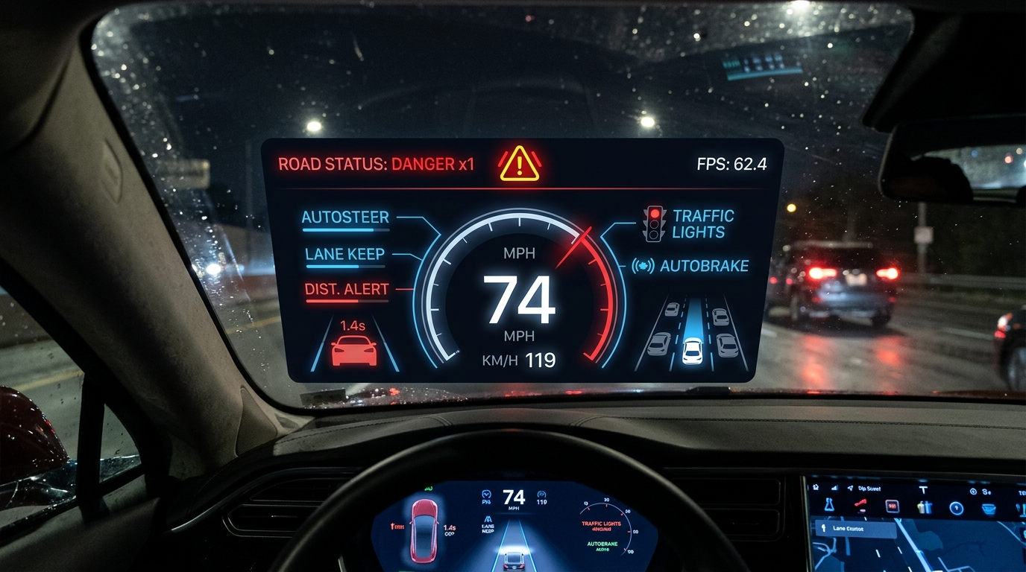
DISTRACTION-FREE COCKPIT HEADS-UP DISPLAY
Tesla-Style Augmented HUD & Telemetry
HUD Ergonomics & Telemetry
📊 Panoramic Status Bar:
Top dark banner: 'ROAD STATUS: DANGER x1'
⏱️ Rolling 30-Frame FPS Meter:
Monitors real-time inference latency
🏷️ Solid Contrast Bounding Pills:
Guarantees 100% legibility in sunlight & glares
🏎️ Augmented Yellow Polylines:
Visual lane overlay projected on the road
⚡ Ultra-Low Render Overhead:
Pure OpenCV drawing adds < 1.5 ms / frame
AI Dashcam ADAS & Road Risk System • Slide 8 / 10

Slide 9
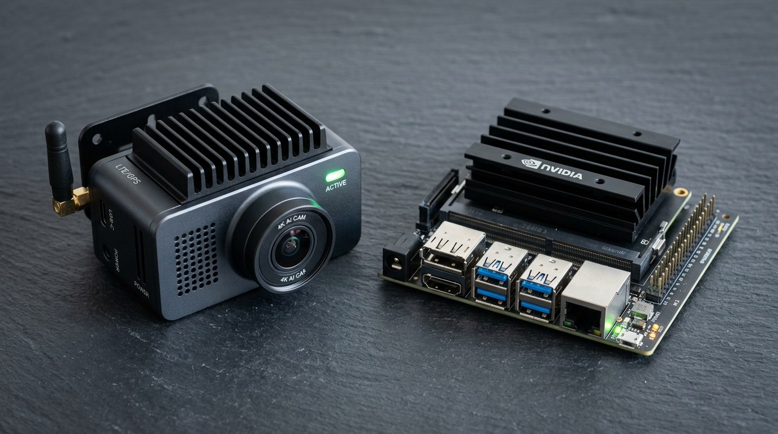
EMPIRICAL EXECUTION ACROSS HARDWARE
Performance Benchmarks & Edge Deployment
Execution Benchmark Matrix
🚀 NVIDIA RTX GPU:
60 - 85+ FPS (Full HD Pipeline) • Super Real-Time
💻 Modern Laptop CPU (i7 / Ryzen 7):
12 - 18 FPS (640px) • Sufficient for Urban ADAS
📟 Low-Power Edge SBC (Pi 5 / Jetson):
20 - 30 FPS (--imgsz 320) • Standalone Unit
📦 Dynamic Resolution Scaling:
--imgsz 320 cuts compute by 75% for embedded
⚡ Quantization Ready:
Exportable to ONNX & TensorRT FP16/INT8
AI Dashcam ADAS & Road Risk System • Slide 9 / 10

Slide 10
NEXT ENGINEERING MILESTONES & TAKEAWAYS
Future Roadmap & Project Conclusion
🧠 Learned Lane Seg.
Replace Hough lines with lightweight U-Net on BDD100K for curved & weathered roads
🚦 Sign Domain Tuning
Fine-tune YOLOv8 on KITTI for full sign taxonomies: speed limits, school zones, lights
📼 Blackbox Incident Log
Automated circular video recording triggered on DANGER with telemetry snapshots
📡 Radar / Sensor Fusion
Fuse low-cost 24GHz/77GHz mmWave radar for zero-visibility fog and heavy rain
AI Dashcam ADAS & Road Risk System • Slide 10 / 10

