Slide 1
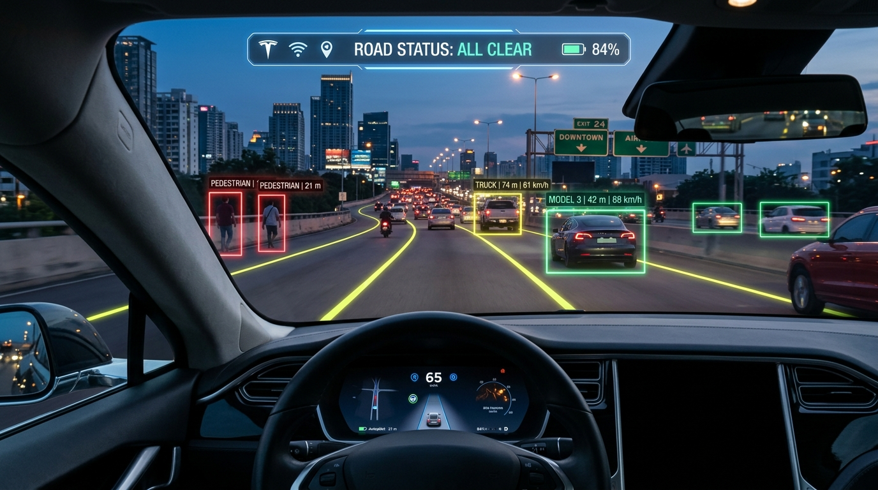

BIRLA VISHVAKARMA MAHAVIDYALAYA
Engineering College (An Autonomous Institution)
Department of Information Technology
DASHCAMERA AI
Real-Time Object Detection & Road Risk Analysis System
PROJECT CREDENTIALS
• Prepared By: Sujal Patel
Student ID: 23IT401 | B.Tech Information Technology
• Guided / Mentored By: Dhruvin R. Kotak
Department of Information Technology, BVM Engineering College

Slide 2
PROBLEM STATEMENT & MOTIVATION
From Passive Recording to Active Safe AI System
Conventional Dashcam (Passive)
• Purely Recording videos : Only records video to an SD card for post-accident insurance claims.
• Zero Real-Time Warnings: Provides no alert when drifting out of lane or rapidly approaching stationary obstacles.
• Human Inattention & Fatigue: Distraction and fatigue account for over 80% of preventable highway collisions.
• High Cost of OEM ADAS: Built-in ADAS is restricted to expensive vehicles and cannot be retrofitted easily.
Our Dashcam AI Solution (Active Safety)
• Proactive Collision Prevention: Computes real-time risk levels (SAFE / CAUTION / DANGER) every frame.
• Proximity-Adaptive Audio Alerts: Generates rapid high-pitch beeps when obstacles approach, fading away when clear.
• Commodity Hardware Ready: Runs efficiently on laptops, Jetson edge boards, and Raspberry Pi without LiDAR.
Dashcam AI • Birla Vishvakarma Mahavidyalaya • Sujal Patel (23IT401) • Slide 2 / 10

Slide 3
5-STAGE REAL-TIME PERCEPTION PIPELINE
End-to-End System Architecture
1. Input
Dashcam MP4 / AVI / MOV or live camera feeds at 640px resolution.
2. AI Detection
YOLOv8 Nano detects vehicles, pedestrians, cyclists & road signs in real time.
3. Tracking
ByteTrack assigns unique IDs and tracks trajectories across frames.
4. Geometry
Monocular distance Z = (f * W) / w & Canny/Hough lane departure offset.
Dashcam AI • Birla Vishvakarma Mahavidyalaya • Sujal Patel (23IT401) • Slide 3 / 10

Slide 4
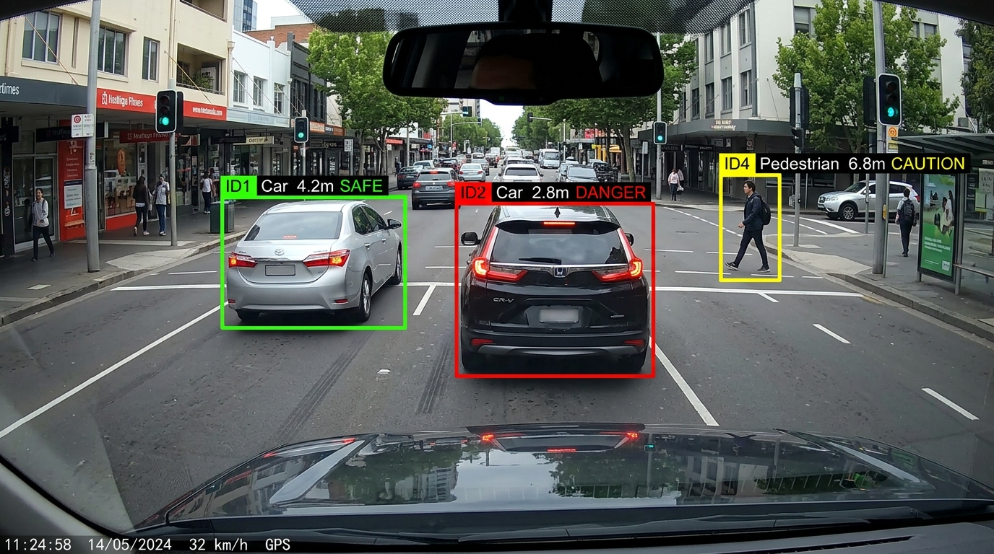
YOLOV8 NANO + BYTETRACK MULTI-TARGET ASSOCIATION
Multi-Object Detection & Tracking
Detection & Tracking Highlights
• Model: YOLOv8 Nano (3.2M parameters) optimized for high-speed edge inference.
• Target Classes: Cars, trucks, buses, motorcycles, bicycles, persons, traffic lights, and stop signs.
• ByteTrack MOT: Solves object re-identification during occlusions, preserving tracking IDs across frames.
• Hood Rejection Filter: Masks out reflections on the vehicle's own windshield and hood to eliminate false alerts.
Dashcam AI • Birla Vishvakarma Mahavidyalaya • Sujal Patel (23IT401) • Slide 4 / 10

Slide 5
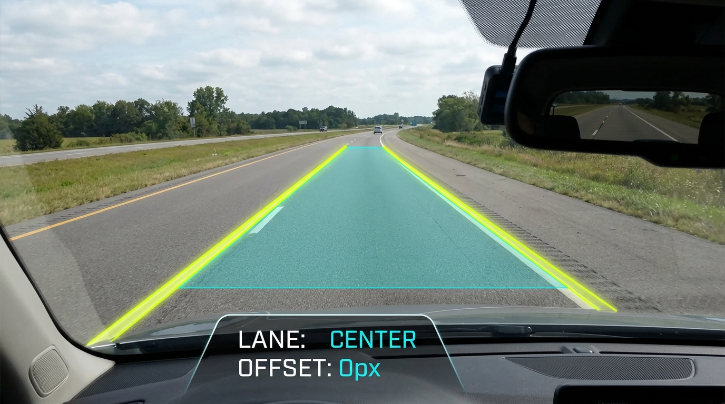
CANNY EDGES, HOUGH TRANSFORM & DRIVING CORRIDOR
Lane Departure Warning (LDW)
Lane Centering Pipeline
• Region of Interest (ROI): Dynamic trapezoid mask focused exclusively on the drivable road surface ahead.
• Edge Detection & Hough: Canny edges filtered through Probabilistic Hough Lines (cv2.HoughLinesP).
• Polynomial Slope Fitting: Separates lines into left and right boundaries using slope sign thresholds.
• Lateral Offset: Compares road center against vehicle center; alerts driver when lane departure is detected.
Dashcam AI • Birla Vishvakarma Mahavidyalaya • Sujal Patel (23IT401) • Slide 5 / 10

Slide 6
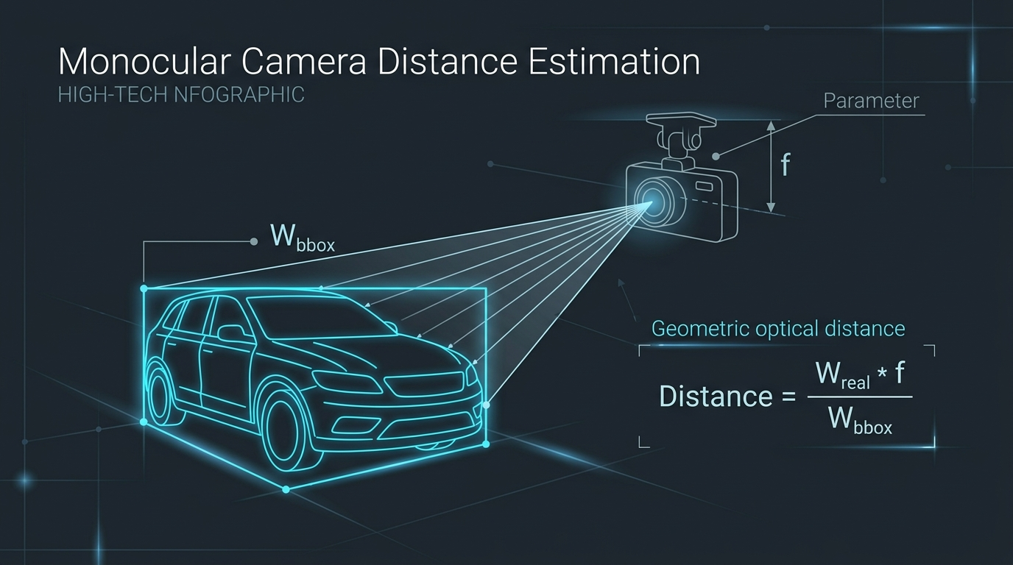
PINHOLE CAMERA GEOMETRY & ZERO-HARDWARE DEPTH
Monocular Distance Estimation
Mathematical Formulation
• Formula:
Distance (Z) = (focal_length * Real_Width) / bbox_pixel_width
• Class-Calibrated Widths (W):
- Car: 1.80m | Bus: 2.60m
- Truck: 2.50m | Person: 0.55m
- Motorcycle: 0.80m
• Relative Velocity:
Computes rate of distance closure (delta d / delta t) over a rolling 10-frame window.
• Zero Extra Hardware: Replaces bulky LiDAR sensors with pure 2D geometry.
Dashcam AI • Birla Vishvakarma Mahavidyalaya • Sujal Patel (23IT401) • Slide 6 / 10

Slide 7
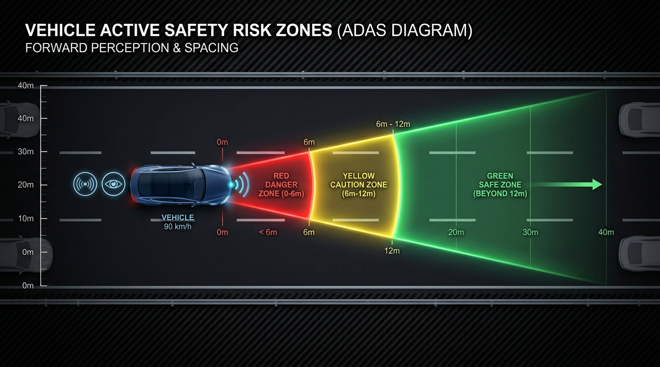
CLASS-AWARE SPATIAL THREAT MATRIX & VELOCITY
Dynamic Collision Risk & Time-to-Collision (TTC)
Active Risk Thresholds
• Time-to-Collision (TTC):
TTC = Distance / Closing_Speed (m/s)
- TTC < 2.0s --> URGENT DANGER
- TTC < 3.5s --> ACTIVE CAUTION
• SAFE (Green Zone):
Distance >= 12m or outside forward trajectory.
• CAUTION (Amber Zone):
Distance 6m - 12m or closing TTC < 3.5s.
• DANGER (Crimson Alert):
Distance < 6m OR TTC < 2.0s directly in front of the vehicle.
Dashcam AI • Birla Vishvakarma Mahavidyalaya • Sujal Patel (23IT401) • Slide 7 / 10

Slide 8
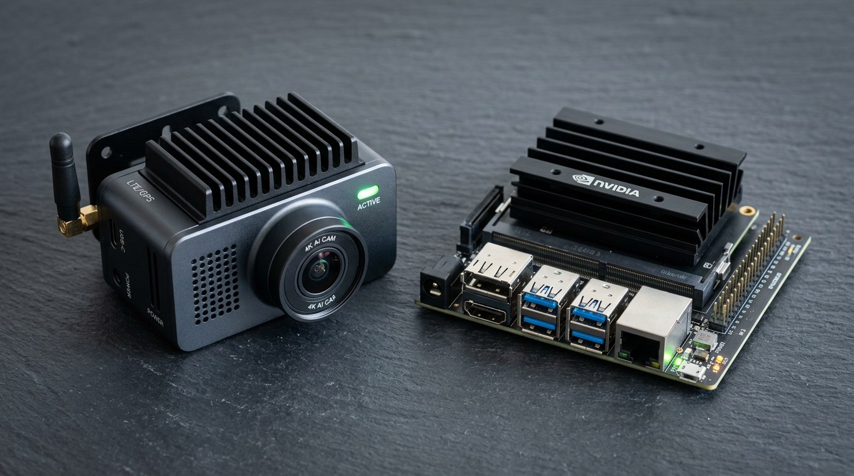
EMPIRICAL EXECUTION ACROSS HARDWARE PLATFORMS
Performance Benchmarks & Edge Deployment
Hardware Benchmark Matrix
• NVIDIA RTX GPU:
60 - 85+ FPS (Full HD Pipeline) - Real-time ADAS.
• Modern Laptop CPU (i7 / Ryzen 7):
12 - 18 FPS (640px) - Practical for dashcam replay.
• Low-Power Edge SBC (Jetson Nano / Pi 5):
20 - 30 FPS (--imgsz 320) - Compact standalone device.
• Resolution Scaling:
--imgsz 320 cuts compute by 75% for embedded deployments.
• TensorRT & ONNX Exportable:
Allows INT8/FP16 quantization for edge accelerators.
Dashcam AI • Birla Vishvakarma Mahavidyalaya • Sujal Patel (23IT401) • Slide 8/ 10

Slide 9
NEXT ENGINEERING MILESTONES & TAKEAWAYS
Future Roadmap & Project Conclusion
Learned Lane Segmentation
Replace Hough lines with lightweight U-Net on BDD100K for curved, weathered, and unlit roads.
Sign & Signal Recognition
Fine-tune YOLOv8 on Indian traffic dataset for comprehensive speed limit, school zone, and light recognition.
Blackbox Incident Recorder
Automated circular video recording triggered during DANGER states with encrypted telemetry snapshots.
Radar / Sensor Fusion
Fuse low-cost 24GHz/77GHz mmWave radar sensors for zero-visibility fog, heavy rain, and night conditions.
Dashcam AI • Birla Vishvakarma Mahavidyalaya • Sujal Patel (23IT401) • Slide 9 / 10

Slide 10
THANK YOU!
Questions & Discussion
Dashcam AI: Real-Time Object Detection & Road Risk Analysis System
Presented By:
Sujal Patel (ID No: 23IT401)
Department of Information Technology, BVM Engineering College
Under the Mentorship / Guidance of:
Prof. Dhruvin R. Kotak
Birla Vishvakarma Mahavidyalaya Engineering College (Vallabh Vidyanagar)

