Slide 1

MYSQL DATABASE PROJECT
LIBRARY
MANAGEMENT SYSTEM
A Relational Database for Books, Members, Loans, Authors & Fines
Sujal Upadhyay
MySQL — Project
2026–27
Notes:
1

Slide 2
INTRODUCTION
Project Overview
01
02
THE SYSTEM
Book Management
Member Management
One relational database for the whole library
Titles, genres, publication years
Profiles and membership dates
03
04
Designed in MySQL to manage books, members, authors, book loans and fines.
Loan Tracking
Author Management
Issue and return records
Authors linked to books
05
06
6 tables · 15 queries
Fine Management
Library Analysis
Fine amounts and payments
Popular books, active members
LIBRARY MANAGEMENT SYSTEM · MYSQL DATABASE PROJECT
2 / 25
Notes:
2

Slide 3
INTRODUCTION
Problem Statement
Manual management
✕
Difficult to track book availability
SOLUTION
Centralized MySQL database
✕
Manual recording of member information
✕
Hard to monitor borrowed and returned books
✕
Hard to calculate and track fines
Connects books, members, authors, loans and fines in one consistent structure.
✕
Limited analysis of borrowing patterns
✕
Duplicate or inconsistent records
Manual Library Management
➜
MySQL-Based Library Management
LIBRARY MANAGEMENT SYSTEM · MYSQL DATABASE PROJECT
3 / 25
Notes:
3

Slide 4
INTRODUCTION
Project Objectives
01
02
03
Manage Books
Manage Members
Track Loans
Store book details, publication year and genre.
Maintain member information and membership dates.
Record issued books, loan dates and return dates.
04
05
06
Manage Authors
Manage Fines
Generate Insights
Maintain author information and book relationships.
Track fine amounts and payment dates.
Analyze borrowing patterns, popular books and member activity.
LIBRARY MANAGEMENT SYSTEM · MYSQL DATABASE PROJECT
4 / 25
Notes:
4

Slide 5
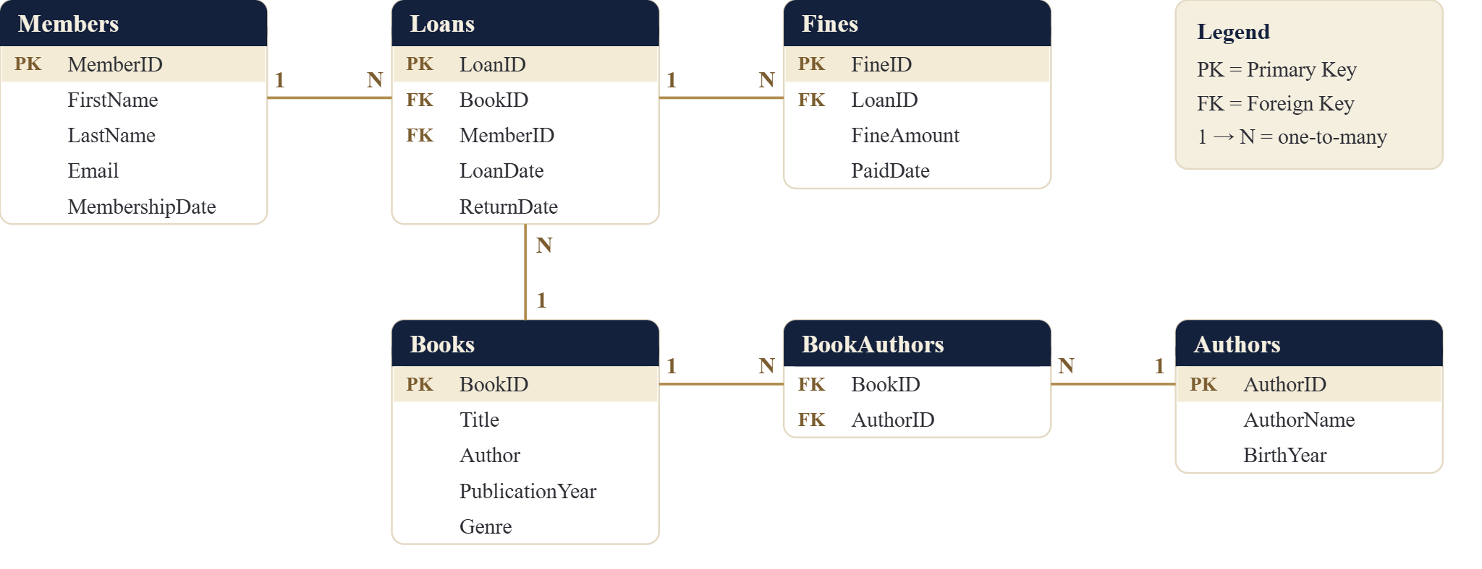
DATABASE DESIGN
Database Architecture
LIBRARY MANAGEMENT SYSTEM · MYSQL DATABASE PROJECT
5 / 25
Notes:
5

Slide 6
DATABASE DESIGN
Database Schema
Members
Books
Loans
PK
MemberID
PK
BookID
PK
LoanID
FirstName
Title
FK
BookID
LastName
Author
FK
MemberID
Email
PublicationYear
LoanDate
MembershipDate
Genre
ReturnDate
Authors
BookAuthors
Fines
PK
AuthorID
FK
BookID
PK
FineID
AuthorName
FK
AuthorID
FK
LoanID
BirthYear
FineAmount
PaidDate
PK = Primary Key FK = Foreign Key
LIBRARY MANAGEMENT SYSTEM · MYSQL DATABASE PROJECT
6 / 25
Notes:
6

Slide 7
DATABASE DESIGN
Database Relationships
Members
1
Many
Loans
WHY RELATIONSHIPS?
Connected records, consistent data
Books
1
Many
Loans
Books
1
Many
BookAuthors
Foreign keys link related records and maintain referential integrity.
Authors
1
Many
BookAuthors
All five relationships are 1 : Many.
Loans
1
Many
Fines
LIBRARY MANAGEMENT SYSTEM · MYSQL DATABASE PROJECT
7 / 25
Notes:
7

Slide 8
IMPLEMENTATION
MySQL Implementation
1
Create Database
CREATE TABLE Books (
BookID INT PRIMARY KEY,
Title VARCHAR(150),
PublicationYear YEAR,
Genre VARCHAR(50)
);
2
Create Tables
3
Define Primary & Foreign Keys
4
Insert Records
5
Execute SQL Queries
6
Generate Library Insights
Primary Keys
Foreign Keys
Composite PK
UNIQUE (Email)
Referential integrity
10+ records per table
LIBRARY MANAGEMENT SYSTEM · MYSQL DATABASE PROJECT
8 / 25
Notes:
8

Slide 9
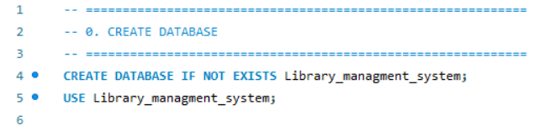
IMPLEMENTATION
MySQL Code — Database Creation
01
MYSQL CODE
CREATE DATABASE
What was done?
✔
Created the Library Management database
✔
Selected it using USE
✔
Prepared it for table creation
LIBRARY MANAGEMENT SYSTEM · MYSQL DATABASE PROJECT
9 / 25
Notes:
9

Slide 10
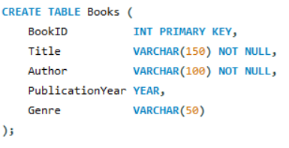
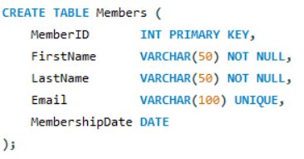
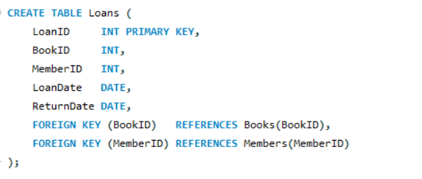
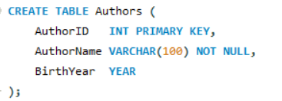
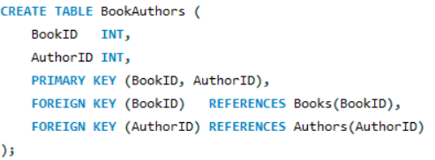
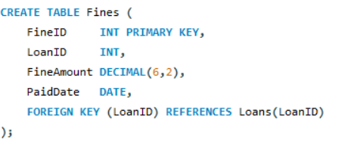
IMPLEMENTATION
MySQL Code — Creating Tables
01
BOOKS
02
MEMBERS
03
LOANS
04
AUTHORS
05
BOOKAUTHORS
06
FINES
SQL CONCEPTS
PRIMARY KEY
FOREIGN KEY
NOT NULL
UNIQUE
COMPOSITE PK
REFERENTIAL INTEGRITY
LIBRARY MANAGEMENT SYSTEM · MYSQL DATABASE PROJECT
10 / 25
Notes:
10

Slide 11
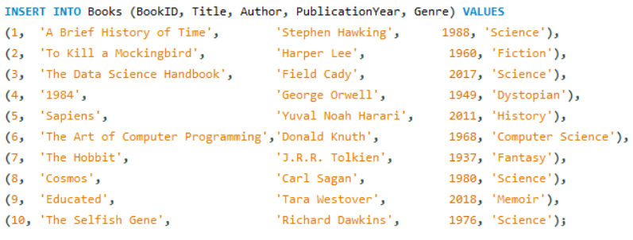
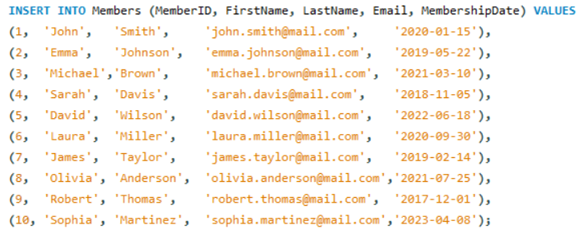
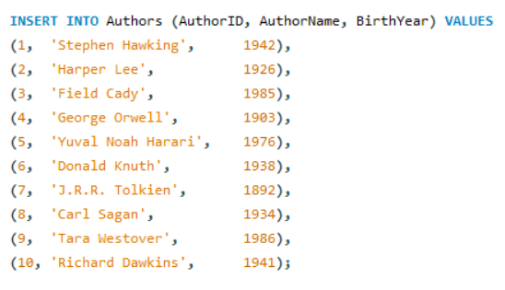
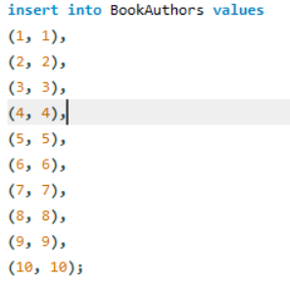
IMPLEMENTATION
MySQL Code — Data Insertion
01
BOOKS — 10 RECORDS
02
MEMBERS — 10 RECORDS
03
AUTHORS — 10 RECORDS
04
BOOKAUTHORS — 10 RECORDS
LIBRARY MANAGEMENT SYSTEM · MYSQL DATABASE PROJECT
11 / 25
Notes:
11

Slide 12
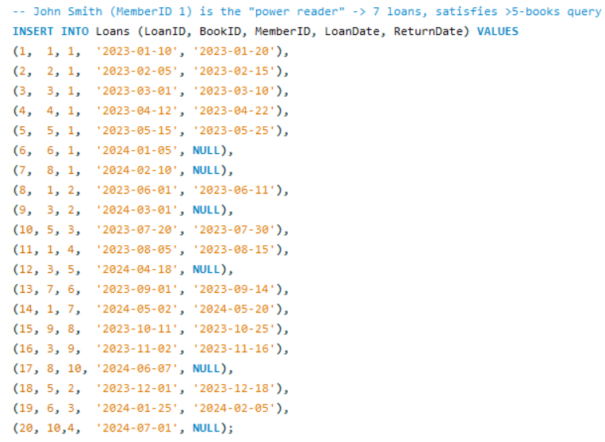
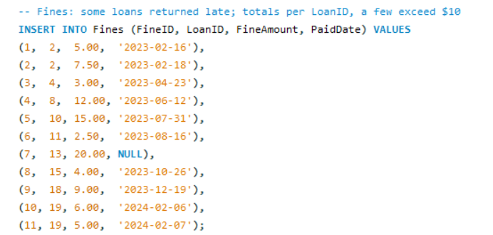
IMPLEMENTATION
MySQL Code — Data Insertion
05
LOANS — 20 RECORDS
06
FINES — 11 RECORDS
LIBRARY MANAGEMENT SYSTEM · MYSQL DATABASE PROJECT
12 / 25
Notes:
12

Slide 13
SQL CONCEPTS
SQL Operations Implemented
01
02
03
04
Basic Operations
Filtering & Conditions
Aggregation
Advanced Queries
CREATE TABLE
AND / OR
COUNT()
Subqueries
INSERT
LIKE
SUM()
INNER JOIN
SELECT
CASE
GROUP BY
LEFT JOIN
WHERE
LIMIT
HAVING
JOIN + Aggregation
15 queries implemented across these four categories
LIBRARY MANAGEMENT SYSTEM · MYSQL DATABASE PROJECT
13 / 25
Notes:
13

Slide 14
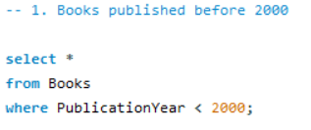
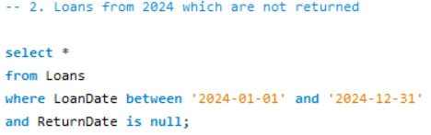
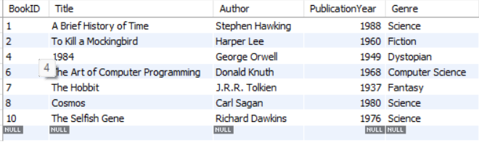
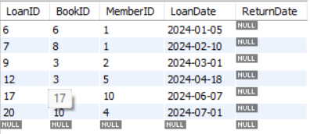
SQL QUERY
SQL Query — SELECT & WHERE
Query 1 — Books Published Before 2000
Query 2 — 2024 Loans Not Returned
SELECT + WHERE
WHERE + AND + IS NULL
MYSQL CODE
MYSQL CODE
QUERY OUTPUT
QUERY OUTPUT
RESULT
7 BOOKS
RESULT
6 LOANS
LIBRARY MANAGEMENT SYSTEM · MYSQL DATABASE PROJECT
14 / 25
Notes:
14

Slide 15
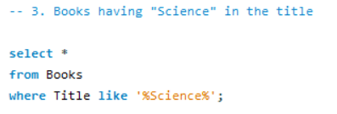
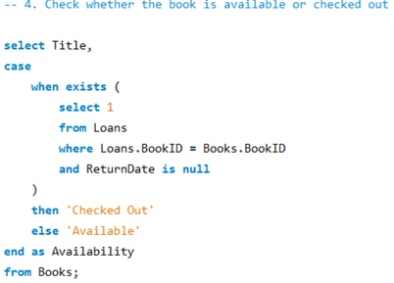
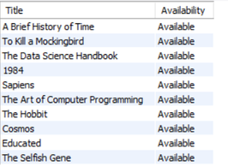

SQL QUERY
SQL Query — LIKE & CASE
Query 3 — Books Containing “Science”
Query 4 — Book Availability Using CASE + EXISTS
LIKE
CASE + EXISTS
MYSQL CODE
MYSQL CODE
QUERY OUTPUT
QUERY OUTPUT
RESULT
1 BOOK
RESULT
4 CHECKED OUT · 6 AVAILABLE
LIBRARY MANAGEMENT SYSTEM · MYSQL DATABASE PROJECT
15 / 25
Notes:
15

Slide 16
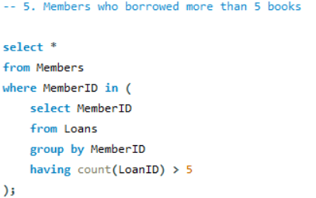

SQL QUERY
SQL Query — Subquery
Query 5 — Members Who Borrowed More Than 5 Books
SUBQUERY
MYSQL CODE
QUERY OUTPUT
RESULT
1 MEMBER · JOHN SMITH — 7 LOANS
The subquery groups loans by MemberID and keeps members with more than five loans.
LIBRARY MANAGEMENT SYSTEM · MYSQL DATABASE PROJECT
16 / 25
Notes:
16

Slide 17
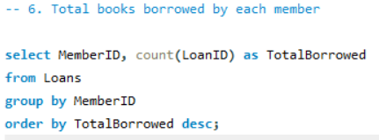
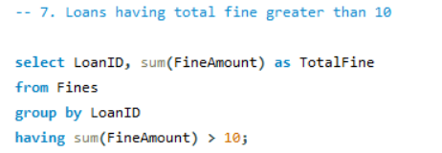
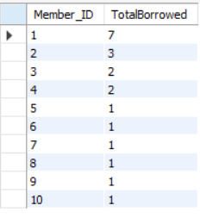
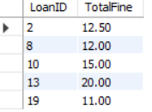
SQL QUERY
SQL Query — GROUP BY & HAVING
Query 6 — Total Books Borrowed by Each Member
Query 7 — Loans with Total Fine Above $10
GROUP BY
HAVING
MYSQL CODE
MYSQL CODE
QUERY OUTPUT
QUERY OUTPUT
RESULT
MEMBER 1 LEADS — 7 LOANS
RESULT
5 HIGH-FINE LOANS
LIBRARY MANAGEMENT SYSTEM · MYSQL DATABASE PROJECT
17 / 25
Notes:
17

Slide 18
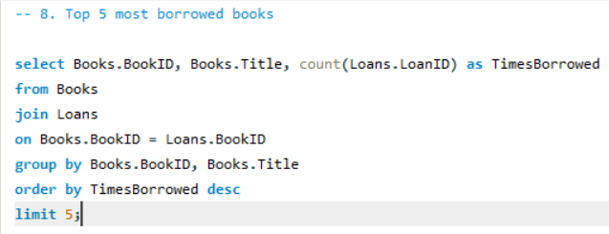
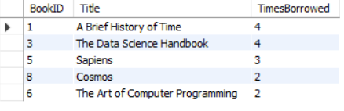
SQL QUERY
SQL Query — LIMIT
Query 8 — Top 5 Most Frequently Borrowed Books
JOIN + COUNT + ORDER BY + LIMIT
MYSQL CODE
QUERY OUTPUT
01
4 borrows
02
4 borrows
03
3 borrows
04
2 borrows
05
2 borrows
A Brief History of Time
The Data Science Handbook
Sapiens
The Art of Computer Programming
Cosmos
RESULT
TOP 5 BOOKS
JOIN + COUNT + ORDER BY + LIMIT 5 ranks the most frequently borrowed books.
LIBRARY MANAGEMENT SYSTEM · MYSQL DATABASE PROJECT
18 / 25
Notes:
18

Slide 19
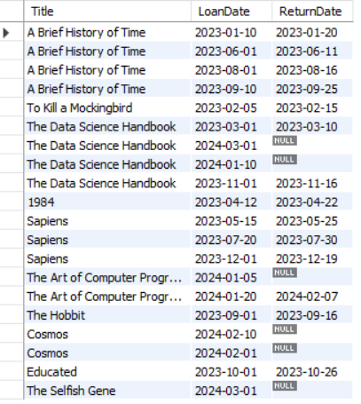
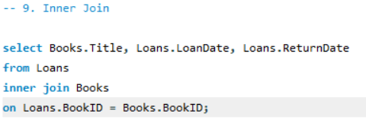
SQL QUERY
SQL Query — INNER JOIN
BOOKS
LOANS
QUERY OUTPUT
Query 9 — Loans with Book Details
INNER JOIN
MYSQL CODE
RESULT
LOANS + BOOK TITLES
INNER JOIN returns matching records from both tables.
LIBRARY MANAGEMENT SYSTEM · MYSQL DATABASE PROJECT
19 / 25
Notes:
19

Slide 20
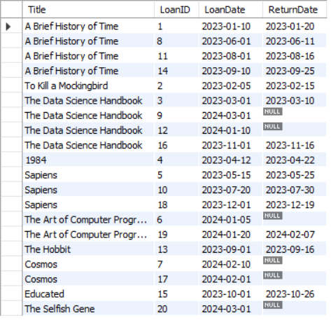
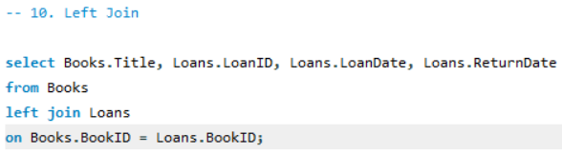
SQL QUERY
SQL Query — LEFT JOIN
BOOKS
LOANS
QUERY OUTPUT
Query 10 — All Books and Associated Loans
LEFT JOIN
MYSQL CODE
RESULT
ALL BOOKS INCLUDED
LEFT JOIN returns all books, including books without associated loans.
LIBRARY MANAGEMENT SYSTEM · MYSQL DATABASE PROJECT
20 / 25
Notes:
20

Slide 21
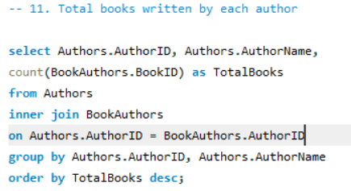
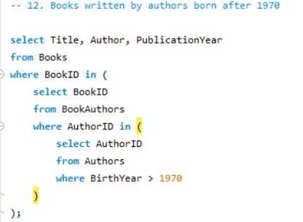
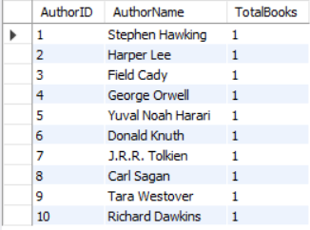
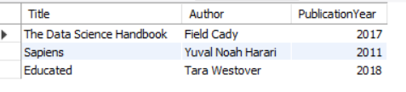
ADVANCED SQL
Advanced SQL — Aggregation & Subquery
Query 11 — Total Books Written by Each Author
Query 12 — Books by Authors Born After 1970
JOIN + COUNT() + GROUP BY
10 AUTHORS · 1 BOOK EACH
SUBQUERY + JOIN
3 BOOKS
MYSQL CODE
MYSQL CODE
QUERY OUTPUT
QUERY OUTPUT
LIBRARY MANAGEMENT SYSTEM · MYSQL DATABASE PROJECT
21 / 25
Notes:
21

Slide 22
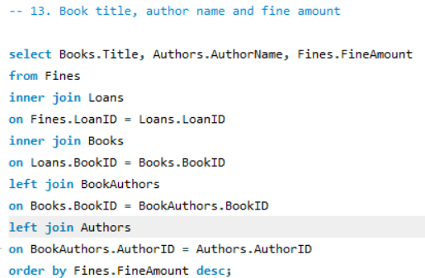
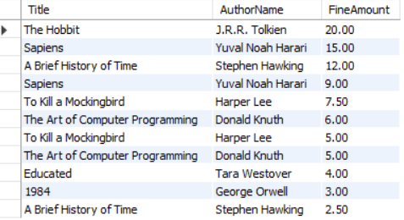
ADVANCED SQL
Advanced SQL — Multiple JOINs
Query 13 — Fined Books with Author Details
INNER JOIN + LEFT JOIN
MYSQL CODE
QUERY OUTPUT
RESULT
FINED BOOKS + AUTHORS
Links Fines, Loans, Books and Authors to list Title, AuthorName and FineAmount.
LIBRARY MANAGEMENT SYSTEM · MYSQL DATABASE PROJECT
22 / 25
Notes:
22

Slide 23
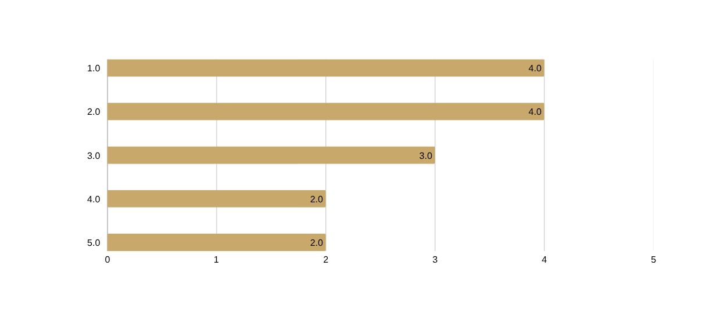
ANALYSIS
Query Results & Library Insights
POWER READER
CURRENTLY CHECKED OUT
HIGH FINE LOANS
TOP BOOK
John Smith
6 Loans
5 Loans
A Brief History of Time
7 Loans
4 Titles
Fines above $10
4 Borrows
The Art of Computer Programming, Cosmos, The Data Science Handbook, The Selfish Gene
High Fine Loans (> $10)
Top 5 Most Borrowed Books
Loan 2
$12.50
Loan 8
$12.00
Loan 10
$15.00
Loan 13
$20.00
Loan 19
$11.00
LIBRARY MANAGEMENT SYSTEM · MYSQL DATABASE PROJECT
23 / 25
Notes:
23

Slide 24
REAL-WORLD VALUE
Real-World Applications
10
Books
10
Members
20
Loans
11
Fine records
01
02
BOOK AVAILABILITY
MEMBER ACTIVITY
Know which books are available or checked out.
Identify frequent borrowers and patterns.
03
04
LOAN TRACKING
FINE MANAGEMENT
Monitor issue dates and return status.
Track fines and high-value outstanding fines.
05
06
AUTHOR ANALYSIS
LIBRARY ANALYTICS
Analyze books associated with each author.
Identify popular books and borrowing trends.
LIBRARY MANAGEMENT SYSTEM · MYSQL DATABASE PROJECT
24 / 25
Notes:
24

Slide 25
PROJECT SUMMARY
Conclusion & Future Scope
CONCLUSION
FUTURE SCOPE
MySQL can power a structured relational database for library operations. The project implements:
Web Application
1
2
User Login
Database Design
Data Management
3
Book Reservation
SQL Filtering
Conditional Logic
4
Automatic Fine Calculation
5
Email Notifications
Aggregation
Subqueries
6
Admin Dashboard
Joins
Analytics
7
Advanced Library Analytics
THANK YOU
Questions & Discussion
LIBRARY MANAGEMENT SYSTEM · MYSQL DATABASE PROJECT
25 / 25
Notes:
25

