Slide 1
Principal Component Analysis (PCA) using SVD
By: Sujal Sinha(2311191)
Date: 26th November 2025

Slide 2
What is PCA?
A technique to find the directions of maximum variance in data.
  Used for dimensionality reduction and pattern discovery.
  Transforms data into new orthogonal axes called Principal Components.

Slide 3
Why Use PCA?
Removes redundancy by combining correlated features.
  Simplifies datasets while preserving important patterns.
  Useful in visualization, ML preprocessing, noise reduction.

Slide 4
Core Mathematical Idea
Given centered data matrix Xc:
  Compute covariance matrix C = Xcᵀ Xc.
  Eigenvectors of C = PCA directions.
  Eigenvalues of C = variance along each direction.

Slide 5
Why and how do we center the Data?
Means are subtracted so PCA analyzes shape, not location.
  Centering ensures it reflects true variability.
1. Compute mean of each column.
  2. Subtract mean from each data point.

Slide 6
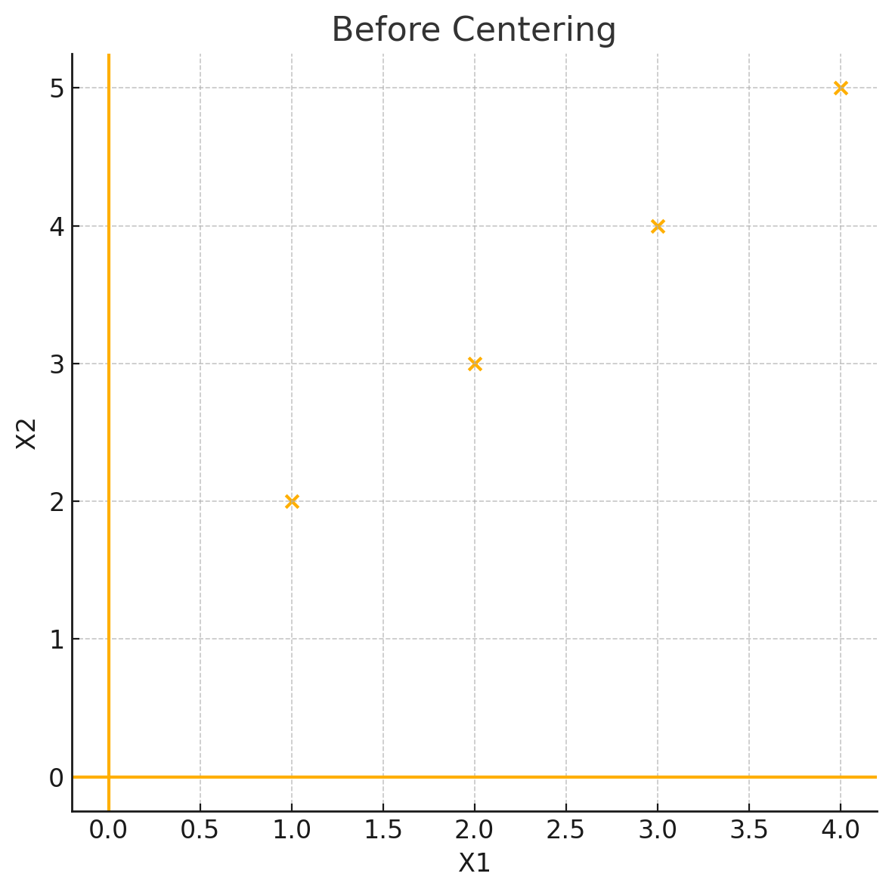
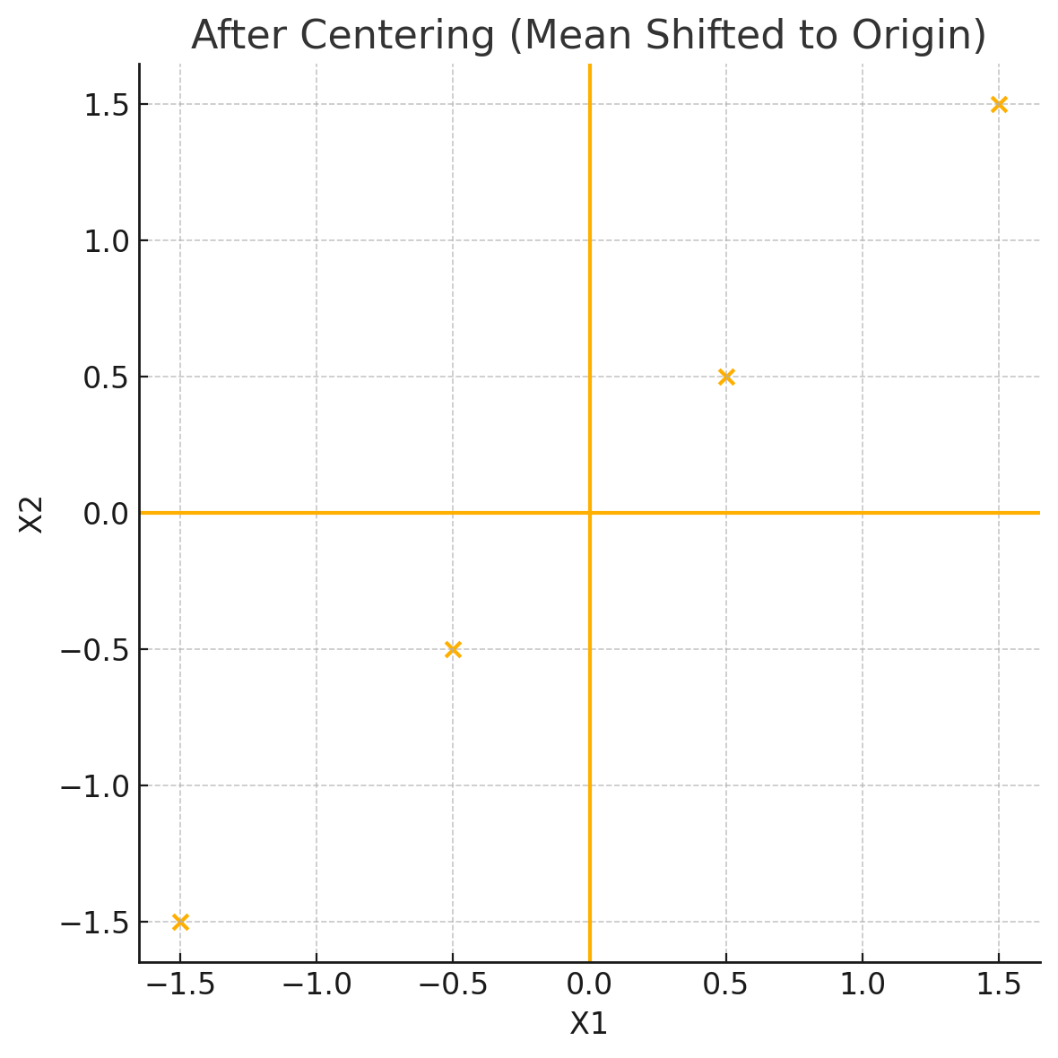
Before and after centering our data

Slide 7
SVD and PCA Connection
Xc = U Σ Vᵀ (Singular Value Decomposition).
  Columns of V are principal directions.
  Singular values σ → variance = σ².
  SVD avoids numerical issues with XᵀX.

Slide 8
Understanding the Code:
PCA using SVD
1. Compute column means.
  2. Subtract means → Xc.
  3. Use SVD(Xc) → returns singular values S and V matrix.
  4. PCA variances = S².
  5. Principal components = columns of V.

Slide 9
Understanding the Code: Jacobi Eigenvalue
1. Iteratively zeroes out off-diagonal entries using rotations.
  2. Finds angle θ so rotation eliminates M[p][q].
  3. Repeats until matrix is diagonal.
  4. Diagonal entries = eigenvalues
  5. Rotation matrix = eigenvectors.

Slide 10
Understanding the Code: SVD Function
1. Computes AᵀA using matrix multiplication.
  2. Calls jacobi_eigen() to find eigenvalues/vectors.
  3. Singular values = sqrt(eigenvalues).
  4. Uses these V vectors as PCA directions.

Slide 11
Final Output of PCA Code
1. Means: used to center any future data.
  2. Principal components V: directions of maximum variance.
  3. Variances S²: tells how important each component is.
  4. These are used to project or reduce dimensionality.

Slide 12
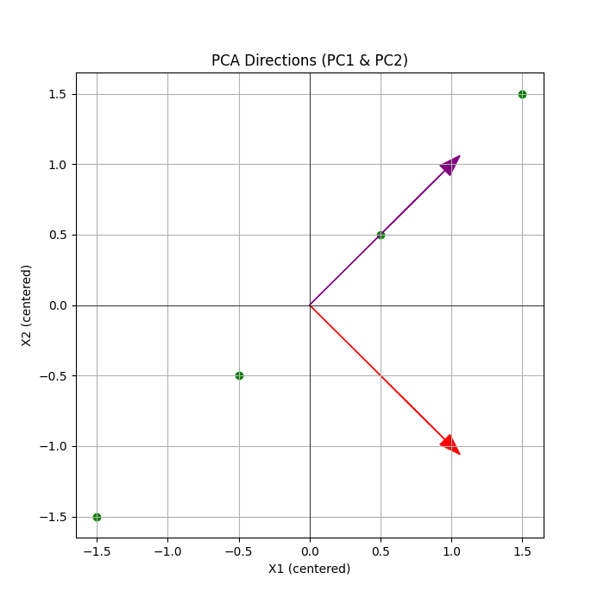

Slide 13
Applications of PCA
  Data compression.
  2. Noise filtering.
  3. Machine Learning preprocessing (scaling + PCA).

Slide 14
Summary
PCA finds patterns by rotating data into meaningful axes.
  Outputs: Means, Variances, PCA Directions.
  Result: A powerful dimensionality reduction tool.

Slide 15
References
Ian T. Jolliffe, and Jorge Cadima. “Principal component analysis: a review and recent developments.” Philosophical Transactions of the Royal Society A: Mathematical, Physical and Engineering Sciences.
Jolliffe, I.T. Principal Component Analysis. 2nd edition. Springer, 2002. DOI:10.1098/rsta.2015.0202.

