Slide 1


WELCOME

Slide 2

Domain

Slide 3
Presented by
Monik Dudhat
Devang Chudasama
Sujal Dhruve
Prince Khunt

Slide 4

AI
Healthcare
System

Slide 5
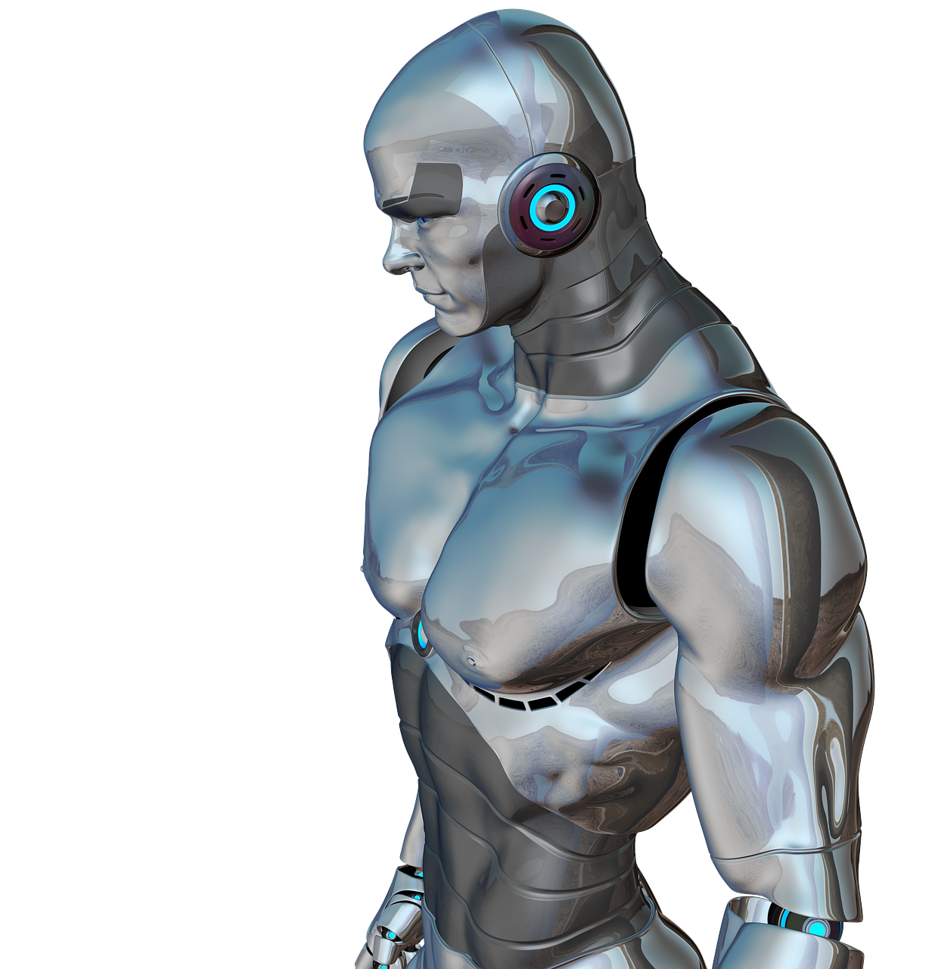
Provided Features
Smart patient Profiling
Attractive Dashboard
Convenient Appointment System
Virtual Meeting With Expert Doctors
AI enabled Report Explanation and QA System
Smart YouTube Video Recommender
AI powered Chatbot for Mental & physical Health with Two mode 1.Genrel 2.Ayurveda
Track Global Health Insights

Slide 6

1. Smart Profiling
Records All Necessary Health Related Information
Age
DOB
Regular Medicine
Allergies
Height
Weight
BMI

Slide 7
2. Attractive Dashboard
Contains
Health Tips
Upcoming Appointment
Medication Reminder
Health Overview
Personalized Health Insight
Recent Activities

Slide 8
3. Convenient Appointment System
Contains
AI Recommendation: Our AI analyzes the symptoms and suggests the most appropriate type of specialized doctor.
Doctor Selection: Patients view a map with nearby doctors, filtered by reviews and ratings, to choose the best option for their needs.
Appointment Details: Once selected, the doctor receives all necessary patient details and medical history.
Post-Appointment: Prescriptions and recommendations are displayed on the homepage.

Slide 9
4. Virtual Meeting with Experts
Contains
Remote Consultations: Ideal for patients who need advice from doctors who are not locally available.
Meeting Scheduling: Patients choose from available time slots, and a unique meeting link is generated upon doctor’s approval.
Follow-Up: After the virtual meeting, patients receive prescribed medications and advice directly on their homepage.
Post-Appointment: Prescriptions and recommendations are displayed on the homepage.

Slide 10
5. Track Global Insights
Contains
Global Insights:
Latest Updates: Users receive up-to-date news and updates on healthcare topics.
Information Hub: Keeps patients informed about the latest trends and research in the healthcare field.

Slide 11
6. AI enabled Report Explanation and QA System
Contains
Report Explanation:
Upload & Analyze: Users can upload their medical reports in PDF format.
Detailed Summary: The AI provides a comprehensive summary of the report.
Interactive Q&A: Users can ask specific questions about the report, and the AI will provide contextually relevant answers.

Slide 12
7. Smart YouTube Video Recommender
Contains
Video Search:
Users can search for medical topics to find relevant videos. Content Approval: We ensure the accuracy of video content by approving it, preventing the dissemination of misleading information.
Users receive trustworthy and informative videos based on their search queries.

Slide 13
8. AI powered Chatbot for Health with Two mode 1.Genrel 2.Ayurveda
Contains
Chat-Bot:
24/7 Assistance: Patients can ask medical-related questions at any time.
AI Responses: The chatbot provides accurate and timely responses based
on AI-driven analysis.

Slide 14


