Slide 1
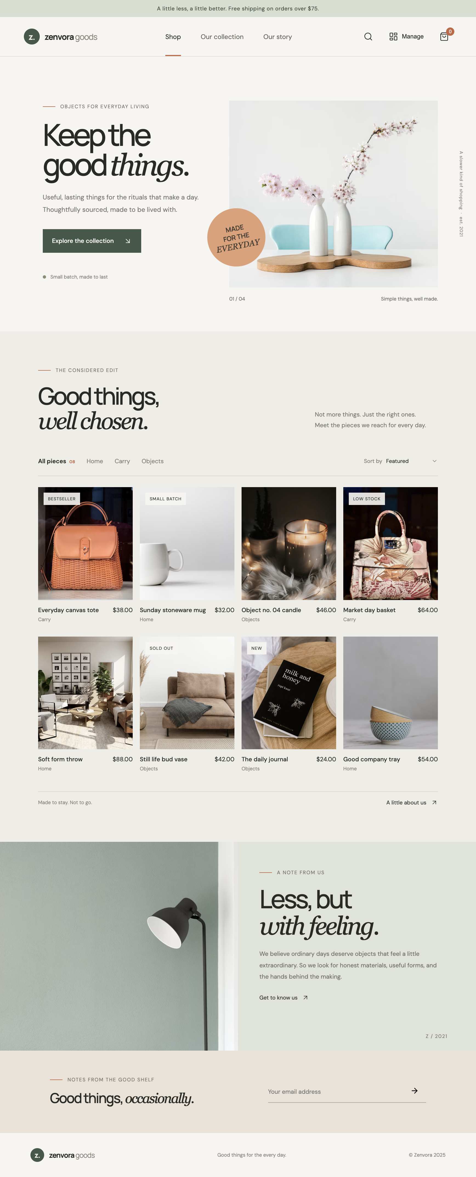
Z.
ZENVORA
Single-page e-commerce website
with inventory management
PROJECT REPORT / 2026
Submitted by: ____________________
Class / Roll No.: ____________________

Slide 2
01 / INTRODUCTION
Project overview
A small online shop concept with a built-in stock room for the shop owner.
Brand: Zenvora, a curated everyday-goods store
PROJECT AIM
Customer side: browse, filter, sort, and add products to a bag
Make the shopping experience and day-to-day stock updates feel like parts of one simple tool.
Admin side: add products, search stock, and adjust quantities
Built with HTML, CSS, and JavaScript; browser storage keeps demo data
The current demo saves data in this browser only. It is not connected to a real database or payment service.

Slide 3
02 / PLAN
What I wanted to build
I planned the main customer journey and the basic store-owner workflow first.
01
02
03
04
Shop
Bag
Stock room
Finish
A clear landing section, product categories, and a scannable product grid.
Quick add, quantity controls, and a subtotal that updates with the bag.
Inventory totals, stock statuses, search, and quantity adjustment.
Responsive layouts, local persistence, and a project hand-in checklist.

Slide 4
03 / PROMPT
Prompt used to shape the website
Lovable-style prompt used as the starting brief for the interface.
“Build a responsive, single-page e-commerce website for a curated everyday-goods brand called Zenvora. Use a warm editorial visual style, product filters and sorting, an add-to-bag interaction, and a separate inventory management panel. The inventory panel should show product count, stock value, low-stock and out-of-stock totals, searchable products, stock adjustment controls, and an add-product form. Use accessible controls, realistic sample products, and local browser storage for this prototype. Keep the customer storefront and inventory dashboard easy to switch between.”
The actual project is implemented with plain HTML, CSS, and JavaScript.

Slide 5
04 / CUSTOMER VIEW
The storefront
The product list can be browsed by category and sorted by price or name.
Zenvora storefront and brand identity
Eight sample products across three categories
Quick add-to-bag interaction and quantity controls
Story and newsletter sections complete the single-page layout

Slide 6
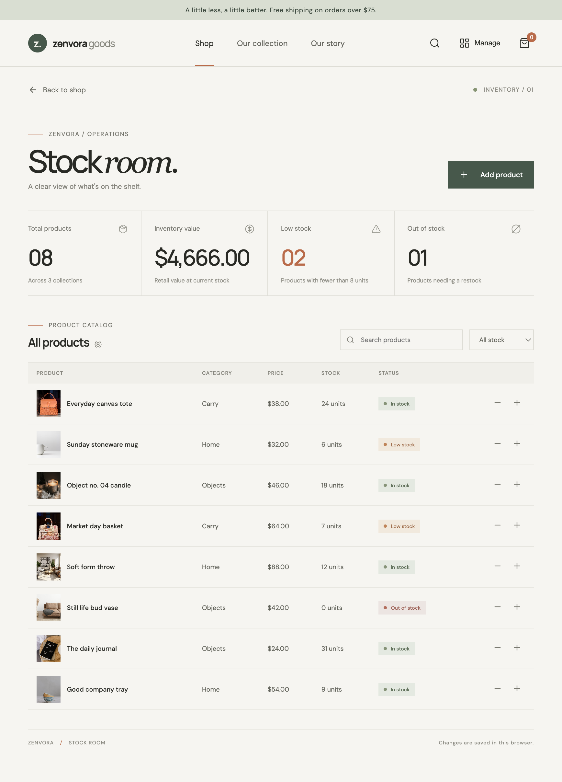
05 / STORE OWNER VIEW
Inventory management
The Manage button opens a working stock panel alongside the customer shop.
Inventory value is calculated from price × stock
Low stock is fewer than 8 units; zero units is out of stock
Search and stock-status filters narrow the product table
Plus/minus controls update quantities; the form adds products

Slide 7
06 / LOCAL SETUP
Run and test the project
These are the commands used from the project folder.
1
Install
npm install
2
Start locally
npm run dev
3
Create production build
npm run build
4
Generate report files
npm run docs
The site uses a Vite dev server. The generated dist/ folder is the deployment output.

Slide 8
07 / GITHUB
Save the code on GitHub
The project has a GitHub origin configured. Push access depends on account authentication.
Open the project folder in VS Code and review the files
Repository
Run: git add .
github.com/Sujal9r/E-Commerce
Run: git commit -m "Build Zenvora store and inventory panel"
A remote is configured, but no commit or push has been made from this workspace.
Run: git push -u origin main
Confirm the latest commit appears in the GitHub repository

Slide 9
08 / VERCEL
Deploy with Vercel
Connect the GitHub repository to Vercel to get a public website link.
Sign in to Vercel with the GitHub account
Choose Add New → Project, then import Sujal9r/E-Commerce
LIVE WEBSITE URL
Pending Vercel deployment
Framework preset: Vite; build command: npm run build
Output directory: dist; keep the root directory as the project root
Paste the real URL here after publishing.
Select Deploy and wait for the build to finish
Copy the generated Production URL into the assignment

Slide 10
09 / DRIVE AND SUBMISSION
Share the files with your teacher
Upload the finished PDF and PPTX to your own Google Drive account.
Open drive.google.com and upload Zenvora_Project_Report.pdf and .pptx
For each file, open Share → General access
ASSIGNMENT LINKS
Website: [paste Vercel URL]
PDF: [paste Drive link]
PPT: [paste Drive link]
Choose “Anyone with the link” and set Viewer access
Copy each share link and test it in a private browser window
Paste the real website URL and both Drive links into the assignment description
These links are placeholders until the files are published from the owner’s accounts.

Slide 11
10 / CONCLUSION
What I learned
The prototype is ready locally; public hosting and Drive sharing are the remaining account steps.
Connected the storefront with basic inventory updates
Used browser storage to retain demo products and the shopping bag
Added Git ignore rules for secrets, dependencies, and generated build files
Next improvement: use a database, secure admin login, and a real checkout provider
THANK YOU

