Slide 1
Chatline
A Real Time Chat Application
By :- Sujal Munikar
Sandesh Bata

Slide 2
Contents
- Introduction
- Objectives
- Scope & Limitation
- System Architecture Overview
- Model Diagram
- Algorithm Used

Slide 3
Chatline, the project created to provide encrypted end to end messaging while using real-time communication to safeguard your sensitive information.
Introduction
As Privacy is important in this digital age for using any application, Our projects main concern is to create an app with encryption for sending and receiving messages while also protecting their identity in real-time Communication.
Our application employs RSA encryption for encryption, Hashing for securing user information while Socket.io for real-time communication.

Slide 4
Objectives
To develop a application for sending and receiving secure messages.
To create a clean and modern UI interface with responsive interaction.
User-to-user communication with friend system.
Real-time messaging with encryption and secured Information with no interruption by anybody.

Slide 5
Scope & Limitation
Application created to give access to user after verification and sharing messages.
  Real-time messaging with socket.io
  Secure key exchange mechanism for encrypted messaging.
  Text filtering to block inappropriate words.
  Friend system to create connection.
  User Activity Indicator.
There are some weakness here and they are:
  Does not support image, audio or video.
  Does not allow sending multi-line messages.
  No indication for new messages being sent.
  Only support email-based Verification.

Slide 6
System Architecture Overview
Our system uses modern full-stack architecture focusing on responsive Interface, speed, scalability and security.
  Frontend is built using React.js for Interactive UI and smooth rendering,
  Redux Toolkit for global state library to store state and data consistently,
  TailwindCSS for utility CSS framework.
  Backend uses Node.js a JavaScript runtime for server and routing operations,
  Express.js is used for APIs to route login, OTP, sharing public keys.
  MySql for storing data in the database
  Socket.io for real-time connectivity between servers
  RSA encryption for encrypted messages using public and private keys.

Slide 7
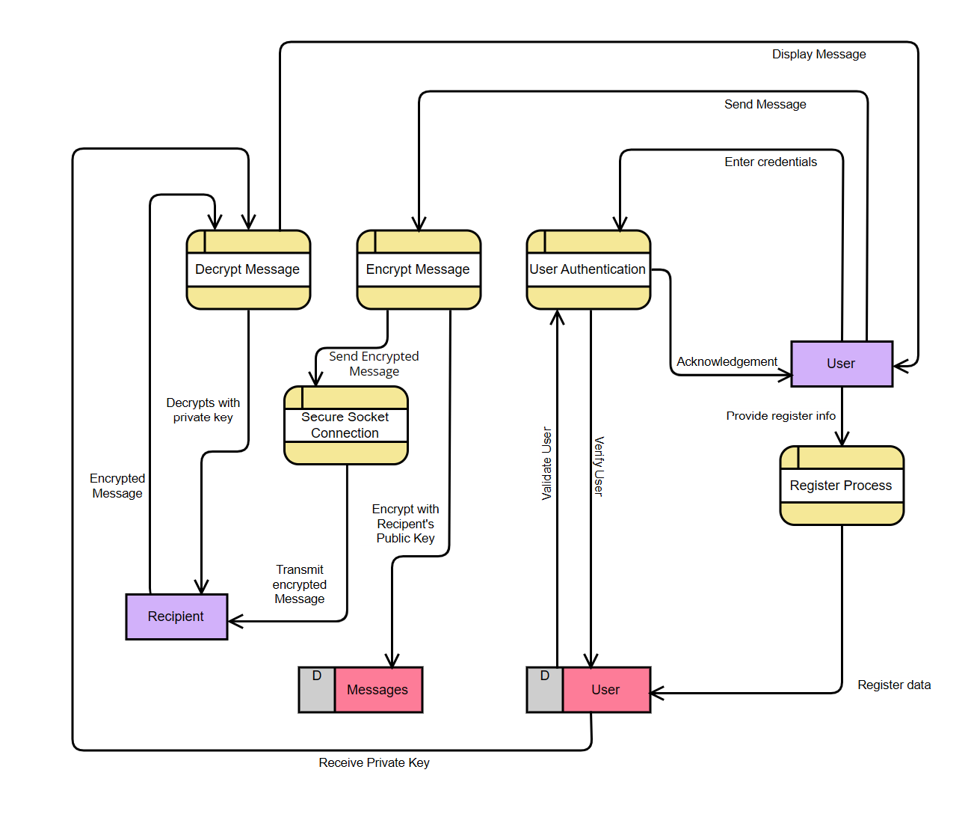
Model Diagram
Data Flow Diagram level 1

Slide 8
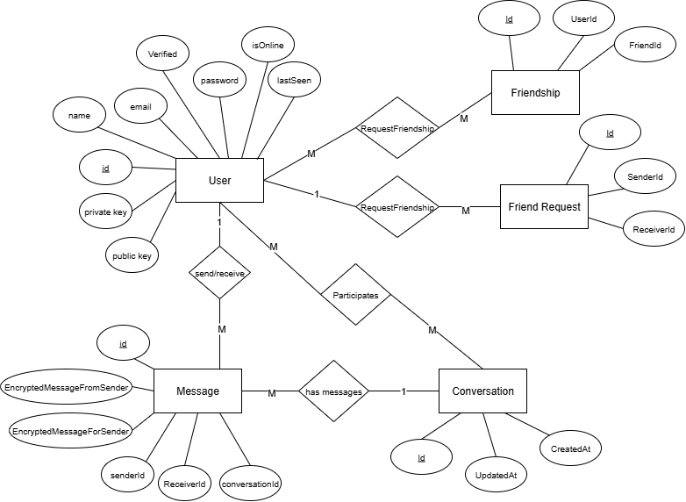
Model Diagram
ER- diagram

Slide 9
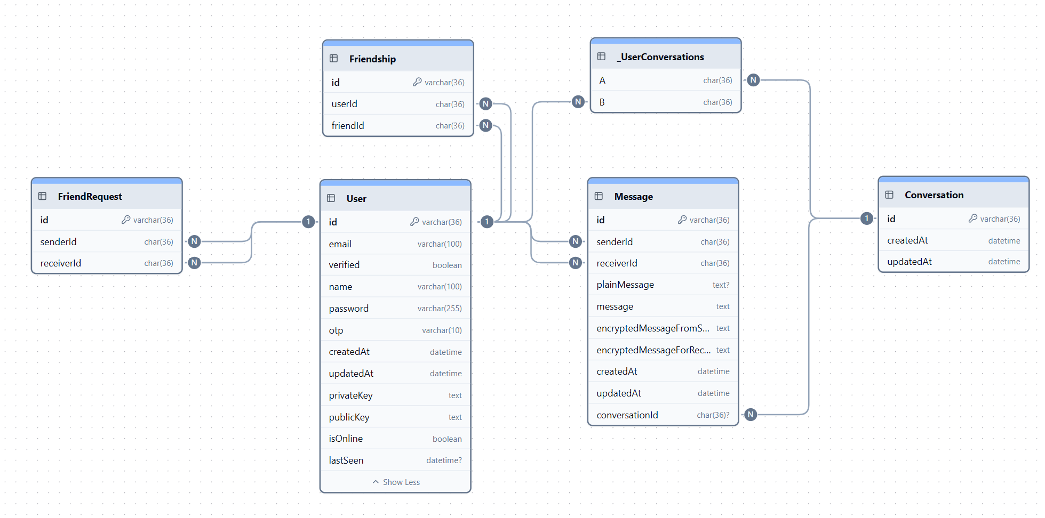
Model Diagram
Database Schema Design

Slide 10
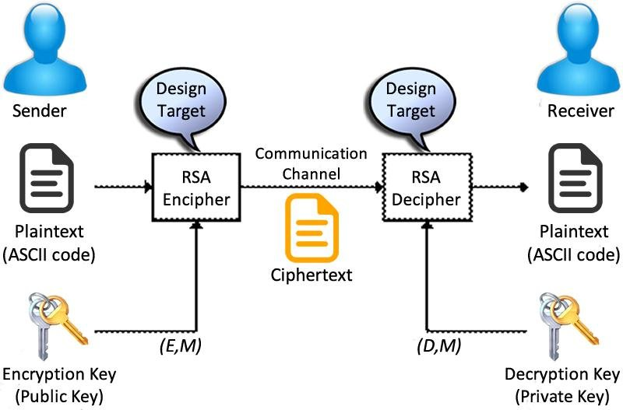
Algorithm
RSA algorithm is a public-key cryptography algorithm that relies on the mathematical properties of prime numbers to generate secure keys.
RSA encryption involves two keys: a public key for encryption and a private key for decryption.

Slide 11
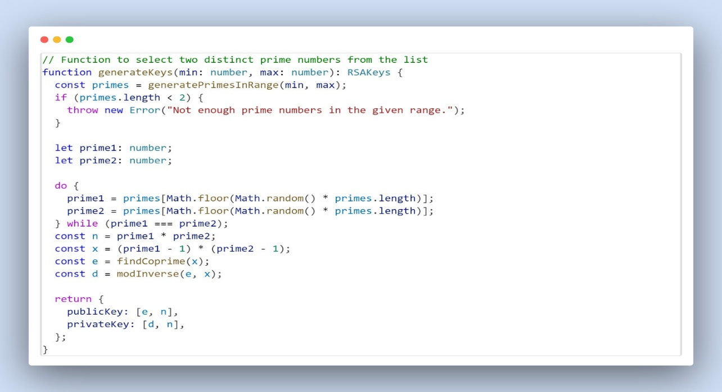
RSA Key Generation
  As shown is the code snippet of RSA key generation in our project.
  First, It defines a function two take two prime integer min & max number and return RSA keys.
  The const primes, calls a function to get array of prime number interval in [min,max].
  Initialize two prime variables and run a loop to pick two random numbers from prime array while not being same.
  Compute modulus n for both public and private keys.
  Compute Euler totient with x to choose public and private exponent.
  Return public key and private key.

Slide 12
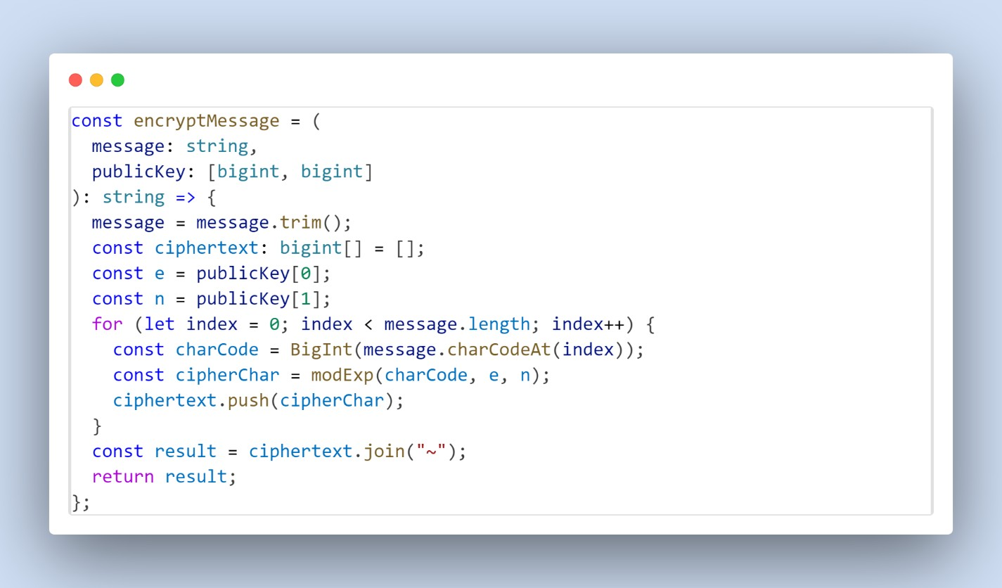
RSA Tracing
  As shown is the code snippet of RSA Tracing in our project.
  First, It defines a constant in which a string and public key parameter are taken.
  The string is trimmed and a array is created to collect encrypted character.
  Extract public key values and iterate through encryption loop.
  Message.charCodeAt(index) return integer for ASCII values.
  modExp(charCode,e,n) computes RSA formula to compute exponent and generate larger numeric values.
  Those all values are joined and returned.

Slide 13
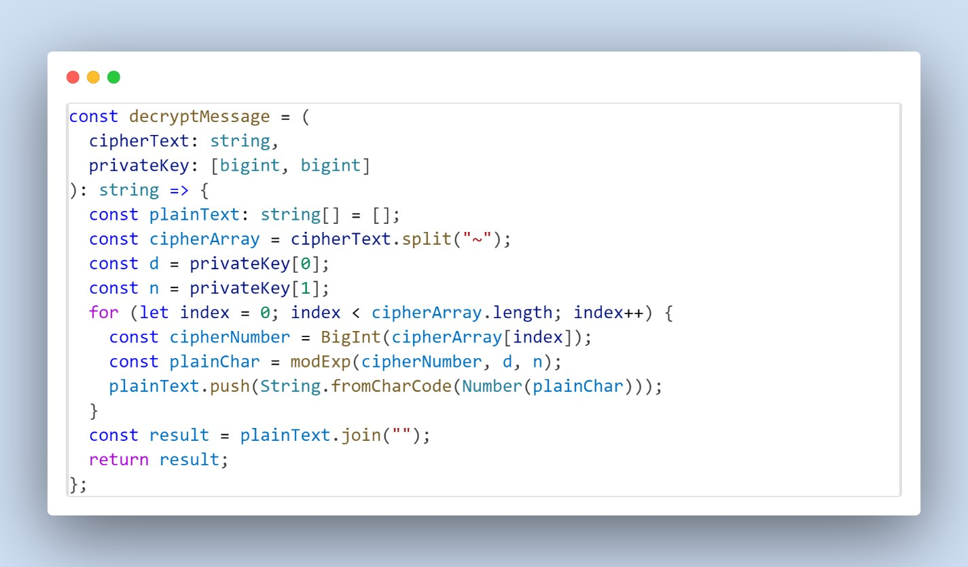
RSA Decryption
  As shown is the code snippet of RSA decryption precess in our project.
  First, Create a constant and add string for encrypted message and privatekey parameter.
  The constant plaintext is created to hold individual decrypted character at end.
  CipherText is split into separate numbers and extract private key parameters.
  Private key uses exponent d and n in decryption formula.
  Iterate the ciphertext in decryption loop where string is turned into BigInt and can be used for exponent.
  modExp(cipherNumber, d, n) modular inverse of encryption with keys and decrypted character are turned into character with String.fromCharCode(Number(plainChar))
  Return the reassembled message.

Slide 14
Conclusion
Chatline is built to provide secure communication and real-time messaging while providing low latency and modern and interactive UI.
Future Update might include:
- Sharing various media types
- Admin management
- Multi-line messages
- Phone Verification

Slide 15
Thank you

