Slide 1


Personalized Top-N Product
Recommendation System
Amazon Reviews 2023 (McAuley Lab, UCSD) — Electronics
Presented By: Sujal Parajuli
London Met ID: 23050262

Slide 2

Agenda
Introduction
Problem & Motivation
Dataset Overview
AI Concepts & Research Evidence
System Pipeline: How it works
Comparison of Methods
Solution and Achieved Results
TruncatedSVD: How the Main Model Works
Synthesis: Pseudocode and Flowchart
Conclusion and Further Work

Slide 3
Introduction

Slide 4

1. Introduction
This project develops a personalized Top-N product recommendation system using the Amazon Electronics Reviews 2023 dataset. It addresses choice overload by generating tailored product rankings per user. The solution integrates collaborative filtering and matrix factorization techniques, delivering a working CLI demo that outputs ranked product titles for enhanced user discovery.

Slide 5
Problem & Motivation

Slide 6

2.1. Problem:
Choice Overload:
E-commerce platforms offer vast product selections, causing choice overload for users. This complexity makes it difficult and time-consuming for consumers to find relevant products efficiently. The abundance of options often leads to decision fatigue and can reduce user satisfaction and engagement.

Slide 7

2.2. Motivation after addressing the problems:
Choice Overload
Personalized Discovery
The exponential growth of e-commerce platforms leads to an overwhelming number of product choices for consumers.
Users require tailored recommendations to efficiently discover relevant products, saving time and enhancing their shopping experience.
Project Goal
Deliverable
Develop a system to generate a personalized Top-N ranked list of product recommendations for individual users.
A working Command Line Interface (CLI) demonstration outputting recommended product titles.

Slide 8

2.3. Final Thoughts after addressing the problems:
Personalized recommendations helps by filtering and ranking products based on individual user preferences and behaviors. This tailored approach increases discovery efficiency, saves users’ time, and improves shopping experience, which benefits both consumers and vendors.

Slide 9
Data Set Overview

Slide 10
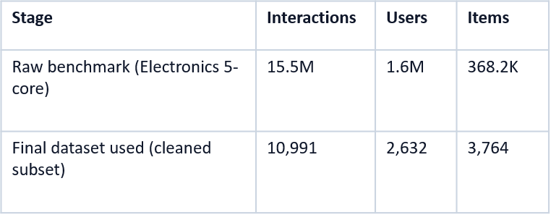
3.1. Dataset Overview
Source:
Dataset size (raw vs final)
Amazon Reviews 2023 (McAuley Lab, UCSD)
Fields used:
user_id, parent_asin, rating, timestamp (+ title from metadata)
Final file characteristics
Note: Raw benchmark statistics are from the Amazon Reviews 2023 documentation.
10,991 rows × 25 columns
Time span: 2004-06-03 → 2023-03-16

Slide 11

3.2. Original Dataset Size & Structure
Raw Dataset Scale
15.5M interactions, 1.6M users, 368.2K items
Final Modelling Subset
10,991 interactions; 2,632 users; 3,764 items
Time Span
Covers 2004–2023 (nearly 20 years of data)

Slide 12
AI Concepts & Research Evidence

Slide 13




4. AI Concepts & Research Evidence
Recommender Systems & Top-N
Collaborative Filtering
Focus on systems designed to predict and rank the most relevant items for a user.
Leverages user-item interaction patterns (memory-based) or underlying latent factors.
Item-Item Similarity
Truncated SVD
Utilizes cosine similarity to find relationships between items based on user ratings. (Sarwar et al., 2001)
Personalized Top-N ranking by learning latent
patterns from sparse interaction data. (Hu, Koren & Volinsky, 2008; Koren, Bell & Volinsky, 2009)

Slide 14
4.1. Research Evidence
Item-based Collaborative Filtering
Recommends products based on item similarity (Sarwar et al., 2001)
Popularity Baseline
Suggests Top N popular Item
(Koren et al., 2009)
Truncated SVD
Handles sparse user-item data using confidence scores (Hu et al., 2008)

Slide 15
System Pipeline: How it Works

Slide 16

5. System Pipeline Overview
Data Preprocessing & Metadata Merge
Clean reviews, merge with product info for readable titles
Time-Aware Train/Test Split
Latest user interaction for test, earlier for training
Model Training & Recommendation
Train Popularity, Item-CF, and TruncatedSVD models
Interactive CLI Output
User inputs ID, receives Top-N product recommendations

Slide 17
5.1. How it Works:
Notebook 1: load reviews + metadata; merge on parent_asin; clean; export CSV.
Notebook 2: train models; evaluate; run CLI demo.
Time-aware split: hold out each user’s most recent interaction for test.
Exclude previously seen items when generating recommendations.

Slide 18
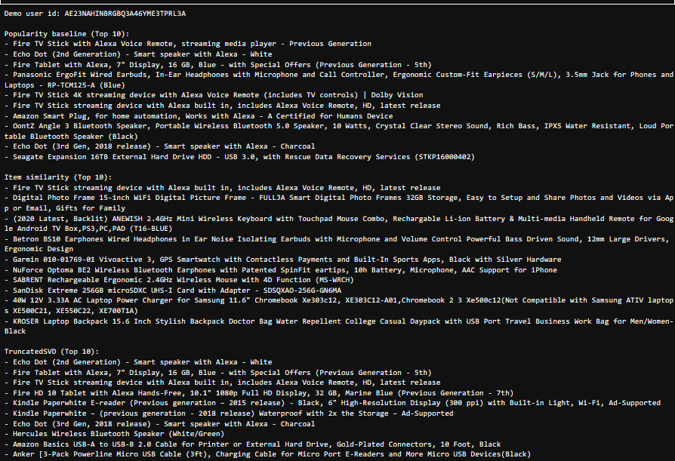
5.1.1. Demo:

Slide 19
Comparison Of Methods

Slide 20

6. Models Implemented
Popularity Baseline
Ranks items by overall interaction count; ideal for new users
Item-Item Collaborative Filtering
Uses cosine similarity to recommend items similar to user history
TruncatedSVD
Recommender
Main personalized model; learns latent user-item patterns for Top-N ranking

Slide 21
6.1. Comparison of Methods:
Popularity baseline
Item–Item CF (cosine)
TruncatedSVD (main model)
Ranks globally popular items.
Strong baseline and cold-start friendly.
Finds similar items using cosine similarity.
Explainable: “similar to items you liked”.
Learns latent factors from sparse matrix.
Captures subtle user preferences.

Slide 22
Solution and Achieved Results

Slide 23
7.1.How We Used Train/Test Strategy
Time-Aware Train/Test Split
Assign each user's latest interaction to test set
Training on Historical Data Only
Use all earlier interactions for model training
Prevent Data Leakage
Exclude items already seen by user from recommendations

Slide 24
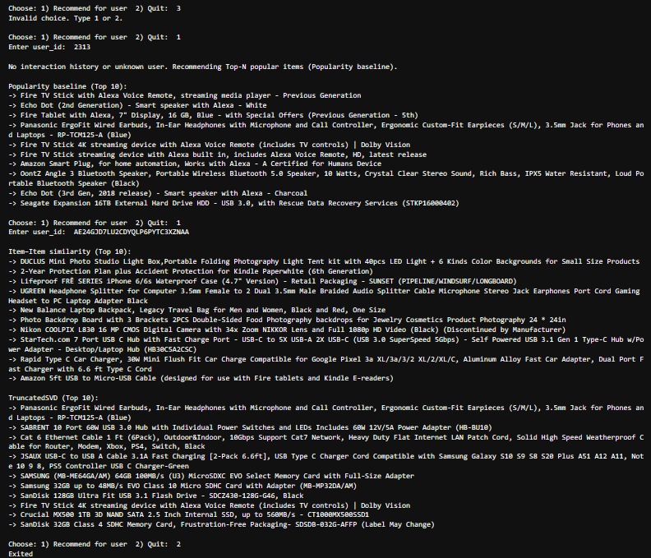
7.2. Final CLI Output:
Inputs used in this run (as shown in the screenshot):
At the main menu, an invalid option was entered first: 3 (system responds: “Invalid choice. Type 1 or 2.”)
Menu option selected: 1 → Recommend for user
Entered user_id: 2313 → triggers Popularity baseline due to no history
Menu option selected again: 1 → Recommend for user
Entered user_id: → generates Item-Item Similarity Top-10 and TruncatedSVD Top-10
Exit input: 2 → Quit

Slide 25
7.2.1. Final CLI Output Summary:
Our system was able to take a user_id as input and generate Top-10 product recommendations successfully. When the input user had no interaction history (cold-start), it automatically switched to the popularity baseline and returned the most popular items; when the user had history, it produced personalized recommendations using item–item similarity and TruncatedSVD.

Slide 26
Truncated SVD: How the Main Model Works

Slide 27
8. TruncatedSVD: How the Main Model Works
1. Build a sparse user–item matrix (ratings).
2. Apply TruncatedSVD to learn latent factors.
3. Reconstruct predicted preference scores.
4. Filter seen items and rank the remaining items → Top-N.
Output: Top-N list of recommended products with readable titles (via metadata).
How this works: recommendations are generated only from unseen items (items already interacted with are removed before ranking).

Slide 28
Synthesis: Pseudocode and Flowchart

Slide 29
Pseudocode Overview
End-to-End Pipeline
Overview
Preprocess data, merge metadata, clean & filter
Time-aware split: train on history, test on latest
Recommendation Logic
Train models on user-item matrix
Generate Top-N by ranking unseen items
TruncatedSVD Model
Steps
Fit SVD, reconstruct scores, filter seen, output Top-N

Slide 30
9. Synthesis: Pseudocode
Item –Item Cosine Similarity
Popularity Baseline
START
LOAD TRAIN interactions
COUNT interactions per item
SORT items by count descending
STORE result AS Popular_Items list
INPUT user_id
GET items seen by user in TRAIN
FILTER Popular_Items to remove seen items
SELECT Top-N items from remaining list
OUTPUT Top-N recommended items
END
START
LOAD TRAIN interactions
BUILD user-item matrix R
COMPUTE cosine similarity matrix SIM between items
INPUT user_id
GET user history from TRAIN
COMPUTE candidate scores using similarity-weighted sum (SIM + user history)
REMOVE items already in user history
SORT candidates by score descending
SELECT Top-N items
OUTPUT Top-N recommended items
END

Slide 31
9.1. Synthesis: Pseudocode
Overall pipeline
TruncatedSVD recommendation
START
LOAD TRAIN user-item matrix R
FIT TruncatedSVD on R
COMPUTE latent user factors and item components
RECONSTRUCT predicted score matrix
INPUT user_id
GET predicted scores for user across all items
REMOVE items already seen in TRAIN
SORT remaining items by score descending
SELECT Top-N items
OUTPUT Top-N recommended items
END
Input: reviews.jsonl, metadata.jsonl
Output: cleaned.csv, recommendation results
START
LOAD Electronics reviews dataset
LOAD Electronics metadata dataset
MERGE reviews and metadata ON parent_asin
CLEAN dataset (drop missing values, drop duplicates, filter minimum interactions)
EXPORT cleaned dataset AS CSV
LOAD cleaned CSV (Notebook 2)
RUN EDA plots and summaries
APPLY time-aware split INTO TRAIN and TEST
BUILD user-item matrix R FROM TRAIN
TRAIN popularity baseline USING TRAIN
TRAIN item-item cosine similarity model USING R
TRAIN TruncatedSVD model USING R and reconstruct predicted scores
EVALUATE each model USING Precision@K, Recall@K, NDCG@K
OUTPUT metrics table and comparison bar chart
ASK user: "User wants recommendations?"
IF user says NO THEN
END
ELSE
INPUT method choice and user_id
GENERATE Top-N recommendations using chosen method
OUTPUT results by mapping ASIN to title and printing recommendations
GO BACK to "User wants recommendations?"
ENDIF

Slide 32
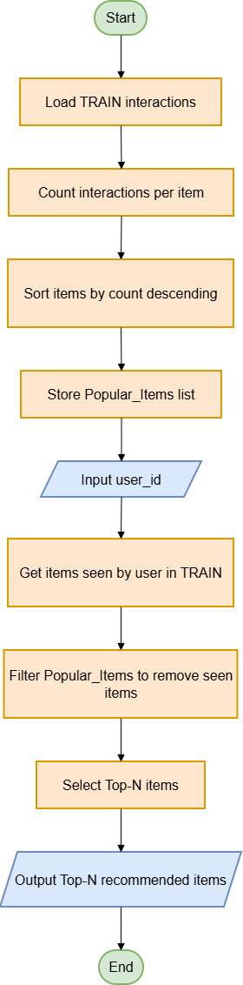
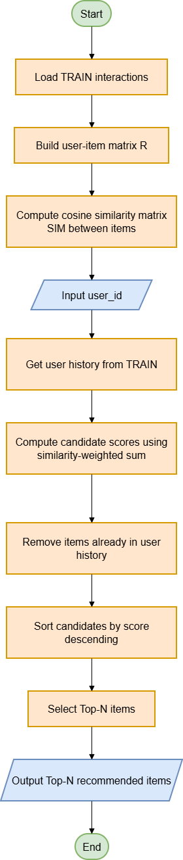
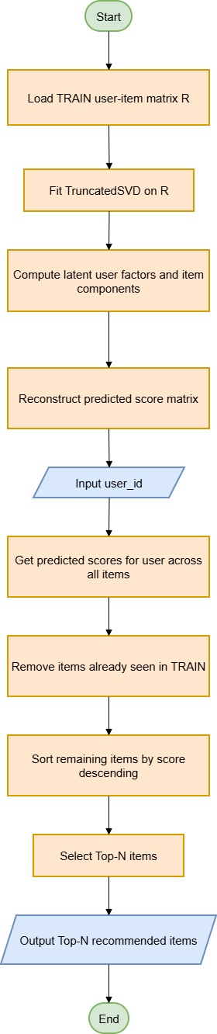
9.2. Synthesis: Flowchart

Slide 33
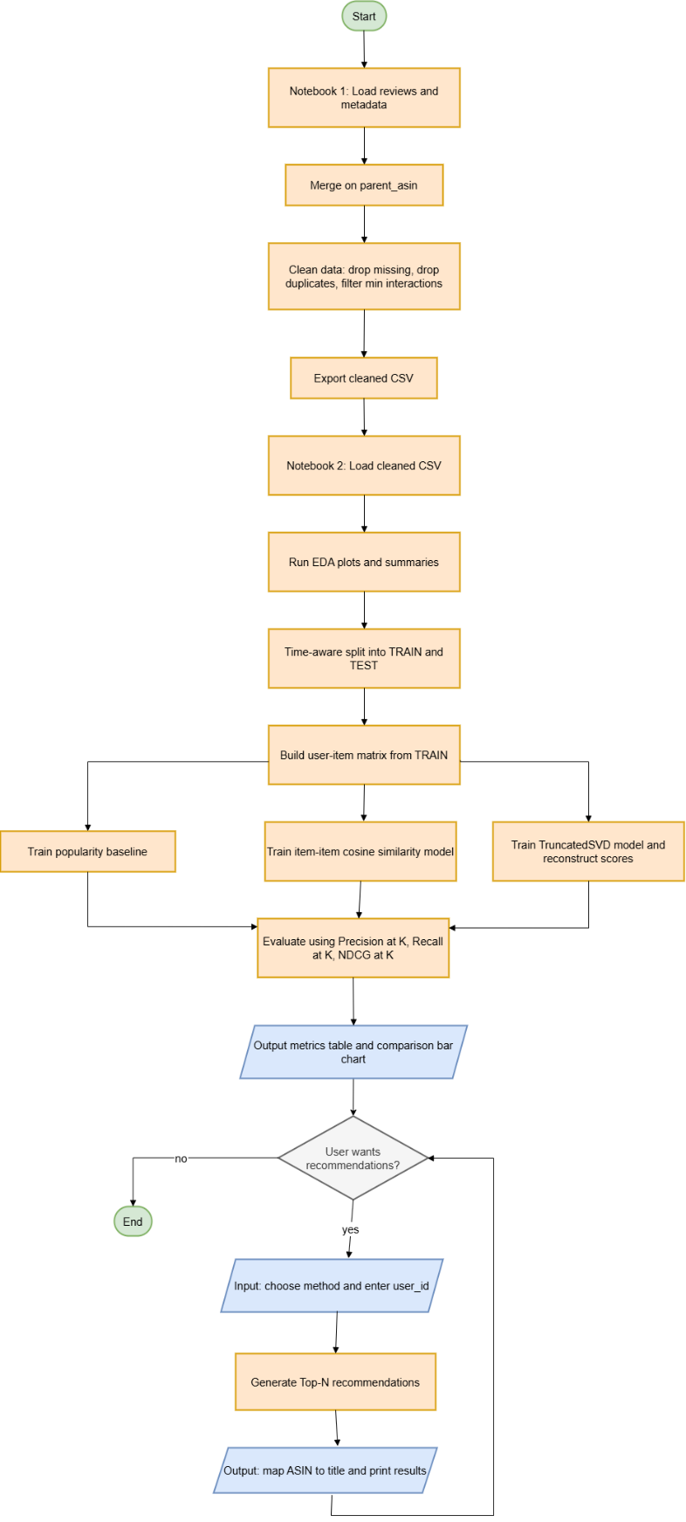
9.2.1. Synthesis: Overall System Flowchart

Slide 34
Conclusion and Further Work

Slide 35
10. Conclusion & Further Work
What worked
Real-world value
Limitations / Next steps
End-to-end Top-N pipeline
Time-aware evaluation
Functional CLI demo
Improves product discovery
Saves browsing time
Reduces choice overload
System Implementation
Live Dataset from a store
Hybrid model and web UI
Using more advanced Models for more accurate results

Slide 36
Thank You!

