Slide 1
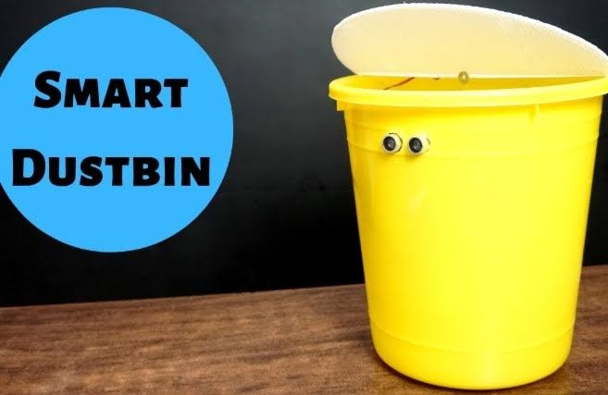
SMART
DUSTBIN
USING
ARDUINO
Name- Sujal Aswal
University Roll no- 2019160
Section- F
Mentor- Mr. Prabhdeep Singh

Slide 2

.
INTRODUCTION & PROBLEM STATEMENT
The Internet of things describes physical object with sensors, processing ability, software and other technologies that connect and exchange data with other devices and systems over the internet or other communication networks.
As the world is in a stage of up gradation, there is one problem we have to deal with Garbage in our daily life, we see the pictures of garbage bins being overfull. This leads to the number of diseases as large number of insects and mosquito breeds on it. The project gives us on of the most efficient ways to keep our environment clean and green. The prime need of a lifestyle begins with cleanliness and cleanliness begins with dustbin.
The main problem in the current waste management system in most of the Indian cities is the unhealthy status of dustbins. In this project we have tried to solve a problem of waste management system.
.

Slide 3

ABSTRACT
As people are getting smarter, so are the things , while the though comes up for smart cities. There is requirement for Smart waste management. It is a common sight to witness garbage spilled out in and around the dustbins. The environment around a dustbin is also conducive for increasing the pollution level in Air.
Air pollution due to a dustbin can produce bacteria and virus which can produce diseases in human beings. The idea of smart dustbin is for the colleges, hospitals , smart buildings and bus stands. The Smart Dustbin thus thought is an improvement of normal dustbin by elevating it to be Smart using sensors and logics.
fdgd
ABSTRACT

Slide 4
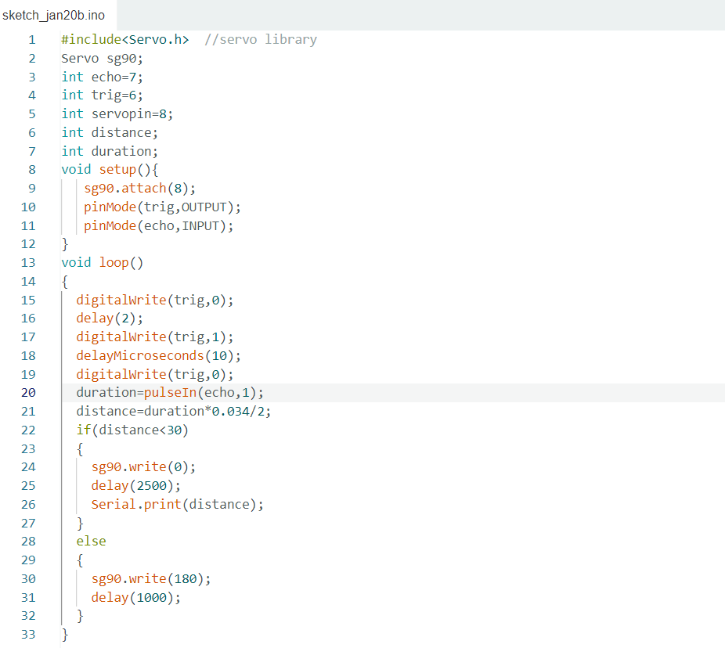
METHODOLOY
Code Used:
The code which I have used in Arduino IDE. To create the smart dustbin is :

Slide 5
STEPS
Steps to open the Dustbin
First , I have connected the circuit properly.
When ultrasonic sensor detect object near around him, it will send a signal to the Arduino UNO board.
When the Arduino received signal then, the Arduino will send a signal to the Micro Servo motor.
The signal received from the Arduino will tend the micro servo motor to move 180 degrees.
When the motor rotates 180 degrees, it will open the dustbin cap.

Slide 6
MAIN COMPONENT USED
In this project, I have used software component as well as hardware component such as:
SOFTWARE COMPONENT:
Arduino IDE
HARDWARE COMPONENT:
Arduino Uno
Ultrasonic Sensor
Jumper wires(Male to male & Male to female)
Servo motor
9V Battery

Slide 7
RESULT ANALYSIS & DISCUSSION
The dustbin is able to open the cap of dustbin with the help of servo motor whenever it detects motion. The Ultrasonic Sensor is giving the details about the waste present in the dustbin. The
Status of the waste is transferred to the municipal authority it is exceeding the threshold value.
The population increases day by day and generates million tons of waste per year. Waste management organizations in different countries faces the challenge to provide to recycle the waste keeping health standard and environment friendliness. The smart waste management system collects the waste in proper time, dispose and recycle in the proper way.

Slide 8
CONCLUSION & FUTURE WORK
Here we are going to make an evolution change toward cleanliness. The combination of intelligent waste monitoring and trash compaction technologies , smart dustbins are and shoulders above traditional garbage dustbin, it is equipped with smart devices like sensors Arduino etc. Cap of the dustbin will automatically open when an object come near to the dustbin and after certain time period it will close the cap. For society, it will help towards health and hygiene so that normal people to rich people can take benefit from it. Believe this will bring something changes in terms of cleanliness as well technology.
For social it will help toward health and hygiene, for business for we try to make it affordable to many as many possible. So our next work will be adding one more sensor which will sense whether our dustbin is full or not. And there will be a display will be added so that user can notify that dustbin is full or not.

Slide 9
THANK YOU

