Slide 1
Team Name Zenith-V

Slide 2
Team Name Zenith-V
Ministry / Organization Name
Department of Empowerment of Persons with Disabilities (Divyangjan),
Ministry of Social Justice and Empowerment.
Problem Statement
Difficulties in walking with a white cane in surrounding environments.
Institute Code
U-0513
GLA University
Mathura
Team and Problem Statement
Details

Slide 3
Idea / Approach Details
Our Idea :
To help out the disabled person by alerting him/her.
The solution of the problem is catered out by using a camera, used for our A.I. program to detect the obstacles and read the text present in the surrounding for our blind user.
It would, after the analysis, alert the user by playing/announcing the message via earphone jack to the user in audio format.
It’s a small box connected to the cane of the blind person which consists of a camera, GPS, SBC (Single Board Computer) known as Raspberry Pi.
Technology Used :
OCR (Optical Character Reader)
OBD (Object Detection)
GPS (Global Positioning System)

Slide 4
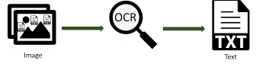
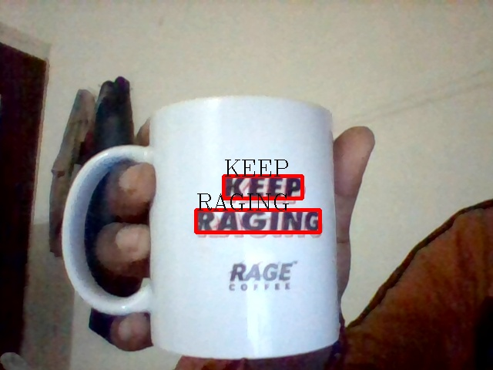
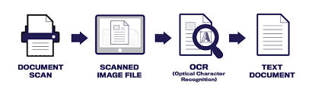
Use Cases & Show Stoppers
OCR (Optical Character Reader) :
Here we used OpenCV (Open Computer Vision) as our ML Library, whereas, pytesseract is used to fetch the text from the given image, pyttsx3 is used for announcing the text.
We have tried to develop a system that would actually dictate the text in front of the blind person (timely), it is still under development, as different lighting conditions, font, color of text, etc greatly influence the performance of OCR.

Slide 5
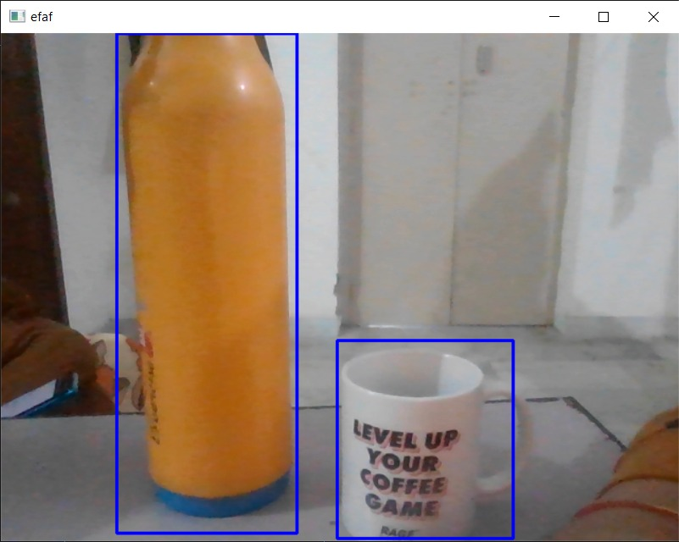

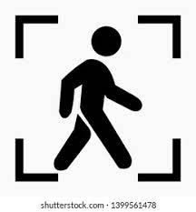
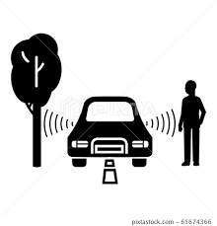
OBD (Object Detection) :
Here only OpenCV is used, to detect random objects coming in the way of the blind person.
By detecting the item from the self-build label library (Under Development) we could classify each object and set a label for it, like for a "Human", it would announce "Person" to the blind person, and for "Mug", it would announce its name as well.
If an object tries to obstruct the way of the blind person, it would start shooting an alert message as "Something in Front !! Please Wait !! ".
After the obstacle is gone, it would fall back to normal working.

Slide 6


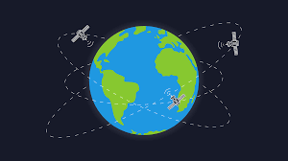


GPS (Global Positioning System) :
We used GPS Module for Raspberry Pi, which sends the longitude and latitude of the current position which is redirected to our site, from where our user's relative could get their current location
Unfortunately, our GPS Module got some issues, and we can't present its working, but we have completed the rest of its setup...
Later on we could also apply Emergency SOS to it so that current location, with 5 consecutive photos clicked by our CAM, could be sent to our User's emergency contacts...

Slide 7
Future Plans
For later development, We will improve our AI for both OCR and OBD.
We would also install a smart virtual assistant (Alexa or Google).
So that our humble user can enjoy his/her time walking down the road listening to songs they like, news they want to search, weather condition/temperature, calling people hands free (avoiding the use of smartphones), etc by putting a microphone in it.
We would create a whole UI (User Interface) for the app, by which each user will have their personalized fitness tracker too, along with a handy stick.
Thank You…

Slide 8
Team Members
Shrishti Prakash (Team Leader)(CCV)
Uday Gupta (AIML)
Maulik Pandey (CCV)
Shobhit Upadhyay (DA)
Neelesh Srivastava (AIML)
Sujal Kulshrestha (AIML)
Thanks for watching…

