Slide 1
PYSUSTAIN-2026 · TRACK 1: CODE TO CURE
EyeGuard
A webcam-powered eye strain monitor that tells students when to blink, sit back and rest.
Team Dark Fantasy · Sujan Anand, Dhayanithi S V, Padhmesh N, Akshaith P
SDG 3.4
Notes:
Introduce the team and the one-line pitch: EyeGuard uses only a webcam and Python to catch eye strain before it builds up.

Slide 2
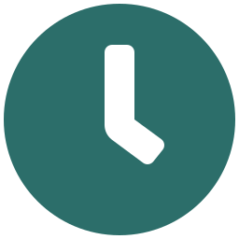


Students live on screens, and their eyes pay for it
THE PROBLEM
Hours of screen time
Strain you don't notice
Rising myopia
Online classes, assignments, coding and entertainment keep students in front of screens most of the day.
Dry eyes, headaches and blurred vision build up slowly. We stop blinking and lean closer without realising it.
Short-sightedness among young people is rising worldwide, and close-up screen habits are a major factor.
Notes:
Ask the judges how many hours they spent on a screen today. Most strain is invisible until it hurts: we blink less and lean in without noticing.

Slide 3
WHAT HAPPENS WHEN WE STARE AT A SCREEN
15–20
5–7
blinks per minute, normally
blinks per minute on a screen
Fewer blinks mean drier, more tired eyes, and nobody notices it happening.
Notes:
This is the core insight EyeGuard measures. Blink rate commonly drops sharply during screen use. Check and cite your source for these figures before presenting.

Slide 4
Prevention before damage
SUSTAINABLE DEVELOPMENT GOALS
SDG 3.4
SDG 4
Good health and well-being
Quality education
Target 3.4 calls for prevention of non-communicable disease and the promotion of well-being. EyeGuard prevents a lifestyle health problem early, at zero cost, using hardware students already own.
Healthier eyes mean longer, more comfortable study sessions and better focus.
Notes:
Primary: SDG 3 target 3.4 (prevention and well-being). Secondary: SDG 4, because students who are comfortable study better.

Slide 5

EyeGuard watches your eyes so you don't have to
OUR SOLUTION
A Python app that uses an ordinary laptop webcam to track blinking, screen distance and breaks in real time, and alerts you before strain builds up.
No extra hardware
Free and open
Data stays on your laptop
Notes:
The pitch in one sentence. Stress the three points: no new hardware, no cost, and the video stays private because nothing is uploaded.

Slide 6
From webcam frame to alert, 30 times a second
HOW IT WORKS
1
2
3
4
Capture
Map the face
Measure
Alert and log
OpenCV reads each webcam frame.
MediaPipe finds 478 face points, including eyes and irises.
Python computes blink rate, distance and head tilt.
On-screen and sound alerts, plus a CSV log for reports.
Python · OpenCV · MediaPipe · NumPy · pandas · Matplotlib
Notes:
Walk through the pipeline left to right. Everything runs locally on the laptop; no video is saved or uploaded, only numbers are logged.

Slide 7


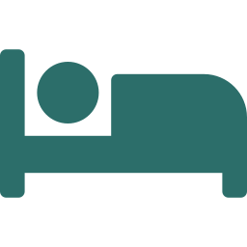
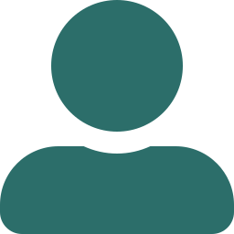
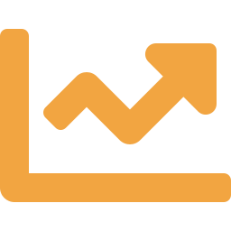
Six checks running at once
FEATURES
Blink counter
Distance meter
20-20-20 breaks
Live blinks/min; warns below 7, strong alert below 5.
"Too close" alert under 50 cm.
Every 20 minutes, look 20 feet away for 20 seconds.
Drowsiness
Posture and light
Strain score
Eyes closed over 2 seconds triggers a rest alert.
Warns on head tilt and dark rooms.
One 0–100 number, plus a session report with tips.
Notes:
Six checks run on every frame. The strain score combines them into one number students can understand.

Slide 8
Two simple formulas do the heavy lifting
THE SCIENCE BEHIND IT
Blinks: Eye Aspect Ratio
Distance: the iris trick
EAR = eye height ÷ eye width
d = f × 1.17 cm ÷ iris px
6 points around each eye. An open eye gives about 0.3; a closed eye drops sharply. A short dip below the threshold counts as one blink. The threshold is tuned to each user in the first 3 seconds.
The human iris is about 11.7 mm wide in almost every adult. The smaller it looks on camera, the farther away you are. One calibration at 50 cm makes it accurate.
Strain score = low blinks (40) + too close (30) + time since break (20) + drowsiness (10)
Notes:
Be ready for questions here. EAR: vertical eye distances divided by horizontal. Distance uses the pinhole camera model with the iris as a known-size ruler.

Slide 9
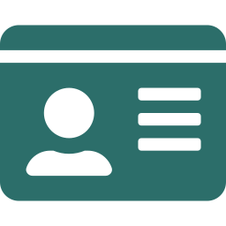

Eye power changes what the camera sees
BUILT FOR GLASSES WEARERS
Glasses change how big the iris looks on camera. Minus lenses (short sight) make the eyes look smaller, so distance is over-estimated and "Too close" warnings would be missed. EyeGuard stores each user's correction and fixes this.
EXAMPLE: −7.00 D GLASSES
~10%
m = 1 ÷ (1 − 0.015 × P) → distance × m
smaller eyes on camera
Profiles: Glasses, contacts or none, plus power (e.g. −7.00 D)
Without correction, sitting at 45 cm reads about 50 cm, so the warning never fires. Calibration makes it exact.
Calibrate wearing them: Press c at 50 cm with your usual glasses on
Glare and check-up: Glare warning; gentle check-up reminder at high power
Notes:
Explain: glasses act like a lens between the eye and the camera. At -7 D the eye looks about 10 percent smaller. EyeGuard applies the lens formula automatically, and calibration while wearing the glasses makes it exact. Astigmatism is ignored. EyeGuard cannot measure or diagnose eye power.

Slide 10

Runs quietly while you study
BACKGROUND MODE
Start it with py eyeguard.py --background and keep working in any app. EyeGuard keeps checking through the webcam and shows a small pop-up in the corner of the screen only when your eyes need it.
Blink more — only 6/min
EyeGuard · now
Windows notifications: Blinking, distance, drowsiness and break alerts
Too close: 42 cm — sit back
EyeGuard · 2 min ago
Mini window: Live blinks/min, distance and strain score in a corner
Breaks still verified: "Break done ✓" only after you really look away
Break done ✓ Nice rest!
EyeGuard · 20 min ago
Same session log: Dashboard and reports still work afterwards
Notes:
Background mode is for real study sessions: no big video window, just corner notifications and a small mini window. The verified break and the CSV log still work, so the website dashboard shows the session afterwards.

Slide 11

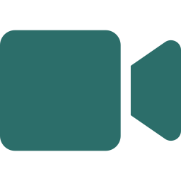

Try it, track it and understand it in the browser
THE EYEGUARD WEBSITE
Home
Live Check
My Profile
The problem, how it works and our SDG goals
Webcam check in the browser with live readings
Glasses, power and calibration settings
Dashboard
Insights
About
Key numbers, charts and personal tips
Patterns across sessions, like your worst hour
Formulas, privacy and AI usage disclosure
Built with Streamlit, deployed free on Streamlit Community Cloud. Scan the QR code on the last slide to try it.
Notes:
The website has six pages. Live Check depends on the network; if campus Wi-Fi blocks it, the desktop app is the backup.

Slide 12
Watch EyeGuard catch strain in real time
LIVE DEMO
1
Start EyeGuard: the blink count appears live
2
Stare without blinking: the low-blink alert fires
3
Lean in: "Too close!" shows the distance in cm
4
Break time: keep looking at the screen and the timer pauses
5
Switch to background mode: a corner notification pops up
6
Open the website dashboard and strain score
Notes:
Switch to the laptop and run: py eyeguard.py --demo. Press c at arm's length to calibrate first. Turn sound on with m so judges hear the alert.

Slide 13
It checks that you actually rest
WHAT MAKES IT DIFFERENT
Feature | Typical break timer | EyeGuard
Reminds you to rest | Yes | Yes
Checks you looked away | No | Yes, with the camera
Measures blink rate | No | Yes, live
Measures screen distance | No | Yes, in cm
Works for glasses wearers | Not applicable | Yes, power-aware calibration
Runs in the background | Yes | Yes, with verified breaks
Extra hardware needed | None | None, just a webcam
Notes:
The verified break is the unique part: if you keep staring at the screen during the break, the 20-second timer pauses until you really look away.

Slide 14
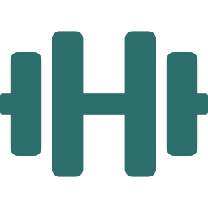

From one laptop to the whole campus
FUTURE SCOPE
Guided eye exercises
Mobile and browser
Campus insights
Camera-checked eye movements during breaks.
A phone app and a browser extension for online classes.
Anonymous, opt-in data to spot exam-week strain across hostels.
AI usage disclosure: we used AI assistants (Claude) to help write and debug parts of the code and documentation. The idea, feature design, testing, calibration and presentation are our team's work, and every member can explain how the code works. EyeGuard is an awareness tool, not a medical device.
Notes:
Mention the website plan, then read the AI disclosure plainly. Edit the wording so it matches exactly what your team did.

Slide 15
THANK YOU
[QR code to the EyeGuard website]
Blink more. Sit back. Look away.
Team Dark Fantasy · Sujan Anand, Dhayanithi S V, Padhmesh N, Akshaith P
Scan to try it
Questions welcome
Notes:
Close with the three habits. Replace the white box with a QR code for the website once it is online.

