Slide 1





A
PROJECT ON
Legal Document Analysis and Q&A Using RAG Framework
Submitted To
JAWAHARLAL NEHRU TECHNOLOGICAL UNIVERSITY, ANANTAPUR.
In Partial Fulfillment Of The Requirements For The Award Of The Degree Of
Bachelor Of Technology
In
ARTIFICIAL INTELLIGENCE & MACHINE LEARNING
Under The Guidance Of
Mr.O.DEVANANDH, M.Tech,
Assistant professor
Department Of AI&ML
T.BHASKAR REDDY | (22JN1A3304)
T.V.SUJAN KUMAR | (22JN1A3359)
S.NICHITHA | (22JN1A3356)
K.V.CHANDANA | (22JN1A3321)
T.LEELA MADHAVI P.RANJITH KUMAR | (22JN1A3358) (22JN1A3343)
SREE VENKATESWARA COLLEGE OF ENGINEERING
(An UGC Autonomous Institution)
NAAC ‘A’ Grade Accredited Institution, An ISO 9001: 2015 Certified Institution
(Approved by AICTE, New Delhi and Affiliated to JNTU,Anantapur)
Northrajupalem (Vi), Kodavaluru(M), S.P.S.R Nellore (Dt)-524316

Slide 2
AGENDA
Abstract
Introduction
Problem Identification
Proposed System – Features
System Requirement Specifications
System Analysis
System Architecture and Architectural diagram
Modules Description

Slide 3
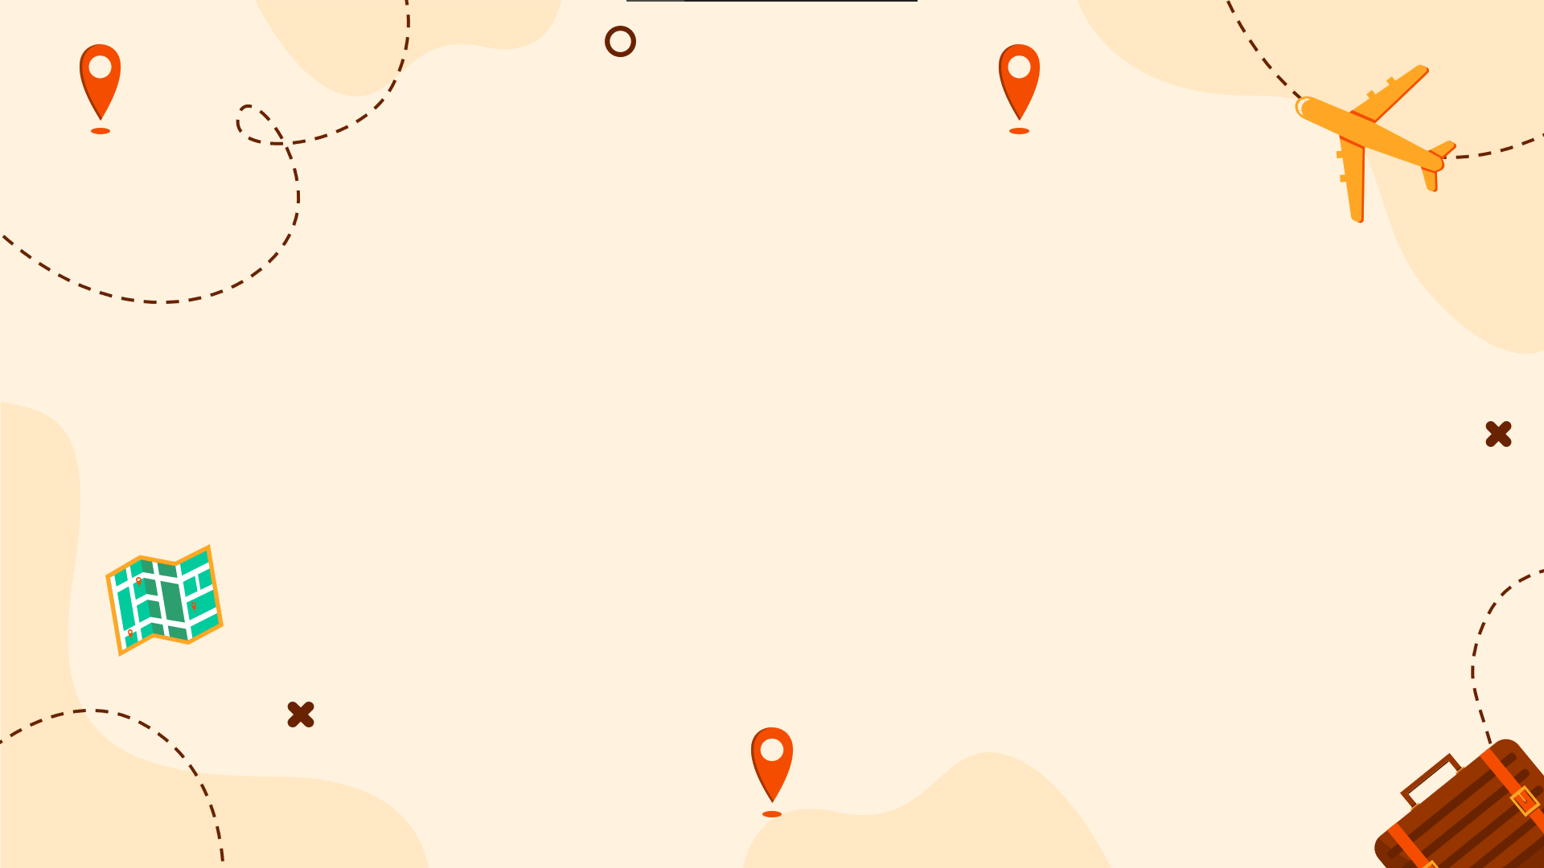
ABSTRACT
The rapid growth of legal documents such as contracts, statutes, case laws, and regulatory texts has created significant challenges for legal professionals in efficiently analyzing and retrieving relevant information. Traditional keyword-based search systems often fail to provide accurate and context-aware answers. This project presents a Legal Document Analysis and Question Answering System using Retrieval-Augmented Generation (RAG) framework, which combines advanced information retrieval techniques with large language models (LLMs) to deliver precise, document-grounded responses. The system retrieves relevant legal text from a vector database and generates accurate answers along with references, ensuring reliability, transparency, and reduced hallucinations.

Slide 4
INTRODUCTION
Legal professionals handle vast volumes of unstructured legal text, making document review and analysis time-consuming and prone to errors. Artificial Intelligence (AI), particularly Natural Language Processing (NLP), has emerged as a powerful tool to support legal research and analysis. However, standalone language models may produce inaccurate or unverifiable information. To address these limitations, this project adopts a Retrieval-Augmented Generation (RAG) approach, which grounds the language model’s responses in retrieved legal documents. The proposed system allows users to ask natural language questions and receive accurate, reliable answers strictly derived from the provided legal corpus.

Slide 5
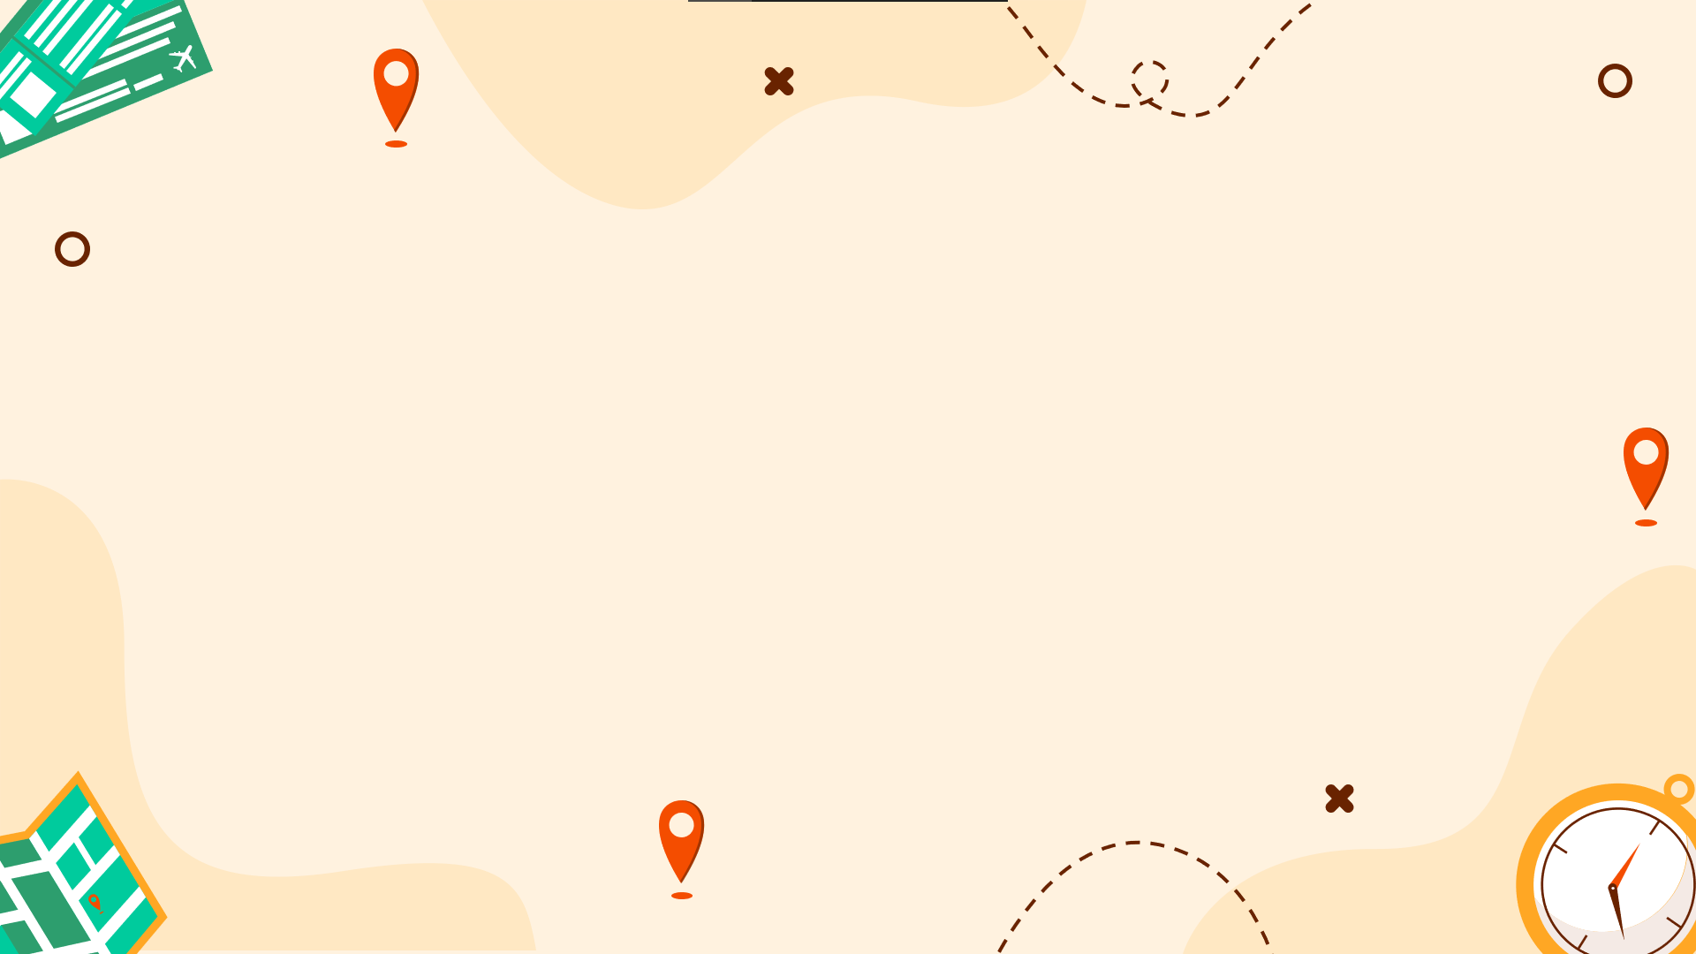
PROBLEM IDENTIFICATION
Existing legal search systems primarily depend on keyword-based matching and lack deep contextual understanding of legal language. Additionally, general-purpose AI models may generate hallucinated or incorrect legal information, which is unacceptable in the legal domain. Therefore, there is a critical need for a system that can understand legal terminology and document structure, retrieve relevant legal clauses or sections, and generate accurate, explainable, and traceable answers grounded in authoritative legal sources.

Slide 6

PROPOSED SYSTEM
The proposed system consists of the following stages:
Document Ingestion: Legal documents are uploaded into the system and processed for analysis.
Text Preprocessing and Chunking: The documents are cleaned and divided into meaningful chunks, such as clauses or sections, to preserve legal context.
Embedding Generation: Each text chunk is transformed into vector embeddings using a transformer-based language model.
Vector Database Storage: The generated embeddings are stored in a vector database to enable efficient similarity-based retrieval.
Retrieval Module: Based on the user’s query, the system retrieves the most relevant document chunks from the vector database.
Answer Generation: A large language model (LLM) generates accurate answers using the retrieved contextual information.
User Interface: Users interact with the system through a simple and intuitive web-based interface.

Slide 7
Technologies Used
Programming Language: Python
Frameworks: LangChain / LlamaIndex
Embedding Models: OpenAI Embeddings / Sentence Transformers
Vector Database: FAISS / ChromaDB
LLM: GPT-based or open-source LLMs
Backend: FastAPI
Frontend: Streamlit / React

Slide 8
THANK YOU

