Slide 1

Cyber Industry Analytics Dashboard
Traceability Matrix & Application Validation
Presented by: Team 17/ Group Members:
Sujan Buddha
Sai Krishna Teja
Gunnam Pavan
Suneel Kumar Vikas Reddy
Due Date: 04/22/2025

Slide 2
Project Overview
Objective: To analyze cybersecurity job data using visual insights.
Dataset Source: Synthea-generated job dataset
Platform Used: Power BI
Goals:
Help users explore job trends, salaries, skills, and employment patterns
Provide accurate, filterable, and validated visual reports

Slide 3
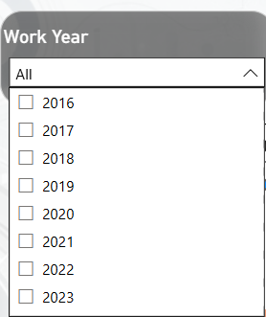
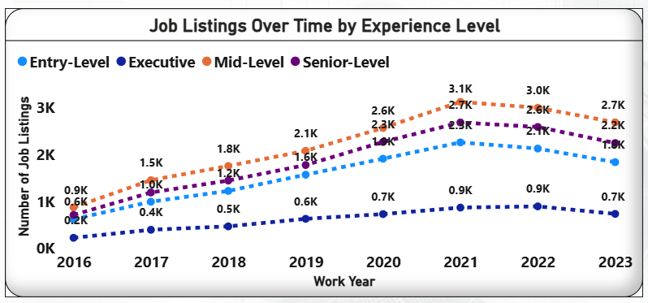
Requirement– Track Cybersecurity Job Trends
Requirement: Track cybersecurity job trends over time
Information Used: Count of job listings per year
Power BI Visual: Line chart
Validation: Cross-checked job_id counts grouped by year from the dataset

Slide 4
Requirement– Compare Job Types by Experience Level
Requirement: Compare job types by experience level
Information Used: Experience level field in job listings
Power BI Visual: Line chart grouped by Entry, Mid, Senior, Exec
Validation: Verified correct categorization and mapping to chart groupings

Slide 5
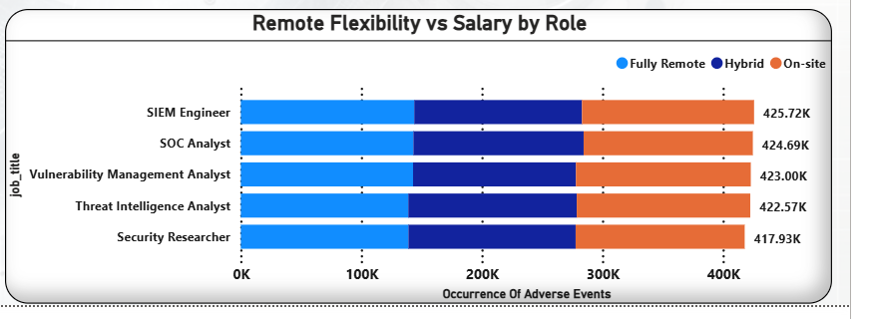
Requirement– Compare remote work opportunities
Requirement: Compare remote work opportunities
Information Used: Remote ratio (0, 50, 100)
Power BI Visual: Stacked bar chart by remote ratio
Validation: Use legend to verify remote levels are mapped properly

Slide 6
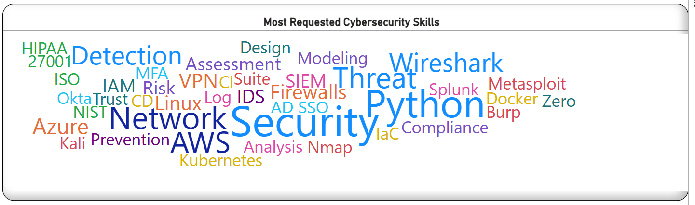
Requirement– Highlight skill demand across job titles
Requirement: Highlight skill demand across job titles
Information Used: Skills column from the dataset
Power BI Visual: Word cloud visualization showing most common skills
Validation: Cross-check word cloud entries with the required_skills column in the dataset to ensure accuracy

Slide 7
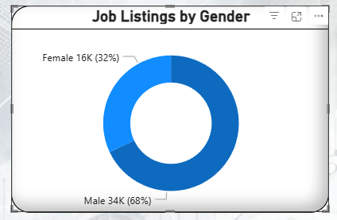
Requirement– Understand job listing patterns by gender
Requirement: Understand job listing patterns by gender
Information Used: Gender field simulated from job_id
Power BI Visual: Pie chart and clustered bar chart by gender
Validation: Validate gender distribution vs. calculated column

Slide 8
Validation Summary
Manual checks performed using raw Synthea data
Ensured alignment between visualizations and dataset values
Dropdown filters and slicers tested for dynamic behavior
Validation performed per requirement as per traceability matrix

Slide 9
Conclusion
Dashboard meets key analytical needs for cybersecurity job insights
Fully interactive and validated using real data
Future additions: predictive modeling, industry benchmarking

