Slide 1
GUARDIANNET
DONE BY:
SRADDHA V
SRISUJAN VM

Slide 2
Alignment with United Nations SDG Frameworks
SDG 5: Gender Equality — Lowers structural transit vulnerabilities for women, directly expanding safe access to nighttime workspaces, education, and public infrastructure.
SDG 11: Sustainable Cities & Communities — Builds reliable, distributed safety infrastructure by integrating automated, community-driven volunteer networks directly into municipal transit corridors.
SDG 16: Peace, Justice & Strong Institutions — Combines end-to-end local encryption (AES-GCM-256) with a 7-day automated cache purge cycle to fully isolate user privacy and prevent unauthorized data persistence.

Slide 3
The Manual Trigger Fallacy
The Structural Flaw: Current emergency apps rely entirely on manual user activation. They assume a victim can access their phone, unlock the screen, and press a button during an acute threat window.
The Reality Gaps:
Target Neutralization: In physical altercations, perpetrators actively target and compromise mobile devices first.
Human Operational Latency: Situational shock severely impairs fine motor control and processing speed.
Response Overhead: Traditional reactive security apps exhibit a dispatch delay exceeding 6 minutes.

Slide 4
Introducing the Guardian Band Ecosystem
The Paradigm Shift: Moving away from human-dependent manual alerts into a zero-touch, autonomous protection loop.
Core Capabilities:
Continuous Passive Monitoring: Low-power edge frameworks run non-intrusively in the background without draining battery life.
Context-Aware Autonomy: The system evaluates threat profiles based on behavioral data, completely removing human error or panic from the alert trigger chain.
Instant Multi-Tiered Dispatch: Alerts deploy instantly the precise millisecond combined risk metrics cross critical thresholds.
Visual Directive: Feature a clean mockup of the circular wearable device interface displaying the pulsing "SOS ACTIVE" core text to establish immediate product context.

Slide 5
Dual-Engine Predictive Inference Matrix
Spatial Pathing Engine: Maps travel routes using an on-device Hidden Markov Model (HMM) and Isolation Forest algorithmAcoustic Processing Core: A minimized neural network running on the device edge. It filters urban ambient background noise to isolate human distress signatures and vocal altercations strictly within the 3.0 kHz to 4.5 kHz spectrum.
Dynamic Risk Aggregation: Triggers emergency workflows automatically when a weighted multi-factor calculation combines kinetic impact, path deviation, and acoustic validation to exceed a threshold of ≥0.75

Slide 6
High-Load Decoupled Ingestion Pipeline
Edge Compute Layer: Maximizes processing speed and user privacy by executing raw acoustic parsing and kinetic threshold filtration directly on the client device.
Transient Stream Grid: Manages continuous tracking updates from over 1,000,000 concurrent devices by routing logs through cloud ingestion queues into an in-memory Redis Enterprise Cluster, bypassing database bottlenecks.
Decentralized Mesh Communications: Writes permanently to Firestore NoSQL nodes only during active alert changes

Slide 7
Real-Time Location & Mesh Intelligence
The Live Control Plane: Demonstrating the end-to-end interface built on a responsive Leaflet GIS Dark-Tile Map Engine.
Active Telemetry Feed: Real-time tracking of exact GNSS coordinates, active satellite connections, and hardware recording states.
Live Mesh Verification Matrix:
Smartphone & Cloud Gateway: Secure Mesh Link Connected / Stable Ingestion Uplink
Police Control Desk: Threat Profile Dispatched & Actively Transmitting
Civic Responders: Verified Volunteers actively tracked within the intercept geofence area.
Project link:

Slide 8
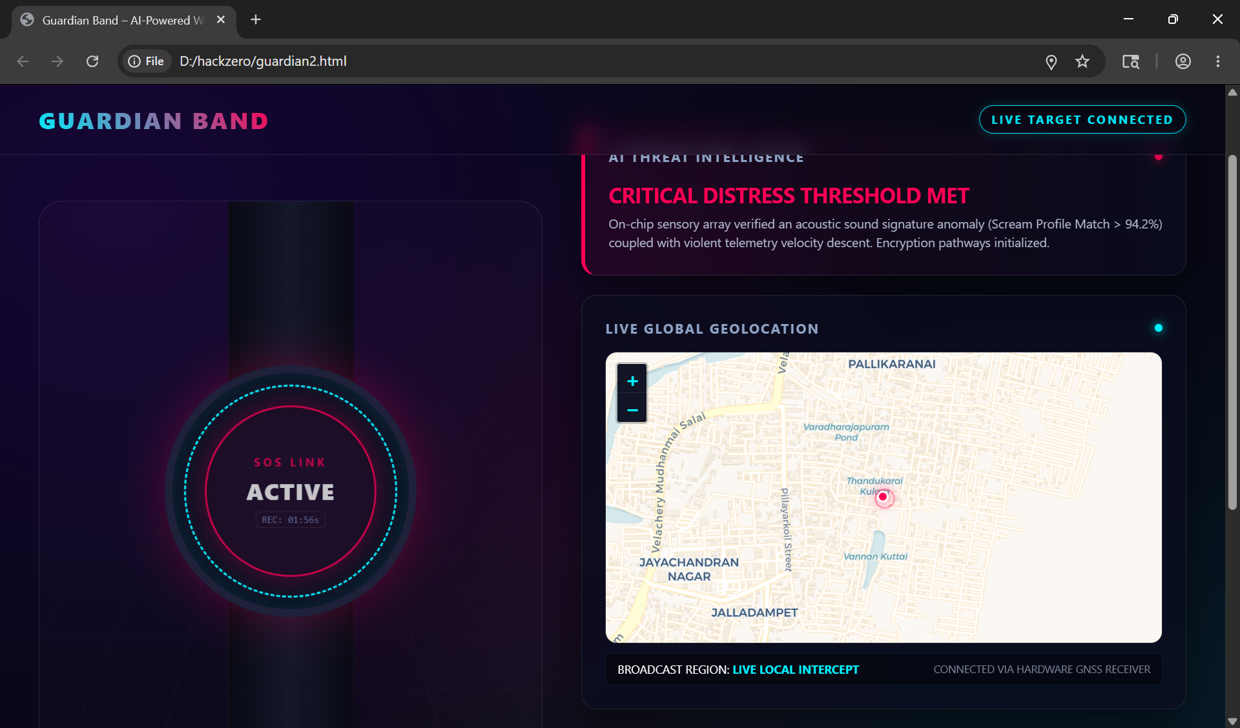
OUTPUT IMAGES

Slide 9
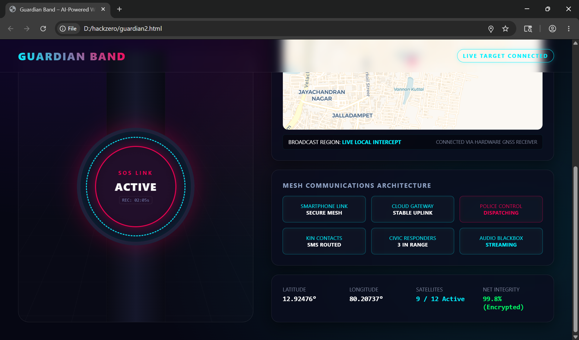
OUTPUT IMAGES

Slide 10
Conclusion
Our Core Mission: Establishing an intelligent, autonomous standard for personal protection that works independently of manual constraints.
Strategic Seed Allocation Requirements:
Expanding core technical teams (Edge Neural Engineering / High-Load GIS Data Infrastructure Systems).
Deploying regional police dispatch integration models and university campus pilot implementations.
Closing Statement: "We don't wait for a user to call for help—our technology responds when it matters most."

