Slide 1
NEPAL PHARMACY COUNCILL

Slide 2
UPDATES
New Design.
New Field Category in Registered Pharmacists and Assistants.
Better Data Management which ultimately leads to better experience.
Add Blogs and Event
Create New Pages all through admin page.

Slide 3
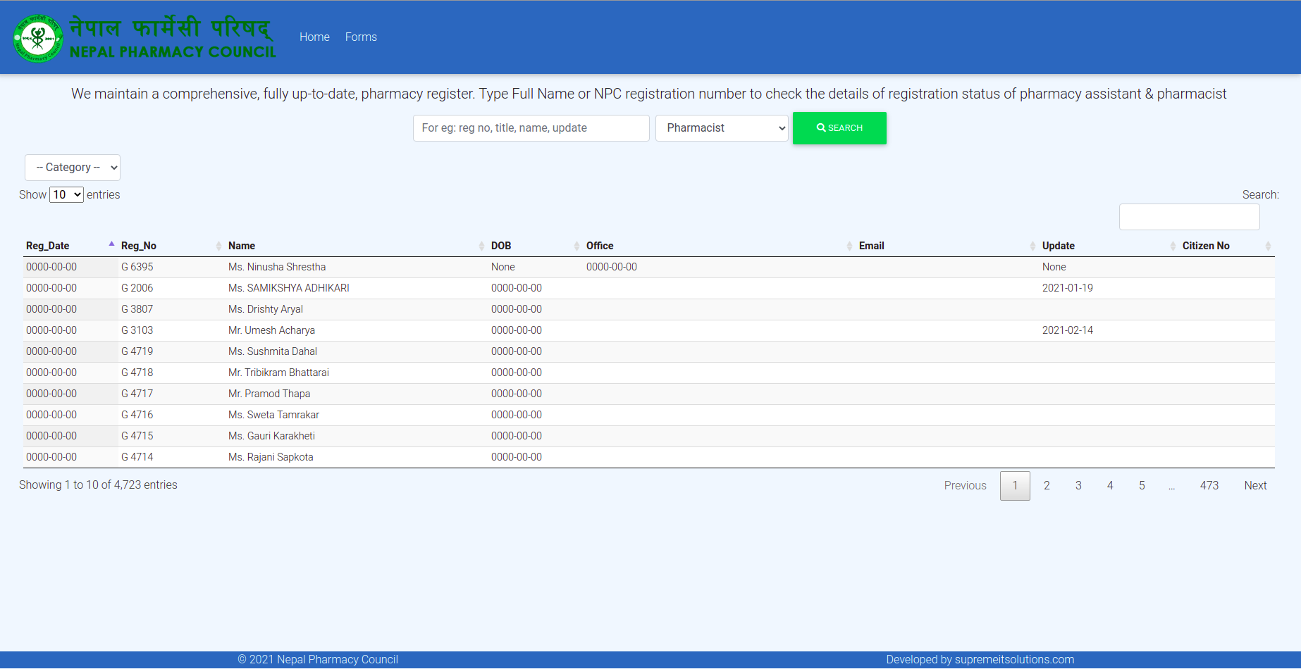

Slide 4


Slide 5
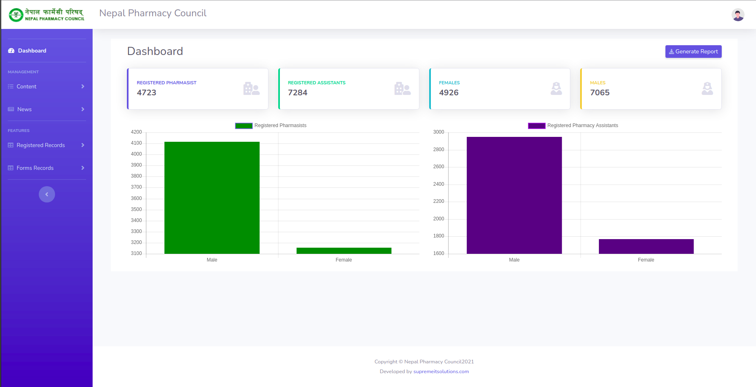
Dashboard

Slide 6
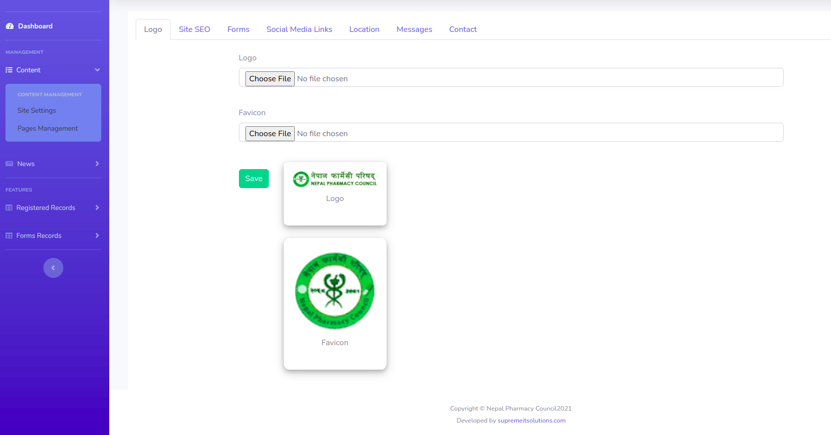
Site Management

Slide 7
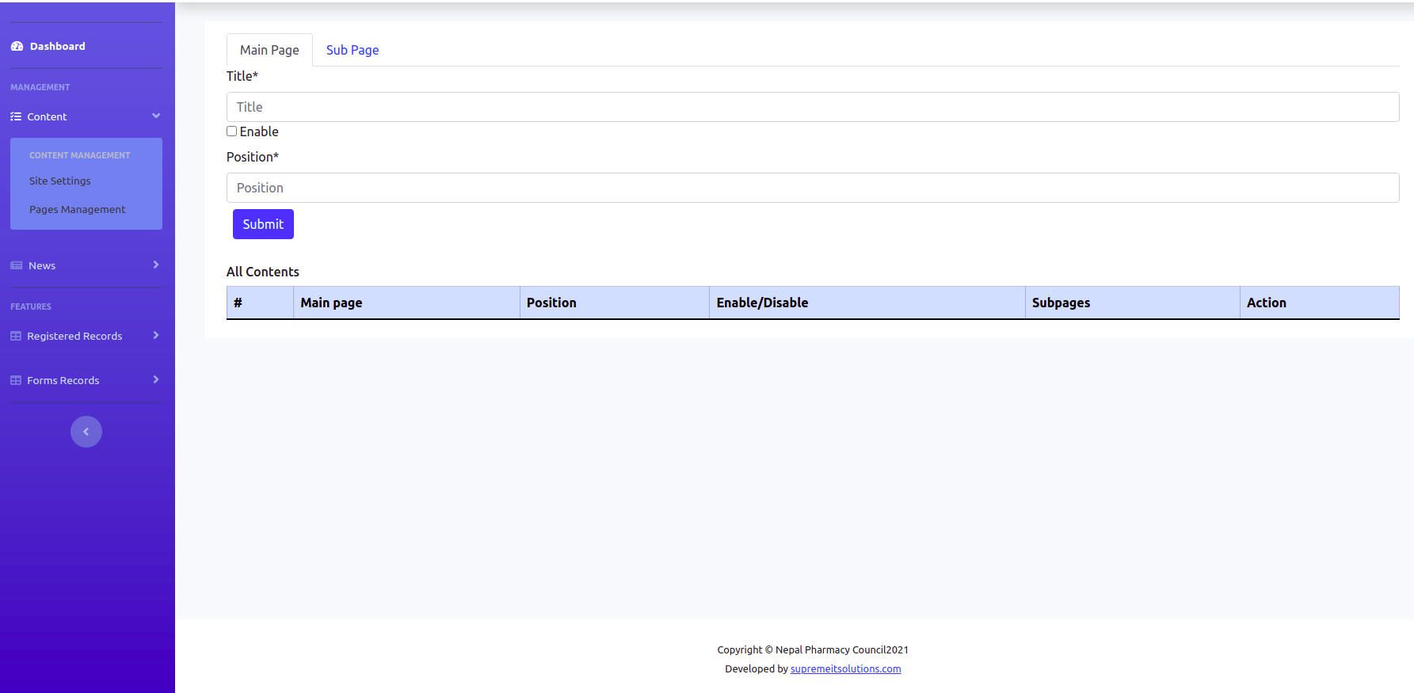
Page Managements

Slide 8
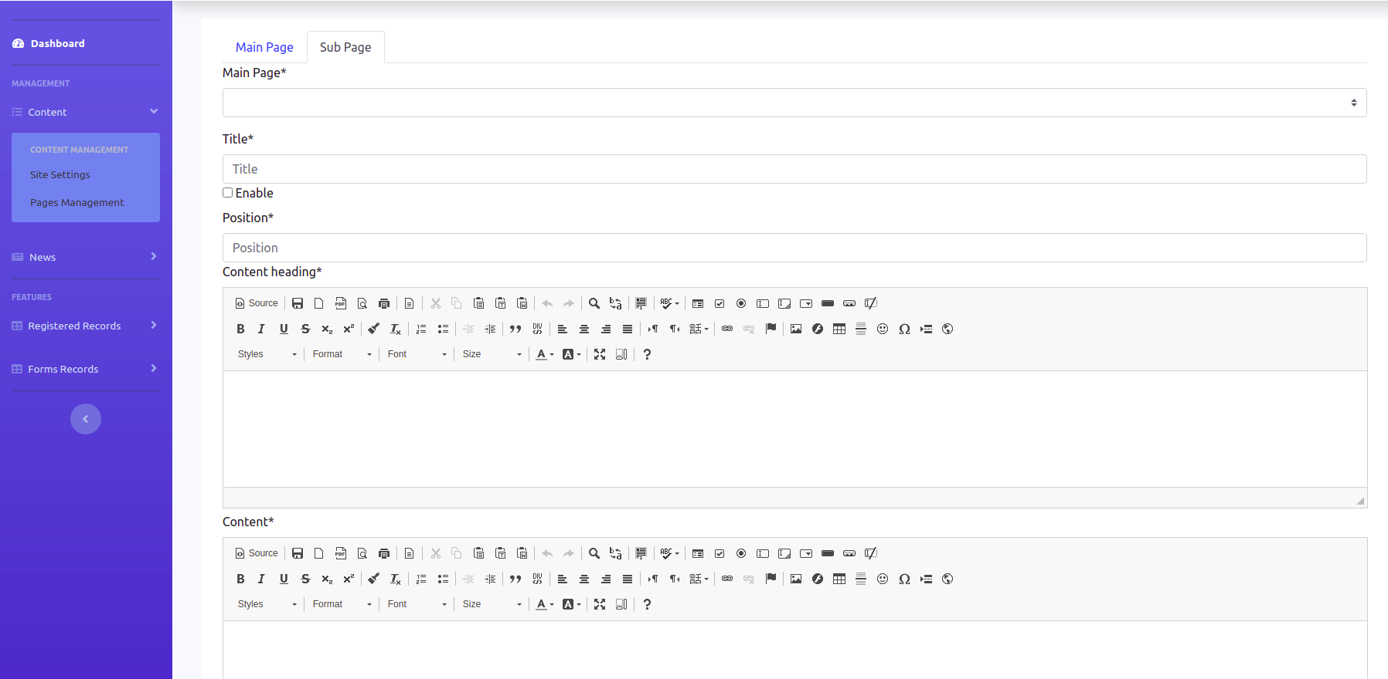
SubPage Managements

Slide 9
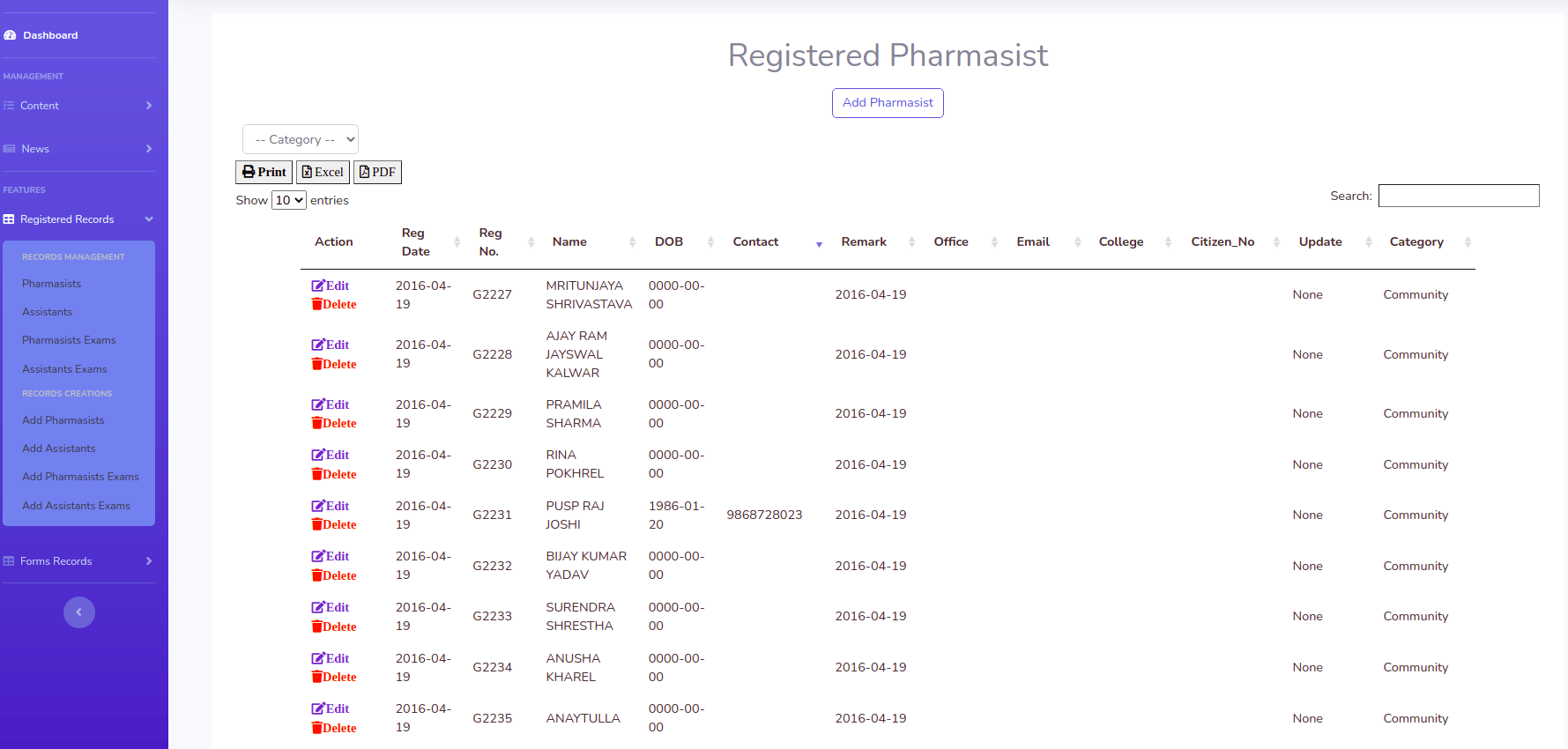
All Registered Records Views

Slide 10
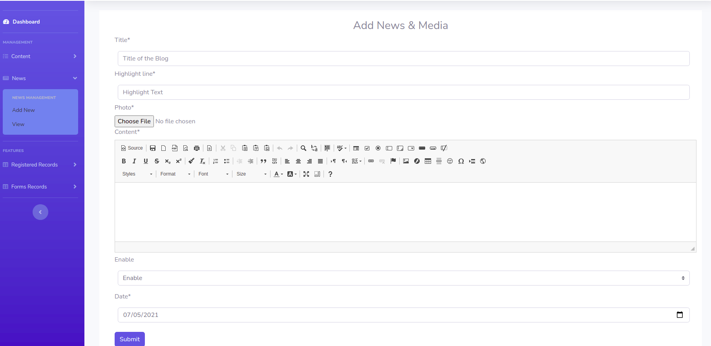
Blogs and Post Creations

Slide 11
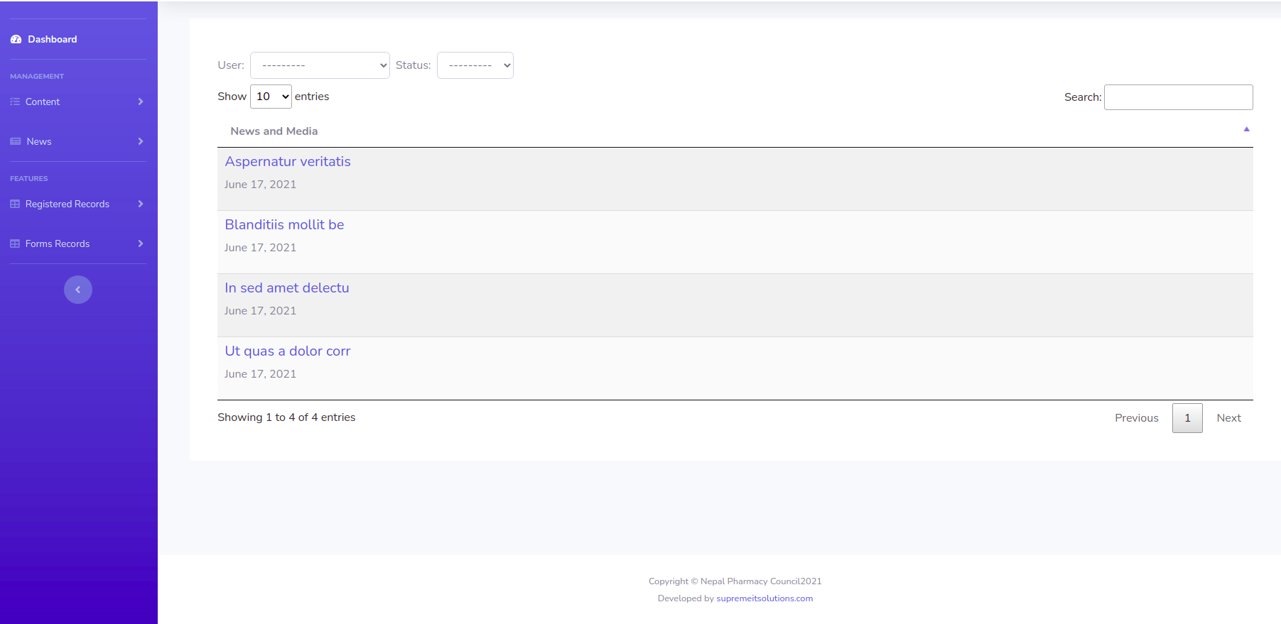
Blogs and Post Management

Slide 12
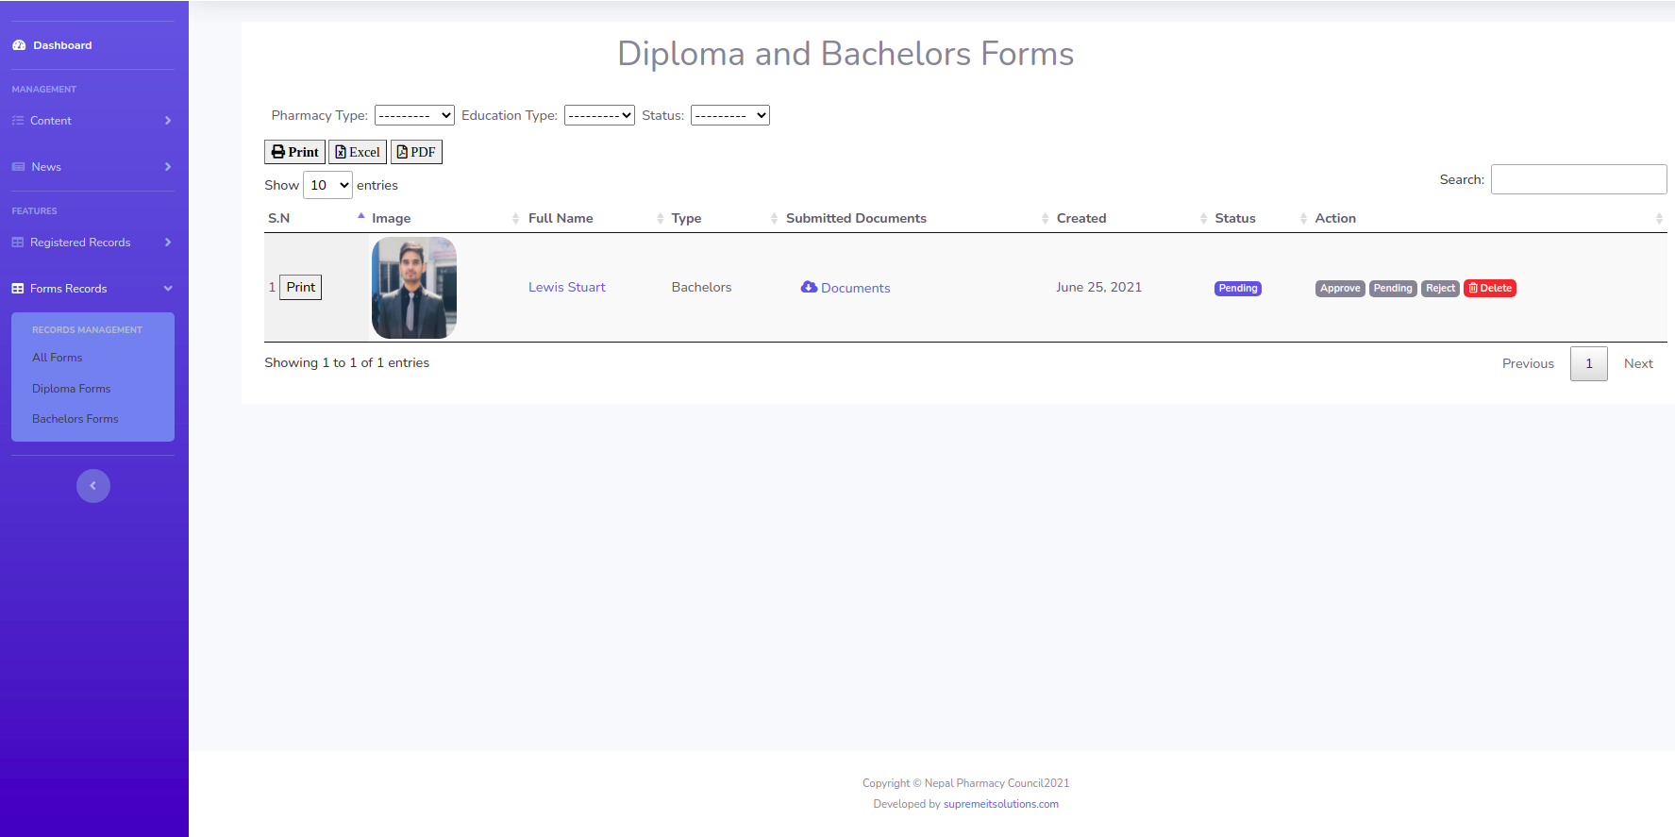
View / Edit Submitted Forms

Slide 13
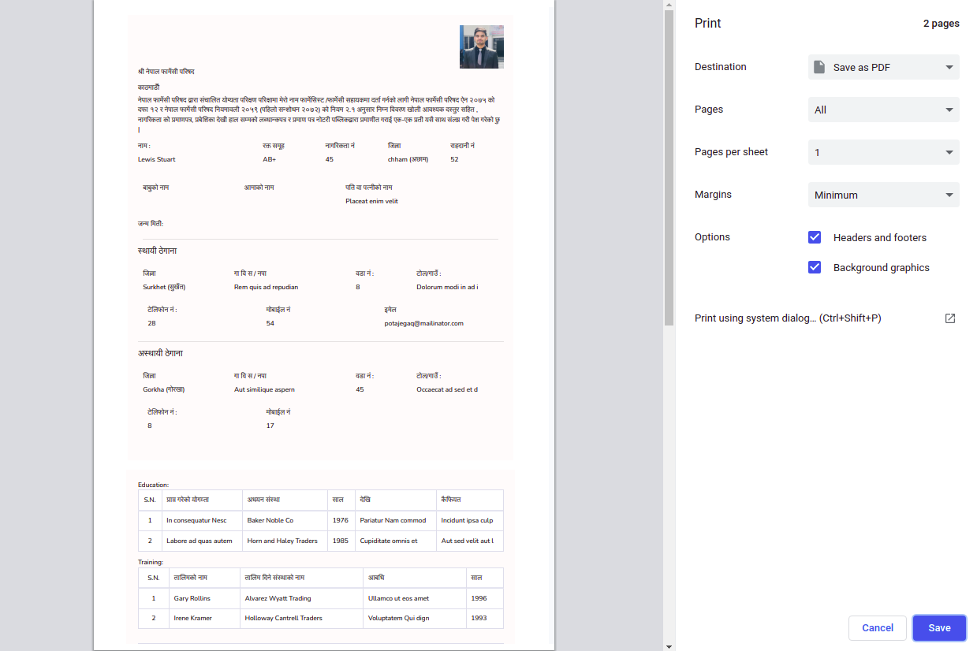
Form Details Print Page

Slide 14
THANK YOU

