Slide 1


DISTRIBUTED COMPUTER SYSTEMS CT024-3-3-DCOMS Online ordering system
Members:
Suman Paudel (NP000612)
Sujan Shrestha (NP000611)
Rashiv Singh (NP000603) Anup Panta (NP000562)
Lecturer:
Shambhu Gautam

Slide 2
Introduction
A multinational e-commerce company called CKF Group provides a wide range of well-liked products all over the world.
Rapid growth has exposed weaknesses in CKF's current Product Delivery System (PDS), raising issues related to security, scalability, and usability.
By utilizing Remote Method Invocation (RMI) technology in a Java-based Product Delivery System, CKF is addressing these problems. Client-server communication is secured using SSL/TLS.
By enhancing usability, scalability, and security, the new PDS aims to help CKF better satisfy customers and meet growing product demand.

Slide 3
Objective
To develop a more effective PDS for CFK that facilitates seamless communication between client and server applications.
To increase sales, streamline delivery processes, shorten delivery times, and expand into new markets.
To ensure client satisfaction, provide a dependable and user-friendly PDS.
Scope
This project's scopes are to develop as well as implement an improved Product Delivery System (PDS) through completion of project staged testing, development of a user-friendly solution, and use of technology to increase logistics.

Slide 4
Problem Overview
The current Product Delivery System at CKF has complex interfaces that make it difficult to operate, negatively impacting both customer satisfaction and internal productivity.
The present PDS's failure to keep up with the growth in market demand causes delivery delays and inventory management issues.
Orders are fulfilled slowly and incorrectly due to inefficiencies in the delivery process, which has an influence on overall operational performance.
CKF wants to address these challenges by developing a new PDS with an intuitive user interface, scalability, fast delivery operations, client account management, and comprehensive reporting using RMI and Java programming.

Slide 5
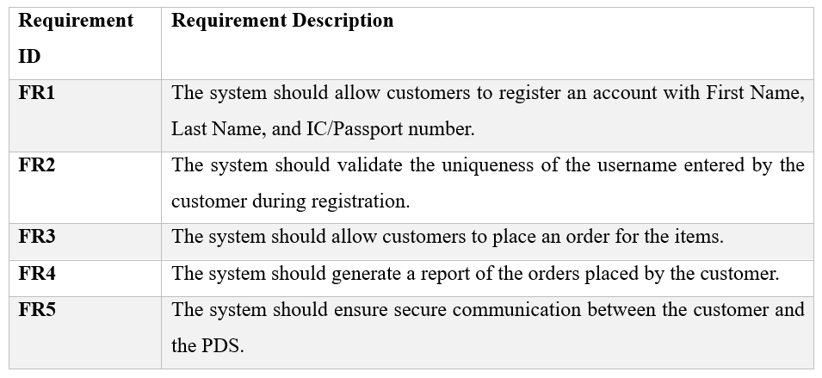
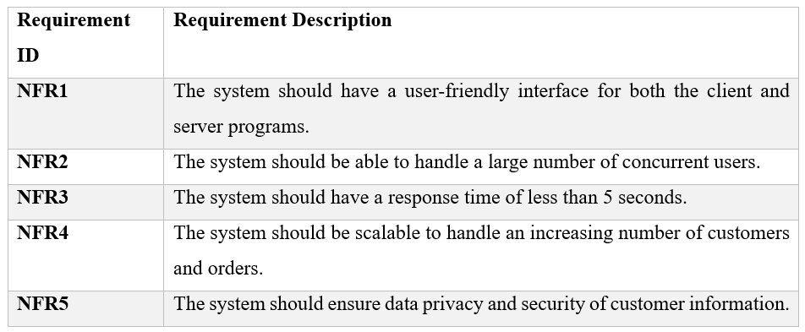
Requirements
Functional Requirement
Non-Functional Requirement

Slide 6
Research and Design
The group thoroughly outlined the needs for the new Product Delivery System using use cases and graphics.
Critical features and requirements were found through a careful examination, ensuring that the system meets the needs of both the company and its clients.
The team looked at a number of tools and technologies to ensure compatibility and dependability before deciding on Java and RMI.

Slide 7
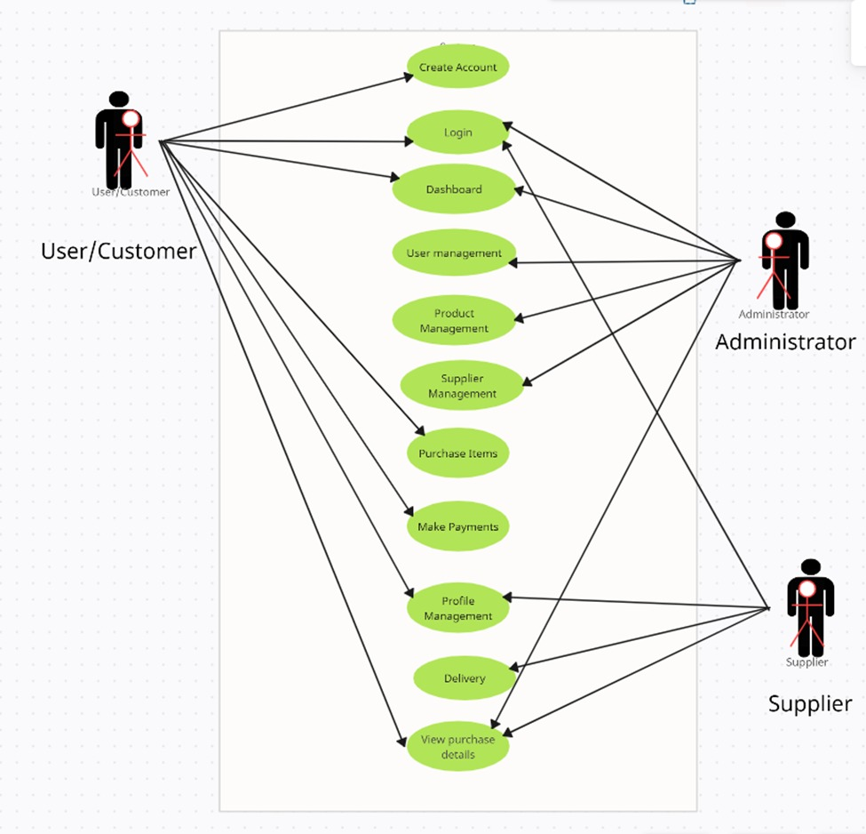
Use case Diagram

Slide 8
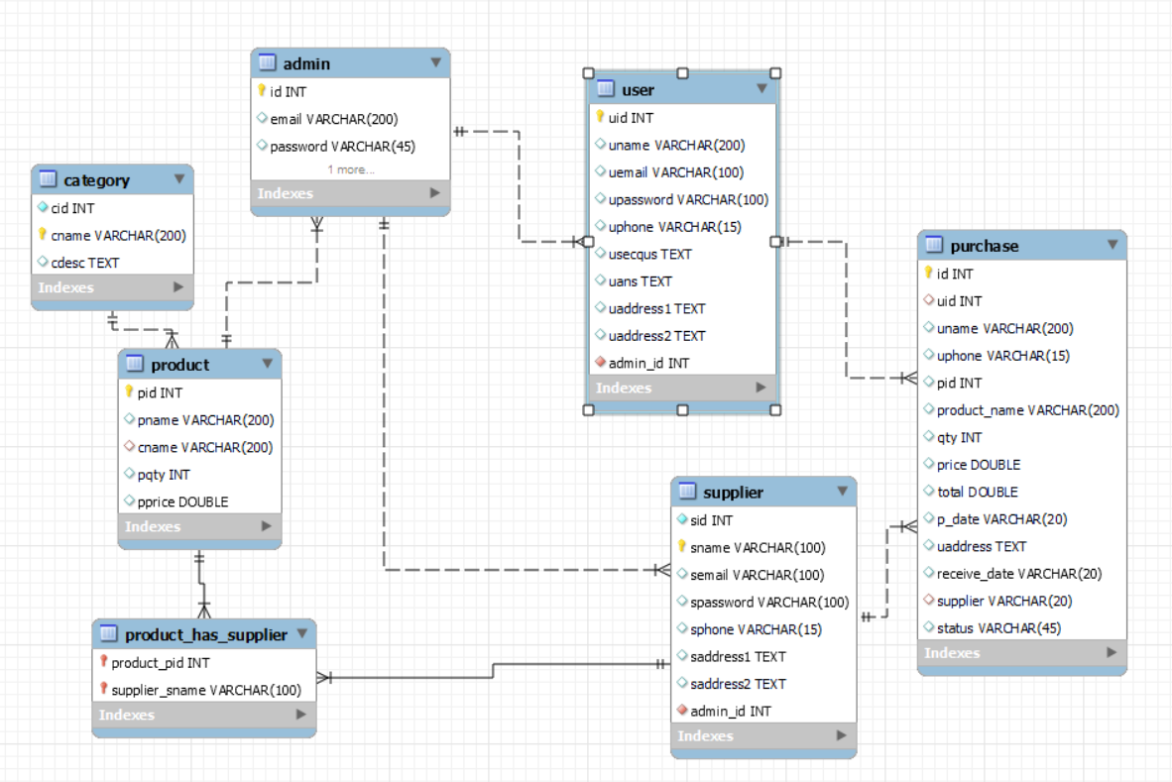
Schema Diagram

Slide 9
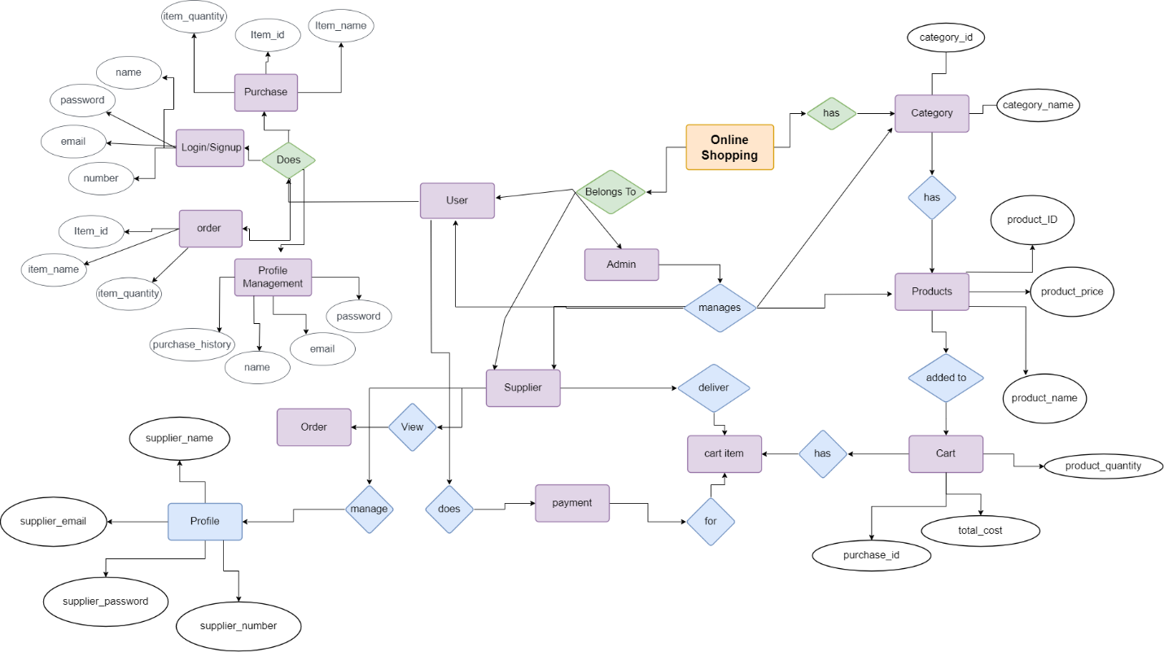
ERD

Slide 10
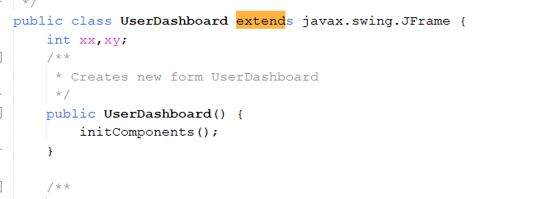
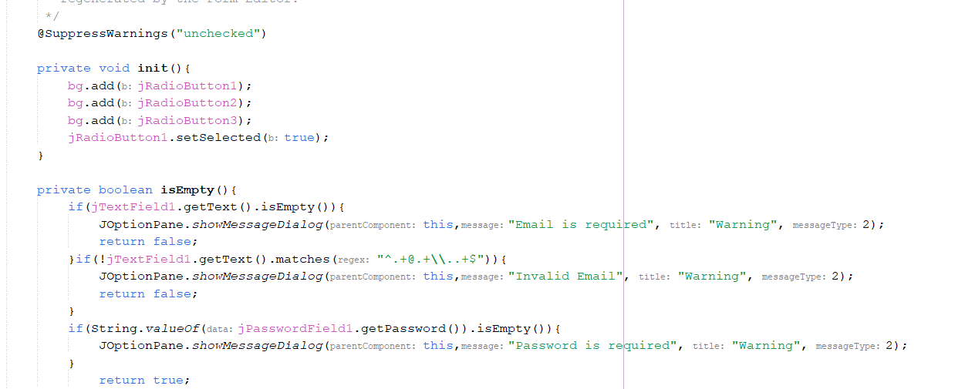
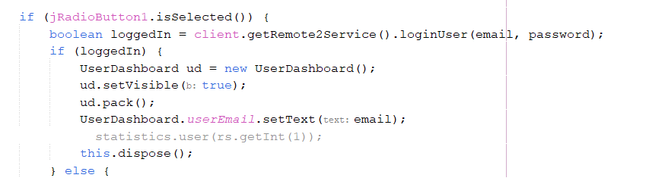
Object Oriented Programming
Encapsulation
Abstraction

Slide 11
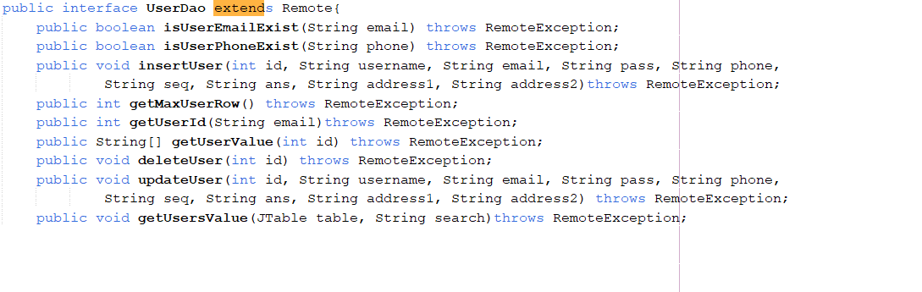
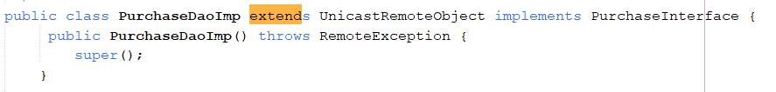
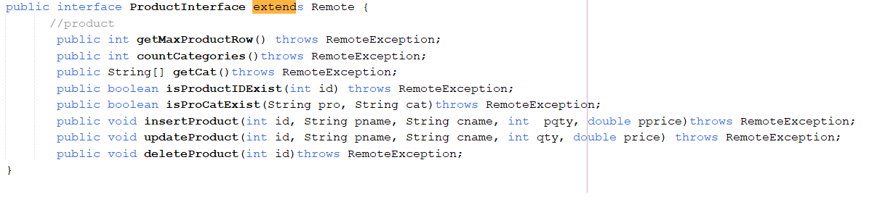
Object Oriented Programming
Inheritance
Polymorphism

Slide 12
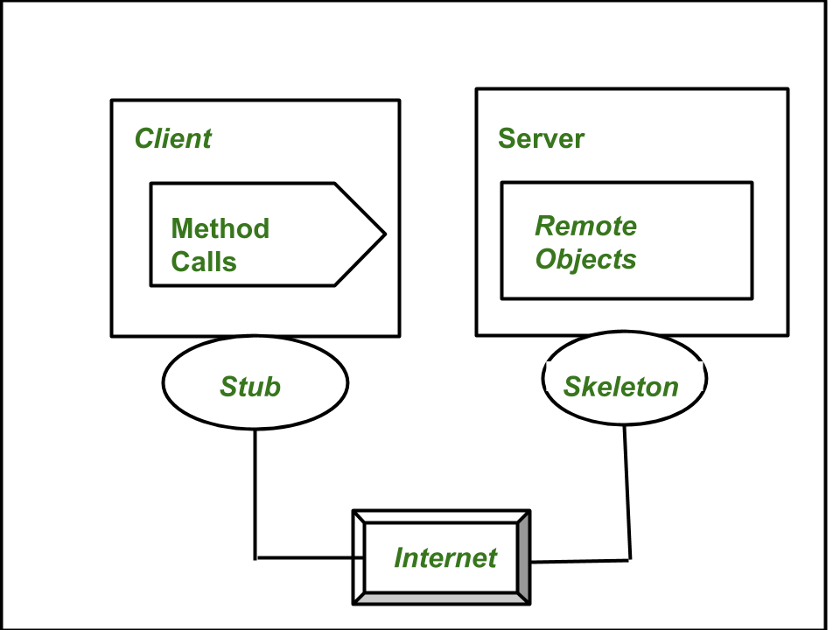
Implementation of Distributed Application

Slide 13
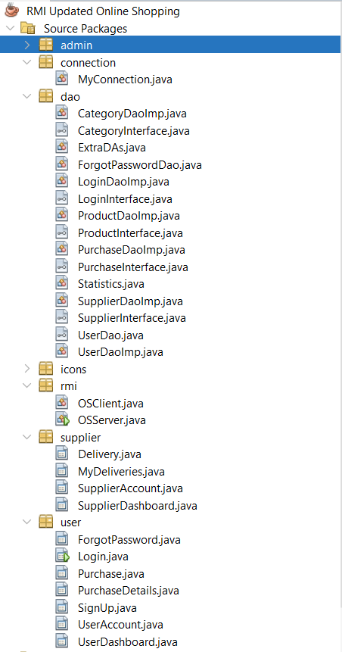
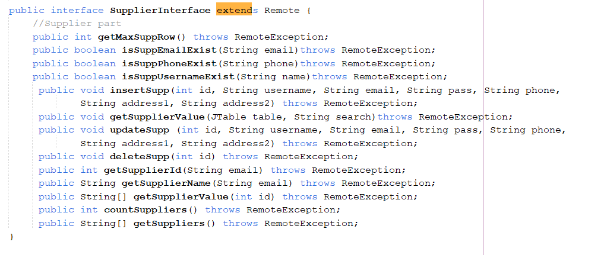
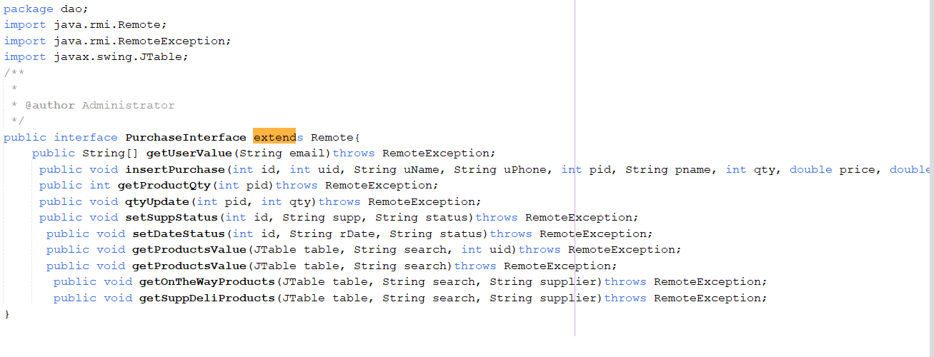
Implementation of Distributed Application
RMI Interface Implementation
Code Architecture

Slide 14
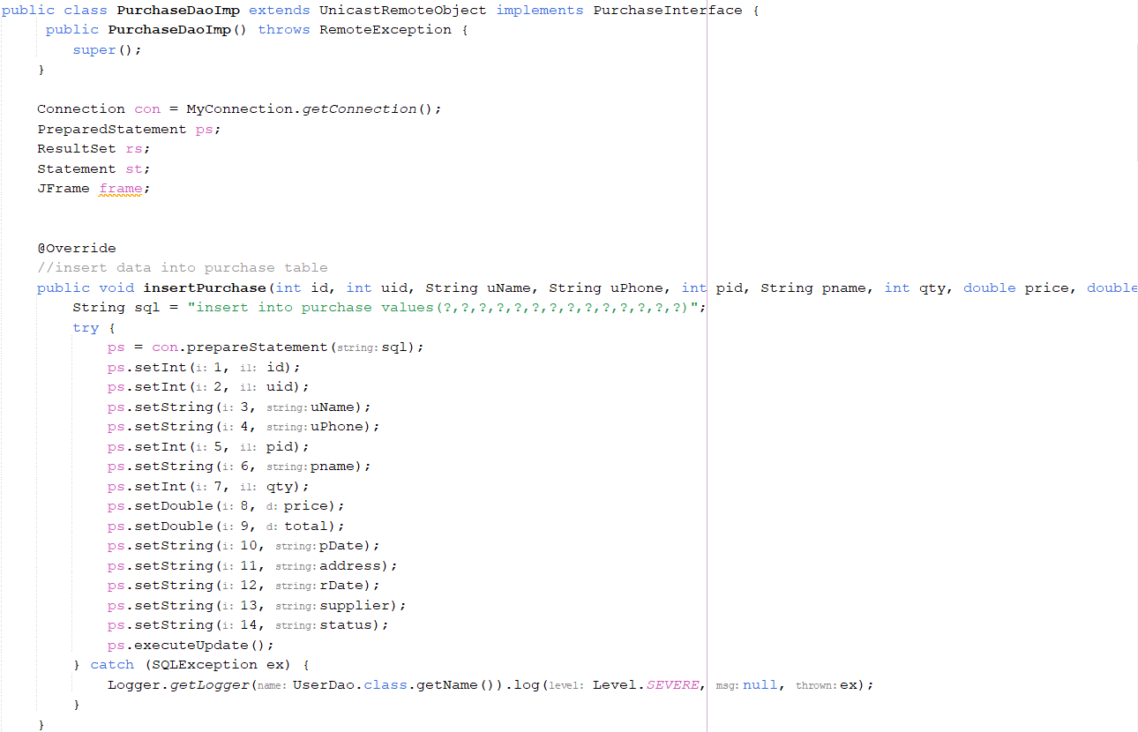
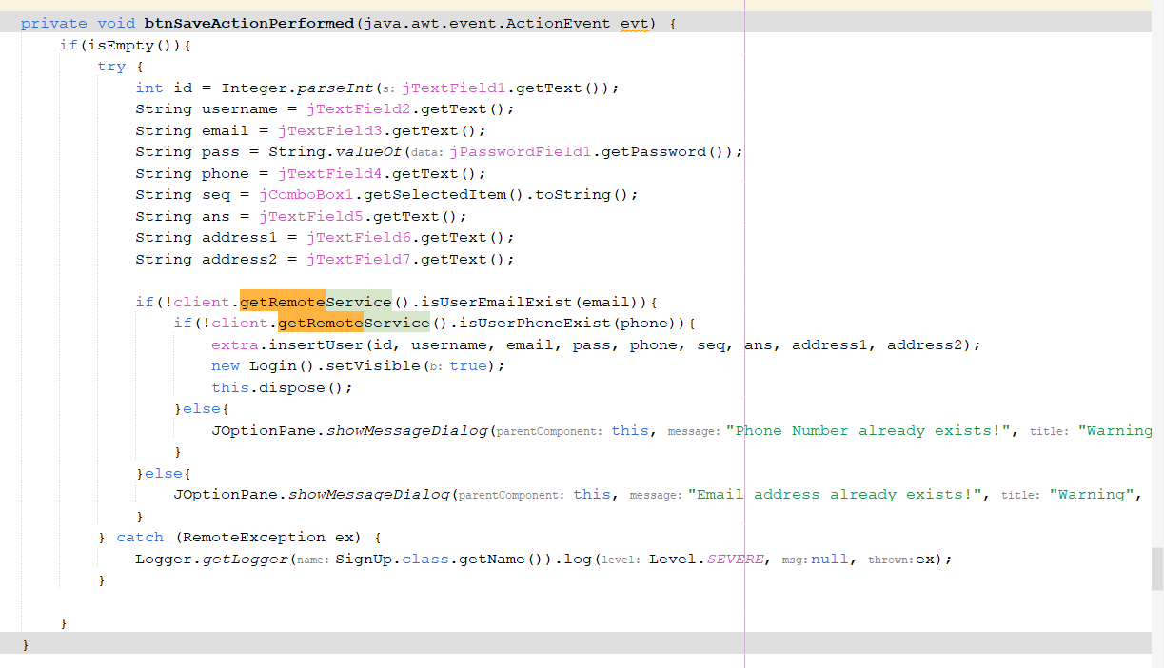
Implementation of Distributed Application
Implementation of RMI methods
Implementation of Remote Method

Slide 15
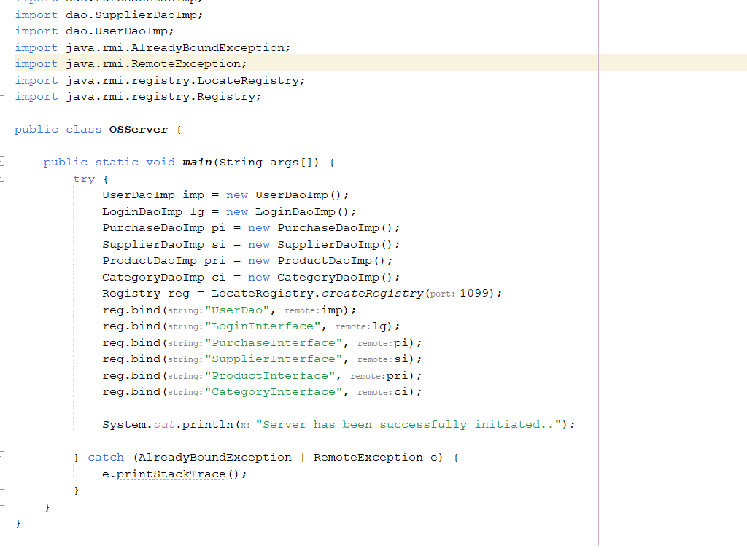
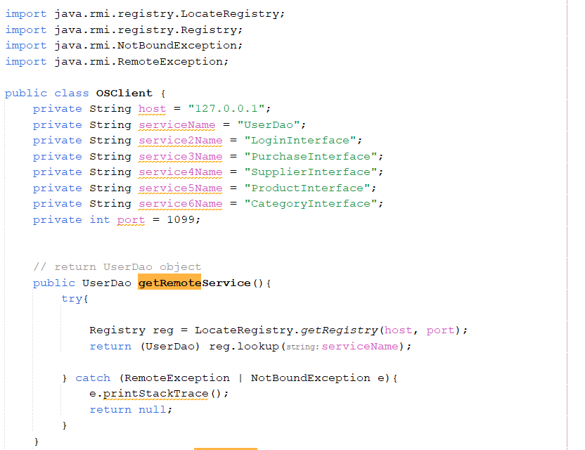
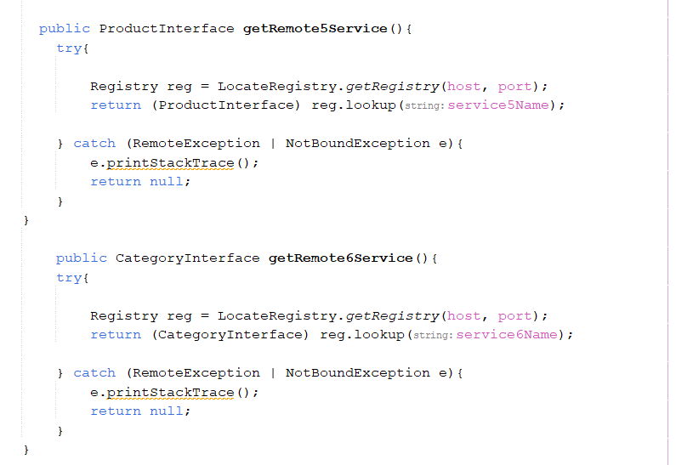
Implementation of Distributed Application
RMI Client Setup Code
RMI server setup code

Slide 16
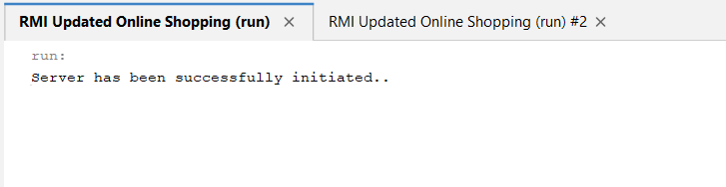
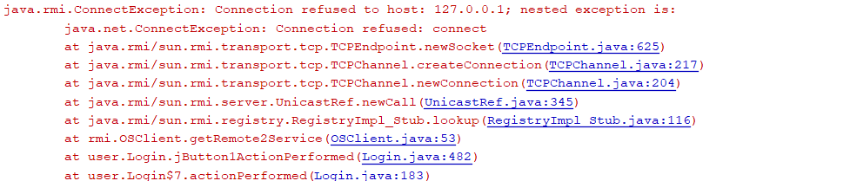
Implementation of Distributed Application
Server Initialization
Error Message if issue

Slide 17
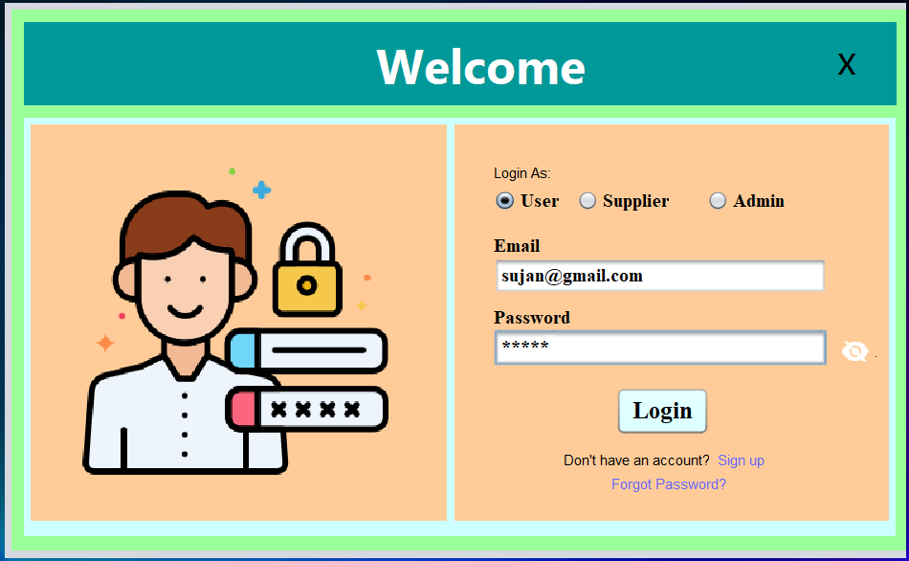
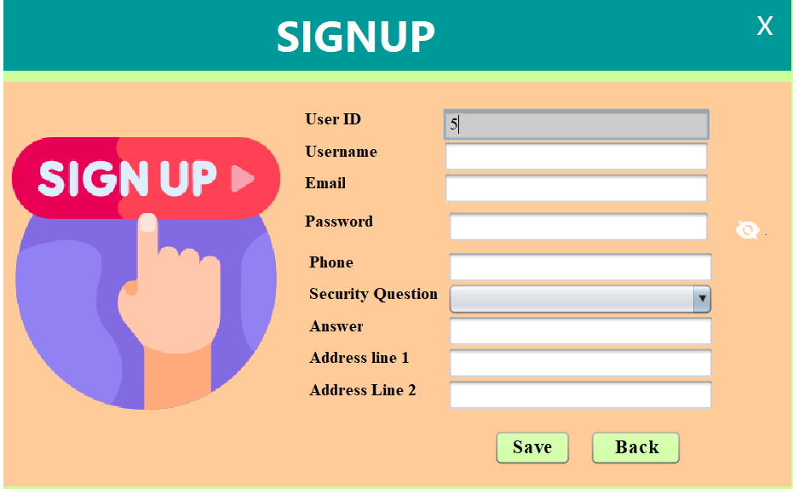
Graphical Interface
Login Interface
Signup Interface

Slide 18
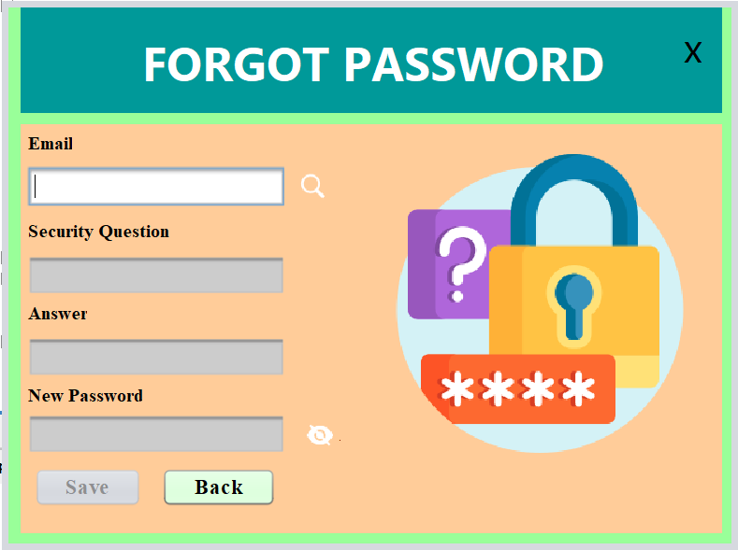
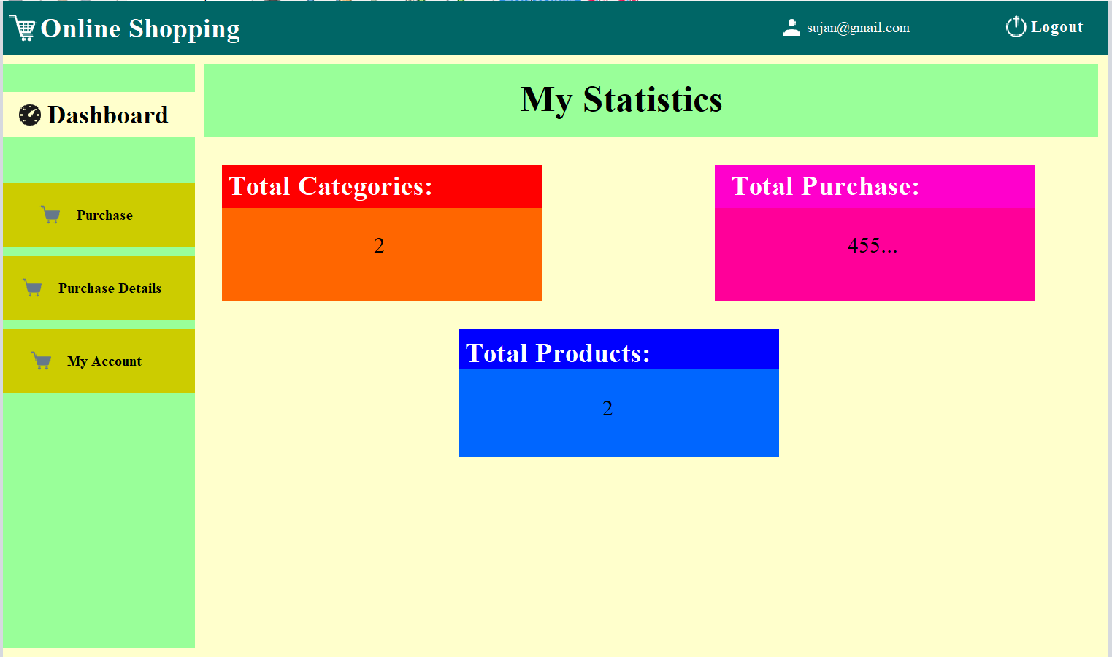
Graphical Interface
Forgot Password Interface
User Dashboard

Slide 19
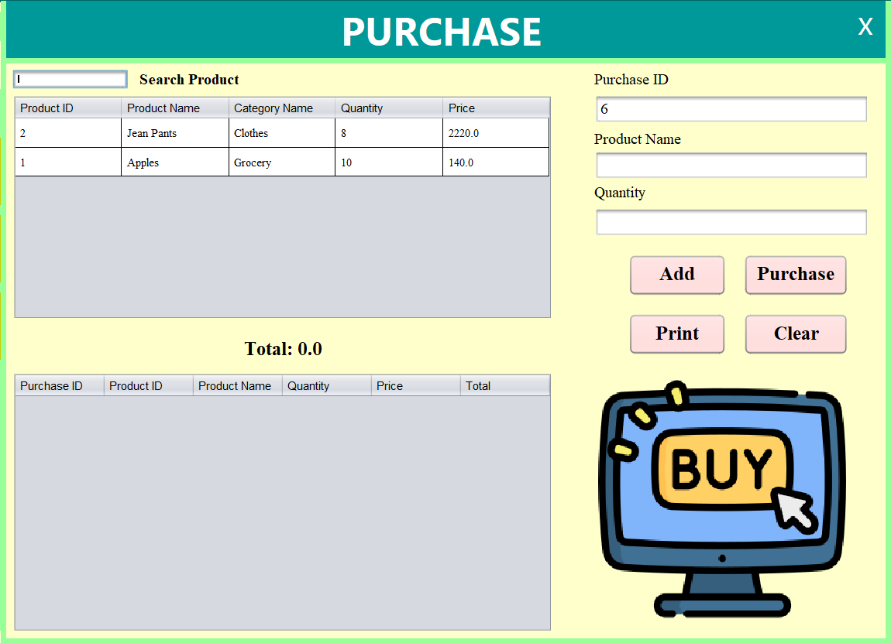
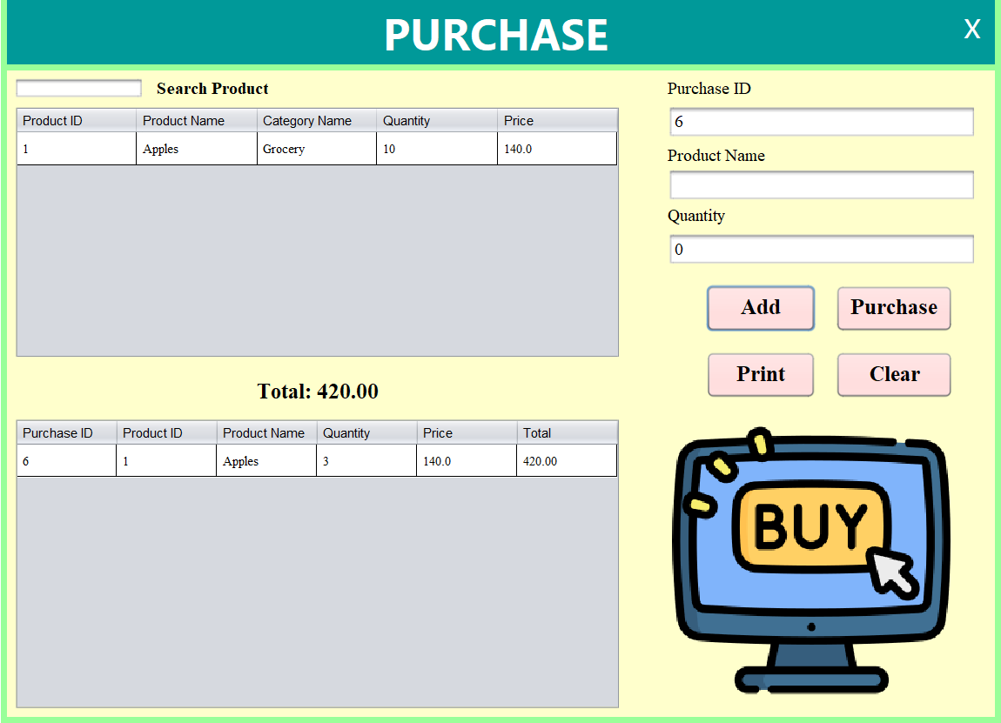
Graphical Interface
Purchase Item Interface
Purchase Item with Cart Table Interface

Slide 20
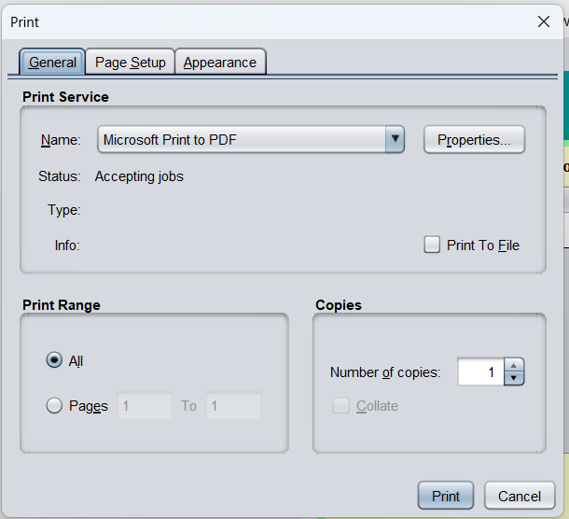
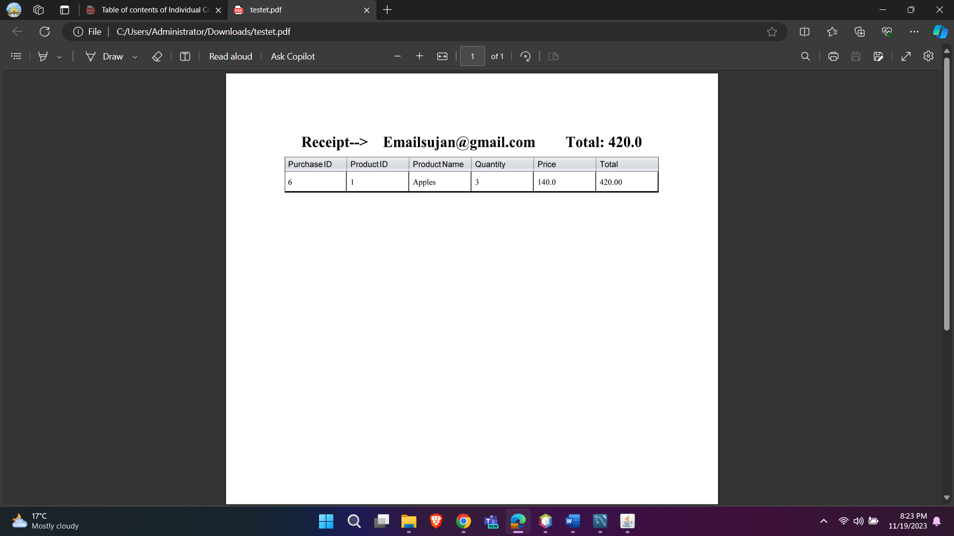
Graphical Interface
Receipt and Invoice interface
Receipt Generation Interface

Slide 21
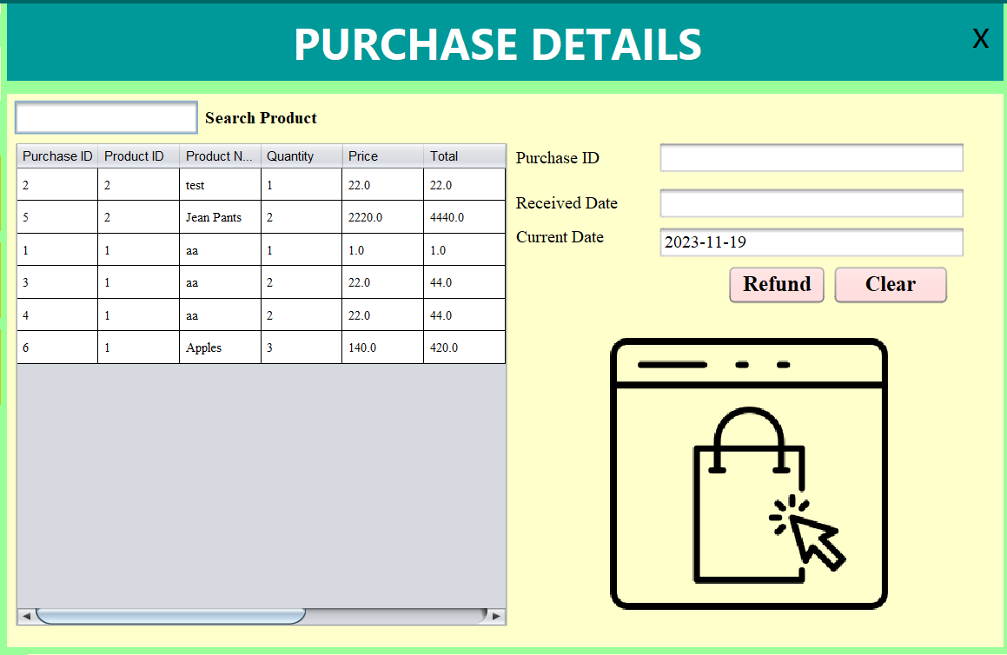
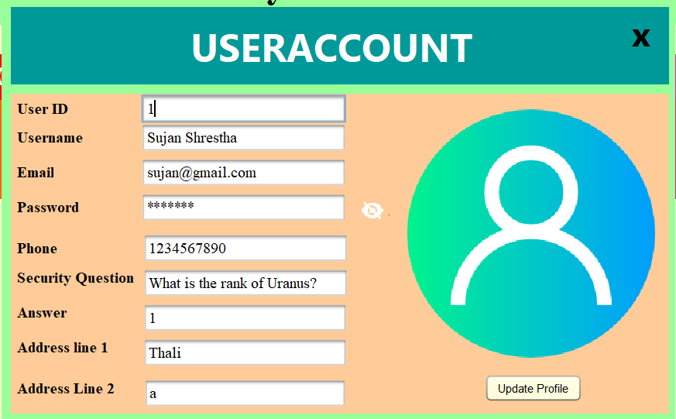
Graphical Interface
Purchase Details Interface
User Profile Management Interface

Slide 22
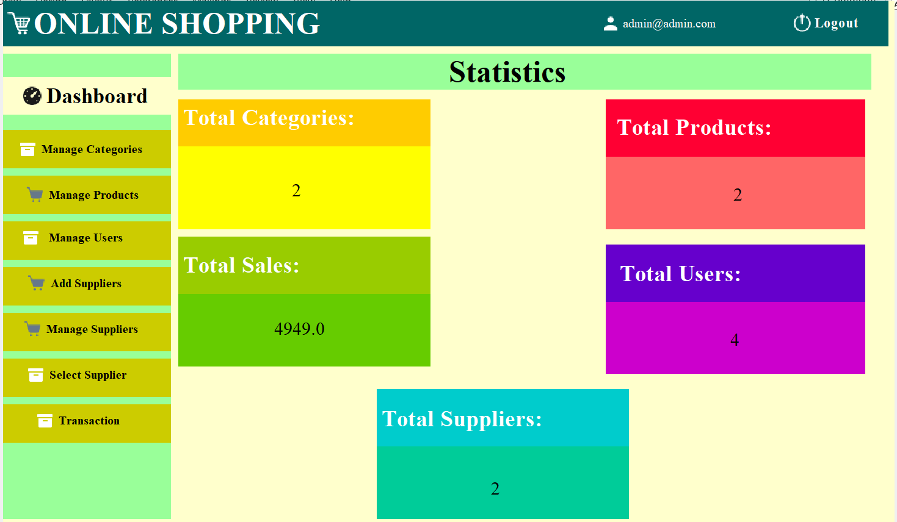
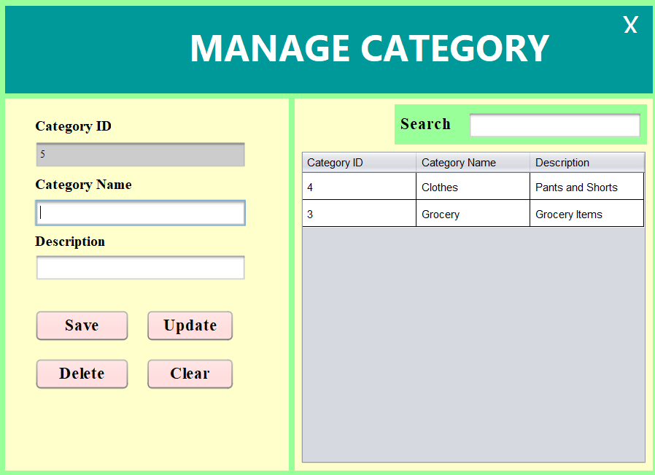
Graphical Interface
Admin Dashboard
Manage Category Interface

Slide 23
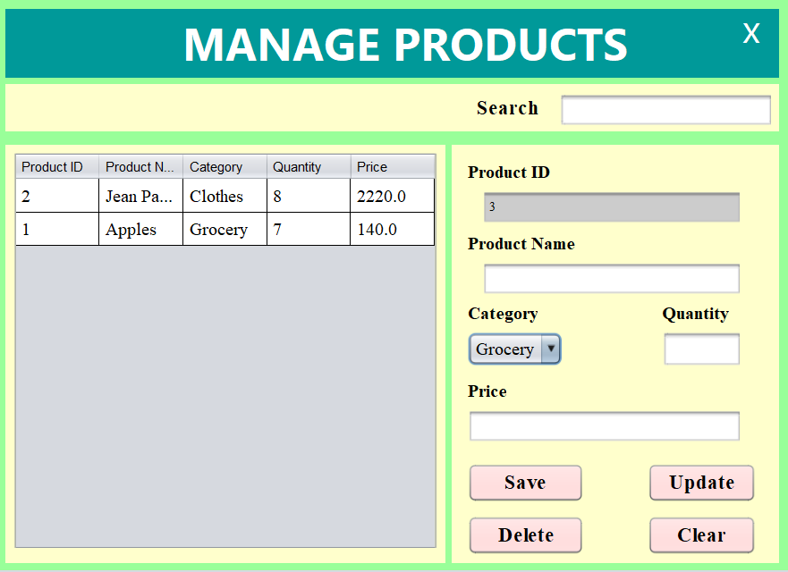
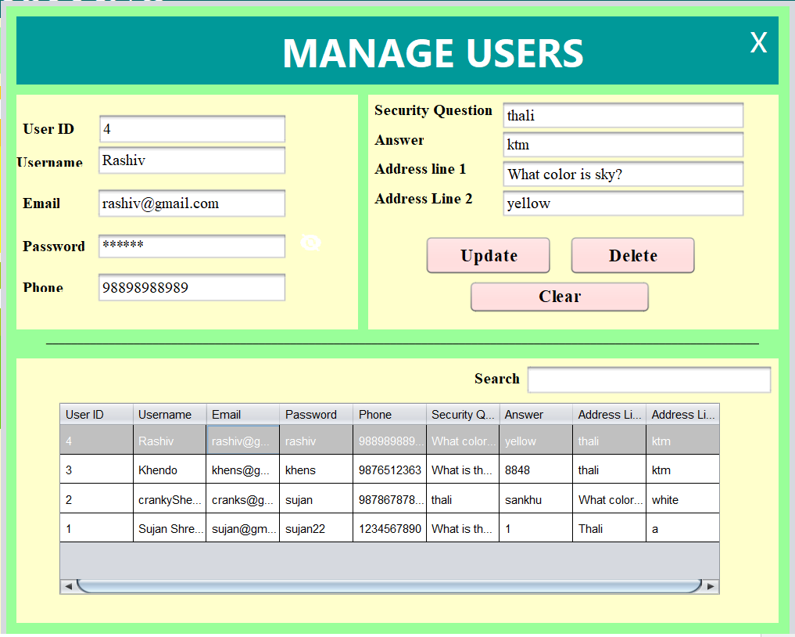
Graphical Interface
Product Management interface
User Management Interface

Slide 24
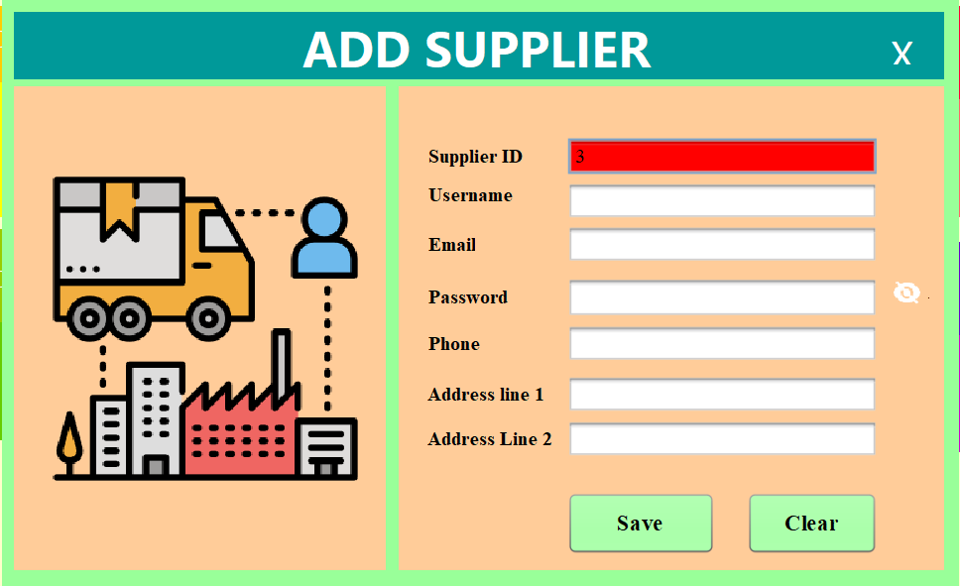
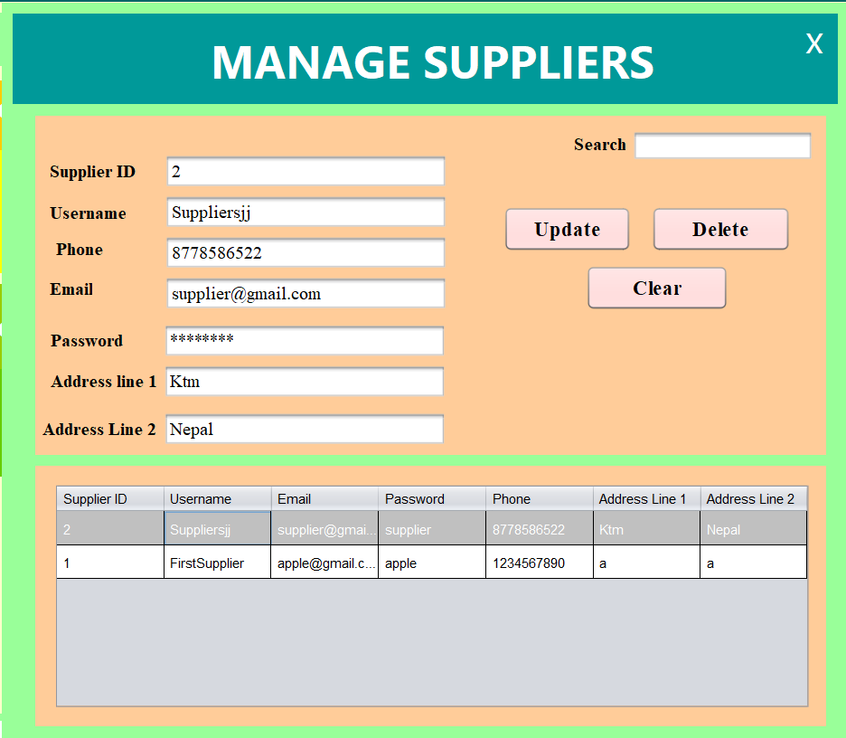
Graphical Interface
Add Supplier interface
Manage Supplier Interface

Slide 25
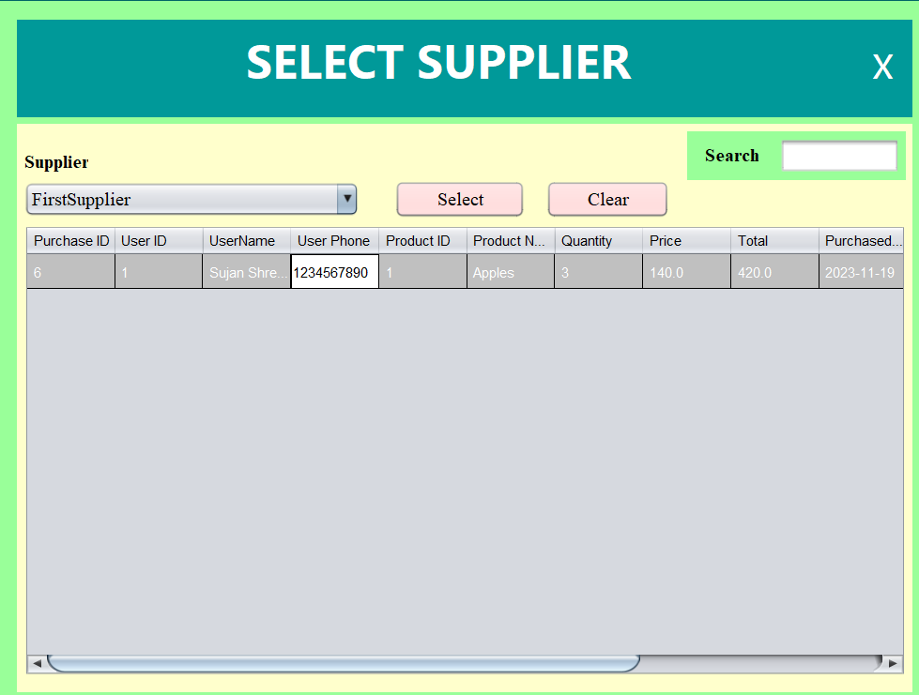
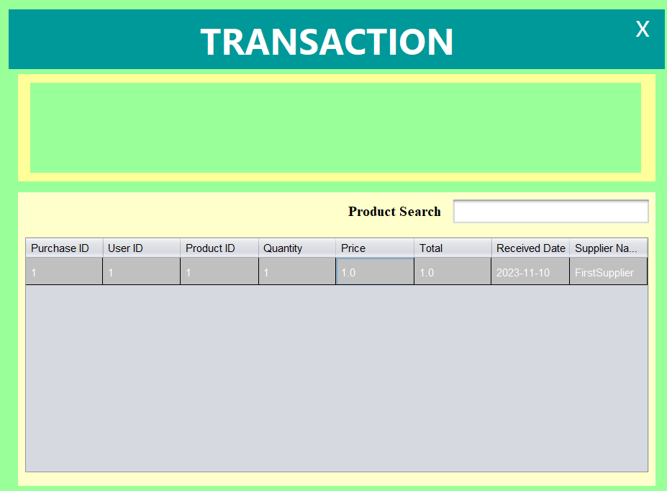
Graphical Interface
Select Supplier Page
Transaction View Page

Slide 26
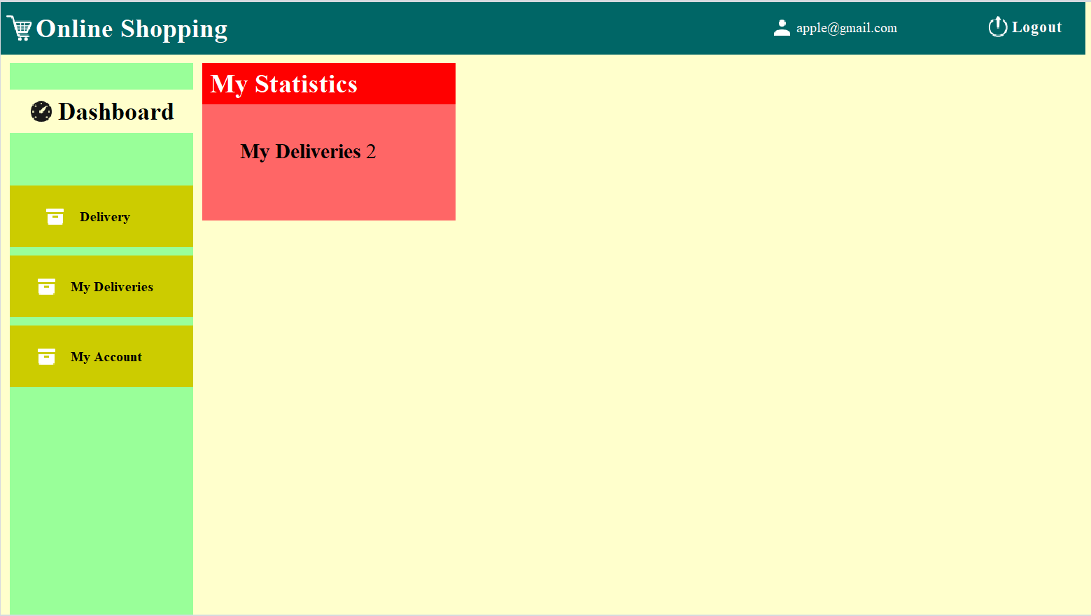
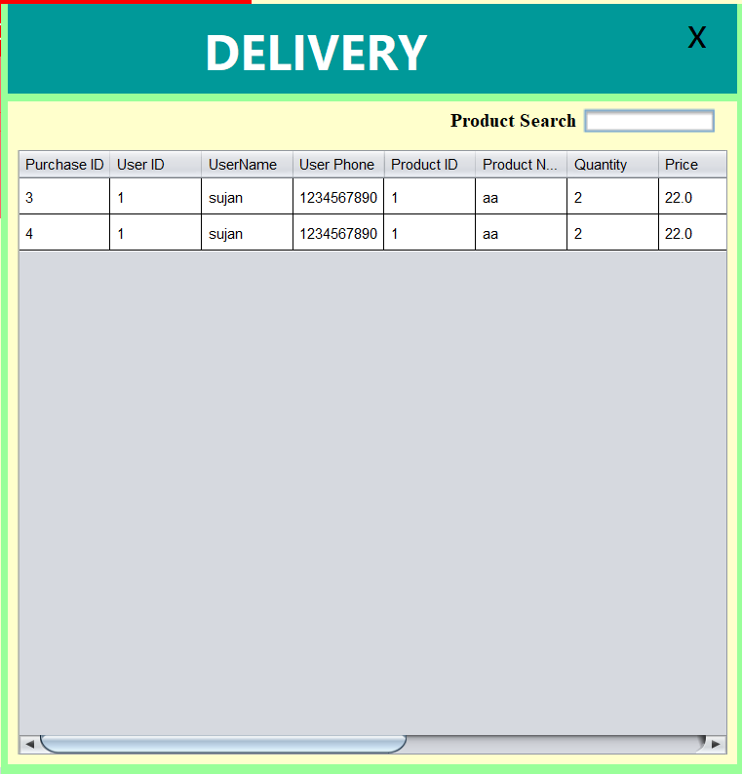
Graphical Interface
Supplier Dashboard
Delivery List and Confirmation Interface

Slide 27
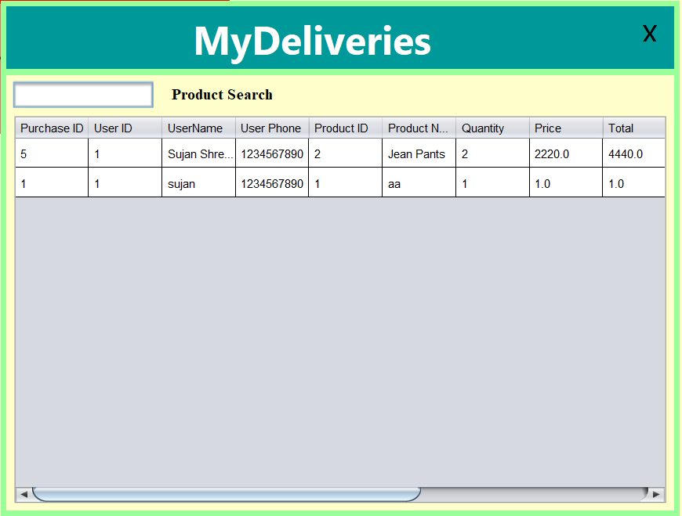
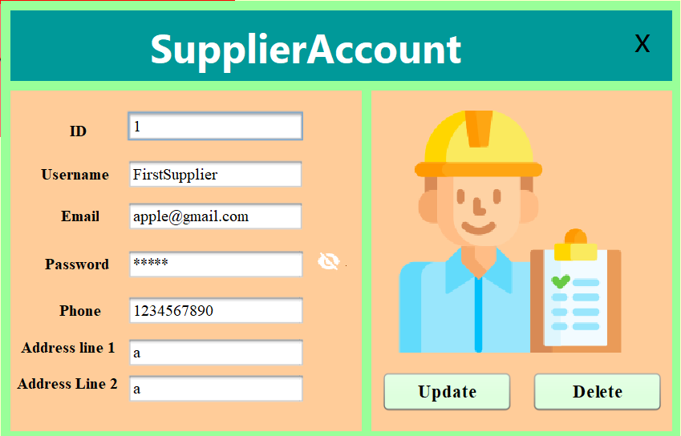
Graphical Interface
MyDeliveries details Interface
Supplier Account Management Interface

Slide 28
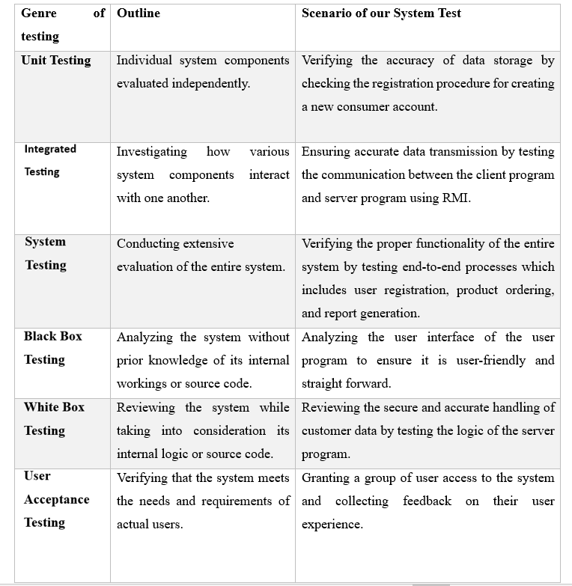
Testing

Slide 29
Relation: Distributed System and BlockChain
In order to improve fault tolerance and scalability, the CKF Product Delivery System (PDS) is a distributed system that interacts using Remote Method Invocation (RMI).
The PDS uses blockchain technology to encrypt data in transit, restrict unauthorized access, and provide security and transparency through its decentralized peer-to-peer network.
Smart contracts are built within blockchain technology, they allow for programmable and automated operations inside the PDS, which enhances security and efficiency in certain processes.

Slide 30
Conclusion
The project focused on developing and implementing a new Product Delivery System (PDS) in order to efficiently address problems with the current system.
Remote Method Invocation (RMI) and a distributed system architecture enhanced the PDS's scalability, fault tolerance, and user-friendly interfaces.
The confidentiality of critical data was protected by the use of SSL/TLS technology and a stringent registration procedure, enhancing system security overall.
The foundation for later advancements was laid with the advent of the Java programming language, which enhanced system adaptability by supporting both command line and graphical user interfaces.

Slide 31


