Slide 1


AUTOMATED INFORMATION EXTRACTION FROM MULTILINGUAL CV DOCUMENTS
Subject Code: CM461
Guided By:
Mr. K. V. Ranga Rao
Assistant Professor, CSE(AIML)
Presented By:
A. Sujana (Y22CM006)
J. Durga Prasad (Y22CM062)
G. Keerthi (Y22CM054)
DEPARTMENT OF COMPUTER SCIENCE AND ENGINEERING (AIML)
R.V.R & J.C COLLEGE OF ENGINEERING , CHOWDAVARAM, GUNTUR
MAY 2026

Slide 2
CONTENTS
INTRODUCTION
PROBLEM STATEMENT
LITERATURE SURVEY
RESEARCH GAP
PROJECT OBJECTIVES
PROPOSED METHODOLOGY
SYSTEM ARCHITECTURE
DUALMODEL ARCHITECTURE
ALGORITHMS USED
IMPLEMENTATION
TOOLS & TECHNOLOGIES
DATASET DESCRIPTION
RESULTS AND ANALYSIS
CONCLUSION
FUTURE SCOPE
REFERENCES

Slide 3
INTRODUCTION
In today’s digital era, organizations receive thousands of CVs for recruitment
Efficiently processing this data has become a major challenge
CVs are highly unstructured and vary in format and language
Manual screening is slow, inconsistent, and prone to errors
Information extraction transforms raw CV text into structured data
Key sections include Personal, Experience, Education, and Skills
The dataset shows higher frequency in Personal and Experience sections
Such imbalance influences model learning and extraction accuracy
This work aims to automate multilingual CV information extraction

Slide 4
PROBLEM STATEMENT
In today’s data-driven recruitment environment, efficiently processing large volumes of CVs has become a significant challenge. Resumes are inherently unstructured, making automatic extraction of relevant information difficult. Existing methods often provide limited support for multilingual data and fail to capture complete details accurately. Therefore, there is a need for a robust system that can automatically extract and organize CV information in a structured manner.

Slide 5
LITERATURE SURVEY
Reference Paper | Method Used | Year | Accuracy/ F1 | Strengths | Limitations
AI-Powered Automated Resume Screening and Job Matching System – Kumar et al., IEEE Transactions on Computational Social Systems | mBERT + XLM-RoBERTa + Similarity | 2025 | 91% Accuracy | Supports multilingual job matching and ranking | Focuses more on matching than deep extraction
Resume Information Extraction via Post-OCR Text Correction – Zhang et al., Expert Systems with Applications | Post-OCR + NLP Pipeline | 2023 | 85% F1-score | Handles noisy scanned CVs effectively | Depends on OCR quality
Resume Parser Using Hybrid Approach – Sharma et al., International Journal of Advanced Computer Science and Applications | Transformer + spaCy Hybrid | 2023 | 88% Accuracy | Combines rule-based and DL methods for robustness | Increased system complexity
Enhancing Human Resources Through Data Science – Singh et al., Journal of Big Data | XLM-RoBERTa-Longformer | 2023 | 89% F1-score | Handles long documents and multilingual data | High computational cost

Slide 6
LITERATURE SURVEY
Paper (Title, Author, Publication) | Method Used | Year | Accuracy / F1 | Strengths | Limitations
End-to-End Framework for Information Extraction from Italian Resumes – Barducci et al., LREC Proceedings | Segmentation + Pretrained LM | 2022 | 87% F1-score | Works well on real-world unstructured resumes | Limited to specific language dataset
Information Extraction from Free-Form CV Documents in Multiple Languages – Vukadin et al., IEEE Access | Multilingual BERT Dual Model | 2021 | 90% F1-score | Joint section & entity extraction improves accuracy | Limited scalability for very diverse formats
LayoutXLM: Multimodal Pre-training for Multilingual Document Understanding – Xu et al., arXiv | LayoutXLM (Multimodal Transformer) | 2021 | 79.2% F1-score | Uses layout + text for better understanding | Requires layout/visual data
Unsupervised Cross-lingual Representation Learning at Scale – Conneau et al., ACL | XLM-RoBERTa | 2020 | 65.4% F1-score | Strong multilingual representation learning | Lower task-specific performance

Slide 7
RESEARCH GAP
Most existing systems focus only on Named Entity Recognition (NER) and ignore section-level classification
Lack of unified models that perform both entity extraction and structural classification together
Many approaches are designed for single-language CVs, limiting real-world applicability
Multilingual handling is still insufficient, especially for diverse and low-resource languages
Traditional and hybrid methods rely on manual feature engineering, reducing scalability
Some models struggle with unstructured and highly varied CV formats
Multimodal approaches (like LayoutXLM) require layout/visual data, increasing complexity
High-performing transformer models often have high computational cost
Limited focus on efficient, scalable, real-time recruitment systems

Slide 8
PROJECT OBJECTIVES
To design an intelligent system that converts unstructured CV data into structured, machine-readable format.
To develop a multilingual CV parsing model using XLM-RoBERTa for improved language adaptability.
To perform section-level classification of CV content such as education, skills, and employment details.
To extract item-level entities like name, organization, role, date, and location with high accuracy.
To build a unified end-to-end framework integrating section-level and entity-level extraction.
To improve model accuracy using contextual understanding of textual information in CVs.
To reduce dependency on manual rules and feature engineering using deep learning techniques.
To ensure robust performance across diverse CV formats, layouts, and multilingual data.
To enable efficient and scalable solutions for real-world recruitment and resume processing systems.

Slide 9
PROPOSED METHODOLOGY
Step 1: Data ingestion of BIO-annotated multilingual CV dataset
Step 2: Text preprocessing (cleaning, normalization, formatting)
Step 3: Multilingual tokenization using XLM-RoBERTa tokenizer
Step 4: Input passed to shared XLM-RoBERTa encoder
Step 5: Item-level NER to extract entities (name, org, skills, etc.)
Step 6: Section-level classification (personal, education, experience, skills)
Step 7: Combined loss training for both tasks
Step 8: Post-processing to merge tokens and refine output
Step 9: Generate structured JSON output

Slide 10
SYSTEM ARCHITECTURE
INPUT LAYER
PDF / DOCX / TXT / RTF
PREPROCESSING
Normalize + [NEW_LINE]
TOKENIZATION
SentencePiece (256 tok)
XLM-RoBERTa ENCODER
12 Transformer Layers
OUTPUT
Structured JSON
SECTION HEAD
6 section types | line-level
ITEM NER HEAD
14 entity types | word-level

Slide 11
DUALMODEL ARCHITECTURE
INPUT SEQUENCE
[CLS] + Tokenized Tokens + [SEP]
XLM-RoBERTa Encoder (12 Transformer Layers)
Multi-Head Self-Attention | Positional Embeddings | Layer Norm
Shared Contextual Token Embeddings
ITEM-LEVEL NER HEAD (word-level)
14 classes: NAME, ORG, ROL, EDU, DEG, DAT ... | BIO Tagging | F1=0.9709
SECTION-LEVEL HEAD (line-level)
6 classes: PERSONAL, EMP_INFO, EDUCATION ... | F1=0.9491
ENTITY PREDICTIONS
Structured JSON | NAME, ORG, DEG, SKILL...
SECTION PREDICTIONS
Consistent section label per line

Slide 12
ALGORITHMS USED
Model Architecture
XLM-RoBERTa
Self-Attention Mechanism
Optimization & Loss
AdamW
Cross-Entropy
Data Processing
BIO Tagging Scheme
SentencePiece
Evaluation & Analysis
Seqeval
t-SNE

Slide 13
IMPLEMENTATION
Module 1: Data Loading — read_bio_file() parses BIO-format text files
Module 2: DualModel — XLM-RoBERTa + two parallel linear classifiers
Module 3: Inference — Hugging Face Trainer.predict() + argmax logits
Module 4: Evaluation — precision, recall, F1 via sklearn classification_report
Module 5: Ablation & Robustness — compare 4 model configurations
Module 6: Benchmarking — latency, throughput, and parameter count
Output: get_structured_json() groups BIO spans into named entity phrases
Serialization: Model saved in safetensors format for reuse in inference

Slide 14
TOOLS & TECHNOLOGIES
Programming Language: Python
Deep Learning: PyTorch, Hugging Face Transformers
Pretrained Model: xlm-roberta-base (XLM-RoBERTa)
Dataset Format: BIO-annotated multilingual CV text files
Evaluation: Scikit-learn (classification_report) and seqeval
Data Handling: NumPy, Pandas
Development Tools: Jupyter Notebook and Google Colab
Hardware: Intel i5+, 8–16 GB RAM, GPU recommended for training

Slide 15
DATASET DESCRIPTION
1,686 manually annotated multilingual CV documents
Languages: English, Swedish, Finnish, Polish, Norwegian
English has the highest number of CV samples
Two-level annotation strategy is used
Section-level: PERSONAL, EMP_INFO, EDUCATION, SKILLS
Item-level: NAME, ADR, MAI, NMR, ORG, ROL, DAT, DUR, EDU, DEG, CER, LOC, LAN, SKILL
BIO tagging scheme applied for entity labeling
Dataset split: Train (66.7%), Validation (16.7%), Test (16.7%)

Slide 16
RESULTS AND ANALYSIS
INPUT
PROCESS
OUTPUT
Multilingual CV (PDF/DOCX/TXT)
XLM-RoBERTa Tokenization (max 256 tok)
Item NER F1 = 0.9709 (Test Set)
BIO-annotated tokens (BIO format)
DualModel: NER Head + Section Head
Section F1 = 0.9491 (Test Set)
5 Languages: EN SV FI PL NO
Combined Cross-Entropy Loss Training
Structured JSON (NAME, ORG, DEG …)
KEY RESULTS | Item NER F1: 0.9709 | Section F1: 0.9491 | 5 Languages | All F1 > 0.95

Slide 17
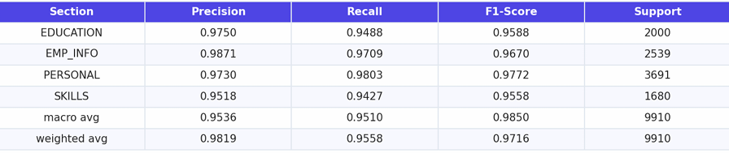
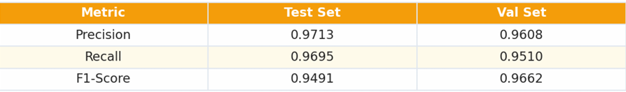
RESULTS AND ANALYSIS
Table 1: Section Level of the Dual Model : Evaluation Results
Table 2: Section Level : Macro-Averaged Evaluation Results

Slide 18
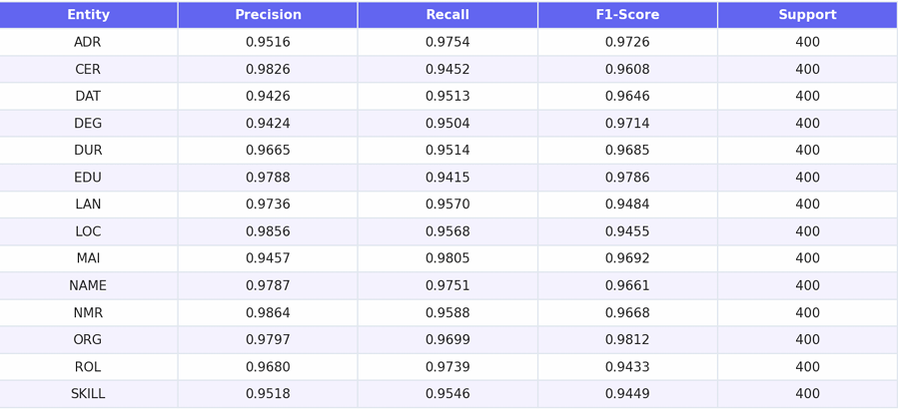
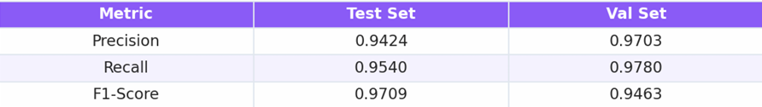
RESULTS AND ANALYSIS
Table 3: Items Level of the Dual Model : Evaluation Results
Table 4: Items Level : Macro-Averaged Evaluation Results

Slide 19
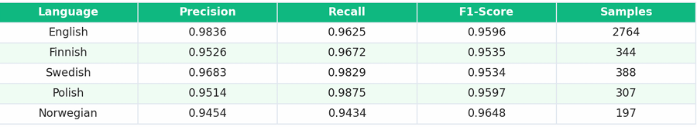
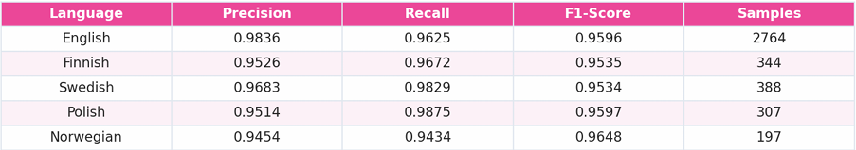
RESULTS AND ANALYSIS
Table 5: Section Level : Evaluation Results(All Languages)
Table 6: Section Level : Evaluation Results(All Languages)

Slide 20
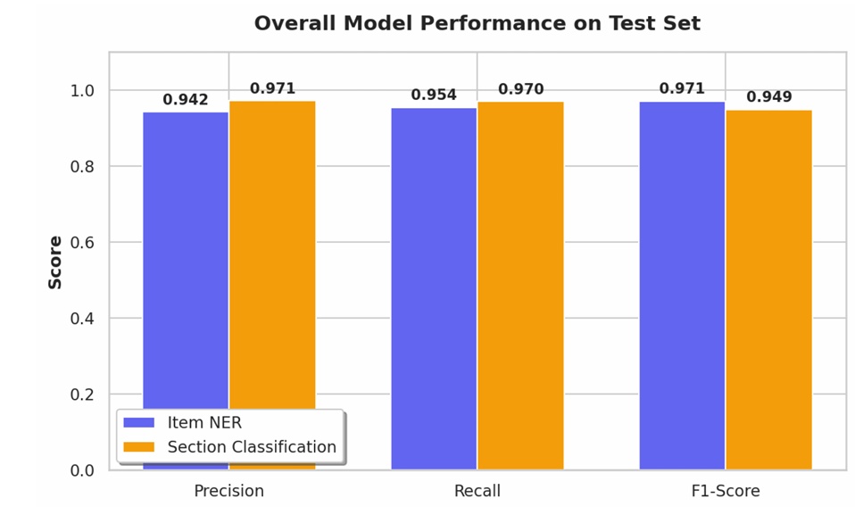
RESULTS AND ANALYSIS

Slide 21
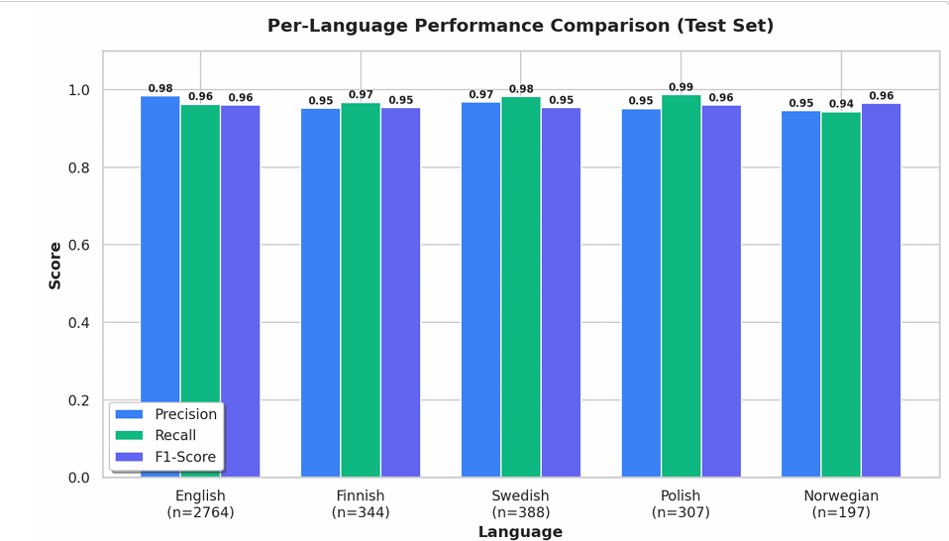
RESULTS AND ANALYSIS

Slide 22
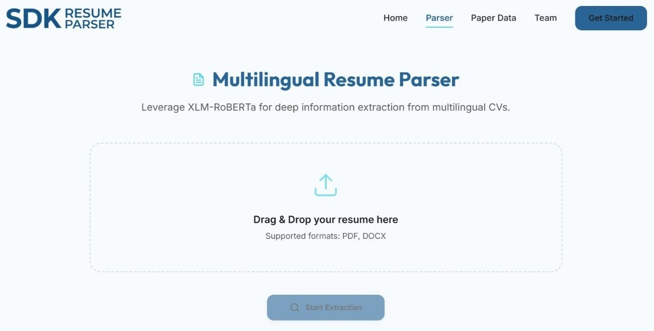
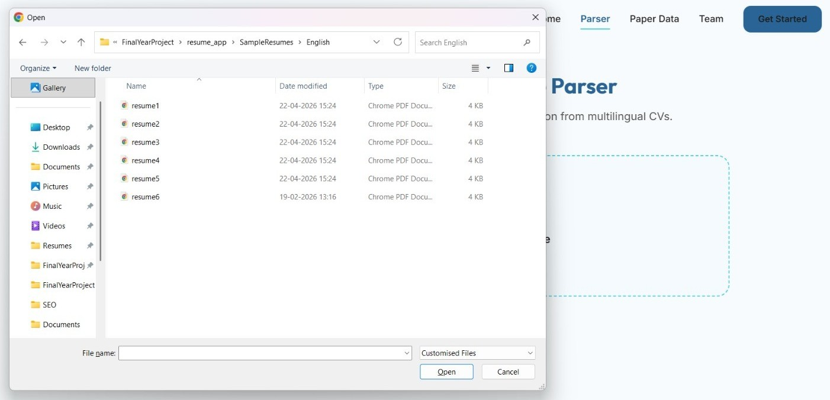
RESULTS AND ANALYSIS
Figure 1: Resume parsing interface
Figure 2: Uploading resume for parsing

Slide 23
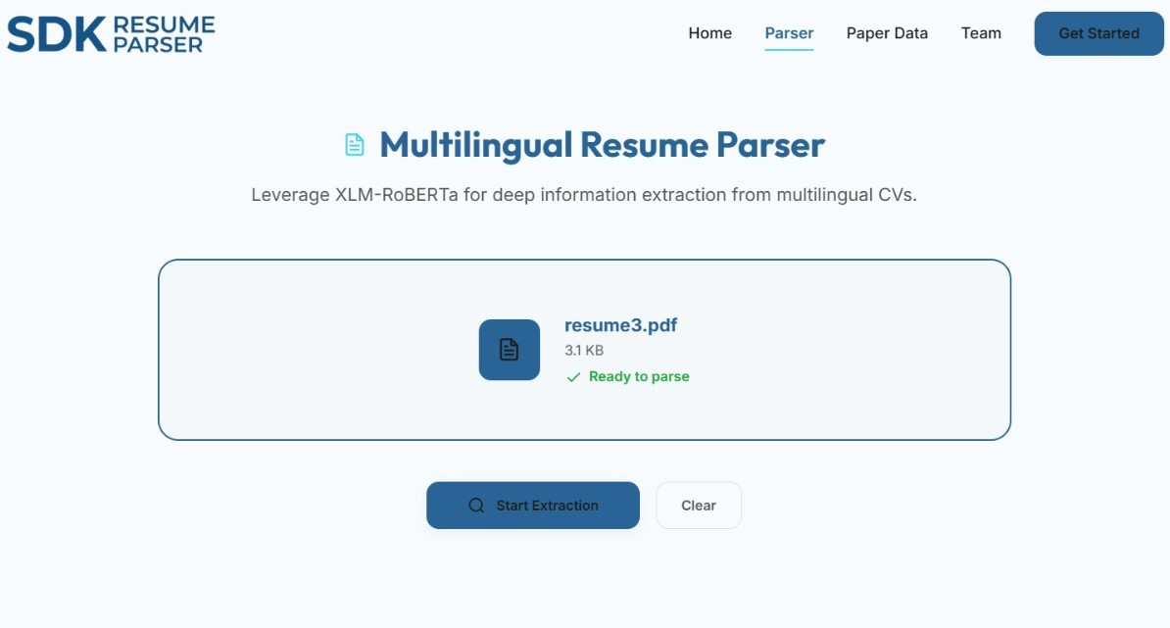
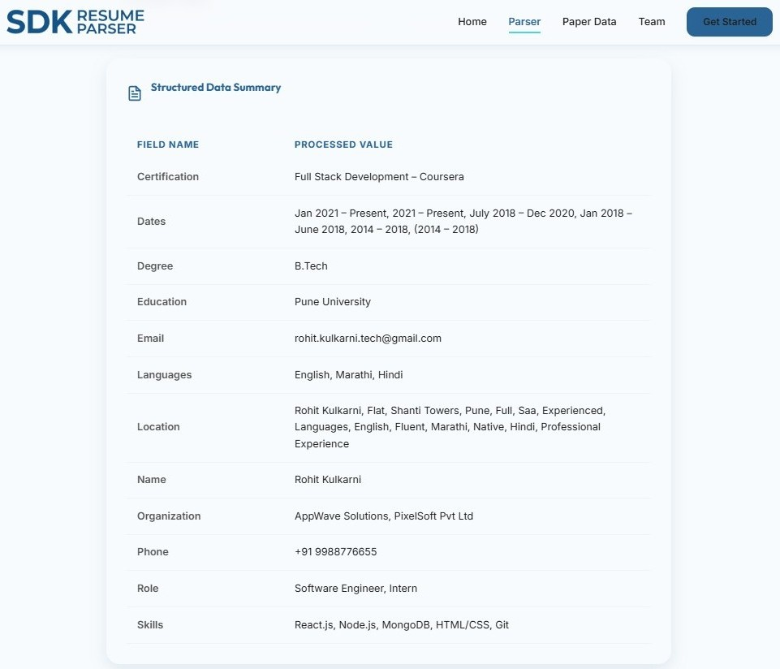
RESULTS AND ANALYSIS
Figure 3: Interface after uploading resume
Figure 4: Extracted information after resume parsing

Slide 24
CONCLUSION
The proposed system successfully enables automated CV information extraction
The model leverages XLM-RoBERTa for effective multilingual resume processing
The DualModel architecture integrates both NER and section classification
The BIO tagging scheme ensures accurate entity boundary detection
The system achieves an Item-level F1-score of 0.9709 on test data
The model also attains a Section-level F1-score of 0.9491 on test data
The approach effectively handles unstructured and multilingual CV formats
The system significantly reduces manual effort in recruitment processes
The framework generates structured output for downstream applications

Slide 25
FUTURE SCOPE
The proposed model can be extended to support more languages and diverse CV formats
The system can be enhanced by integrating layout-aware models for better document understanding
The approach can be improved to handle complex and highly unstructured resumes
The model can be optimized for real-time and large-scale recruitment applications
The framework can be expanded to include job matching and recommendation systems
The extraction module can be enhanced with skill proficiency-level analysis
The system can be developed further with user-friendly interfaces for practical deployment
The computational efficiency can be improved for faster and cost-effective performance

Slide 26
REFERENCES
[1] Kumar et al., AI-Powered Automated Resume Screening and Job Matching System, IEEE Transactions on Computational Social Systems, 2025
[2] Zhang et al., Resume Information Extraction via Post-OCR Text Correction, Expert Systems with Applications, 2023
[3] Sharma et al., Resume Parser Using Hybrid Approach, International Journal of Advanced Computer Science and Applications, 2023
[4] Singh et al., Enhancing Human Resources Through Data Science, Journal of Big Data, 2023
[5] Barducci et al., End-to-End Framework for Information Extraction from Italian Resumes, LREC Proceedings, 2022
[6] Vukadin et al., Information Extraction from Free-Form CV Documents in Multiple Languages, IEEE Access, 2021
[7] Xu et al., LayoutXLM: Multimodal Pre-training for Multilingual Document Understanding, arXiv, 2021
[8] Conneau et al., Unsupervised Cross-lingual Representation Learning at Scale, ACL, 2020

Slide 27
THANK YOU

