Slide 1
LLM FUNDAMENTALS
prompt
predicted
LLMs
&
Transformer Architecture
The
▁sky
▁is
▁blue
next-token prediction: the one task behind every LLM
Notes:
Welcome. This deck walks through how an LLM turns text into numbers, generates text one token at a time, and how the Transformer and attention make that work.

Slide 2
What we will cover
1
2
3
4
Text → Numbers
Generation
Transformer
Attention
LLM
Tokenization (BPE, SentencePiece)
Embeddings vs tokens
Context window
Probability distribution
Deterministic vs stochastic
Encoder and decoder
GPT: decoder-only
Self-attention (Q, K, V)
Multi-head attention
Why it scales as O(n²)
One prompt, followed all the way through the model: text in, next token out.
Notes:
Four blocks: text to numbers, generation, the Transformer architecture, and attention.

Slide 3
PART 1 · TEXT → NUMBERS
What is an LLM?
A neural network trained on huge amounts of text to predict the next token.
“Large” means billions of parameters and trillions of training tokens.
One simple task (next-token prediction) is enough to give translation, coding, Q&A and more.
Input text
“The sky is”
LLM
billions of parameters
Next token
blue
Same task, many skills
Translation
Coding
Q&A
Summaries
Example: “The sky is” → the most likely next token is “blue”.
3
Notes:
An LLM is a neural network trained to predict the next token. That single objective, at large scale, gives translation, coding, Q&A and more.

Slide 4
PART 1 · TEXT → NUMBERS
Why tokenization?
Character
Sequences get very long, and single letters carry little meaning.
u
n
h
a
p
p
i
n
e
s
s
Word
Vocabulary explodes, and unseen words become “unknown”.
unhappiness
Subword
Balanced: small vocabulary, rare words built from known pieces.
un
happi
ness
Same word, three ways to split it.
4
Notes:
Models work on numbers, so text must be split into pieces first. Characters are too long, whole words make the vocabulary too large. Subwords are the middle ground.

Slide 5
PART 1 · TEXT → NUMBERS
BPE: Byte Pair Encoding
1
Split every word into characters
play → [play]
playing → [play] [ing]
replay → [re] [play]
replaying → [re] [play] [ing]
read → [read]
reader → [read] [er]
2
Count all adjacent pairs
3
Merge the most frequent pair into one new token
4
Repeat until the vocabulary hits the target size
5
Notes:
Start with characters. Count adjacent pairs. Merge the most frequent pair into a new token. Repeat until the vocabulary is big enough. The table re-segments the words after each merge.

Slide 6
PART 1 · TEXT → NUMBERS
SentencePiece
Raw stream: no pre-splitting on spaces; text is treated as one character sequence.
Space symbol ▁: spaces become part of tokens, so decoding is fully reversible.
Language-agnostic: works for Kannada, Hindi, Japanese and others that do not rely on spaces.
Two algorithms: trains either BPE or Unigram models.
Raw text
Hello world
Space becomes ▁
Hello▁world
Tokens
▁Hello
▁world
 | What it is
BPE | An algorithm: repeatedly merge the most frequent pair.
SentencePiece | A tool that trains and applies BPE or Unigram directly on raw text.
6
Notes:
SentencePiece works on the raw character stream, using a visible space symbol so tokenization is reversible. It is a tool that can train BPE or Unigram models.

Slide 7
PART 1 · TEXT → NUMBERS
Tokenization in action
Raw text
“I love AI”
1
Tokens
I
▁love
▁AI
2
Token IDs
40
1842
9552
3
IDs are illustrative
7
Notes:
Text is split into tokens, and each token is mapped to an integer ID. The IDs shown are illustrative; every model has its own tokenizer and ID map.

Slide 8
PART 1 · TEXT → NUMBERS
Tokens vs embeddings
 | Token | Embedding
What it is | An integer ID | A dense vector of numbers
Example | 1842 | [0.21, −0.53, 0.88, …]
Carries meaning? | No, just a lookup key | Yes, learned semantics
Embedding space (2D sketch)
king
queen
man
woman
Lookup: ID → row of the embedding matrix → vector
1842
[0.21, −0.53, 0.88, …]
banana
Similar meaning → nearby vectors.
apple
vocab × d_model
Position information is added to these vectors so the model knows word order.
8
Notes:
A token ID is just a label. The embedding matrix turns it into a learned vector, and similar meanings end up close together. Positional information is added so word order is known.

Slide 9
PART 1 · TEXT → NUMBERS
Context window
older tokens fall out
next
Context window: at most N tokens (prompt + output together)
Shared budget
Hard edge
Costly to grow
Your prompt, the chat history and the model’s reply all count toward the limit.
Anything beyond the window is truncated, so the model simply does not see it.
Attention cost rises with the square of length, so bigger windows cost more.
Example: an 8K-token window holds roughly 10–15 pages, so a 50-page document has to be split or summarised.
9
Notes:
The context window is the maximum number of tokens the model can see at once, prompt plus output. Older tokens fall off; longer windows cost more because of attention.

Slide 10
PART 2 · GENERATION
Output = a probability distribution
“The capital of France is ___”
1
Logits: the model scores every token in its vocabulary (tens of thousands of tokens).
2
Softmax: turns those scores into probabilities.
3
Sum to 1: the output is a distribution over tokens, not a single word.
10
Notes:
The model does not output one word. It scores every token in the vocabulary, softmax turns the scores into probabilities, and they sum to 1.

Slide 11
PART 2 · GENERATION
Deterministic distribution vs stochastic generation
“Once upon a”
Model
deterministic
P(token)
Sampler
random
time
Deterministic: the distribution
Stochastic: the choice
Same prompt + same weights → the same probabilities, every time.
Sampling a token from that distribution adds randomness, so outputs can differ between runs.
Same prompt, three runs
Run 1 → “time”
Run 2 → “midnight”
Run 3 → “time”
11
Notes:
The model part is deterministic: same input and weights give the same distribution. The randomness comes from the sampler that picks a token from it.

Slide 12
Difference
Feature | Deterministic | Stochastic
Meaning | Selects highest probability distribution token always | Samples token from probability distribution
Common method | Greedy method | Random sampling
Randomness | No | Yes
Output | Same | Can differ
Use case | Factual and consistent output | Diverse and creative output
12

Slide 13
PART 3 · TRANSFORMER
Why Transformers?
RNN / LSTM
Transformer
t1
t2
t1
t2
t3
t4
t3
t4
one step after another
every token connects to every other
Sequential, so slow to train
Long-range context fades
Parallel: all tokens processed at once
Attention links any two tokens directly
“Attention Is All You Need”, Vaswani et al., 2017
14
Notes:
RNNs and LSTMs process tokens one after another. Transformers process all tokens in parallel and use attention to connect any two tokens directly.

Slide 14
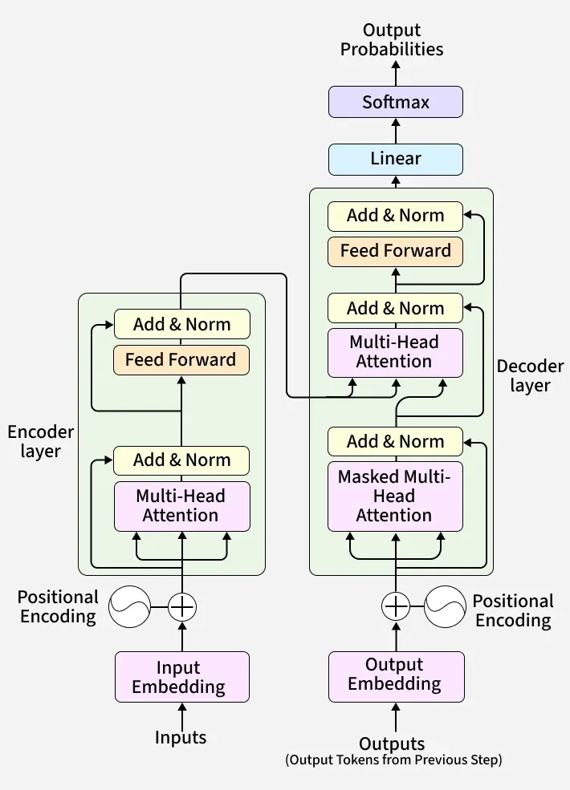
PART 3 · TRANSFORMER
The Transformer architecture
15

Slide 15
PART 3 · TRANSFORMER
The encoder
Encoder self-attention
Reads the whole input at once, in both directions
Every token attends to every other token (no mask)
Output: a rich, contextual vector for each token
Best for understanding: classification, search, NER
The
cat
sat
down
The
cat
sat
Example models
down
BERT
Amber = allowed to attend. Every token sees every token.
16
Notes:
The encoder reads the entire input bidirectionally: every token can attend to every other token. It suits understanding tasks such as classification and search.

Slide 16
PART 3 · TRANSFORMER
The decoder
Generates output left to right, one token at a time
Masked (causal) self-attention: a token cannot see future tokens
In the original Transformer, cross-attention reads the encoder’s output
“I love AI”
Encoder
reads the source
cross-attention
Decoder
writes the target
J'
aime
l'IA
generated one token at a time
Example: English → French translation
17
Notes:
The decoder generates left to right with masked self-attention. In the original Transformer it also uses cross-attention over the encoder output, as in translation.

Slide 17
PART 3 · TRANSFORMER
Three Transformer families
Encoder-only
Encoder–decoder
Decoder-only
Reads and understands
Reads, then writes
Predicts the next token
Encoder
Encoder
Decoder
Decoder
Examples
Examples
Examples
BERT, RoBERTa
T5, original Transformer
GPT, LLaMA, Mistral
Best for
Best for
Best for
Classification, search, embeddings, NER
Translation, summarization
Chat, text generation, code: most modern LLMs
18
Notes:
Encoder-only models understand, encoder-decoder models translate or summarise, and decoder-only models generate. Most modern LLMs are decoder-only.

Slide 18
PART 3 · TRANSFORMER
GPT is decoder-only
Softmax → next-token probabilities
Causal mask
The
cat
sat
on
Each token can attend to itself and earlier tokens only. Future positions are set to −∞ before softmax, so their weight becomes 0.
Linear (to vocabulary size)
The
−∞
−∞
−∞
Feed-Forward
cat
−∞
−∞
× N
sat
−∞
Masked Self-Attention
on
Embeddings + Positions
No encoder and no cross-attention
Trained purely on next-token prediction
Prompts let one model both understand and generate
Input tokens
19
Notes:
GPT keeps only masked self-attention and feed-forward blocks. The causal mask blocks attention to future positions, so training is pure next-token prediction.

Slide 19
PART 4 · ATTENTION
Attention: which words matter?
“it” looks back at “animal”
The
animal
didn’t
cross
the
street
because
it
was
tired
0.55
0.12
0.08
0.07
0.02
0.03
0.04
0.01
0.03
0.05
Attention weight from “it” to each word (illustrative)
“I sat on the river bank”
“I deposited cash at the bank”
“bank” attends to “river”, so it means the land beside water.
“bank” attends to “deposited” and “cash”, so it means the financial institution.
20
Notes:
Each word decides which other words matter for its meaning. For the word “it”, the attention weights are highest on “animal”. The same mechanism disambiguates “bank”.

Slide 20
PART 4 · ATTENTION
Self-attention: Query, Key, Value
Q
Query
K
Key
V
Value
What information I need?
What kind of information it contains?
Actual information
Asks: which tokens matter to me?
Matched against every query.
Blended using the attention weights.
Q = X · W_Q K = X · W_K V = X · W_V
Library analogy: your query is matched against every book’s key (its title); you then read the values (the contents) of the best matches.
21
Notes:
Every token is projected into three vectors. The query is matched against keys to get weights, and the weights blend the values.

Slide 21
PART 4 · ATTENTION
Self-attention, step by step
1
2
3
4
5
Project
X → Q, K, V
Score
Q · Kᵀ
Scale
÷ √d_k
Softmax
row-wise
Mix
weights × V
Each token’s embedding is multiplied by three learned matrices.
Dot product of every query with every key: how well does each pair match?
Keeps scores in a stable range so softmax is not too peaked.
Turns scores into attention weights; each row sums to 1.
A weighted sum of value vectors gives a context-aware vector per token.
Attention(Q, K, V) = softmax ( Q K^{T} / √d_{k} ) · V
22
Notes:
Five steps: project to Q, K, V; score with QK transpose; scale by root d_k; softmax; and take the weighted sum of V.

Slide 22
PART 4 · ATTENTION
A tiny worked example
I
love
AI
Step 1 · weights for “love”
I
0.6
0.3
0.1
I 0.2 love 0.5 AI 0.3
love
0.2
0.5
0.3
Step 2 · toy value vectors
AI
0.1
0.4
0.5
V(I)=[1,0] V(love)=[0,1]
V(AI)=[1,1]
Attention weights: rows = the token looking, columns = the token looked at.
Step 3 · weighted sum
0.2·[1,0] + 0.5·[0,1] + 0.3·[1,1]
= [0.5, 0.8]
Numbers are illustrative. Real models use vectors of 64–128+ dimensions per head.
23
Notes:
Three tokens, toy numbers. The row for “love” gives weights 0.2, 0.5, 0.3, and the output is those weights applied to toy value vectors. Real vectors have many more dimensions.

Slide 23
PART 4 · ATTENTION
Multi-head attention
Head 1
syntax (subject ↔ verb)
Concat
Input
X
Head 2
references (it → animal)
Linear
W_O
Output
Head 3
nearby words / position
Head 4
other patterns
Each head has its own Q, K, V projections, so it can learn a different kind of relationship in parallel.
24
Notes:
Several attention heads run in parallel, each with its own Q, K, V projections. Their outputs are concatenated and projected back.

Slide 24
PART 4 · ATTENTION
Why attention scales as O(n²)
Tokens (n) | Score matrix entries
1,000 | 1 million
10,000 | 100 million
100,000 | 10 billion
Per attention head, per layer
n = 2
4 cells
n = 4
16 cells
n = 8
64 cells
10×
100×
Every token attends to every other token, so the score matrix is n × n. Doubling the length quadruples compute and memory.
longer input
more attention cost
25
Notes:
Every token attends to every other token, giving an n by n score matrix. Doubling the length quadruples the cost; ten times longer means a hundred times more.

Slide 25
PART 4 · ATTENTION
Taming the O(n²) problem
FlashAttention
Sparse / sliding-window
KV cache
Same math, memory-efficient GPU kernels that avoid storing the full n × n matrix.
Attend only to nearby or selected tokens instead of all of them.
Reuse past keys and values while generating, instead of recomputing them.
Saves memory + time
Saves compute
Saves repeated work
GQA / MQA
Linear attention / state-space
Exact vs approximate
Share keys and values across heads to shrink memory use.
Approximate or replace attention so cost grows roughly linearly.
FlashAttention and KV cache keep results exact. The others trade some modelling power for speed or memory.
Saves memory
Cuts to ~O(n)
26
Notes:
Several techniques reduce the cost of attention. FlashAttention and the KV cache keep the results exact; the others trade some modelling power for speed or memory.

Slide 26
Putting it all together
1
Text
2
Tokenizer
3
Token IDs
4
Embeddings
“The sky is”
BPE / SentencePiece
[464, 6766, 318]
vectors + positions
8
Next token
7
Sampling
6
Logits → Softmax
5
Transformer blocks
append and repeat
greedy / temp / top-p
scores → probabilities
attention + FFN × N
blue = text → numbers green = Transformer violet = generation amber = output
Notes:
The full pipeline in one picture: text to tokens to IDs to embeddings, through the Transformer blocks, to logits, softmax, sampling and the next token, which is appended and the loop repeats.

Slide 27
Key takeaways
1
LLMs predict the next token from a probability distribution.
2
Tokenization (BPE, SentencePiece) turns text into IDs; embeddings turn IDs into meaning.
3
The model is deterministic; sampling makes generation stochastic.
4
GPT is a decoder-only Transformer built on masked self-attention.
5
Attention (Q, K, V) is powerful but O(n²), which is why long context is costly.
Notes:
Five things to remember.

Slide 28
Questions?
Thank you
Notes:
Open the floor for questions.

