Slide 1






1
AI-Powered Cricket Query Engine
(Smart Crick)
Group_No: 84
Review -1
Guide: Dr. (Col.) Kumar P. N.
SL NO. | Name | Roll No
1 | Sujan Karthik M | CB.EN.U4CSE22547
2 | Vignesh Raja K | CB.EN.U4CSE22555
3 | Praysun Raja M | CB.EN.U4CSE22537
4 | Kamalakrishnan U D | CB.EN.U4CSE22519

Slide 2

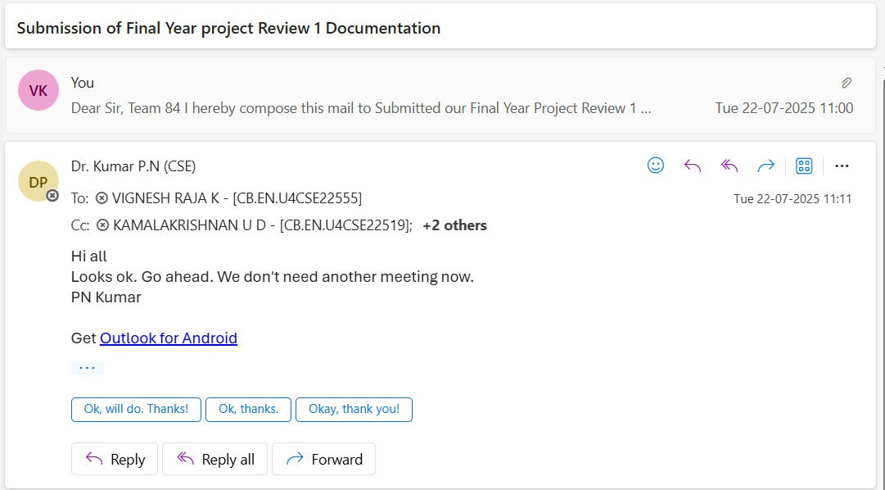
2
Mail Approval

Slide 3
Core Problem Statement
Cricket information systems lack intelligent routing between historical databases and real-time data sources, forcing manual .This project creates a RAG-based chatbot with MCP tools that automatically selects optimal data sources and provides unified conversational access to cricket information.

Slide 4
Problem Understanding and Clarity
Imagine you’re watching a cricket match and want to ask questions like "How is Kohli performing compared to his last 5 matches?" or "What’s the team’s chances of winning from this position?" Current AI systems can’t answer these questions because they don’t have access to live cricket data or understand cricket-specific contexts.
Current Problems:
• AI models don’t know live match scores
• They can’t understand cricket situations
• Information becomes outdated quickly
• No real-time context awareness
• Generic responses lack cricket insights
What We Need:
• Live cricket data integration
• Cricket-smart responses
• Fast answer generation
• Context-aware insights
• Multiple format support (T20, ODI, Test)

Slide 5
Literature Review and State of the Art
Model | Core Concept & Functionality | Key Innovation
RAG (Lewis et al., 2020) | Combines neural memory with external databases using dense retrieval for context-aware generation. | First to show RAG reduces hallucinations and improves factual accuracy.
REALM (Guu et al., 2020) | Retrieval is built into pre-training; jointly learns to retrieve and predict masked tokens. | Retrieval during pre-training enhances knowledge acquisition better than fine-tuning.
FiD (Izacard & Grave, 2020) | Independently encodes multiple retrieved passages, then fuses in the decoder. | Separate passage processing outperforms early fusion for multi-passage RAG.

Slide 6
Literature Review and State of the Art
Model | Core Concept & Functionality | Key Innovation
GraphRAG | Uses knowledge graphs instead of text passages; combines structured data with natural language generation. | Structured knowledge improves reasoning in complex, relational tasks.
ColBERT-RAG | Uses token-level interaction for retrieval; fine-grained semantic matching. | Offers better retrieval precision for domain-specific, nuanced queries.

Slide 7
Research Gaps Analysis
Gap 1: No Sports-Specific AI Systems
What We Know:
Most RAG systems are designed for general knowledge (like Wikipedia) or specialized fields like medicine or law. Very few focus on sports.
The Problem:
Cricket has unique needs:
Special terms (e.g., boundary, wicket, over)
Constantly changing data (like scores every ball)
Different rules in different formats (Test, ODI, T20)
Context matters—a score of 100 can mean different things depending on the situation
Why It Matters:
A general AI may know what cricket is, but it won’t understand the difference between:
“15 runs needed in 6 balls” (a tight finish) vs. “150 runs needed in 60 balls” (a longer chase)

Slide 8
Research Gaps Analysis
Gap 2: No Real-Time Integration
What We Know:
Most RAG systems work with static data like textbooks or articles that don’t change often.
The Problem:
Cricket changes fast—every 30 seconds there’s new data:
Live scores
Player updates
Match situations
Weather conditions
Why It Matters:
A question like “How is India doing?” will have a very different answer depending on whether it’s the beginning of the match or 10 overs in.

Slide 9
Research Gaps Analysis
Gap 3: Limited Understanding of Match Formats
What We Know:
Most sports AI focuses on one format (e.g., only football or basketball).
The Problem:
Cricket has three very different formats (T20, ODI, Test), each with:
Unique rules and strategies
Different ways to measure performance
Varying match lengths
Different expectations for success
Why It Matters:
A score like 150/5 is good in a T20 match, but poor in a Test match. The AI must understand these format-specific differences.

Slide 10
Research Gaps Analysis
Gap 4: No Evaluation Methods for Cricket AI
What We Know:
Current RAG systems are evaluated using general tests (like academic Q&A benchmarks).
The Problem:
Cricket queries need special treatment because:
Live answers can become outdated fast
Accurate understanding of match context is essential
Stats need to be interpreted differently in each format
Users expect different answers during live games vs. historical analysis
Why It Matters:
Typical tests can’t show if the system really understands things like match momentum or who’s likely to win next.

Slide 11
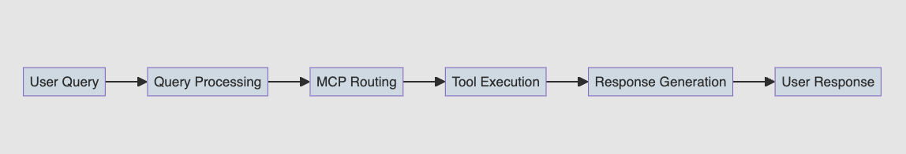
Overall workflow

Slide 12
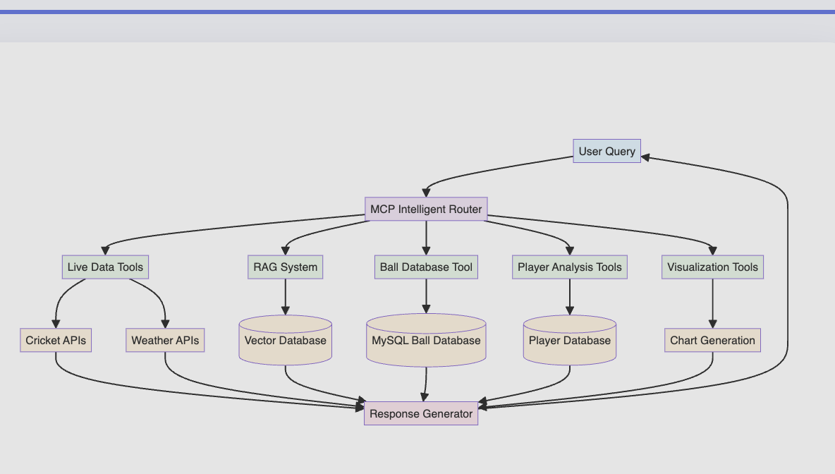
High level Architecture

Slide 13
Plan for Project Execution
Phase 1: Foundation & Core Setup
1. Data Infrastructure Setup
Set up vector database (ChromaDB/Pinecone)
2. Web Scraping Infrastructure
Build scrapers for ESPNCricinfo, Cricbuzz, ICC
Create data validation pipeline
Set up automated data collection
3. Basic RAG System
Implement document processing and chunking
Generate embeddings for historical cricket data
Create vector search functionality
Build retrieval pipeline

Slide 14
Plan for Project Execution
Phase 2: MCP Integration & Intelligence
1. MCP Tools Development
Live data tool (real-time scores/commentary)
Historical data tool (RAG queries)
Weather API tool
Ball database tool (MySQL with AI queries)
2. Intelligent Router
Query classification system
Context analysis engine
Tool selection logic
Multi-source data fusion
3. Advanced Tools
Player comparison tool with ML insights
Social sentiment analysis tool
Data visualization tool

Slide 15
Plan for Project Execution
Phase 3: Chatbot Interface & Enhancement
1. Conversation System
FastAPI backend development
Query processing pipeline
Response generation system
Context management
2. Web Interface
User-friendly chat interface
Real-time data display
Interactive visualizations
Mobile-responsive design

Slide 16
Plan for Project Execution
Phase 4: Testing & Optimization 1. Testing & Validation
Unit testing for all components
Integration testing
Performance testing
User acceptance testing
2. Performance Optimization
Database query optimization
Caching strategy refinement
API response time optimization
Scalability improvements

Slide 17
References
Foundational RAG Papers:
[1] P. Lewis, E. Perez, A. Piktus, F. Petroni, V. Karpukhin, N. Goyal, H. Schwenk, D. Kiela, and P. Stoyanov, “Retrieval-Augmented Generation for Knowledge-Intensive NLP Tasks,” in Advances in Neural Information Processing Systems (NeurIPS), 2020.
[2] K. Guu, T. Lee, Z. Tung, P. Pasupat, and M. Chang, “REALM: Retrieval-Augmented Language Model Pre-Training,” in Proc. 37th Int. Conf. on Machine Learning (ICML), 2020.
[3] G. Izacard and E. Grave, “Leveraging Passage Retrieval with Fusion-in-Decoder for Open-Domain Question Answering,” in arXiv preprint arXiv:2007.01282, 2020.
[4] Y. Gao, H. Liu, S. Hou, and W. Che, “Retrieval-Augmented Generation for Large Language Models: A Survey,” in arXiv preprint arXiv:2303.17760, 2023.

