Slide 1
CHAPTER 8
Chapter 8: Inferences Based on a Single
Sample: Tests of Hypotheses
8.5: Test of Hypothesis about a Population Mean:
Student’s t-Statistic
8.6: Large-Sample Test of a Hypothesis about a
Population Proportion

Slide 2
CHAPTER 8
8.5: Test of Hypothesis about a Population
Mean: Student’s t-Statistic
Hypotheses:
Let μ be the population mean.
Null Hypothesis, H0: μ = μ₀, a specified value; (in words)
Alternative hypothesis,
Ha: μ > μ₀, a specified value; (in words)
or
Ha: μ < μ₀, a specified value; (in words)
or
Ha: μ ≠ μ₀, a specified value; (in words)

Slide 3
CHAPTER 8
Test Statistic
We will perform a small sample t-test for the population mean.
Required Conditions:
The sample was randomly selected from the population of interest or there is some other indication that it was representative(implying randomness).
n<30.
The original population is known to be normal.
Population standard deviation (σ ) is unknown.

Slide 4
CHAPTER 8
Level of significance
α = ??? (usually given, if not choose α =.05)
Rejection Region
if upper tailed test (or Ha: μ>μ₀)
or
if lower tailed test (or Ha: μ< μ₀)
or
if two-tailed test (or Ha: μ ≠ μ₀)
Remember you have to find out the critical values t_{α} or t_{α/2} from t table
Calculation of test statistic

Slide 5
CHAPTER 8
Decision and conclusion
If the calculated value of the proposed test statistic belongs to the rejection region, we reject H₀; otherwise we fail to reject H₀.
Write the conclusion in the context.

Slide 6
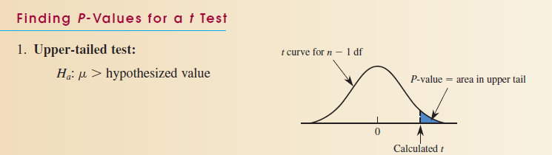
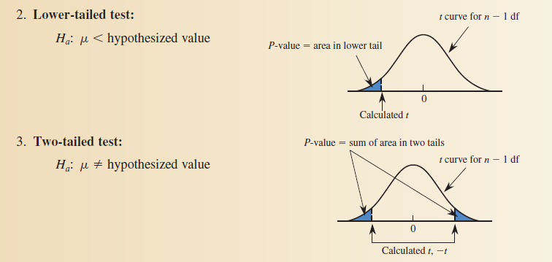
CHAPTER 8
= P (t > tcal)
= P (t < tcal)
= 2 *P (t > |tcal|)
Decision Rule: If p value < α, we reject H₀

Slide 7
CHAPTER 8
Example
Dogspal indicated that the weight of their 40 pound bags of dog food had a mean of 40.5 pounds. This they have told us nothing about the distribution of weights or the population standard deviation. From a consumer point of view, bags that are too heavy are not an issue, but those that are too light make customers feel cheated. We have taken a random sample of 10 bags and found a sample mean and standard deviation from the sample. Here is our raw data:
37.25 38.25 40.10 40.50 41.25
39.45 37.00 39.25 38.00 40.75
Conduct a test of significance to test the claim that Dogspal 40 pound bags have less than 40.5 pounds of dog food in their bags. Use a significance level, α = .05.

Slide 8
CHAPTER 8
Hypotheses.
Let µ be the true mean weight of all “40 pound bags” packaged by Dogspal.
H₀: µ = 40.5; the mean of all “40 pound” bags from Dogspal is 40.5 pounds, as stated by the company.
H_{a}: µ < 40.5; the mean of all “40 pound” bags from Dogspal is less than the 40.5 pounds stated by the company.

Slide 9
CHAPTER 8
2. Test procedure.
We will perform a one sample t- test for the population mean.
Conditions:
i) We are told that the sample of 10 was a random sample.
We assume that the distribution of weights packaged by Dogspal is normal. (It can be checked based on sample evidence)
The standard deviation of weights packaged by Dogspal is unknown.
Therefore, we can perform the proposed t-test.

Slide 10
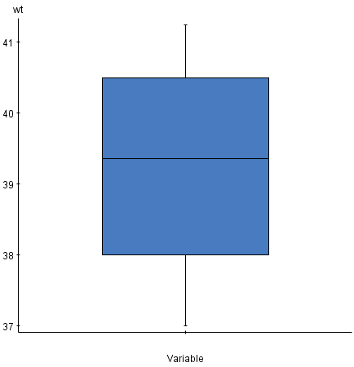
CHAPTER 8
Verify Normality Assumption
One way to check the normality assumption is to graph the distribution of data such as stem-and-leaf plot, dotplot, or boxplot. If the sample data are approximately normally distributed, then the population from which the sample is selected is very likely to be normal. A boxplot for the sample data is displayed below. The distribution is approximately symmetric. Therefore, the assumption of normality appears to be reasonably satisfied.

Slide 11
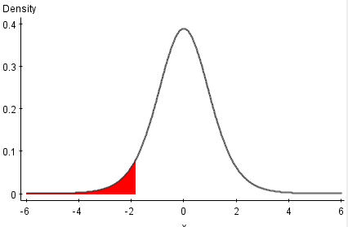
CHAPTER 8
iii) Level of significance.
α = 0.05
iv) Rejection region.
t < -1.833
α =.05
t = -1.833
v) Calculation of test statistic.
We are given, n = 10
= 39.18
s = 1.4963

Slide 12
CHAPTER 8
vi) Decision and Conclusion
Since t_{cal} = -2.79 is less than -1.833 so we reject the null hypothesis.
We conclude that there is sufficient evidence at 5% level of significance to support the claim that the mean of all “40 pound” bags from Dogspal is less than the 40.5 pounds stated by the company.

Slide 13
CHAPTER 8
Making Decision Using p-Value
P-value=Pr(t<-2.79)= ?
Note Pr(t>2.79)=Pr(t<-2.79)
Now in t table you will not find the exact probability for the point -2.79.
Look at the table for degree of freedom 9, 2.79 lies between 2.262 and 2.821.
The probability difference for those two points are .025-.010=.015 for point difference 2.821-2.262=.559
For (2.821-2.79)=.031 what is the probability difference?
(.015/.559)*.031=.0008
Pr(t>2.79)= .01+.0008=.011=Pr(t<-2.79)=P-value<.05(level of significance)
We are going to reject H_{0.}

Slide 14
CHAPTER 8
Exercise
1.For each of the following rejection regions what is the probability of Type I error(α)
t> 1.440 when degrees of freedom is 6.
t< -2.060 or t>2.060 when degrees of freedom is 25
t<-1.782 when degrees freedom 12.
2. Summary statistics for the scores of the 27 students who completed Dental Anxiety Scale questionnaire are sample mean as 10.6 and sample standard deviation 3.3. Scores range from 0 to 20(extreme anxiety). Conduct a test of hypothesis to determine whether the mean Dental Anxiety Scale Score for the population of college students differs from µ=11. Use α=.01

Slide 15
CHAPTER 8
i) Hypotheses.

Slide 16
CHAPTER 8
ii) Test procedure.

Slide 17
CHAPTER 8
iii) Level of significance.
iv) Rejection region.
v) Calculation of test statistic.

Slide 18
CHAPTER 8
vi) Decision and Conclusion

Slide 19
CHAPTER 8
Making Decision Using p-Value

