Slide 1
Partitioning Histopathological Images: An Integrated Framework for Supervised Color-Texture Segmentation and Cell Splitting Hui Kong, Metin Gurcan, Senior Member, IEEE, and Kamel Belkacem-Boussaid, Senior Member, IEEE
Implemented by:
Luna Biswas

Slide 2
Context
For quantitative analysis of histopathological images, such as grading systems of lymphoma diseases, quantification of features is usually carried out on single cells, before categorizing them by classification algorithms.
The success of an automatic cell analysis system largely depends on the quality of cell segmentation from the background and extra-cellular regions, and the splitting of the interweaved cells.
Segmentation of cell images is difficult due to
Overlapping / touching nuclei
Wide variation of nucleus sizes and shapes
Non-uniformity of staining
Changing contrast between the nuclei and background among different sections (due to illumination inconsistency)
This paper proposed an integrated framework that can be used to deal with the outlined issues in computer-assisted histopathological image analysis.

Slide 3
Goals
To develop a segmentation algorithm which can partition histopathological images as cell regions, background and extra-cellular areas.
Reason : The color and texture of the cell regions typically do not exhibit uniform statistical characteristics, but segmentation of these cells into perceptually or semantically uniform regions is highly desired for subsequent feature quantification or cell-type classification purposes.
To develop a splitting algorithm for touching cells.
Reason : both feature quantization and cell-type classification depend to a large extent on shape, size and the interior texture characteristic of each individual cell, the overlapping of cells may result in a misleading cell-type classification.

Slide 4
Steps followed for implementation
Image collection
(1)
Normalization
(2)
Collection of training data (3)
Feature extraction
(4)
Optimization
(5)
Touching cell split
(6)

Slide 5
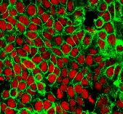
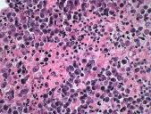
(1) Image collection
Challenges faced
Unavailability of histopathological images
With high resolution
At least 2000 x 2000 pixels, so that 11 x 11 pixels training samples can be collected from the image
With dense and overlapping cell structures
Multiple images of the same type
Following two images were collected and used for developing and testing the segmentation model.
2296 x 1744 pixels 2220 x 2068 pixels

Slide 6
(2) & (3) Normalization and collection of training images
Due to the nonuniform staining, and especially, the varying contrast between the nuclei and extra-cellular regions across different sections (caused by inconsistent illumination), histopathological images usually exhibit inconsistent colors. Therefore, it is desirable to normalize the contrast across different section images. To do this, we transform the original section images by applying histogram equalization to each channel of the RGB color space.
From each of the transformed images, we manually mark locations in the nuclei and extra-cellular regions, respectively. An 11 x 11 local neighborhood at each marked location is cropped as a training image patch.

Slide 7
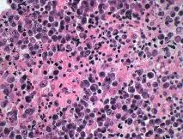
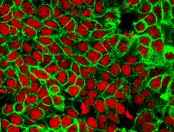
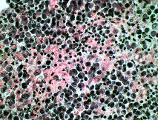
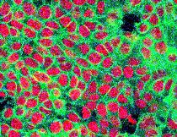
(2) & (3) Normalization and collection of training images - continued
Original training images
Training images after histogram equalization
Code : histogramEqualisation.py
Small positive (left) and negative (right) image patches extracted from nuclear and extra-cellular regions of each training image
Code: sampleCollection.py

Slide 8
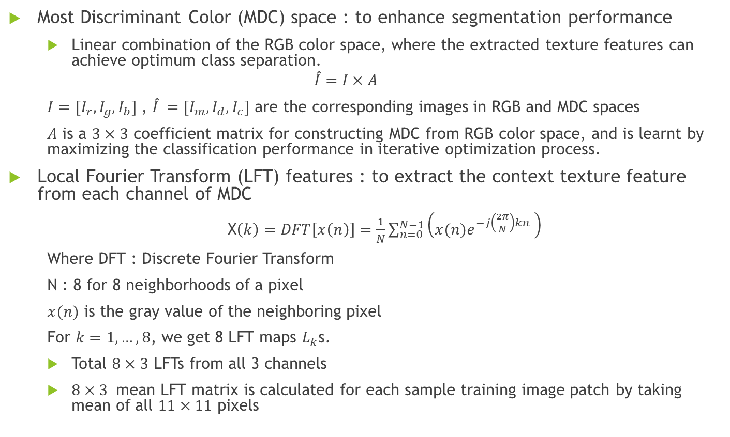
(4) Feature extraction
Most Discriminant Color (MDC) space : to enhance segmentation performance
Linear combination of the RGB color space, where the extracted texture features can achieve optimum class separation.
$$\hat{I}=I×A$$
$I=[I_{r},I_{g},I_{b}]$ , $\hat{I} =[I_{m},I_{d},I_{c}]$ are the corresponding images in RGB and MDC spaces
$A$ is a $3×3$ coefficient matrix for constructing MDC from RGB color space, and is learnt by maximizing the classification performance in iterative optimization process.
Local Fourier Transform (LFT) features : to extract the context texture feature from each channel of MDC
X$\left(k\right)=DFT\left[x\left(n\right)\right]=\frac{1}{N}\sum_{n=0}^{N−1}{\left(x(n)e^{−j\left(\frac{2π}{N}\right)kn} \right)}$
Where DFT : Discrete Fourier Transform
N : 8 for 8 neighborhoods of a pixel
$x(n)$ is the gray value of the neighboring pixel
For $k=1,…,8$, we get 8 LFT maps $L_{k}$s.
Total $8×3$ LFTs from all 3 channels
$8×3$ mean LFT matrix is calculated for each sample training image patch by taking mean of all $11×11$ pixels
x(0) | x(7) | x(6)
x(1) | (x,y) | x(5)
x(2) | x(3) | x(4)

Slide 9
(4) Feature extraction - continued
Efficient LFT feature extraction
Calculating LFTs from 11 x 11 neighbourhood of each pixel, for large images (2000 x 2000 pixels) is extremely time-consuming.
Image shifting – for mean LFT of a pixel from
Integral map
intermediate representation of LFT map for fast calculation of mean LFT from 11 x 11 neighbourhood of any pixel in a big image

Slide 10
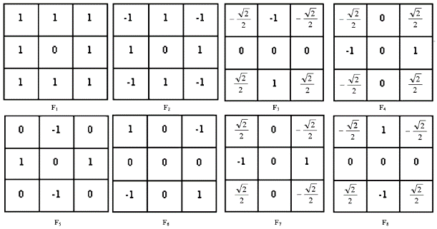
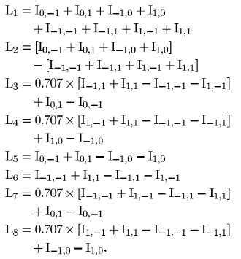
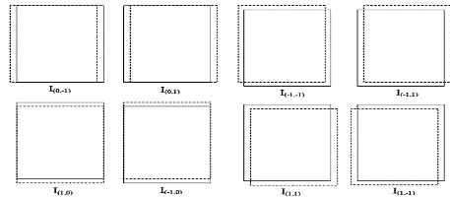
(4) Feature extraction - Image shifting
LFT feature extraction is equivalent to applying eight kernels below to the image
getLFTmean
Code:
package transform
program localFourier.py
function getLFTmean()

Slide 11
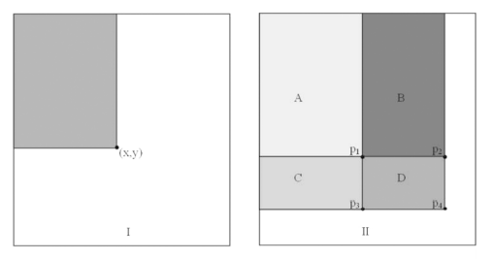
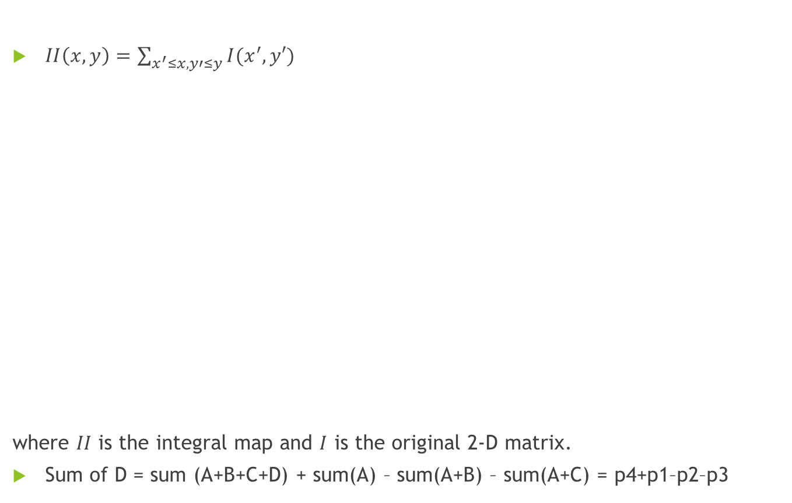
(4) Feature extraction – Integral map
Code: package transform
program localFourier.py
function getLFTIntegral ()
$II\left(x,y\right)=\sum_{x^{′}≤x,y′≤y}{I(x^{′},y′)}$
where $II$ is the integral map and $I$ is the original 2-D matrix.
Sum of D = sum (A+B+C+D) + sum(A) – sum(A+B) – sum(A+C) = p4+p1–p2–p3

Slide 12
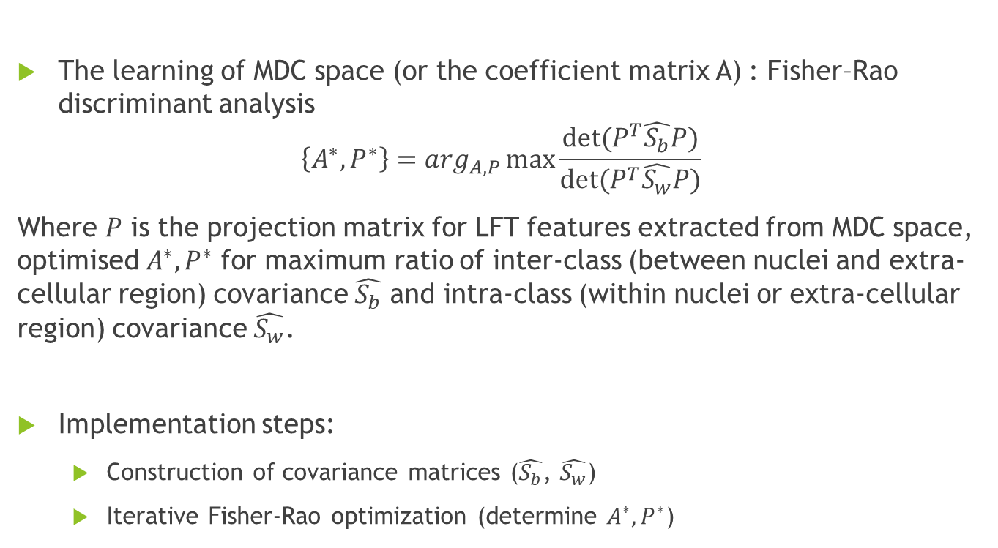
(5) Optimization
The learning of MDC space (or the coefficient matrix A) : Fisher–Rao discriminant analysis
$$\left\{A^{∗},P^{∗}\right\}=\arg_{A,P}\max{\frac{det⁡(P^{T}\hat{S_{b}}P)}{det⁡(P^{T}\hat{S_{w}}P)}}$$
Where $P$ is the projection matrix for LFT features extracted from MDC space, optimised $A^{∗},P^{∗}$ for maximum ratio of inter-class (between nuclei and extra-cellular region) covariance $\hat{S_{b}}$ and intra-class (within nuclei or extra-cellular region) covariance $\hat{S_{w}}$.
Implementation steps:
Construction of covariance matrices ($\hat{S_{b}}$, $\hat{S_{w}}$)
Iterative Fisher-Rao optimization (determine $A^{∗},P^{∗}$)

Slide 13
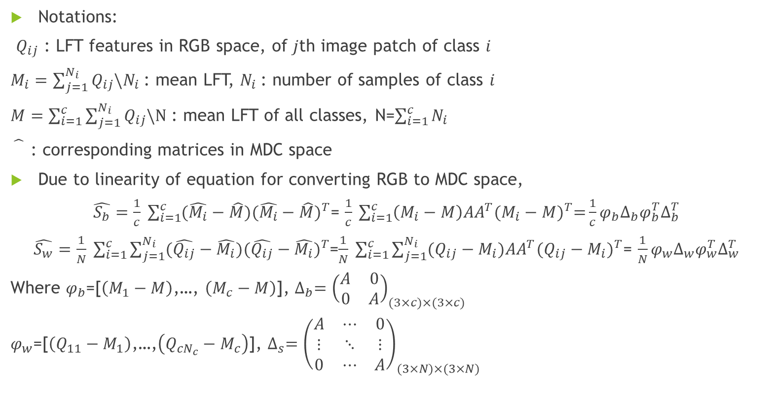
(5) Optimization- Construction of covariance matrices
Notations:
$Q_{ij}$ : LFT features in RGB space, of $j$th image patch of class $i$
$M_{i}=\sum_{j=1}^{N_{i}}{Q_{ij}\backslash N_{i}}$ : mean LFT, $N_{i}$: number of samples of class $i$
$M=\sum_{i=1}^{c}{\sum_{j=1}^{N_{i}}{Q_{ij}\backslash N}}$ : mean LFT of all classes, N=$\sum_{i=1}^{c}{N_{i}}$
: corresponding matrices in MDC space
Due to linearity of equation for converting RGB to MDC space,
$\hat{S_{b}}=\frac{1}{c} \sum_{i=1}^{c}{(\hat{M_{i}}−\hat{M}){(\hat{M_{i}}−\hat{M})}^{T}}$= $\frac{1}{c} \sum_{i=1}^{c}{\left(M_{i}−M\right)AA^{T}{(M_{i}−M)}^{T}=}\frac{1}{c}φ_{b}∆_{b}φ_{b}^{T}∆_{b}^{T}$
$\hat{S_{w}}=\frac{1}{N} \sum_{i=1}^{c}{\sum_{j=1}^{N_{i}}{(\hat{Q_{ij}}−\hat{M_{i}}){(\hat{Q_{ij}}−\hat{M_{i}})}^{T}}}$=$\frac{1}{N} \sum_{i=1}^{c}{\sum_{j=1}^{N_{i}}{(Q_{ij}−M_{i})AA^{T}{(Q_{ij}−M_{i})}^{T}}}$= $\frac{1}{N}φ_{w}∆_{w}φ_{w}^{T}∆_{w}^{T}$
Where $φ_{b}$=[$\left(M_{1}−M\right)$,…, $\left(M_{c}−M\right)$], $∆_{b}={\left(\begin{matrix}A & 0 \\ 0 & A\end{matrix}\right)}_{(3×c)×(3×c)}$
$φ_{w}$=[$\left(Q_{11}−M_{1}\right)$,…,$\left(Q_{cN_{c}}−M_{c}\right)$], $∆_{s}={\left(\begin{matrix}A & ⋯ & 0 \\ ⋮ & ⋱ & ⋮ \\ 0 & ⋯ & A\end{matrix}\right)}_{(3×N)×(3×N)}$

Slide 14
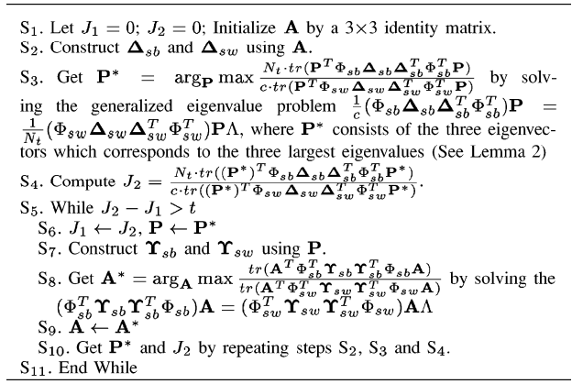
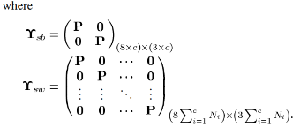
(5) Optimization- Iterative Fisher-Rao optimization
Code: package classification
program lda.py
package dataplot
program plot.py

Slide 15
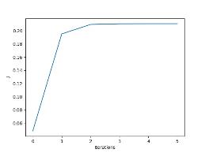
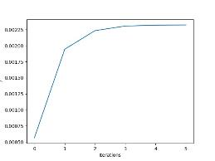
(5) Optimization- Iterative Fisher-Rao optimization - results
 | Image Type 1 | Image Type 2
A* | [[-0.75333141 1.43670891 -1.06533492] [-0.0386781 -1.88313552 0.19268587] [-0.25842227 0.40582022 0.9000814 ]] | [[ 0.29262545 0.37943054 0.6201555 ] [ 0.46058635 -1.26796741 -0.09822927] [-2.06987755 -0.90791054 -0.1073818 ]]
t (interval in J for convergence) | 0.00001 Converged after 5 steps | 0.00001 Converged after 5 steps
J* in MDC space | 0.21067343407967515 | 0.0023232204857797406
J* in RGB space | 0.04839291647985899 | 0. 0005676431394596465
Plot of J

Slide 16
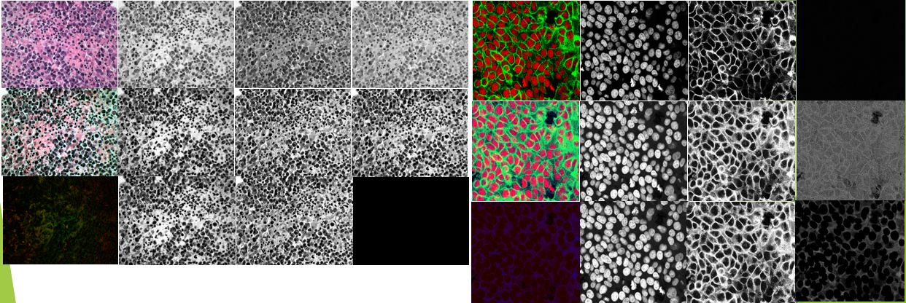
(6) Segmentation
Based on learnt A*, histogram equalised RGB image is transformed to MDC space
row 1: RGB channels, row2: RGB channels after histogram equalization, row3 : MDC channels

Slide 17
(6) Segmentation-continued
8 x 3 LFT feature matrices are extracted 11 x 11 neighbourhoods using integral map and projected by learnt P* to get more compact 3 x 3 feature matrices.
Number of samples are reduces to 20 positive and 20 negative using K-Means algorithm (K=20).
Class labels are decided using K-NN classifier (K=9).
Code: cellSegmentation.py
package transform
program mdc.py
package classification
kmean.py
knn.py

Slide 18
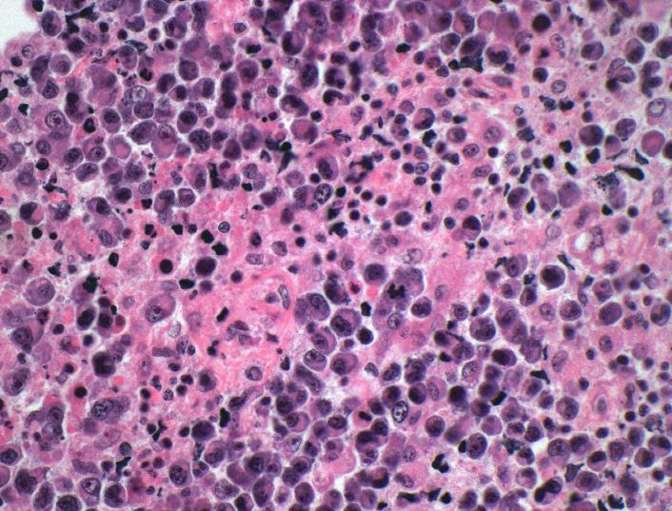
(6) Segmentation result – image 1 (Actual)
Actual image in RGB space

Slide 19
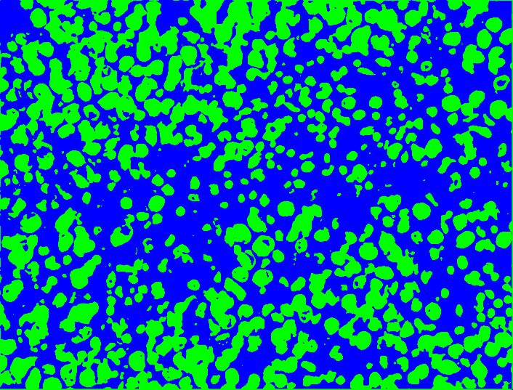
(6) Segmentation result – image 1 (segmented)
K-NN on MDC

Slide 20
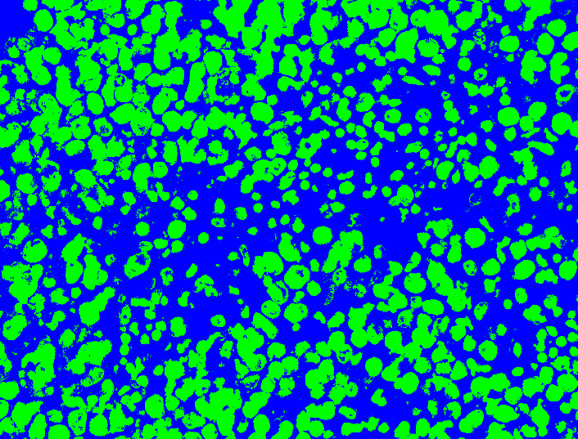
(6) Segmentation result – image 1-comparison
K-NN on RGB
(Segmentation quality is inferior to the result obtained in this implementation)

Slide 21

(6) Segmentation result – image 2 (Actual)
Actual image in RGB space

Slide 22
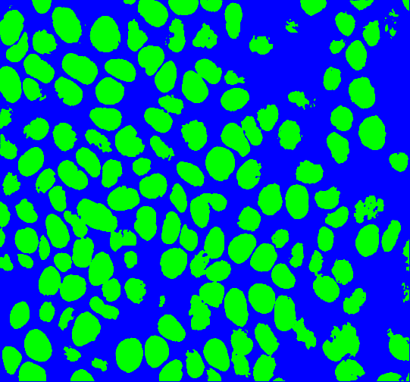
(6) Segmentation result – image 2 (segmented)
K-NN on MDC

Slide 23
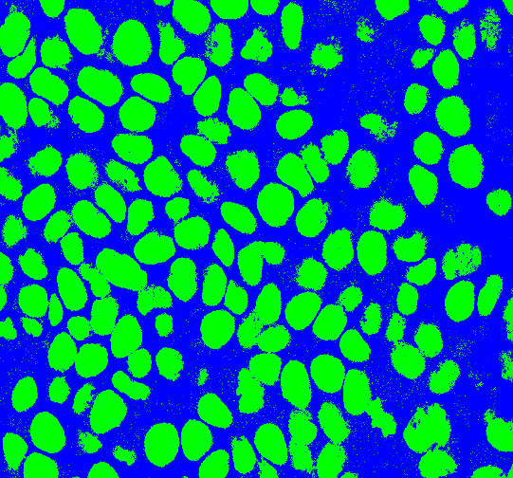
(6) Segmentation result – image 2-comparison
K-NN on RGB
(Segmentation quality is inferior to the result obtained in this implementation)

Slide 24
Learnings
Local Fourier Transform
Efficient LFT feature extraction using image shift
Integral map
Fisher-Rao optimization
Matrix operations using Python NumPy package
Scikit and OpenCV packages

Slide 25
References
F. Zhou, J.-F. Feng, and Q. Y. Shi, “Texture feature based on local fourier transform,” in Proc. IEEE Int. Conf. Image Process., 2001, pp. 610–613.
H.Yu,M. Li, H.-J. Zhang, and J. Feng, “Color texture moments for content-based image retrieval,” in Proc. IEEE Int. Conf. Image Process., 2002, vol. 3, pp. 929–933.
Eigenvalue and Generalized Eigenvalue Problems: Tutorial Benyamin Ghojogh, Fakhri Karray, Mark Crowley
R. O. Duda, P. E. Hart, and D. G. Stork, Pattern Classification, 2nd ed. New York: Wiley, 2001.

Slide 26
THANK YOU

