Slide 1
Security
Fusion AI Agent Studio Security – Basics
01
04
05
Role Setup: Create custom roles with the required permission groups enabled.
Access Assignment: Assign appropriate admin duty roles for configuration tasks and end-user privileges for agent interaction, based on organizational requirements.
06
CLOUDSHINE • ORACLE FUSION AI AGENT STUDIO

Slide 2
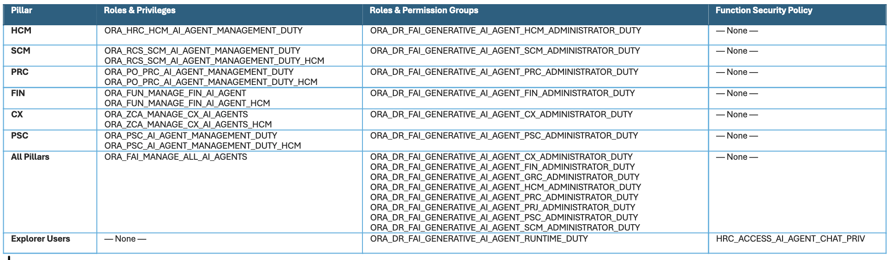
01
04
05
06
CLOUDSHINE • ORACLE FUSION AI AGENT STUDIO

Slide 3
01
04
05
Agent Creation Process
06
CLOUDSHINE • ORACLE FUSION AI AGENT STUDIO

Slide 4
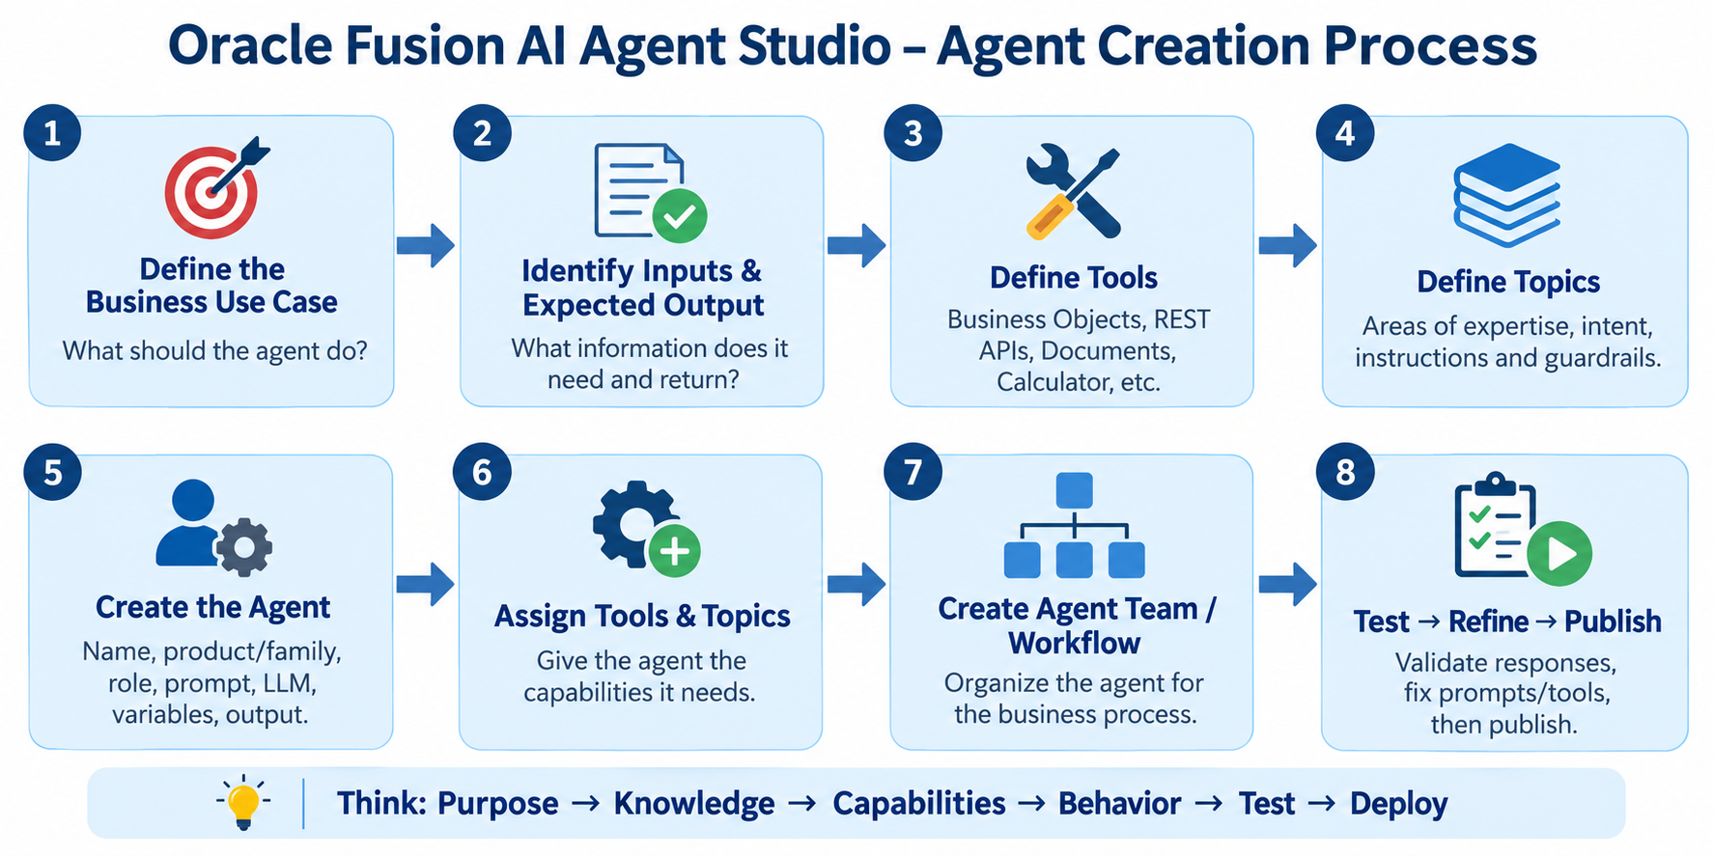
01
04
05
06
CLOUDSHINE • ORACLE FUSION AI AGENT STUDIO

Slide 5
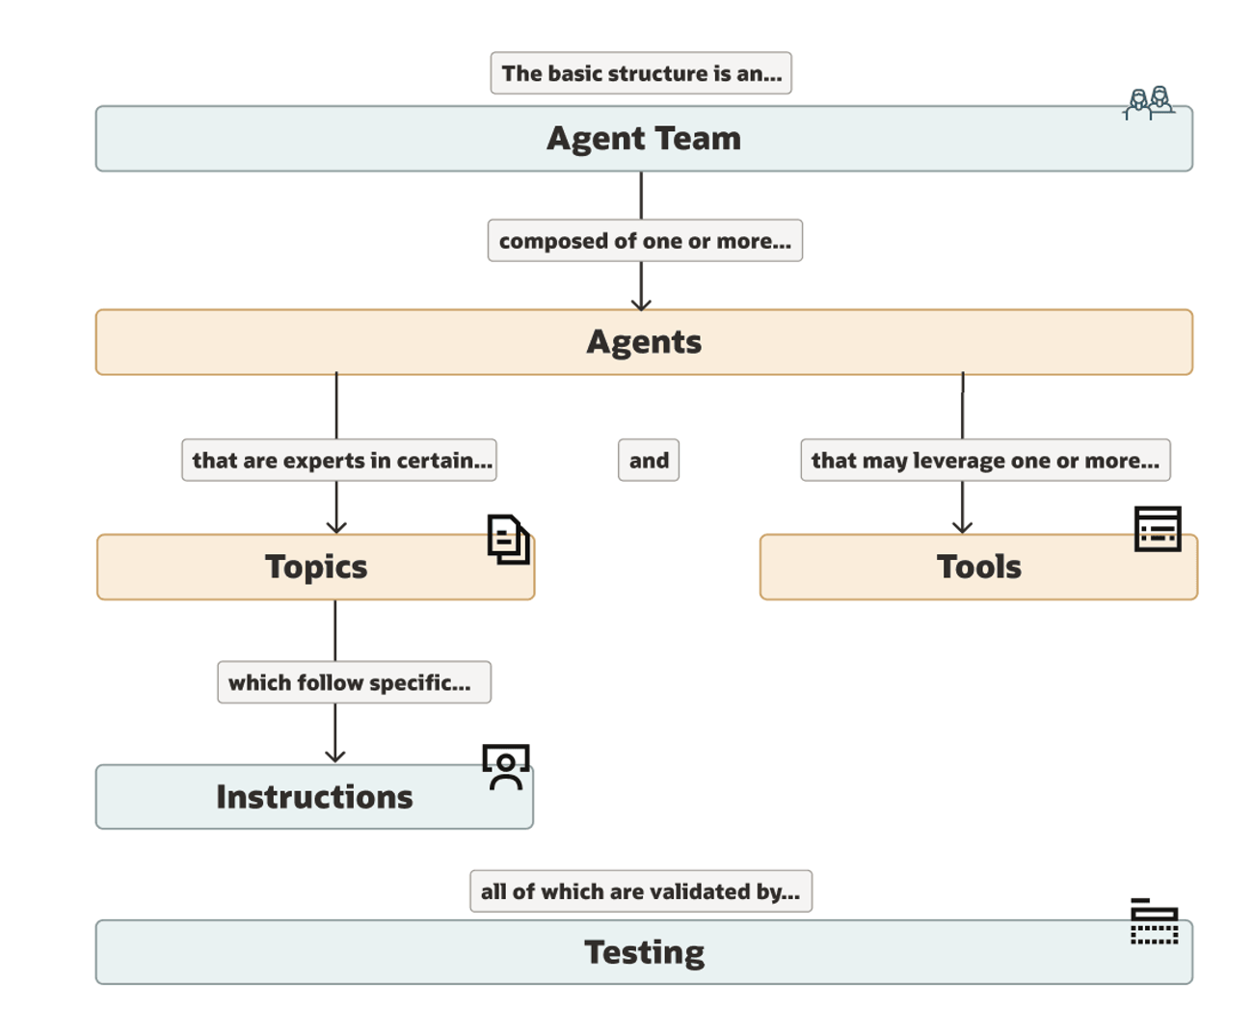
01
04
05
06
CLOUDSHINE • ORACLE FUSION AI AGENT STUDIO

Slide 6
01
04
05
Business Objects
06
CLOUDSHINE • ORACLE FUSION AI AGENT STUDIO

Slide 7
01
04
05
Rest APIs And Demo
06
CLOUDSHINE • ORACLE FUSION AI AGENT STUDIO

Slide 8
01
04
05
DeepLinks
06
CLOUDSHINE • ORACLE FUSION AI AGENT STUDIO

Slide 9
01
04
05
Demo
06
CLOUDSHINE • ORACLE FUSION AI AGENT STUDIO

Slide 10
01
04
05
Workflow Agent
06
CLOUDSHINE • ORACLE FUSION AI AGENT STUDIO

Slide 11
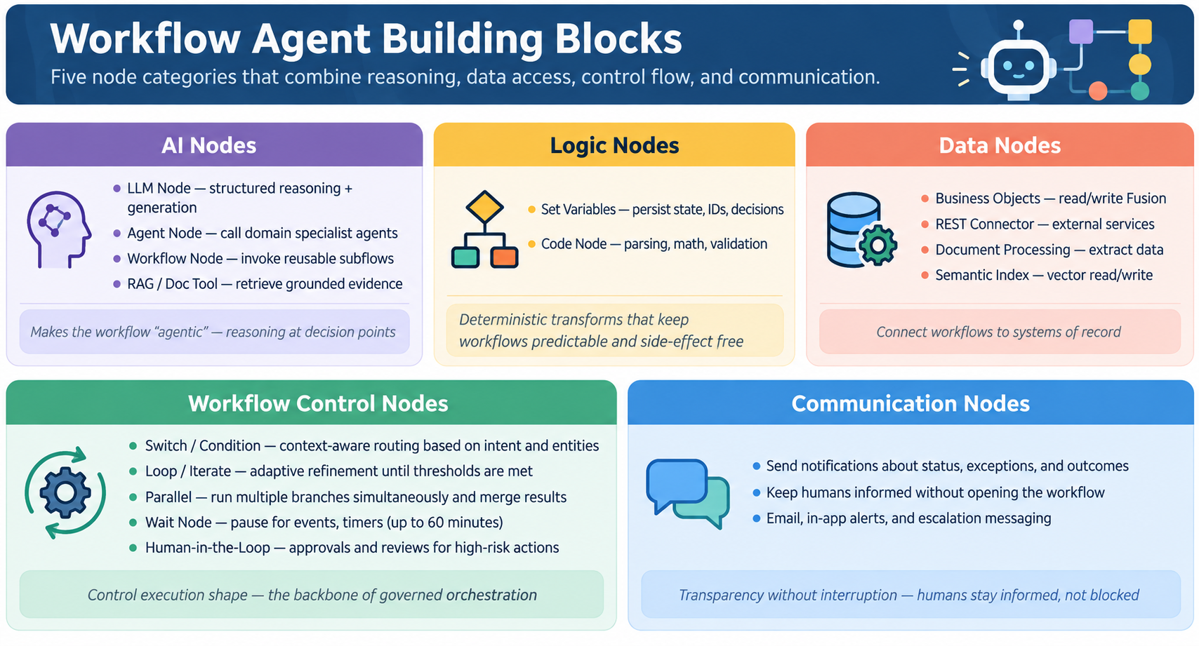
01
04
05
06
CLOUDSHINE • ORACLE FUSION AI AGENT STUDIO

Slide 12



