Slide 1


Programming with Java

Slide 2

Sujata Batra - sujatabatra@hotmail.com
Training Delivery Specialist Since 2000
Conducting Java Training Since 2011
More than 75+ Corporate Clients

Slide 3
Objective
Describe the key features of Java technology
Write, compile, and run a simple Java application
Describe the function of the Java Virtual Machine
Define garbage collection

Slide 4
History of Java
Conceived as Programming language for embedded systems like microwave ovens, televisions etc
One of the first projects developed using Java
    personal hand-held remote control named Star 7.
The original language was called Oak
Java was developed in the year 1991 at Sun Microsystems
  Java is a simple, object oriented, interpreted distributed, robust, secure, architecture neutral, portable high-performance, multithreaded, and dynamic language
Notes:
Java was conceived by a team of engineers in Sun Microsystems in 1991 as a part of a research project, which was led by James Gosling and Patrick Naughton. It took 18 months to develop the first working version. This language was initially called “Oak” but was renamed as “Java” in 1995.
Modeled after C++, the Java language was designed to be small, simple, and portable across platforms and operating systems, both at the source and at the binary level, which means that Java programs (applets and applications) can run on any machine that has the Java virtual machine installed.

Slide 5
Primary Goals of Java
Provides an easy-to-use language by:
  Avoiding many pitfalls of other languages
  Being object-oriented
  Enabling users to create streamlined and clear code
Provides an interpreted environment for:
  Improved speed of development
  Code portability
  Enables users to run more than one thread of activity
  Loads classes dynamically; that is, at the time they are actually needed
  Supports changing programs dynamically during runtime by loading classes from disparate sources

Slide 6
Features of Java
The following features fulfill these goals:
  The Java Virtual Machine (JVM)
  Garbage collection
  The Java Runtime Environment (JRE)
  JVM tool interface

Slide 7
The Java Virtual Machine
Executes instructions that a Java compiler generates.
A runtime environment, is embedded in various products, such as web browsers, servers, and operating systems
Its Imaginary machine that is implemented by emulating software on a real machine
Reads compiled byte codes that are platform-independent
Bytecode
  a special machine language that can be understood by the JVM independent of any particular computer hardware,

Slide 8
JVM Tasks
Loads code
  Loads all classes necessary for the execution of a program
  Maintains classes of the local file system in separate namespaces
Verifies code (Bytecode Verifier)
  The code adheres to the JVM specification.
  The code does not violate system integrity.
  The parameter types for all operational code are correct.
  No illegal data conversions have occurred.

Slide 9
Class Loader
Bootstrap Class Loader
  loads java’s core classes like java.lang, java.util etc.
Extensions Class Loader
  JAVA_HOME/jre/lib/ext contains jar packages that are extensions of standard core java classes.
  Extensions class loader loads classes from this ext folder.
  Using the system environment propery java.ext.dirs you can add ‘ext’ folders and jar files to be loaded using extensions class loader.
System Class Loader
  Java classes that are available in the java classpath are loaded using System class loader.

Slide 10
Garbage Collection
Allocated memory that is no longer needed should be deallocated.
In other languages, deallocation is the programmer’s responsibility.
The Java programming language provides a system-level thread to track memory allocation.
Garbage collection has the following characteristics:
  Checks for and frees memory no longer needed
  Is done automatically
  Can vary dramatically across JVM implementations

Slide 11
Application and Runtime Environment
The JRE of the SDK contains the complete set of class files for all the Java technology packages, which includes basic language classes, GUI component classes, and so on.
The Java Application Programming Interface (API) is prewritten code, organized into packages of similar topics.
Applet and AWT packages include classes for creating fonts, menus, and buttons. The full Java API is included in the Java 2 Standard Edition

Slide 12
Application and Runtime Environment
J2SE includes the essential compiler, tools, runtimes, and APIs for writing, deploying, and running applets and applications in the Java programming language.
JDK is the short-cut name for the set of Java development tools, consisting of the API classes, a Java compiler, and the Java virtual machine interpreter, regardless of which version.
The JDK is used to compile Java applications and applets. The most current version is the J2SE is 6.0

Slide 13
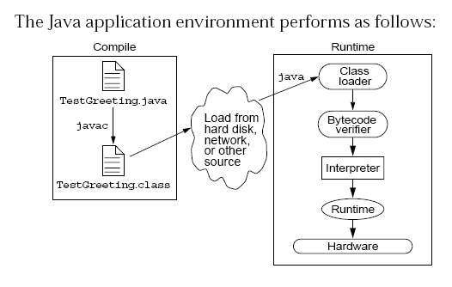
Java Run Time Environment

Slide 14
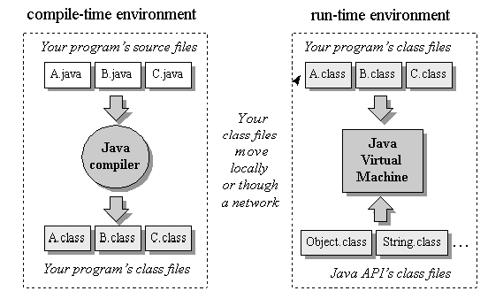
Compile time and Runtime Environment

Slide 15
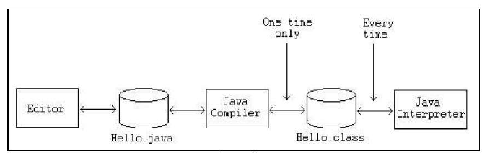
Phases of a Java Program
The following figure describes the process of compiling and executing a Java program

Slide 16
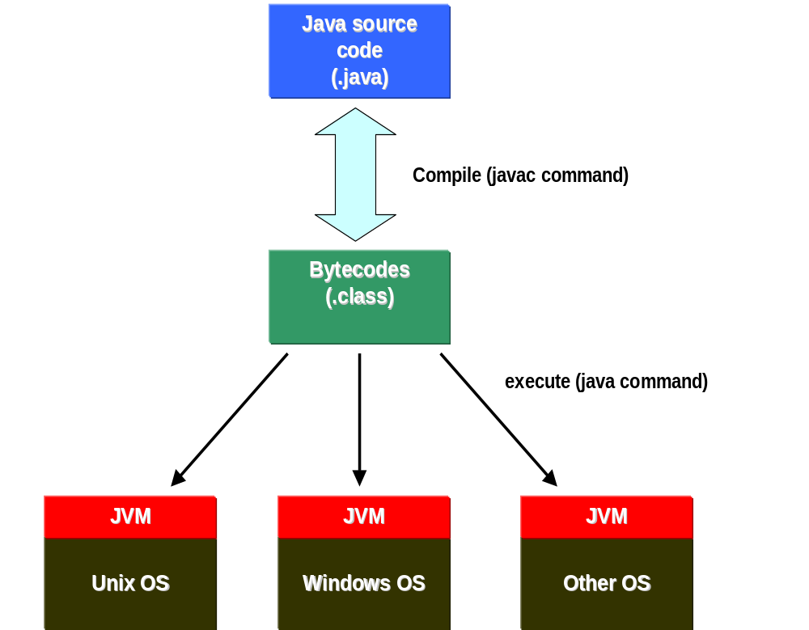

Slide 17
Integrated Development Environments
An IDE is the high-productivity tool
Used to edit, compile, and test programs, manage projects, debugging, building GUI interfaces, etc.
IDE provides extensive programming support for editing and project management,
The Popular IDE’s
  Eclipse
  NetBeans
  IntelliJ

Slide 18
Java language syntax

Slide 19
Objectives
Identify the basic parts of a Java program
Differentiate among Java literals, primitive data types,
variable types ,identifiers and operators
Develop a simple valid Java program using the concepts learned in this chapter

Slide 20
Program structure
A program in Java consists of one or more class definitions
One of these classes must define a method main(), which is where the program starts running
Java programs should always end with the .java extension.
There can be More than one Class Definition in a class ,but only one public class
Source Filenames should match the name of the public class.

Slide 21
Source File Layout
Basic syntax of a Java source file is:
[<package_declaration>]
<import_declaration>*
<class_declaration>+

Slide 22
Software Packages
Packages help manage large software systems.
Packages can contain classes and sub-packages.
package <top_pkg_name>[.<sub_pkg_name>]*;
Specify the package declaration at the beginning of the source file.
Only one package declaration per source file.
If no package is declared, then the class is placed into the default package.
Package names must be hierarchical and separated by dots.

Slide 23
The import Statement
import <pkg_name>[.<sub_pkg_name>]*.<class_name>;
import <pkg_name>[.<sub_pkg_name>]*.*;
import java.util.List;
import java.io.*;
import shipping.gui.reportscreens.*;
The import statement does the following:
  Precedes all class declarations
  Tells the compiler where to find classes

Slide 24
Example 1.1
  package com.training;
  public class Greetings {
  public String getMessage() {
  return "Welcome to Java Programming";
  }
  }

Slide 25
Example 1.1 (contd)
  package com.training;
  public class TestGreetings {
  public static void main(String[] args) {
  Greetings grtObj = new Greetings();
  System.out.println(grtObj.getMessage());
  }
  }

Slide 26
The System Class
Its part of the java.lang package
The classes in this package are available without the need for an import statement
This class contains several useful class fields and methods.
It can’t be Instantiated
It also Provides facilities for
  Standard Input
  Standard Output
  Error Output Streams
  Access to externally defined properties

Slide 27
Objectives
Define modeling concepts: abstraction, encapsulation,
Discuss why you can reuse Java technology application code
Define class, member, attribute, method, constructor, and package
Use the access modifiers private and public as appropriate for the guidelines of encapsulation
Invoke a method on a particular object
Use the Java technology application programming interface (API) online documentation

Slide 28
The Analysis and Design Phase
Analysis describes what the system needs to do:
Modeling the real-world, including actors and activities, objects, and behaviors
Design describes how the system does it:
Modeling the relationships and interactions between objects and actors in the system
Finding useful abstractions to help simplify the problem or solution

Slide 29
Abstraction
Functions – Write an algorithm once to be used in many situations
Objects – Group a related set of attributes and behaviors into a class
Frameworks and APIs – Large groups of objects that support a complex activity;
Frameworks can be used as is or be modified to extend the basic behavior

Slide 30
Classes as Blueprints for Objects
In manufacturing, a blueprint describes a device from which many physical devices are constructed.
In software, a class is a description of an object:
A class describes the data that each object includes.
A class describes the behaviors that each object exhibits.
In Java technology, classes support three key features OOP
  Encapsulation
  Inheritance
  Polymorphism

Slide 31
Declaring Java Technology Classes
Basic syntax of a Java class:
  <modifier>* class <class_name> {
  <attribute_declaration>*
  <constructor_declaration>*
  <method_declaration>*
  }

Slide 32
Declaring Attributes
Basic syntax of an attribute:
<modifier>* <type> <name> [ = <initial_value>];
public class Foo {
private int x;
private float y = 10000.0F;
private String name = "Bates Motel";
}

Slide 33
Declaring Methods
Basic syntax of a method:
<modifier>* <return_type> <name> ( <argument>* ) {
<statement>*
}
  public int getWeight() {
  return weight;
  }
  public void setWeight(int newWeight) {
  if ( newWeight > 0 ) {
  weight = newWeight;
  }
  }

Slide 34
Accessing Object Members
The dot notation is: <object>.<member>
  used to access object members, including attributes and methods.
d.setWeight(42);
d.weight = 42; // only permissible if weight is public

Slide 35
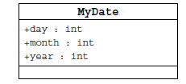
Information Hiding
Client code has direct access to internal data
(d refers to a MyDate object):
d.day = 32; // invalid day
d.month = 2; d.day = 30; // plausible but wrong
d.day = d.day + 1; // no check for wrap around

Slide 36
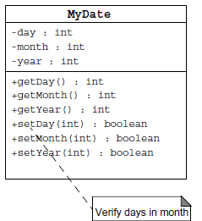
Encapsulation
Hides the implementation details of a class
Forces the user to use an interface to access data
Makes the code more maintainable

Slide 37
Objects and Data Abstraction
Consider the data
  In many applications, data is more complicated than just a simple value
  An Employee
    The data here are actually:
      int empId – an integer of Employee Id
      double[] phoeNumber – an array of Phone Numbers
      double salary – the salary of employee
    Note that individually the data are just int or a double
      However, together they make up a Employee
    This is fundamental to object-oriented programming (OOP)

Slide 38
Objects and Data Abstraction
Consider the operations
  Now consider operations that an Employee can do
    Note how that is stated – we are seeing what a Employee CAN DO rather than WHAT CAN BE DONE to it
    This is another fundamental idea of OOP – objects are ACTIVE rather than PASSIVE
Objects enable us to combine the data and operations of a type together into a single entity

Slide 39
Encapsulation and Data Abstraction
  We do not need to know the implementation details of a data type in order to use it
    This includes the methods AND the actual data representation of the object
  This concept is exemplified through objects
    We can think of an object as a container with data and operations inside
      We can see some of the data and some of the operations, but others are kept hidden from us
      The ones we can see give us the functionality of the objects

Slide 40
Declaring Constructors
Basic syntax of a constructor
  [<modifier>] <class_name> ( <argument>* ) {
  <statement>*
  }
  public class Dog {
  private int weight;
  public Dog() {
  weight = 42;
  }
  }

Slide 41
The Default Constructor
There is always at least one constructor in every class.
If the writer does not supply any constructors, the default constructor is present automatically:
The default constructor takes no arguments
The default constructor body is empty
The default enables you to create object instances with new Xxx()without having to write a constructor.

Slide 42
Comments
Java supports three forms of comments
  // single line comments
  /* multi
    line
    comment
    */
  /** a
    * Javadoc
    * comment
    */

Slide 43
Variables and Methods
A variable, which corresponds to an attribute, is a named memory location that can store a certain type of value.
Variable is a kind of special container that can only hold objects of a certain type.
Primitive type Variable
    Basic, built-in types that are part of the Java language
    Two basic categories
      boolean
      Numeric
        Integral - byte, short, int, long, char
        Floating point - float, double

Slide 44
Instance Variables and Methods
Variables and methods can be associated either with objects or their classes
An instance variable and instance method belongs to an object.
They can have any one of the four access levels
  Three access modifies – private, public , protected
  Can be Marked final, transient
They have a default value
A class variable (or class method) is a variable (or method) that is associated with the class itself.

Slide 45
Example for Variables
  public class VariableTypes {
  private int inst_empid;
  private static String cls_empName
  public void getData() { }
  public static void getSalary() { }
  public void showData(int a)
  {
  int localVariable ;
  }
  }
Instance Variable
Class Variable
Parameter Variable
Local Variable

Slide 46
Identifiers
Identifiers are used to name variables, methods, classes and interfaces
Identifiers
  start with an alphabetic character
  can contain letters, digits, or “_”
  are unlimited in length
Examples
  answer, total, last_total, relativePoint, gridElement, person, place, stack, queue

Slide 47
Initialization
Local variables
  must be explicitly initialized before use
Parameter variables
  Pass by value
Class and instance variables
  Instance variables Have a Default Value

Slide 48
Local Variable needs to Be Initialized
  public class LocalVariable {
  private String name;
  public void display()
  {
  int age;
  System.out.println("Age"+age);
  System.out.println("Name"+name);
  }
Age Should be Initialized before Use

Slide 49
Instance Variable have Default Values
class Values
{
private int a;
private float b;
private String c;
public void display()
{
System.out.println("integer"+a);
System.out.println("float"+b);
System.out.println("String"+c);
}
public class DefaultVales {
public static void main(String[] args) {
Values v = new Values();
v.display();
}
}

Slide 50
Assignment of reference variables
int x = 7;
int y = x;
String s = “Hello”;
String t = s;
x
y
s
t
7
7
0x01234
0x01234
Hello

Slide 51
Pass-by-Value
The Java programming language only passes arguments by value for primitive data types.
When an object instance is passed as an argument to a method, the value of the argument is a reference to the object
The contents of the object can be changed in the called method, but the object reference is never changed
For primitives, you pass a copy of the actual value.
For references to objects, you pass a copy of the reference
You never pass the object. All objects are stored on the heap.
Notes:
The Java programming language only passes arguments by value.
When an object instance is passed as an argument to a method, the value of the argument is a reference to the object.
The contents of the object can be changed in the called method, but the object reference is never changed .

Slide 52

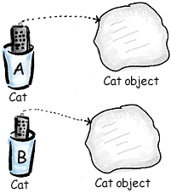
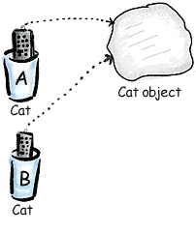
Pass By Value

Slide 53
Casting Primitive Types
Casting creates a new value and allows it to be treated as a different type than its source
JVM can implicitly promote from a narrower type to a wider type
To change to a narrow type explicit casting is required
Byte -> short -> int -> long -> float -> double

Slide 54
Casting Primitive Types
  public class PrimCasting {
  public static void main (String [] args){
  int x = 99;
  double y = 5.77;
  x = (int)y; //Casting
  System.out.println("x = "+ x);
  double y1 = x; //No Casting
  int i =42;
  byte bt;
  bt= (byte)i;
  System.out.println("The Short number"+ bt);
  }
  }

Slide 55
Flow Control

Slide 56
Objectives
Decision control structures (if, else, switch)
Repetition control structures (while, do-while, for)
Branching statements (break, continue, return)

Slide 57
Control Structures
To change the ordering of the statements in a program
Two types of Control Structures
decision control structures ,
  allows us to select specific sections of code to be executed
    if -- else , if – else if
    switch -- case
repetition control structures
  allows us to execute specific sections of the code a number of times
    while
    do -- while
    for

Slide 58
Decision Control Structures
Types:
  if-statement
  if-else-statement
  If-else if-statement
If Specifies that a statement or block of code will be executed if and only if a certain boolean statement is true.
      if( boolean_expression )
      statement;
    or
      if( boolean_expression ){
      statement1;
      statement2;
      }
boolean_expression : can be an expression or variable.

Slide 59
if-else statement
if( boolean_exp ){
Statement(s)
}
else {
Statement(s)
}
  if(boolean_exp1 )
  statement1;
  else if(boolean_exp2)
  statement2;
  else
  statement3;
For Comparison == used instead =
= being an assignment operator
equals Method Should Be Used for Objects comparison

Slide 60
switch-statement
Allows branching on multiple outcomes.
switch expression is an integer ,character expression or variable
case_selector1, case_selector2 and unique integer or character constants.
If none of the cases are satisfied, the optional default block if present is executed.
    switch( switch_expression ){
    case case_selector1:
    Statement(s);
    break;
    case case_selector2:
    Statement(s);
    break;
    default:
    statement1;
    }

Slide 61
switch-statement
When a switch is encountered,
  evaluates the switch_expression,
  jumps to the case whose selector matches the value of the expression.
  executes the statements in order from that point on until a break statement is encountered
  break statement stops executing statements in the subsequent cases, it will be last statement in a case.
  Used to make decisions based only on a single integer or character value.
  The value provided to each case statement must be unique.

Slide 62
switch-statement
  public double CalculateDiscount(int pCode)
  {
  double discountPercentage=0.0d;
  switch(pCode)
  {
  case 1:
  discountPercentage=0.10d;
  break;
  case 2:
  discountPercentage=0.15d;
  break;
  case 3:
  discountPercentage=0.20d;
  break;
  default:
  discountPercentage=0.0;
  }
  return discountPercentage;
  }

Slide 63
Switch-Case in a Method
Can have Either Return or Break if present inside a Method, but should provide a default Value
    public String switchExample(int key) {
    switch (key) {
    case 1:
    return "Good Morning";
    case 2:
    return "Good AfterNoon";
    case 3:
    return "Good Evening";
    default:
    return "Good Night";
    }

Slide 64
Repetition Control Structures
while-loop
  The statements inside the while loop are executed as long as the Boolean expression evaluates to true
do-while loop
  statements inside a do-while loop are executed several times as long as the condition is satisfied, the statements inside a do-while loop are executed at least once
Watch this
  while(boolean_expression){
  statement1;
  statement2;
  }
do{
statement1;
statement2;
}while(boolean_expression);

Slide 65
for-loop
Same code a number of times.
for(Initialexpr;LoopCondition;StepExpr) {
  statement1;
  }
  Declaration parts are left out so the for loop will act like an endless loop.
  for( ; ; ) {
    System.out.println("Inside an endless loop");
  }

Slide 66
Enhanced For Loop
The enhanced for loop, simplifies looping through an array or a collection.
Instead of having three components, the enhanced for has two.
declaration
  The newly declared block variable, of a type compatible with the elements of the array being accessed.
expression
  This must evaluate to the array you want to loop through. This could be an array variable or a method call that returns an array
int [] a = {1,2,3,4};
for(int n : a)
System.out.print(n);.

Slide 67
Branching Statements
Branching statements allows to redirect the flow of program execution.
  break
  continue
  return.
System.exit() All program execution stops; the VM shuts down.

Slide 68
Classes

Slide 69
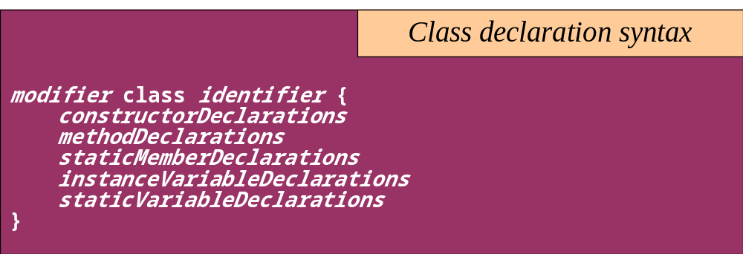
Classes
The class declaration introduces a new class
  A class describes the structure and behavior of its instance objects in terms of instance variables and methods
  Like variables, classes may be declared at different scopes. The scope of a class directly affects certain properties of the class

Slide 70
Classes
Top-level classes can be declared as
  public
    a public class is globally accessible.
    a single source file can have only one public class or interface
  abstract
    an abstract class cannot be instantiated
  final
    a final class cannot be subclassed
  Default
    With any Modifier
They can’t be declared as protected and private

Slide 71
Constructors
Have no return type
Have the same name as the class
If we don't’ put a constructor the compiler puts a default one
  The default constructor has the same access modifier as the class.
  The default constructor has no arguments.
  The default constructor is always a no-arg constructor, but a no-arg constructor is not necessarily the default constructor
  The default constructor includes a no-arg call to the super constructor (super()).
They are not inherited and hence they are not overridden
It can be Overloaded
It can have any of the Four Access Modifies
It cannot be synchronized
It can have throws clause

Slide 72
Instantiation with new
It is the process by which individual objects are created.
  Class objectReference = new Constructor();
Declaration
  Employee empObj;
Instantiation
  empObj = new Employee()
Declaration and Instantiation
  Employee empObj = new Employee()
  new operator allocates memory for an object.

Slide 73
Constructor Overloading
One constructor can call another overloaded constructor of the same class by using this keyword.
this() is used to call a constructor from another overloaded constructor in the same class
The call to this() can be used only in a constructor ,and must be the first statement in a constructor
A constructor can call its super class constructor by using the super keyword.
A constructor can have a call to super() or this() but never both

Slide 74
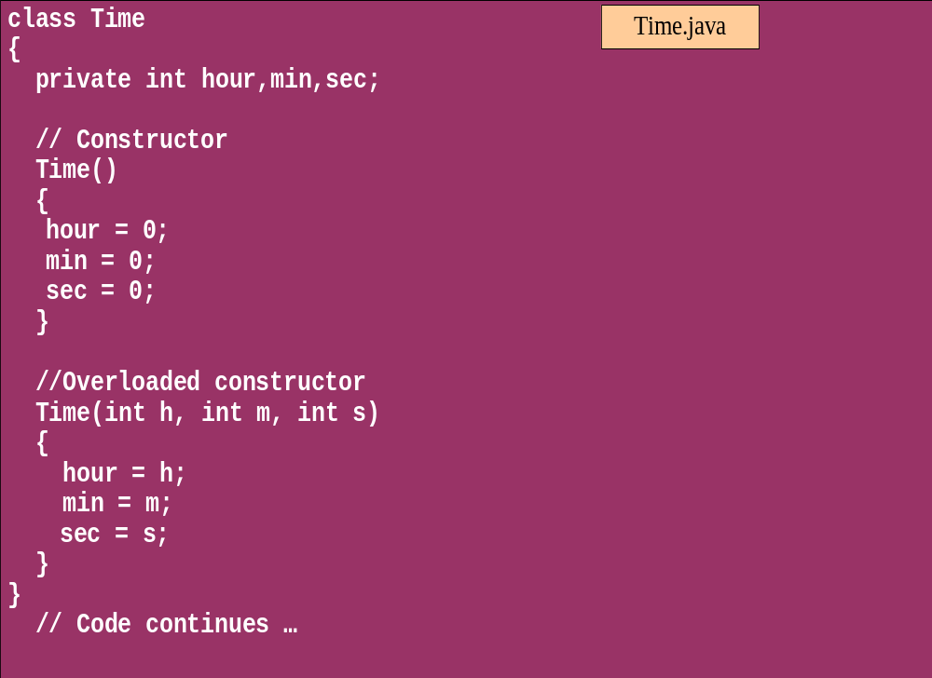
Overloaded Constructor

Slide 75
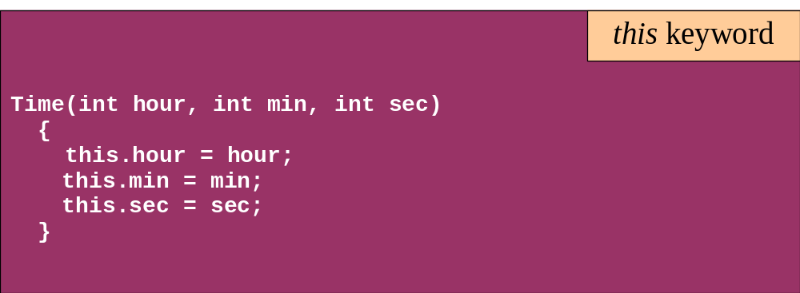
this keyword
Is a reference to the object from which the method was invoked

Slide 76
Modifiers for declarations
There are Four Access Level and 3 Modifiers
Any declaration can be preceded by
  public
    a declaration is accessible by any class
  protected
    Accessible by any class in the same package as its class, and accessible only by subclasses of its class in other packages.
    Works just like default , Except it also allows subclasses outside the package to inherit the protected thing.
  default(no modifier)
    Only accessible by classes, including subclasses, in the same package as its class(package accessibility).
  private
    a declaration is only accessible within the class in which it is declared

