Slide 1
CI/CD

Slide 2
What is CI/CD
CI/CD is the practice of automating the integration of code changes from multiple developers into a single codebase.
It is a software development practice where the developers commit their work frequently to the central code repository (Github or Stash).
Then there are automated tools that build the newly committed code and do a code review, etc as required upon integration.

Slide 3
What is CI/CD
The key goals of Continuous Integration are to find and address bugs quicker, make the process of integrating code across a team of developers easier, improve software quality, and reduce the time it takes to release new feature updates.
Some popular CI tools are Jenkins, TeamCity, and Bamboo.

Slide 4
Continuous Integration
With Continuous Integration, developers frequently commit to a shared common repository using a version control system such as Git.
A continuous integration pipeline can automatically run builds, store the artifacts, run unit tests, and even conduct code reviews using tools like Sonar.
We can configure the CI pipeline to be triggered every time there is a commit/merge in the codebase.

Slide 5
Continuous Delivery
Continuous delivery helps developers test their code in a production-similar environment, hence preventing any last-moment or post-production surprises.
These tests may include UI testing, load testing, integration testing, etc.
By automating the software release process, CD contributes to low-risk releases, lower costs, better software quality, improved productivity levels, and most importantly, it helps us deliver updates to customers faster and more frequently.

Slide 6
Continuous Delivery
Continuous Delivery is carried out after Continuous Integration to make sure that we can release new changes to our customers quickly in an error-free way.
This includes running integration and regression tests in the staging area (similar to the production environment) so that the final release is not broken in production.
It ensures automation of the release process so that we have a release-ready product at all times and we can deploy our application at any point in time.

Slide 7
Continuous Delivery
Continuous Delivery automates the entire software release process.
The final decision to deploy to a live production environment can be triggered by the developer/project lead as required.
Some popular CD tools are AWS CodeDeploy, Jenkins, and GitLab.

Slide 8
Continuous Deployment
The final stage of CI and CD will be continuous deployment.
It's an extension of continuous delivery, which automate the proper code to the code repository, continuous deployment will automate the related app for production purpose because there is not having any manual gate at the stage of the pipeline before production, continuous deployment relies on high automation.

Slide 9
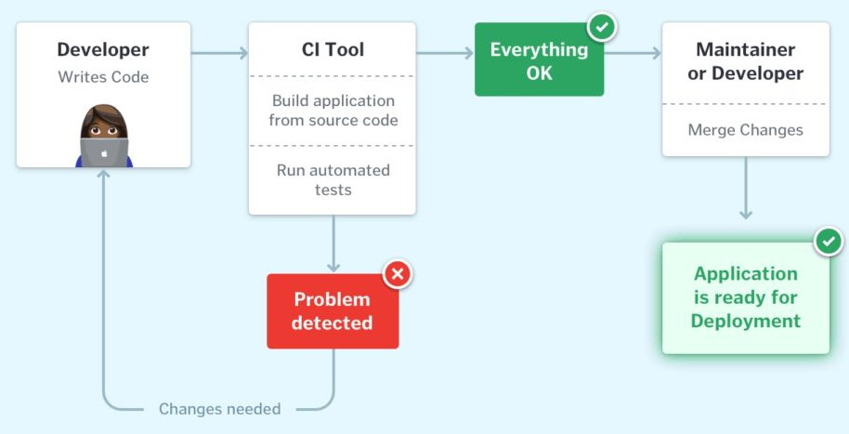
CI Workflow

Slide 10
CI Workflow
Once the developer commits their code to a version control system like Git, it triggers the CI pipeline which fetches the changes and runs automated build and unit tests.
Based on the status of the step, the server then notifies the concerned developer whether the integration of the new code to the existing code base was a success or a failure.
This helps in finding and addressing the bugs much more quickly, makes the team more productive by freeing the developers from manual tasks, and helps teams deliver updates to their customers more frequently.

Slide 11
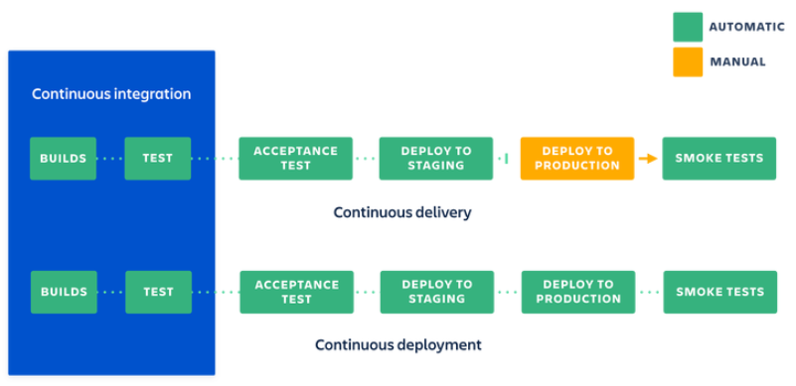
CI and CD Workflow

Slide 12
CI and CD Workflow
We have seen how Continuous Integration automates the process of building, testing, and packaging the source code as soon as it is committed to the code repository by the developers.
Once the CI step is completed, the code is deployed to the staging environment where it undergoes further automated testing (like Acceptance testing, Regression testing, etc.).
Finally, it is deployed to the production environment for the final release of the product.

Slide 13
Why CI/CD important
CI/CD tool helps in the automaton of software delivery process from writing code step to deploying it in live production environment.
When developers push code, CI/CD tools like Jenkins, Github Actions etc automatically build the application, run tests to catch the bugs in the early stage and deploy the code to servers in a consistent and authentic way.
This automation enables faster feedback, reduces manual errors and speeds up the release cycle. As a result, teams can deliver high quality software faster and more efficient way after this.

Slide 14
What are the Benefits of CI/CD?
Improves Software Quality & Security: Automated testing helps catch bugs early, making the software more reliable and secure.
Makes Code More Profitable: By reducing errors, companies spend less time fixing issues and more time delivering value.
Speeds Up Product Releases: CI/CD pipelines help roll out new features faster, keeping customers happy.
Reduces Developer Workload: Automation takes care of repetitive tasks, allowing developers to focus on innovation.
Gives a Competitive Edge: Faster updates help businesses stay ahead of their competitors.

Slide 15
What are the Benefits of CI/CD?
Attracts Skilled Professionals: A well-structured CI/CD process creates an efficient work environment that appeals to top talent.
Eliminates Bottlenecks: By moving away from slow, step-by-step processes, teams can work more efficiently.

Slide 16
What is CI/CD Pipelines?
Continuous Integration and Continuous Delivery(CI/CD) refers to the set of processes where you can made multiple changes to the code simultaneously to improve software delivery while a CI/CD pipeline is a process that takes your code from development to production automatically and smoothly.
While,CI/CD pipeline is the combination of automated steps that helps software development teams to deliver code in quick, secure and efficient way. In simple words we can CI/CD pipeline is a process of taking your code from development to production environment automatically and smoothly.

Slide 17
Steps in CI/CD pipeline
Source Stage
A developer writes code using any IDEs like VSCode or Pycharm. After writing the complete code pushes that code to shared repository(like Github,Gitlab). The Github stores everything like Code, test scripts, documentation and even build files.
Build Stage
Once the code is pushed,a CI tool like Github Actions or Jenkins is triggered automatically. The pipeline pulls the code, install all the dependencies, compiles the code and packages it.

Slide 18
Steps in CI/CD pipeline
Test Stage
After the build is ready, a series of automated tests are run:
Unit tests to check small pieces of code
Integration tests to check how components work together
Static code analysis by using Synk or SonarQube for security issues.
User Acceptance Tests (UAT) by using tools like Selenium to validate functionality.
If all tests pass, the pipeline continues.
If any tests fails, the pipeline will stop working and report the issue. The test reports are integrated into Github Actions or Jenkins.

Slide 19
Steps in CI/CD pipeline
Deployment Stage
If tests pass, the pipeline deploys the app:
First, it is deployed to a staging server for final checks.
After approval, it automatically goes to production server where users can use it.
For example:
The app is packaged into a Docker image and stored in Docker Hub
Then it’s deployed using Ansible, which sets up the server and runs the app
With this CI/CD pipeline:
Every time developer pushes code, the app is automatically built, tested, and deployed.
Teams catch bugs early, reduce manual work, and release features faster with more confidence.

