Slide 1
PostgreSQL
By : Sujata Batra

Slide 2
Introduction
PostgreSQL is an Object-relational Database Management System (ORDBMS) based on POSTGRES, Version 4.2, developed at the University of California at Berkeley Computer Science Department.
PostgreSQL supports a large part of the SQL standard and offers many modern features:
- Complex Queries
- Foreign Keys
- Triggers
- Updatable Views
- Transactional Integrity
- Multi Version Concurrency Control (MVCC)
PostgreSQL can be extended by the user in many ways, for example by adding new:
- Data Types
- Functions
- Operations
- Aggregate Functions
- Index Method
-Procedural Language

Slide 3
History
With over two decades of development behind it, PostgreSQL is now the most advanced open-source database available anywhere.
The POSTGRES project, led by Professor Michael Stonebraker, was sponsored by the Defense Advanced Research Projects Agency (DARPA), the Army Research Office (ARO), the National Science Foundation (NSF), and ESL, Inc. The implementation of POSTGRES began in 1986.
In 1994, Andrew Yu and Jolly Chen added an SQL language interpreter to POSTGRES. Under a new name, Postgres95 was subsequently released to the web to find its own way in the world as an open-source descendant of the original POSTGRES Berkeley code.
In 1995, POSTGRES was renamed as PostgreSQL.

Slide 4
Installation
To make an installation PostgreSQL. We have two ways:
1. Install PostgreSQL from source code:
You can go to website to download from http://www.postgresql.org/ftp/source
2. Install PostgreSQL from file:
You can go to website to download binary file from http://www.postgresql.org/download/.
Note: In database jargon, PostgreSQL uses a client/server model. A PostgreSQL session consists of the following cooperating processes (programs):
- A server process, which manages the database files, accepts connections to the database from client applications, and performs database actions on behalf of the clients. The database server program is called postgres.
- The user's client (frontend) application that wants to perform database operations. Client applications can be very diverse in nature: a client could be a text-oriented tool, a graphical application, a web server that accesses the database to display web pages, or a specialized database maintenance tool. Some client applications are supplied with the PostgreSQL distribution; most are developed by users.

Slide 5
Manipulated Database
To create a database, we have two ways to create:
1. First way: we can use by command to create:
Ex: createdb dbname
2. Second way: we can use by sql standard to create:
Ex: create database dbname;
To drop a database, we have two ways to drop:
1. First way: we can use by command to drop:
Ex: dropdb dbname
2. Second way: we can use by sql standard to drop:
Ex: drop database dbname;

Slide 6
Accessing Database
To access to PostgreSQL database, we have several ways:
1. Using PostgreSQL Terminal:
PostgreSQL provides a terminal to access, is called psql.
$ psql dbname
2. Using GUI Tools:
GUI Tools that can access to PostgreSQL such as Navicat, PgAdmin, PHPPgAdmin, …
3. Using Customize Applications:
Using one of the several available language bindings.

Slide 7
SQL Language
Every Databases, they have to follow the SQL standard. The SQL provides as below:
1. Data Definition Language (DDL)
2. Data Manipulation Language (DML)
3. Data Control Language (DCL)
4. Transaction Control (TCL)

Slide 8
DDL
Data Definition Language (DDL) statements are used to define the database structure or schema.
Some examples:
1. CREATE - to create objects in the database
2. ALTER - alters the structure of the database
3. DROP - delete objects from the database
4. TRUNCATE - remove all records from a table, including all spaces allocated for the records are removed
5. COMMENT - add comments to the data dictionary
6. RENAME - rename an object

Slide 9
DML
Data Manipulation Language (DML) statements are used for managing data within schema objects.
Some examples:
1. SELECT - retrieve data from the a database
2. INSERT - insert data into a table
3. UPDATE - updates existing data within a table
4. DELETE - deletes all records from a table, the space for the records remain
5. MERGE - UPSERT operation (insert or update)
6. CALL - call a PL/SQL or Java subprogram
7. EXPLAIN PLAN - explain access path to data
8. LOCK TABLE - control concurrency

Slide 10
DCL
Data Control Language (DCL) statements.
Some examples:
1. GRANT - gives user's access privileges to database
2. REVOKE - withdraw access privileges given with the GRANT command

Slide 11
TCL
Transaction Control (TCL) statements are used to manage the changes made by DML statements. It allows statements to be grouped together into logical transactions.
Some example:
1. COMMIT - save work done
2. SAVEPOINT - identify a point in a transaction to which you can later roll back
3. ROLLBACK - restore database to original since the last COMMIT
4. SET TRANSACTION - Change transaction options like isolation level and what rollback segment to use

Slide 12
Creating a New Table
You can create a table using CREATE keyword.
Syntax:
CREATE TABLE [IF NOT EXISTS] table_name (
column1 datatype(length) column_constraint,
column2 datatype(length) column_constraint,
... table_constraints);

Slide 13
PostgreSQL supports the following data types:
Boolean
A Boolean data type can hold one of three possible values: true, false, or null.
Character types such as char, varchar, and text.
CHAR(n) is the fixed-length character with space padded. If you insert a string that is shorter than the length of the column, PostgreSQL pads spaces. If you insert a string that is longer than the length of the column, PostgreSQL will issue an error.
VARCHAR(n) is the variable-length character string. The VARCHAR(n) allows you to store up to n characters. PostgreSQL does not pad spaces when the stored string is shorter than the length of the column.
TEXT is the variable-length character string. Theoretically, text data is a character string with unlimited length.

Slide 14
PostgreSQL supports the following data types:
Numeric types such as integer and floating-point number.
PostgreSQL provides two distinct types of numbers:
Integers
There are three kinds of integers in PostgreSQL:
Small integer ( SMALLINT) is a 2-byte signed integer that has a range from -32,768 to 32,767.
Integer ( INT) is a 4-byte integer that has a range from -2,147,483,648 to 2,147,483,647.
Serial is the same as integer except that PostgreSQL will automatically generate and populate values into the SERIAL column.
floating-point numbers
There are three main types of floating-point numbers:
float(n) is a floating-point number whose precision, is at least, n, up to a maximum of 8 bytes.
realor float8is a 4-byte floating-point number.
numericor numeric(p,s) is a real number with p digits with s number after the decimal point. This numeric(p,s) is the exact number.

Slide 15
PostgreSQL supports the following data types:
Temporal types such as date, time, timestamp, and interval
PostgreSQL has five main temporal data types:
DATE stores the dates only.
TIME stores the time of day values.
TIMESTAMP stores both date and time values.
TIMESTAMPTZ is a timezone-aware timestamp data type. It is the abbreviation for timestamp with the time zone.
INTERVAL stores periods.
UUID for storing Universally Unique Identifiers
The UUID data type allows you to store Universal Unique Identifiers defined by RFC 4122 . The UUID values guarantee a better uniqueness than SERIAL and can be used to hide sensitive data exposed to the public such as values of id in URL.

Slide 16
PostgreSQL supports the following data types:
Array for storing array strings, numbers, etc.
In PostgreSQL, you can store an array of strings, an array of integers, etc., in array columns. The array comes in handy in some situations e.g., storing days of the week, and months of the year.
JSON stores JSON data
PostgreSQL provides two JSON data types:
JSON : The JSON data type stores plain JSON data that requires reparsing for each processing.
JSONB : The JSONB data type stores JSON data in a binary format which is faster to process but slower to insert. In addition, JSONB supports indexing, which can be an advantage.

Slide 17
PostgreSQL supports the following data types:
Special types such as network address and geometric data.
box – a rectangular box.
line– a set of points.
point – a geometric pair of numbers.
lseg – a line segment.
polygon – a closed geometric.
inet – an IP4 address.
macaddr– a MAC address.

Slide 18

Constraints
PostgreSQL includes the following column constraints:
NOT NULL– ensures that the values in a column cannot be NULL.
UNIQUE – ensures the values in a column are unique across the rows within the same table.
PRIMARY KEY – a primary key column uniquely identifies rows in a table. A table can have one and only one primary key. The primary key constraint allows you to define the primary key of a table.
CHECK – ensures the data must satisfy a boolean expression. For example, the value in the price column must be zero or positive.
FOREIGN KEY – ensures that the values in a column or a group of columns from a table exist in a column or group of columns in another table. Unlike the primary key, a table can have many foreign keys.

Slide 19
Example
CREATE TABLE accounts (
user_id SERIAL PRIMARY KEY,
username VARCHAR (50) UNIQUE NOT NULL,
password VARCHAR (50) NOT NULL,
email VARCHAR (255) UNIQUE NOT NULL,
created_at TIMESTAMP NOT NULL,
last_login TIMESTAMP
);
Note: To view the accounts table, you can use the \d command

Slide 20
Changing the structure of an existing table
Syntax : ALTER TABLE table_name action;
PostgreSQL provides you with many actions:
Add a column
Syntax : ALTER TABLE table_name ADD COLUMN column_name datatype column_constraint;
Drop a column
Syntax : ALTER TABLE table_name DROP COLUMN column_name;
Rename a column
Syntax : ALTER TABLE table_name RENAME COLUMN column_name TO new_column_name;

Slide 21
Changing the structure of an existing table
Set a default value for the column
ALTER TABLE table_name ALTER COLUMN column_name [SET DEFAULT value | DROP DEFAULT];
Add a constraint to a column.
ALTER TABLE table_name ADD CONSTRAINT constraint_name constraint_definition;
To change the NOT NULL constraint
ALTER TABLE table_name ALTER COLUMN column_name [SET NOT NULL| DROP NOT NULL];
To add a CHECK constraint
ALTER TABLE table_name ADD CHECK expression;
Rename a table
ALTER TABLE table_name
RENAME TO new_table_name;

Slide 22
Drop Table
Syntax : DROP TABLE [IF EXISTS] table_name[CASCADE | RESTRICT];
Use the CASCADE option to remove the table and its dependent objects.
Use the RESTRICT option rejects the removal if there is any object depending on the table. The RESTRICT option is the default if you don’t explicitly specify it in the DROP TABLE statement.

Slide 23
Inserting Data into Table
To insert data into table, we can use INSERT keyword:
We can insert data into table with different ways:
Example:
- INSERT INTO table_name VALUES (value1,value2,value3); // Insert all fields in table
- INSERT INTO table_name (field1, field2, field3) VALUES (value1,value2,value3); // Insert specific fields in table
- INSERT INTO table_name VALUES (value1,value2,value3), (value4,value5,value6), (value7,value8,value9);
Inserting multiple rows at once has advantages over inserting one row at a time:
Performance: Inserting multiple rows in a single statement is often more efficient than multiple individual inserts because it reduces the number of round-trips between the application and the PostgreSQL server.
Atomicity: The entire INSERT statement is atomic, meaning that either all rows are inserted, or none are. This ensures data consistency.
- COPY weather FROM '/home/user/table_name.txt'; // Insert from file into table

Slide 24
Updating Data (Modified Data)
To update or modify data in table, we have to use UPDATE key word:
Example:
- UPDATE table_name SET column1 = value1, column2 = value2, ... WHERE condition;

Slide 25
Deleting Data
To clear or delete data from table, we have to use DELETE keywork:
Example:
- DELETE FROM table_name; // Clear all Data from table
- DELECT FROM table_name WHERE condition; // Delete data from table with condition

Slide 26
Display Data (Querying Data)
To retrieved data from table, we can use SELECT keyword.
Example:
- SELECT * FROM table_name;
- SELECT field_name1, field_name2, field_name3 FROM table_name;
- SELECT * FROM table_name WHERE condition;
- SELECT * FROM table_name WHERE condition ORDER BY field_name ASC/DESC;
- SELECT * FROM table_name WHERE condition GROUP BY field_name ORDER BY field_name ASC/DESC;

Slide 27
Capabilities of SQL SELECT Statements
Projection
Selection
Table 1
Table 1
Join
Table 1
Table 2

Slide 28
Basic SELECT Statement
SELECT *|{[DISTINCT] column|expression [alias],...}
FROM table;
SELECT identifies the columns to be displayed
FROM identifies the table containing those columns

Slide 29
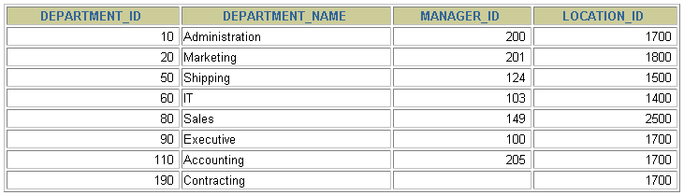
Selecting All Columns
SELECT *
FROM departments;

Slide 30
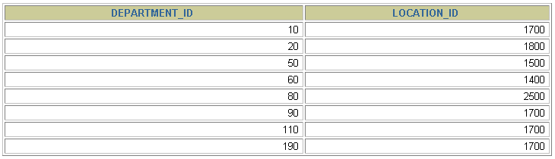
Selecting Specific Columns
SELECT department_id, location_id
FROM departments;

Slide 31
Writing SQL Statements
SQL statements are not case-sensitive.
SQL statements can be on one or more lines.
Keywords cannot be abbreviated or split across lines.
Clauses are usually placed on separate lines.
Indents are used to enhance readability.

Slide 32
Arithmetic Expressions
Create expressions with number and date data by using arithmetic operators.
Operator | Description
+ | Add
- | Subtract
* | Multiply
/ | Divide

Slide 33
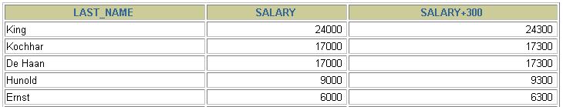
Using Arithmetic Operators
SELECT last_name, salary, salary + 300
FROM employees;
…

Slide 34


Operator Precedence
SELECT last_name, salary, 12*salary+100
FROM employees;
1
…
SELECT last_name, salary, 12*(salary+100)
FROM employees;
2
…

Slide 35
Defining a Null Value
A null is a value that is unavailable, unassigned, unknown, or inapplicable.
A null is not the same as a zero or a blank space.
SELECT last_name, job_id, salary, commission_pct
FROM employees;
…
…

Slide 36
Null Values in Arithmetic Expressions
Arithmetic expressions containing a null value evaluate to null.
SELECT last_name, 12*salary*commission_pct
FROM employees;
…
…

Slide 37
Defining a Column Alias
A column alias:
Renames a column heading
Is useful with calculations
Immediately follows the column name (There can also be the optional AS keyword between the column name and alias.)
Requires double quotation marks if it contains spaces or special characters or if it is case-sensitive

Slide 38


Using Column Aliases
SELECT last_name AS name, commission_pct comm
FROM employees;
…
SELECT last_name "Name" , salary*12 "Annual Salary"
FROM employees;
…

Slide 39

Concatenation Operator
A concatenation operator:
Links columns or character strings to other columns
Is represented by two vertical bars (||)
Creates a resultant column that is a character expression
SELECT last_name||job_id AS "Employees"
FROM employees;
…

Slide 40
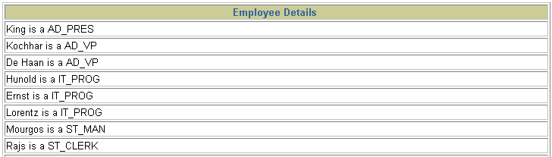
Using Literal Character Strings
SELECT last_name ||' is a '||job_id
AS "Employee Details"
FROM employees;
…

Slide 41


Duplicate Rows
The default display of queries is all rows, including duplicate rows.
SELECT department_id
FROM employees;
1
…
SELECT DISTINCT department_id
FROM employees;
2
…

Slide 42
Restricting and Sorting Data

Slide 43
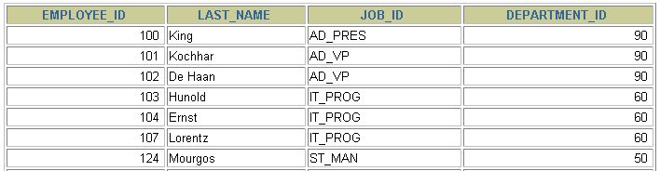

Limiting Rows Using a Selection
EMPLOYEES
…
“retrieve all employees in department 90”
Notes:
Limiting Rows Using a Selection
In the example in the slide, suppose that you want to display all the employees in department 90. The rows with a value of 90 in the DEPARTMENT_ID column are the only ones that are returned. This method of restriction is the basis of the WHERE clause in SQL.

Slide 44
Limiting the Rows That Are Selected
Restrict the rows that are returned by using the WHERE clause:
The WHERE clause follows the FROM clause.
SELECT *|{[DISTINCT] column|expression [alias],...}
FROM table
[WHERE condition(s)];
Notes:
Limiting the Rows That Are Selected
You can restrict the rows that are returned from the query by using the WHERE clause. A WHERE clause contains a condition that must be met, and it directly follows the FROM clause. If the condition is true, the row meeting the condition is returned.
In the syntax:
WHERE restricts the query to rows that meet a condition
condition is composed of column names, expressions, constants, and a comparison operator
The WHERE clause can compare values in columns, literal values, arithmetic expressions, or functions. It consists of three elements:
Column name
Comparison condition
Column name, constant, or list of values

Slide 45

Using the WHERE Clause
SELECT employee_id, last_name, job_id, department_id
FROM employees
WHERE department_id = 90 ;
Notes:
Using the WHERE Clause
In the example, the SELECT statement retrieves the employee ID, name, job ID, and department number of all employees who are in department 90.

Slide 46
Character Strings and Dates
Character strings and date values are enclosed by single quotation marks.
Character values are case-sensitive, and date values are format-sensitive.
The default date format is DD-MON-RR.
SELECT last_name, job_id, department_id
FROM employees
WHERE last_name = 'Whalen' ;
Notes:
Character Strings and Dates
Character strings and dates in the WHERE clause must be enclosed by single quotation marks (''). Number constants, however, should not be enclosed by single quotation marks.
All character searches are case-sensitive. In the following example, no rows are returned because the EMPLOYEES table stores all the last names in mixed case:
SELECT last_name, job_id, department_id
FROM employees
WHERE last_name = 'WHALEN';
Oracle databases store dates in an internal numeric format, representing the century, year, month, day, hours, minutes, and seconds. The default date display is DD-MON-RR.
Note: For details about the RR format and about changing the default date format, see the next lesson.

Slide 47
Comparison Conditions
Operator | Meaning
= | Equal to
> | Greater than
>= | Greater than or equal to
< | Less than
<= | Less than or equal to
<> | Not equal to
BETWEEN ...AND... | Between two values (inclusive)
IN(set) | Match any of a list of values
LIKE | Match a character pattern
IS NULL | Is a null value
Notes:
Comparison Conditions
Comparison conditions are used in conditions that compare one expression to another value or expression. They are used in the WHERE clause in the following format:
Syntax
... WHERE expr operator value
Example
... WHERE hire_date = '01-JAN-95'
... WHERE salary >= 6000
... WHERE last_name = 'Smith'
An alias cannot be used in the WHERE clause.
Note: The symbols != and ^= can also represent the not equal to condition.

Slide 48

Using Comparison Conditions
SELECT last_name, salary
FROM employees
WHERE salary <= 3000 ;
Notes:
Using Comparison Conditions
In the example, the SELECT statement retrieves the last name and salary from the EMPLOYEES table for any employee whose salary is less than or equal to $3,000. Note that there is an explicit value supplied to the WHERE clause. The explicit value of 3000 is compared to the salary value in the SALARY column of the EMPLOYEES table.

Slide 49
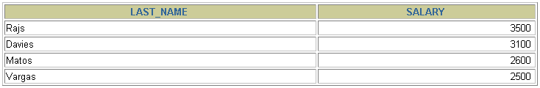
Using the BETWEEN Condition
Use the BETWEEN condition to display rows based on a range of values:
SELECT last_name, salary
FROM employees
WHERE salary BETWEEN 2500 AND 3500 ;
Lower limit
Upper limit
Notes:
Using the BETWEEN Condition
You can display rows based on a range of values using the BETWEEN range condition. The range that you specify contains a lower limit and an upper limit.
The SELECT statement in the slide returns rows from the EMPLOYEES table for any employee whose salary is between $2,500 and $3,500.
Values that are specified with the BETWEEN condition are inclusive. You must specify the lower limit first.
You can also use the BETWEEN condition on character values:
SELECT last_name FROM employees WHERE last_name BETWEEN 'King' AND 'Smith';

Slide 50
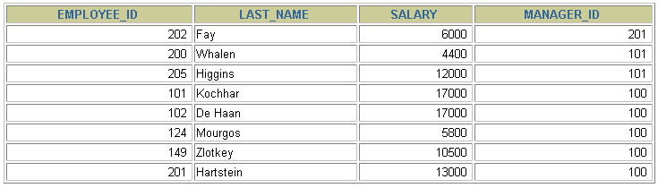
Using the IN Condition
Use the IN membership condition to test for values in a list:
SELECT employee_id, last_name, salary, manager_id
FROM employees
WHERE manager_id IN (100, 101, 201) ;
Notes:
Using the IN Condition
To test for values in a specified set of values, use the IN condition. The IN condition is also known as the membership condition.
The slide example displays employee numbers, last names, salaries, and manager’s employee numbers for all the employees whose manager’s employee number is 100, 101, or 201.
The IN condition can be used with any data type. The following example returns a row from the EMPLOYEES table for any employee whose last name is included in the list of names in the WHERE clause:
SELECT employee_id, manager_id, department_id
FROM employees
WHERE last_name IN ('Hartstein', 'Vargas');
If characters or dates are used in the list, they must be enclosed by single quotation marks ('').

Slide 51
Using the LIKE Condition
Use the LIKE condition to perform wildcard searches of valid search string values.
Search conditions can contain either literal characters or numbers:
% denotes zero or many characters.
_ denotes one character.
SELECT first_name
FROM employees
WHERE first_name LIKE 'S%' ;
Notes:
Using the LIKE Condition
You may not always know the exact value to search for. You can select rows that match a character pattern by using the LIKE condition. The character pattern–matching operation is referred to as a wildcard search. Two symbols can be used to construct the search string.
The SELECT statement in the slide returns the employee first name from the EMPLOYEES table for any employee whose first name begins with the letter S. Note the uppercase S. Names beginning with an s are not returned.
The LIKE condition can be used as a shortcut for some BETWEEN comparisons. The following example displays the last names and hire dates of all employees who joined between January 1995 and December 1995:
SELECT last_name, hire_date
FROM employees
WHERE hire_date LIKE '%95';

Slide 52

Using the LIKE Condition
You can combine pattern-matching characters:
You can use the ESCAPE identifier to search for the actual % and _ symbols.
SELECT last_name
FROM employees
WHERE last_name LIKE '_o%' ;
Notes:
Combining Wildcard Characters
The % and _ symbols can be used in any combination with literal characters. The example in the slide displays the names of all employees whose last names have the letter o as the second character.
ESCAPE Option
When you need to have an exact match for the actual % and _ characters, use the ESCAPE option. This option specifies what the escape character is. If you want to search for strings that contain ‘SA_’, you can use the following SQL statement:
SELECT employee_id, last_name, job_id
FROM employees WHERE job_id LIKE '%SA\_%' ESCAPE '\';
The ESCAPE option identifies the backslash (\) as the escape character. In the pattern, the escape character precedes the underscore (_). This causes the Oracle Server to interpret the underscore literally.

Slide 53
Using the NULL Conditions
Test for nulls with the IS NULL operator.
SELECT last_name, manager_id
FROM employees
WHERE manager_id IS NULL ;
Notes:
Using the NULL Conditions
The NULL conditions include the IS NULL condition and the IS NOT NULL condition.
The IS NULL condition tests for nulls. A null value means the value is unavailable, unassigned, unknown, or inapplicable. Therefore, you cannot test with = because a null cannot be equal or unequal to any value. The slide example retrieves the last names and managers of all employees who do not have a manager.
Here is another example: To display last name, job ID, and commission for all employees who are not entitled to receive a commission, use the following SQL statement:
SELECT last_name, job_id, commission_pct
FROM employees
WHERE commission_pct IS NULL;
…

Slide 54
Logical Conditions
Operator | Meaning
AND | Returns TRUE if both component conditions are true
OR | Returns TRUE if either component condition is true
NOT | Returns TRUE if the following condition is false
Notes:
Logical Conditions
A logical condition combines the result of two component conditions to produce a single result based on those conditions, or it inverts the result of a single condition. A row is returned only if the overall result of the condition is true.
Three logical operators are available in SQL:
AND
OR
NOT
All the examples so far have specified only one condition in the WHERE clause. You can use several conditions in one WHERE clause using the AND and OR operators.

Slide 55

Using the AND Operator
AND requires both conditions to be true:
SELECT employee_id, last_name, job_id, salary
FROM employees
WHERE salary >=10000
AND job_id LIKE '%MAN%' ;
Notes:
Using the AND Operator
In the example, both conditions must be true for any record to be selected. Therefore, only employees who have a job title that contains the string ‘MAN’ and earn $10,000 or more are selected.
All character searches are case-sensitive. No rows are returned if ‘MAN’ is not uppercase. Character strings must be enclosed by quotation marks.
AND Truth Table
The following table shows the results of combining two expressions with AND:

Slide 56
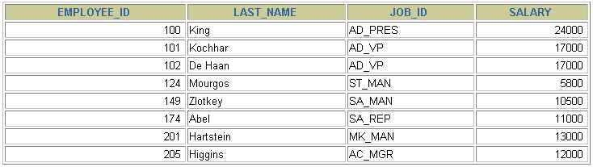
Using the OR Operator
OR requires either condition to be true:
SELECT employee_id, last_name, job_id, salary
FROM employees
WHERE salary >= 10000
OR job_id LIKE '%MAN%' ;
Notes:
Using the OR Operator
In the example, either condition can be true for any record to be selected. Therefore, any employee who has a job ID that contains the string ‘MAN’ or earns $10,000 or more is selected.
OR Truth Table
The following table shows the results of combining two expressions with OR:

Slide 57
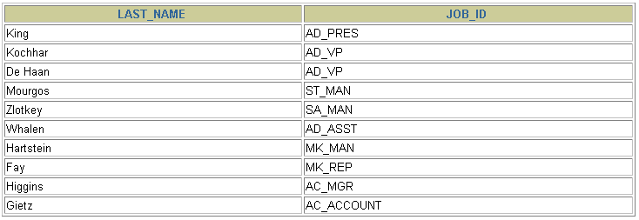
Using the NOT Operator
SELECT last_name, job_id
FROM employees
WHERE job_id
NOT IN ('IT_PROG', 'ST_CLERK', 'SA_REP') ;
Notes:
Using the NOT Operator
The slide example displays the last name and job ID of all employees whose job ID is not IT_PROG, ST_CLERK, or SA_REP.
NOT Truth Table
The following table shows the result of applying the NOT operator to a condition:
Note: The NOT operator can also be used with other SQL operators, such as BETWEEN, LIKE, and NULL.
... WHERE job_id NOT IN ('AC_ACCOUNT', 'AD_VP')
... WHERE salary NOT BETWEEN 10000 AND 15000
... WHERE last_name NOT LIKE '%A%'
... WHERE commission_pct IS NOT NULL

Slide 58
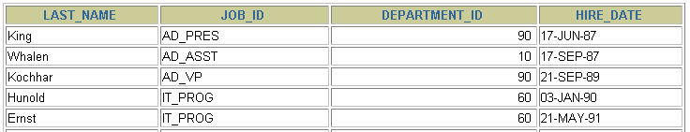
Using the ORDER BY Clause
Sort retrieved rows with the ORDER BY clause:
ASC: ascending order, default
DESC: descending order
The ORDER BY clause comes last in the SELECT statement:
SELECT last_name, job_id, department_id, hire_date
FROM employees
ORDER BY hire_date ;
…
Notes:
Using the ORDER BY Clause
The order of rows that are returned in a query result is undefined. The ORDER BY clause can be used to sort the rows. If you use the ORDER BY clause, it must be the last clause of the SQL statement. You can specify an expression, an alias, or a column position as the sort condition.
Syntax
SELECT expr
FROM table
[WHERE condition(s)]
[ORDER BY {column, expr, numeric_position} [ASC|DESC]];
In the syntax:
ORDER BY specifies the order in which the retrieved rows are displayed
ASC orders the rows in ascending order (this is the default order)
DESC orders the rows in descending order
If the ORDER BY clause is not used, the sort order is undefined, and the Oracle server may not fetch rows in the same order for the same query twice. Use the ORDER BY clause to display the rows in a specific order.

Slide 59
Sorting
Sorting in descending order:
Sorting by column alias:
Sorting by multiple columns:
SELECT last_name, job_id, department_id, hire_date
FROM employees
ORDER BY hire_date DESC ;
1
SELECT employee_id, last_name, salary*12 annsal
FROM employees
ORDER BY annsal ;
2
SELECT last_name, department_id, salary
FROM employees
ORDER BY department_id, salary DESC;
3
Notes:
Default Ordering of Data
The default sort order is ascending:
Numeric values are displayed with the lowest values first (for example, 1 to 999).
Date values are displayed with the earliest value first (for example, 01-JAN-92 before 01-JAN-95).
Character values are displayed in alphabetical order (for example, A first and Z last).
Null values are displayed last for ascending sequences and first for descending sequences.
You can sort by a column that is not in the SELECT list.
Examples
1. To reverse the order in which rows are displayed, specify the DESC keyword after the column name in the ORDER BY clause. The slide example sorts the result by the most recently hired employee.
2. You can use a column alias in the ORDER BY clause. The slide example sorts the data by annual salary.
3. You can sort query results by more than one column. The sort limit is the number of columns in the given table. In the ORDER BY clause, specify the columns and separate the column names using commas. If you want to reverse the order of a column, specify DESC after its name.

Slide 60
Reporting Aggregated Data Using the Group Functions

Slide 61
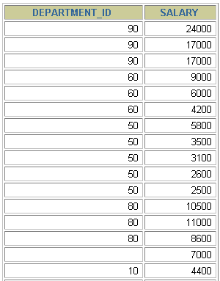

What Are Group Functions?
Group functions operate on sets of rows to give one result per group.
EMPLOYEES
Maximum salary in EMPLOYEES table
…
Notes:
Group Functions
Unlike single-row functions, group functions operate on sets of rows to give one result per group. These sets may comprise the entire table or the table split into groups.

Slide 62
Types of Group Functions
AVG
COUNT
MAX
MIN
SUM
Group
functions
Notes:
Types of Group Functions
Each of the functions accepts an argument. The following table identifies the options that you can use in the syntax:

Slide 63
Group Functions: Syntax
SELECT [column,] group_function(column), ...
FROM table
[WHERE condition]
[GROUP BY column]
[ORDER BY column];
Notes:
Guidelines for Using Group Functions
DISTINCT makes the function consider only nonduplicate values; ALL makes it consider every value, including duplicates. The default is ALL and therefore does not need to be specified.
The data types for the functions with an expr argument may be CHAR, VARCHAR2, NUMBER, or DATE.
All group functions ignore null values. To substitute a value for null values, use the NVL, NVL2, or COALESCE functions.

Slide 64
Using the AVG and SUM Functions
You can use AVG and SUM for numeric data.
SELECT AVG(salary), MAX(salary),
MIN(salary), SUM(salary)
FROM employees
WHERE job_id LIKE '%REP%';
Notes:
Using the Group Functions
You can use AVG, SUM, MIN, and MAX functions against columns that can store numeric data. The example in the slide displays the average, highest, lowest, and sum of monthly salaries for all sales representatives.

Slide 65
Using the MIN and MAX Functions
You can use MIN and MAX for numeric, character, and date data types.
SELECT MIN(hire_date), MAX(hire_date)
FROM employees;
Notes:
Using the Group Functions (continued)
You can use the MAX and MIN functions for numeric, character, and date data types. The slide example displays the most junior and most senior employees.
The following example displays the employee last name that is first and the employee last name that is last in an alphabetized list of all employees:
SELECT MIN(last_name), MAX(last_name)
FROM employees;
Note: The AVG, SUM, VARIANCE, and STDDEV functions can be used only with numeric data types. MAX and MIN cannot be used with LOB or LONG data types.

Slide 66
Using the COUNT Function
COUNT(*) returns the number of rows in a table:
COUNT(expr) returns the number of rows with non-null values for the expr:
SELECT COUNT(*)
FROM employees
WHERE department_id = 50;
1
SELECT COUNT(commission_pct)
FROM employees
WHERE department_id = 80;
2
Notes:
COUNT Function
The COUNT function has three formats:
COUNT(*)
COUNT(expr)
COUNT(DISTINCT expr)
COUNT(*) returns the number of rows in a table that satisfy the criteria of the SELECT statement, including duplicate rows and rows containing null values in any of the columns. If a WHERE clause is included in the SELECT statement, COUNT(*) returns the number of rows that satisfy the condition in the WHERE clause.
In contrast, COUNT(expr) returns the number of non-null values that are in the column identified by expr.
COUNT(DISTINCT expr) returns the number of unique, non-null values that are in the column identified by expr.
Examples
1. The slide example displays the number of employees in department 50.
2. The slide example displays the number of employees in department 80 who can earn a commission.

Slide 67
Using the DISTINCT Keyword
COUNT(DISTINCT expr) returns the number of distinct non-null values of the expr.
To display the number of distinct department values in the EMPLOYEES table:
SELECT COUNT(DISTINCT department_id)
FROM employees;
Notes:
DISTINCT Keyword
Use the DISTINCT keyword to suppress the counting of any duplicate values in a column.
The example in the slide displays the number of distinct department values that are in the EMPLOYEES table.

Slide 68
Group Functions and Null Values
Group functions ignore null values in the column:
The NVL function forces group functions to include null values:
1
SELECT AVG(commission_pct)
FROM employees;
SELECT AVG(NVL(commission_pct, 0))
FROM employees;
2
Notes:
Group Functions and Null Values
All group functions ignore null values in the column.
The NVL function forces group functions to include null values.
Examples
The average is calculated based on only those rows in the table where a valid value is stored in the COMMISSION_PCT column. The average is calculated as the total commission that is paid to all employees divided by the number of employees receiving a commission (four).
The average is calculated based on all rows in the table, regardless of whether null values are stored in the COMMISSION_PCT column. The average is calculated as the total commission that is paid to all employees divided by the total number of employees in the company (20).

Slide 69
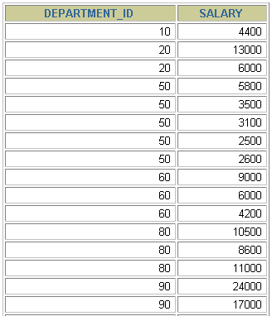
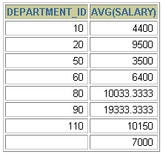
Creating Groups of Data
EMPLOYEES
4400
9500
3500
Average salary in
EMPLOYEES table for each
department
6400
10033
…
Notes:
Creating Groups of Data
Until this point in our discussion, all group functions have treated the table as one large group of information.
At times, however, you need to divide the table of information into smaller groups. This can be done by using the GROUP BY clause.

Slide 70
Creating Groups of Data: GROUP BY Clause Syntax
You can divide rows in a table into smaller groups by using the GROUP BY clause.
SELECT column, group_function(column)
FROM table
[WHERE condition]
[GROUP BY group_by_expression]
[ORDER BY column];
Notes:
GROUP BY Clause
You can use the GROUP BY clause to divide the rows in a table into groups. You can then use the group functions to return summary information for each group.
In the syntax:
group_by_expression specifies columns whose values determine the basis for grouping rows
Guidelines
If you include a group function in a SELECT clause, you cannot select individual results as well, unless the individual column appears in the GROUP BY clause. You receive an error message if you fail to include the column list in the GROUP BY clause.
Using a WHERE clause, you can exclude rows before dividing them into groups.
You must include the columns in the GROUP BY clause.
You cannot use a column alias in the GROUP BY clause.

Slide 71
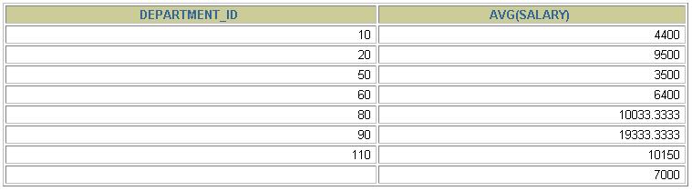
Using the GROUP BY Clause
All columns in the SELECT list that are not in group functions must be in the GROUP BY clause.
SELECT department_id, AVG(salary)
FROM employees
GROUP BY department_id ;
Notes:
Using the GROUP BY Clause
When using the GROUP BY clause, make sure that all columns in the SELECT list that are not group functions are included in the GROUP BY clause. The example in the slide displays the department number and the average salary for each department. Here is how this SELECT statement, containing a GROUP BY clause, is evaluated:
The SELECT clause specifies the columns to be retrieved, as follows:
Department number column in the EMPLOYEES table
The average of all the salaries in the group that you specified in the GROUP BY clause
The FROM clause specifies the tables that the database must access: the EMPLOYEES table.
The WHERE clause specifies the rows to be retrieved. Because there is no WHERE clause, all rows are retrieved by default.
The GROUP BY clause specifies how the rows should be grouped. The rows are grouped by department number, so the AVG function that is applied to the salary column calculates the average salary for each department.

Slide 72
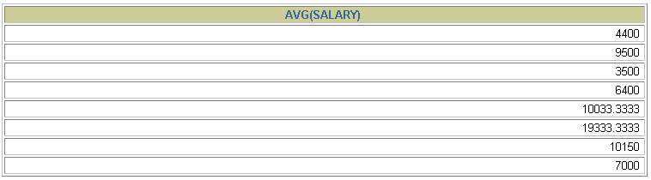
Using the GROUP BY Clause
The GROUP BY column does not have to be in the SELECT list.
SELECT AVG(salary)
FROM employees
GROUP BY department_id ;
Notes:
Using the GROUP BY Clause (continued)
The GROUP BY column does not have to be in the SELECT clause. For example, the SELECT statement in the slide displays the average salaries for each department without displaying the respective department numbers. Without the department numbers, however, the results do not look meaningful.
You can use the group function in the ORDER BY clause:
SELECT department_id, AVG(salary)
FROM employees
GROUP BY department_id
ORDER BY AVG(salary);

Slide 73
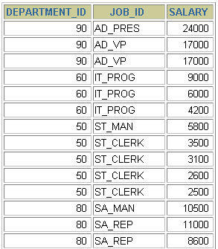
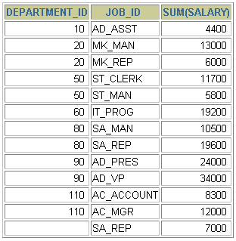

Grouping by More Than One Column
EMPLOYEES
Add the
salaries in
the EMPLOYEES
table for each job, grouped by department
…
Notes:
Groups Within Groups
Sometimes you need to see results for groups within groups. The slide shows a report that displays the total salary that is paid to each job title in each department.
The EMPLOYEES table is grouped first by department number and then by job title within that grouping. For example, the four stock clerks in department 50 are grouped together, and a single result (total salary) is produced for all stock clerks in the group.

Slide 74
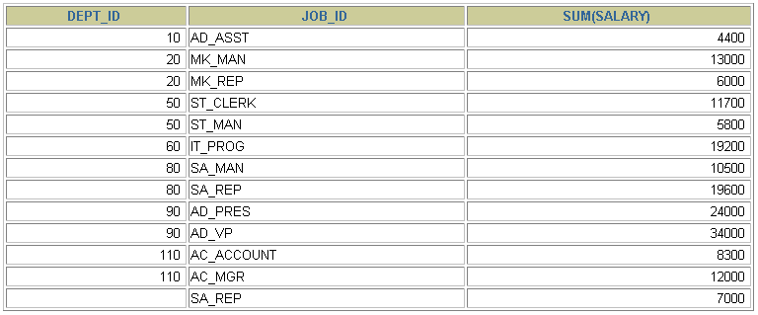
Using the GROUP BY Clause on Multiple Columns
SELECT department_id dept_id, job_id, SUM(salary)
FROM employees
GROUP BY department_id, job_id ;
Notes:
Groups Within Groups (continued)
You can return summary results for groups and subgroups by listing more than one GROUP BY column. You can determine the default sort order of the results by the order of the columns in the GROUP BY clause. In the slide example, the SELECT statement containing a GROUP BY clause is evaluated as follows:
The SELECT clause specifies the column to be retrieved:
Department number in the EMPLOYEES table
Job ID in the EMPLOYEES table
The sum of all the salaries in the group that you specified in the GROUP BY clause
The FROM clause specifies the tables that the database must access: the EMPLOYEES table.
The GROUP BY clause specifies how you must group the rows:
First, the rows are grouped by department number.
Second, the rows are grouped by job ID in the department number groups.
So the SUM function is applied to the salary column for all job IDs in each department number group.

Slide 75
Illegal Queries Using Group Functions
Any column or expression in the SELECT list that is not an aggregate function must be in the GROUP BY clause:
SELECT department_id, COUNT(last_name)
FROM employees;
SELECT department_id, COUNT(last_name)
*
ERROR at line 1:
ORA-00937: not a single-group group function
Column missing in the GROUP BY clause
Notes:
Illegal Queries Using Group Functions
Whenever you use a mixture of individual items (DEPARTMENT_ID) and group functions (COUNT) in the same SELECT statement, you must include a GROUP BY clause that specifies the individual items (in this case, DEPARTMENT_ID). If the GROUP BY clause is missing, then the error message “not a single-group group function” appears and an asterisk (*) points to the offending column. You can correct the error in the slide by adding the GROUP BY clause:
SELECT department_id, count(last_name)
FROM employees
GROUP BY department_id;
Any column or expression in the SELECT list that is not an aggregate function must be in the GROUP BY clause.

Slide 76
Illegal Queries Using Group Functions
You cannot use the WHERE clause to restrict groups.
You use the HAVING clause to restrict groups.
You cannot use group functions in the WHERE clause.
SELECT department_id, AVG(salary)
FROM employees
WHERE AVG(salary) > 8000
GROUP BY department_id;
WHERE AVG(salary) > 8000
*
ERROR at line 3:
ORA-00934: group function is not allowed here
Cannot use the WHERE clause to restrict groups
Notes:
Illegal Queries Using Group Functions (continued)
The WHERE clause cannot be used to restrict groups. The SELECT statement in the slide example results in an error because it uses the WHERE clause to restrict the display of average salaries of those departments that have an average salary greater than $8,000.
You can correct the error in the example by using the HAVING clause to restrict groups:
SELECT department_id, AVG(salary)
FROM employees
HAVING AVG(salary) > 8000
GROUP BY department_id;

Slide 77
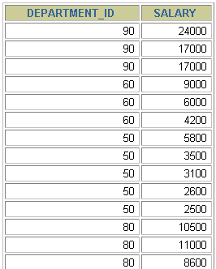
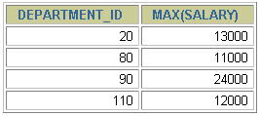

Restricting Group Results
EMPLOYEES
The maximum salary per department
when it is
greater than $10,000
…
Notes:
Restricting Group Results
In the same way that you use the WHERE clause to restrict the rows that you select, you use the HAVING clause to restrict groups. To find the maximum salary in each of the departments that have a maximum salary greater than $10,000, you need to do the following:
1. Find the average salary for each department by grouping by department number.
2. Restrict the groups to those departments with a maximum salary greater than $10,000.

Slide 78
Restricting Group Results with the HAVING Clause
When you use the HAVING clause, the Oracle server restricts groups as follows:
1. Rows are grouped.
2. The group function is applied.
3. Groups matching the HAVING clause are displayed.
SELECT column, group_function
FROM table
[WHERE condition]
[GROUP BY group_by_expression]
[HAVING group_condition]
[ORDER BY column];
Notes:
Restricting Group Results with the HAVING Clause
You use the HAVING clause to specify which groups are to be displayed, thus further restricting the groups on the basis of aggregate information.
In the syntax, group_condition restricts the groups of rows returned to those groups for which the specified condition is true.
The Oracle server performs the following steps when you use the HAVING clause:
1. Rows are grouped.
2. The group function is applied to the group.
3. The groups that match the criteria in the HAVING clause are displayed.
The HAVING clause can precede the GROUP BY clause, but it is recommended that you place the GROUP BY clause first because that is more logical. Groups are formed and group functions are calculated before the HAVING clause is applied to the groups in the SELECT list.

Slide 79
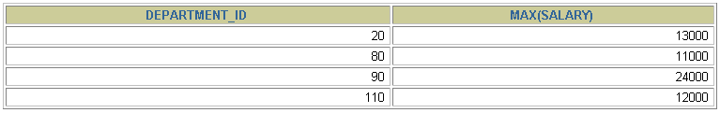
Using the HAVING Clause
SELECT department_id, MAX(salary)
FROM employees
GROUP BY department_id
HAVING MAX(salary)>10000 ;
Notes:
Using the HAVING Clause
The slide example displays department numbers and maximum salaries for those departments with a maximum salary that is greater than $10,000.
You can use the GROUP BY clause without using a group function in the SELECT list.
If you restrict rows based on the result of a group function, you must have a GROUP BY clause as well as the HAVING clause.
The following example displays the department numbers and average salaries for those departments with a maximum salary that is greater than $10,000:
SELECT department_id, AVG(salary)
FROM employees
GROUP BY department_id
HAVING max(salary)>10000;

Slide 80

Using the HAVING Clause
SELECT job_id, SUM(salary) PAYROLL
FROM employees
WHERE job_id NOT LIKE '%REP%'
GROUP BY job_id
HAVING SUM(salary) > 13000
ORDER BY SUM(salary);
Notes:
Using the HAVING Clause (continued)
The slide example displays the job ID and total monthly salary for each job that has a total payroll exceeding $13,000. The example excludes sales representatives and sorts the list by the total monthly salary.

Slide 81
Nesting Group Functions
Display the maximum average salary:
SELECT MAX(AVG(salary))
FROM employees
GROUP BY department_id;
Notes:
Nesting Group Functions
Group functions can be nested to a depth of two. The slide example displays the maximum average salary.

Slide 82
Displaying Data from Multiple Tables

Slide 83

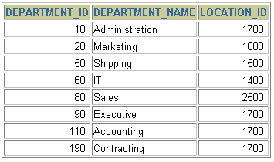



Obtaining Data from Multiple Tables
EMPLOYEES
DEPARTMENTS
…
…
Notes:
Obtaining Data from Multiple Tables
Sometimes you need to use data from more than one table. In the slide example, the report displays data from two separate tables:
Employee IDs exist in the EMPLOYEES table.
Department IDs exist in both the EMPLOYEES and DEPARTMENTS tables.
Department names exist in the DEPARTMENTS table.
To produce the report, you need to link the EMPLOYEES and DEPARTMENTS tables and access data from both of them.

Slide 84
Types of Joins
Joins that are compliant with the SQL:1999 standard include the following:
INNER JOIN
LEFT JOIN
RIGHT JOIN
FULL OUTER JOIN
Notes:
Types of Joins
To join tables, you can use join syntax that is compliant with the SQL:1999 standard.
Note: Prior to the Oracle9i release, the join syntax was different from the ANSI standards. The SQL:1999–compliant join syntax does not offer any performance benefits over the Oracle-proprietary join syntax that existed in prior releases. For detailed information about the proprietary join syntax, see Appendix C.

Slide 85
Joining Tables Using SQL:1999 Syntax
Use a join to query data from more than one table:
SELECT table1.column, table2.column
FROM table1
[NATURAL JOIN table2] |
[JOIN table2 USING (column_name)] |
[JOIN table2
ON (table1.column_name = table2.column_name)]|
[LEFT|RIGHT|FULL OUTER JOIN table2
ON (table1.column_name = table2.column_name)]|
[CROSS JOIN table2];
Notes:
Defining Joins
In the syntax:
table1.column denotes the table and column from which data is retrieved
NATURAL JOIN joins two tables based on the same column name
JOIN table USING column_name performs an equijoin based on the column name
JOIN table ON table1.column_name performs an equijoin based on the condition in the ON clause, = table2.column_name
LEFT/RIGHT/FULL OUTER is used to perform outer joins
CROSS JOIN returns a Cartesian product from the two tables
For more information, see “SELECT” in Oracle SQL Reference.

Slide 86
Creating Natural Joins
The NATURAL JOIN clause is based on all columns in the two tables that have the same name.
It selects rows from the two tables that have equal values in all matched columns.
If the columns having the same names have different data types, an error is returned.
Notes:
Creating Natural Joins
You can join tables automatically based on columns in the two tables that have matching data types and names. You do this by using the keywords NATURAL JOIN.
Note: The join can happen on only those columns that have the same names and data types in both tables. If the columns have the same name but different data types, then the NATURAL JOIN syntax causes an error.

Slide 87
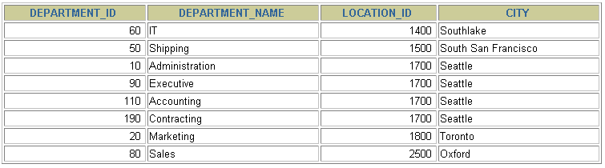
Retrieving Records with Natural Joins
SELECT department_id, department_name,
location_id, city
FROM departments
NATURAL JOIN locations ;
Notes:
Retrieving Records with Natural Joins
In the example in the slide, the LOCATIONS table is joined to the DEPARTMENT table by the LOCATION_ID column, which is the only column of the same name in both tables. If other common columns were present, the join would have used them all.
Natural Joins with a WHERE Clause
Additional restrictions on a natural join are implemented by using a WHERE clause. The following example limits the rows of output to those with a department ID equal to 20 or 50:
SELECT department_id, department_name,
location_id, city
FROM departments
NATURAL JOIN locations
WHERE department_id IN (20, 50);

Slide 88
Creating Joins with the USING Clause
If several columns have the same names but the data types do not match, the NATURAL JOIN clause can be modified with the USING clause to specify the columns that should be used for an equijoin.
Use the USING clause to match only one column when more than one column matches.
Do not use a table name or alias in the referenced columns.
The NATURAL JOIN and USING clauses are mutually exclusive.
Notes:
USING Clause
Natural joins use all columns with matching names and data types to join the tables. The USING clause can be used to specify only those columns that should be used for an equijoin. The columns that are referenced in the USING clause should not have a qualifier (table name or alias) anywhere in the SQL statement.
For example, the following statement is valid:
SELECT l.city, d.department_name
FROM locations l JOIN departments d USING (location_id)
WHERE location_id = 1400;
The following statement is invalid because the LOCATION_ID is qualified in the WHERE clause:
SELECT l.city, d.department_name
FROM locations l JOIN departments d USING (location_id)
WHERE d.location_id = 1400;
ORA-25154: column part of USING clause cannot have qualifier
The same restriction also applies to NATURAL joins. Therefore, columns that have the same name in both tables must be used without any qualifiers.

Slide 89
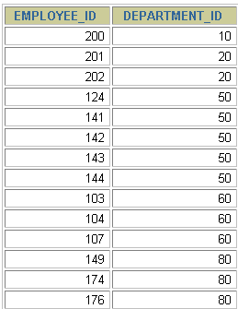
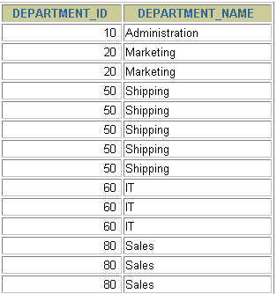
Joining Column Names
EMPLOYEES
DEPARTMENTS
…
…
Foreign key
Primary key
Notes:
The USING Clause for Equijoins
To determine an employee’s department name, you compare the value in the DEPARTMENT_ID column in the EMPLOYEES table with the DEPARTMENT_ID values in the DEPARTMENTS table. The relationship between the EMPLOYEES and DEPARTMENTS tables is an equijoin; that is, values in the DEPARTMENT_ID column in both tables must be equal. Frequently, this type of join involves primary and foreign key complements.
Note: Equijoins are also called simple joins or inner joins.

Slide 90
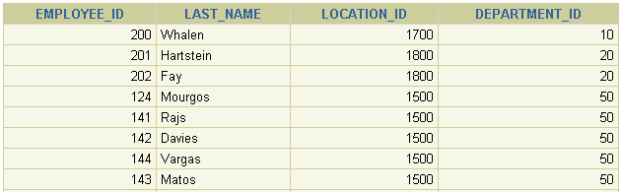
Retrieving Records with the USING Clause
SELECT employees.employee_id, employees.last_name,
departments.location_id, department_id
FROM employees JOIN departments
USING (department_id) ;
…
Notes:
Retrieving Records with the USING Clause
The slide example joins the DEPARTMENT_ID column in the EMPLOYEES and DEPARTMENTS tables, and thus shows the location where an employee works.

Slide 91
Qualifying Ambiguous Column Names
Use table prefixes to qualify column names that are in multiple tables.
Use table prefixes to improve performance.
Use column aliases to distinguish columns that have identical names but reside in different tables.
Do not use aliases on columns that are identified in the USING clause and listed elsewhere in the SQL statement.
Notes:
Qualifying Ambiguous Column Names
You need to qualify the names of the columns with the table name to avoid ambiguity. Without the table prefixes, the DEPARTMENT_ID column in the SELECT list could be from either the DEPARTMENTS table or the EMPLOYEES table. It is necessary to add the table prefix to execute your query:
SELECT employees.employee_id, employees.last_name,
departments.department_id, departments.location_id
FROM employees JOIN departments
ON employees.department_id = departments.department_id;
If there are no common column names between the two tables, there is no need to qualify the columns. However, using the table prefix improves performance, because you tell the Oracle server exactly where to find the columns.
Note: When joining with the USING clause, you cannot qualify a column that is used in the USING clause itself. Furthermore, if that column is used anywhere in the SQL statement, you cannot alias it.

Slide 92
Using Table Aliases
Use table aliases to simplify queries.
Use table aliases to improve performance.
SELECT e.employee_id, e.last_name,
d.location_id, department_id
FROM employees e JOIN departments d
USING (department_id) ;
Notes:
Using Table Aliases
Qualifying column names with table names can be very time consuming, particularly if table names are lengthy. You can use table aliases instead of table names. Just as a column alias gives a column another name, a table alias gives a table another name. Table aliases help to keep SQL code smaller, therefore using less memory.
Notice how table aliases are identified in the FROM clause in the example. The table name is specified in full, followed by a space and then the table alias. The EMPLOYEES table has been given an alias of e, and the DEPARTMENTS table has an alias of d.
Guidelines
Table aliases can be up to 30 characters in length, but shorter aliases are better than longer ones.
If a table alias is used for a particular table name in the FROM clause, then that table alias must be substituted for the table name throughout the SELECT statement.
Table aliases should be meaningful.
The table alias is valid for only the current SELECT statement.

Slide 93
Creating Joins with the ON Clause
The join condition for the natural join is basically an equijoin of all columns with the same name.
Use the ON clause to specify arbitrary conditions or specify columns to join.
The join condition is separated from other search conditions.
The ON clause makes code easy to understand.
Notes:
ON Clause
Use the ON clause to specify a join condition. This lets you specify join conditions separate from any search or filter conditions in the WHERE clause.

Slide 94
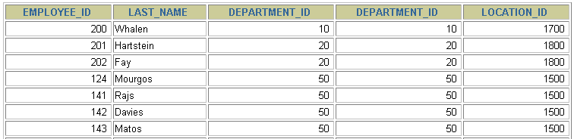
Retrieving Records with the ON Clause
SELECT e.employee_id, e.last_name, e.department_id,
d.department_id, d.location_id
FROM employees e JOIN departments d
ON (e.department_id = d.department_id);
…
Notes:
Creating Joins with the ON Clause
In this example, the DEPARTMENT_ID columns in the EMPLOYEES and DEPARTMENTS table are joined using the ON clause. Wherever a department ID in the EMPLOYEES table equals a department ID in the DEPARTMENTS table, the row is returned.
You can also use the ON clause to join columns that have different names.

Slide 95
INNER Versus OUTER Joins
The join of two tables returning only matched rows is called an inner join.
A join between two tables that returns the results of the inner join as well as the unmatched rows from the left (or right) tables is called a left (or right) outer join.
A join between two tables that returns the results of an inner join as well as the results of a left and right join is a full outer join.
Notes:
INNER Versus OUTER Joins
Joining tables with the NATURAL JOIN, USING, or ON clauses results in an inner join. Any unmatched rows are not displayed in the output. To return the unmatched rows, you can use an outer join. An outer join returns all rows that satisfy the join condition and also returns some or all of those rows from one table for which no rows from the other table satisfy the join condition.
There are three types of outer joins:
LEFT OUTER
RIGHT OUTER
FULL OUTER

Slide 96

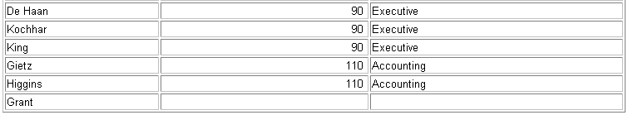
LEFT OUTER JOIN
SELECT e.last_name, e.department_id, d.department_name
FROM employees e LEFT OUTER JOIN departments d
ON (e.department_id = d.department_id) ;
…
Notes:
Example of LEFT OUTER JOIN
This query retrieves all rows in the EMPLOYEES table, which is the left table even if there is no match in the DEPARTMENTS table.

Slide 97
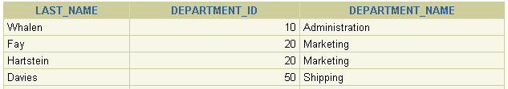
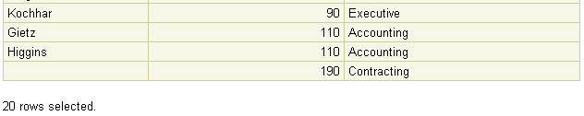
RIGHT OUTER JOIN
SELECT e.last_name, e.department_id, d.department_name
FROM employees e RIGHT OUTER JOIN departments d
ON (e.department_id = d.department_id) ;
…
Notes:
Example of RIGHT OUTER JOIN
This query retrieves all rows in the DEPARTMENTS table, which is the right table even if there is no match in the EMPLOYEES table.

Slide 98

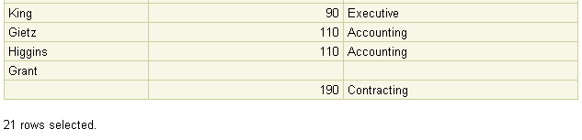
FULL OUTER JOIN
SELECT e.last_name, d.department_id, d.department_name
FROM employees e FULL OUTER JOIN departments d
ON (e.department_id = d.department_id) ;
…
Notes:
Example of FULL OUTER JOIN
This query retrieves all rows in the EMPLOYEES table, even if there is no match in the DEPARTMENTS table. It also retrieves all rows in the DEPARTMENTS table, even if there is no match in the EMPLOYEES table.

Slide 99
Subquery
A subquery is a query nested within another query. A subquery is also known as an inner query or nested query.
Syntax: SELECT select_list FROM table1 WHERE columnA operator ( SELECT column FROM table2 WHERE condition );

Slide 100
Example
select *
from sharetransaction
where share_Id= (select share_id
from ShareTransaction
where customerid=102);

Slide 101
Using a subquery with the IN operator
A subquery can return zero or more rows. If the query returns more than one row, you can use it with the IN operator.
Example: select *
from sharetransaction
where share_Id IN (select share_id
from ShareTransaction
where customerid=102);

Slide 102
Correlated Subquery
A correlated subquery is a subquery that references the columns from the outer query.
Unlike a regular subquery, PostgreSQL evaluates the correlated subquery once for each row processed by the outer query.
Since PostgreSQL reevaluates the correlated subquery for every row in the outer query, this may lead to performance issues, especially when dealing with large datasets.
A correlated subquery can be useful when you need to perform a query that depends on the values of the current being processed.

Slide 103
Example
SELECT film_id, title, length, rating
FROM film f
WHERE length > (
SELECT AVG(length)
FROM film
WHERE rating = f.rating
);

Slide 104
PostgreSQL Views
A view is a named query stored in the PostgreSQL database server.
A view is defined based on one or more tables which are known as base tables, and the query that defines the view is referred to as a defining query.
Views do not store data .

Slide 105
Advantages of PostgreSQL views
Simplifying complex queries
Views help simplify complex queries. Instead of dealing with joins, aggregations, or filterin conditions, you can query from views as if they were regular tables.
Typically, first, you create views based on complex queries and store them in the database. Then, you can use simple queries based on views instead of using complex queries.
2) Security and access control
Views enable fine-grained control over data access. You can create views that expose subsets of data in the base tables, hiding sensitive information.
This is particularly useful when you have applications that require access to distinct portions of the data.
3) Logical data independence
If your applications use views, you can freely modify the structure of the base tables. In other words, views enable you to create a layer of abstraction over the underlying tables.

Slide 106
CREATE VIEW statement
Syntax
CREATE VIEW view_name AS query;
Example
CREATE VIEW contact AS SELECT first_name, last_name, email FROM customer;
Note: display the view information using the \d+ view_name command

Slide 107
DROP VIEW
Syntax:
DROP VIEW [IF EXISTS] view_name[CASCADE | RESTRICT];
CASCADE option to remove dependent objects along with the view.
RESTRICT option to reject the removal of the view if other objects depend on the view. The RESTRICT option is the default.

Slide 108
Transaction
Transactions are a fundamental concept of all database systems. The essential point of a transaction is that it bundles multiple steps into a single, all-or-nothing operation. The intermediate states between the steps are not visible to other concurrent transactions, and if some failure occurs that prevents the transaction from completing, then none of the steps affect the database at all.
For example, consider a bank database that contains balances for various customer accounts, as well as total deposit balances for branches. Suppose that we want to record a payment of $100.00 from Alice's account to Bob's account.
BEGIN;
UPDATE accounts SET balance = balance - 100.00
WHERE name = 'Alice';
SAVEPOINT my_savepoint;
UPDATE accounts SET balance = balance + 100.00
WHERE name = 'Bob';
-- oops ... forget that and use Wally's account
ROLLBACK TO my_savepoint;
UPDATE accounts SET balance = balance + 100.00
WHERE name = 'Wally';
COMMIT;

Slide 109
Window Function
Window functions are powerful tools used to perform calculations across a set of table rows that are related to the current row. Unlike aggregate functions, window functions do not collapse rows into a single result; instead, they return a value for each row in the result set.
Key Features of Window Functions:
Partitioning: Divide rows into groups (partitions) for calculations.
Ordering: Define the order of rows within each partition.
Frame Specification: Control the subset of rows used for calculations.

Slide 110
Window Function
function_name([arguments]) OVER (
[PARTITION BY column_name(s)]
[ORDER BY column_name(s)]
[frame_clause]
)

Slide 111
Window Function
PARTITION BY clause
The PARTITION BY clause divides rows into multiple groups or partitions to which the window function is applied. Like the example above, we used the product group to divide the products into groups (or partitions).
The PARTITION BY clause is optional. If you skip the PARTITION BY clause, the window function will treat the whole result set as a single partition.
ORDER BY clause
The ORDER BY clause specifies the order of rows in each partition to which the window function is applied.
The ORDER BY clause uses the NULLS FIRST or NULLS LAST option to specify whether nullable values should be first or last in the result set. The default is NULLS LAST option.

Slide 112
Window function
If you use multiple window functions in a query:
SELECT
wf1() OVER(PARTITION BY c1 ORDER BY c2),
wf2() OVER(PARTITION BY c1 ORDER BY c2)
FROM table_name;
you can use the WINDOW clause to shorten the query as shown in the following query:
SELECT
wf1() OVER w,
wf2() OVER w,
FROM table_name
WINDOW w AS (PARTITION BY c1 ORDER BY c2);

Slide 113
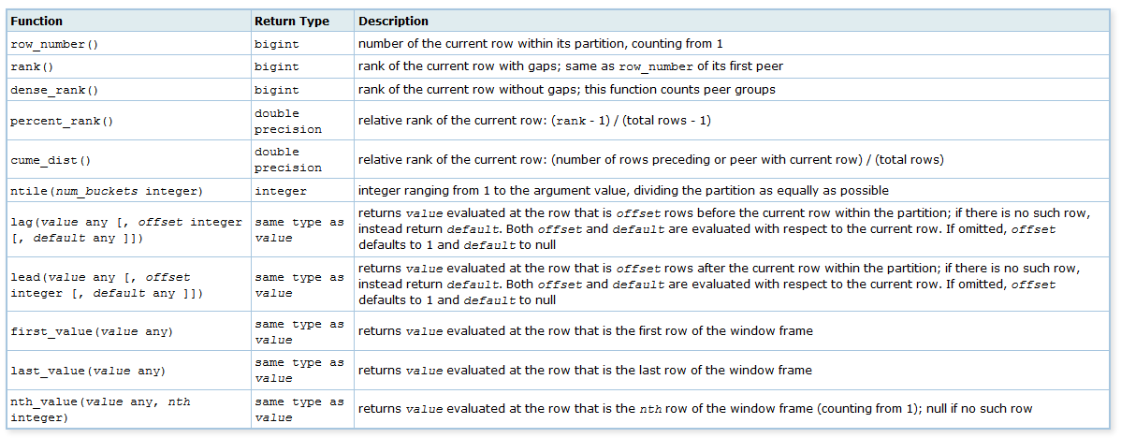
Window Functions

Slide 114
Example
create table personNames(
gender varchar(10),
name varchar(30),
total int);
insert into personNames values('Male','Amit',50),
('Female','Bharti',70),
('Female','Charu',100),
('Male','Deepak',150),
('Female','Esha',20),
('Male','Faiz',90),
('Female','Geeta',5);

Slide 115
Example
select * from personNames
order by total desc;
select gender,name,total,
Row_Number() Over(order by total desc) as "Popularity"
from personNames;
select gender,name,total,
Row_Number() Over(order by total desc) as "Popularity",
Rank() Over(order by total desc) as "Rank",
dense_rank() Over(order by total desc) as "Dense Rank"
from personNames;
select gender,name,total,
Row_Number() Over(Partition by gender order by total desc) as "Popularity"
from personNames;

Slide 116
Example
select * from
(select gender,name,total,
Row_Number() Over(order by total desc) as Popularity
from personNames) as pop
where Popularity<=3;
select gender,name,total,
Row_Number() Over w as "Popularity",
Rank() Over w as "Rank",
dense_rank() Over w as "Dense Rank"
from personNames
window w as(order by total desc);

Slide 117
Common Table Expression (CTE)
A common table expression (CTE) allows you to create a temporary result set within a query.
A CTE helps you enhance the readability of a complex query by breaking it down into smaller and more reusable parts
Syntax:
WITH cte_name (column1, column2, ...) AS ( -- CTE query SELECT ... ) -- Main query using the CTE SELECT ... FROM cte_name;

Slide 118
Example
WITH cte_film AS (
SELECT film_id,
title,
rating,
length,
RANK() OVER (
PARTITION BY rating
ORDER BY length DESC)
length_rank
FROM
film
)
SELECT *
FROM cte_film
WHERE length_rank = 1;

Slide 119
Example
WITH pop as(select gender,name,total,
Row_Number() Over(order by total desc) as Popularity
from personNames)
select * from pop;

Slide 120
PostgreSQL indexes
An index is a separate data structure that enhances the speed of data retrieval from a table, at the cost of additional writes and storage required to maintain it.
An index allows you to improve the query performance when using it appropriately, especially on large tables.Example : An index in PostgreSQL works like an index in a book, providing a quick reference to the page where specific content can be found.
Syntax: CREATE INDEX [IF NOT EXISTS] index_name ON table_name(column1, column2, ...);
Note :
Index creating may take time, depending on the number of rows in the table.
By default, PostgreSQL allows data selection from a table during index creation but blocks insert, update, and delete operations.

Slide 121
Benefits of Indexes
Faster data access: Indexes allow queries to quickly access relevant data instead of scanning the entire table.
Performance improvement: Creating indexes on frequently queried columns can significantly reduce query times.
Data integrity: UNIQUE indexes ensure that values in a column are unique.

Slide 122
Drawbacks of Indexes
Storage cost: Each index requires additional storage space in the database.
Slower write operations: Insert, update, and delete operations become slower because indexes need to be updated alongside the data.

Slide 123
Types of PostgreSQL indexes
PostgreSQL offers various index types, each designed to cater to specific data scenarios and query patterns.
B-tree index (Default)
B-tree indexes are the most common index type in PostgreSQL. They are suitable for equality, range (<, <=, >=, >) and sorting-based queries. B-tree indexes are particularly beneficial for queries involving ORDER BY, GROUP BY, and DISTINCT clauses.
Use Case:
Commonly used for primary keys, unique constraints, and general-purpose indexing.
Queries that involve equality and sorting.
Frequently queried columns for faster lookups.
Syntax : CREATE INDEX idx_column ON table_name(column_name);

Slide 124
Types of PostgreSQL indexes
Hash Index
Hash indexes are designed for equality comparisons (=) only. They are simpler than B-tree indexes and can be faster for certain equality searches. However, hash indexes do not support range or sorting queries.
Use Case: Useful when only equality checks are performed, though less versatile than B-Tree.
Syntax : CREATE INDEX idx_hash ON table_name USING HASH(column_name);
GIN (Generalized Inverted Index)
Purpose: Efficient for indexing composite types, arrays, and full-text search.
Use Case: Ideal for jsonb data, array containment (@>), and full-text search.
Syntax:
CREATE INDEX idx_gin ON table_name USING GIN(column_name);

Slide 125
Types of PostgreSQL indexes
GiST (Generalized Search Tree)
Purpose: Supports complex queries like range, nearest-neighbor, and geometric data.
Use Case: Spatial data, full-text search, and custom data types.
Syntax: CREATE INDEX idx_gist ON table_name USING GiST(column_name);
BRIN (Block Range Index)
Purpose: Efficient for large tables with sequentially ordered data. They divide the table into blocks and store summarized information for each block, making them efficient for range queries on sorted data.
Use Case: Suitable for columns with natural ordering (e.g., timestamps).
Syntax : CREATE INDEX idx_brin ON table_name USING BRIN(column_name);

Slide 126
Types of PostgreSQL indexes
BRIN (Block Range Index) index
BRIN indexes are used for very large tables and are highly efficient in terms of storage. They work well on tables with sequentially increasing or decreasing data, such as timestamps. BRIN indexes index data by ranges of blocks, making them space-efficient and suitable for certain large datasets..
Use Cases:
Very large tables.
Columns with sequentially increasing or decreasing values (e.g., timestamps).
Syntax: CREATE INDEX idx_brin ON table_name USING BRIN(column_name);

Slide 127
Indexes
User Permissions
To create an index, you must have appropriate privileges on the table. Specifically:
You must own the table or
Have the ALTER privilege on the table.

Slide 128
Using CONCURRENTLY for Large Tables
Syntax : CREATE INDEX CONCURRENTLY idx_customers_last_name ON customers (last_name);
This process takes longer but allows the database to continue processing queries while the index is being built.

Slide 129
Drop Indexes
Removing unused or redundant indexes can free up space and improve database performance. To drop an index, use the DROP INDEX command:
DROP INDEX index_name;

Slide 130
Explain
EXPLAIN command is used to display the execution plan of a query. It helps you understand how the database engine plans to execute a query, including details about the operations, indexes, and estimated costs. This is particularly useful for optimizing queries.
Syntax
EXPLAIN [ ( option [, ...] ) ] statement;
Key Options
ANALYZE: Executes the query and provides actual runtime statistics.
VERBOSE: Displays additional details about the execution plan.
COSTS: Shows estimated startup and total costs (enabled by default).
BUFFERS: Displays buffer usage (requires ANALYZE).
TIMING: Includes execution time (enabled by default with ANALYZE).
Examples:
EXPLAIN SELECT * FROM employees WHERE department = 'HR';

Slide 131
CREATE ROLE
PostgreSQL uses the concept of roles to represent user accounts. It doesn’t use the concept of users like other database systems.
Typically, roles that can log in to the PostgreSQL server are called login roles. They are equivalent to user accounts in other database systems.
When roles contain other roles, they are referred to as group roles.

Slide 132
To create a new Role
CREATE ROLE role_name;
To retrieve all roles in the current PostgreSQL server
SELECT rolname FROM pg_roles;
In psql, use the \du command to show all roles

Slide 133
Role attributes
The attributes of a role define privileges for that role, including login, superuser status, database creation, role creation, password management, and so on.
Here’s the syntax for creating a new role with attributes.
CREATE ROLE name WITH option;
In this syntax, the WITH keyword is optional. The option can be one or more attributes like SUPERUSER, CREATEDB, CREATEROLE, etc.

Slide 134
GRANT statement
After creating a role with the LOGIN attribute, the role can log in to the PostgreSQL database server.
However, it cannot do anything to the database objects like tables, views, functions, etc.
To allow a role to interact with database objects, you need to grant privileges on the database objects to the role using the GRANT statement.
GRANT privilege_list | ALL
ON table_name
TO role_name;

Slide 135
Example
GRANT INSERT, UPDATE, DELETEON candidatesTO joe;
GRANT ALL ON candidates TO joe;

Slide 136
REVOKE statement
The REVOKE statement revokes previously granted privileges on database objects from a role.
REVOKE privilege | ALL ON TABLE table_name | ALL TABLES IN SCHEMA schema_name FROM role_name;
Example:
REVOKE SELECT ON actor FROM jim;

Slide 137
ALTER ROLE to modify attributes of roles
ALTER ROLE role_name [WITH] option;
The option can be:
SUPERUSER | NOSUPERUSER – determine if the role is a superuser or not.
CREATEDB | NOCREATEDB– allow the role to create new databases.
CREATEROLE | NOCREATEROLE – allow the role to create or change roles.
INHERIT | NOINHERIT – determine if the role inherits the privileges of roles of which it is a member.
LOGIN | NOLOGIN – allow the role to log in.
REPLICATION | NOREPLICATION – determine if the role is a replication role.
BYPASSRLS | NOBYPASSRLS – determine if the role is to bypass the row-level security (RLS) policy.
CONNECTION LIMIT limit – specify the number of concurrent connections a role can make, -1 means unlimited.
PASSWORD 'password' | PASSWORD NULL – change the role’s password.
VALID UNTIL 'timestamp' – set the date and time after which the role’s password is no longer valid.

Slide 138
PostgreSQL Row-Level Security
Row-level security (RLS) is a feature that allows you to restrict rows returned by a query based on the user executing the query.
The RLS allows you to control access to individual rows in tables based on the current user and specific conditions defined by policies.
The basic steps for implementing row-level security are as follows:

Slide 139
Row Level Security
First, enable row-level security on a table using the ALTER TABLE statement:
ALTER TABLE table_name
ENABLE ROW LEVEL SECURITY;
Second, create a new row-level security policy for a table using the CREATE POLICY statement:
CREATE POLICY name ON table_name
USING (condition);
In the policy, you define a condition that determines which rows are visible.
Note that superusers and roles with the BYPASSRLS attribute can bypass the row security system when accessing a table.
Additionally, table owners also bypass row-level security. To enforce the row-level security to the table owners, you can modify the table using the FORCE ROW LEVEL SECURITY option:
ALTER TABLE table_name
FORCE ROW LEVEL SECURITY;

Slide 140
Example
create database hr;
\c hr1) Create a new database called hr:
create database hr;
2) Change the current database to the hr database:
\c hr

Slide 141
3) Create a new table called departments to store department data:
create table departments(
id serial primary key,
name VARCHAR(255) NOT NULL UNIQUE,
manager VARCHAR(255) NOT NULL
);
4) Insert some rows into the departments table:
INSERT INTO departments(name, manager)
VALUES('Sales', 'alice'),
('Marketing', 'bob'),
('IT', 'jack');

Slide 142
5) Create a group role called managers:
CREATE ROLE managers;
6) Grant the SELECT privileges of all tables in the public schema to the group role managers:
GRANT SELECT ON ALL TABLES
IN SCHEMA public
TO managers;

Slide 143
7) Create three new roles alice, bob, peter and assign them as members of the managers group role:
CREATE ROLE alice WITH LOGIN PASSWORD 'SecurePass1'
IN ROLE managers;
CREATE ROLE bob WITH LOGIN PASSWORD 'SecurePass2'
IN ROLE managers;
CREATE ROLE jack WITH LOGIN PASSWORD 'SecurePass3'
IN ROLE managers;
The roles alice, bob, and jack will implicitly inherit privileges from the group role managers. In other words, they can retrieve data from all tables in the public schema.
8) Enable row-level security on the departments table:
ALTER TABLE departments
ENABLE ROW LEVEL SECURITY;

Slide 144
9) Create a policy that the current user can access the rows whose value in the manager column of the departments table matches the current role name:
CREATE POLICY department_managers
ON departments
TO managers
USING (manager = current_user);
10) Connect to the hr database using the alice role in a separate session:
psql -U alice -d hr
11) Retrieve data from the departments table:
SELECT * FROM departments;

Slide 145
PostgreSQL backup
A PostgreSQL backup is a copy of the data that you can use to recover the database later.
The pg_dump tool is a command-line utility that you can use to create a logical backup of a PostgreSQL database.
pg_dump [connection_option] [option] [dbname]
Example
pg_dump -U postgres -d dvdrental -F tar -f d:\backup\dvdrental.tar

Slide 146
PostgreSQL pg_restore tool
To restore a database created by the pg_dump or pg_dumpall tools, you can use the pg_restore tool.
pg_restore [connection-option] [option] [filename]
Example
pg_restore -U postgres -d dvdrental D:/backup/dvdrental.tar

