Slide 1


Programming With Java

Slide 2


Sujata Batra - sujatabatra@hotmail.com
IT Trainer Since 2000
Conducting Java Training Since 2011
More than 60+ Corporate Clients

Slide 3
Day -1
Java evolution
Where is Java good to use
Where not to use Java
Core libraries (io, database, collections)
Java Debugging
Functional Programming
Java 8 Features – Lambda and Streams

Slide 4
Java - An Introduction
Java - The new programming language developed by Sun Microsystems in 1991.
Originally called Oak by James Gosling, one of the inventors of the Java Language.
Java -The name that survived a patent search
Java Authors: Gosling, Arthur Van , and others

Slide 5
JAVA COMPILER
(translator)
JAVA BYTE CODE
(same for all platforms)
JAVA
(one for each different system)
Windows
Linux
Mac
Solaris

Slide 6
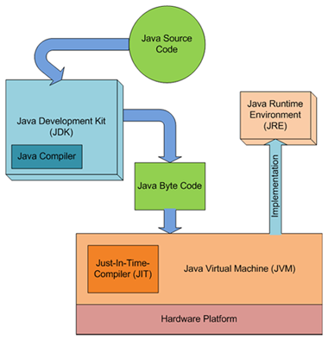
JDK,JVM and JRE

Slide 7
When to Use Java
Java is truly portable.
Software libraries and software components like web servers
Good Development environment
To Create Web Services or distributed applications
Good Database support
Networking support

Slide 8
When Not to Use Java
Applications that are entirely bound by CPU time and need to be as fast as possible should be written in C++
Applications where a virtual machine would not really work well.
Database engines for database systems.
Software that has to interface directly to the hardware (operating systems)
Language processors that have to be fast (e.g., compilers)

Slide 9
Classes
Top-level classes can be declared as
public
a public class is globally accessible.
a single source file can have only one public class or interface
abstract
an abstract class cannot be instantiated
final
a final class cannot be subclassed
Default
Without any Modifier
They can’t be declared as protected and private

Slide 10
Source File Layout
Basic syntax of a Java source file is:
[<package_declaration>]
<import_declaration>*
<class_declaration>+

Slide 11
Declaring Java Technology Classes
Basic syntax of a Java class:
<modifier>* class <class_name> {
<attribute_declaration>*
<constructor_declaration>*
<method_declaration>*
}
Define an attribute:
<modifier>* <type> <name> [ = <initial_value>];

Slide 12
Constructors
Have no return type
Have the same name as the class
If we don't’ put a Constructor the compiler puts a default one
It can have any of the Four Access Modifies
It can be overloaded.

Slide 13
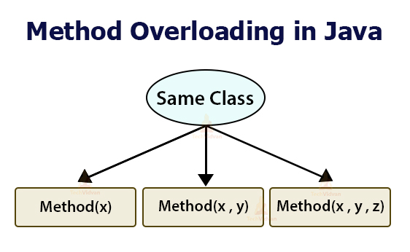

Slide 14
Overloading Methods
Overloaded methods MUST change the argument list.
Overloaded methods CAN change the return type.
Overloaded methods CAN change the access modifier.
Overloaded methods CAN declare new or broader checked exceptions.

Slide 15
Overview
A class can inherit from another class
Original class is the “superclass”
New class is called the “subclass”
Inheritance is a fundamental OO concept
Superclass
Car
Subclasses
SportsCar
Taxi
PoliceCar

Slide 16
Overriding
When a sub-class defines a
“method with same method name, argument types, argument order and return type as a method in its super class, its called method overriding. “
Methods declared as final, static and private cannot be overridden.
An overriding method can be declared as final
The method can’t be less accessible
Public => only public
Protected => Both Public and Protected
Default => default, public and protected

Slide 17
Interfaces
An interface is like a fully abstract class
All the methods are public and abstract- Till Java 8
No instance variables if present they are public static final
Defines a set of methods that other classes can implement
A class can implement many interfaces,
but can extend only one class
can extend other interfaces and extend multiple interfaces

Slide 18
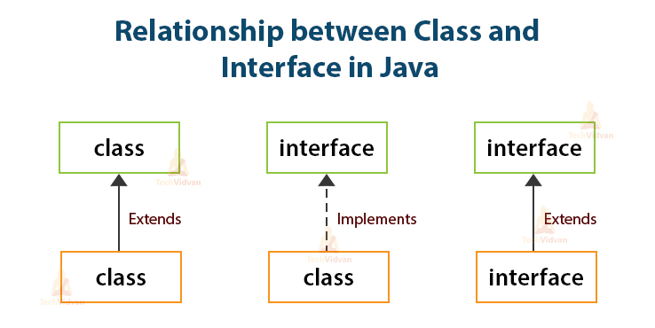

Slide 19
Exception handling

Slide 20
Exception Handling
java.lang.Object
java.lang.Throwable
java.lang.Error
java.lang.Exception
Checked : Child classes of Exception (Forced by compiler to handle exception)
java.io.IOException
java.lang.RuntimeException
Unchecked : Child classes of RuntimeException
Notes:
The class Object is the root of the class hierarchy. Every class has Object as a superclass. All objects, including arrays, implement the methods of this class.
The Throwable class is the superclass of all errors and exceptions in the Java language. Only objects that are instances of this class (or of one of its subclasses) are thrown by the Java Virtual Machine or can be thrown by the Java throw statement. Similarly, only this class or one of its subclasses can be the argument type in a catch clause.
An Error is a subclass of Throwable that indicates serious problems that a reasonable application should not try to catch. Most such errors are abnormal conditions. The ThreadDeath error, though a "normal" condition, is also a subclass of Error because most applications should not try to catch it.
The class Exception and its subclasses are a form of Throwable that indicates conditions that a reasonable application might want to catch.
RuntimeException is the superclass of those exceptions that can be thrown during the normal operation of the Java Virtual Machine. A method is not required to declare in its throws clause any subclasses of RuntimeException that might be thrown during the execution of the method but not caught.
IOException signals that an I/O exception of some sort has occurred. This class is the general class of exceptions produced by failed or interrupted I/O operations.

Slide 21
Handle or Declare Rule
Handle the exception by using the try-catch-finally block.
try{
// some code
} catch(Exception e){
}
Declare that the code causes an exception by using the throws clause.
void trouble() throws IOException { ... }
void trouble() throws IOException, MyException { ... }
Other Principles
You do not need to declare runtime exceptions or errors.
You can choose to handle runtime exceptions

Slide 22
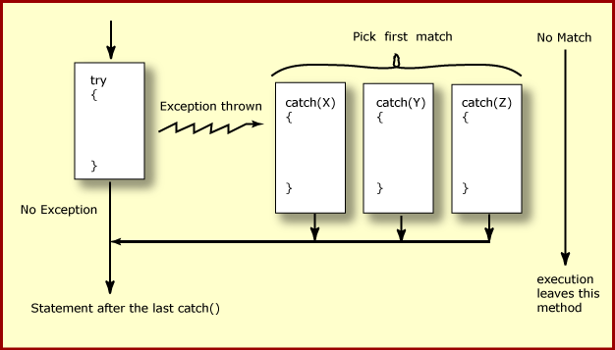
How try catch Work

Slide 23
Effective Exception Hierarchy
The exception classes are arranged in a hierarchy.
Catches for specific exceptions should always be written prior to the generic handler.
A generic handler for Exception would cover any missing situation.
try
{
}
catch (NumberFormatException e) {
}
catch (Exception ex2) {
}
try
{
}
catch (Exception e1) {
}
catch(NumberFormatException e2) {
}

Slide 24
Multiple Catch
try {
Object value = "twenty";
Integer number = (Integer) value;
String mark ="50";
Integer.parseInt(mark);
}
catch ( ClassCastException| NumberFormatException ex ) {
ex.printStackTrace();
}

Slide 25
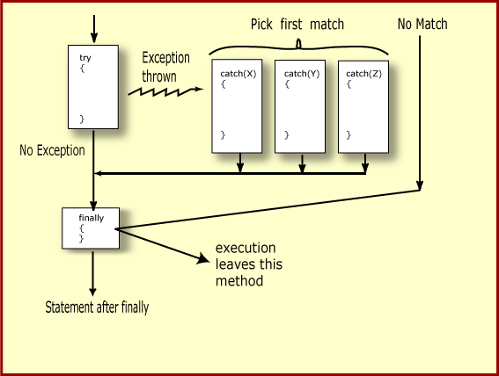
Finally Block

Slide 26
The try-with-resources Statement
A try statement that declares one or more resources.
A resource is an object that must be closed after the program is finished with it.
Ensures the resource is closed at the end of the statement.
Any object that implements java.lang.AutoCloseable, and java.io.Closeable, can be used as a resource.

Slide 27
The try-with-resources Statement
System.out.print("Enter an integer: ");
try(Scanner scan = new Scanner( System.in )) {
int num = scan.nextInt();
System.out.println("square" + num + "is" + num*num );
}
catch ( InputMismatchException ex ) {
System.err.println("You entered bad data." );
System.err.println("Run the program again." );
}
System.out.println("Good-bye" );
}

Slide 28
Java Collection Framework
Provides tools to maintain data container of object
Is an alternative to the creation of custom data structures
Consists of interfaces and classes that implement interfaces within the java.util package
Collection is the root interface for most of the Java collections hierarchy

Slide 29
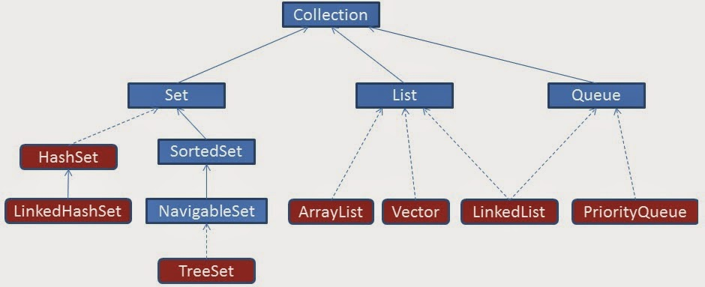
Collection Hierarchy

Slide 30
Collection categories
Ordered Collection
The objects within the collection are maintained in a particular order or not
When an object is added or removed from an ordered collection , the order is automatically maintained
Duplicate Elements
Whether or not the collection allows duplicate objects
Collection will automatically reject an attempt to add an object
Mapping of Key & Value
Whether or not the collection maps a key to a particular object .
This provides a means of quickly locating the object.
Such collections do not allow duplicate objects

Slide 31
Class ArrayList
ArrayList() Constructs an empty list with an initial capacity of ten.
ArrayList(Collection c) Constructs a list containing the elements of the specified collection, in the order they are returned by the collection's iterator.
ArrayList(int initialCapacity) Constructs an empty list with the specified initial capacity.

Slide 32
Generics
Introduced in Java 5.0
Can put any Object in to Collections, because they hold Just Objects
Type-safe Collections are created ,ensuring type-safety at compile time rather than run-time
Creating an Instance of Classes of Generic Type
new ArrayList<Employee>
ArrayList<Employee> mylist = new ArrayList<Employee>();

Slide 33
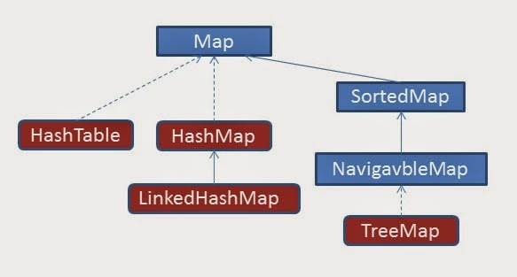
Collection Hierarchy- Map

Slide 34
Map
interface Map (does not extend Collection)
An object that maps keys to values
Ordering may be provided by implementation class, but not guaranteed
Methods to Add and Get Objects
Object put( Object key, Object value)
Object get( Object key)
Iterators for keys, values, (key, value) pairs

Slide 35
Map Implementations
Hash Map
A hash table implementation of Map
Supports null keys & values
Not Ordered
Tree Map
A balanced binary tree implementation
Imposes an ordering on its elements based on comparable/compartor
Hash table
Synchronized hash table implementation of Map interface.
Doesn't support null keys and values

Slide 36
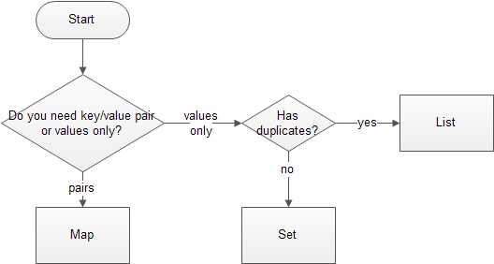
Deciding the Collection Interface

Slide 37
Files & IO

Slide 38
Overview
At its lowest level, all Java I/O involves a stream of bytes either entering or leaving memory
Packaged classes exist to make it easy for a program to read and write larger units of data.
Low-level stream class object are used to handle byte I/O
High-level stream class object will allow the program to read and write primitive data values and objects

Slide 39
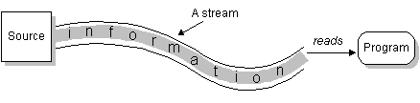
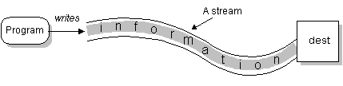
File Classes
Java views the data in files as a stream of bytes.
A stream of bytes from which data are read is called an input stream.
A stream of bytes to which data are written is called an output stream.
Java provides classes for connecting to and manipulating data in a stream.
The classes are defined in the package java.io and are organized in a large complex hierarchy.

Slide 40
Classes in I/O Package
File Reader
Used to read characters from files
The read() method of this class is used to read characters
These are wrapped by BufferedReader to improve the performance
File Writer
Used to write character to files
The Write method() of this classes is used to write characters
Wrapped by BufferedWriter to improve the performance

Slide 41
FileWriter
Constructors:
FileWriter(File file)
FileWriter(File file, boolean append)
FileWriter(String fileName)
FileWriter(String fileName, boolean append)
Same methods of Writer
public void write(int c)
All constructors and methods throw IOException

Slide 42
FileReader
Constructors:
FileReader(File file) throws FileNotFoundException
FileReader(String fileName) throws FileNotFoundException

Slide 43
Classes in I/O Package
BufferedReader
Buffers give a temporary holding place to group until it reaches final place.
It helps in efficent reading of files
Reads a large amount of data from a file at once and keep that data in buffer
Minimizes the number of times of file access.
Provides a readLine() method , which reads a line of characters from the file
BufferedReader in =
new BufferedReader(new FileReader(“file.txt"));
BufferedWriter
Provides a newLine() method , which that creates line separators automatically

Slide 44
Handling file input and output
PrintWriter
Provides number of flexible and powerful methods to write data to files
Methods like format(),printf() and append() are used to work with data
print() or println() of this class take a single parameter of any data type
PrintWriter wraps the FileWriter
The resulting file can be read with a text editor or an input stream reader.

Slide 45
Write To File
public static void main(String args[]) {
try {
PrintWriter out = new PrintWriter(
new FileWriter("myAccount2.dat"));
out.println("sujata");
out.println("10099");
out.println(5000);
out.close();
}
catch (FileNotFoundException e){
}
catch (IOException e) {
}
}

Slide 46
Read From File
public static void main(String[] args) {
try {
FileReader fr = new FileReader("TextFile.txt");
BufferedReader br = new BufferedReader(fr);
String line=null;
try
{
while(( line=br.readLine()) !=null) {
System.out.println(line); }
}
catch (IOException e) {
e.printStackTrace();
} }
catch (FileNotFoundException e) {
e.printStackTrace();
}
}

Slide 47
Read From File
public static void main(String[] args) {
try {
FileReader fr = new FileReader("TextFile.txt");
BufferedReader br = new BufferedReader(fr);
String line=null;
try
{
while(( line=br.readLine()) !=null) {
System.out.println(line); }
}
catch (IOException e) {
e.printStackTrace();
} }
catch (FileNotFoundException e) {
e.printStackTrace();
}
}

Slide 48
Lambdas

Slide 49
Lambda Introduction
Representation of an anonymous function : it doesn’t have a name, but it has a list of parameters, a body, a return type, and also possibly a list of exceptions that can be thrown.
Can be passed around as a parameter thus achieving behavior parameterization.
Let you pass code in a concise way.
An instance of a lambda can be assigned to any functional interface whose single abstract method’s definition matches the definition of the lambda.
Lamda can be
assigned to variables
passed to functions

Slide 50
What are Lambda’s good for
Forms the basis of functional programming
Make parallel programming easier
Write more compact code
Richer data structure collection
Develop cleaner APIs

Slide 51
Syntax
Lambda expression is composed of parameters,an arrow and a body.
parameter -> expression body Or (parameters) -> { statements; } or () -> expression
Following are Some examples of Lambda
(int a, int b) -> a * b // takes two integers and returns their multiplication
(a, b) -> a - b // takes two numbers and returns their difference
() -> 99 // takes no values and returns 99
(String a) -> System.out.println(a) // takes a string, prints its value to the console, and returns nothing
a -> 2 * a // takes a number and returns the result of doubling it
c -> { //some complex statements } // takes a collection and do some procesing

Slide 52
Rules for writing lambda expressions
A lambda expression can have zero, one or more parameters.
The type of the parameters can be explicitly declared or it can be inferred from the context.
Multiple parameters are enclosed in mandatory parentheses and separated by commas. Empty parentheses are used to represent an empty set of parameters.
When there is a single parameter, if its type is inferred, it is not mandatory to use parentheses. e.g. a -> return a*a.
The body of the lambda expressions can contain zero, one or more statements.
If body of lambda expression has single statement curly brackets are not mandatory and the return type of the anonymous function is the same as that of the body expression. When there is more than one statement in body than these must be enclosed in curly brackets.

Slide 53
Functional Interface

Slide 54
Functional Interfaces in Java 8
A functional interface, is an interface which has only a single abstract method.
@FunctionalInterface annotation
used to explicitely specify that a given interface is to be treated as a functional interface.
is an informative annotation.

Slide 55
Custom Or User defined Functional Interfaces
Interfaces defined by the user and have a single abstract method. These may/may not be annotated by @FunctionalInterface.
package com.sujata.java8training;
@FunctionalInterface public interface MyCustomFunctionalInterface {
//This is the only abstract method.Hence, this
//interface qualifies as a Functional Interface
public void firstMethod();
}

Slide 56
Pre-existing functional interfaces in Java prior to Java 8
interface java.lang.Runnable{ void run(); }
interface java.util.Comparator<T>{ int compare(T o1,T o2) }

Slide 57
Newly defined functional interfaces in Java 8
These are pre-defined Functional Interfaces introduced in Java 8 in java.util.function package.
They are defined with generic types and are re-usable for specific use cases.
One such Functional Interface is the Predicate<T> interface which is defined as follows –
//java.util.function.Predicate<T>
@FunctionalInterface
public interface Predicate<T> {
boolean test(T t);
}

Slide 58
Java 8 java.util.function package
Provides a set of re-usable common functional interfaces( and their corresponding lambda) definitions which can be used by the programmer in his code instead of creating brand new functional interfaces.
4 major Categories
Consumer<T>
Used in all contexts where an object T needs to be consumed,i.e. taken as input, and some operation is to be performed on the object without returning any result.
Function<T,R>
Used when an object of a type T is taken as input and it is converted(or mapped) to another type R.
Predicate<T>
Used wherever an object T needs to be evaluated and a boolean value needs to be returned
Supplier<T>
Used in all contexts where there is no input but an output T is expected.

Slide 59
Common Functional Interfaces in Java8
Functional Interface | Functional Descriptor | Primitives Specializations
Predicate<T> | T -> Boolean | IntPredicate, LongPredicate, DoublePredicate
Consumer<T> | T -> void | IntConsumer, LongConsumer, DoubleConsumer
Function<T, R> | T -> R | IntFunction<R>, IntToDoubleFunction, IntToLongFunction, LongFunction<R>, LongToDoubleFunction, LongToIntFunction, DoubleFunction<R>, ToIntFunction<T>, ToDoubleFunction<T>, ToLongFunction<T>
Supplier<T> | () -> T | BooleanSupplier, IntSupplier, LongSupplier, DoubleSupplier
UnaryOperator<T> | T -> T | IntUnaryOperator, LongUnaryOperator, DoubleUnaryOperator

Slide 60
Common Functional Interfaces in Java8
Functional Interface | Functional Descriptor | Primitives Specializations
BinaryOperator<T> | (T, T) -> T | IntBinaryOperator, LongBinaryOperator, DoubleBinaryOperator
BiPredicate<L, R> | (L, R) ->boolean
BiConsumer<T, U> | (T, U) -> void | ObjIntConsumer<T>, ObjLongConsumer<T>, ObjDoubleConsumer<T>
BiFunction<T, U, R> | (T, U) -> R | ToIntBiFunction<T, U>, ToLongBiFunction<T, U>, ToDoubleBiFunction<T, U>

Slide 61
Method References

Slide 62
Types of Method Reference
Reference to a static method.
Reference to an instance method.
Reference to a constructor.

Slide 63
Type 1: Reference to a static method
Lambda Syntax:
(arguments) -> <ClassName>.<staticMethodName>(arguments);
Equivalent Method Reference:
<ClassName> :: <staticMethodName>
Example
//Lambda Expession
Function<String, Double> doubleConvertorLambda=(String s) ->Double.parseDouble(s);
//Equivalent Method Reference
Function<String, Double> doubleConvertor=Double::parseDouble;

Slide 64
Type 2: Reference to an instance method of an arbitrary type
Lambda Syntax
(arg0,rest)->arg0.instanceMethod(rest)
Note: arg0 is of type ClassName
Equivalent Method Reference:
ClassName of arg0 ::instanceMethod

Slide 65
Type 2: Example
List <String> str=Arrays.asList(“a”,”b”,”A”,”B”);
//Lambda
str.sort((s1,s2)->s1.compareToIgnoreCase(s2));
//Equivalent Method Reference
str.sort(String::compareToIgnoreCase);

Slide 66
Type 2: Reference to an instance method
Lambda Syntax:
(arguments) -> <expression>.<instanceMethodName>(arguments)
Equivalent Method Reference:
<expression> :: <instanceMethodName>

Slide 67
Type 2 :Example
interface Sayable{
void say();
}
public class InstanceMethodReference {
public void saySomething(){
System.out.println("Hello, this is non-static method.");
}
public static void main(String[] args) {
InstanceMethodReference methodReference = new InstanceMethodReference(); // Creating object
//lambda
Sayable sayablex=()->{methodReference.saySomething()};
// Referring non-static method using reference
Sayable sayable = methodReference::saySomething;
// Calling interface method
sayable.say();
// Referring non-static method using anonymous object
Sayable sayable2 = new InstanceMethodReference()::saySomething; // You can use anonymous object also
// Calling interface method
sayable2.say();
}
}

Slide 68
Type 3:Reference to a Constructor
Syntax of Constructor References:
<ClassName>::new
Type 3: Example
public class Employee{
String name;
Integer age;
//Contructor of employee
public Employee(String name, Integer age){
this.name=name;
this.age=age;
}
}

Slide 69
Type 3 : Example
public interface EmployeeFactory{
public Employee getEmployee(String name,Integer age);
}
//Client Code for invoking Factory Interface
//lambda Example
EmployeeFactory empFactory=(name,age)-> new Employee(name,age);
//Equivalent Method Reference
EmployeeFactory empFactory=Employee::new;
Employee emp= empFactory.getEmployee("John Hammond", 25);

Slide 70
Streams

Slide 71
Stream API in JAVA 8
The Stream API in Java 8 lets you write code that’s
Declarative : More concise and readable
Composable : Greater Flexibility
Parallelizable : Better performance

Slide 72
What is Stream
A sequence of elements from a source that supports data processing operations.
Sequence of elements— Like a collection, a stream provides an interface to a sequenced set of values of a specific element type.
Source— Streams consume from a data-providing source such as collections, arrays, or I/O resources.
Data processing operations— Streams support database-like operations and common operations from functional programming languages to manipulate data, such as filter, map, reduce, find, match, sort, and so on. Stream operations can be executed either sequentially or in parallel.

Slide 73
Stream operations have two important characteristics:
Pipelining— Many stream operations return a stream themselves, allowing operations to be chained and form a larger pipeline. A pipeline of operations can be viewed as a database-like query on the data source.
Internal iteration— In contrast to collections, which are iterated explicitly using an iterator, stream operations do the iteration behind the scenes for you.

Slide 74
Example
public class Dish {
private final String name;
private final boolean vegetarian;
private final int calories;
private final Type type;
//argumented constructor
//setters & getters
public enum Type { MEAT, FISH, OTHER }
}

Slide 75
In Java 7

Slide 76
In Java 8

Slide 77
Another Example Java 8

Slide 78
Stream Operations
Intermediate Operation
Allows the operations to be connected to form a query.
Don’t perform any processing until a terminal operation is invoked.
Terminal Operation
produce a result from a stream pipeline.
A result is any nonstream value such as a List, an Integer, or even void.

Slide 79
Working with Streams
A data source (such as a collection) to perform a query on
A chain of intermediate operations that form a stream pipeline
A terminal operation that executes the stream pipeline and produces a result

Slide 80
List of Intermediate Operations
Operation | ReturnType | Argument of Operation | Function Description
filter | Stream<T> | Predicate<T> | T->boolean
map | Stream<R> | Function<T,R> | T->R
limit | Stream<T>
sorted | Stream<T> | Comparator<T> | (T,T)->int
distinct | Stream<T>

Slide 81
List of Terminal operation
Operation | Purpose
forEach | Consumes each element from a stream and applies a lambda to each of them. The operation returns void.
count | Returns the number of elements in a stream. The operation returns a long.
collect | Reduces the stream to create a collection such as a List, a Map, or even an Integer.

Slide 82
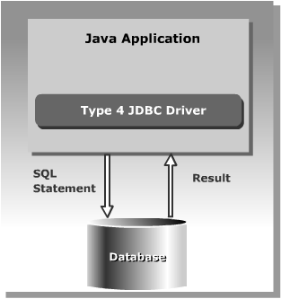
Type -4 Native Protocol Pure Java Driver

Slide 83
Querying a Database With JDBC
Connect
Register the driver
Query
Connect to the database
Process results
Close

Slide 84
Loading a Driver Programmatically:
forName()
In the java.lang.Class class.
Loads the JDBC driver and registers the driver with the driver manager.
Class.forName("oracle.jdbc.driver.OracleDriver");
Required before Java 6
Not required after Java 6 and JDBC 4.0 API
Need to place the Product Specific JAR file with JDBC 4.X driver in class path.
Java automatically detects the Driver class and loads it.

Slide 85
Connecting to a Database
The DriverManager class provides the getConnection() method to create a Connection object.
The getConnection()method has the form
Connection getConnection (String <url>, String <username>, String <password>)
JDBC uses a URL to identify the database connection.
jdbc:<subprotocol>:<subname>
jdbc:oracle:<driver>:@<database>

Slide 86
JDBC URLs with Oracle Drivers
Thin driver
jdbc:oracle:thin:@<host>:<port>:<SID>
Connection conn = DriverManager.getConnection ("jdbc:oracle:thin:@myhost:1521:orcl", "scott", "tiger");
jdbc:microsoft:sqlserver:@10.161.3.94:1433:javatraining,sa,”L2USER;
Notes:
JDBC URLs with Oracle Drivers
For connecting to a database using one of the Oracle JDBC drivers, the basic structure of the JDBC URL is jdbc:<subprotocol>:<driver>:@<database>.
Thin Driver
<driver> is thin.
<database> is a string of the form <host>:<port>:<sid>. That is, it is the host name, TCP/IP port, and Oracle SID of the database to which you want to connect. For example: jdbc:oracle:thin:@eduhost:1521:ORCL
OCI Driver
<driver> is oci8 or oci7, depending on which OCI driver you are using.
<database> is a TNSNAMES entry from the tnsnames.ora file. For example: jdbc:oracle:oci8:@eduhost
Note: For the thin and OCI drivers, <database> can also use the SQL name-value pair syntax. For example:
(DESCRIPTION=(ADDRESS_LIST=(ADDRESS=(PROTOCOL=TCP)(HOST=<hostname>) (PORT=<port>)))(CONNECT_DATA=(SID=<sid>)) Server-Side Driver
The server-side driver is for connecting within the server. You do not need a URL to do this; you can use the default connection. You will learn how to do this later in this lesson.

Slide 87
Data Base Connection Property
src/resources/DbConnection.properties
datasource.url=jdbc:mysql://localhost:3306/test
datasource.username=root
datasource.password=sujata
datasource.driverClassName=com.mysql.jdbc.Driver

Slide 88
Connection Utility
public static Connection getMySqlConnection() {
Connection con = null;
try {
String fileName = "resources/DbConnection.properties";
Properties props=new Properties();
InputStream inStream= new FileInputStream(new File(filename));

Slide 89
Connection Utility
props.load(inStream);
con=DriverManager.getConnection(
props.getProperty("datasource.url"),
props.getProperty("datasource.username"),
props.getProperty("datasource.password"));
} catch (SQLException | IOException e) {
e.printStackTrace();
}
return con;
}

Slide 90
Statements - PreparedStatement
PreparedStatement extends the Statement interface.
Provides methods to bind various object types
Code becomes easy to understand:
Uses pre-compilation.
As soon as the database gets a query, it will check the cache before pre-compiling the query.
Used for statements that is called more than once.
Suitable for DML queries like Insert,Update and Delete
Notes:
Prepared Statements
PreparedStatement is inherited from Statement; the difference is that a PreparedStatement holds precompiled SQL statements.
If you execute a Statement object many times, its SQL statement is compiled each time. PreparedStatement is more efficient because its SQL statement is compiled only once, when you first prepare the PreparedStatement. After that, each time you execute the SQL statement in the PreparedStatement, the SQL statement does not have to be recompiled.
Therefore, if you need to execute the same SQL statement several times within an application, it is more efficient to use PreparedStatement than Statement.
PreparedStatement Parameters
A PreparedStatement does not have to execute exactly the same query each time. You can specify parameters in the PreparedStatement SQL string and supply the actual values for these parameters when the statement is executed.
The following slide shows how to supply parameters and execute a PreparedStatement.

Slide 91
Statements - PreparedStatement
String sqlAdd = "insert into emp values(?,?,?)";
PreparedStatement pstmt = con.prepareStatement(sqlAdd);
pstmt.setInt(1, empid);
pstmt.setString(2, empname);
pstmt.setDouble(3, salary);
int n = pstmt.executeUpdate();

Slide 92
Executing JDBC Statements
Can Use SQL statements to send requests to a database to retrieve results.
The Following methods are used to send static SQL statements to a database:
ResultSet executeQuery(String str)
int executeUpdate(String str)
boolean execute(String str)

Slide 93
Dao Interface
public interface DataAccess<T> {
public boolean add(T t);
public List<T> findAll();
public boolean remove(T t);
public int update(int key,T t);
public T findById(int key);
}

Slide 94
DAO Implementation
public class InvoiceDaoImpl implements DataAccess<Invoice> {
private Connection connection;
public InvoiceService(Connection connection) {
super();
this.connection = connection;
}

Slide 95
DAO Implementation
public boolean add(Invoice t) {
String sql = "insert into invoice values(?,?,?)";
int rowAdded =0;
try (PreparedStatement pstmt = connection.prepareStatement(sql)) {
pstmt.setInt(1, t.getInvoiceNumber());
pstmt.setString(2, t.getCustomerName());
pstmt.setDouble(3, t.getAmount());
rowAdded = pstmt.executeUpdate();
} catch (SQLException e) {
e.printStackTrace();
}
return rowAdded==1?true:false;
}

Slide 96
DAO Implementation
public List<Invoice> findAll() {
String sql = "select * from invoice ";
List<Invoice> invoiceList = new ArrayList<>();
try (PreparedStatement pstmt = connection.prepareStatement(sql)) {
ResultSet result = pstmt.executeQuery();
while(result.next()) {
int invoiceNumber =result.getInt("invoiceNumber");
String customerName = result.getString("customerName");
double amount = result.getDouble("amount");

Slide 97
DAO Implementation
Invoice invoice = new Invoice(invoiceNumber, customerName, amount);
invoiceList.add(invoice);
}
} catch (SQLException e) {
e.printStackTrace();
}
return invoiceList;
}

Slide 98
DAO Implementation
public boolean remove(Invoice t) {
String sql = "delete from invoice where invoiceNumber=?";
int rowDeleted =0;
try (PreparedStatement pstmt = connection.prepareStatement(sql)) {
pstmt.setInt(1, t.getInvoiceNumber());
rowDeleted = pstmt.executeUpdate();
} catch (SQLException e) {
e.printStackTrace();
}
return rowDeleted==1?true:false;
}

Slide 99
DAO Implementation
public void closeConnection() {
try {
this.connection.close();
} catch (SQLException e) {
e.printStackTrace();
}
}

Slide 100
DAO Implementation
public Invoice findById(int key) {
String sql = "select * from invoice where invoiceNumber=?";
Invoice foundInvoice =null;
try (PreparedStatement pstmt = connection.prepareStatement(sql)) {
pstmt.setInt(1, key);
ResultSet result = pstmt.executeQuery();

Slide 101
DAO Implementation
if(result.next()) {
int invoiceNumber =result.getInt("invoiceNumber");
String customerName = result.getString("customerName");
double amount = result.getDouble("amount");
foundInvoice = new Invoice(invoiceNumber, customerName, amount);
}
} catch (SQLException e) {
e.printStackTrace();
}
return foundInvoice;
}

