Slide 1


Programming With Java

Slide 2
Day -3
Software quality and basic of Unit testing
Definition of Unit and technique to test Unit in isolation. Example of testing simple math like units
Introduce JUnit framework and basic hands on examples. BDD Orientation
Introduction to Sonar
Introduction to Spring framework
Getting started with Spring Boot, Creating REST application with 3 tier architecture

Slide 3
What is Testing
Testing is a group of techniques to determine the correctness of the application under the predefined script .
Testing cannot find all the defect of application.
Main intent of testing is to detect failures of the application so that failures can be discovered and corrected.
It does not demonstrate that a product functions properly under all conditions but only that it is not working in some specific conditions.

Slide 4
What is Testing
Testing furnishes comparison that compares the behavior and state of software against mechanisms.
The mechanism may include past versions of the same specified product, comparable products, and interfaces of expected purpose, relevant standards, or other criteria but not limited up to these.

Slide 5
What is Testing
Testing includes an examination of code and also the execution of code in various environments, conditions as well as all the examining aspects of the code.
In the current scenario of software development, a testing team may be separate from the development team so that Information derived from testing can be used to correct the process of software development.

Slide 6
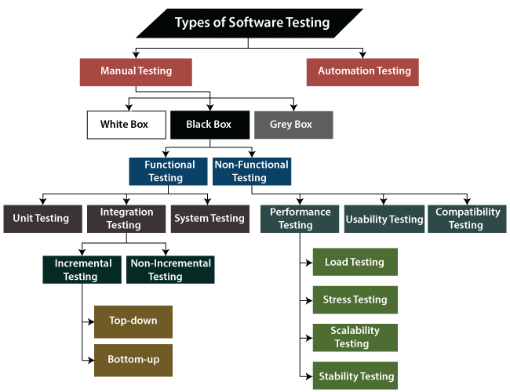
Types of Software Testing

Slide 7
What is Manual Testing?
Testing any software or an application according to the client's needs without using any automation tool is known as manual testing.
In software testing, manual testing can be further classified into three different types of testing:
White Box Testing
Black Box Testing

Slide 8
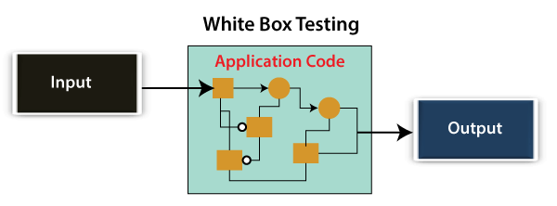
White Box Testing
Developer will execute the complete white-box testing for the particular software and send the specific application to the testing team.
The purpose of implementing the white box testing is to emphasize the flow of inputs and outputs over the software and enhance the security of an application.
White box testing is also known as open box testing, glass box testing, structural testing, clear box testing, and transparent box testing.

Slide 9
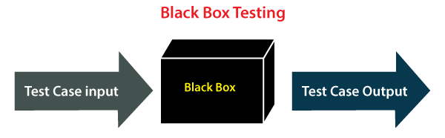
Black Box Testing
Test engineer will analyze the software against requirements, identify the defects or bug, and sends it back to the development team.
Developers will fix those defects, do one round of White box testing, and send it to the testing team.
The main objective of implementing the black box testing is to specify the business needs or the customer's requirements.
It is a process of checking the functionality of an application as per the customer requirement. The source code is not visible in this testing; that's why it is known as black-box testing.

Slide 10
Types of Black Box Testing
Black box testing further categorizes into two parts:
Functional Testing
Non-function Testing

Slide 11
Functional Testing
The test engineer will check all the components systematically against requirement specifications is known as functional testing. Functional testing is also known as Component testing.
In functional testing, all the components are tested by giving the value, defining the output, and validating the actual output with the expected value.
Functional testing is a part of black-box testing as its emphases on application requirement rather than actual code. The test engineer has to test only the program instead of the system.
Types of Functional Testing:
Unit Testing
Integration Testing

Slide 12
1. Unit Testing
Unit testing is the first level of functional testing in order to test any software.
In this, the test engineer will test the module of an application independently or test all the module functionality is called unit testing.
The primary objective of executing the unit testing is to confirm the unit components with their performance.
Unit is defined as a single testable function of a software or an application.
Verified throughout the specified application development phase.

Slide 13
2. Integration Testing
It is the second level of functional testing, test the data flow between dependent modules or interface between two features is called integration testing.
The purpose of executing the integration testing is to test the statement's accuracy between each module.

Slide 14
Non-function Testing
Provides detailed information on software product performance and used technologies.
Non-functional testing will help us minimize the risk of production and related costs of the software.
Non-functional testing is a combination of performance, load, stress, usability and, compatibility testing.

Slide 15


JUNIT 5.0
Kent Beck
Erich Gamma

Slide 16
Test Driven Development
TDD starts with developing test for each one of the features.
The test might fail as the tests are developed even before the development.
Development team then develops and refactors the code to pass the test.
test-first as part of extreme programming concepts.

Slide 17
Testing phases
Unit Testing
on individual units of source code (mostly methods)
Integration Testing
on groups of individual software modules
System testing
on a complete end-to-end system

Slide 18
Benefits of TDD
Much less debug time
Code proven to meet requirements
Tests become Safety Net
Near zero defects
Shorter development cycles

Slide 19
Development Process
Add a Test
Run all tests and see if the new one fails
Write some code
Run tests and Refactor code
Repeat

Slide 20
What is unit testing
Unit
A Method , a class, a package, or a subsystem.
Can Test :
an entire object
part of an object – a method or some interacting methods
interaction between several objects
Helps discover failures in the logic and improve the quality of their code.
Used to ensure that the code work as expected in case of future changes.

Slide 21
When to Write Test
During Development
To add new functionality
When adding new features,
During Debugging
While a defect is discovered in code to demonstrates the defect.
write unit tests to thoroughly test a single class
write tests as develop (even before you implement)
write tests for every new piece of functionality

Slide 22
Junit

Slide 23
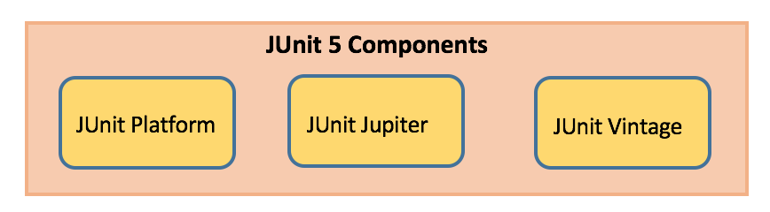
Junit 5
Composed of modules from three different sub-projects.
Requires Java 8 (or higher) at runtime.
Can also test code that has been compiled with previous versions of the JDK.

Slide 24
Tips for testing
You cannot test every possible input, parameter value, etc.
So you must think of a limited set of tests likely to expose bugs.
Think about boundary cases
positive; zero; negative numbers
right at the edge of an array or collection's size
Think about empty cases and error cases
0, -1, null; an empty list or array
test behavior in combination
maybe add usually works, but fails after you call remove
make multiple calls; maybe size fails the second time only

Slide 25
Tips for testing-Effective Tests
Should Not Test
Other framework libraries (you should assume they work correctly)
The database (you should assume it works correctly when it is available)
Other external resources (again you assume they work correctly when available)
Really trivial code (like getters and setters for example)
Should Test
Tests should cover code with “business logic”.
Core code that is accessed by a lot of other modules
Code that seems to gather a lot of bugs

Slide 26
Code Coverage
Although 100% code coverage may appear like a best possible effort, even 100% code coverage is estimated to only expose about half the faults in a system.
Low code coverage indicates inadequate testing, but high code coverage guarantees nothing.
Some test cases are expensive to reproduce but are highly improbable.
Code shared among several projects is only partially utilized by the project under test.
Generally, the tester should stop increasing code coverage when the tests become contrived.
When you focus more and more on making the coverage numbers better, your motivation shifts away from finding bugs.

Slide 27
Create Project
Create a Maven project with archetype
groupId : org.apache.maven.archetypes
artificatId :maven-archetype-simple
<dependency>
<groupId>org.junit.jupiter</groupId>
<artifactId>junit-jupiter</artifactId>
<version>5.8.2</version>
<scope>test</scope>
</dependency>

Slide 28
Test Classes and Methods
Test Class
Top-level class, Must NOT be abstract
Static member class,
@Nested class that contains at least one test method.
Can declare custom display name with @DisplayName
Test Method:
Instance method annotated with @Test
Method must be void
Need not be Public but should not be private
Can declare custom display name with @DisplayName
Can also have following annotations
@RepeatedTest, @ParameterizedTest

Slide 29
Write Unit Test
public class Greeting {
public String getMessage() {
return "Welcome to Java Programming";
}
}

Slide 30
Assertions
Assertions
Static methods in org.junit.jupiter.api.Assertions class.
Used to support asserting conditions in a Test Method

Slide 31
Assertions
assertEquals(expected, actual)
Fails when expected does not equal actual
assertNull(actual)
Fails when actual is not null
assertAll()
Group many assertions
Every assertion is executed even if one or more of them fails
assertThrows()
Class to be tested is expected to throw an exception

Slide 32
Writing a Junit Test – Assert Equals
import static org.junit.jupiter.api.Assertions.*;
import org.junit.jupiter.api.Test;
class TestGreeting {
private Greeting grtObj = new Greeting();
@Test
void testGetMessageLength() {
int actual = grtObj.getMessage().length();
assertEquals(5,actual);
}
}

Slide 33
Example
public String findResult(int mark){
String result =null;
if(mark<60)
{
result="B";
}
if(mark>60 && mark<80)
{
result ="C";
}
return result;
}

Slide 34
Writing a Junit Test – Assert Not Null
@Test
@DisplayName("Test for Method Should Not Throw Null Value")
void testFindResultForNotNull() {
String actual = grtObj.findResult(95);
assertNotNull(actual);
}

Slide 35
Writing a Junit Test – Assert All
@Test
@DisplayName("Using Assert All")
void testFindUsingAssertAll() {
assertAll("Testing Cases",
() -> {
String expected = grtObj.getMessage();
assertNotNull(expected);
},
() -> assertEquals("Hello World",grtObj.getMessage())
);
}
}

Slide 36
Example
public String checkUserId(String ... values) {
String message = "invalid";
try {
int id = Integer.parseInt(values[1]);
message="valid";
} catch (NumberFormatException e) {
System.err.println(e.getMessage());
}
return message;
}

Slide 37
Writing a Junit Test – Assert Throws
@Test
@DisplayName("Test For Number Format Exception ")
void testForException() {
Throwable exception =
assertThrows(NumberFormatException.class, ()-> grtObj.checkUserId("fourTwenty"));
assertEquals("Invalid Number",exception.getMessage());
}

Slide 38
Disabling Tests
@Disabled
Entire test classes or individual test methods can be disabled
Can also be declared without providing a reason
@Disabled("Disabled until bug #560 has been fixed")
class DisabledClassDemo {
@Test
void testWillBeSkipped() {
}
}

Slide 39
Lifecycle Method
@BeforeAll
Denotes that the annotated method should be executed once before all Test Methods
Methods must be static
Used for expensive common operation like database connection or the startup of a server.
@AfterAll
Denotes that the annotated method should be executed after all the Test Methods
Methods must be static

Slide 40
Lifecycle Method
@BeforeEach
Denotes that the annotated method should be executed before EACH Test Method
To execute some common code before running a test
@AfterEach
Denotes that the annotated method should be executed after EACH Test Method

Slide 41
Writing a Junit Test Life Cycle Methods
@BeforeEach
void setUp(TestInfo info) throws Exception {
System.out.println("BEFORE EACH Called on "+ info.getDisplayName());
}
@AfterEach
void tearDown(TestInfo info) throws Exception {
System.out.println("AFTER EACH Called on"+ info.getDisplayName());
}

Slide 42
Example - Timeouts
public String getMessage() {
try {
Thread.sleep(5000);
} catch (InterruptedException e) {
e.printStackTrace();
}
return "Welcome to Java Programming";
}

Slide 43
Test Timeouts
import static java.time.Duration.ofMillis;
import static org.junit.jupiter.api.Assertions.assertTimeout;
@Test
@DisplayName("Testing For Timeout")
void timeoutNotExceededWithMethod() {
String actualGreeting = assertTimeout(ofMillis(1000),() -> grtObj.getMessage());
assertEquals("Hello, World!", actualGreeting);
}

Slide 44
ParameterizedTest
@ParameterizedTest
Denotes that a method is a parameterized test.
When executing the parameterized test method
Each invocation will be passed with arguments and reported separately.
@ValueSource
Used to pass an array of values to the test method.
Values can be int,byte,short ,double,char,String
Can Pass Only one Argument to the method.

Slide 45
ParameterizedTest
@DisplayName("Testing For elements in even position should not be null")
@ParameterizedTest
@ValueSource(ints = {0,2,4,6})
void checkingForNullInList(int idxPos) {
assertNotNull(grtObj.findElement(idxPos));
}

Slide 46
ParameterizedTest
public String findElement(int idxPos) {
List<String> names =
Arrays.asList("Ramesh","Suresh",null,"magesh",null,"Rajesh","Siva");
return names.get(idxPos);
}

Slide 47

Introduction to Spring boot

Slide 48
Introduction
Spring
An application development framework and inversion of control container for Java
Spring Boot
Makes it easy to create stand-alone, production-grade Spring Applications and expose them as services

Slide 49
Spring Framework
Light-weight comprehensive framework for building Java SE and Java EE applications
Java Bean-based configuration management,
Integration with persistence frameworks.
MVC web application framework
Aspect-oriented programming (AOP) framework
Publishing REST API’s

Slide 50
The Container

Slide 51
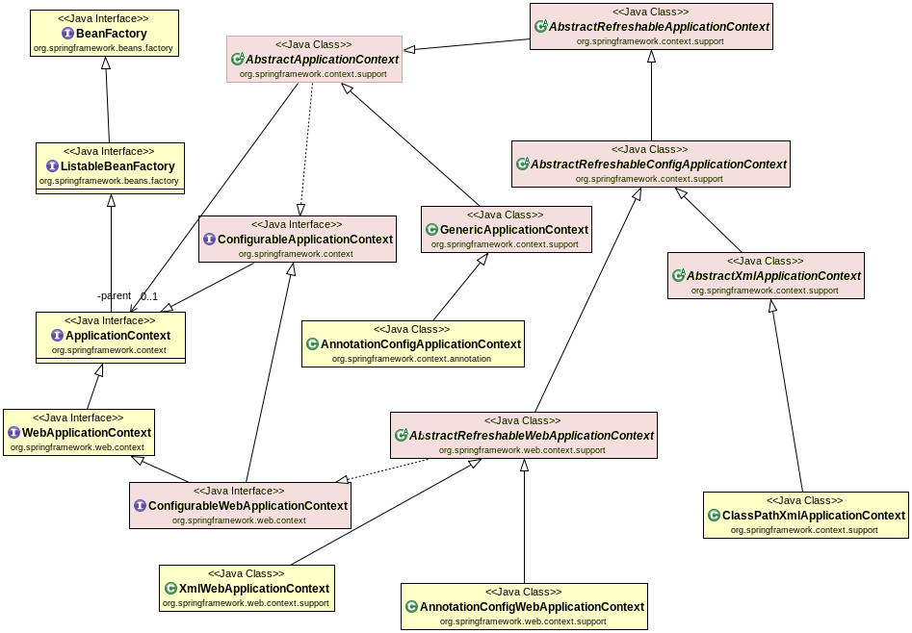
Container Hierarchy

Slide 52
Beans
A bean is an object that is instantiated, assembled, and otherwise managed by a Spring IoC container.
The “beans” are in the form of JavaBeans
Present in a Named Package
No Argument constructor
getter and setter methods for the properties
Can be controlled for scope, life cycle and callbacks.
Beans are singletons by default
Beans are Eagerly Initialized by default

Slide 53
Dependency Injection
Dependencies between the beans can be Injected by following ways
Setter Injection
uses setter method to set the value
Constructor Injection
Happens at the time of creating the object itself
Field Injection (@Autowired at field)
Uses reflection to set the values of private variables
@Autowired
private UserService userService;

Slide 54
Constructor Injection
Dependency can be one of the following
Injected via a class constructor
primitive and String-based values
Dependent object (contained object)
Collection values
@Component
public class UserController {
private UserService userService;
public UserController(UserService userService){
this.userService = userService;
} }

Slide 55
Setter Injection
Setter Injection
Injected via setter methods
Allows flexible initialization
Requires Java Bean conventions to be followed
Can add post initialization checking methods
private UserService userService;
@Autowired
public void setUserService(UserService userService){
this.userService = userService;
}

Slide 56
Registering beans

Slide 57
Configuration Meta Data
Instructs IoC Container to instantiate, configure, and assemble the objects
Can be done in XML format
Supported from Spring 2.0
Can be done with Annotation
Supported from Spring 2.5
Can be done with Just Java
Supported from Spring 3.0

Slide 58
@ Component
@Component
Spring can scan all the beans through auto scan if the class has this or similar annotation
The Registered Beans can be access by Its name
The Name is first Character of the Class Name in lowercase
‘CustomerService’ to ‘customerService’.
CustomerService cust = (CustomerService)context.getBean("customerService");
@Component(“custService”)
Can Customize the component name by passing a string value

Slide 59
@Bean
Method-level annotation in Class annotated @Configuration
Added to the public Method of the configuration class
Methods should not be private or final
Method should return an object that should be registered as a Bean
Supports following attributes
init-method
destroy-method
autowireCandidate
name

Slide 60
Register Bean
Beans can also be registered with Java Based Configuration
Done in the Java class with @Configuration Annotation
This class acts as a source of Bean Definitions
@Configuration
public class EmployeeConfig {
@Bean
public Employee idOfTheBean(){
return new Employee();
}
@Bean (name=“ram”) // bean Id overridden with name attribute
public Employee employee(){
return new Employee();
}
}

Slide 61
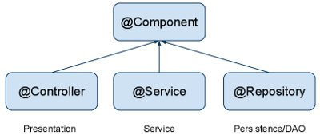
Auto Component Scan Types
@Component
Indicates a auto scan component.
@Repository
Indicates DAO component in the persistence layer.
@Service
Indicates a Service component in the business layer.
@Controller
Indicates a controller component in the presentation layer.

Slide 62
Constructor DI
@Component
@Data
public class Invoice {
private Customer customer;
private Product product;
@Autowired
public Invoice(Customer customer, Product product) {
super();
this.customer = customer;
this.product = product;
}
}

Slide 63
Setter DI
@Autowired
public void setCustomer(Customer customer) {
this.customer = customer;
}
public Product getProduct() {
return product;
}
@Autowired
public void setProduct(Product product) {
this.product = product;
}
public Invoice() {
// TODO Auto-generated constructor stub
}

Slide 64
Spring Boot
Extension of the Spring framework
A faster and more efficient development
Eliminates the boilerplate configurations required for setting up a Spring application.
Opinionated ‘starter’ dependencies to simplify build and application configuration
Embedded server to avoid complexity in application deployment
Metrics, Health check, and externalized configuration
Automatic configuration whenever possible

Slide 65
Spring Boot Bootstrap
@SpringBootApplication
public class Application {
public static void main(String[] args) {
SpringApplication.run(Application.class, args);
}
}
Spring Boot can scan all the classes in the same package or sub packages of Main-class for components.
Equivalent to using @Configuration, @EnableAutoConfiguration, and @ComponentScan with their default attributes,

Slide 66
Spring Application
public static void main(String[] args) {
ConfigurableApplicationContext ctx = SpringApplication.run(BootIocApplication.class, args);
Invoice invoice= ctx.getBean(Invoice.class);
System.out.println(invoice);
ctx.close();
}

Slide 67
Rest service using Spring data JPA

Slide 68
REST Overview
REpresentational State Transfer
An architectural style of creating API's
Makes it easier for systems to communicate with each other.
The implementation of the client and server can be done independently without each knowing about the other.
Different clients hit the same REST endpoints, perform the same actions, and receive the same responses.

Slide 69
REST Overview
Resource Oriented Architecture
Data and functionality are considered resources
Accessed using Uniform Resource Identifiers (URIs)
Accessed Using HTTP standard methods.

Slide 70
Lightweight Web Services
REST is a lightweight alternative to Web Services and RPC.
REST services is:
Platform-independent
Language-independent
Runs on top of HTTP Protocol
Used in the Presence of firewalls too.
REST does not offer
built-in security features
encryption
session management
These feature can be added by building on top of HTTP:

Slide 71
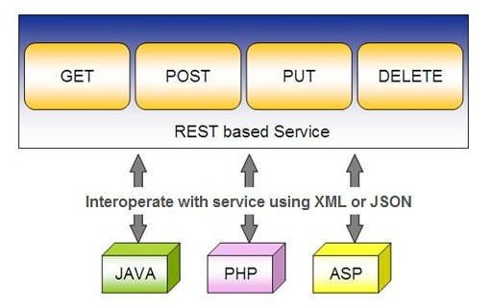
Spring RESTful Services
REST does not require the client to know anything about the structure of the API.
Server needs to provide whatever information the client needs to interact with the service.

Slide 72
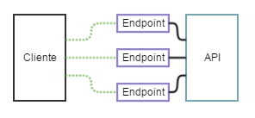
API and Endpoint

Slide 73
Spring data rest with JPA

Slide 74
Spring RESTful Services
A RESTful architecture may expose multiple representations of a resource.
From Spring 4 @RestController annotation is added to controller
A combination of @Controller and @ResponseBody
A Rest Controller method returns a domain object instead of a view.

Slide 75
REST Stereotypes
@RestController
An implicit @ResponseBody is being added to the methods.
Allows Spring to render the returned HttpEntity and its payload, directly to the response.
@GetMapping
To map HTTP GET requests onto specific handler methods.
Composed annotation for @RequestMapping(method = RequestMethod.GET).

Slide 76
REST Stereotypes
@PathVariable
Indicates that the Method parameter should be bound to a URI template variable.
@GetMapping("/members/{id}")
public String getById(@PathVariable String id) { }
@PostMapping
Combined shortcut for @RequestMapping(method = RequestMethod.POST).
@PostMapping("/members“)
public void addMember(@RequestBody Member member) { }

Slide 77
@Repository
There are three repository in Spring Data
CrudRepository
Extends Repository
provides CRUD functions
PagingAndSortingRepository
Extends CrudRepository
provides methods to do pagination and sort records
JpaRepository
Extends PagingandSortingRepository
Provides Methods such as flushing the persistence context and delete records in a batch
Querying methods return List's instead of Iterable's

