Slide 1


Programming With Java

Slide 2
Day - 4
Introduction to Microservices
Understanding the Monolith application and its challenges What are Microservices
Basic building blocks of Microservices
How do Microservices solve the challenges with Monolith?
Microservices in action
How to build, deploy and test Microservices Common design patterns for creating Microservices REST and JSON
Popular frameworks in use Key benefits
Introduction to Spring cloud

Slide 3
Introduction to Micro services

Slide 4
Micro Services
Problems with Monolithic Application
What is Microservices
Advantages and disadvantages
When not to use Microservice
Use case for MicroServices

Slide 5
Monolith Application
A monolithic application is a single-tiered software application
Has user interface and data access code combined into a single program from a single platform.
Its characteristics
Doesn’t have Module but Modularized using object-based approach to be distributed across multiple computers
Deployed together as a single deployment unit- EAR or WAR.
Long Release Cycles
Large Teams

Slide 6
Challenges to Monolith
Large codebases become mess over the time
Multiple teams working on single codebase become tedious
Difficulty in Adapting to Device Explosion
Scaling up certain parts of the application
Technology updates/rewrites become complex and expensive tasks

Slide 7
Micro Services
An engineering approach focused on decomposing applications with well-defined interfaces - service contracts such as a JSON schema or WSDL
Deployed independently as services and operated by small teams who own the entire lifecycle of the service.
Each service handles a specific business domain (logging, auth, orders, customers)
Each Service provides the implementation for user interface, business logic, and connection to database.
Each Service can be scaled up Individually

Slide 8
Micro Service
class UserApp() {
User getUser() {
// 1. auth user
// 2. get user data
// 3. log user actions }
}
class UserApp() {
void authUser(User user) { ... }
User getUserData() { ... }
void logUserActions() { ... }
}

Slide 9
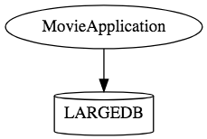
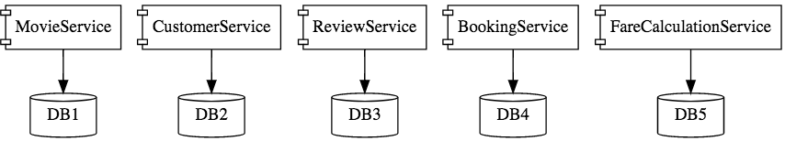
Micro Services

Slide 10
Characteristics of Micro Service
Single-function
Each and every service has a specific function, or responsibility.
A service can do many tasks, but all of them are relevant to a single function.
Well-defined interfaces
Services must provide an interface that defines to communicate with it.
Defines a list of methods, and their inputs and outputs.
JSON Schema or WSDL files

Slide 11
Characteristics of Micro Service
Independent
Services doesn’t know about each other implementation.
They can get tested, deployed, and maintained independently.
Services may be implemented using different language stacks, and communicate with different databases.
They can work together to complete a required operation.

Slide 12
Characteristics of Micro Service
Small Teams
Split the work up and team across the services.
Each team focuses on a specific service, they don’t need to know about internal workings of other teams.
Teams can work efficiently, communicate easily,
Each service can be deployed rapidly as soon as it’s ready.
Entire Lifecycle
The team is responsible for the entire lifecycle of the service; from coding, testing, staging, deploying, debugging, maintaining.
No separate team for coding, deployment. Etc

Slide 13
Characteristics of Micro Service
Minimizing Communication
Only essential cross-team communication should be through the interface that each service provides.
They all need to agree on the external interface, so that communication between services is clearly defined.
Cloud Enabled
Dynamic Scaling

Slide 14
When Not to use Micro Services
Complexity is a key factor
"...don't even consider microservices unless you have a system that's too complex to manage as a monolith...“ –Martin Fowler
If complexity isn't problem, microservices aren't the solution.
Micro service architecture also brings with it significant overhead
Design
Interoperability of services
Management
Use of system resources.

Slide 15
Challenges with Micro service
Development has some inherent complexities
Quick Setup needed
Should be able to create micro services quickly.
Automation
Smaller component build ,deployment, monitoring etc should automated
Visibility :
Should be able to monitor and identify problems automatically.
Need great visibility around all the components.
Debugging
Centralized Logging and Dashboards are essential to debug problems.

Slide 16
Challenges with Micro service
Configuration Management
Need to maintain configurations for hundreds of components across environments.
Should Have Configuration Management solution
Dynamic Scale Up and Scale Down
Applications should be easily scaled up and down
Pack of Cards :
If a Service at the bottom of the call chain fails, it can have knock on effects on all other services.
Services should be fault tolerant by Design.
Consistency
Should have some decentralized governance around the languages, platforms, technology and tools used for implementing/deploying/monitoring

Slide 17
Solutions to Challenges
Spring Boot
Enable building production ready applications quickly
Provide non-functional features
embedded servers (easy deployment with containers)
metrics (monitoring)
health checks (monitoring)
externalized configuration

Slide 18
Solutions to Challenges
Spring Cloud
Cloud solutions – From Spring and Open Sourced
Dynamic Scale Up and Down.
Using a combination of Naming Server (Eureka)
Client Side Load Balancing
Feign (Easier REST Clients)
Visibility and Monitoring
Zipkin Distributed Tracing
API Gateway
Configuration Management
Spring Cloud Config Server
Fault Tolerance
Cloud Circuit Breaker

Slide 19
Spring Cloud Eureka

Slide 20
Service Register and Discovery
Application is decomposed into Many Microservices.
Each deployed in different servers and different ports.
Services may need to communicate with each other to execute some tasks
Using ip address and port number has many limitations on invoking the services

Slide 21
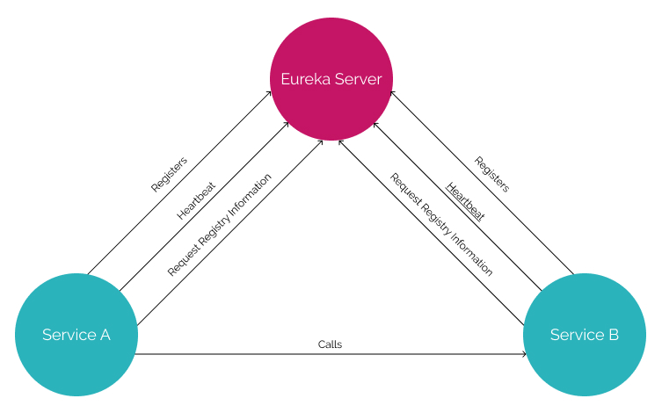
Service Registry

Slide 22
Netflix Eureka Server
@EnableEurekaServer
Added to the main Spring Boot Application configuration class
Used to Notify the Spring Container that this application is a registration service by Netflix technology
It also activates Eureka Server related configurations
@EnableEurekaServer
@SpringBootApplication
public class EurekaServerApplication {
public static void main(String[] args) {
SpringApplication.run(EurekaServerApplication.class, args);
}
}

Slide 23
Server Config Properties
server:
port: 8761
spring:
application:
name: eureka-server-registry
eureka:
client:
fetch-registry: false
register-with-eureka: false
service-url:
defaultZone: http://localhost:8761/eureka

Slide 24
Configuration Properties
fetch-registry=false (default: true)
A Eureka instance is also a Eureka client
It can fetch the registry containing the details of other instances.
“false” means it will not be fetching the registry information
register-with-eureka=false (default: true)
Should this server register itself as a client;
“false” means it prevents itself from acting as a client.

Slide 25
Configuration Properties
eureka.client.serviceUrl.defaultZone
In a standalone mode
points to the local server address.
Switch off the client-side behavior
Does not keep trying and failing to reach its peers.

Slide 26
Eureka discovery client

Slide 27
Discovery From Eureka Server
EurekaClientConfigBean
Implementation of EurekaClientConfig.
Properties are prefixed by eureka.client.
Discovery clients
Clients can look up and fetch information of other services
Can communicate without IP addresses and port numbers

Slide 28
Discovery Clients
@EnableDiscoveryClient
Added in the main spring boot configuration class
Works with any Discovery Client implementations
Example : Eureka, Consul, Zookeeper
@EnableEurekaClient
Works only with Eureka

Slide 29
Discovery Client Service
@SpringBootApplication
@EnableEurekaClient
public class BloodDonarServiceApplication {
public static void main(String[] args) {
SpringApplication.run(BloodDonarServiceApplication.class, args);
}
}

Slide 30
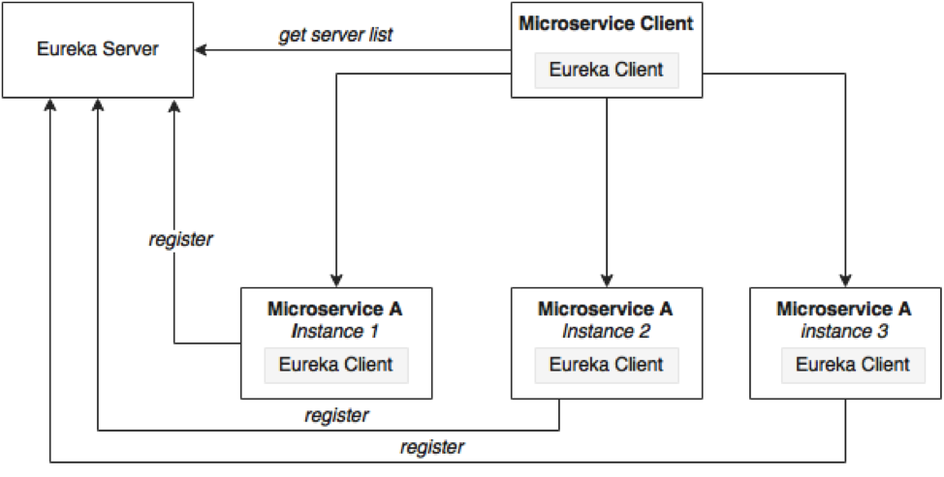
Load Balancing

Slide 31
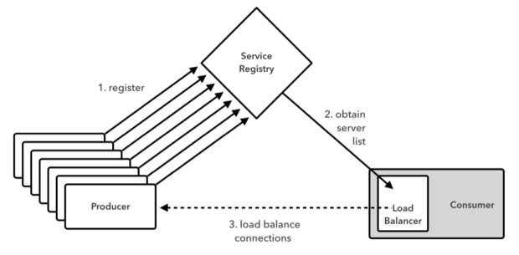
Working of Load Balancer

Slide 32
@LoadBalanced
Eliminates direct use of Ribbon
Ribbon automatically integrates with RestTemplate
Makes RestTemplate ribbon aware.
Also helps to use "logical identifiers" for the URLs passed to restTemplate.
logical identifiers are name of a service.
@Bean
@LoadBalanced
public RestTemplate template() {
return new RestTemplate();
}

Slide 33
Rest Client - Application
@SpringBootApplication
@EnableDiscoveryClient
public class PaymentServiceApplication {
public static void main(String[] args) {
SpringApplication.run(PaymentServiceApplication.class, args);
}
@Bean
@LoadBalanced
public RestTemplate template() {
return new RestTemplate();
}
}

Slide 34
Rest Client - Controller
@RestController
@Slf4j
public class PaymentController {
@Autowired
private RestTemplate template;
String baseURL = "http://CUSTOMER-SERVICE/";
@GetMapping(path = "/api/v1/client/customers")
public String getCustomerDetails() {
String reqURL = baseURL+"api/v1/customers";
return this.template.getForObject(reqURL, String.class);
}
}

