Slide 1


Programming With Java

Slide 2
Day -2
Concurrency
Program Documentation
SOLID principles
GoF patterns - Some common Creational, Structural, Behavioral Design Principles
Java Do’s and Don’ts/ best practices

Slide 3
Concurrency
Java platform always has a strong support for concurrent programming and multithreading.
earlier days the support was in the form of calling native constructs itself in the application layer.
Before java 1.5, multithreading applications were created using thread group, thread pool or custom thread pool.
Entire thread management was the responsibility of the programmer keeping in mind the following points.
Thread synchronization
Thread waiting
Thread joining
Thread locking
Thread notification
Handling dead lock
Disadvantage
Handle those primitive construct calls efficiently. Otherwise the application will not run properly and unexpected results will be generated.

Slide 4
Thread Pool
A thread pool is a group of pre-instantiated, idle threads which stand ready to be given work.
Preferred over instantiating new threads for each task when there is a large number of short tasks to be done rather than a small number of long ones.
Prevents having to incur the overhead of creating a thread a large number of times.

Slide 5
Executor Framework
Introduced in Java 1.5 .
Part of java concurrency package.
Abstraction layer over the actual implementation of java multithreading.
hides the critical parts of concurrent execution and the programmer only concentrates on the business logic implementation.
First concurrent utility framework in java ,used for standardizing invocation, scheduling, execution and control of asynchronous tasks in parallel threads.
Executor implementation thread pools which consists of worker threads.

Slide 6
Executor Framework
Parallel works are considered as tasks instead of simple threads.
Application deals simply with instances of Runnable (which is basically collections of tasks or parallel works) and then it is passed to an Executor to process.
The ExecutorService interface extends the simplistic Executor interface.
The Java Executor framework has life cycle methods to manage the entire concurrent execution flow.

Slide 7
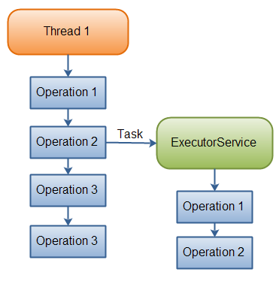
Executor Framework

Slide 8
Creating Thread Pool
This class java.util.concurrent.Executors provides the following factory methods to create thread Pool:
newFixedThreadPool() creates and executor with the fixed thread pool.
The newCachedThreadPool() creates an executor with an expandable thread pool. This executor is suitable for applications that launch many short-lived tasks.
The newSingleThreadExecutor() creates an executor that executes a single task at a time.

Slide 9
Executor Interfaces
The java.util.concurrent package defines the following executor interfaces:
Executor, a simple interface that supports launching new tasks.
ExecutorService, a subinterface of Executor, which adds features that help manage the lifecycle, both of the individual tasks and of the executor itself.

Slide 10
The Executor Interface
Provides a single method, execute, designed to be a drop-in replacement for a common thread-creation idiom.
If r is a Runnable object, and e is an Executor object you can replace
(new Thread(r)).start(); with e.execute(r);

Slide 11
The ExecutorService Interface
Supplements execute with a similar(), but more versatile submit method.
submit() accepts Runnable objects, but also accepts Callable objects, which allow the task to return a value.
submit() returns a Future object, which is used to retrieve the Callable return value and to manage the status of both Callable and Runnable tasks.
Provides methods for submitting large collections of Callable objects.
invokeAny() method takes a collection of Callable objects, or subinterfaces of Callable.
The invokeAll() method invokes all of the Callable objects passed as parameter,returns a list of Future objects .

Slide 12
Shutdown Pool
ExecutorService provides() a number of methods for managing the shutdown of the executor. To support immediate shutdown, tasks should handle interrupts correctly.
shutdown() method will not shut down immediately
Will no longer accept new tasks.
once all threads have finished current tasks, the ExecutorService shuts down.
All tasks submitted to the ExecutorService before shutdown() is called, are executed.
to shut down the ExecutorService immediately, call shutdownNow() method.

Slide 13
Solid principle

Slide 14
SOLID Design Principle
S ->Single Responsibility Principle
One class should have one and only one responsibility“
O -> Open Close Principle
"Software components should be open for extension, but closed for modification“
L-> Liskov Substitution Principle
"Derived types must be completely substitutable for their base types"
I ->Interface Segregation Principle
"Clients should not be forced to implement unnecessary methods which they will not use“
D->Dependency Inversion Principle
"Depend on abstractions, not on concretions"

Slide 15
Single Responsibility Principle (SRP)
There should not be more than one reason for a class to change
a class should always handle single functionality.
One class at the most is responsible for doing one task or functionality among the whole set of responsibilities
And only when there is a change needed in that specific task or functionality should this class be changed.
Provides cohesiveness
Attributes & behavior – are specific to that single functionality only
Class should be split into two If there are 2 reasons to change

Slide 16
Single Responsibility Principle (SRP)
public class Item {
private int itemNumber;
private String itemName;
private long ratePerUnit;
public Item() {
super();
}
}

Slide 17
Single Responsibility Principle (SRP)
public class Customer {
private String name;
private int age;
private long bill;
private List<Item> listsOfItems;
// Calculate bill should not be responsibility of customer
public long calculateBill(long tax) {
}
//Report generation should not be responsibility of customer
public void generateReport(String reportType)
{ }
}
There are two Responsibilities in the Customer Class.

Slide 18
Applying SRP
public class BillCalculator {
public long calculateBill(Customer customer,long tax) {
}
public class ReportGenerator {
public void generateReport(Customer customer,String reportType) {
}
}

Slide 19
Open Closed Design Principle
Classes, methods or functions should be Open for extension (new functionality) and Closed for modification.
Prevents some-one from changing already tried and tested code.
New functionality should added by creating subclasses or methods, or by reusing existing code through delegation
New functionality should be tested and that's the goal of Open Closed Design principle.

Slide 20
Liskov Substitution Principle (LSP)
If a program module is using a Base class, then the reference to the Base class can be replaced with a Derived class without affecting the functionality of the program module.
Classes are created in some class hierarchies, we extend some classes creating some derived classes.
Need to ensure that the new derived classes just extend without replacing the functionality of old classes.
Otherwise the new classes can produce undesired effects when they are used in existing program modules.

Slide 21
Interface Segregation principle (ISP)
interface IWorker { public void work(); public void eat(); } class Worker implements IWorker{ public void work() { // ....working } public void eat() { // ...... eating in lunch break } } class SuperWorker implements IWorker{ public void work() { //.... working much more } public void eat() { //.... eating in lunch break } } class Manager { IWorker worker; public void setWorker(IWorker w) { worker=w; } public void manage() { worker.work(); } }
What Happens when a new Robot worker is introduced

Slide 22
Dependency Injection or Inversion principle
High-level modules should not depend on low-level modules. Both should depend on abstractions.
Abstractions should not depend on details. Details should depend on abstractions.
Don't ask for dependency it will be provided to you by framework.
This has been very well implemented in Spring framework,
Any class which is injected by DI framework is easy to test with mock object and easier to maintain because object creation code is centralized in framework and client code is not littered with that.

Slide 23
Design Patterns

Slide 24
Introduction
General repeatable solution to a commonly occurring problem in software design.
A design pattern isn't a finished design that can be transformed directly into code.
It is a description or template for how to solve a problem that can be used in many different situations.

Slide 25
Benefits of Design Pattern
They give the developer a selection of tried and tested solutions to work with
They are language neutral and so can be applied to any language that supports object-orientation
They aid communication by the very fact that they are well documented and can be researched if that is not the case.
They have a proven track record as they are already widely used and thus reduce the technical risk to the project
They are highly flexible and can be used in practically any type of application or domain

Slide 26
What is Gang of Four(GoF)
In 1994, four authors :
Erich Gamma
Richard Helm
Ralph Johnson
John Vlissides
published a book titled Design Patterns - Elements of Reusable Object-Oriented Software which initiated the concept of Design Pattern in Software development.
These authors are collectively known as Gang of Four (GOF).

Slide 27
Types of Design Pattern
Creational
Deals with object creation mechanisms, trying to create objects in a manner suitable to the situation. The basic form of object creation could result in design problems or added complexity to the design. Creational design patterns solve this problem by somehow controlling this object creation.
Structural
Ease the design by identifying a simple way to realize relationships between entities.
Behavioural
Identify common communication patterns between objects and realize these patterns. By doing so, these patterns increase flexibility in carrying out this communication.

Slide 28
Types of Creational Design Pattern
Singleton
Factory
Builder

Slide 29
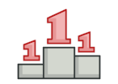
Singleton pattern

Slide 30
Singleton Design Pattern
Intent
Ensure a class has only one instance, and provide a global point of access to it.
Encapsulated "just-in-time initialization" or "initialization on first use".
Problem
Application needs one, and only one, instance of an object.

Slide 31
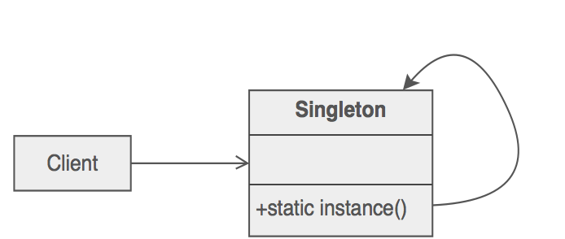
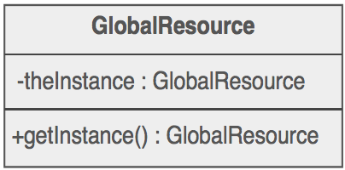
Structure
Make the class of the single instance responsible for access and "initialization on first use". The single instance is a private static attribute. The accessor function is a public static method.

Slide 32
Implementation
Define a private static attribute in the "single instance" class.
Define a public static accessor function in the class.
Do "lazy initialization" (creation on first use) in the accessor function.
Define all constructors to be protected or private.
Clients may only use the accessor function to manipulate the Singleton.

Slide 33
Lazy Initialization Implementation
public final class SingletonDemo {
private static SingletonDemo instance = null;
private SingletonDemo() { }
public static synchronized SingletonDemo getInstance() {
if (instance == null) {
instance = new SingletonDemo();
}
return instance;
}
}

Slide 34
Eager initialization
public final class Singleton {
private static final Singleton INSTANCE = new Singleton();
private Singleton() {}
public static Singleton getInstance() {
return INSTANCE;
}
}

Slide 35
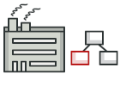
Factory Method pattern

Slide 36
Factory Design Pattern
Uses factory methods to deal with the problem of creating objects without having to specify the exact class of the object that will be created. This is done by creating objects by calling a factory method—either specified in an interface and implemented by child classes, or implemented in a base class and optionally overridden by derived classes—rather than by calling a constructor.
Intent
Define an interface for creating an object, but let subclasses decide which class to instantiate. Factory Method lets a class defer instantiation to subclasses.
Problem
A framework needs to standardize the architectural model for a range of applications, but allow for individual applications to define their own domain objects and provide for their instantiation.

Slide 37
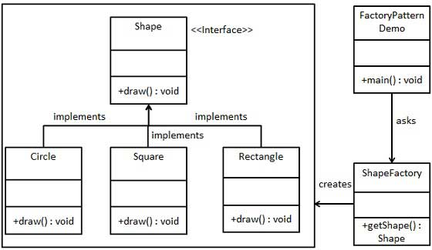
Structure

Slide 38
Implementation
If you have an inheritance hierarchy that exercises polymorphism, consider adding a polymorphic creation capability by defining a static factory method in the base class.
Design the arguments to the factory method. What qualities or characteristics are necessary and sufficient to identify the correct derived class to instantiate?
Consider making all constructors private or protected.

Slide 39
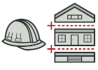
Builder pattern

Slide 40
Builder Pattern
Separate the construction of a complex object from its representation so that the same construction process can create different representations.
It is used to construct a complex object step by step and the final step will return the object.
The process of constructing an object should be generic so that it can be used to create different representations of the same object.
A Builder Pattern solves the issue with a large number of optional parameters and inconsistent states by providing a way to build the object step-by-step and provide a method that will actually return the final Object.

Slide 41
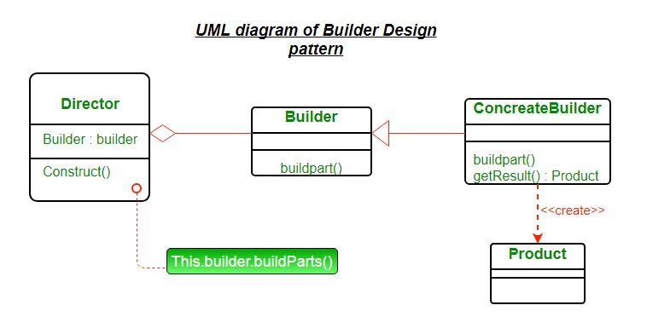

Slide 42
Product – The product class defines the type of the complex object that is to be generated by the builder pattern.
Builder – This abstract base class defines all of the steps that must be taken in order to correctly create a product. Each step is generally abstract as the actual functionality of the builder is carried out in the concrete subclasses. The GetProduct method is used to return the final product. The builder class is often replaced with a simple interface.
ConcreteBuilder – There may be any number of concrete builder classes inheriting from Builder. These classes contain the functionality to create a particular complex product.
Director – The director class controls the algorithm that generates the final product object. A director object is instantiated and its Construct method is called. The method includes a parameter to capture the specific concrete builder object that is to be used to generate the product. The director then calls methods of the concrete builder in the correct order to generate the product object. On completion of the process, the GetProduct method of the builder object can be used to return the product.

Slide 43
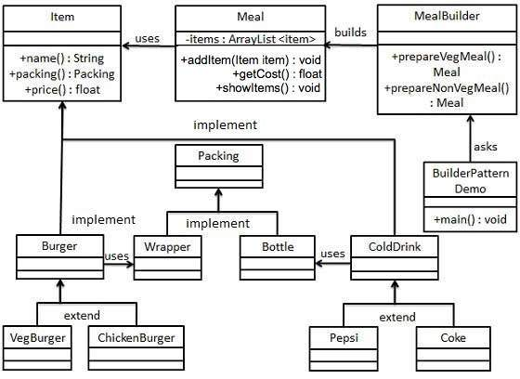
Example

Slide 44
Advantages of Builder Design Pattern
The parameters to the constructor are reduced and are provided in highly readable method calls.
Builder design pattern also helps in minimizing the number of parameters in constructor and thus there is no need to pass in null for optional parameters to the constructor.
Object is always instantiated in a complete state
Immutable objects can be build without much complex logic in object building process.

Slide 45
Disadvantages of Builder Design Pattern
The number of lines of code increase at least to double in builder pattern, but the effort pays off in terms of design flexibility and much more readable code.
Requires creating a separate ConcreteBuilder for each different type of Product.

Slide 46
Structural Design Pattern
Bridge
Decorator
Proxy

Slide 47

Bridge pattern

Slide 48
Bridge Design Pattern
Intent
To split a giant class or a set of closely related classes into two separate hierarchies, abstraction and implementation, which can be developed independently of each other.
Decouple an abstraction from its implementation so that the two can vary independently”
Bridge that coordinates between abstraction and implementation.
.
The pattern is a modified version of the notion of “prefer composition over inheritance”.
The abstraction and implementation can be independently extended or composed

Slide 49
Elements of Bridge Design Pattern
Abstraction (abstract class)
defines the abstract interface maintains the Implementor reference.
RefinedAbstraction (normal class)
extends the interface defined by Abstraction
Implementor (interface)
defines the interface for implementation classes
ConcreteImplementor (normal class)
implements the Implementor interface

Slide 50
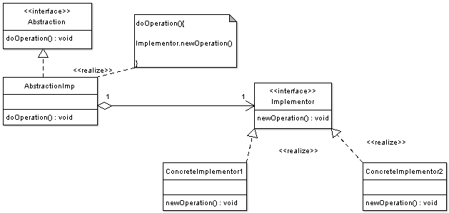
Bridge Pattern

Slide 51
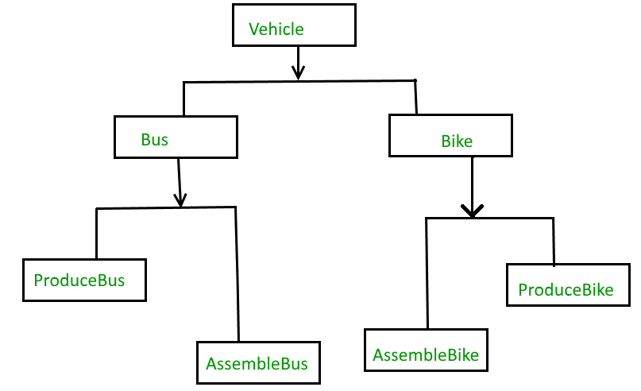
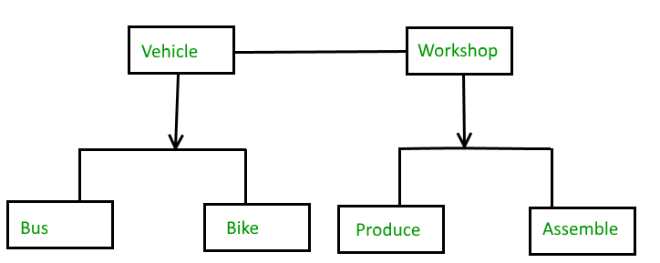
Bridge Pattern
When we need bridge design pattern
The Bridge pattern is an application of the old advice, “prefer composition over inheritance”. It becomes handy when you must subclass different times in ways that are orthogonal with one another.
For Example,
Without Bridge Design Pattern With Bridge Design Pattern

Slide 52
Bridge Pattern
Advantages
Bridge pattern decouple an abstraction from its implementation so that the two can vary independently.
It is used mainly for implementing platform independence feature.
It adds one more method level redirection to achieve the objective.
Publish abstraction interface in a separate inheritance hierarchy, and put the implementation in its own inheritance hierarchy.
Use bridge pattern to run-time binding of the implementation.
Use bridge pattern to map orthogonal class hierarchies
Bridge is designed up-front to let the abstraction and the implementation vary independently.

Slide 53
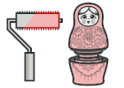
Decorator pattern

Slide 54
Decorator Pattern
Intent
Pattern that attach new behaviors to objects by placing them inside wrapper objects that contain these behaviors.
Problem
Need to add and remove responsibilities to an object dynamically
Inheritance is one of the solution to extend class behaviors.
Inheritance is static, can not add new subclasses to a program when it is already compiled and executed.

Slide 55
Decorator Pattern
Decorator pattern is used a lot in Java IO classes, such as FileReader, bufferedReader etc.
Elements of Decorator Pattern
Component - Interface for objects that can have responsibilities added to them dynamically.
ConcreteComponent - Defines an object to which additional responsibilities can be added.
Decorator - Maintains a reference to a Component object and defines an interface that conforms to Component's interface.
Concrete Decorators - Concrete Decorators extend the functionality of the component by adding state or adding behavior.

Slide 56
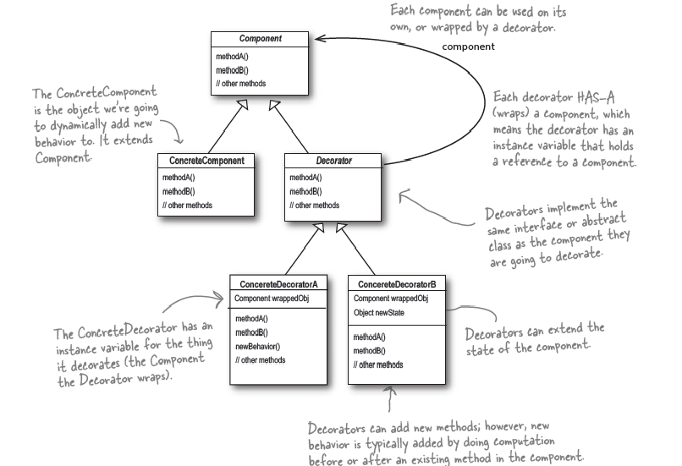
Decorator

Slide 57
Decorator Pattern
The Component- They can be used on its own or wrapped wth Decorator
public abstract class BankAccount {
public abstract double balanceToMaintain();
public abstract double deposit(double amount);
}

Slide 58
Decorator Pattern
The Concrete Component is the object ,to which new behavior is going to added to dynamically, It extends component
//Concrete Component
public class SavingsAccount extends BankAccount {
@Override
public double deposit(double amount) {
return amount;
}
@Override
public double balanceToMaintain() {
return 1000;
}
}

Slide 59
The Decorator
Each decorator Has-A wrapped component, the decorator has an instance variable that hold a reference to the component
Decorators implement the same interface or abstract class as the component they are going to decorator
public abstract class FeatureDectorator extends BankAccount {
public abstract double fundTransfer();
public abstract double balanceToMaintain();
}
}

Slide 60
Decorators
public class InternationalBanking extends FeatureDectorator {
private BankAccount account;
public InternationalBanking(BankAccount account) {
this.account=account;
}
@Override
public double fundTransfer() {
// TODO Auto-generated method stub
return 0;
}

Slide 61
Decorator
public class OnlineBanking extends FeatureDectorator {
private BankAccount account;
public OnlineBanking(BankAccount account) {
this.account = account;
}
public double fundTransfer() {
return 8000;
}
public double balanceToMaintain() {
return account.balanceToMaintain()+5000;
}
public double deposit(double amount) {
return 0;
}
public String chequeBookRequest(){
return "Allowed";
}
}

Slide 62
Test Decorators
public static void main(String[] args) {
BankAccount account1 = new SavingsAccount();
System.out.println("Minimum Balance "+account1.balanceToMaintain());
OnlineBanking account1x = new OnlineBanking(account1);
System.out.println("Minimum Balance with One Feature"+account1x.balanceToMaintain());
System.out.println("Cheque Book Request"+account1x.chequeBookRequest());
InternationalBanking account2x = new InternationalBanking(new OnlineBanking(account1));
System.out.println("Minimum Balance with Two Feature"+account2x.balanceToMaintain());
System.out.println("Airport Lounge Access" +account2x.airportLoungeAccess()); }}

Slide 63
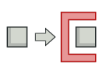
Proxy pattern

Slide 64
Proxy Pattern
proxy pattern is used when we want to provide controlled access of a functionality.
used to represent a complex with a simpler one.
If creation of object is expensive, its creation can be postponed till the very need arises and till then, a simple object can represent it.
This simple object is called the “Proxy” for the complex object
The Proxy holds reference to the RealObject ,Clients interact with the realObject through the proxy .
Because both the proxy and RealObject implement the same interface .
The Proxy can be substituted where Subject can be requested

Slide 65
Proxy Pattern
The participants classes in the proxy pattern are:
Subject
Interface implemented by the RealSubject and representing its services.
The interface must be implemented by the proxy as well so that the proxy can be used in any location where the RealSubject can be used.
Proxy
Maintains a reference that allows the Proxy to access the RealSubject.
Implements the same interface implemented by the RealSubject so that the Proxy can be substituted for the RealSubject.
Controls access to the RealSubject and may be responsible for its creation and deletion.
Other responsibilities depend on the kind of proxy.
RealSubject - the real object that the proxy represents.

Slide 66
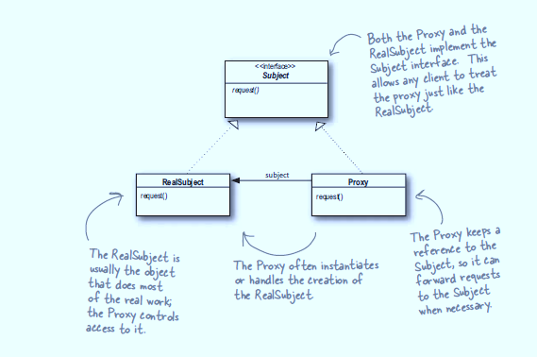
Proxy

Slide 67
Proxy Pattern
public interface Subject {
public void request();
}
public class RealSubject implements Subject {
public void request() {
System.out.println("Hello From Real Subject");
}

Slide 68
The Proxy Class
public class ProxySubject implements Subject {
Subject sub;
public void request() {
sub = new RealSubject();
sub.request();
}
}

Slide 69
Test the Proxy
public class TestProxy {
public void callProxy(Subject sub)
{
sub.request();
}
public static void main(String[] args) {
ProxySubject pxySub = new ProxySubject();
TestProxy tpxy = new TestProxy();
tpxy.callProxy(pxySub);
}

Slide 70
Behavioural Design Pattern
Command
Template
Strategy

Slide 71
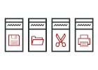
Command pattern

Slide 72
Command Pattern
Intent
Encapsulate a request as an object, thereby letting you parameterize clients with different requests, queue or log requests, and support undoable operations.
Promote "invocation of a method on an object" to full object status
An object-oriented callback
Problem
Need to issue requests to objects without knowing anything about the operation being requested or the receiver of the request.

Slide 73
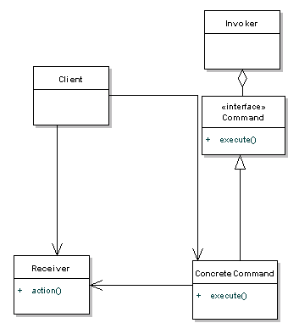
Structure

Slide 74
Implementation
Define a Command interface with a method signature like execute().
Create one or more derived classes that encapsulate some subset of the following: a "receiver" object, the method to invoke, the arguments to pass.
Instantiate a Command object for each deferred execution request.
Pass the Command object from the creator (aka sender) to the invoker (aka receiver).
The invoker decides when to execute().

Slide 75
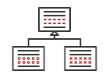
Template pattern

Slide 76
Template Design Pattern
Define an algorithm as skeleton of operations and leave the details to be implemented by the child classes.
Overall structure and sequence of the algorithm is preserved by the parent class.

Slide 77
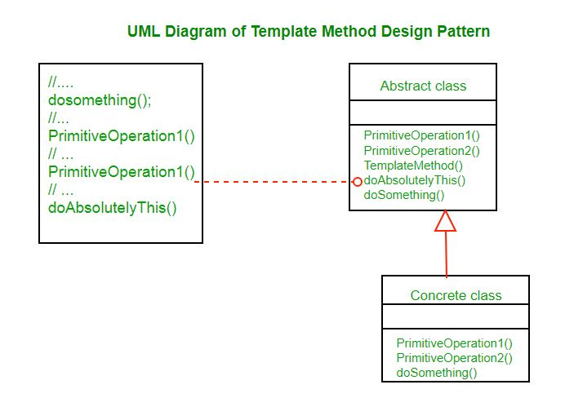
AbstractClass contains the templateMethod() which should be made final so that it cannot be overridden. This template method makes use of other operations available in order to run the algorithm but is decoupled for the actual implementation of these methods. All operations used by this template method are made abstract, so their implementation is deferred to subclasses.
ConcreteClass implements all the operations required by the templateMethod that were defined as abstract in the parent class. There can be many different ConcreteClasses.

Slide 78
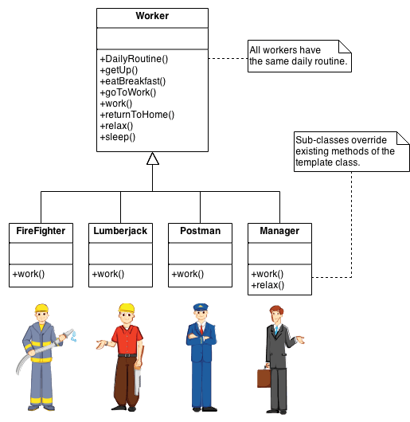

Slide 79
When to use template method
The template method is used in frameworks, where each implements the invariant parts of a domain’s architecture, leaving “placeholders” for customization options.
The template method is used for the following reasons :
Let subclasses implement varying behavior (through method overriding)
Avoid duplication in the code , the general workflow structure is implemented once in the abstract class’s algorithm, and necessary variations are implemented in the subclasses.
Control at what points subclassing is allowed. As opposed to a simple polymorphic override, where the base method would be entirely rewritten allowing radical change to the workflow, only the specific details of the workflow are allowed to change.

Slide 80
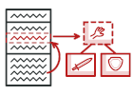
Strategy pattern

Slide 81
Strategy pattern
Intent
Define a family of algorithms, encapsulate each one, and make them interchangeable.
Strategy lets the algorithm vary independently from the clients that use it.
Capture the abstraction in an interface, bury implementation details in derived classes
Also known as Policy Pattern.
Example :
Collections.sort() method that takes Comparator parameter.
Based on Comparators the Objects are getting sorted in different ways,

Slide 82
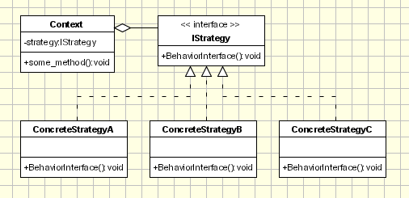
Strategy pattern

Slide 83
Strategy pattern Implementation
Strategy
defines an interface common to all supported algorithms.
Context
Uses to call the algorithms defined by concrete strategy
Contains the reference to a Strategy Object
Concrete Strategy
each concrete strategy implements an algorithm. If necessary, addition objects can be defined to pass data from context object to strategy.

Slide 84
Strategy and Concrete Strategy
Strategy
public interface PaymentStrategy {
public void pay(double amount);
}
Concrete Strategy
public class CardPayment implements PaymentStrategy {
public void pay(double amount) {
System.out.println("Received Payment through Card");
}
}

Slide 85
Context
public class Patient {
private PaymentStrategy strategy;
private double amount;
public Patient(double amount) {
super();
this.amount = amount;
}
public PaymentStrategy getStrategy() {
return strategy;
}
public void setStrategy(PaymentStrategy strategy) {
this.strategy = strategy;
}
public void makePayment(){
strategy.pay(4500);
}
}

Slide 86
Client
public static void main(String[] args) {
Patient p1 =new Patient(4500);
Patient p2 =new Patient(3500);
p1.setStrategy(new CashlessPayment());
p1. makePayment();
p2.setStrategy(new CardPayment());
p2. makePayment();
}

