Slide 1


Programming with Java

Slide 2

Sujata Batra - sujatabatra@hotmail.com
IT Trainer Since 2000
Conducting Java Training Since 2011
More than 50+ Corporate Clients

Slide 3
Objective
Describe the key features of Java technology
Write, compile, and run a simple Java application
Describe the function of the Java Virtual Machine
Define garbage collection

Slide 4
History of Java
Conceived as Programming language for embedded systems like microwave ovens, televisions etc
One of the first projects developed using Java
    personal hand-held remote control named Star 7.
The original language was called Oak
Java was developed in the year 1991 at Sun Microsystems
  Java is a simple, object oriented, interpreted distributed, robust, secure, architecture neutral, portable high-performance, multithreaded, and dynamic language
Notes:
Java was conceived by a team of engineers in Sun Microsystems in 1991 as a part of a research project, which was led by James Gosling and Patrick Naughton. It took 18 months to develop the first working version. This language was initially called “Oak” but was renamed as “Java” in 1995.
Modeled after C++, the Java language was designed to be small, simple, and portable across platforms and operating systems, both at the source and at the binary level, which means that Java programs (applets and applications) can run on any machine that has the Java virtual machine installed.

Slide 5
Primary Goals of Java
Provides an easy-to-use language by:
  Avoiding many pitfalls of other languages
  Being object-oriented
  Enabling users to create streamlined and clear code
Provides an interpreted environment for:
  Improved speed of development
  Code portability
  Enables users to run more than one thread of activity
  Loads classes dynamically; that is, at the time they are actually needed
  Supports changing programs dynamically during runtime by loading classes from disparate sources

Slide 6
Features of Java
The following features fulfill these goals:
  The Java Virtual Machine (JVM)
  Garbage collection
  The Java Runtime Environment (JRE)
  JVM tool interface

Slide 7
The Java Virtual Machine
Executes instructions that a Java compiler generates.
A runtime environment, is embedded in various products, such as web browsers, servers, and operating systems
Its Imaginary machine that is implemented by emulating software on a real machine
Reads compiled byte codes that are platform-independent
Bytecode
  a special machine language that can be understood by the JVM independent of any particular computer hardware,

Slide 8
JVM Tasks
Loads code
  Loads all classes necessary for the execution of a program
  Maintains classes of the local file system in separate namespaces
Verifies code (Bytecode Verifier)
  The code adheres to the JVM specification.
  The code does not violate system integrity.
  The parameter types for all operational code are correct.
  No illegal data conversions have occurred.

Slide 9
Class Loader
Bootstrap Class Loader
  loads java’s core classes like java.lang, java.util etc.
Extensions Class Loader
  JAVA_HOME/jre/lib/ext contains jar packages that are extensions of standard core java classes.
  Extensions class loader loads classes from this ext folder.
  Using the system environment propery java.ext.dirs you can add ‘ext’ folders and jar files to be loaded using extensions class loader.
System Class Loader
  Java classes that are available in the java classpath are loaded using System class loader.

Slide 10
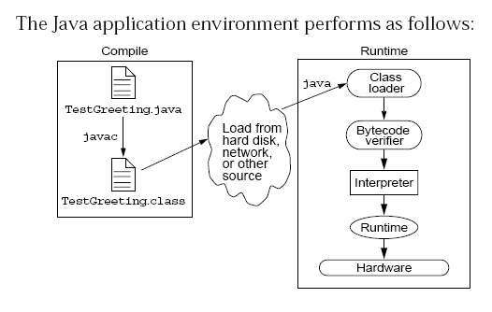
Java Run Time Environment

Slide 11
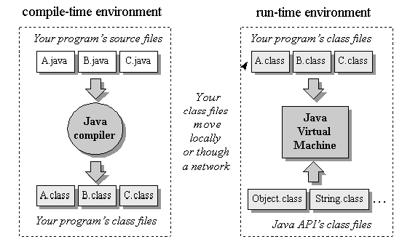
Compile time and Runtime Environment

Slide 12
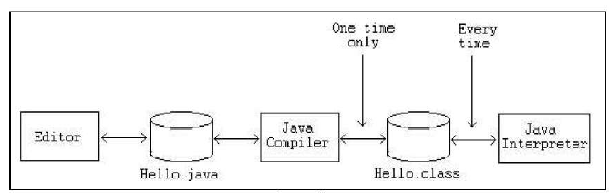
Phases of a Java Program
The following figure describes the process of compiling and executing a Java program

Slide 13
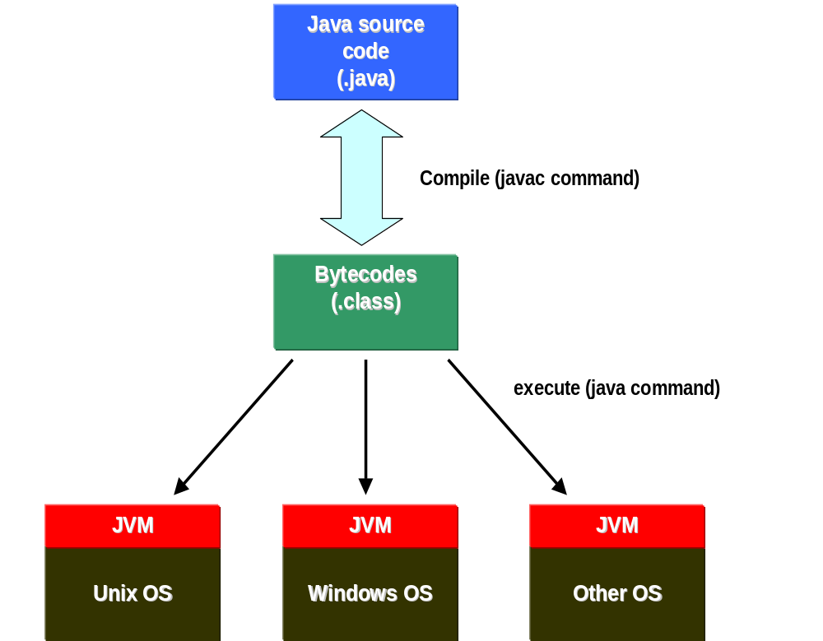

Slide 14
Integrated Development Environments
An IDE is the high-productivity tool
Used to edit, compile, and test programs, manage projects, debugging, building GUI interfaces, etc.
IDE provides extensive programming support for editing and project management,
The Popular IDE’s
  Eclipse
  NetBeans
  IntelliJ

Slide 15
Java language syntax

Slide 16
Objectives
Identify the basic parts of a Java program
Differentiate among Java literals, primitive data types,
variable types ,identifiers and operators
Develop a simple valid Java program using the concepts learned in this chapter

Slide 17
Program structure
A program in Java consists of one or more class definitions
One of these classes must define a method main(), which is where the program starts running
Java programs should always end with the .java extension.
There can be More than one Class Definition in a class ,but only one public class
Source Filenames should match the name of the public class.

Slide 18
Source File Layout
Basic syntax of a Java source file is:
[<package_declaration>]
<import_declaration>*
<class_declaration>+

Slide 19
Software Packages
Packages help manage large software systems.
Packages can contain classes and sub-packages.
package <top_pkg_name>[.<sub_pkg_name>]*;
Specify the package declaration at the beginning of the source file.
Only one package declaration per source file.
If no package is declared, then the class is placed into the default package.
Package names must be hierarchical and separated by dots.

Slide 20
The import Statement
import <pkg_name>[.<sub_pkg_name>]*.<class_name>;
import <pkg_name>[.<sub_pkg_name>]*.*;
import java.util.List;
import java.io.*;
import shipping.gui.reportscreens.*;
The import statement does the following:
  Precedes all class declarations
  Tells the compiler where to find classes

Slide 21
Example 1.1
  package com.training;
  public class Greetings {
  public String getMessage() {
  return "Welcome to Java Programming";
  }
  }

Slide 22
Example 1.1 (contd)
  package com.training;
  public class TestGreetings {
  public static void main(String[] args) {
  Greetings grtObj = new Greetings();
  System.out.println(grtObj.getMessage());
  }
  }

Slide 23
The System Class
Its part of the java.lang package
The classes in this package are available without the need for an import statement
This class contains several useful class fields and methods.
It can’t be Instantiated
It also Provides facilities for
  Standard Input
  Standard Output
  Error Output Streams
  Access to externally defined properties

Slide 24
Objectives
Define modeling concepts: abstraction, encapsulation,
Discuss why you can reuse Java technology application code
Define class, member, attribute, method, constructor, and package
Use the access modifiers private and public as appropriate for the guidelines of encapsulation
Invoke a method on a particular object
Use the Java technology application programming interface (API) online documentation

Slide 25
The Analysis and Design Phase
Analysis describes what the system needs to do:
Modeling the real-world, including actors and activities, objects, and behaviors
Design describes how the system does it:
Modeling the relationships and interactions between objects and actors in the system
Finding useful abstractions to help simplify the problem or solution

Slide 26
Abstraction
Functions – Write an algorithm once to be used in many situations
Objects – Group a related set of attributes and behaviors into a class
Frameworks and APIs – Large groups of objects that support a complex activity;
Frameworks can be used as is or be modified to extend the basic behavior

Slide 27
Classes as Blueprints for Objects
In manufacturing, a blueprint describes a device from which many physical devices are constructed.
In software, a class is a description of an object:
A class describes the data that each object includes.
A class describes the behaviors that each object exhibits.
In Java technology, classes support three key features OOP
  Encapsulation
  Inheritance
  Polymorphism

Slide 28
Declaring Java Technology Classes
Basic syntax of a Java class:
  <modifier>* class <class_name> {
  <attribute_declaration>*
  <constructor_declaration>*
  <method_declaration>*
  }

Slide 29
Declaring Attributes
Basic syntax of an attribute:
<modifier>* <type> <name> [ = <initial_value>];
public class Foo {
private int x;
private float y = 10000.0F;
private String name = "Bates Motel";
}

Slide 30
Declaring Methods
Basic syntax of a method:
<modifier>* <return_type> <name> ( <argument>* ) {
<statement>*
}
  public int getWeight() {
  return weight;
  }
  public void setWeight(int newWeight) {
  if ( newWeight > 0 ) {
  weight = newWeight;
  }
  }

Slide 31
Accessing Object Members
The dot notation is: <object>.<member>
  used to access object members, including attributes and methods.
d.setWeight(42);
d.weight = 42; // only permissible if weight is public

Slide 32
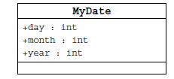
Information Hiding
Client code has direct access to internal data
(d refers to a MyDate object):
d.day = 32; // invalid day
d.month = 2; d.day = 30; // plausible but wrong
d.day = d.day + 1; // no check for wrap around

Slide 33
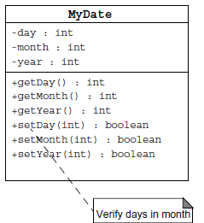
Encapsulation
Hides the implementation details of a class
Forces the user to use an interface to access data
Makes the code more maintainable

Slide 34
Objects and Data Abstraction
Consider the data
  In many applications, data is more complicated than just a simple value
  An Employee
    The data here are actually:
      int empId – an integer of Employee Id
      double[] phoeNumber – an array of Phone Numbers
      double salary – the salary of employee
    Note that individually the data are just int or a double
      However, together they make up a Employee
    This is fundamental to object-oriented programming (OOP)

Slide 35
Objects and Data Abstraction
Consider the operations
  Now consider operations that an Employee can do
    Note how that is stated – we are seeing what a Employee CAN DO rather than WHAT CAN BE DONE to it
    This is another fundamental idea of OOP – objects are ACTIVE rather than PASSIVE
Objects enable us to combine the data and operations of a type together into a single entity

Slide 36
Encapsulation and Data Abstraction
  We do not need to know the implementation details of a data type in order to use it
    This includes the methods AND the actual data representation of the object
  This concept is exemplified through objects
    We can think of an object as a container with data and operations inside
      We can see some of the data and some of the operations, but others are kept hidden from us
      The ones we can see give us the functionality of the objects

Slide 37
Declaring Constructors
Basic syntax of a constructor
  [<modifier>] <class_name> ( <argument>* ) {
  <statement>*
  }
  public class Dog {
  private int weight;
  public Dog() {
  weight = 42;
  }
  }

Slide 38
The Default Constructor
There is always at least one constructor in every class.
If the writer does not supply any constructors, the default constructor is present automatically:
The default constructor takes no arguments
The default constructor body is empty
The default enables you to create object instances with new Xxx()without having to write a constructor.

Slide 39
Comments
Java supports three forms of comments
  // single line comments
  /* multi
    line
    comment
    */
  /** a
    * Javadoc
    * comment
    */

Slide 40
Variables and Methods
A variable, which corresponds to an attribute, is a named memory location that can store a certain type of value.
Variable is a kind of special container that can only hold objects of a certain type.
Primitive type Variable
    Basic, built-in types that are part of the Java language
    Two basic categories
      boolean
      Numeric
        Integral - byte, short, int, long, char
        Floating point - float, double

Slide 41
Instance Variables and Methods
Variables and methods can be associated either with objects or their classes
An instance variable and instance method belongs to an object.
They can have any one of the four access levels
  Three access modifies – private, public , protected
  Can be Marked final, transient
They have a default value
A class variable (or class method) is a variable (or method) that is associated with the class itself.

Slide 42
Example for Variables
  public class VariableTypes {
  private int inst_empid;
  private static String cls_empName
  public void getData() { }
  public static void getSalary() { }
  public void showData(int a)
  {
  int localVariable ;
  }
  }
Instance Variable
Class Variable
Parameter Variable
Local Variable

Slide 43
Identifiers
Identifiers are used to name variables, methods, classes and interfaces
Identifiers
  start with an alphabetic character
  can contain letters, digits, or “_”
  are unlimited in length
Examples
  answer, total, last_total, relativePoint, gridElement, person, place, stack, queue

Slide 44
Initialization
Local variables
  must be explicitly initialized before use
Parameter variables
  Pass by value
Class and instance variables
  Instance variables Have a Default Value

Slide 45
Local Variable needs to Be Initialized
  public class LocalVariable {
  private String name;
  public void display()
  {
  int age;
  System.out.println("Age"+age);
  System.out.println("Name"+name);
  }
Age Should be Initialized before Use

Slide 46
Instance Variable have Default Values
class Values
{
private int a;
private float b;
private String c;
public void display()
{
System.out.println("integer"+a);
System.out.println("float"+b);
System.out.println("String"+c);
}
public class DefaultVales {
public static void main(String[] args) {
Values v = new Values();
v.display();
}
}

Slide 47
Assignment of reference variables
int x = 7;
int y = x;
String s = “Hello”;
String t = s;
x
y
s
t
7
7
0x01234
0x01234
Hello

Slide 48
Pass-by-Value
The Java programming language only passes arguments by value for primitive data types.
When an object instance is passed as an argument to a method, the value of the argument is a reference to the object
The contents of the object can be changed in the called method, but the object reference is never changed
For primitives, you pass a copy of the actual value.
For references to objects, you pass a copy of the reference
You never pass the object. All objects are stored on the heap.
Notes:
The Java programming language only passes arguments by value.
When an object instance is passed as an argument to a method, the value of the argument is a reference to the object.
The contents of the object can be changed in the called method, but the object reference is never changed .

Slide 49

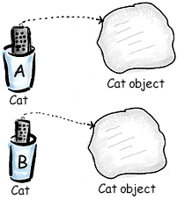
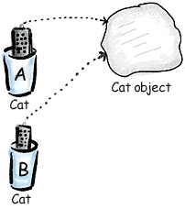
Pass By Value

Slide 50
Casting Primitive Types
Casting creates a new value and allows it to be treated as a different type than its source
JVM can implicitly promote from a narrower type to a wider type
To change to a narrow type explicit casting is required
Byte -> short -> int -> long -> float -> double

Slide 51
Casting Primitive Types
  public class PrimCasting {
  public static void main (String [] args){
  int x = 99;
  double y = 5.77;
  x = (int)y; //Casting
  System.out.println("x = "+ x);
  double y1 = x; //No Casting
  int i =42;
  byte bt;
  bt= (byte)i;
  System.out.println("The Short number"+ bt);
  }
  }

Slide 52
Wrapper Classes
Primitives have no associated methods
Wrapper Classes are used encapsulate primitives
They also provide some static utility methods to work on them
Primitive Type | Wrapper class
-boolean | Boolean
-byte | Byte
-char | Character
-double | Double
-float | Float
-int | Integer
-long | Long
short | Short

Slide 53
Wrapping Primitives
Wrapping a value
  int i = 288
  Integer iwrap = new Integer(i);
unWrapping a value
  int unwrapped = iwrap.intValue();
Methods In Wrapper Class
  parseXxx()
  xxxValue()
  valueOf()

Slide 54
Wrapper Class Method
Convert String to Numbers
public class ParsingStrings
{
public static void main(String args[])
{
int ino=Integer.parseInt(args[0]);
floatfno = Float.parseFloat(args[1]);
double dno = Double.parseDouble(args[2]);
Long lno = Long.parseLong(args[3]);
System.out.println("Integer value" +ino );
String strIno = Integer.toString(ino);
System.out.Println(“String Value”+strIno);
}
}

Slide 55
Auto Boxing
Java 5.0 provided autoboxing
Integer n = new Integer(123) Int m = n.intValue() m++; n=new Integer(m); System.out.println(n); | Integer n = new Integer(123); n++; System.out.println(n);

Slide 56
Auto Boxing
public class ABoxing {
  public void show(int a, float b)
  {
  System.out.println("Integer"+a*2);
  System.out.println("Float"+b*2);
  }
  public static void main(String[] args) {
  ABoxing abObj =new ABoxing ();
  Integer a = 10;
  Float b =20f;
  abObj.show(a,b);
  }
  }

Slide 57
Command Line Arguments
  class CommandLineArgs
  {
  public static void main(String args[])
  {
  System.out.println("hello, welcome to the java world "+args[0]+" to all "+args[1]);
  System.out.println("it is "+args[2]+" a high level language" +args[0]);
  }
  }

Slide 58
java.util.Scanner Class
A simple text scanner which can parse primitive types and strings using regular expressions.
A Scanner breaks its input into tokens using a delimiter pattern, which by default matches whitespace.
The resulting tokens may then be converted into values of different types using the various next methods.
  Scanner sc = new Scanner(System.in);
  int i = sc.nextInt();

Slide 59
java.util.Scanner Class
  public void show()
  {
  Scanner sc = new Scanner(System.in);
  System.out.println("Enter The Number");
  int number = sc.nextInt();
  System.out.println("Enter the Name");
  String name = sc.next();
  System.out.println(number + ":"+name);
  }

Slide 60
java.util.Scanner Class
  public static void main(String[] args) {
  String line="Java,is,in,OOP,Language";
  Scanner sc1 = new Scanner(line);
  sc1.useDelimiter(",");
  while (sc1.hasNext())
  {
  System.out.println(sc1.next());
  }
  }

Slide 61
Flow Control

Slide 62
Objectives
Decision control structures (if, else, switch)
Repetition control structures (while, do-while, for)
Branching statements (break, continue, return)

Slide 63
Control Structures
To change the ordering of the statements in a program
Two types of Control Structures
decision control structures ,
  allows us to select specific sections of code to be executed
    if -- else , if – else if
    switch -- case
repetition control structures
  allows us to execute specific sections of the code a number of times
    while
    do -- while
    for

Slide 64
Decision Control Structures
Types:
  if-statement
  if-else-statement
  If-else if-statement
If Specifies that a statement or block of code will be executed if and only if a certain boolean statement is true.
      if( boolean_expression )
      statement;
    or
      if( boolean_expression ){
      statement1;
      statement2;
      }
boolean_expression : can be an expression or variable.

Slide 65
if-else statement
if( boolean_exp ){
Statement(s)
}
else {
Statement(s)
}
  if(boolean_exp1 )
  statement1;
  else if(boolean_exp2)
  statement2;
  else
  statement3;
For Comparison == used instead =
= being an assignment operator
equals Method Should Be Used for Objects comparison

Slide 66
switch-statement
Allows branching on multiple outcomes.
switch expression is an integer ,character expression or variable
case_selector1, case_selector2 and unique integer or character constants.
If none of the cases are satisfied, the optional default block if present is executed.
    switch( switch_expression ){
    case case_selector1:
    Statement(s);
    break;
    case case_selector2:
    Statement(s);
    break;
    default:
    statement1;
    }

Slide 67
switch-statement
When a switch is encountered,
  evaluates the switch_expression,
  jumps to the case whose selector matches the value of the expression.
  executes the statements in order from that point on until a break statement is encountered
  break statement stops executing statements in the subsequent cases, it will be last statement in a case.
  Used to make decisions based only on a single integer or character value.
  The value provided to each case statement must be unique.

Slide 68
switch-statement
  public double CalculateDiscount(int pCode)
  {
  double discountPercentage=0.0d;
  switch(pCode)
  {
  case 1:
  discountPercentage=0.10d;
  break;
  case 2:
  discountPercentage=0.15d;
  break;
  case 3:
  discountPercentage=0.20d;
  break;
  default:
  discountPercentage=0.0;
  }
  return discountPercentage;
  }

Slide 69
Switch-Case in a Method
Can have Either Return or Break if present inside a Method, but should provide a default Value
    public String switchExample(int key) {
    switch (key) {
    case 1:
    return "Good Morning";
    case 2:
    return "Good AfterNoon";
    case 3:
    return "Good Evening";
    default:
    return "Good Night";
    }

Slide 70
Repetition Control Structures
while-loop
  The statements inside the while loop are executed as long as the Boolean expression evaluates to true
do-while loop
  statements inside a do-while loop are executed several times as long as the condition is satisfied, the statements inside a do-while loop are executed at least once
Watch this
  while(boolean_expression){
  statement1;
  statement2;
  }
do{
statement1;
statement2;
}while(boolean_expression);

Slide 71
for-loop
Same code a number of times.
for(Initialexpr;LoopCondition;StepExpr) {
  statement1;
  }
  Declaration parts are left out so the for loop will act like an endless loop.
  for( ; ; ) {
    System.out.println("Inside an endless loop");
  }

Slide 72
Enhanced For Loop
The enhanced for loop, simplifies looping through an array or a collection.
Instead of having three components, the enhanced for has two.
declaration
  The newly declared block variable, of a type compatible with the elements of the array being accessed.
expression
  This must evaluate to the array you want to loop through. This could be an array variable or a method call that returns an array
int [] a = {1,2,3,4};
for(int n : a)
System.out.print(n);.

Slide 73
Branching Statements
Branching statements allows to redirect the flow of program execution.
  break
  continue
  return.
System.exit() All program execution stops; the VM shuts down.

Slide 74
Arrays

Slide 75
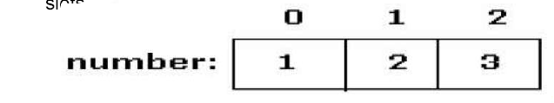
Introduction to Arrays
Array is one variable is used to store a list of data and manipulate
This type of variable is called an array.
It stores multiple data items of the same data type, in a contiguous block of memory, divided into a number of slots.
The new keyword to create an array object.
Need to tell the compiler how many elements will be stored in it.

Slide 76
Creating Arrays
There are three steps to creating an array,
declaring
  int[] k;
  float[] yt;
  String[] names;
allocating
  k = new int[3];
  yt = new float[7];
  names = new String[50];
initializing
  int[ ] k = {1, 2, 3};
  float[ ] yt = {0.0f, 1.2f, 3.4f, -9.87f, 65.4f, 0.0f, 567.9f};

Slide 77
Array Bounds
All array subscripts begin with 0 and ends with n-1
In order to get the number of elements in an array, can use the length field of an array.
The length field of an array returns the size of the array.
  int list [] = new int[10];
  for (int i = 0; i< list.length; i++)
  {
    System.out.println(list[i]);
    }
There is no array element arr[n]! This will result in an array-index-out-of bounds exception.
Notes:
Special care should be taken while accessing an array element, using the length variable of array objects. In the example shown above list.length gives 10, and if we try to access list[10], we will get an exception.

Slide 78
Array of Objects
public class Book
{
private int bookno;
private String bookname;
public Book(int bookno,String bookname)
{
this.bookno=bookno;
this.bookname=bookname;
}
public int getBookno()
{
return this.bookno;
}
public String getBookname()
{
return this.bookname;
}
}

Slide 79
Array of Objects
public class ArrayofObject {
public void displaybooks(Book[] bks)
{
for(int i=0;i<bks.length;i++)
{
System.out.println("Book Number :="+bks[i].getBookno());
System.out.println("Book Name :="+bks[i].getBookname());
}
}
public static void main(String args[])
{
Book[] bk = new Book[2];
Book b1 = new Book(100,"java");
Book b2= new Book(101,"j2ee");
bk[0]=b1;
bk[1]=b2;
ArrayofObject ab= new ArrayofObject();
ab.displaybooks(bk);
}
}

Slide 80
Classes

Slide 81
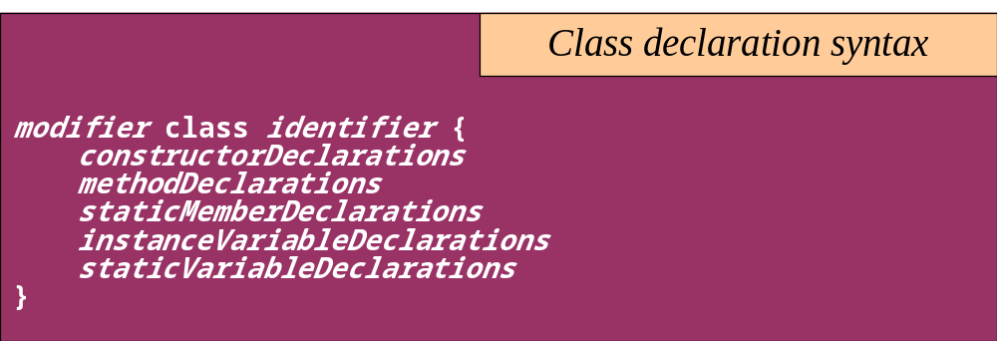
Classes
The class declaration introduces a new class
  A class describes the structure and behavior of its instance objects in terms of instance variables and methods
  Like variables, classes may be declared at different scopes. The scope of a class directly affects certain properties of the class

Slide 82
Classes
Top-level classes can be declared as
  public
    a public class is globally accessible.
    a single source file can have only one public class or interface
  abstract
    an abstract class cannot be instantiated
  final
    a final class cannot be subclassed
  Default
    With any Modifier
They can’t be declared as protected and private

Slide 83
Constructors
Have no return type
Have the same name as the class
If we don't’ put a constructor the compiler puts a default one
  The default constructor has the same access modifier as the class.
  The default constructor has no arguments.
  The default constructor is always a no-arg constructor, but a no-arg constructor is not necessarily the default constructor
  The default constructor includes a no-arg call to the super constructor (super()).
They are not inherited and hence they are not overridden
It can be Overloaded
It can have any of the Four Access Modifies
It cannot be synchronized
It can have throws clause

Slide 84
Instantiation with new
It is the process by which individual objects are created.
  Class objectReference = new Constructor();
Declaration
  Employee empObj;
Instantiation
  empObj = new Employee()
Declaration and Instantiation
  Employee empObj = new Employee()
  new operator allocates memory for an object.

Slide 85
Constructor Overloading
One constructor can call another overloaded constructor of the same class by using this keyword.
this() is used to call a constructor from another overloaded constructor in the same class
The call to this() can be used only in a constructor ,and must be the first statement in a constructor
A constructor can call its super class constructor by using the super keyword.
A constructor can have a call to super() or this() but never both

Slide 86
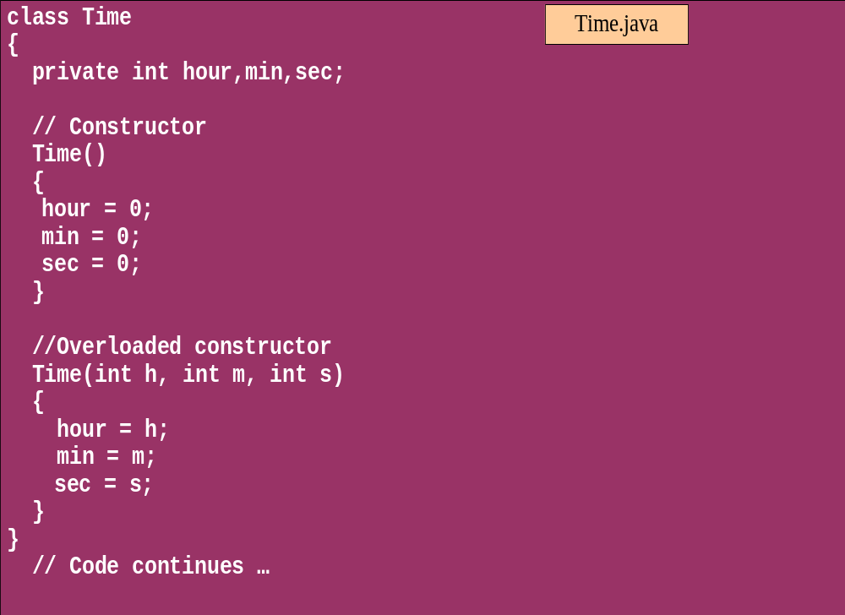
Overloaded Constructor

Slide 87
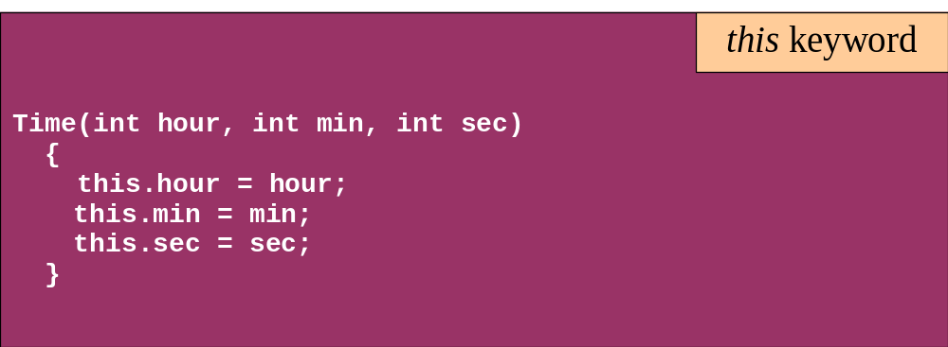
this keyword
Is a reference to the object from which the method was invoked

Slide 88
Modifiers for declarations
There are Four Access Level and 3 Modifiers
Any declaration can be preceded by
  public
    a declaration is accessible by any class
  protected
    Accessible by any class in the same package as its class, and accessible only by subclasses of its class in other packages.
    Works just like default , Except it also allows subclasses outside the package to inherit the protected thing.
  default(no modifier)
    Only accessible by classes, including subclasses, in the same package as its class(package accessibility).
  private
    a declaration is only accessible within the class in which it is declared

Slide 89
Method Overloading
If two (or more) methods of a class have the same name but different signatures, then the method name is said to be overloaded.
The signature of a method consists of the name of the method and the number and types of formal parameters in particular order.
Method overloading is method name overloading.
Several methods that implement similar behavior but for different data types.
They are independent methods of a class and can call each other just like any other method.
A method can be overloaded in the same class or in a subclass.

Slide 90
Overloading Methods
Overloaded methods MUST change the argument list.
Overloaded methods CAN change the return type.
Overloaded methods CAN change the access modifier.
Overloaded methods CAN declare new or broader checked exceptions.

Slide 91
Overloading and AutoBoxing
public class Overloading {
public Integer add(Integer a , Integer b)
{
Integer c = a+b;
return c+100;
}
public int add(int a , int b)
{
return a+b;
}

Slide 92
Main Method
  public static void main(String[] args) {
  Overloading olObj = new Overloading();
  System.out.println(olObj.add(45, 55));
  }
  Output will be 100 and Not 200

Slide 93
INHERITANCE

Slide 94
Overview
  A class can inherit from another class
    Original class is the “superclass”
    New class is called the “subclass”
Inheritance is a fundamental OO concept
Superclass
Car
Subclasses
SportsCar
Taxi
PoliceCar

Slide 95
Example of Inheritance
  The Car class defines certain methods and variables
  Taxi extends Car, and can:
    Add new variables
    Add new methods
    Override methods of the Car class
Car
Taxi

Slide 96
Specifying Inheritance in Java
  Inheritance is achieved by specifying which superclass the subclass
  “extends”
Taxi inherits all the variables and methods of Car
public class Car {
…
}
public class Taxi extends Car {
…
}

Slide 97
Aspects of Inheritance
  Objects
    What does a subclass object look like?
  Construction
    How do constructors work now?
  Methods
    What methods can be called?
    How can methods be overridden?

Slide 98
What Does an Object Look Like?
A subclass inherits all the instance variables of its superclass
Car object
public class Car {
String regNum;
int engineSize; …
}
regNum
engineSize
Taxi object
public class Taxi extends Car {
private int cabNum; …
}
regNum
engineSize
cabNum

Slide 99
Default Initialization
  What happens when a subclass object is created?
  If no constructors are defined:
  No-arg constructor is called in superclass
    No-arg constructor called in subclass
Taxi object
regNum
engineSize
Taxi taxi1 = new Taxi();
cabNum

Slide 100
Nondefault Initialization
Specific initialization can be performed as follows:
public class Car {
Car(String r, int e) {
regNum = r;
engineSize = e;
} …
public class Taxi extends Car {
Taxi(String r, int e, int c) {
super(r, e);
cabNum = c;
} …
Use super() to call superclass constructor

Slide 101
Specifying Additional Methods
  The superclass defines methods that are applicable for all kinds of Car
  The subclass can specify additional methods that are specific to Taxis
public class Car {
public int getReg()…
public void changeOwner()…
…
public class Taxi extends Car {
public void renewCabLicense()…
public boolean isBooked()…
…

Slide 102
Overriding Superclass Methods
  A subclass inherits all the methods of its superclass
  The subclass can override a method with a specialized version, if it needs to:
public class Car {
public String details() {
return "Reg:" + getReg();
}
public class Taxi extends Car {
public String details() {
return "Reg:" + getReg() + cabNum;
}

Slide 103
Overriding
When a sub-class defines a
  “method with same method name, argument types, argument order and return type as a method in its super class, its called method overriding. “
Methods declared as final, static and private cannot be overridden.
An overriding method can be declared as final
The method can’t be less accessible
  Public => only public
  Protected => Both Public and Protected
  Default => default, public and protected

Slide 104
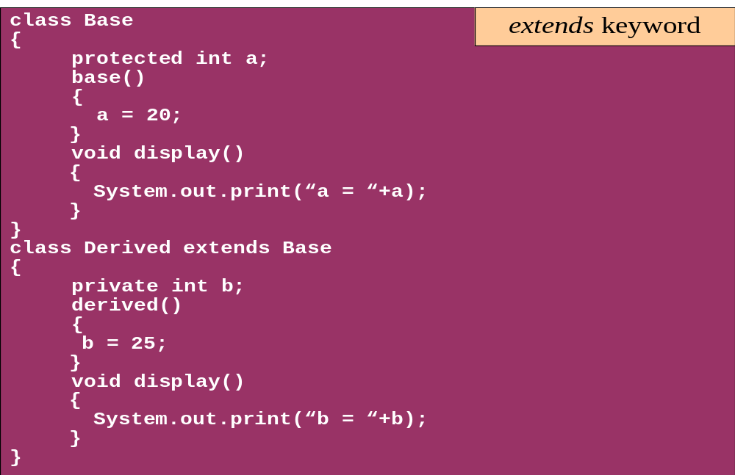
Overriding

Slide 105
Overriding with Compatible Return type
Arguments must be same and return type must be compatible
  class Base
  {
  private int i = 5;
  public Number getNumber()
  {
  return i;
  }
  }
  class Derived extends Base
  {
  @Override
  public Integer getNumber()
  {
  return new Integer(10);
  }
  }

Slide 106
Invoking Superclass Methods
  If a subclass overrides a method, it can still call the original superclass method
  Use super.method()to call a superclass method from the subclass
  Though keyword super is used to refer super class, method call super.super.method() is invalid.
public class Car {
public String details() {
return "Reg:" + getReg();
}
public class Taxi extends Car {
public String details() {
return super.details() + cabNum;
}

Slide 107
super keyword
The keyword super refers to the base class
  super( )
    invokes the base class constructor
    base class constructors are automatically invoked
  super.method( )
    invokes the specified method in the base class
  super.variable
    to access the specified variable in the base class
super must be the first statement in a constructor

Slide 108
Overriding –When Method Has Exceptions
Any exceptions declared in overriding method must be of the same type as those thrown by the super class, or a subclass of that type.
  class MyBase {
  public void method1() throws Exception
  { }
  public void method2() throws RuntimeException
  { }
  }
  class Sub extends MyBase
  {
  public void method1() throws Throwable {
  }
  public void method2() throws ArithmeticException {
  }
  }
This is compile Time Exception
This is Allowed

Slide 109
Hiding-Fields and Static Members
A Sub Class can hide the fields but cannot override that of the super class, its done by defining fields with the same name as in the super class.
Code in the subclass can use the keyword super to access such members
A static method can hide a static method from the Super Class
A hidden super class static method is not inherited., will result in compile time Exception

Slide 110
Hiding-Fields and Static Members
Variable Hiding
class MyBase
{
int var1=100 ;
public static void method1()
{
System.out.println(“Super Class Method1");
}
public void method2()
{
System.out.println(“Super Class method2 ");
}
}
class Mysub extends MyBase
{
int var1 =200;
public static void method1()
{
System.out.println(“Sub Class Method1");
}
public void method2()
{
System.out.println(“Sub Class Method2");
System.out.println(“Var"+var1
+"superclass Var"+super.var1);
} }
Method Hiding

Slide 111
Abstract Class
An abstract class is a shared superclass
  Provides a high-level partial implementation of some concept
  Cannot be instantiated
Use the abstract keyword to declare a class as abstract
Vehicle
Vehicle
Abstract superclass
Concrete subclasses
Car
Car
Truck

Slide 112
Defining Abstract Classes in Java
  Use the abstract keyword to declare a method as abstract
    Only provide the method signature
    Class must also be abstract
  Must be implemented by a concrete subclass
    Each concrete subclass can implement the method differently
public abstract class Vehicle {
private String regNum;
public String getRegNum()…
public abstract boolean isRoadWorthy();
}
public class Car
extends Vehicle{
private int numSeats;
public void fitRack()…
public class Truck
extends Vehicle{
private int axles;
public void setLoad()…

Slide 113
The Abstract Class-Super Class
Note
this
  public abstract class BankAccount {
  public abstract void deposit(float amount);
  public abstract void withdraw(float amount);
  public void sayHello() {
  System.out.println("Thanks-Come Again");
  }
  }

Slide 114
Child Class –Its alsoAbstract
  public abstract class Savingaccount extends BankAccount {
  public abstract void getClientdetails();
  }

Slide 115
The Concrete Class
  public class Supersavings extends Savingaccount {
  float balance,amount ;
  String custname;
  int accno;
  public void deposit(float amt)
  {
  balance+=amt;
  }
  public void withdraw(float amt)
  {
  balance-=amt;
  }
  public void getClientdetails()
  {
  System.out.println(custname);
  System.out.println(accno);
  System.out.println(amount);
  System.out.println(balance);
  }
  }

Slide 116
Interfaces & Polymorphism

Slide 117
Interfaces
  An interface is like a fully abstract class
    All of its methods are public and abstract
    No instance variables if present they are public static final
  An interface defines a set of methods that other classes can implement
    A class can implement many interfaces, but can extend only one class
  Can extend other interfaces and extend multiple interfaces
  Extends another sub interface inherits everything from super interface

Slide 118
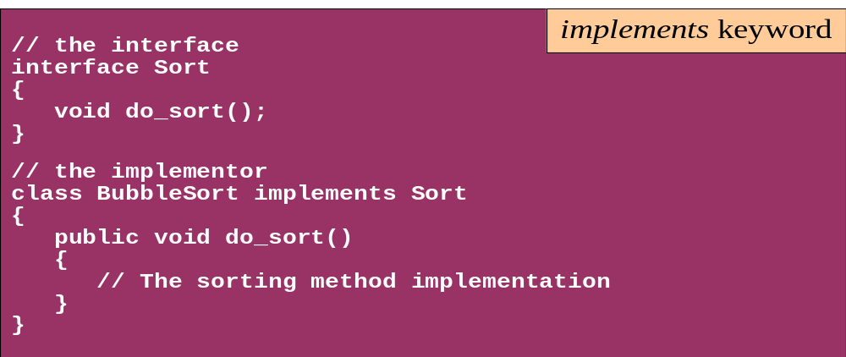
Interface
Interfaces define types in an abstract form
  An interface declaration allows the specification of a reference type without providing an implementation
  The class that implements the interface decides how to implement

Slide 119



Example of Interfaces
  Interfaces describe an aspect of behavior that different classes can support
  For example, any class that supports the “Steerable” interface can be steered:
Steerable
Not Steerable

Slide 120
Defining an Interface in Java
  Use interface keyword instead of class
public interface Steerable {
int maxTurn = 135;
void turnLeft(int deg);
void turnRight(int deg);
}

Slide 121
Implementing an Interface
public interface Steerable {
int maxTurn = 135;
void turnLeft(int deg);
void turnRight(int deg);
}
public class Car
extends Vehicle
implements Steerable {
public void turnLeft(int deg)
{…}
public void turnRight(int deg)
{…}

Slide 122
Partial Implementation of an Interface
Declare the class as abstract if the class does not implement all the methods of an interface
Implement the methods in the sub class level
Public abstract class Car
extends Vehicle
implements Steerable {
public void turnLeft(int deg)
{…}
}

Slide 123
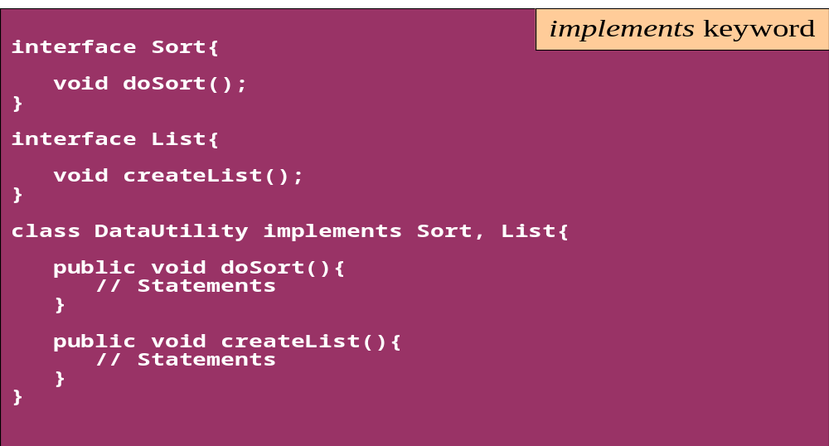
Interface
A single class can implement many interfaces

Slide 124
Using instanceof with Interfaces
  The instanceof operator can be used to check if an object implements an interface
  Downcasting can be used if necessary, to call methods defined in the interface
public void aMethod(Object obj) {
…
if (obj instanceof Steerable)
((Steerable)obj).turnLeft();
}

Slide 125
Extending an Interface
One Interface can extend another Interface
public interface Steerable {
int maxTurn = 135;
void turnLeft(int deg);
void turnRight(int deg);
}
public interface Navigator
extends Steerable {
void calcSpeed(int distance);
}

Slide 126
Polymorphism
This OO Principle allows the programmer to program abstractly
Objects of a subclass can be treated as objects of its superclass
The base class of a hierarchy is usually an abstract class or an Interface
  They define the common behavior (functionality)
Classes and Subclasses inherit this behavior and extend it according to their own properties by overriding the methods of the super class
Subclass objects can be treated as super class objects through references,
  But, super class objects are not subclass objects

Slide 127
Polymorphism
Allows for hierarchies to be highly extensible
New classes can be introduced and can still be processed without changing other parts of the program
Same method can do different things, depending on the class that implements it.
Method invoked is associated with OBJECT and not with reference.
Types of Polymorphism -
  Method Overloading.
  Method Overriding.

Slide 128
Polymorphism
  class SuperClass
  {
  int value = 100;
  void callMe()
  {
  System.out.println("I am in Super Class");
  }
  }
  class SubClass extends SuperClass
  {
  int value = 10;
  void callMe()
  {
  System.out.println("I am in Sub Class");
  }
  }

Slide 129
Polymorphism
This Object Reference is polymorphic
  public class TestDMD
  {
  public static void main(String s[])
  {
  SuperClass objSuperClass = new SubClass();
  objSuperClass.callMe();
  System.out.println(objSuperClass.value);
  }
  }
This means object variables are polymorphic , A variable of type Super Class can refer to an object of type Super class as well as subclass.

Slide 130
Substitution of Object References in Method Calls
A subclass object can be passed into any method that expects a superclass object
The method that got invoked, is the version that's present in the object type and NOT the reference type.
public static void main(String[] args) {
Taxi t = new Taxi("ABC123", 2000, 79);
displayDetails(t);
public static void displayDetails(Car c) {
System.out.println(c.details());
}
Notes:
The same object reference (that is, an object reference of the same reference type) is capable of behaving differently at runtime, depending on the object that it points to.

Slide 131
Dynamic Method Dispatch
Related Through Inheritance
superclass = subclass
  always valid
subclass=(subclass)superclass
  valid at compile time, checked at runtime. if is invalid then the exception ClassCastException is thrown.
subclass = superclass
  not valid at compile time, needs a cast
Unrelated Classes – Not Allowed
someClass = someUnrelatedClass
  not valid, won’t compile
somcClass = (someClass)someUnrelatedClass
  not valid, won’t compile

Slide 132
Dynamic Method Dispatch
subclass=
(subclass)superclass
Valid at both Compile ,RunTime
  class First
  {
  public void show()
  {
  System.out.println("ShowFirst");
  }
  }
  class Second extends First
  {
  public void show()
  {
  System.out.println("Show Second");
  }
  }
First fst = new Second();
Second sec = (Second)fst;
sec.show();
First fst2 = new First();
Second sec2 = (Second)fst2;
sec2.show();
subclass=
(subclass)superclass
Valid at Compile time exception at ,RunTime

Slide 133
Packages
Packages are containers of classes
An organized collection of classes that are logically related
Mechanism for partitioning the class name space
Helps Distributed Computing
Some of Packages in Java are
  java.lang
  java.io
  java.util
  java.net
User defined classes can also be organized into packages

Slide 134
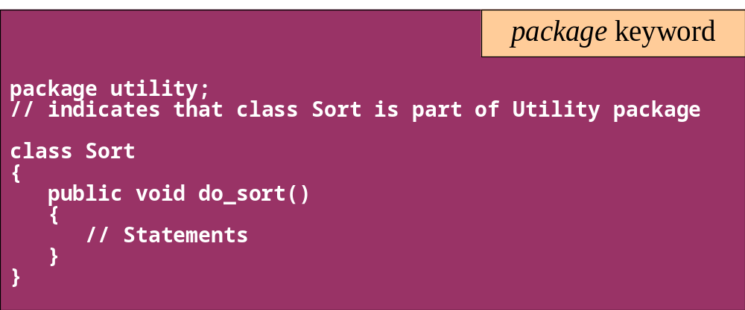
Package
In the following example, the class class1 is part of the package pack1
Use the javac -d option to compile

Slide 135
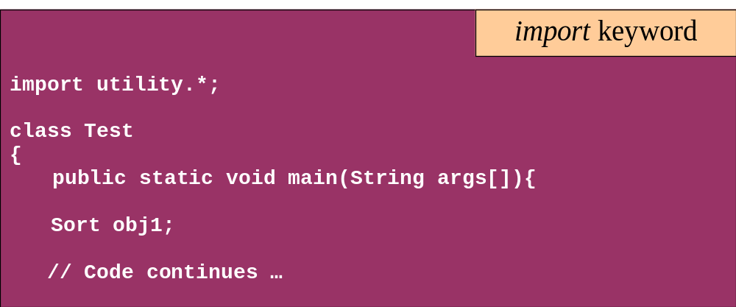
Package
Use the import keyword to access the classes in a package

Slide 136
toString( )
The objectS can be passed to
  System.out.println( )
  Methods
  Or Can be used string concatenation,
Java automatically calls its toString( ) method.
The toString() just prints the class name, an @ sign, and the object's memory address -hashCode) value
toString( ) implementation prints the state of the object which will result in formatting control in println( ) and anywhere objects get referred to in a String context.

Slide 137
CLASSPATH
Is an environment variable which specifies the location of the class files
For compiling the Sort.java (listed earlier)
  javac -d c:\packages Sort.java
  this would create a sub-directory Utility under c:\packages and store Sort.class over there
While compiling test.java (listed earlier), set
  CLASSPATH = . ; c:\packages
Any package can be included in the working package
Include all packages in CLASSPATH
    import package_name.class_name;
    import package_name.subpackage_name.class_name;
    import package_name.*;

Slide 138
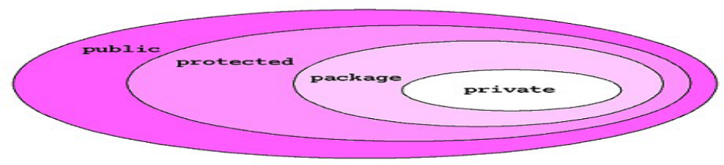
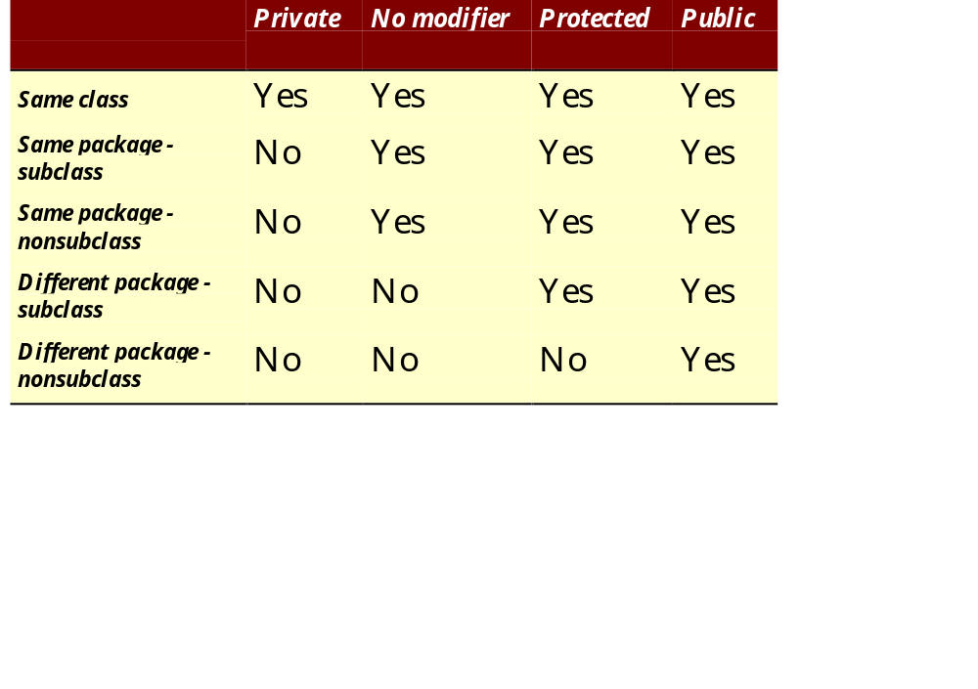
Package - Access modifiers

Slide 139
final keyword
A final method or class is Java’s way of prohibiting inheritance and/or overriding
Final methods cannot be overridden by subclasses
All private methods are implicitly final
Final classes Cannot be extended and their methods are implicitly final
Can be applied to variables too
  The value of a final variable cannot be altered
  final int max_limit = 23
  final void method( )
  final class last_class

Slide 140
Interface vs Abstract Class
A class may implement several interface
An interface cannot provide any code at all
Interfaces are often used to describe the peripheral abilities of a class, not its central identity,
A class may extend only one class
An abstract class can provide complete or partial code
An abstract class defines the core identity of its descendants.

Slide 141
Interface, Abstract Class,Subclass,Class
A plain class is designed when in doesn't pass the “is-a” test.
A Plain class is designed when its not extending any other class other than object class
Make a subclass , when it needs to extend a super class
Make a subclass, when it needs to override or add new behaviors
Make an abstract class , when there is a requirement for a kind of “template” for a group of subclasses, and there are some implementation in the class which the subclass can use .
Make an abstract class , to guarantee that nobody can make objects of that type.
Design an interface , to define a role that other classes can play, regardless of the inheritance tree,

Slide 142
Exception handling

Slide 143
Topics
Define exceptions
Use try, catch, and finally statements
Describe exception categories
Identify common exceptions
Develop programs to handle your own exceptions
Use assertions
Distinguish appropriate and inappropriate uses of assertions
Enable assertions at runtime

Slide 144
Exception Handling
java.lang.Object
java.lang.Throwable
java.lang.Error
java.lang.Exception
java.io.IOException
java.lang.RuntimeException
Notes:
The class Object is the root of the class hierarchy. Every class has Object as a superclass. All objects, including arrays, implement the methods of this class.
The Throwable class is the superclass of all errors and exceptions in the Java language. Only objects that are instances of this class (or of one of its subclasses) are thrown by the Java Virtual Machine or can be thrown by the Java throw statement. Similarly, only this class or one of its subclasses can be the argument type in a catch clause.
An Error is a subclass of Throwable that indicates serious problems that a reasonable application should not try to catch. Most such errors are abnormal conditions. The ThreadDeath error, though a "normal" condition, is also a subclass of Error because most applications should not try to catch it.
The class Exception and its subclasses are a form of Throwable that indicates conditions that a reasonable application might want to catch.
RuntimeException is the superclass of those exceptions that can be thrown during the normal operation of the Java Virtual Machine. A method is not required to declare in its throws clause any subclasses of RuntimeException that might be thrown during the execution of the method but not caught.
IOException signals that an I/O exception of some sort has occurred. This class is the general class of exceptions produced by failed or interrupted I/O operations.

Slide 145
Exceptions
Conditions that can readily occur in a correct program are checked exceptions.
These are represented by the Exception class.
Problems that reflect program bugs are unchecked exceptions.
Fatal situations are represented by the Error class.
Probable bugs are represented by the RuntimeException class.
The API documentation shows checked exceptions that can be thrown from a method

Slide 146
Handle or Declare Rule
Handle the exception by using the try-catch-finally block.
Declare that the code causes an exception by using the throws clause.
void trouble() throws IOException { ... }
void trouble() throws IOException, MyException { ... }
Other Principles
You do not need to declare runtime exceptions or errors.
You can choose to handle runtime exceptions

Slide 147
Example of Exception
public class ExceptionDemo {
public static void main(String [] args) {
System.out.println(3/0);
System.out.println(“Hi”);
}
}
}
Default exception handler
  Provided by Java runtime ,Prints out exception description
  Prints the stack trace
Hierarchy of methods where the exception occurred
  Causes the program to terminate

Slide 148
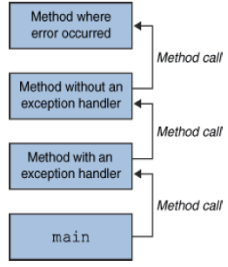
What Happens When an Exception
Occurs
When an exception occurs within a method,
  the method creates an exception object and hands it off to the runtime system - “throwing an exception”
  These Exception object contains information about the error, including its type and the state of the program when the error occurred
  The runtime system searches the call stack for a method that contains an exception handler

Slide 149
What Happens When an Exception
Occurs
When an appropriate handler is found, the runtime system passes the exception to the handler
  An exception handler is considered appropriate if the type of the exception object thrown matches the type that can be handled by the handler
  The exception handler chosen is said to catch the exception.
If appropriate exception handler is not found by the runtime system the application terminates and uses the default exception handler

Slide 150
Checked and Unchecked
Checked exceptions include all subtypes of Exception, excluding classes that extend Runtime Exception.
Checked exceptions are subject to the handle or declare rule; any method that might throw a checked exception
  must either declare the exception using the throws keyword, or handle the exception with an appropriate try/catch.
Subtypes of Error or Runtime Exception are unchecked, so the compiler doesn’t enforce the handle or declare rule.

Slide 151
Catching Exceptions
  class DivByZero {
  public static void main(String args[]) {
  try {
  System.out.println(3/0);
  System.out.println(“Please print me.”);
  } catch (ArithmeticException exc) {
  //Division by zero is an ArithmeticException
  System.out.println(exc);
  }
  System.out.println(“After exception.”);
  }
  }

Slide 152
Method Overriding and Exceptions
The overriding method can throw:
No exceptions
One or more of the exceptions thrown by the overridden method
One or more subclasses of the exceptions thrown by the overridden method
The overriding method cannot throw:
Additional exceptions not thrown by the overridden method
Superclasses of the exceptions thrown by the overridden method

Slide 153
Catching Exception –Multiple Catch
  class MultipleCatch {
  public static void main(String args[]) {
  try {
  int den = Integer.parseInt(args[0]);
  System.out.println(3/den);
  }
  catch (ArithmeticException exc)
  {
  System.out.println(“Divisor was 0.”);
  }
  catch (ArrayIndexOutOfBoundsException exc2)
  {
  System.out.println(“Missing argument.”);
  }
  System.out.println(“After exception.”);
  }
}
}

Slide 154
Catching Exception –Nested Try’s
    public static void main(String args[]){
  try {
    int a = Integer.parseInt(args[0]);
    try {
    int b = Integer.parseInt(args[1]);
    System.out.println(a/b);
    }
    catch (ArithmeticException e1)
    {
    System.out.println("Div by zero error!");
    }
  }
  catch(ArrayIndexOutOfBoundsException e2)
  {
    System.out.println("Need 2 parameters!");
    }
    }
  }

Slide 155
Finally block
Its optional and will always be invoked,
  whether an exception in the corresponding try is thrown or not,
  whether a thrown exception is caught or not.
finally-will-always-be-called except if the JVM shuts down. When the try or catch blocks may call System.exit();
Block of code is always executed despite of different scenarios:
  Forced exit occurs using a return, a continue or a break statement
  Normal completion
  Caught exception thrown
  Exception was thrown and caught in the method
  Uncaught exception thrown
  Exception thrown was not specified in any catch block in the method

Slide 156
Throwing Exceptions
The throw Keyword
Java allows you to throw exceptions (generate exceptions)
  throw <exception object>
An exception you throw is an object
  You have to create an exception object in the same way you create any other object
Example:
  throw new ArithmeticException(“testing...”);

Slide 157
Throws Clause
A method is required to either catch or list all exceptions it might throw
  Except for Error or RuntimeException, or their subclasses
If a method may cause an exception to occur but does not catch it, then it must say so using the throws keyword
Applies to checked exceptions only
  <type> <methodName> (<parameterList>) throws <exceptionList>
  {
  <methodBody>
}

Slide 158
Uncaught Exception
Uncaught exceptions propagate back through the call stack,
Starting from the method where the exception is thrown and ending with either the first method that has a corresponding catch for that exception type or a JVM shutdown

Slide 159
Effective Exception Hierarchy
The exception classes are arranged in a hierarchy.
Catches for specific exceptions should always be written prior to the generic handler.
FileNotFoundException is a child of IOException, a catch for FileNotFoundException should occur before the one for IOException.
A generic handler for Exception would cover any missing situation.

Slide 160
Java Collections Framework

Slide 161
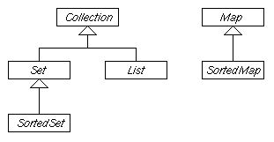
Java Collection Framework
Provides tools to maintain data container of object
Is an alternative to the creation of custom data structures
Consists of interfaces and classes that implement inerfaces within the java.util package
Collection is the root interface for most of the Java collections hierarchy

Slide 162
Collection categories
Ordered Collection
  The objects within the collection are maintained in a particular order or not
  When an object is added or removed from an ordered collection , the order is automatically maintained
Duplicate Elements
  Whether or not the collection allows duplicate objects
  Collection will automatically reject an attempt to add an object
Mapping of Key & Value
  Whether or not the collection maps a key to a particular object .
  This provides a means of quickly locating the object.
  Such collections do not allow duplicate objects

Slide 163
Collection Interface
The root interface in the collection hierarchy.
Represents a group of objects, known as its elements.
There is no direct implementation the more specific sub-interfaces are Set and List.
This interface is typically used to pass collections around and manipulate them

Slide 164
List Interface
can contain only Objects
An ordered collection
Elements can be accessed by their integer index (position in the list)
Lists typically allow duplicate and null elements.
Iterating over the elements in a list is typically preferable to indexing

Slide 165
Methods in List Interface
void add(object o)
void addAll(Collection c)
void clear()
boolean contains(object)
Object get(int index)
int indexOf(object o)
ListIterator listIterator()
Object set (int index, Object element)

Slide 166
List Implementations
Array List
  a resizable-array implementation like Vector
    unsynchronized
Linked List
  a doubly-linked list implementation
  if elements frequently inserted/deleted within the List
    May provide better performance than ArrayList
  For queues and double-ended queues (deques)
Vector
  a synchronized resizable-array implementation of a List with additional "legacy" methods.

Slide 167
Class ArrayList
Resizable-array implementation of the List interface.
permits all elements, including null.
Each ArrayList instance has a capacity. The capacity is the size of the array used to store the elements in the list. , its capacity grows automatically.

Slide 168
Class ArrayList
ArrayList()
Constructs an empty list with an initial capacity of ten.
ArrayList(Collection c)
Constructs a list containing the elements of the specified collection, in the order they are returned by the collection's iterator.
ArrayList(int initialCapacity)
Constructs an empty list with the specified initial capacity.

Slide 169
Generics
Introduced in Java 5.0
Can put any Object in to Collections, because they hold Just Objects
Type-safe Collections are created ,ensuring type-safety at compile time rather than run-time
Creating an Instance of Classes of Generic Type
  new ArrayList<Employee>
  ArrayList<Employee> mylist = new ArrayList<Employee>();

Slide 170
ArrayList – Creating ArrayList
ArrayList<Employee> alist=new ArrayList<Employee>();
  Employee e1 = new Employee(101,”Ramesh”);
alist.add(e1);

Slide 171
Two Schemes of Traversing Collections
for-each
  The for-each construct allows you to concisely traverse a collection or array using a for loop
for (Object o: collection)
  System.out.println(o);
Iterator
  An Iterator is an object that enables you to traverse through a collection and to remove elements from the collection selectively, if desired

Slide 172
ArrayList – Enhanced For Loop
  public void ehForLoop()
  {
  for(Employee e :alist)
  {
  System.out.println(e.getEmpname());
  System.out.println(e.getEmpno());
  }
  }

Slide 173
The Iterator Interface
Provides for the one-way traversal of a Set or SortedSet collection (forward only)
Has several required methods but the most frequently used are:
Method
Usage
hasNext()
Returns true if the iteration has more elements
next()
Returns the next element in the iteration (as a generic Object)

Slide 174
Array List –with Iterator
public void dispalyArrayList()
{
Iterator<Employee> itr = alist.iterator();
while(itr.hasNext())
{
Employee empObj = itr.next();
System.out.println(empObj.getEmpname());
System.out.println(empObj.getEmpno());
}
}

Slide 175
The ListIterator Interface
Extends the Iterator interface to provide for the two-way traversal of a List collection (forward and backward)
The most frequently used are:
Method | Usage
haxNext() | Returns true if this list iterator has more elements when traversing the list in the forward direction
hasPrevious() | Returns true if this list iterator has more elements when traversing the list in the backward direction
next() | Returns the next element in the list (as a generic Object)
previous() | Returns the previous element in the list (as a generic Object)

Slide 176

JDBC
JDBC is a standard interface for connecting to relational databases from Java.
The JDBC classes and interfaces are in the java.sql package.
JDBC 1.22 is part of JDK 1.1; JDBC 2.0 is part of Java 2
Notes:
About Java Database Connectivity (JDBC)
The java.sql package contains a set of interfaces that specify the JDBC API. This package is part of Java 1.1.7 and Java 2, and is supported by JDeveloper. Database vendors implement these interfaces in different ways, but the JDBC API itself is standard.
Using JDBC, you can write code that:
Connects to one or more data servers
Executes any SQL statement
Obtains a result set so that you can navigate through query results
Obtains metadata from the data server
Instructor Note
JDBC 1.22 is part of JDK 1.1; JDBC 2.0 is part of Java 2.

Slide 177

Database Connectivity
  JDBC Architecture:
    Provides the mechanism to translate Java statements into SQL statements.
    Can be classified into two layers:
      JDBC application layer
      JDBC driver layer

Slide 178
JDBC Drivers:
    Convert SQL statements into a form that a particular database can interpret.
    Retrieve the result of SQL statements and convert the result into equivalent JDBC API class objects.
    Are of four types:
      JDBC-ODBC Bridge driver
      Native-API Partly-Java driver
      JDBC-Net Pure-Java driver
      Native Protocol Pure-Java driver

Slide 179
JDBC Drivers
JDBC
Type I
“Bridge”
ODBC
ODBC
Driver
Type II
“Native”
CLI (.lib)
Type III
“Middleware”
Middleware
Server
Type IV
“Pure”
Notes:
Copyright © 1997 Alex Chaffee

Slide 180

Native Protocol Pure Java Driver

Slide 181
Type-4 Driver
Advantages
  They Don't translate the requests into an intermediary format (such as ODBC),
  No need for a middleware layer to service requests.
  The JVM can manage all aspects of the application-to-database connection facilitating debugging.
Disadvantages
  Clients require a separate driver for each database.
  Drivers are database dependent.

Slide 182
Java.sql packages.
The commonly used classes and interfaces in the JDBC API are:
    DriverManager class: Loads the driver for a database.
    Driver interface: Represents a database driver. All JDBC driver classes must implement the Driver interface.
    Connection interface: Enables you to establish a connection between a Java application and a database.
    Statement interface: Enables you to execute SQL statements.
    ResultSet interface: Represents the information retrieved from a database.
    SQLException class: Provides information about the exceptions that occur while interacting with databases.

Slide 183
Connect
Query
Process
results
Close
Notes:
Steps to Querying a Database with JDBC
The slide shows the four main steps to querying a database with JDBC. The following slides explain each step in detail.
The JDBC Package
Your Java class must import java.sql.* to be able to use the JDBC classes.

Slide 184
Querying a Database With JDBC
Connect
Register the driver
Query
Connect to the database
Process
results
Close

Slide 185
Loading a Driver Programmatically:
Use the forName() method
    The forName() method is available in the java.lang.Class class.
    The forName() method loads the JDBC driver and registers the driver with the driver manager.
Class.forName("oracle.jdbc.driver.OracleDriver");

Slide 186
Connecting to a Database
    The DriverManager class provides the getConnection() method to create a Connection object.
    The getConnection()method has the form
    Connection getConnection (String <url>, String <username>, String <password>)
    JDBC uses a URL to identify the database connection.
jdbc:<subprotocol>:<subname>
jdbc:oracle:<driver>:@<database>

Slide 187
JDBC URLs with Oracle Drivers
Thin driver
jdbc:oracle:thin:@<host>:<port>:<SID>
Connection conn = DriverManager.getConnection
("jdbc:oracle:thin:@myhost:1521:orcl",
"scott", "tiger");
jdbc:microsoft:sqlserver:@10.161.3.94:1433:javatraining,sa,”L2USER;
Notes:
JDBC URLs with Oracle Drivers
For connecting to a database using one of the Oracle JDBC drivers, the basic structure of the JDBC URL is jdbc:<subprotocol>:<driver>:@<database>.
Thin Driver
<driver> is thin.
<database> is a string of the form <host>:<port>:<sid>. That is, it is the host name, TCP/IP port, and Oracle SID of the database to which you want to connect. For example: jdbc:oracle:thin:@eduhost:1521:ORCL
OCI Driver
<driver> is oci8 or oci7, depending on which OCI driver you are using.
<database> is a TNSNAMES entry from the tnsnames.ora file. For example: jdbc:oracle:oci8:@eduhost
Note: For the thin and OCI drivers, <database> can also use the SQL name-value pair syntax. For example:
(DESCRIPTION=(ADDRESS_LIST=(ADDRESS=(PROTOCOL=TCP)(HOST=<hostname>)
(PORT=<port>)))(CONNECT_DATA=(SID=<sid>))
Server-Side Driver
The server-side driver is for connecting within the server. You do not need a URL to do this; you can use the default connection. You will learn how to do this later in this lesson.

Slide 188
Data Base Connection Property
DbConnection.proerties
  db.driver=oracle.jdbc.driver.OracleDriver
  db.url=jdbc:oracle:thin:@localhost:1521:XE
  db.user=system
  db.password=sujata

Slide 189
Creating and Executing JDBC Statements
The Connection object provides the createStatement() method to create a Statement object.
You can use static SQL statements to send requests to a database to retrieve results.
The Statement interface contains the following methods to send static SQL statements to a database:
  ResultSet executeQuery(String str)
  int executeUpdate(String str)
  boolean execute(String str)

Slide 190
The PreparedStatement Object
SQL statement is precompiled and stored in a PreparedStatement object
Used for statements that is called more than once.
A prepared statement can contain variables that you supply each time you execute the statement.
  String sqlAdd = "insert into emp values(?,?,?)";
  PreparedStatement pstmt = con.prepareStatement(sqlAdd);
  pstmt.setInt(1, empid);
  pstmt.setString(2, empname);
  pstmt.setDouble(3, salary);
  int n = pstmt.executeUpdate();
Notes:
Prepared Statements
PreparedStatement is inherited from Statement; the difference is that a PreparedStatement holds precompiled SQL statements.
If you execute a Statement object many times, its SQL statement is compiled each time. PreparedStatement is more efficient because its SQL statement is compiled only once, when you first prepare the PreparedStatement. After that, each time you execute the SQL statement in the PreparedStatement, the SQL statement does not have to be recompiled.
Therefore, if you need to execute the same SQL statement several times within an application, it is more efficient to use PreparedStatement than Statement.
PreparedStatement Parameters
A PreparedStatement does not have to execute exactly the same query each time. You can specify parameters in the PreparedStatement SQL string and supply the actual values for these parameters when the statement is executed.
The following slide shows how to supply parameters and execute a PreparedStatement.

Slide 191
Query From table
  ArrayList alist = new ArrayList();
  Connection con=jdbcConnection.getmyConnection();
  PrepatedStatement stmt =con.prepareStatement();
  ResultSet rs=stmt.executeQuery ("select * from custorder");
  while(rs.next()) {
  int os1 = rs.getInt("orderno");
  String os2 = rs.getString("customername");
  float os3 =rs.getFloat("ordervalue");
  order ord = new order(os1,os2,os3);
  alist.add(ord);
  }

Slide 192
Update & Delete Row of a Table
  PreparedStatement ps =con.prepareStatement("update books set book_name=? where book_name=?”);
  ps.setString(1,”Java”);
  ps.setString(2,"J2ee");
  int rws= ps.executeUpdate();
  PreparedStatement ps =con.prepareStatement("Delete from books where book_name=?");
  ps.setString(1,"J2ee");
  int rws= ps.executeUpdate();

