Slide 1

Agile Overview
Review of Agile Principles

Slide 2

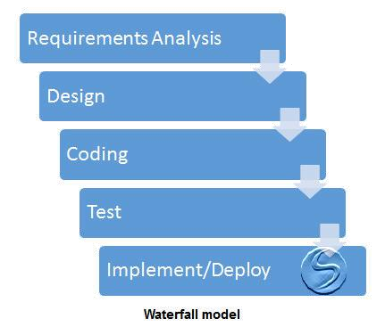
Agile
Software Development
• Since the 1970s, Waterfall continues
be widely used.
• Serialized approach to software development.
• Premise; extensive upfront planning
to
answers most questions, produces the
best plan.
• Once started, changing the plan is often
cumbersome and expensive.

Slide 3
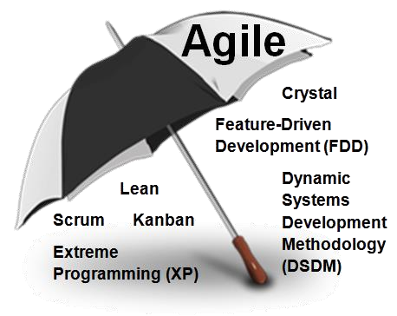
Agile
Software Agility (Agile)
•
Late 1990s, accelerating “pace of
business” drove a rethink how to
develop software more “nimbly” with
tighter customer partnership.
Software agility (Agile) methods emerged; several practice frameworks defined.
In 2001, Manifesto for Agile Software Development defined core values and principles common to all frameworks.
•
•
Individuals and Interactions
Working Software
Customer Collaboration
Responding to change
over
over
over
over
Processes and Tools
Comprehensive Documentation
Contract Negociation
Following a Plan
While there is value in the items on the right, we value the items on the left more

Slide 4
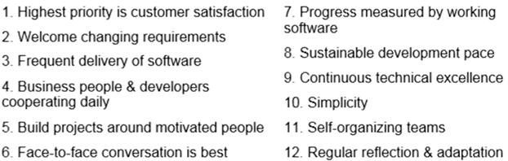
Agile
Software Agility (Agile)
• Core principles expand upon values
to build and deliver software.
• Focus: what does the business need as defined by the business.
• IT and business partnering together.
• Welcome and adapt to change.
• Deliver installments of value
• Strive for continuous improvement

Slide 5
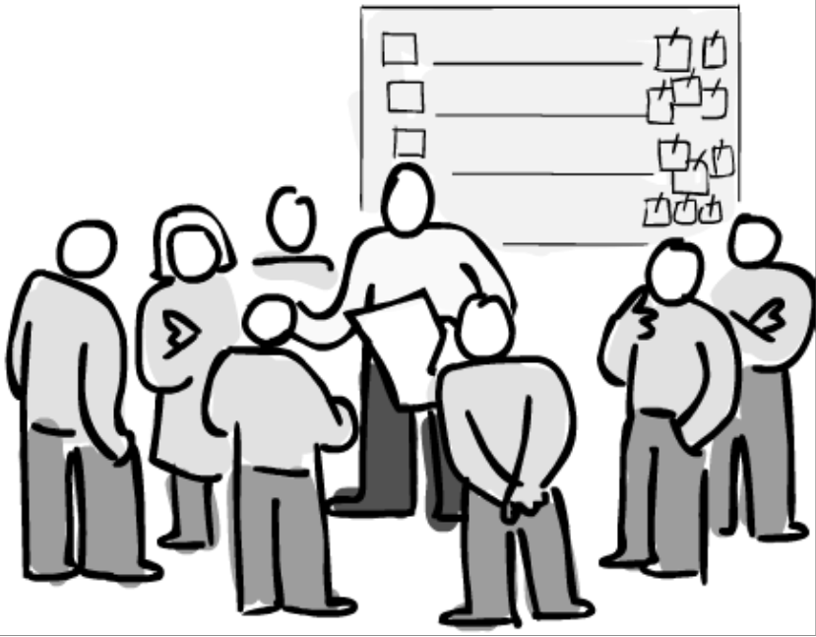
Agile
Empowered Teams
• Teams are empowered to organize and manage their work; work to be done, who and how to get it done.
• Teams radiate transparency in the form of “information radiators”; current work commitments, progress; and backlog of work yet to be planned.

Slide 6

Agile
Transparency and Feedback
• Work in progress and work
remaining is visible to all
• Feedback from stakeholders and users helps to optimize feature sets and priorities.
• Retrospectives support ongoing learning and continuous improvement.

Slide 7
Scrum
Overview of the Scrum Practice Framework

Slide 8
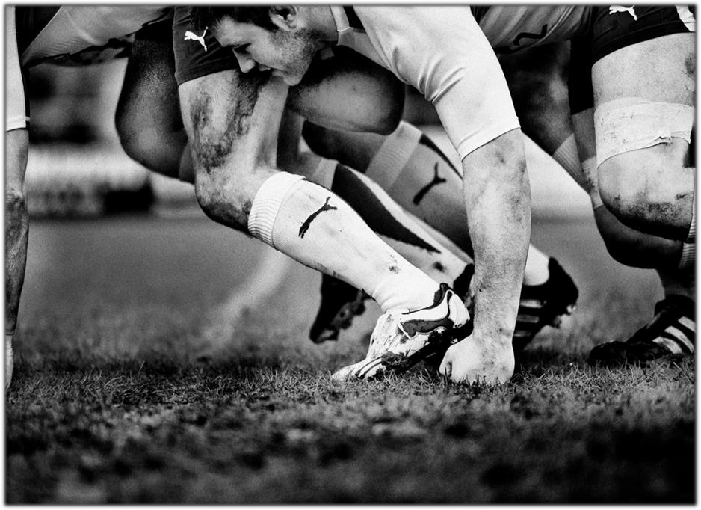
Scrum
Scrum
Scrum is the framework that helps teams work together.
Gets its name from a Rugby term used as a metaphor to reflect the
degree of team cooperation needed to advance the football across
the goal line.

Slide 9
Scrum
How Does
It
Work
Visioning
Backlog
Sprint
Planning
Sprint
Execution
• Coding and Testing in parallel
• Product
Owner
Reviews;
• Functional
Demonstration
• Retrospective
Release
• Product
Owner’s
Vision
Statement
•
Define all
the discrete
deliverables
the team(s)
will need to
produce.
Prioritize
each in
order of
highest
business
value
•
Pull in
highest
priority
backlog
items
Size each
item
(complexity)
Add tasks
needed to
fulfill the
item
• Incremental
production
releases to
accelerate
delivery of
partial
feature sets
•
•
•

Slide 10
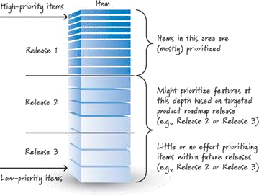
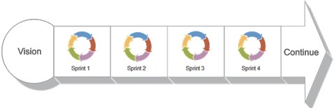
Scrum
How Does It Work
•
Product Backlog: Single Source of
Functional and non-functional requirements.
Chops up the Product Backlog into
series of smaller pieces
Each piece is worked within a time boxed period called a Sprint.
Work is inspected, accepted or
rejected each Sprint by the Product
Owner (business owner).
•
a
•
•

Slide 11
Scrum
How Does It Work
• Business Value
• Work is prioritized highest business value to lower business value.
• Highest value items should be elaborated in
detail; ready for the next Sprint Planning.
• Tactics
• MoSCoW (must have, should have, could
have, won't have)
• REIO (Required, Essential, Important, Optional)
• Cost – Benefit Matrix

Slide 12

Scrum
User Story
Describes a small discrete “need” from
the perspective of a role or persona.
Contains acceptance criteria that defines
“done” (story is done when . . .)
As a [call center agent]
I need to [login with my password] So that [I can access the customer’s
reservation to cancel it]
(WHO)
(WHAT)
❑
a premium member can cancel same day
without a fee
a non-premium member is charged 10%
for a same-day cancellation
email confirmation is sent to the customer
hotel is notified of the cancellation
❑
(WHY)
❑
❑

Slide 13
Scrum
User Story
• Contains tasks that describe the actions and estimated effort required to fulfill the Story
need.
• Typically starts with a verb, concise, and self evident what the action is and an estimate of effort
o Create User Table
o Create password encryption service
o Create login service
(1 hr)
(4 hr)
(4 hr)
• Is testable (functionally)
• Well constructed acceptance criteria doubles as functional test criteria for the story (positive and negative)
o User can login using a valid password
o User cannot login using an invalid password

Slide 14
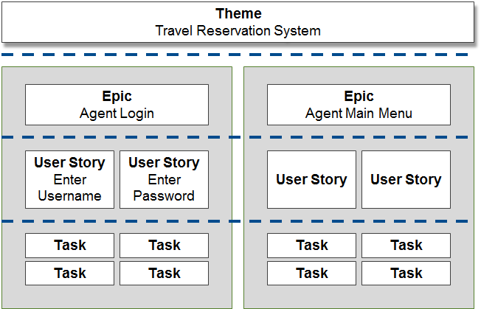
Scrum
User Story Scope
• Theme
• Very broad high level category of related
Epics and Stories
• Epic
• High level User Story; typically
representing a broad functional feature
• Epics are sometimes referred to as Feature
• User Story
• Represents a discreet detailed functional
requirement.

Slide 15
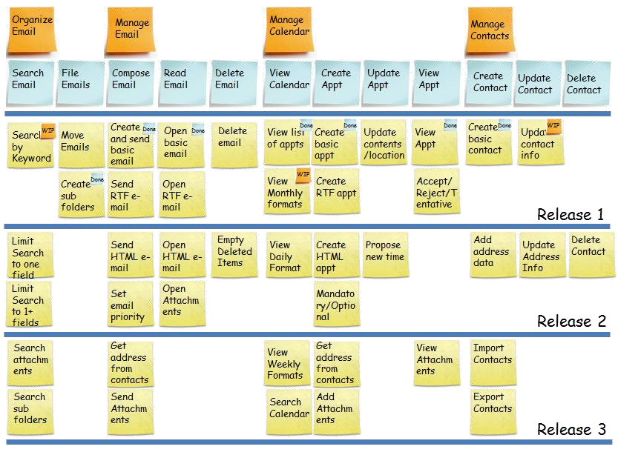
Scrum
Story Map
•
Make visible the workflow or value chain
Show relationships of larger
stories to child stories
Help confirm the completeness of the Backlog
Provide a useful context for prioritization
Plan releases in complete slices of functionality
•
•
•
•

Slide 16
Scrum
Release Roadmap
• Helps align stakeholder expectations
• List the Release Name or
Number
Timeline
2016Q1
2016Q2
2016Q3
2016Q4
Rel ID
R1
R2
R3
R4
Version
Goal
One UI; all admin systems, basic search functions
Add additional search types
Integration of IVR pop, SWAP, and CLASS
Additional Notes
Functionality
Features
• Name search
• Organization search
• Policy number search
• View Contract details (Summary)
• Search usage reporting
• Customer search using last 4 of SSN
• Search using
FULL SSN
• Adjustments to Agent Result Data
• Search usage reporting adjustments
• IVR Pop integration
• View note by Policy Number and Owner
• SWAP Integration CLASS Integration
• Attention and Alert note handling
• Copy/paste functionality
• Ability to enter notes on UI and write back to source system
• List the goals for each release
• List the Preliminary feature set for
each release
• Optionally include metrics that help define if the goal(s) were met

Slide 17
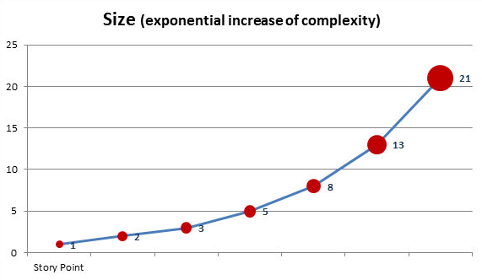
Scrum
Estimating
• Story Points
• Variation of tee-shirt sizing estimated in points relative to perceived complexity of the story (effort, complexity, and risk)
• Much quicker and accurate than time spent
‘breaking down and measuring’
• Techniques
• Planning poker cards
• Reference Story. 2 story points = ‘small’, size other User Stories relative to that; smaller, larger, same.

Slide 18
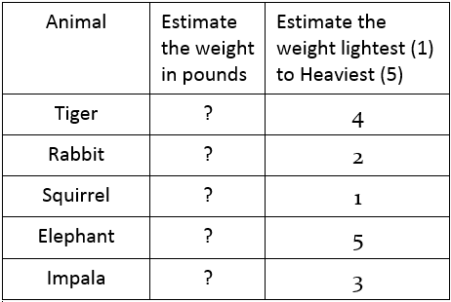
Scrum
Relative Estimation Advantage
• Humans are terrible at absolute estimation but quite good at relative estimation.
• It is generally faster
• It gets a team thinking (and talking) as a group, rather than as individuals
• It encourages spending analysis time
appropriately
• It is cost-effective

Slide 19
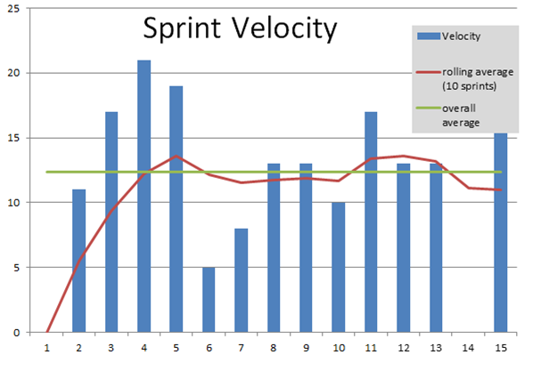
Scrum
Velocity
•
Points total from all completed
stories is the team’s velocity for
Sprint.
After several Sprints, velocity “norms”. Average velocity then becomes a predictor of Sprint throughput.
that
•
•
The team can periodically compute
estimated project completion based on backlog remaining points

Slide 20
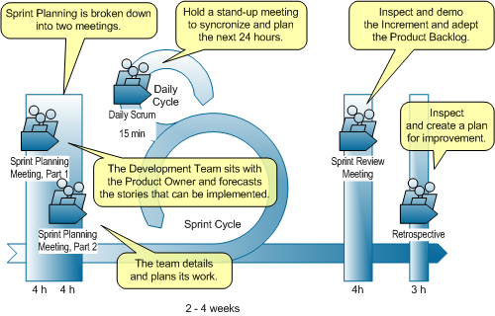
Scrum
Sprints
• Time boxed
• Typically 2-4 weeks
• Sprint Planning (Day 1)
• Pull in the next highest priority items from the backlog.
• First session with the Product Owner
• Second session to work out the technical strategy for completing the work.

Slide 21
Scrum
Sprints
• Daily Stand-up (Each Day)
• Each team member:
• What they did yesterday
• What they plan to do today
• Any impediments blocking progress.
• Sprint Review (Final Day)
• Product Owner reviews achievements of the
Sprint with the team
• Product Owner and team presents a demonstration or discusses latest functionality with external audience.

Slide 22
Scrum
How Does It Work
• Retrospective
•
The Retrospective, or ‘Retro’, is attended
by the Scrum Master and the team and is
the final team meeting in the Sprint.
The primary purpose is to determine what went well, what didn't go well, and how the team can improve in the next Sprint.
The Retrospective is the opportunity for
the team to focus on its overall performance and identify strategies for continuous improvement on its processes
•
•

Slide 23



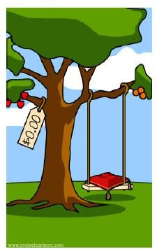






Scrum
Putting It All
Together
The Customer Needs This
Months
Requirements
Designs
Development
Testing
Delivery
Waterfall
2-3 Weeks
Sprint 1
2-3 Weeks
Sprint 2
2-3 Weeks
Sprint 3
2-3 Weeks
Sprint 4
Agile
(Scrum)
1 User Story =
1 Functional
Requirement
User Stories
Plan
Design
Code
Test
Demo
Accepted
Rejected
Accepted
Accepted
• Defects discovered and corrected within each Sprint
• Product Owner / Customer sees functionality each Sprint, accepts or rejects

Slide 24
Agile Toolsets

Slide 25
Stories On Board
StoriesOnBoard.com Toolset

Slide 26
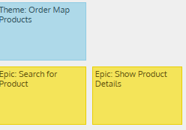
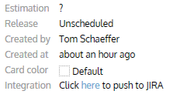
SoB
Stories On Board
• Product Owner’s & Team Backlog Workspace
• SoB stories can be linked to Jira with simple “click”
• New linked stories are added to the backlog in Jira
• While stories are linked, any changes to Title, Description,
or Estimation fields in either tool, updates the other tool
• SoB story status is driven by story status in Jira
• Themes, Epics, and attachments do not synchronize
• Suggested Practice:
• Update stories in SoB until the story in Jira has been
positioned for the next or future Sprint.
• Demo
• Life Issues CyberLife Team (Team 1)

Slide 27
SoB
Stories On Board
• First time Log-In access request:
• Contact Pete Slusinski or Tom Schaeffer
• Look for email invitation, click the link
• Use https://app.storiesonboard.com/login for
subsequent logins
-----Original Message-----
From: hello@storiesonboard.com
[mailto:hello@storiesonboard.com]
Sent: Tuesday, June 13, 2017 10:46 AM
To: Umphfleet, Craig <CUmphfleet@sfgmembers.com>
Subject: Invitation to join for 7447 Standard & Preferred
Loans storymap on StoriesOnBoard
Welcome to StoriesOnBoard!
Tom Schaeffer shared '7447 Standard & Preferred Loans' story map with you.
You can open the Story Map by visiting the following url: https://app.storiesonboard.com/signup/acceptinvite?invited id=1c_ryHNSrYXskznftE7-tQ
Sincerely, StoriesOnBoard

Slide 28
Jira
Working with the Jira Toolset

Slide 29

Jira
Global Concepts
• Developed by Australian Company Atlassian. Has
many uses depending on organizational
• bug tracking,
• issue tracking
• Agile project management
needs:

Slide 30
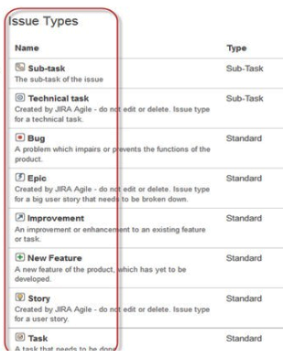
Jira
Global Concepts
• “Issue” - organic work item in Jira.
• Labels are used to designate type
• New Feature
• Improvement
• Epic
• User Story
• Task
• Sub-Task
• Bug
of Issue (Issue Type):
• “Project” - Collection
of issues common to a specific
purpose
• Every issue belongs to a project.

Slide 31
Questions?

