Slide 1
Object based programming in JavaScript

Slide 2
Recall some terms
Object
Abstraction
Class
Encapsulation

Slide 3
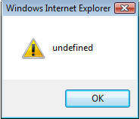
Creating objects in JavaScript
Using built-in data type called Object
Any number of properties can be added to an object at any time.
  <SCRIPT type=“text/JavaScript”>
  obj = new Object;
  obj.x = 1;
  obj.y = 2;
  alert(obj.x + " "+ obj.y);
  </SCRIPT>
alert(obj.k);
will display →

Slide 4
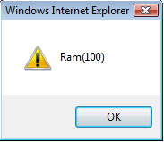
Class
A class is defined using function.
When a function is called with the new operator, the function is considered as the constructor for that class!
<SCRIPT type=“text/JavaScript”>
function Person(name,eid){
this.name=name;
this.eid =eid;
}
p=new Person("Ram",100);
alert(p.name+ "("+ p.eid+")");
</SCRIPT>
constructor
attributes

Slide 5
Methods
To define a method <classname>.prototype.<methodName>= function syntax is used.
<SCRIPT type="text/JavaScript">
function Person(name,eid){
this.name=name;
this.eid=eid;
}
Person.prototype.display = function(){
alert(this.name+ "("+ this.eid+")"); }
Person.prototype.change = function(name){
this.name=name;
}
p=new Person("Ram",100);
p.display();
p.change("Ramakrishna");
p.display();</SCRIPT>

Slide 6
Beware!
The keyword this is used to distinguish between local variable and member variables in Java. Here also it is the same.
But here, once you have defined member variable using this, you must always access it using this (even if there are no clashing local variables,
Next slide demonstrates this

Slide 7
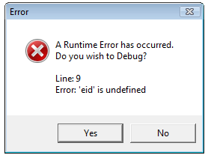
Example: this
<HTML>
<BODY>
<SCRIPT type="text/JavaScript">
function Person(){
this.name="ss";
this.eid=22;
}
Person.prototype.display = function()
{
alert(name+ "("+ eid+")");
}
p=new Person("Ram",100);
p.display();
</SCRIPT>
</BODY></HTML>
Correct way is this:
alert(this.name+ "("+ this.eid+")");

Slide 8
Cookie

Slide 9
Cookie
Cookie is small piece of textual information sent by the server to the browser client. It is stored on the client’s machine, and returned by the client’s machine with each request made to the server.
Web server sends cookies by sending the Set-Cookie response header.
Cookies maintain information between more than one browser session.

Slide 10
Components of a cookie
name= value
comment= cmt
domain= domainName
expires = date
path= path
Set-Cookie: uid=732423sdfs73242; expires=Fri, 31-Dec-2010 23:59:59 GMT; path=/; domain=.example.net

Slide 11
Example-cookie
This example displays a textbox which is empty first time it is viewed.
After the name has been entered in the textbox and button is clicked, the cookie is set.
Next time when the file is opened, the textbox has the name already set from the cookies.
<html><head>
<script>
function getCookie(name){
if (document.cookie.length>0) {
ind=document.cookie.indexOf(name);
if (ind!=-1) {
ind=ind+name.length+1 ;
ind1=document.cookie.indexOf(";",ind);
if (ind1==-1) ind1=document.cookie.length;
return unescape(document.cookie.substring(ind,ind1));
}
}
return "“;}

Slide 12
function setCookie(value){
var dt=new Date();
dt.setDate(dt.getDate()+1);
document.cookie="uname=" +escape(value)+"; expires="+dt.toGMTString();
}
function checkCookie(){
username=getCookie('uname');
if (username!=null && username!="") {
document.forms[0].uname.value=username;
}
}
</script></head>
<body onLoad="checkCookie()">
<form>Name:<input type="text" name="uname">
<input type="button" value="set" onClick="setCookie(document.forms[0].uname.value)">
</form></body></html>

