Slide 1
UML Class Diagram and Design Practices

Slide 2
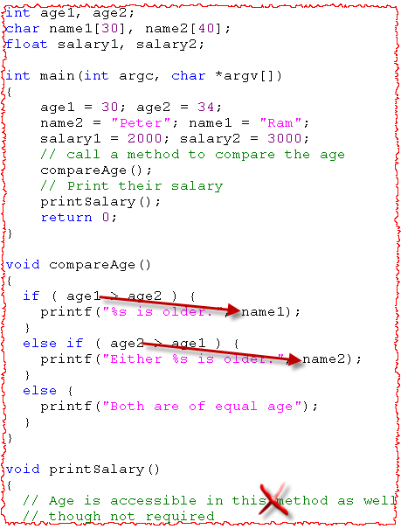
Procedural vs. OO Programming
Programming involves
Data (Attribute/Variables)
Behavior (Function/Proc/Method)
Procedural Programming
The data and behaviors are normally separated.
The programmer needs to remember which code applies to which data.
No control over data (any code can modify it) so testing, debugging more difficult.

Slide 3
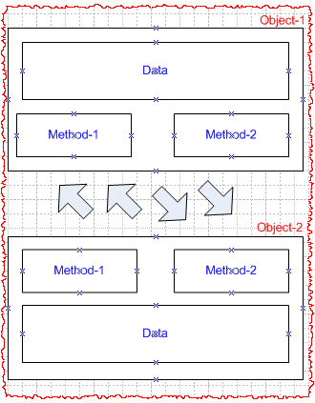
Procedural vs. OO Programming (Contd..)
What is an Object?
An entity that contains both data and behavior. For ex. Person.
OO Programming
Based on real-life scenarios. Objects are the building blocks.
The data and the operation that manipulate the data are encapsulated in the object.
The objects communicate with each others through methods and change ‘only’ its own data.

Slide 4

What is an object?
An object is an instance of a thing.
It is something for which we like to hold information.
It can be either concrete or abstract .
Look around and identify objects:
Student, Instructor, Chair, Table
Objects share two characteristics:
They have state.
They have behavior.

Slide 5
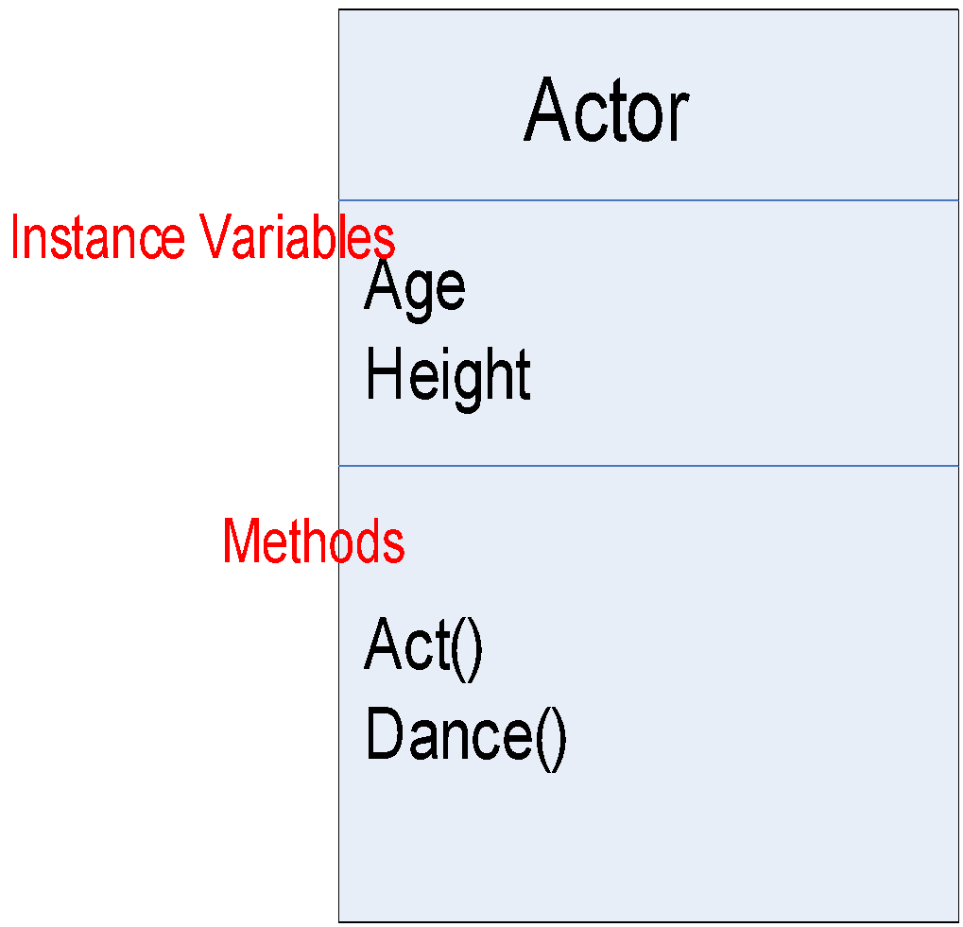



What is a class?
A class is a blueprint from which individual objects are created.
For ex. All the actors are built from the same set of blueprints and contain the same components.
Things an object knows about itself
Instance Variables (State)
Things an object can do
Methods (Behavior)
One Class
Operates on
Many Objects

Slide 6
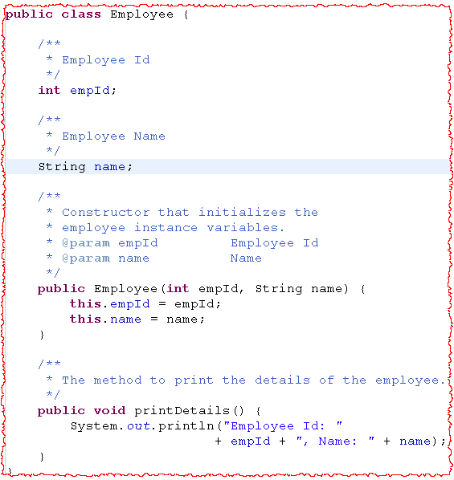
Class Definition
Definition of Employee Class:
Attributes – Stores the state of the object
Methods – Implement the behavior of the class.
Message
Communication mechanism between objects.
Company object can send message to Employee object through the method call and parameters.
Employee object will send the message back in terms of the response to the calling method.

Slide 7
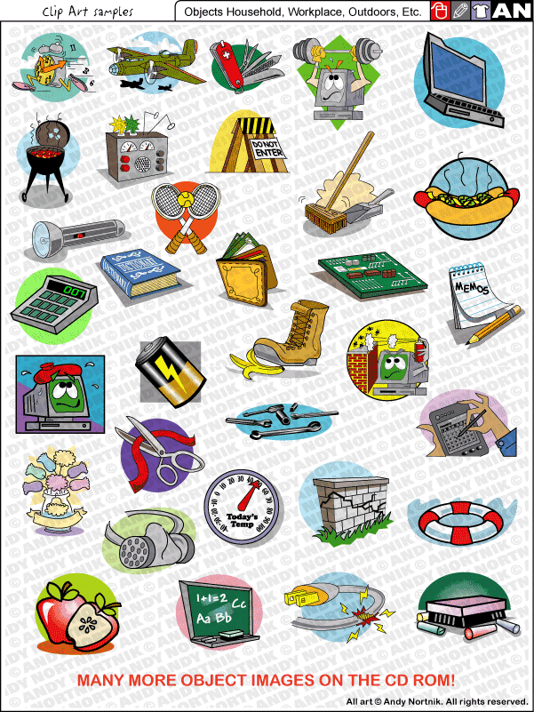
Example – Identify classes and objects
Identify the classes and objects in
This training classroom.
This floor of the building.
Identify the classes and objects in following problem statement:
NTT has three business units – Global Markets, Nitro and Government Services. Each business unit has projects and projects in-turn have employees. Few employees are managers. A project has mix of both employees and managers.

Slide 8

Encapsulation (Information Hiding)
An object should not disclose all its attributes and behaviors.
It should reveal only the required methods which the other object require to interact with.
These methods which need to be exposed to other objects define the interface of the class.
For ex. An object to sort a list of employees should only expose the method which accepts list of employees as parameter and the algorithm to sort the employees should be hidden from the other object.

Slide 9
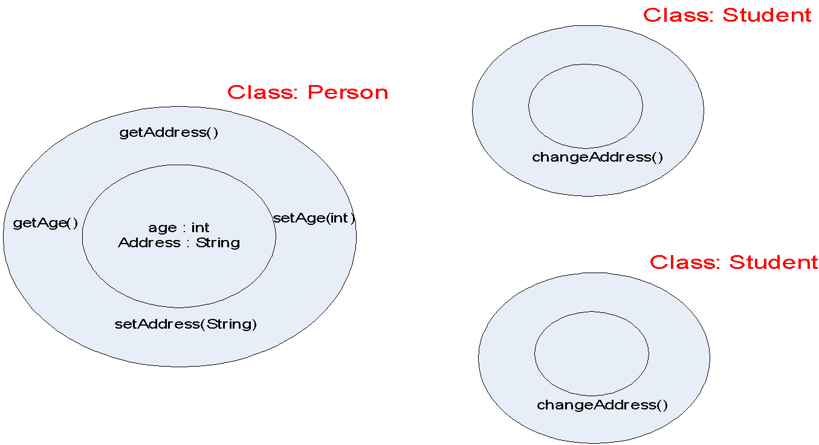

Information Hiding
Only the object’s own code may read and change its own data values.

Slide 10

Interfaces and Implementation
The public methods and attributes of a class are considered interfaces.
Interfaces define how the users of the class interact with the class.
There could be multiple ways of defining the interfaces of the class – interface, abstract class, public methods.
Implementation details like algorithm to sort employees, calculate square root of a number should be hidden from the other objects.

Slide 11

What is UML?
Standard modeling language for OO software.
Includes a set of graphic notation techniques to create visual models of object-oriented software-intensive systems.
Formal Definition:
The Unified Modeling Language (UML) is used to construct, visualize, and document the artifacts of an object-oriented software-intensive system under development.
We will study the following today - Actor, Use Case, Use Case Diagram, Class, Object, Class Diagram, and Sequence Diagram.

Slide 12
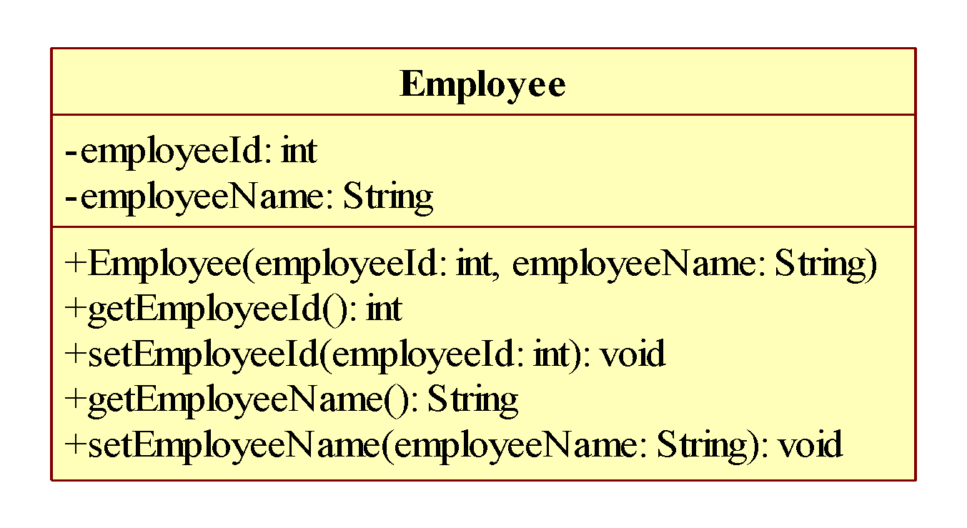
UML Notation - Class
Class Name
Attributes
Constructor
Methods
In UML, the visibility is normally designated by a plus or minus symbol:
+ for public visibility
- for private visibility
# for protected visibility

Slide 13
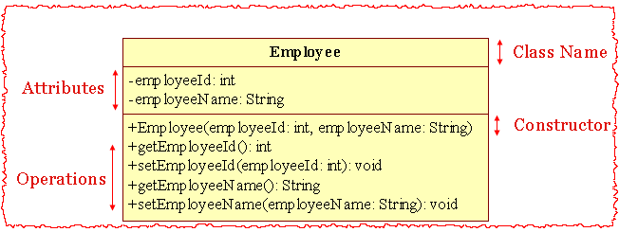

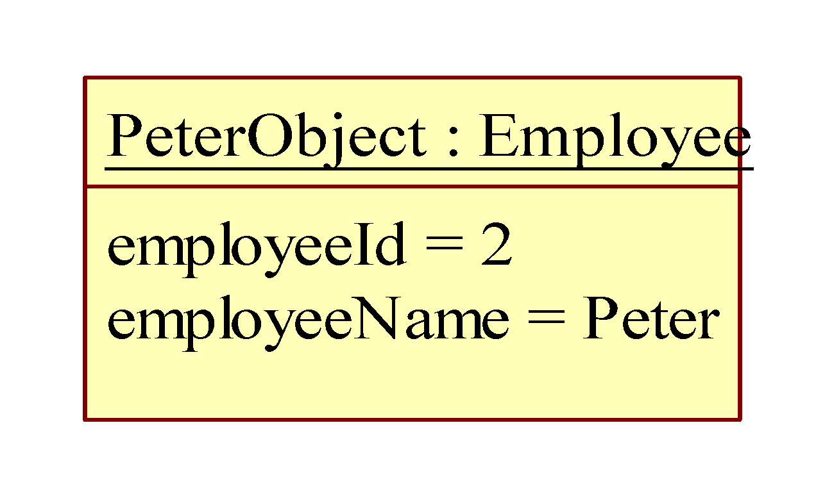
UML Notation - Object
Class
Instances (Objects)
Object Name
Object Attributes

Slide 14

Inheritance
Inheritance is a way to form new classes using classes that have already been defined.
Helps in reusing existing code.
Helps in defining the relationship between classes.
Is-A Relationship.
For ex.
CivilEngineer is an Enginner.
Manager is an Employee.
Lion is an Animal.
MountainBike is a Bicycle.

Slide 15
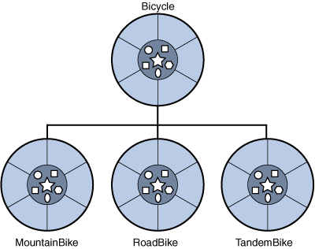
Abstraction
Super class or parent class has all the methods and attributes common to all the child classes.
Sub class or child class inherit the attributes and methods from the base class.
The process of identifying the common behavior in the related classes and keeping it in the parent class is called abstraction.
For ex. Dog and Cat share certain attributes like eyeColor, weight etc. These can be moved to Mammal class.

Slide 16
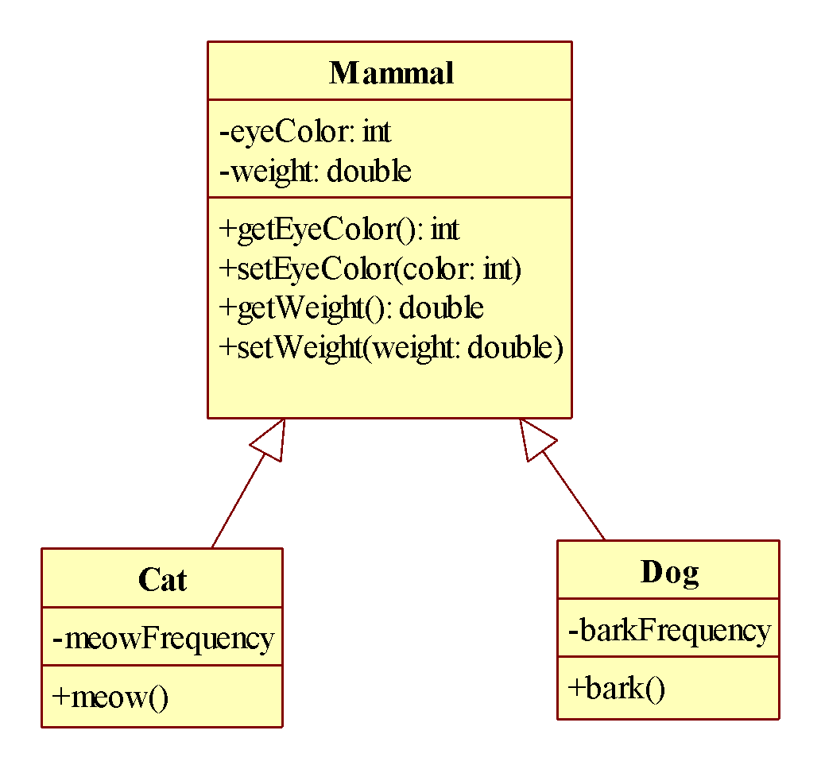
UML Notation - Inheritance
Inheritance UML Symbol

Slide 17
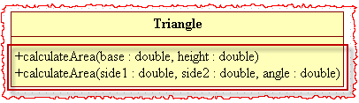
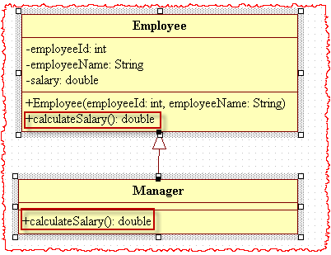
Overloading and Overriding
Overloading
Writing two or more methods with the same name in the same class.
The method parameters are different.
The methods can’t be overloaded just by changing the return type.
Overriding
A method with the same name and parameters present in base and child class.
The child class method is overriding the base class method.
Overriding changes the behavior of the method in the child class.

Slide 18
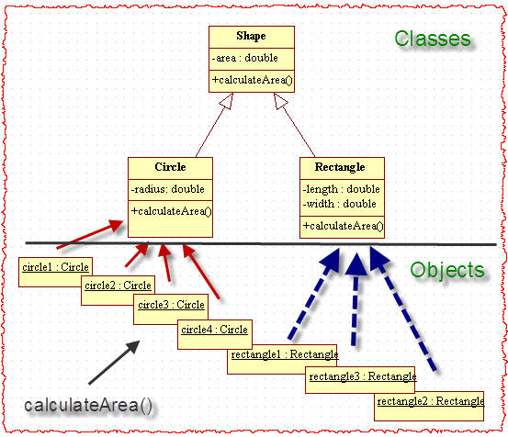
Polymorphism
An ability to appear in many forms.
Sending identical messages to objects of different classes.
Each object responds to the message in a different, yet still an appropriate way.

Slide 19
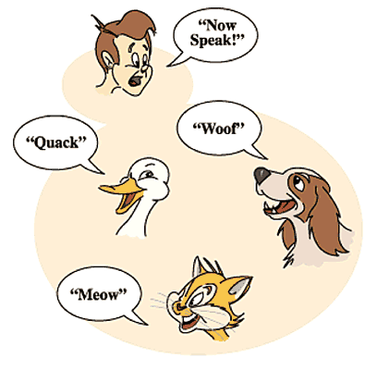
Polymorphism (Contd..)
Let us now define Polymorphism formally.
Polymorphism is a programming language feature that allows values of different data types to be handled using a uniform interface.

Slide 20

Containership
Objects containing other objects.
Objects are often built/composed of other objects.
Few classes don’t support IS-A relationship like Basket and Fruit.
Explains Has-A or USES-A relationship For ex. Building has washroom, Professor teaches students.
Shows whole/part relationship.

Slide 21
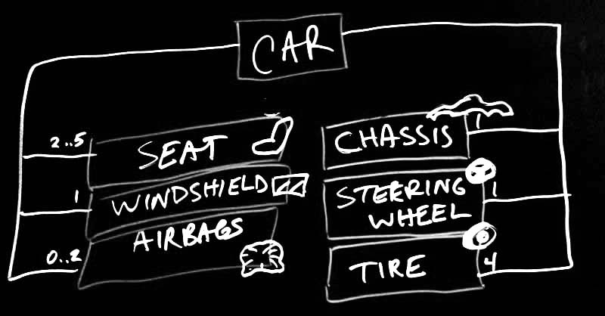
Containership – Benefits and Types
Represents the way objects interact.
Decoupling - Break the big complex objects into small simpler objects.
Decoupling reduces the complexity of the system and increase the ease in maintenance.
Two types of composition – Aggregation and Composition.

Slide 22
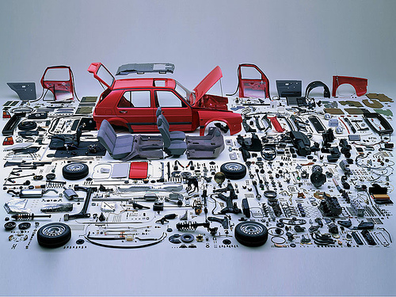
Aggregation
Only see the whole.
A complex object composed of other objects.
TV composed of transistor, picture tube, tuner etc.
Car composed of engine, stereo, door. Engine is composed of piston and spark plug etc.

Slide 23
Composition
Hand
is_part_of
Crate
*
has
A finger cannot exist on its own
A bottle of beer can exist on its own
Finger
is_part_of
*
1
has
Nail
Beer Bottle
Composition
Strong containment propery
Aggregation
Weak containment property

Slide 24
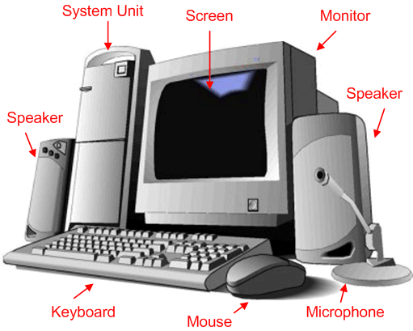
Association
Association represent the relationship between objects.
An object wants another object to perform a service for it.
Computer system is composed of monitor, keyboard, mouse and system box.
Meeting room is composed of chairs, table, phone etc.

Slide 25
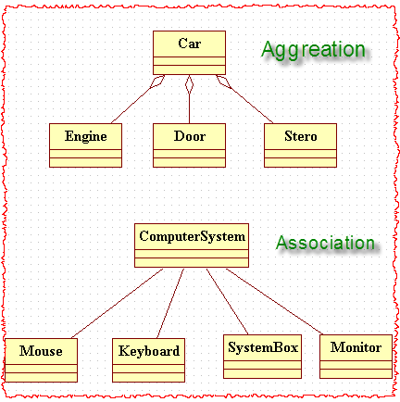
Aggregation and Association - UML Notation

Slide 26
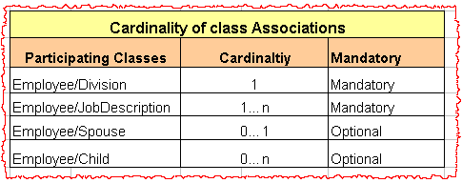
Cardinality
It specifies how many times (minimum and maximum) an entity is related to another entity in a given relationship.
Determine the cardinality by asking following questions -
Which objects collaborate with other objects?
How many objects participate in the collaboration?
Is the collaboration optional or mandatory?

Slide 27
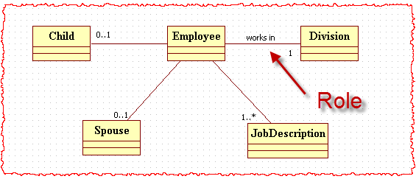
Cardinality – UML Notation
Cardinality is indicated along the association lines.
A role identifies the meaning for the association end and it is used to navigate to an object of the other class to the association.

Slide 28
Exercise
Create the Class diagram for the following -
Department
Attribute: dept Id, dept name
Methods: getter and setter
Associations:
Identify the roles between classes.
Identify the cardinality between classes.
Person
Attributes: Name (String), Age (int)
Methods: int hashCode(), String toString(), int compareTo(Person)
Student
Extends Person.
Attributes: rollNumber
Methods: getter and setter
Lecturer
Extends Person.
Attributes: salary
Methods: getter and setter

Slide 29
Overview: Good Software Features
Desired characteristics/properties
Usability
Scalability
Flexibility
Maintainability
Performance requirements
Good Software
Notes:
Faculty Notes:
Review the slide content and Participant Notes with the participants.
Animation on slide.
On Display: Desired Characteristics / Arrow / Good Software
On clicks 1-5: Usability, Scalability, Flexibility, Maintainability, Performance requirements
Participant Notes:
Meeting complex requirements and incorporating desired characteristics/properties requires a systematic engineering approach.
Usability: Refers to the ease of use
Scalability: The degree to which an application can support an increase in processing volume or in number of users
Flexibility: The ability of a software to change swiftly
Maintainability: The ability to perform preventive and remedial maintenance activities on the infrastructure
Performance Requirements: The response time of the system to reacte to a user request
When programmers do not follow a systematic approach, the software design is bad.

Slide 30

Overview: Bad Class Design
Badly designed classes may be able to perform tasks...but they may not be very efficient or robust.
Many of the problems with badly designed classes are exposed when existing applications need to be changed. They can be
very difficult to amend
because they have not been
designed systematically.
5
Notes:
Faculty Notes:
Review the slide content and Participant Notes with the participants.
Participant Notes:
Your class may be producing the desired output, however, it may not be the best possible way to do things.
The way to achieve the best outcome has to do with good design.
If, for example, a programmer needs to fix a bug or to add new functionality to an existing program, the task may be easy and obvious if the programmer has used well-designed classes.
However, if the classes are badly designed, the task may well be very difficult and involve a great deal of work.
In larger applications, the effect of using bad design starts with the original implementation, but has a ripple effect:
If the implementation starts with a bad structure, finishing it might later become overly complex.
The complete program may not be finished, or might contain bugs, or it could take a lot longer to build than necessary.

Slide 31
Principles of Object-Oriented Design: Cohesion
Cohesion
Cohesion is a measure of how strongly related the responsibilities of a single module are.
With high cohesion, the reusability of the program increases.
Cohesion decreases if the methods of a class have little in common.
Notes:
Faculty Notes:
Review the slide content and Participant Notes with the participants.
Animation on slide.
On display: Cohesion
On clicks 1-3: Cohesion characteristics
Participant Notes:
Understanding terms like Cohesion and Cohesiveness is important to understanding OO Principles.
Before OO programing people did not always use cohesion in their design. Cohesion is a principle of good design.
Elements with low cohesion often suffer from being hard to comprehend, reuse, maintain, and change.
Before moving on to discuss Design Patterns, it is important to understand some terms like Cohesion and Cohesiveness.
You can achieve high cohesion by:
Keeping related methods in a class.
Moving unrelated methods to other classes.

Slide 32
Principles of Object-Oriented Design: Coupling
Coupling
Coupling is the degree to which each program relies on other modules.
Coupling helps to achieve maintainability.
Coupling should be low (loose) if possible.
Notes:
Faculty Notes:
Review the slide content and Participant Notes with the participants.
Animation on slide.
On display: Coupling
On clicks 1-3: Coupling characteristics
Participant Notes:
You can achieve low coupling by using interfaces. Interfaces act like media that classes use to communicate with each other.
Good design has High Cohesion/Low Coupling.

Slide 33
Principles of Object-Oriented Design: Low Coupling – Overview
Low coupling
Low Coupling is useful because individual design elements should share as little information as possible with other design elements.
Low Coupling can be achieved using interfaces
Notes:
Faculty Notes:
Review the slide content with the participants.
Animation on slide.
On display: Low Coupling
On click: Low coupling characteristics
Participant Notes:
N/A

Slide 34
Principles of Object-Oriented Design: Low Coupling – Using Interfaces
Why do you need interfaces to achieve low coupling?
Interfaces provide a means of setting a standard.
Interfaces provide a level of abstraction that makes programs easier to understand.
Notes:
Faculty Notes:
Review the slide content and Participant Notes with the participants.
Animation on slide.
On display: Question
On click: Answers
Participant Notes:
Interfaces define a contract that a class (an implementation) must satisfy.
If a class implements an interface, the class promises to conform to a standard.
Another class which may be a consumer of this class, accesses it through its interface.
An interface acts like a contract between these two classes.
Interfaces:
Also, provide a level of abstraction that makes programs easier to understand.
Allow developers to show the general way that code behaves without having to get into the details.

Slide 35

Overview: Use Principles for Good Class Design
Coding quality classes pays off!
To create long-lasting, solid designs, follow good
design principles.
Well designed classes:
Have one (or a small number of similar) well defined functions.
Share only the information they need to with other classes.
Notes:
Faculty Notes:
Review the slide content and Participant Notes with the participants.
Participant Notes:
In terms of the time and effort you expend, quality class design will give you a solid payoff, especially later, when you need to make changes because requirements change or any other enhancements are required to be incorporated into the current design.

Slide 36
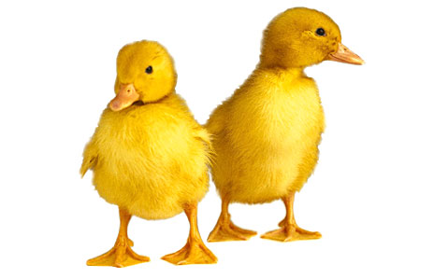
Good Design
Two Aspects
Design should make the application work.
Design is reusable, flexible and maintainable.

Slide 37
Design Principle
Is a basic tool or technique that can be applied to designing or writing code to make that code more maintainable , flexible and extensible.

Slide 38

Single Responsibility Principle (SRP)
A class should have a single reason to change.
Problem Statement:
An internet and GUI application is planning to use a modem class which should be able to perform the following –
Connect to the server.
Disconnect from the server.
Send the data to server.
Receive data from the server.
Draws the shape of the modem.
The first four behaviour is required by the internet application while the last is required by the GUI application.

Slide 39
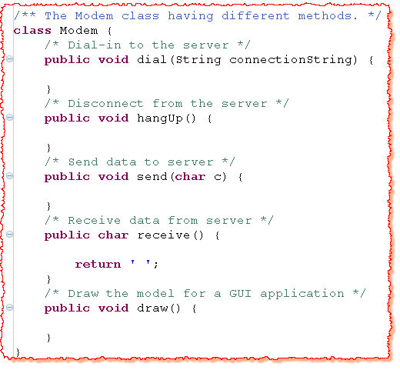

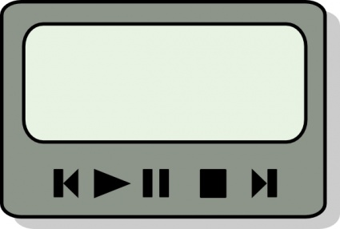
Solution#1
Internet App
GUI App

Slide 40
Solution#1 | Problems
Responsibility means “Reason for a change” (in context of SRP).
Modem class has the following responsibilities:
Connection Related
Data Transmission Related
Drawing related
InternetGUI application will have the access to methods which it does not require. (deployment overhead)
If only draw method is changed, redeployment required in both the applications.

Slide 41
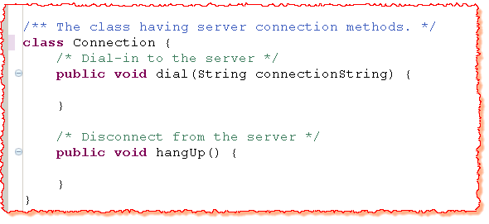

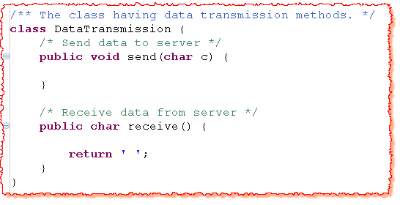
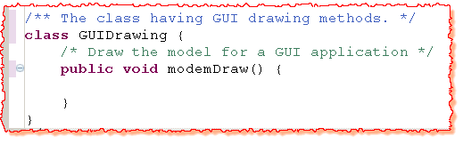

Slide 42
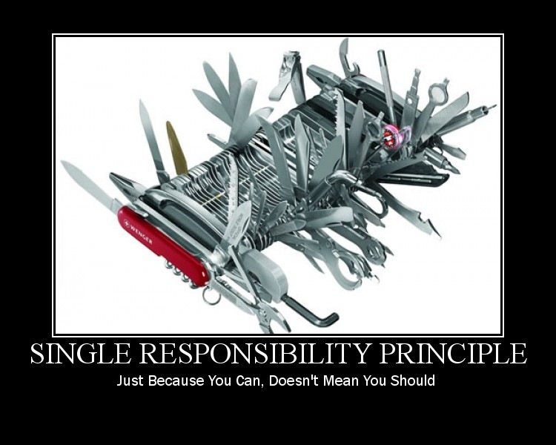
Advantages
Code complexity reduced.
Improved Readability.
Reduced Coupling.
Code has better chances of cleanly evolving.

Slide 43
The Open-Closed Principle (OCP)
A software module (classes) should be open for extension and closed for modification.
Problem Statement:
Design a banking application in which a particular loan is passed through a software module for approval. This software module approves the loan only if the balance in the applicant’s bank account is above certain value.

Slide 44
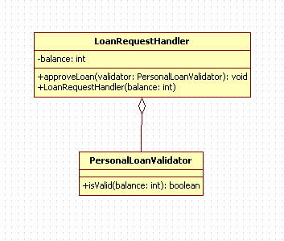
UML Diagram

Slide 45
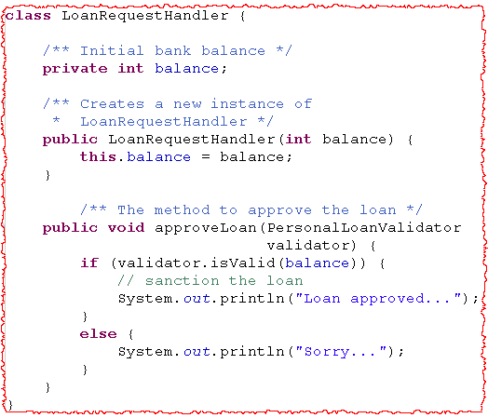

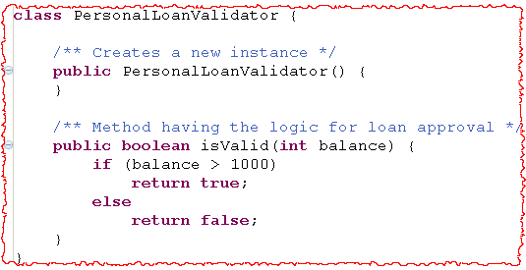

Slide 46
Problem in Solution#1
High Coupling between LoanRequestHandler and PersonalLoadValidator.
Every time bank decides to provide a different type of loan, modifications are required in both the classes.
How to solve above design problems?
Avoid the strong coupling between the two classes.
Abstract the common loan validator and use this abstracted entity in the LoanRequestHandler.

Slide 47
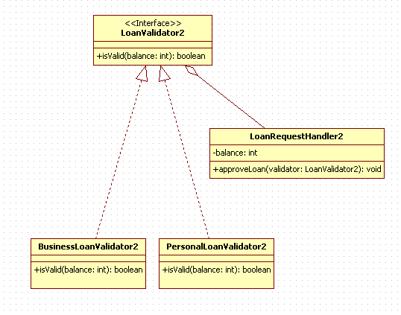
UML Diagram (Solution)

Slide 48

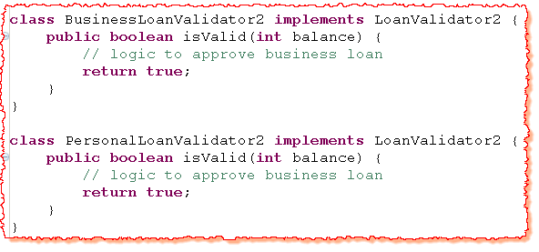
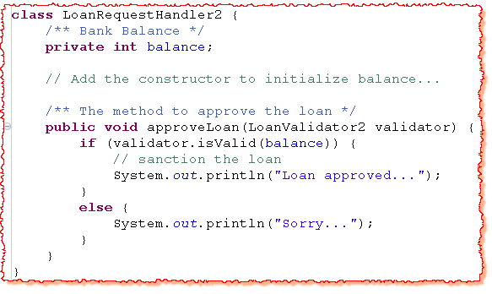

Slide 49
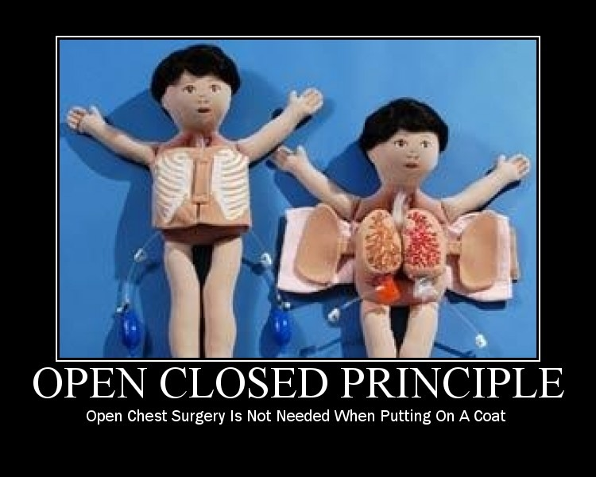
Benefits and Usage
Low Coupling between LoanRequestHandler and PersonalLoadValidator.
No modification required in LoanRequestHandler to handle different types of loan in future.

Slide 50
Liskov’s Substitution Principle (LSP)
Subtypes must be completely substitutable for their base types.
Problem Statement:
A bank manages two types of accounts – Current Account and Timed Current Accounts. The current account can be closed only if the balance on that account is positive. To close timed current account, the balance needs to be positive and it needs to be open for at least 6 months. The Timed Current Accounts give additional 1% interest. Design the classes.
Some Facts:
All methods except closing an Account and calculating interest rate are same.

Slide 51
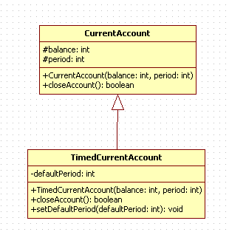
UML Diagram

Slide 52
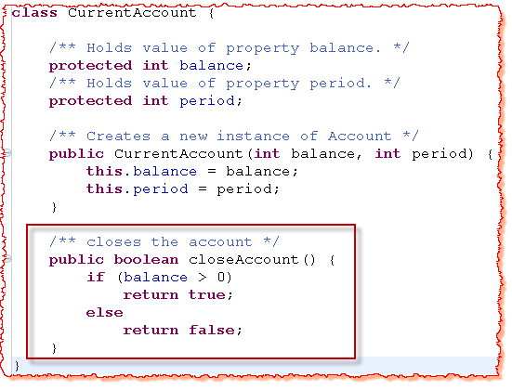

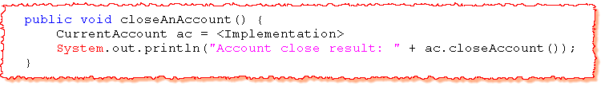
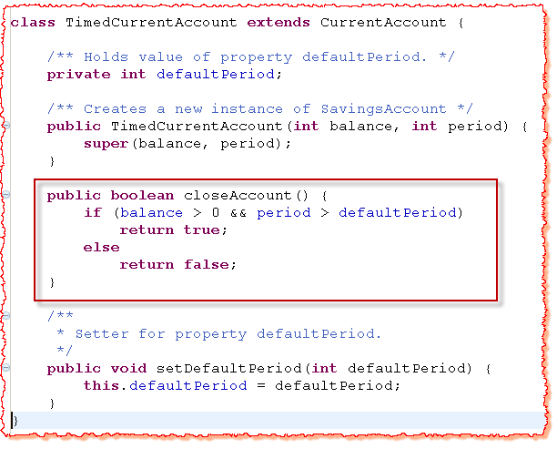
Behaviour dependant upon the object type.

Slide 53

Problem in Solution#1
Unexpected Result.
User to know the internal implementation of the classes.
How to solve above design problems?
Subclasses should completely replace the base class.
Design by Contract Principle

Slide 54
Design by Contract
Each method can have pre-conditions and post-conditions.
Pre-conditions
Criteria to be met before the method offers a behaviour
Post-condition
State or behaviour offered by the method after it meets preconditions
A sub-type can only have
weaker pre-conditions
and
stronger post-conditions
than its base class.

Slide 55
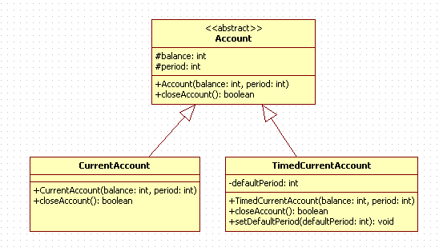
UML Diagram(Solution)

Slide 56
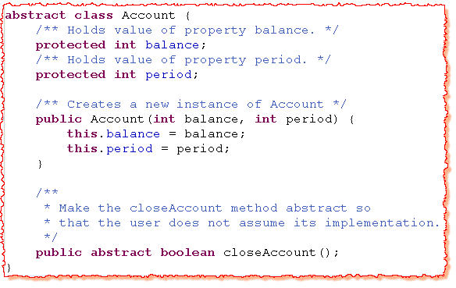
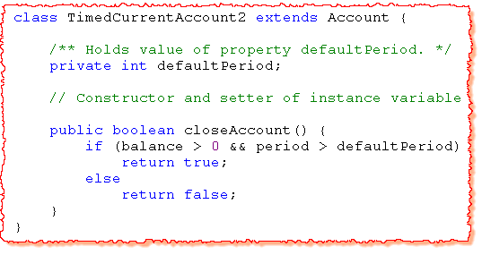
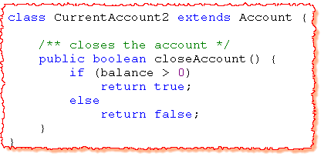

Slide 57
Benefits and Usage
The user won’t assume the implementation of closeAccount method.
Always Remember
Derived Classes must enforce weaker pre condition and stronger post conditions while over riding any base class methods.

Slide 58
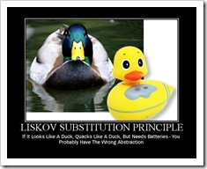

Slide 59
Composite Reuse Principle (CRP)
Favour composition over inheritance as a way of achieving polymorphism.
Problem Statement:
Design a payroll system for an organization. The organization has three types of employees – Regular, Part-time and Temporary. The regular and part-time employees are given bonus as a fixed % of their base salary while the temporary gets a fixed lump sum amount as the bonus. The company gives same amount of insurance cover to all its employees.

Slide 60
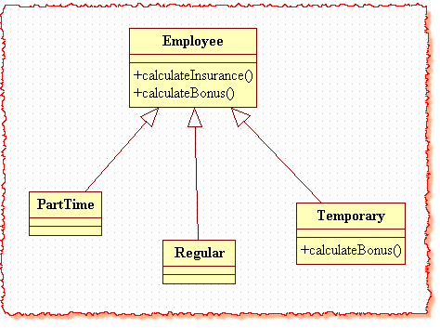
Solution#1
Now the organization adds an new Contractor Employee and likes to give bonus to its contractors as well. It likes to give exactly same bonus to its contractors as it is giving to its temporary employees.

Slide 61
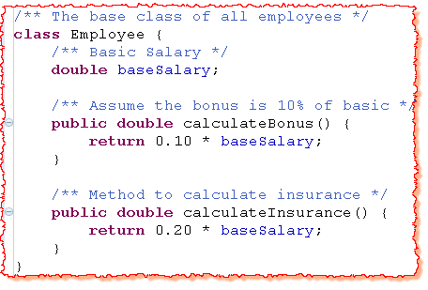
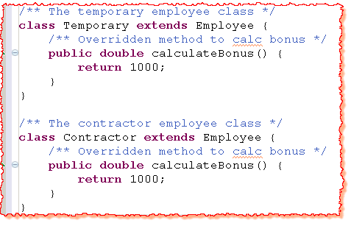
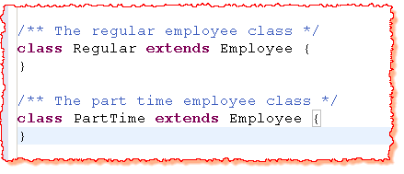
Solution#1 (Contd..)

Slide 62
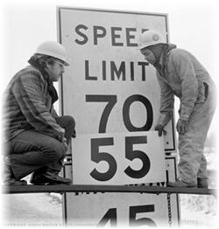
Solution#1 (Contd..)
Two approaches
Contractor extends Temporary
Contractor extends Employee but calculateBonus code is duplicated.
Both the above approaches has limitations
Contractor is not a temporary employee.
Duplication of code leads to more maintenance efforts.
Hence, the original class structure (implemented through inheritance) was highly limiting to incorporate the change in requirements.

Slide 63
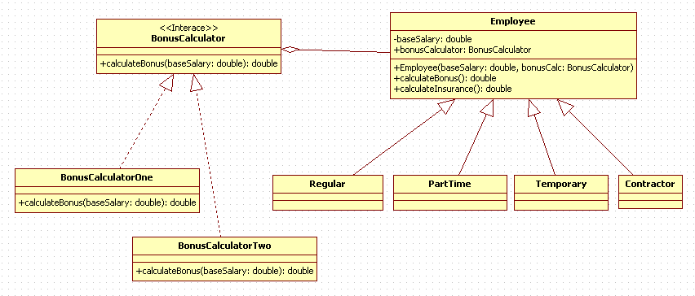
UML Diagram(Solution)

Slide 64




Slide 65

Benefits
No duplication of code.
Easy to modify later.
BonusCalculator logic can be changed dynamically.

Slide 66



Program to an interface (PTI)
Do not tie the relationship to classes but tie them to interfaces.
Problem Statement:
A gaming application is planning to use car, boat and bike for water sport. The player should be able to move left, right, forward, reverse and set the speed of the vehicle. The application should also demonstrate the manoeuvring of these vehicles with the help of a demo.

Slide 67

UML Diagram

Slide 68



Solution#1

Slide 69
Solution#1 | Problems
Code duplication.
The impact if the signature of a method changes.
The impact if the application discontinues one of its vehicle.

Slide 70


Slide 71

Advantages
Differentiated ‘what’ versus ‘How’.
No impact on the client as long as the contract with the client does not change.
All disadvantages of solution#1 are solved.
Standard interface for all cars, implementation may be different !

Slide 72

Abstract class vs. Interface
Both are used to provide the contract.
Erich Gamma says –
Changing an interface means breaking the code of your clients .
An abstract class can provide the default implementation of the method hence impact can be minimized.
If classes are closely related, abstract classes may be used.
In unrelated classes, the interfaces should be used. (keeping the above quote in the mind)

Slide 73


Interface Segregation Principle (ISP)
Many specific interfaces are better than a single general interface.
Problem Statement:
An ATM can have the following types of output – a screen and a speech. It supports the following two types of transactions – deposit and withdrawal. A company supports two types of ATMs – only screen (for ppl who can see) and screen with speech (for handicapped ppl). Design the classes.

Slide 74

UML Diagram

Slide 75


Solution#1

Slide 76
Solution#1 | Problems
Contract change in one UI will affect the other UI implementations.
Fat interface – Grow rapidly.

Slide 77

UML Diagram (Solution)

Slide 78




Slide 79

Advantages
Small and relevant contracts.
Easy to understand and maintain.
Contract change in one UI will not affect the other UI implementations.

Slide 80
Principle # 6: The Don’t Repeat Yourself Principle (DRY)
In The Pragmatic Programmer, DRY is defined as
Every piece of knowledge must have a single, unambiguous, authoritative representation within a system.
Avoid duplicate code by abstracting out things that are common and placing those things in a single location.

Slide 81
Summary
Knowledge duplication is always a DRY principle violation.
Code duplication doesn’t necessarily mean violation of the DRY principle.

Slide 82

Object Oriented Thought Process

Slide 83

How to think in term of Objects?
Fundamental Unit = Class.
Design is an iterative process. Don’t hung up to perfect the design in first go.
Three important things to develop a good sense of OO though process
Difference between interface and implementation
Giving the users minimal interfaces possible.
Using abstract thinking when designing interfaces

Slide 84

Class Design Guidelines
Think about real world objects.
Common Mistake – only behavior in the class.
Identifying public interfaces
Keep public interfaces to minimum
Hide implementation
Design exception handling of a class
Design robust constructors
Document a class
Build objects with the intent to reuse and extend
Make names descriptive
Abstract non-portable code
How to copy and compare objects
Keep the scope as minimum as possible
Class should be responsible for itself.

Slide 85
Class Design Guidelines
Inheritance vs. Composition
Interface vs. Abstract class
Aggregation vs. Association

Slide 86
Designing Objects
Having a prototype can help in identifying the classes.
Identify the classes – highlight all nouns.
Determine Responsibility of each class.
Collaboration of each class with other.
CRC Cards.

Slide 87
Exercise | Identify the Classes
A customer visits the online shopping portal. A customer may buy item or just visit the page and logout. The customer can select a segment, then a category, and brand to get the different products in the desired brand.
The customer can select the product for purchasing. The process can be repeated for more items. Once the customer finishes selecting the product/s the cart can be viewed , If the customer wants to edit the final cart it can be done here.
For final payment the customer has to login the portal, if the customer is visiting for the 1st time he must register with the site, else the customer must use the login page to proceed. Final cart is submitted for payment and card details and address (where shipment has to be made) are be confirmed by the customer.

Slide 88
Eliminating Class Proliferation in Java
Class proliferation, or the excessive creation of classes in object-oriented programming, can lead to complexity, reduced maintainability, and decreased reusability. Here are some strategies to manage and eliminate class proliferation in Java:
Use Composition Over Inheritance
Apply Design Patterns
Generalize with Abstract Classes or Interfaces
Leverage Generics
Avoid Over-Specialization
Refactor and Consolidate

Slide 89
Design Patterns

Slide 90
Introduction
General repeatable solution to a commonly occurring problem in software design.
A design pattern isn't a finished design that can be transformed directly into code.
It is a description or template for how to solve a problem that can be used in many different situations.

Slide 91
Benefits of Design Pattern
They give the developer a selection of tried and tested solutions to work with
They are language neutral and so can be applied to any language that supports object-orientation
They aid communication by the very fact that they are well documented and can be researched if that is not the case.
They have a proven track record as they are already widely used and thus reduce the technical risk to the project
They are highly flexible and can be used in practically any type of application or domain

Slide 92
What is Gang of Four(GoF)
In 1994, four authors :
Erich Gamma
Richard Helm
Ralph Johnson
John Vlissides
published a book titled Design Patterns - Elements of Reusable Object-Oriented Software which initiated the concept of Design Pattern in Software development.
These authors are collectively known as Gang of Four (GOF).

Slide 93
Types of Design Pattern
Creational
Deals with object creation mechanisms, trying to create objects in a manner suitable to the situation. The basic form of object creation could result in design problems or added complexity to the design. Creational design patterns solve this problem by somehow controlling this object creation.
Structural
Ease the design by identifying a simple way to realize relationships between entities.
Behavioural
Identify common communication patterns between objects and realize these patterns. By doing so, these patterns increase flexibility in carrying out this communication.

Slide 94
Types of Creational Design Pattern
Singleton
Factory
Abstract Factory
Prototype

Slide 95

Singleton pattern

Slide 96
Singleton Design Pattern
Intent
Ensure a class has only one instance, and provide a global point of access to it.
Encapsulated "just-in-time initialization" or "initialization on first use".
Problem
Application needs one, and only one, instance of an object.

Slide 97


Structure
Make the class of the single instance responsible for access and "initialization on first use". The single instance is a private static attribute. The accessor function is a public static method.

Slide 98
Implementation
Define a private static attribute in the "single instance" class.
Define a public static accessor function in the class.
Do "lazy initialization" (creation on first use) in the accessor function.
Define all constructors to be protected or private.
Clients may only use the accessor function to manipulate the Singleton.

Slide 99
Lazy Initialization Implementation
public final class SingletonDemo {
private static SingletonDemo instance = null;
private SingletonDemo() { }
public static synchronized SingletonDemo getInstance() {
if (instance == null) {
instance = new SingletonDemo();
}
return instance;
}
}

Slide 100
Eager initialization
public final class Singleton {
private static final Singleton INSTANCE = new Singleton();
private Singleton() {}
public static Singleton getInstance() {
return INSTANCE;
}
}

Slide 101
Why is Singleton Design Pattern is Considered an Anti-pattern?

Slide 102
What are Anti-patterns?
Anti-patterns in system design are common mistakes or traps that developers can fall into when designing software. They're solutions that may seem good at first but can lead to problems later on.

Slide 103
Code Example
public class Logger {
private static Logger instance;
private PrintWriter fileWriter;
public static Logger getInstance() {
if (instance == null) {
instance = new Logger();
}
return instance;
}
private Logger() {
try {
fileWriter = new PrintWriter(new FileWriter("app.log", true));
} catch (IOException e) {
e.printStackTrace();
}
}

Slide 104
Code Example
public void log(String message) {
String log = String.format("[%s]- %s", LocalDateTime.now(), message);
fileWriter.println(log);
fileWriter.flush();
}
}

Slide 105
Disadvantages of Singleton
By definition, the Singleton pattern ensures a class has only one instance and, additionally, provides global access to this instance. Therefore, we should use it in cases where we need both of those things.
Looking at its definition, we can notice it violates the Single Responsibility Principle. The principle states one class should have only one responsibility.
However, the Singleton pattern has at least two responsibilities – it ensures the class has only one instance and contains business logic.

Slide 106
Global State
Global states are considered to be a bad practice and, thus, should be avoided.
Although it may not be obvious, a singleton introduces global variables in our code, but they’re encapsulated within a class.
Since they’re global, everyone can access and use them. Moreover, if they aren’t immutable, everyone can change them as well.
Suppose we use the Logger class in several places in our code. Everyone can access and modify its values.
Now, if we encounter a problem in one method that uses it and discover the problem is in the singleton itself, we need to check the entire codebase and every method that uses it to find the impact of the problem.
This can quickly become a bottleneck for our application.

Slide 107
Code Flexibility
When a project is in the early stages of development, we can make the assumption there will be no more than one instance of certain classes and define them using the Singleton design pattern.
However, if requirements change and our assumption turns out to be incorrect, we’d need to put a big effort into refactoring our code.
We assumed we’d only need one instance of our Logger class. What if, in the future, we decide one file isn’t enough?
For instance, we might need separate files for errors and info messages. Additionally, one instance of a class wouldn’t be enough anymore. Next, in order to make the modification possible, we’d need to refactor our entire codebase and remove the singleton, which would require a lot of effort.
With singletons, we’re making our code tightly coupled and less flexible.

Slide 108
Dependency Hiding
When we’re using them in other classes, we’re hiding the fact these classes depend on a singleton instance.
Let’s consider the sum() method:
public static int sum(int a, int b){
Logger logger = Logger.getInstance();
logger.log("A simple message");
return a + b;
}
If we don’t look directly at the implementation of the sum() method, we have no way of knowing it uses the Logger class.
We didn’t pass the dependencies as usual, as arguments to the constructor or a method.

Slide 109
Alternatives to Singleton
In cases where we need only one instance, we could use dependency injection. In other words, we can create only one instance and pass it as an argument where it’s needed. This way, we’d raise the awareness of dependencies a method or another class needs in order to function properly.
Additionally, if we need multiple instances in the future, we’d change our code more easily.
Moreover, we can use the Factory pattern for long-living objects.

Slide 110

Factory Method pattern

Slide 111
Factory Design Pattern
Uses factory methods to deal with the problem of creating objects without having to specify the exact class of the object that will be created. This is done by creating objects by calling a factory method—either specified in an interface and implemented by child classes, or implemented in a base class and optionally overridden by derived classes—rather than by calling a constructor.
Intent
Define an interface for creating an object, but let subclasses decide which class to instantiate. Factory Method lets a class defer instantiation to subclasses.
Problem
A framework needs to standardize the architectural model for a range of applications, but allow for individual applications to define their own domain objects and provide for their instantiation.

Slide 112
When to Use Factory Method Design Pattern?
If object creation process is complex or varies under different conditions, using a factory method can make your client code simpler and promote reusability.
The Factory Method Pattern allows you to create objects through an interface or abstract class, hiding the details of concrete implementations. This reduces dependencies and makes it easier to modify or expand the system without affecting existing code.
If your application needs to create different versions of a product or may introduce new types in the future, the Factory Method Pattern provides a flexible way to handle these variations by defining specific factory methods for each product type.
Factories can also encapsulate configuration logic, allowing clients to customize the object creation process by providing parameters or options to the factory method.

Slide 113

Components of Factory Method Design Pattern
Product: Represents the interface of the objects created by the factory method.
ConcreteProduct: Implements the Product interface and represents the concrete objects created by the factory method.
Creator: Declares the factory method, which returns an instance of the Product interface.
ConcreteCreator: Implements the factory method to create instances of ConcreteProduct.

Slide 114

Structure

Slide 115
Advantages of Factory Method
Encourages loose coupling between client code and the created objects.
Provides a centralized point of control for object creation, facilitating easier maintenance and testing.
Supports the Open/Closed Principle, allowing for the addition of new product types without modifying existing client code.
Promotes code reusability by defining common creation logic in superclass methods.

Slide 116
Disadvantages
Can lead to an explosion of subclasses if there are many variations of products.
Increases complexity in the codebase, especially when dealing with multiple factories and product types.
May introduce runtime errors if the factory method is not implemented properly or if there are inconsistencies in product creation logic across subclasses.

