Slide 1


Data Engineering Final Project Data Analysis of Airbnb Data
Sujatha S
AA.SC.P2MCA2107441
Semester - 3

Slide 2
Project Problem Statement

Slide 3
Problem Statement
Analyzing the Airbnb data to gain insights on the trends and patterns of short-term house-rentals and how it impacts the hospitality sector in Singapore.

Slide 4
Stakeholders
Hosts/Guests
Airbnb employees
The primary stakeholders are the individuals or entities that use Airbnb's platform to book accommodations or list their properties.
Employees of Airbnb who work with data analysis, product development, customer support, and other relevant areas who rely on data to improve the platform, enhance user experience, and make informed business decisions.
Hotel and Hospitality Industry
Local Communities
Traditional hotels and other accommodation providers may be interested in Airbnb data to assess competition, market trends, and the impact of short-term rentals on their businesses.
The communities in which Airbnb operates can have a stake in the data. They may be interested in data related to the impact of short-term rentals on housing availability, local economy, and neighborhood dynamics.

Slide 5
Data Dictionary

Slide 6
Data
Data Source : http://insideairbnb.com/get-the-data
Datasets Used : listings.csv & calender.csv
Volume of Data :
Listings dataset(2.29MB) : 14586 rows and 18 columns of data
Calendar dataset(235.5MB) : 5305261(5.3M) rows and 7 columns of data

Slide 7
Listings Dataset
Field | Type | Description
id | integer | Airbnb's unique identifier for the listing
name | text | Name of the listing
host_id | integer | Airbnb's unique identifier for the host/user
host_name | text | Name of the host. Usually just the first name(s).
neighbourhood_group | text | neighbourhood group
neighbourhood | text | neighbourhood
latitude | numeric | Uses the World Geodetic System (WGS84) projection for latitude and longitude.
longitude | numeric | Uses the World Geodetic System (WGS84) projection for latitude and longitude.

Slide 8
Listings Dataset contd…
Field | Type | Description
room_type | text | Type of room listed by the Airbnb hosts
price | currency | Room cost per night in local currency
minimum_nights | integer | Minimum number of nights stay required for the listing.
number_of_reviews | integer | The number of reviews the listing has.
last_review | date | The date of the last/newest review.
reviews_per_month | numeric | The number of reviews the listing has over the lifetime of the listing
calculated_host_listings_count | integer | The number of listings the host has in the current scrape, in the city/region geography.
availability_365 | integer | The availability of the listing x days in the future as determined by the calendar.
number_of_reviews_ltm | integer | The number of reviews the listing has (in the last 12 months)
license | text | The licence/permit/registration number

Slide 9
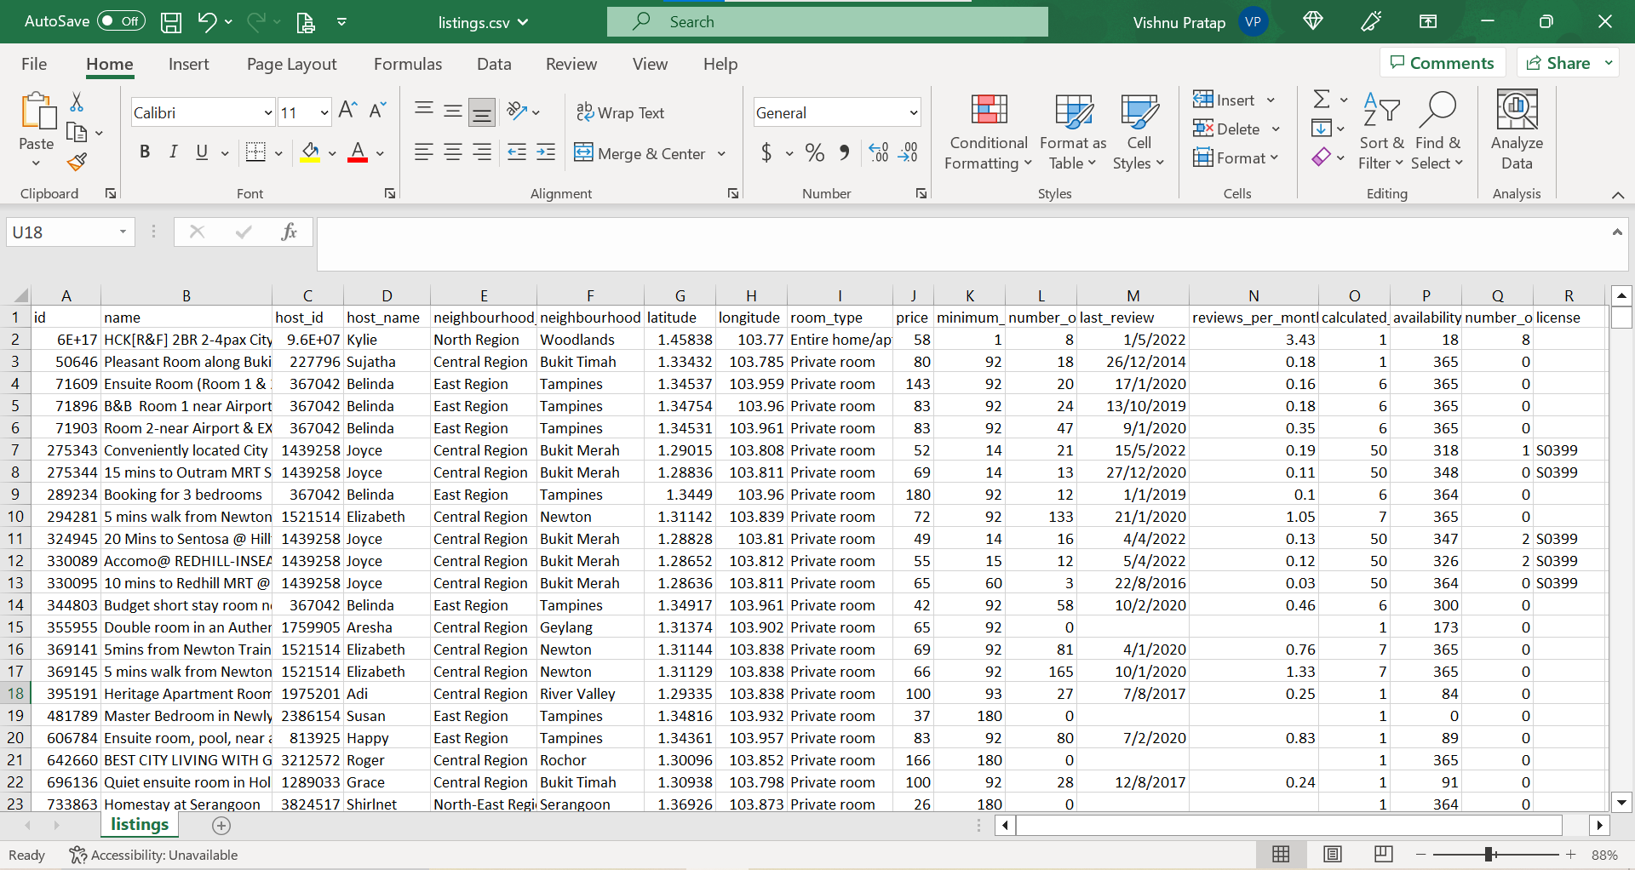

Slide 10
Calendar Dataset
Field | Type | Description
listing_id | integer | Airbnb's unique identifier for the listing
date | date | Calendar dates for booking
available | boolean | [t=true;f=false]. Check whether room is available for booking
price | string | Daily price in local currency
adjusted_price | string | Adjusted price in local currency
minimum_nights | integer | Minimum number of nights stay required for the listing.
maximum_nights | Integer | Maximum number of nights stay allowed for the listing.

Slide 11
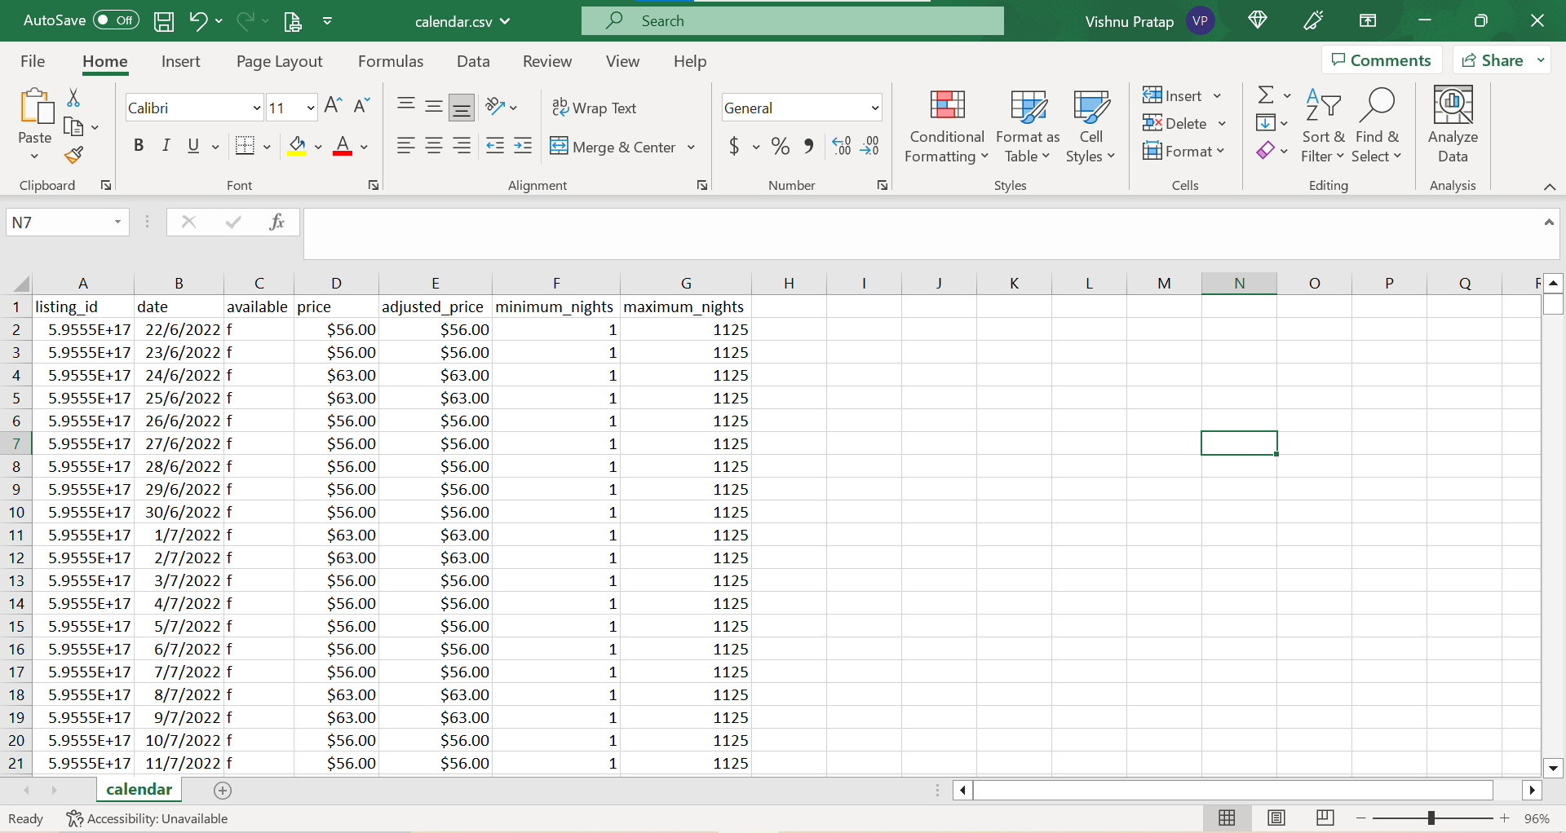

Slide 12
Architecture of the Solution + Tools used

Slide 13
Architecture of the Solution
Extract
Reading tables stored in Databricks.
Transform
Transforming data using SparkSQL & Pyspark
Load
Load data into PowerBI for visualization & analysis

Slide 14
Extract - Extract raw data from sources and load it to the Databricks
Transform - Clean the data received using Pyspark & SparkSQl.
Transformations performed on the data are:
Identify and remove missing values
Remove duplicate rows
Remove outlier data
Remove inconsistent data
Load - Load the transformed data to perform data analysis and visualizations using PowerBI

Slide 15
Tools Used
Azure DataBricks
PowerBI
Pyspark
SparkSQL
Languages Used

Slide 16
Data Insights

Slide 17
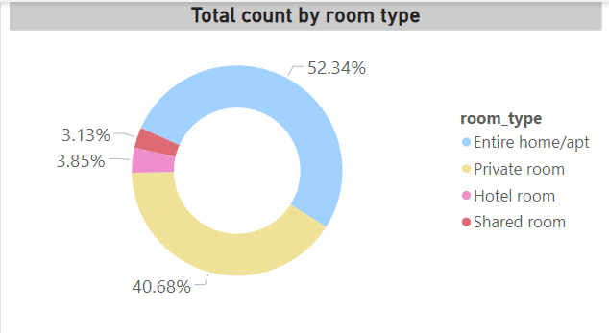
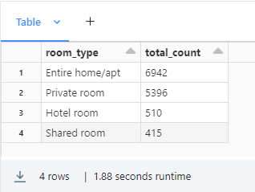
What are the various types of rooms available? Which room type is popular?
The popular choice of accommodation is ‘Entire home/apt’ with 6942(52.34%) listings and is closely followed by ‘Private room’ with 5396(40.68%) listings.

Slide 18
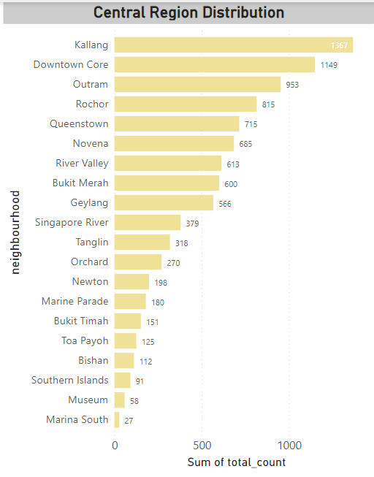
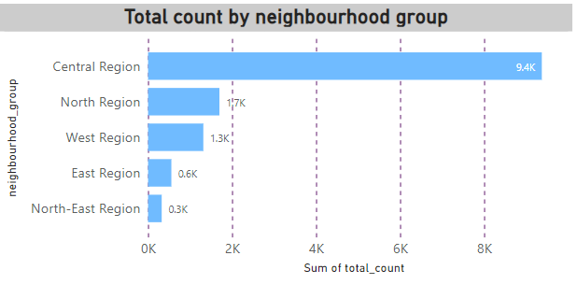
Which neighbourhood is the preferred choice of accommodation? Central Region is the preferred choice of accommodation

Slide 19
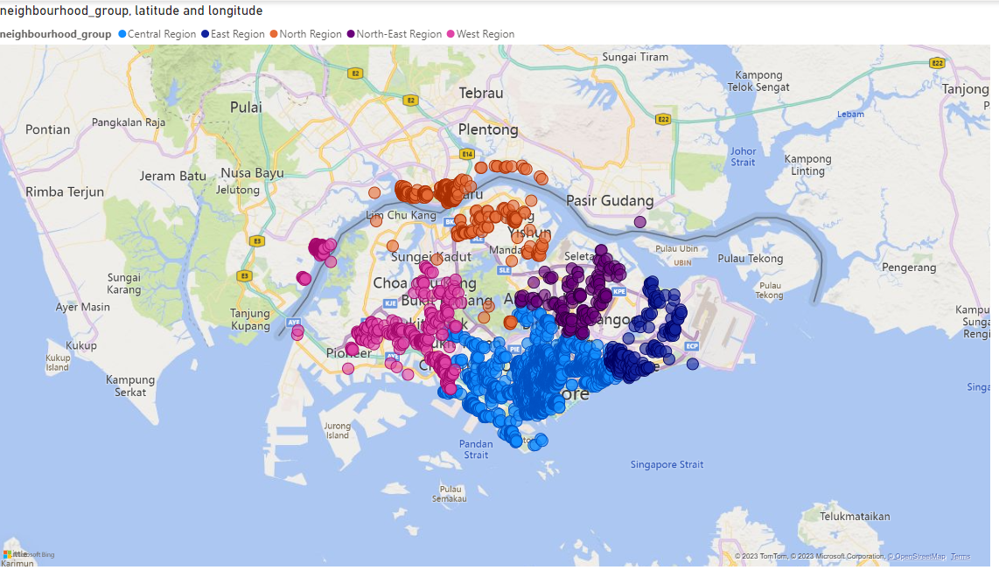
What to infer from the map?
Central Region emerges the clear winner here with a total count of 9372 listings in the area. This could be due to the proximity to the city center.
Moreover, in Singapore, Airbnb doesn't cater to normal tourists as it is illegal, but they are legal to be rent out with a minimum rental period of 3 months
Since Central Region is the preferred area of choice, it most likely seems to be catering to business employees who are here for short-term work commitments.
From the map, we can notice clusters near Industrial Parks such as CBD area, Changi Business Park, Seletar Aerospace Park, Tuas Medical Park etc.

Slide 20
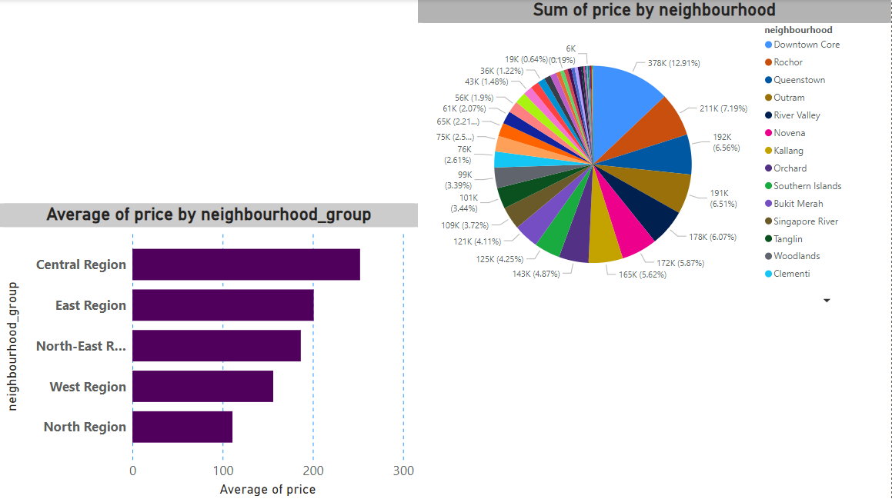
What is the average price by neighbourhood?

Slide 21
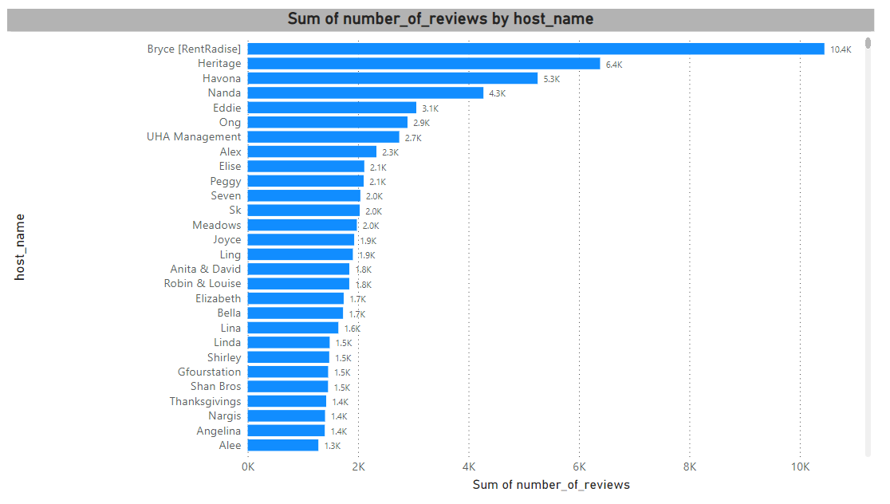
Host with most number of reviews

Slide 22
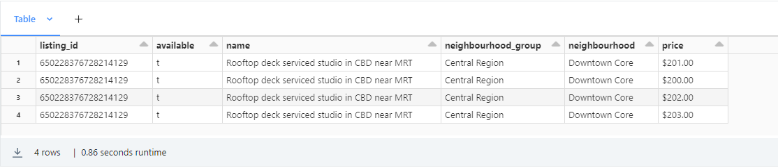
Find out any listing of 'Rooftop' and 'near MRT' which are available

Slide 23
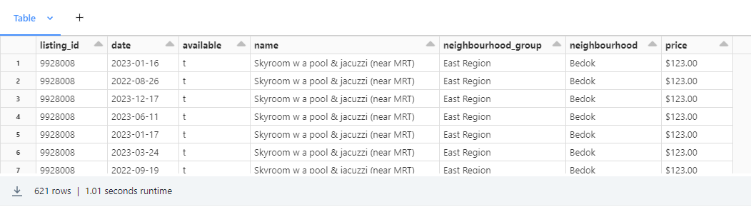
Find out any listing of 'pool' and 'near MRT' which are available. List the dates of availability

Slide 24
Thank You!

