Slide 1
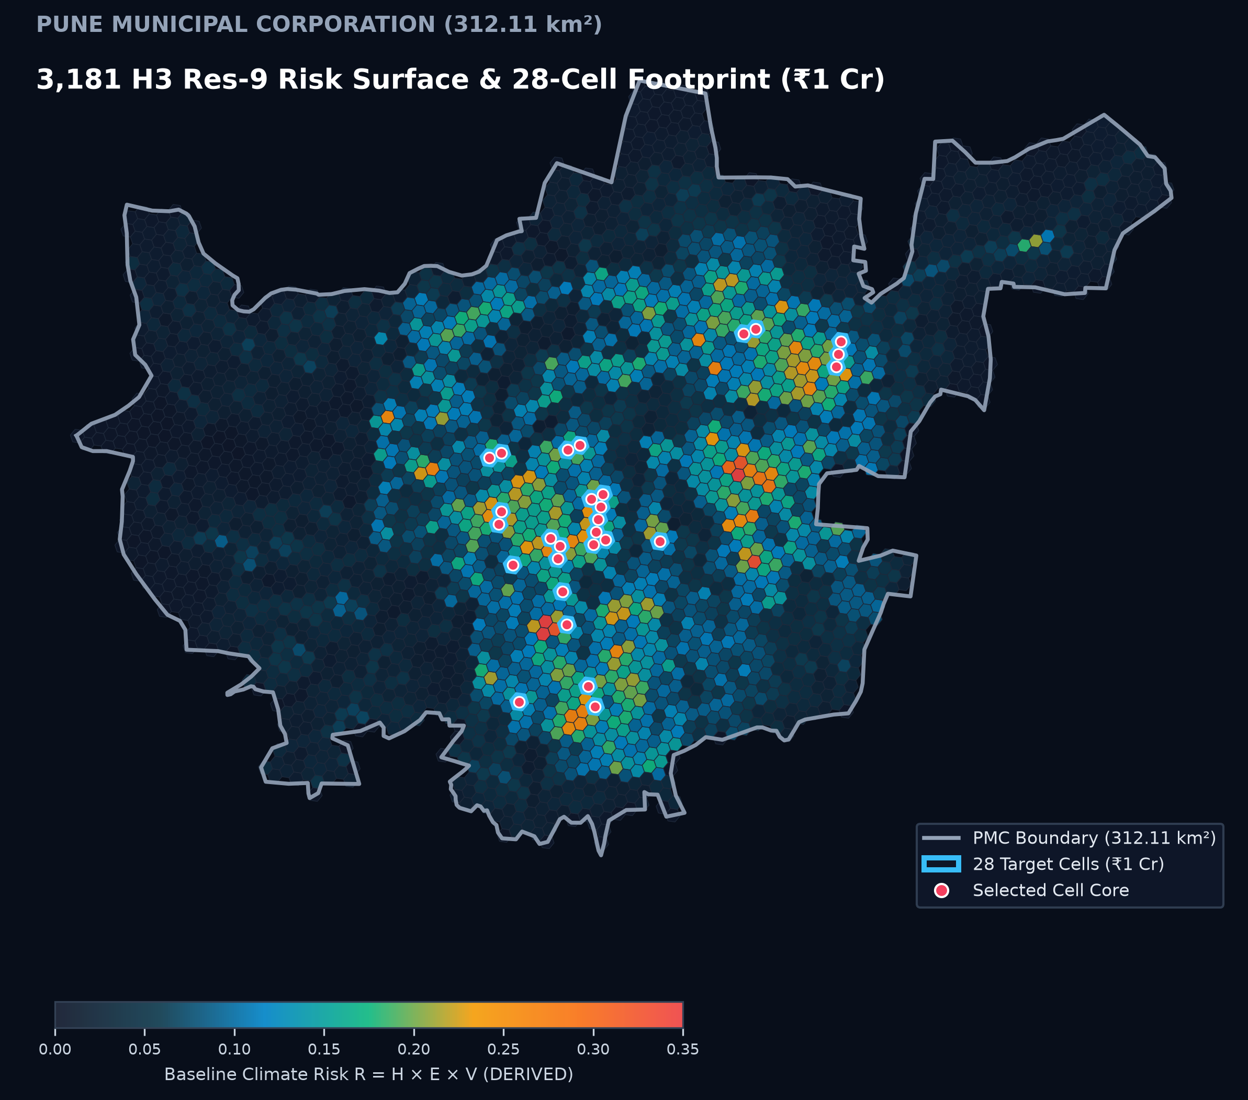
NOVEX 2026 · ROUND 2 PITCH DECK · URBAN CLIMATE RESILIENCE
CLIMORA — a decision layer for urban heat risk.
Where should ₹1 crore go to cut heat-exposure risk in Pune?
DERIVED
MODELED
MODELED
3,181 Cells
PMC Grid Mesh (Res-9)
28 Cells
Selected for Allocation
₹1 Crore
Canonical Budget Preset
CORE THESIS & DEMONSTRATION
Static heat maps detect anomalies but cannot allocate capital. CLIMORA couples Earth Observation with mathematical optimisation to generate auditable, cost-optimal cooling interventions.
PROJECT TEAM (VIT PUNE)
Sujay Korde · Kimaya Kolhe
UG CSE-AIML, Vishwakarma Institute of Technology (VIT Pune)
Study Area: Pune Municipal Corporation (PMC) Boundary 312.11 km² · 5,011,229 residents
PMC Boundary: 3,181 H3 cells with 28 canonical cells ringed in coral [DERIVED / MODELED]

Slide 2
THE URBAN HEAT CRISIS · SYSTEMIC FRAGMENTATION
Climate action is fragmented. Climate risk is not.
Three critical stakeholder groups face deep friction due to the absence of a shared mathematical decision layer.
PLANNING DEFICIT
CITIES & PLANNERS
Face severe thermal anomalies across disparate wards, but lack granular spatial optimization to prioritize capital where exposure is highest.
CAPITAL ALLOCATION
FUNDERS & CAPITAL
Deploy climate finance without empirical spatial benchmarks, unable to verify whether funding targets the densest vulnerable populations.
EXECUTION BOTTLENECK
FIELD IMPLEMENTERS
Implement nature-based cooling interventions without microclimatic baselines, audit trails, or enforceable deployment governance.
The Missing Decision Layer: How do municipal leaders translate citywide satellite heat maps into auditable, cost-optimal project portfolios?
Pune Fact Line: Pune: 5.0M residents, 312 km², 3,181 analysis cells. [DERIVED · WorldPop 2020 & Uber H3 Res-9]

Slide 3
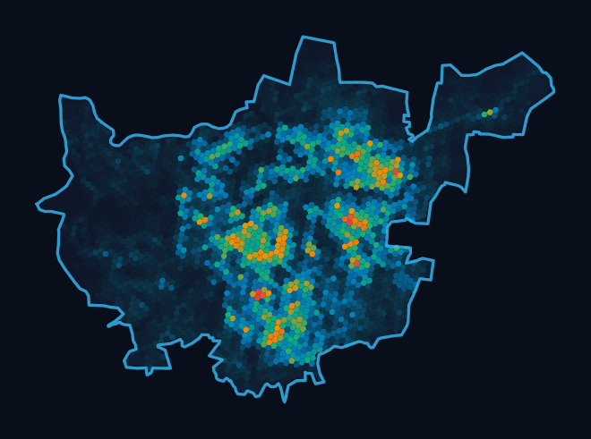
STRUCTURAL DEFICIT · DECISION INTELLIGENCE
Bridging the gap from detection to allocation.
Satellite heat maps observe thermal anomalies. They cannot decide which specific street gets trees or which roof gets coated.
NOT ANOTHER HEAT MAP
TODAY'S STATUS QUO: OBSERVATION WITHOUT ALLOCATION
Raw Satellite Rasters
Landsat 8/9 & Sentinel-2 surface temperature imagery
Heat Map
Displays redness across 300+ sq km
? Where, what, how much?
Missing decision logic: no budgets, costs, or targets
Ad-Hoc Capital Spend
Interventions deployed without microclimate models
THE CLIMORA DECISION LAYER: CONTINUOUS OPTIMIZED ALLOCATION
Harmonized Lineage
Landsat 8/9 + WorldPop + OSM into H3 Res-9 grid [DERIVED]
IPCC AR6 Risk Topology
Risk = Hazard x Exposure x Vulnerability + Moran's I [DERIVED]
HiGHS MILP Optimizer
Solves budget constraints across 5 candidate interventions [MODELED]
Governed Rollout & MRV
Amazon Cedar authorization + Difference-in-Differences [BUILT / PLANNED]
Core Thesis: Observation is not allocation. Satellite sensors detect heat; CLIMORA provides the mathematical optimization layer.

Slide 4
END-TO-END WORKFLOW · CORE VALUE PROPOSITION
Four disciplined moves from vulnerability to action.
A unified lifecycle bridging Earth Observation, mathematical allocation, and statutory municipal governance.
BUILT
DERIVED
BUILT
MODELED
PARTLY BUILT
MODELED
PLANNED
PLANNED
1. IDENTIFY
• Granular H3 Mesh: 3,181 H3 Res-9 cells (~0.0986 km² each) across 312.11 km² PMC boundary.
• IPCC AR6 Risk: Risk = Hazard × Exposure × Vulnerability with zero-exposure axiom; Moran's I & LISA hotspots.
2. OPTIMISE
• HiGHS MILP Engine: Evaluates 5 candidate cooling interventions per cell under physical capacity limits.
• Optimal Allocation: Presets solved to within a 5% optimality gap per rupee of heat-exposure reduction.
3. ACTIVATE
• Project Cards: Auditable project cards (e.g. PROJ-PUNE-2025-BA225D6A) with transparent cost breakdowns.
• Cedar Governance: Server-side authorization: 5 personas, 7 ratified policies [BUILT]. Funder portal is CONCEPT.
4. MEASURE
• In-Situ Loggers: Calibrated canopy-height sensors measure true ambient air temperature reduction across April–May.
• Matched DiD Design: Pairs treated cells with untreated controls to evaluate multi-season empirical cooling.
From 'this area is vulnerable' to 'this is the project that should happen here.'

Slide 5
ANALYTICAL LINEAGE · ARCHITECTURAL TRANSPARENCY
A transparent, deterministic analytical lineage.
Every analytical step is deterministic, auditable, and traceable to canonical Earth Observation and demographic datasets.
OBSERVED
DERIVED
DERIVED
MODELED
MODELED
MODELED
1. Data Ingestion
• Landsat 8/9 C2 L2
• WorldPop 2020
• OpenStreetMap
• NASA POWER daily
• Copernicus DEM
2. Spatial Features
• LST skin temp
• NDVI vegetation
• NDBI built-up
• Road network
• Population count
3. Risk Engine
• IPCC AR6: H × E × V
• Zero-exposure axiom
• Moran's I & LISA
• DETERMINISTIC
• AUDITABLE LOGIC
4. Interventions
• 5 interventions
• Trees, cool roofs
• Corridors, swales
• Permeable surface
• MODELED ASSUMPT.
5. Decision Engine
• HiGHS MILP solver
• Budget-constrained
• Cell capacity limits
• Solved to 5% gap
• Monotonic presets
6. Action Plan
• Ranked presets
• PROJ-PUNE-2025
• Amazon Cedar auth
• 5 verified roles
• Auditable trail
CRITICAL DESIGN RATIONALE: WHY NO BLACK-BOX ML?
No neighbourhood-level heat-health labels exist for Pune, so a trained risk model would fake precision. CLIMORA is transparent and auditable; ML enters where ground truth exists (planned: estimating the cooling response).
Honest AI Claim: AI here = geospatial analytics + mathematical optimisation for allocation. Machine-learning validation is planned.

Slide 6
CANONICAL STUDY · PMC MUNICIPAL INITIATIVE
Canonical validation on Pune Municipal Corporation.
Testing the complete pipeline across Pune Municipal Corporation boundary: 312.11 km² and 5,011,229 residents.
3,181 Cells Analysed
Uber H3 Resolution-9 (~0.0986 km² each) tessellation covering the entire 312.11 km² PMC boundary.
DERIVED
28 Cells Selected
0.88% of the city's area (2.76 km²) prioritized by HiGHS MILP under the ₹1 crore canonical budget.
MODELED
118,941 Residents in Treated Cells
2.37% of Pune population (5,011,229 residents). Living inside treated cells; NOT a health-benefit claim.
DERIVED
Targets Dense Cores by Design
Selected cells average ~4,200 residents vs ~1,575 citywide mean. Targets dense, high-exposure cores.
DERIVED
Modeled Cooling Impact
Mean ~0.07 °C, max ~0.17 °C (small by design). Not satellite-detectable; microclimatic canopy assumption.
MODELED

Slide 7
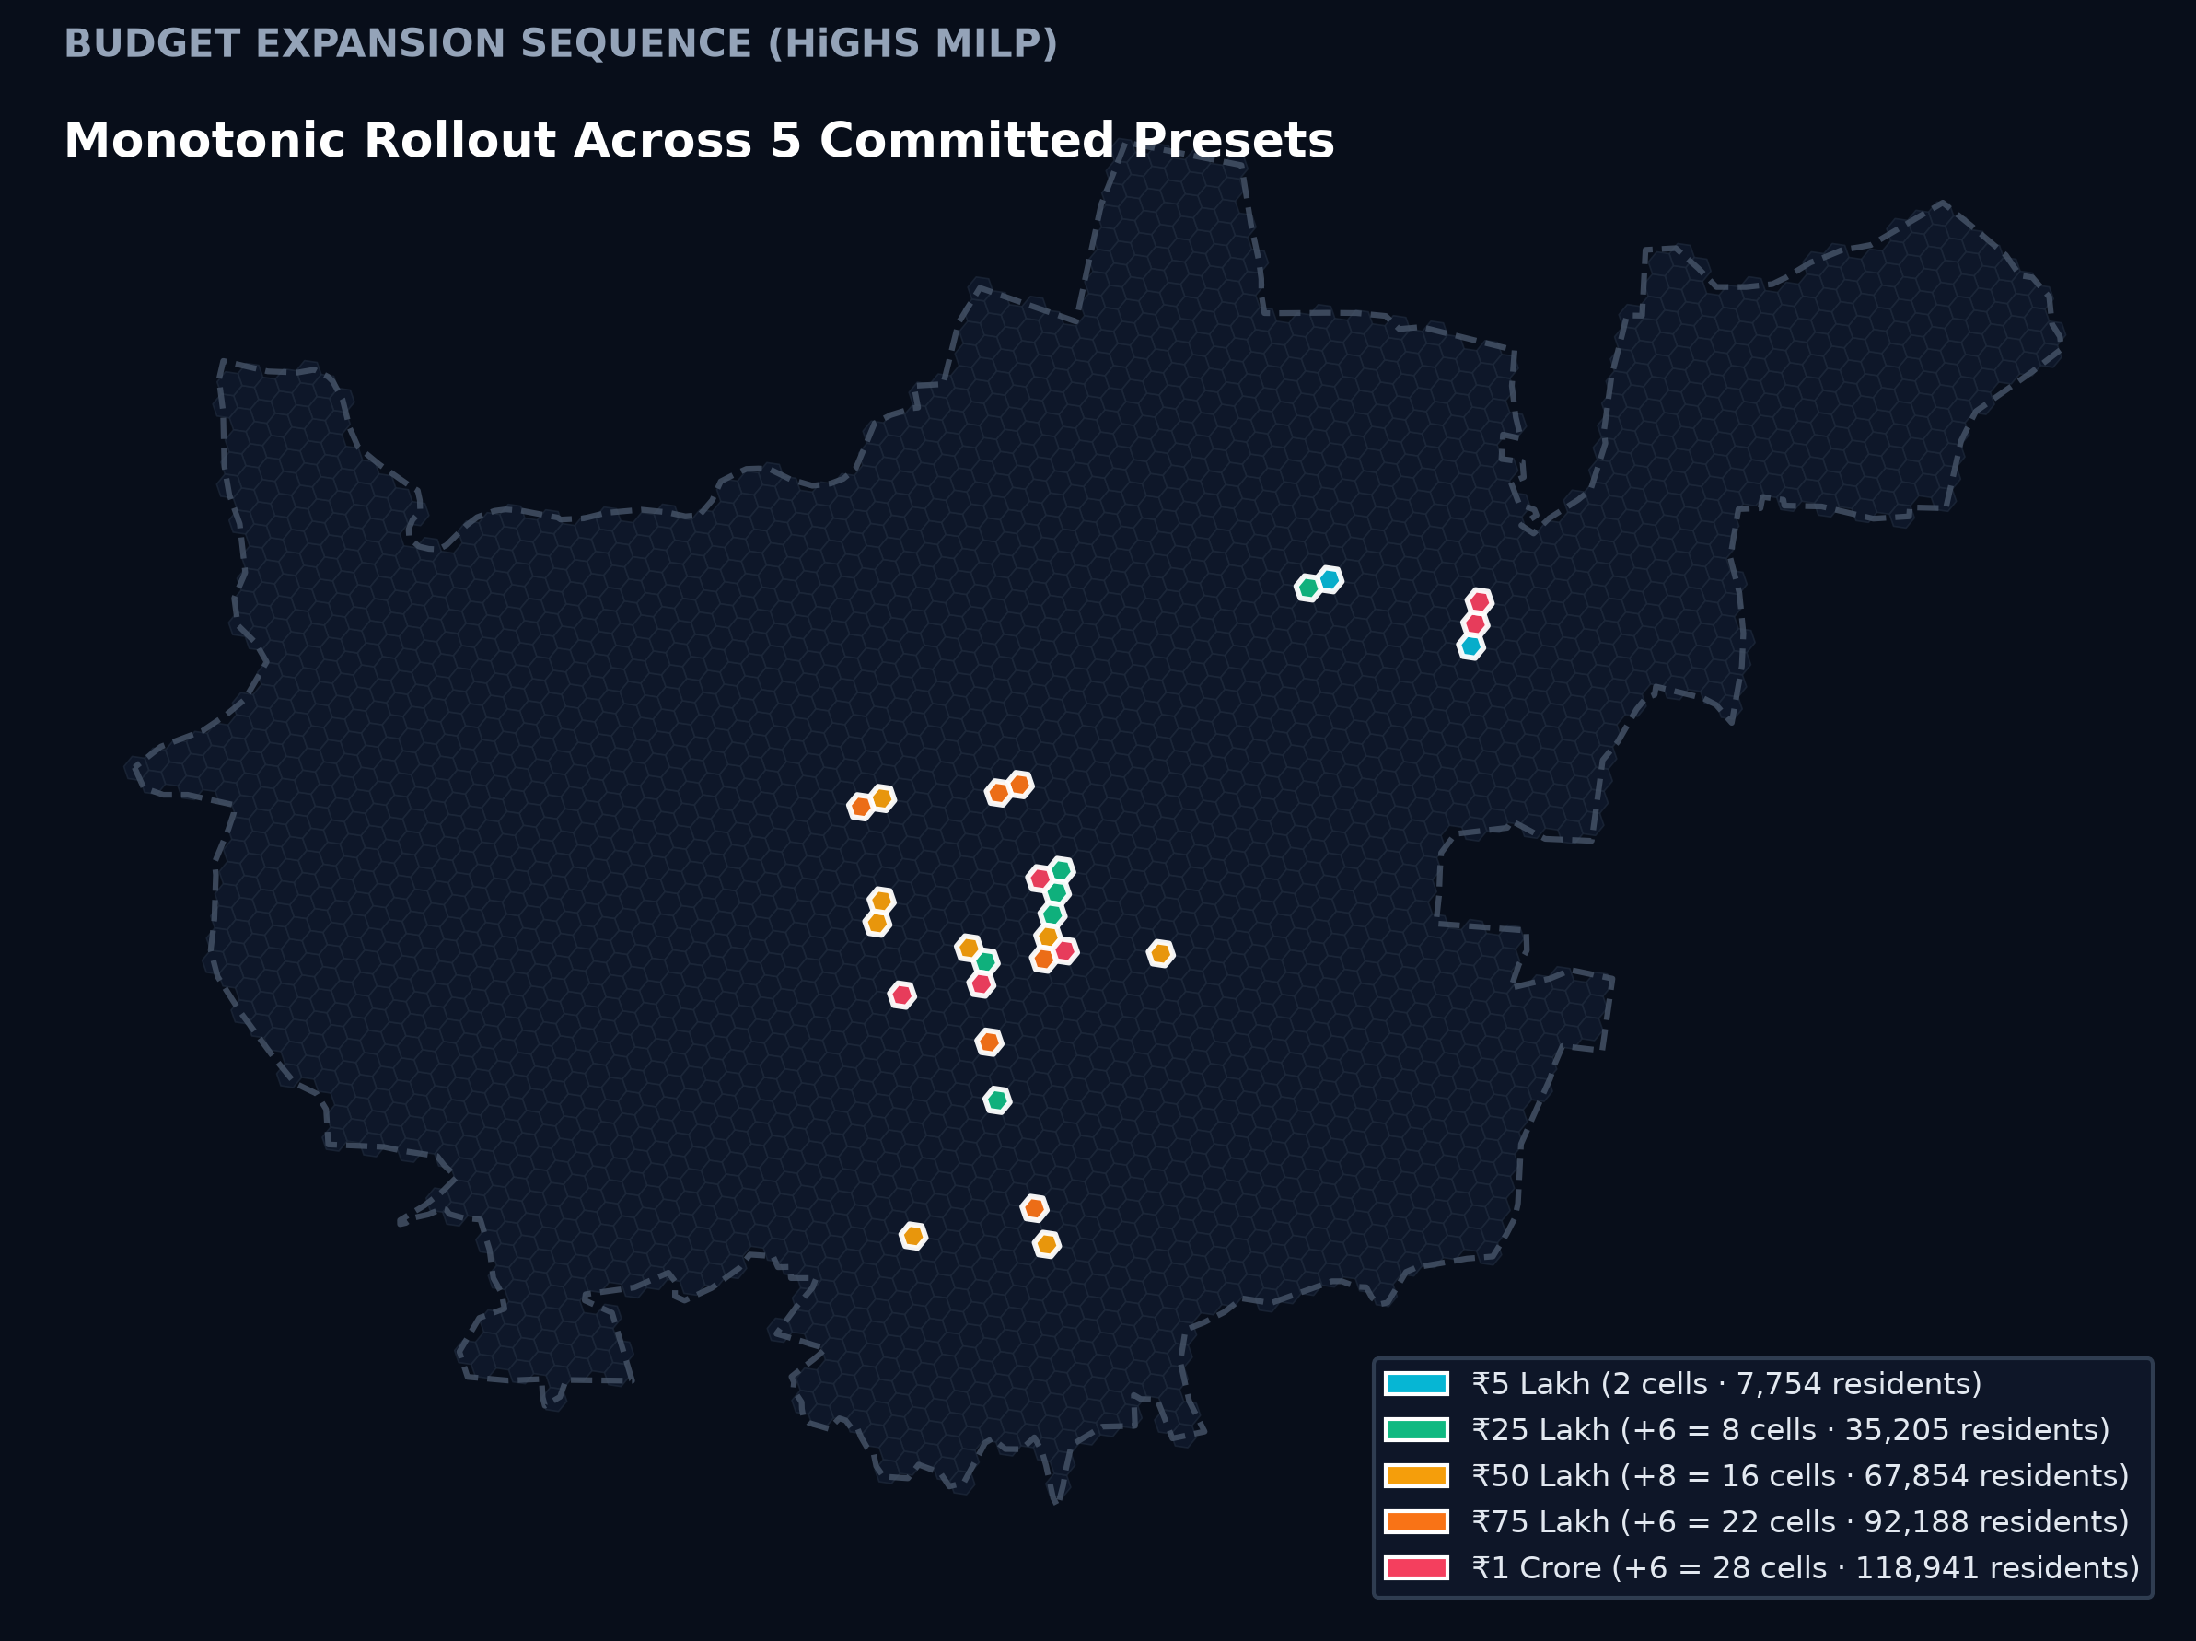
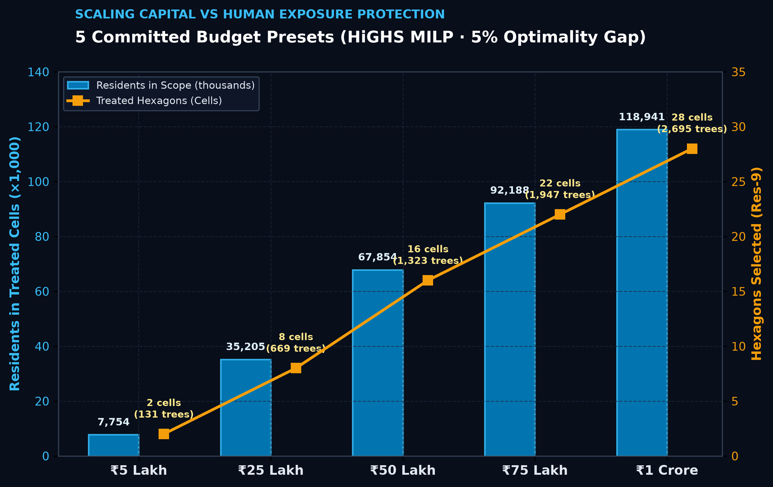
BUDGET ALLOCATION · HIGHS MIXED-INTEGER LINEAR PROGRAMME
More budget extends a ranked rollout.
Five committed presets solved to within a 5% optimality gap. Each tier strictly preserves all previous cells.
₹1 CRORE PRESET
Canonical Project Profile
Budget: ₹1 Crore (₹10,000,000)
Allocated: ₹99,92,500 (₹7,500 slack)
Treated: 28 cells (0.88% PMC area)
Trees: 2,695 trees planted
Residents: 118,941 in scope (2.37%)
Optimality: < 5% gap (HiGHS MILP)
Status: MODELED ASSUMPTIONS
Footnote: 5 interventions were evaluated in every cell; under current assumed costs and cooling inputs, street trees rank highest per rupee at every budget up to ₹1 crore. Solved within a 5% optimality gap. Inputs are engineering assumptions awaiting calibration.
Bottom Line: CLIMORA shows the trade-off and the order of action, not a single magic intervention.

Slide 8
APPLICATION SECURITY · CRYPTOGRAPHIC AUTHORIZATION
Cryptographic governance and accountable execution.
Amazon Cedar enforces deterministic authorization. Unauthorised actions are rejected and change nothing.
AMAZON CEDAR POLICY STORE
Who May Do What (5 Personas)
• Municipal Commissioner: Statutory financial sanction & approval (approve_project)
• Urban Planner: Proposes revisions & budget reallocations (propose_revision)
• Field Contractor: Records planting coordinates & batch logs (record_implementation)
• Independent Auditor: Certifies thermal impact & signs MRV audit (verify_impact)
• Citizen Viewer: Read-only transparent audit of all projects (view_project)
Unauthorised actions are rejected and change nothing. Demo identity is simulated. (7 ratified policies · 22 automated governance tests) [BUILT]
MODELED
CONCEPT
CANONICAL PROJECT CARD
PROJ-PUNE-2025-BA225D6A
Target Cell ID: 89608850003ffff (H3 Res-9)
Intervention: Street-Tree Shade Canopy
Physical Quantity: 76 Trees in Cell
Cell Total Cost: ₹2,86,000 (₹20k mob + ₹3.5k/tree)
Population in Cell: 4,757 residents [DERIVED]
Baseline Risk R_i: 0.2222 (Hazard: 0.81, Exp: 0.92)
Modeled Cooling: 0.0543 °C (~0.05 °C) [MODELED]
Lifecycle State: PROPOSED (Awaiting Sanction)
MATCHING WORKFLOW
Funder & NGO Portal
Concept — not built.
• Funder 'Express Interest': Institutional ESG capital matching against verified project cells.
• NGO Evidence Upload: Civil society partners upload ground photos and tree health logs.
• Public Audit Escrow: Automated smart disbursement conditioned on independent MRV verification.
AWS Infrastructure: Amplify (frontend), ECS Fargate (API), S3 (data lake, public access blocked), Cedar (authorisation). Services paused to control cost.

Slide 9
EMPIRICAL MRV PROTOCOL · MICROCLIMATE VERIFICATION
Don't stop at funding. Plan to measure.
True impact cannot be declared at deployment. It requires multi-season empirical logging and quasi-experimental evaluation.
PLANNED · NOT BUILT
MANDATORY SCIENTIFIC REALISM & HONEST CLAIM:
Modeled cooling is small (~0.07 °C per treated cell), below satellite detection, so on-the-ground measurement is required. No impact is claimed until observed.
1. In-Situ Microclimatic Loggers
• Sensor Deployment: Calibrated temperature and relative humidity data loggers installed at pedestrian canopy height inside treated H3 cells.
• Pre-Monsoon Window: Continuous logging across April–May peak summer period to directly record pedestrian thermal relief.
• Physical Air Relief: Measures true ambient air temperature reduction rather than satellite surface skin temperature.
2. Matched Control Hexagons
• Quasi-Experimental Design: Each treated H3 cell is paired with an untreated control cell sharing identical baseline LST and built-up density.
• Isolating Synoptic Shocks: Guarantees that regional heatwaves and synoptic weather variations affect both cells equally.
• Statistical Integrity: Prevents false claims where citywide weather shifts could be misattributed to project interventions.
3. Difference-in-Differences (DiD)
• Multi-Season Lineage: Compares baseline pre-monsoon (April 2026) vs post-intervention monitoring window (April 2027).
• Statistical Estimation: Computes true treatment effect: (Treated_post - Treated_pre) - (Control_post - Control_pre).
• Uncertainty Reporting: Reports standard errors and confidence intervals; satellite check provides secondary context.
Audit Standard: Strict compliance with IPCC AR6 & ISO 14064-2. No unverified thermal cooling claims permitted.

Slide 10
ENGINEERING INTEGRITY · TECHNICAL AUDIT & ROADMAP
Engineering integrity: separating reality from roadmap.
Clear distinction between operational, tested repository code and planned future architectures.
OPERATIONAL & TESTED IN REPO
Built Production Components
✔ Pune Risk Pipeline (3,181 cells): IPCC AR6 Risk = H × E × V, 5-yr Landsat composite (2021–2025), Moran's I & LISA [DERIVED].
✔ HiGHS Budget Optimiser: 5 committed preset scenarios (₹5L to ₹1 Cr); 5 interventions; 5% optimality gap [MODELED].
✔ Amazon Cedar Governance: 7 ratified policies; 5 demo personas; server authorization; zero mutation on deny [BUILT].
✔ AWS Cloud Architecture: Amplify frontend, ECS Fargate backend API, S3 data lake (services paused for cost) [BUILT].
✔ Automated Test Discipline: 188 backend tests + 25 frontend tests + 22 Cedar governance tests [BUILT].
BUILT
ROADMAP & CONCEPT ARCHITECTURES
Planned & Concept Modules
⏳ Empirical MRV Execution: In-situ sensor deployment and statistical Difference-in-Differences analysis on ground temperature.
⏳ Funder & NGO Matching Portal: Institutional ESG capital matching and contractor bidding marketplace (CONCEPT).
⏳ ML-Based Cooling Calibration: Machine-learning models to calibrate physics cooling curves against real-world observations.
⏳ Ward-Level Reporting: Hierarchical aggregation from H3 hexagons to statutory municipal administrative wards.
⏳ Community Evidence Upload: Citizen and NGO photo uploads for tree survival verification and maintenance auditing.
PLANNED
EVIDENCE BADGES: [OBSERVED] Direct sensor readings (Landsat LST, weather) [DERIVED] Deterministic math (H×E×V, population) [MODELED] Optimization/simulation outputs (HiGHS, 0.07°C) [PLANNED] Architectures awaiting ground truth data

Slide 11
CLIMORA · NOVEX 2026 ROUND 2
Risk is everywhere. Capital isn't.
A transparent, governed decision layer for urban climate resilience.
CORE DECISION THESIS
Data estimates where · Optimisation decides what · Measurement will test if.
CLIMORA transforms fragmented municipal heat spending into governed, mathematically defensible climate investments.
Ground truth satellite data informs where exposure concentrates. Mathematical optimization allocates capital with zero guesswork. Empirical sensors verify every rupee of microclimatic cooling.
PROJECT & INSTITUTION METADATA
Project: CLIMORA (Novex 2026, Round 2)
Scope: Pune Municipal Corporation (PMC 312.11 km²)
Project Authors:
• Sujay Korde
• Kimaya Kolhe
Institution: Vishwakarma Institute of Technology (VIT Pune)
Department: UG CSE-AIML
Core Pipeline:
Earth Observation · HiGHS MILP · Amazon Cedar Governance
HONEST AI COMMITMENT
AI here = geospatial analytics + mathematical optimisation for allocation. Machine-learning validation is planned.

