Slide 1


RAPID Internship 2024
Cryptocurrency Price Prediction Using Various Machine Learning models including Ensemble Method and Sentiment Analysis
Name: Sujay S C, Suhas V, Suraj R
Department: Computer Science
Campus: RR Campus

Slide 2

The Dynamic World of Cryptocurrencies
Introduction to Cryptocurrencies: Cryptocurrencies are digital or virtual
currencies that use cryptography for security. Bitcoin, Ethereum, and other cryptocurrencies have gained significant attention and value in the financial markets.
Market Significance: The cryptocurrency market has grown exponentially, attracting investors, traders, and financial analysts worldwide. The market is known for its high volatility, which presents both opportunities and risks.
Key Characteristics: Cryptocurrencies are decentralized, operate on blockchain technology, and offer global trading opportunities. Their prices are influenced by various factors, including market demand, regulatory news, and social media trends.

Slide 3

Existing Methods and Research Gap
Traditional Financial Models: Traditional models, such as ARIMA, often struggle to accurately predict cryptocurrency prices due to their inability to capture non-linear patterns and high volatility.
Machine Learning Models: Recent advancements in machine learning (ML) have shown promise in predicting financial markets. However, many ML models still fail to incorporate market sentiment, which is a significant driver of cryptocurrency prices.
Research Gap: There is a need for an integrated approach that combines advanced ML models with sentiment analysis to improve prediction accuracy. This project aims to address this gap by developing and evaluating a comprehensive and accurate prediction model.

Slide 4
Problem Statement and Research Objective
Empowering Cryptocurrency Price Prediction through Advanced Models And Sentiment Analysis
Problem Statement: The volatile nature of cryptocurrency prices makes accurate prediction challenging. Traditional financial models and even some advanced ML models fail to capture the complexity and sentiment-driven nature of the market.
Research Objectives: Develop Integrated Models: To create an integrated prediction model that explores various ML algorithms (ANN, LSTM, GRU, GBM, Random Forest) and twitter sentiment analysis.
Evaluate and Compare: To evaluate the performance of individual models and compare them to the ensemble method. Improve Prediction Accuracy: To use an ensemble method to combine the results of different models and achieve better prediction accuracy. Explore the use of sentiment analysis to increase accuracy.

Slide 5
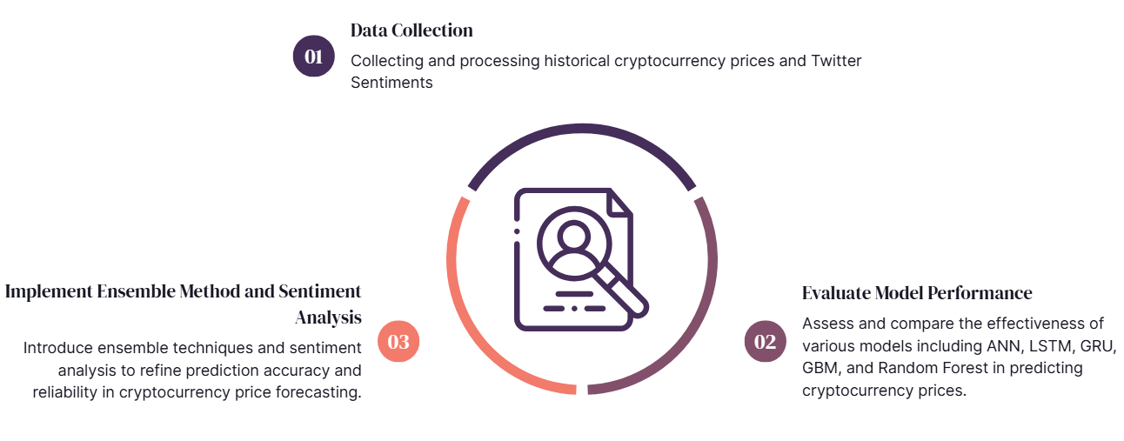
Problem Statement and Research Objective

Slide 6
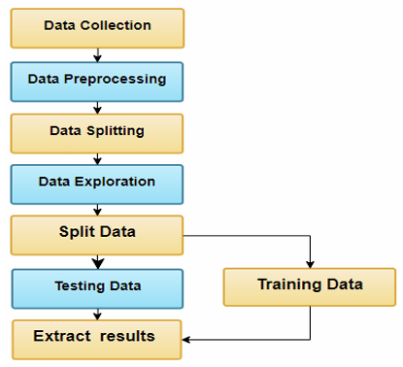
Experimental methodology
Data Collection: The historical price data for Bitcoin was collected from Yahoo Finance.
Bitcoin Tweets dataset and Twitter API
Data Preprocessing: Sentiment scores of tweets calculated using VADER and BERT sentiment analysis tools. Normalization of input data using MinMaxScaler.
Combining Price and Sentiment Data: The price and sentiment data were merged to create a unified dataset

Slide 7
Experimental methodology
Model Development
Evaluation Metrics
Artificial Neural Network (ANN): Captures non-linear relationships. Uses multiple dense layers with ReLU activation.
Long Short-Term Memory (LSTM): Models long-term dependencies in time series data.
Gated Recurrent Unit (GRU): A simpler and computationally efficient alternative to LSTM.
Random Forest Model: Random Forest is an ensemble learning method that constructs multiple decision trees during training and outputs the average prediction of individual trees
Gradient Boosting Machine (GBM) / XGBoost: Handles non-linearities and feature interactions effectively.
Random Forest: Uses an ensemble of decision trees to improve predictive performance.
LSTM-GRU Ensemble Method with and without Twitter Sentiment Analysis: Combines predictions from all models using a weighted average approach for better accuracy.
Root Mean Squared Error (RMSE): This metric measures the standard deviation of the residuals (prediction errors). It provides a measure of how well the model's predictions match the actual values.
Mean Absolute Percentage Error (MAPE): This metric measures the accuracy of the model's predictions as a percentage. It provides a normalized measure of prediction accuracy, allowing for comparison across different scales.
Comparison and Visualization: The performance of the models was compared using RMSE and MAPE. Visualizations, including plots of the actual vs. predicted prices, were used to illustrate the models' performance.

Slide 8
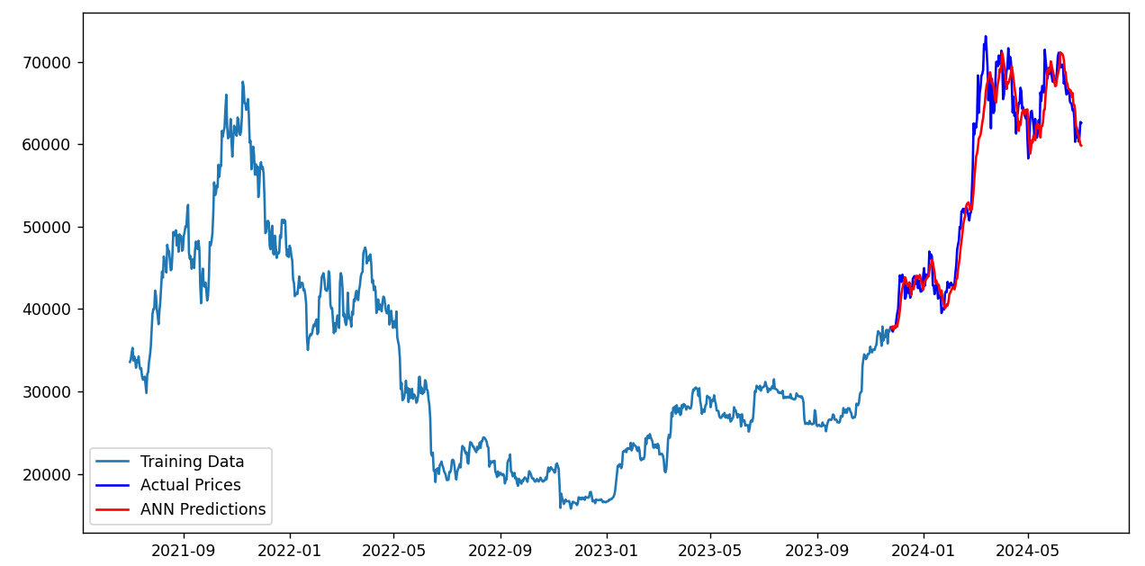
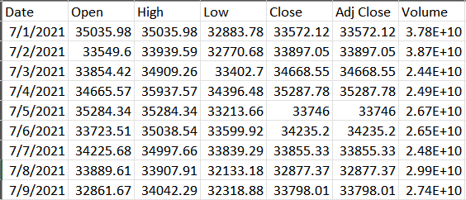
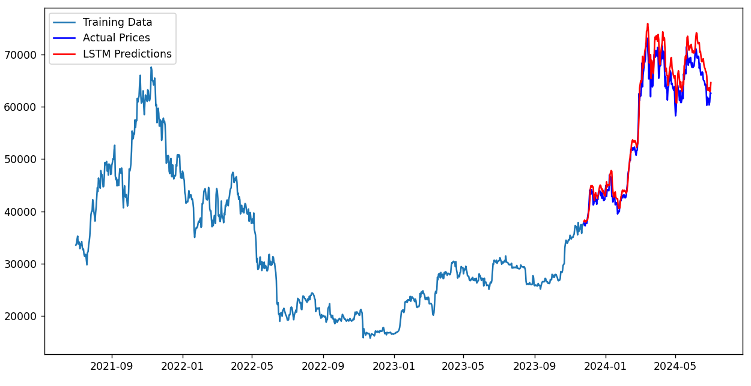
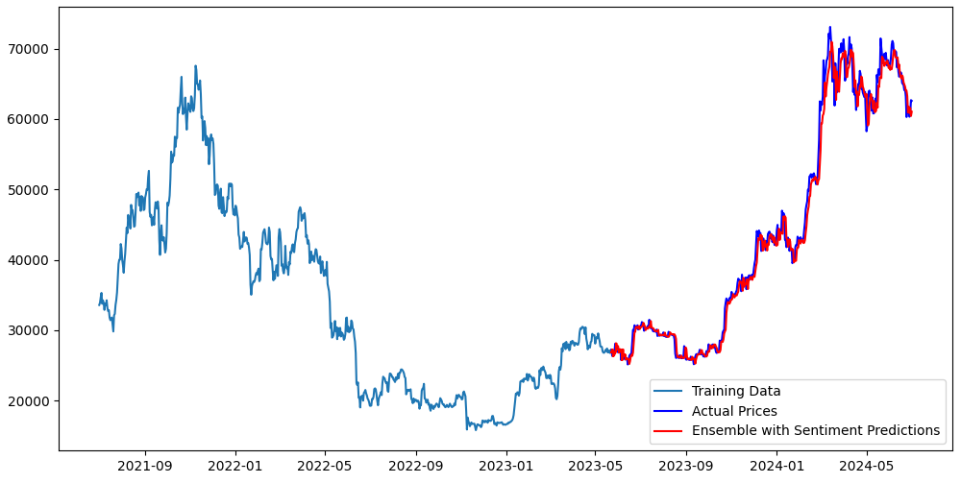
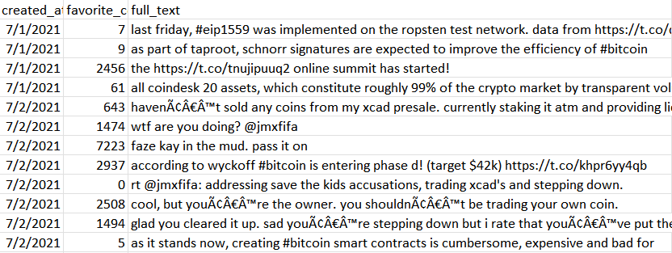
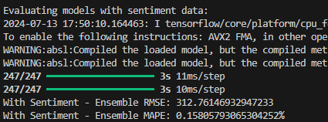
Working Prototype of the Problem
Bitcoin Historical Prices Dataset
Training vs Test vs Predictions
Bitcoin Tweets Dataset
Evaluation Metrics

Slide 9
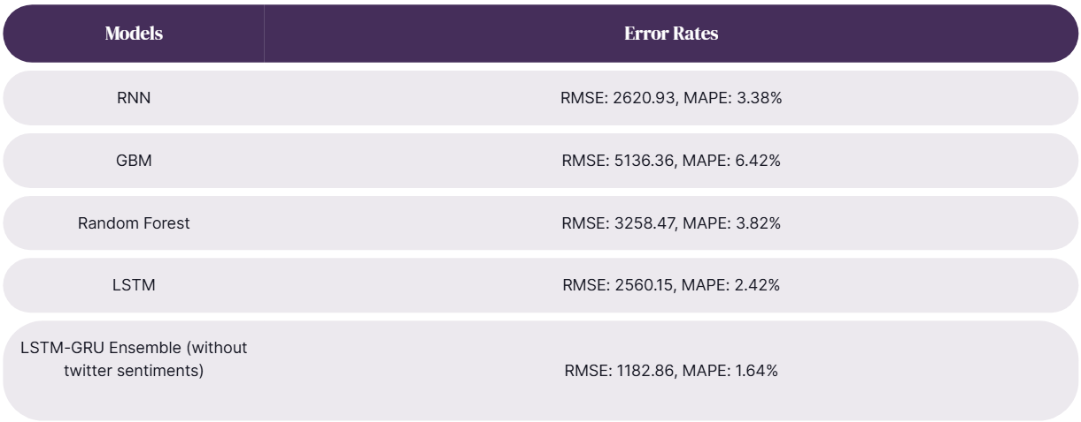

Experimental Results
*Evaluation metrics for predicted bitcoin prices

Slide 10
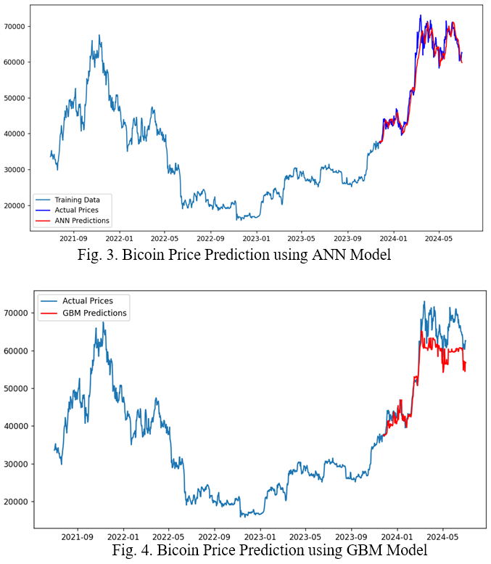
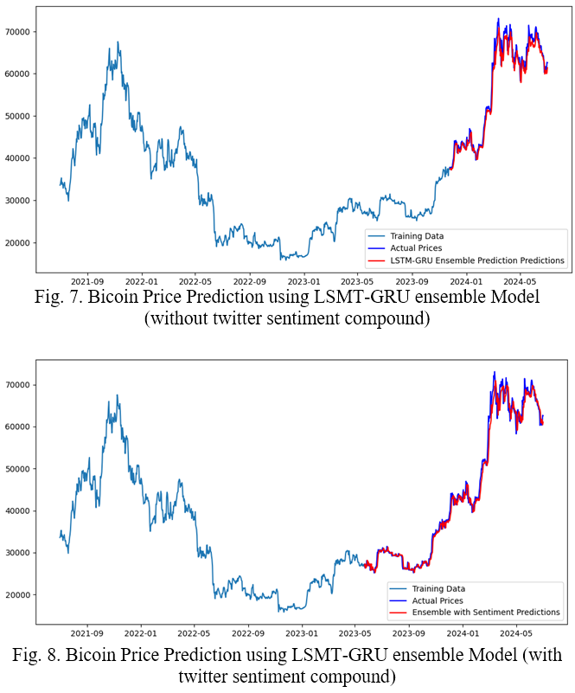
Experimental Results

Slide 11
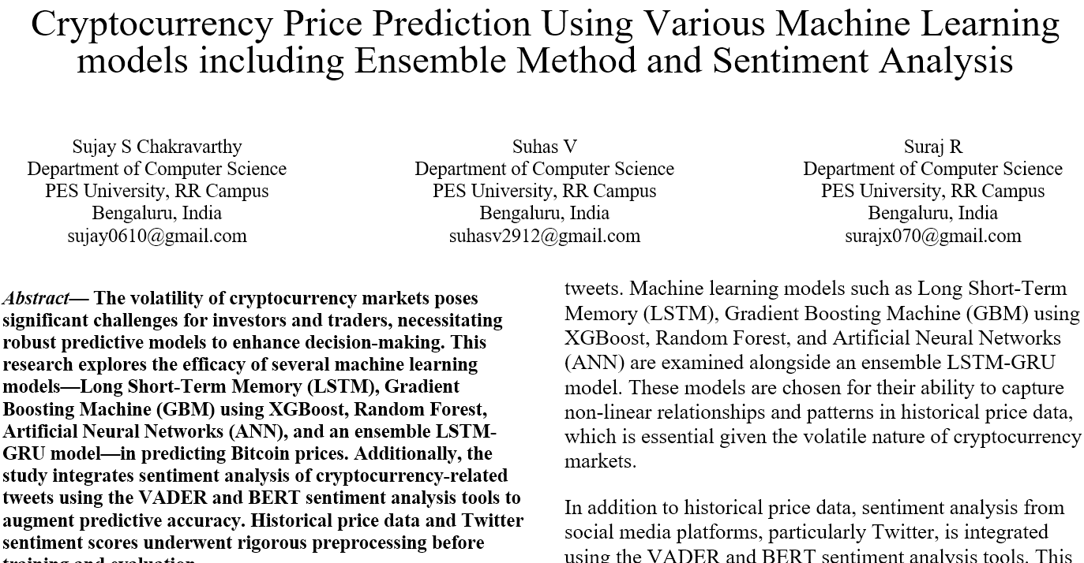
Draft Paper Publications

Slide 12
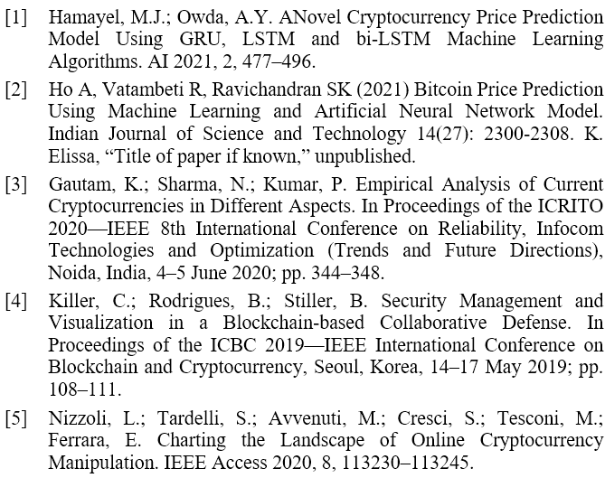
References

Slide 13
THANK YOU

