Slide 1
ML Project
Sujay gad
Mayur Baggan
Jnanesh D

Slide 2
Project details-
The 2 main models implemented are KNN and decision tree.
We replaced the ‘?’ present with the nearest integer to the mean value of that column.
Using PCA we performed dimensionality reduction by removing one column present in the dataset.
We also added random noise into the dataset to check the performance as the original dataset included only 699 rows.

Slide 3

Dimensionality reduction-
Using PCA we observe that 99% percent of variance in the dataset is explained by 8 of the 9 columns.
Using covariance matrix we observe that correlation is high between the 2 columns - uniformity of cell size and uniformity of cell shape.
Hence we drop uniformity of cell size column to generate a new dataset.

Slide 4
KNN
We have implemented KNN using 3 different distance measures Euclidean distance,manhattan distance and cosine similarity.
For each of the distance measure we have compared the performance of original dataset,dataset after dimensionality reduction as well as dataset after adding random noise.

Slide 5
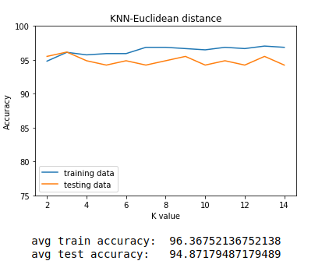
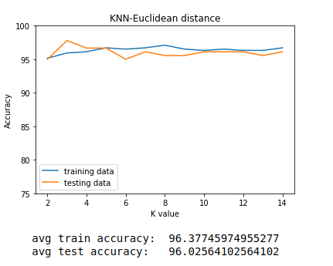
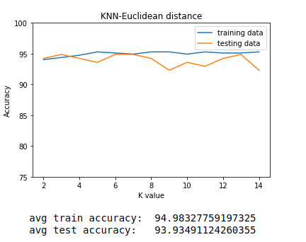
KNN using Euclidean distance
Original dataset Removed column dataset Noise added dataset
All the 3 models perform very well however the accuracy decreases slightly when random noise is added to the dataset.

Slide 6
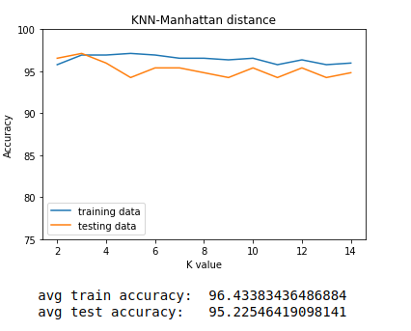
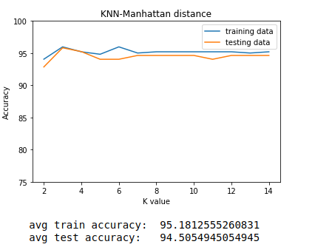
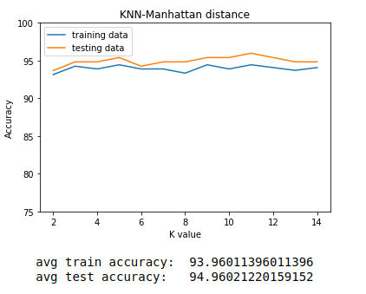
KNN using Manhattan distance
Original dataset Dimensionally reduced dataset Noise added dataset
When noise is added test accuracy overtakes training accuracy.
Overall performance is similar to performance when euclidean distance is used.

Slide 7
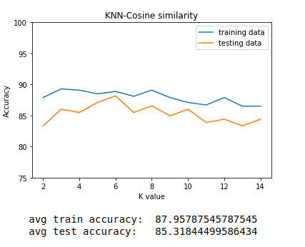
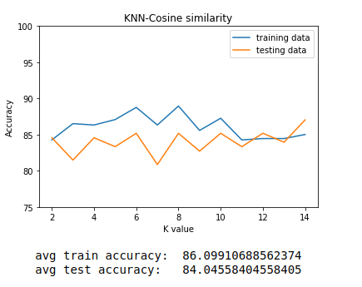
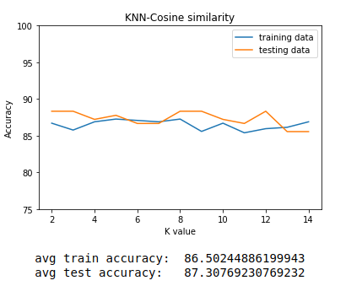
KNN using Cosine similarity
Original dataset Column removed dataset Noise added dataset
Cosine similarity gives poor results when used for the given dataset.
Test accuracy overtakes training accuracy when random noise is added to the dataset.

Slide 8
Conclusion from KNN models-
Overall for the given dataset euclidean or manhattan distance is preferred over cosine similarity as a distance measure for finding k nearest neighbours.
Performing dimensionality reduction makes negligible difference to the accuracy of the model.
Adding random noise to the dataset reduces the training accuracy thereby reducing the risk of overfitting.
We have used CART algorithm which uses gini index to calculate the best split and bias is in favour of larger partitions.

Slide 9
Decision tree
Using decision tree we have compared the performance of original dataset with dimensionally reduced one as well as the dataset containing random noise.
Parameters involved in decision tree model include-
Maximum depth - Maximum depth upto which decision tree is allowed to grow.
Minimum size - If node satisfies less than or equal to min size number of rows than no splitting is performed.

Slide 10
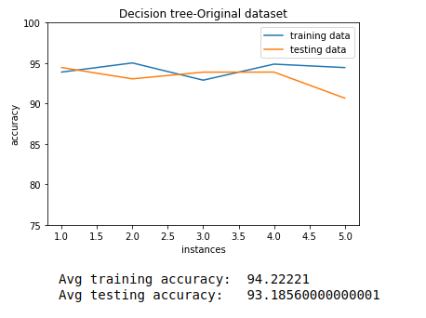
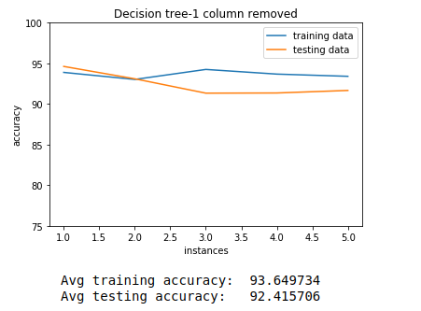
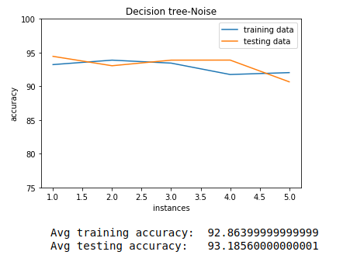
Decision tree performance-
Performance is highest for original dataset and dimensionality reduction as well as random noise has minimal effect on performance of decision tree model.
Hence,we can observe that decision trees are robust to outliers.

Slide 11
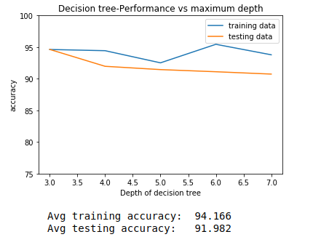
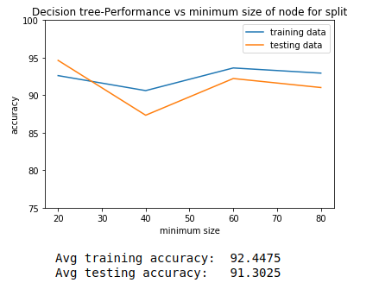
How performance of decision tree varies with change in parameters
As the depth of tree increases performance does not reduce drastically as performance is also bounded by the other parameter which is minimum size required for split to occur and vice-versa.

Slide 12
Conclusion-
Performance of KNN using euclidean and manhattan distance is high and very similar to the performance of decision tree.
Performance of KNN using cosine similarity as distance measure gives poor results compared to the other models.
Dimensionally reducing the dataset and adding noise to the dataset reduces the overall performance of the model by very small amount.
When noise is added training accuracy decreases below test accuracy as the training model learns the noise present.

Slide 13
THANK YOU

