Slide 1
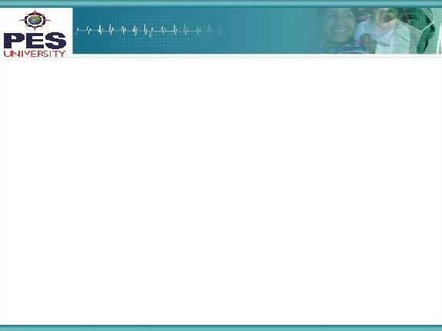





Project Presentation - TDL
Project Title
: Sentimental analysis using
twitter data
Project Team : Sujay Gad PES1201700177

Slide 2
Project Abstract and Scope
Project is based on performing sentimental analysis on tweets.
Dataset used is taken from Stanford University and consists of 6 columns - target class , id , time , tweet_query , username and tweet itself.
Dataset consists of 1.6 million rows.Since it is large 20000 rows are sampled from the dataset each time.
Steps followed are data preprocessing, splitting data into training and testing dataset, using word2vec model to convert words into vectors and also padding the sequences.Than the Keras model is created using embedding, dropout, GRU and dense layers.This model is trained and tested and than it used to predict sentiment of a new tweet.
Applications of sentimental analysis include predicting the next US president based on twitter sentiment, Analysing the general public opinion on a new government policy.

Slide 3
Solution Steps
Data cleaning-
Involves removing twitter usernames as well as removing weblink present in the tweet.
Removing non alphabetic characters present in the tweet.
Removing 1 letter words present in the tweet.
Using nlp library snowballstemmer so that ‘play’ , ‘plays’ ,’playing’ all convert to ‘play’ and vocabulary size is reduced.
Train-test split-
Dataset is split into training and testing set using split ratio 0.75.

Slide 4
Solution Steps
Embedding layer-
Word2vec model present in Gensim library is used on the training set to convert words into vectors.
Max length parameter for the tweets has been kept as 200 since all the tweets in the dataset are from the time when twitter allowed maximum of 140 characters per tweet.
Dropout layer-
Dropout layer is used to prevent overfitting. Unlike movie reviews or amazon product reviews tweets can be based on any topic hence twitter data usually contains noise hence to prevent overfitting dropout layer is used.

Slide 5
Solution Steps
GRU layer-
GRU is preferred over LSTM since it consumes lesser memory and also number of floating point operations performed per second is less for this model.
Target class-
Original dataset consisted of only 2 values in the target class column ie - 0,4 representing positive and negative sentiment.Since many tweets often do not have any + or - sentiment associated with it, a third target class called ‘neutral’ is added.

Slide 6
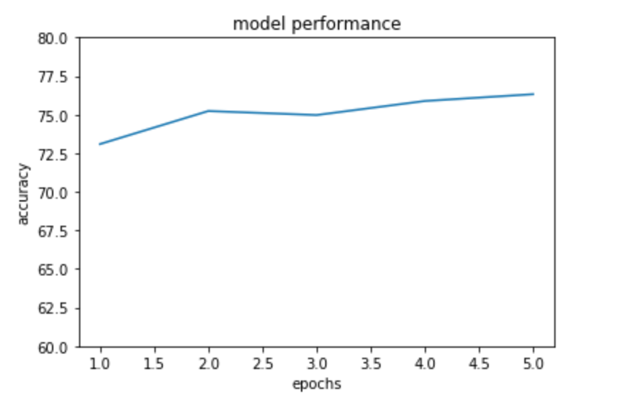
Performance
Overall performance of the model is around 75%.

Slide 7
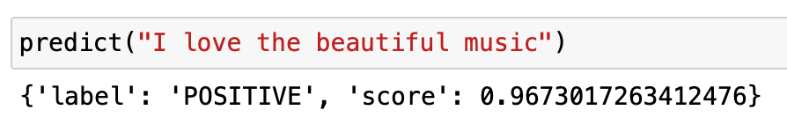
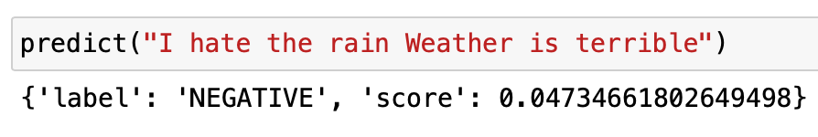
Examples

Slide 8
Constraints, Assumptions & Dependencies
This model works on tweets written only in English language.It ignores non English words as well as emojis which can have emotions attached.
Stop words such as this, that, and, or degrade the performance of the model as most of them do not have any sentiment attached.Stop words can’t be removed since words like “not” play a big role in sentimental analysis.
It also fails to differentiate 1 word having 2 different meanings in 2 different contexts eg - apple.

Slide 9
References
Stanford University, “Sentimental analysis twitter data”, http://cs.stanford.edu/people/alecmgo/trainingandtestdata.zip
Ricky Kim, “Another Twitter sentiment analysis with Python — Part 1”, https://towardsdatascience.com/another-twitter-sentiment-analysis-bb5b01ebad90
NSS, “An Intuitive Understanding of Word Embeddings: From Count Vectors to Word2Vec”, https://www.analyticsvidhya.com/blog/2017/06/word-embeddings-count-word2veec/

Slide 10
Thank You

