Slide 1
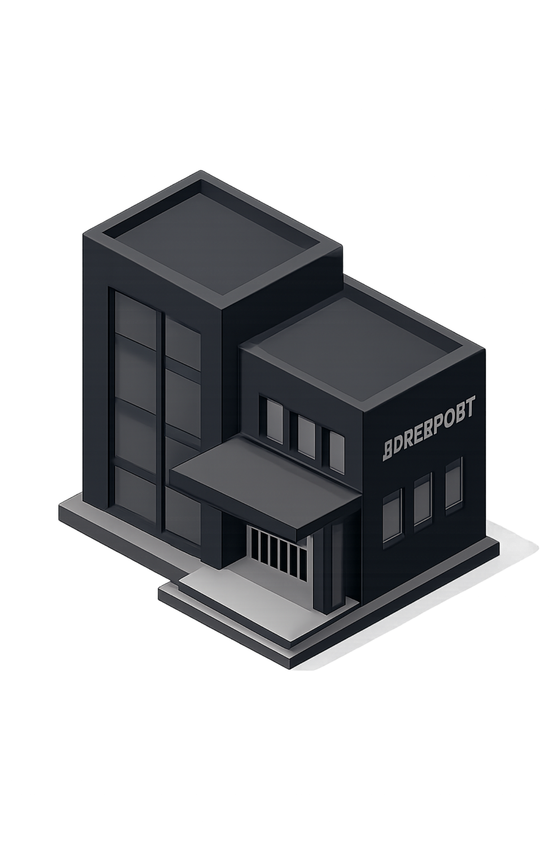
Biometric and Geofencing Based Attendance System
Smart College Attendance System
Team Members:
Sanket Biradar (CO4009)
Sujay Bonde (CO4011)
Dnyaneshwar Danene (CO4013)
Aditya Jagtap (CO4027)
Guide: Dr. D.M Yadav, Principal
Institution: PK Technical Campus, Chakan — SPPU
Academic Year: 2026–27

Slide 2
Introduction & Problem Statement
Manual Attendance
Proxy Attendance Risk
Online Attendance Limitation
Time-consuming process that burdens faculty every session.
Roll calls and signatures can be forged; ID and RFID cards can be shared between students.
Cannot verify actual physical presence in the classroom — students may mark from anywhere.
Face-Only Vulnerability
Need for Solution
Face recognition alone is susceptible to photo and video spoofing attacks without liveness detection.
A secure, automated, and reliable system combining multiple verification layers is required.

Slide 3

Objectives
1
Secure Automated Attendance
Eliminate manual effort and proxy attendance through multi-layer biometric verification.
2
GPS Geofencing + Face Recognition + Liveness
Verify physical presence, student identity, and confirm the person is live — not a photo or video.
3
Multi-Role Dashboards & Reports
Separate interfaces for students, teachers, and administrators with real-time updates and CSV/Excel report generation.
4
Dual Mode Support
Support both classroom and online attendance modes while preventing duplicate records.

Slide 4

Literature Survey: Existing Approaches
Limitations of Current Methods
Proposed Approach
Method | Key Limitation
Manual / Roll Call | Time-consuming, error-prone, easily forged
RFID / Barcode | Verifies card only, not the actual person
Fingerprint | Better identity check but requires dedicated hardware
Face Recognition Alone | Cannot verify physical presence or detect liveness
Geofencing Alone | Verifies location but does not verify identity
A multi-layered verification strategy that addresses all individual weaknesses:
Face Verification
Liveness Detection
Confirms student identity
Prevents spoofing attacks
Geofencing
Confirms physical presence
Attendance is recorded only when all three checks pass simultaneously.

Slide 5

Proposed System: Three-Layer Verification
Layer 1 — GPS Geofencing
Layer 2 — Face Verification
Layer 3 — Liveness Detection
Confirms the student is physically within the classroom-defined radius using browser geolocation and the Haversine distance formula.
Confirms student identity by comparing the captured face against the enrolled face embedding stored in the database.
Confirms the person is live — not a photograph or replayed video — through blink detection and head movement challenges.
✓ Attendance is recorded ONLY when all three verification checks pass successfully.

Slide 6
System Architecture
1
2
3
4
Frontend
Backend (Spring Boot)
CV Service (FastAPI)
Database (PostgreSQL)
React + TypeScript + Tailwind CSS — Student Dashboard, Teacher Dashboard, Camera & Geolocation Capture
Authentication, User & Course Management, Geofence Validation, WebSocket Communication, Reports
Face Detection, Embedding, Matching & Liveness Detection — internal service via Spring Boot only
Users, Courses, Enrollments, Face Embeddings, Attendance Records, Audit Logs

Slide 7
Attendance Marking Workflow
1
2
3
Session Setup
GPS Capture & Geofence Check
Liveness Challenge
Teacher creates course, enrolls students, and opens an attendance session with classroom location, radius, and time window.
Python FastAPI issues a liveness challenge (blink / head turn). Student performs the challenge on camera.
Student logs in and selects "Mark Attendance." Browser captures GPS location; Spring Boot validates using Haversine formula.
4
5
Face Matching & Record
Real-Time Dashboard Update
Face is detected and compared with enrolled embedding. If all checks pass → Attendance stored. ✗ Any failure → Rejected.
WebSocket immediately updates the teacher dashboard with the student's live attendance status.

Slide 8




Technology Stack
Frontend
Backend
Computer Vision
Database & Deployment
React | TypeScript | Tailwind CSS | Recharts / Chart.js
Java Spring Boot | Spring Security | JWT | WebSocket / STOMP over SockJS
Python FastAPI | OpenCV | MediaPipe
PostgreSQL | Docker | Docker Compose | Apache POI | CSV Export | Matplotlib | Browser Geolocation API | Haversine Formula

Slide 9
Advantages, Applications & Future Scope
Advantages
Future Scope
Applications
College lectures, laboratory sessions, seminars, and workshops
Examination hall identity verification
Restricted labs and access-controlled spaces
Mobile App
Automated Reports
Native mobile application with push notifications for attendance alerts
Automated weekly and monthly report generation
Anti-Spoofing
ERP Integration
Stronger depth-based or challenge-response anti-spoofing mechanisms
College ERP integration via REST APIs and enhanced biometric encryption
Reduces proxy attendance — verifies identity, liveness, and location together
Prevents photo and video spoofing attacks
Real-time teacher dashboard updates via WebSocket
No dedicated fingerprint or RFID hardware required
CSV/Excel reports and analytics generation

Slide 10

Conclusion
Three-Layer Verification
Combines geofencing, face recognition, and liveness detection for comprehensive, tamper-resistant attendance verification.
Modular Architecture
React + Spring Boot + FastAPI design ensures separation of concerns; internal isolation of the CV service enhances security.
Reliable Records
PostgreSQL with database-level duplicate prevention ensures organized, consistent, and trustworthy attendance data.
Real-Time Visibility
WebSocket-driven live dashboard helps teachers monitor student attendance efficiently without manual intervention.
Thank You — Questions?

