Slide 1

Striking the Right Chord: Parameter Tuning in Memory Tiering Systems
Konstantinos Kanellis*, Sujay Yadalam*, Shivaram Venkataraman, Michael Swift
University of Wisconsin-Madison

Slide 2
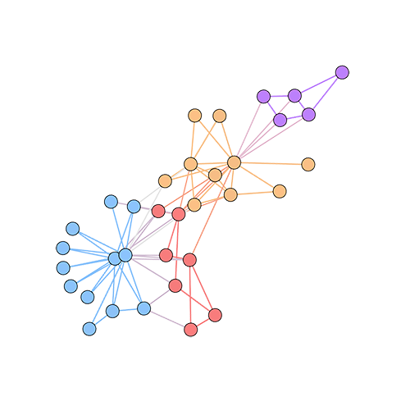
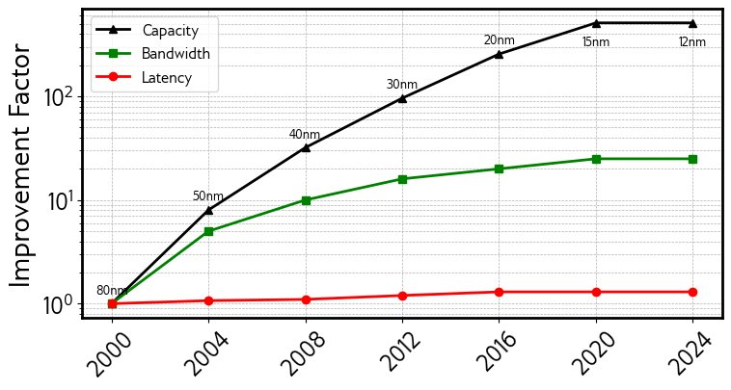

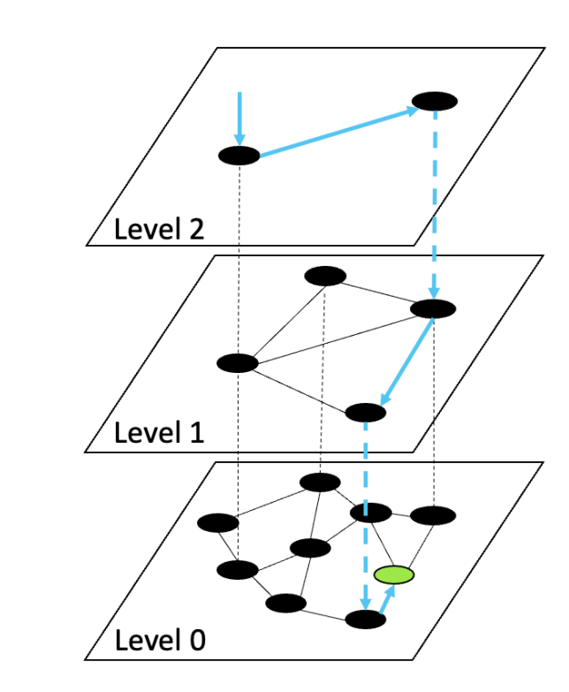
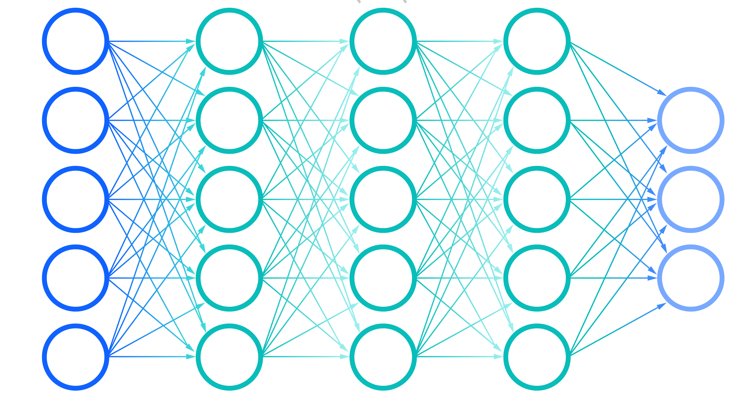


Memory: A critical datacenter resource
In-memory databases
Real-time Analytics
Machine Learning
DRAM capacity, bandwidth and latency scaling¹
Vector Search
Modern workloads demand large memories for good performance
DRAM scaling has slowed down considerably
[1] O. Mutlu et.al. “A Modern Primer on Processing in Memory.” on arXiV.​
Overview

Slide 3
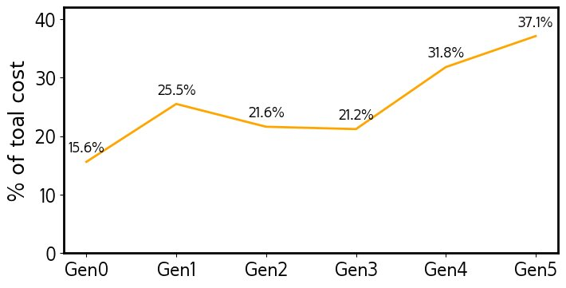
Memory: A critical datacenter resource
Memory as a percentage of rack TCO at Meta^{1​}
Memory costs in datacenters rising!
Overview
[1] H. Maruf. et.al. “TPP: Transparent Page Placement for CXL-Enabled Tiered-Memory” at ASPLOS 2023.​

Slide 4




Cost-effective scaling: Tiering
Key idea: Use cheaper and/or
denser alternatives
CPU
Local DRAM
Challenges:
High latency
Low bandwidth
Memory nodes
over RDMA (far memory)
NVM
CXL memory expander
Overview

Slide 5

Software-managed Memory Tiering
Goal: Maximize app. performance by reducing accesses to slow memory tier
Fast memory tier
Slow memory tier
Overview

Slide 6
Software-managed Memory Tiering
Goal: Maximize app. performance by reducing accesses to slow memory tier
Place hot data in fast tiers cold data in slow tiers
Cold page
demotion
Fast memory tier
Slow memory tier
Overview

Slide 7
Software-managed Memory Tiering
Place hot data in fast tiers cold data in slow tiers
Current systems: Rigid heuristics with pre-configured static thresholds
Cold page
demotion
Fast memory tier
Parameter​​ | Defaults​​
Hot threshold​​ | 8 accesses​​
Cooling trigger​ | 18 accesses​​
Sampling rate​​ | 1 in 10K​​
Migration interval​ | ​10ms​
Migration rate​ | 2 GB/s​
….​ | ​
Slow memory tier
Overview

Slide 8
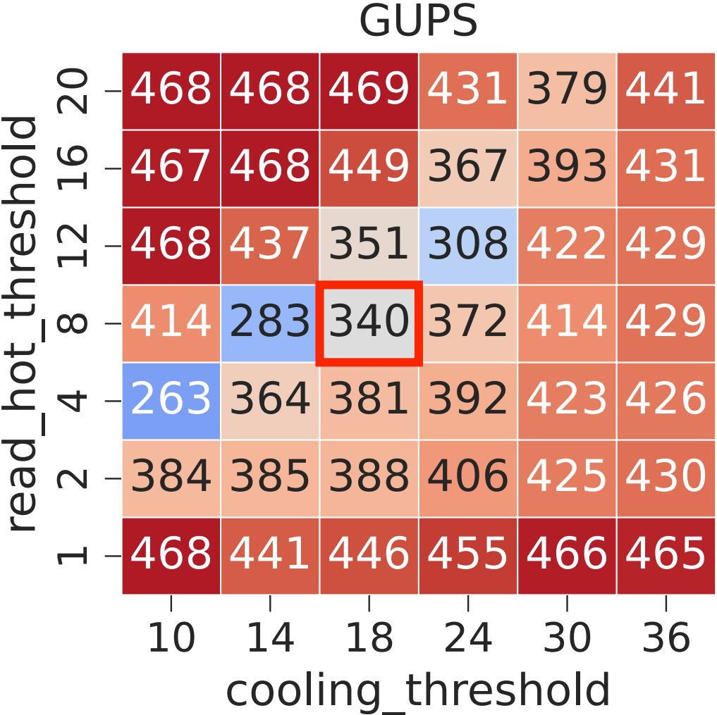
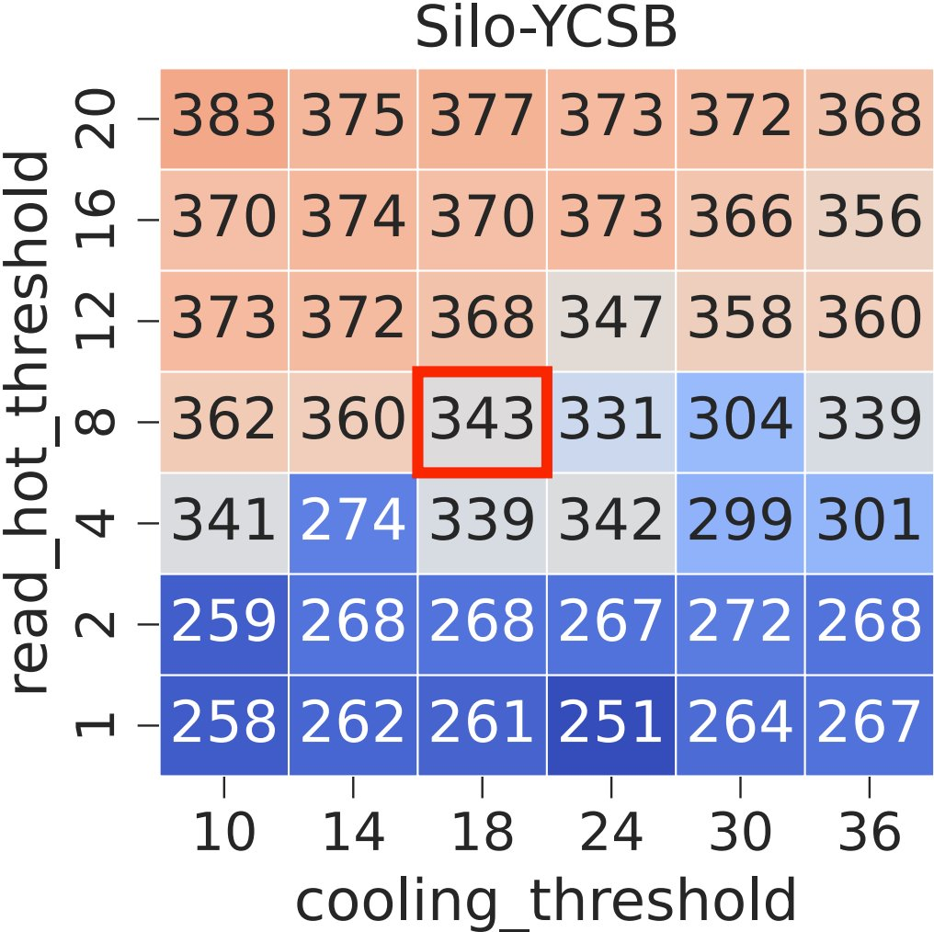
Importance of parameter values
Default values
Best values
Insight #1: Applications are sensitive to parameter values​
Number in each box shows runtime in seconds. Lower (blue) is better.
Insight #2: Different applications have different best parameter values​
Overview
[1] Raybuck A., et al. "Hemem: Scalable tiered memory management for big data applications and real NVM“ at SOSP 2021.
Notes:
Takeaways: 1) Applications are sensitive to the threshold values. 2) The grids look different for different applications. The best configurations are different.

Slide 9
Our work
Goal: Understand role of parameters in tiering systems
Approach: Identify best parameter values and analyze differences in tiering decisions
Tuning existing tiering parameters provides up to 2x benefit!
Overview
9

Slide 10
Outline
Overview
Background: Existing tiering systems
Tuning methodology
Results
Discussion
10

Slide 11
Software-managed Memory Tiering
What data should be placed where and when should we move it?
Step 1: Gather memory access info
Cold page
demotion
Fast memory tier
Step 2: Classify hot and cold data
Hot page
promotion
Step 3: Migrate data across tiers
Slow memory tier
Background
11

Slide 12
Existing systems
Page table scanning (e.g. DAMON)
HW event sampling (e.g. PEBS)
Page faults
Access Frequency
Thermostat HeMem HybridTier
Memtis ArtMem M5
Chrono
Heuristic
HMSDK IDT
TMTS
FlexMem
AutoTiering TPP
Multi-Clock
Access Recency
Page access monitoring
Background

Slide 13
Reliance on static parameters
Gathering access info
Hot/cold classification
Migration decisions
Tiering system | Parameter​​
HeMem | read_sample_period
 | write_sample_period
Memtis | read_sample_period
 | write_sample_period
HMSDK | scan_interval
 | aggr_interval
Tiering system | Parameter​​
HeMem | hot_threshold
 | cold_threshold
Memtis | adaptation_interval
 | cooling_interval
HMSDK | promo:age
 | promo:nr_accesses
Tiering system | Parameter​​
HeMem | migration_period
 | max_migration_rate
Memtis | promotion_period
 | demotion_period
HMSDK | quotas:time_ms
 | quotas:max_sz_bytes
[1] Raybuck A., et al. "Hemem: Scalable tiered memory management for big data applications and real NVM“ at SOSP 2021.
[2] T. Lee, et.al. ”Memtis: Efficient memory tiering with dynamic page classification and page size determination at SOSP 2023.
[3] K. Lee, et.al. “Improving Key-Value Cache Performance With Heterogeneous Memory Tiering” at IEEE Micro 2024.
Background
13
Notes:
While Memtis has few dynamic paramters, still several parameters are static

Slide 14
Parameter value importance
Goal: How important are these parameter values for application performance?
How do the parameter values affect tiering decisions?
What factors affect the best values?
Is one system more robust than others?
14

Slide 15
Parameter tuning study
Tiering systems tuned: 1. HeMem[1]: 10 parameters 2. Memtis[2]: 6 parameters 3. HMSDK[3]: 16 parameters
Hardware: 1. NUMA CXL emulation
2. PMEM slow tier
Workloads: 1. Graph algorithms: BC, CC, PR
2. Classifier training: Liblinear
3. In-memory database: Silo
4. Index lookup: Btree
5. HPC: XSBench
6. Microbenchmark: GUPS
Different configurations:
Different inputs
Thread counts
Memory ratios
Grid-search or random-search for finding best parameter values is extremely expensive!
Tuning study
15

Slide 16
Tuning methodology
Approach: Utilize Bayesian Optimization to identify best parameter configurations efficiently
Ground Truth, f(x)
Approx. Function, f*(x)
16

Slide 17



Tuning methodology
Approach: Utilize Bayesian Optimization to identify best parameter configurations efficiently
Performance metric (throughput/ latency)
Register Observation
Workload
Knowledge Base
Controller
Update Optimizer
Invoke
Execute
Configuration Optimizer
Tiering system
Suggest Configuration
Set Config
17

Slide 18
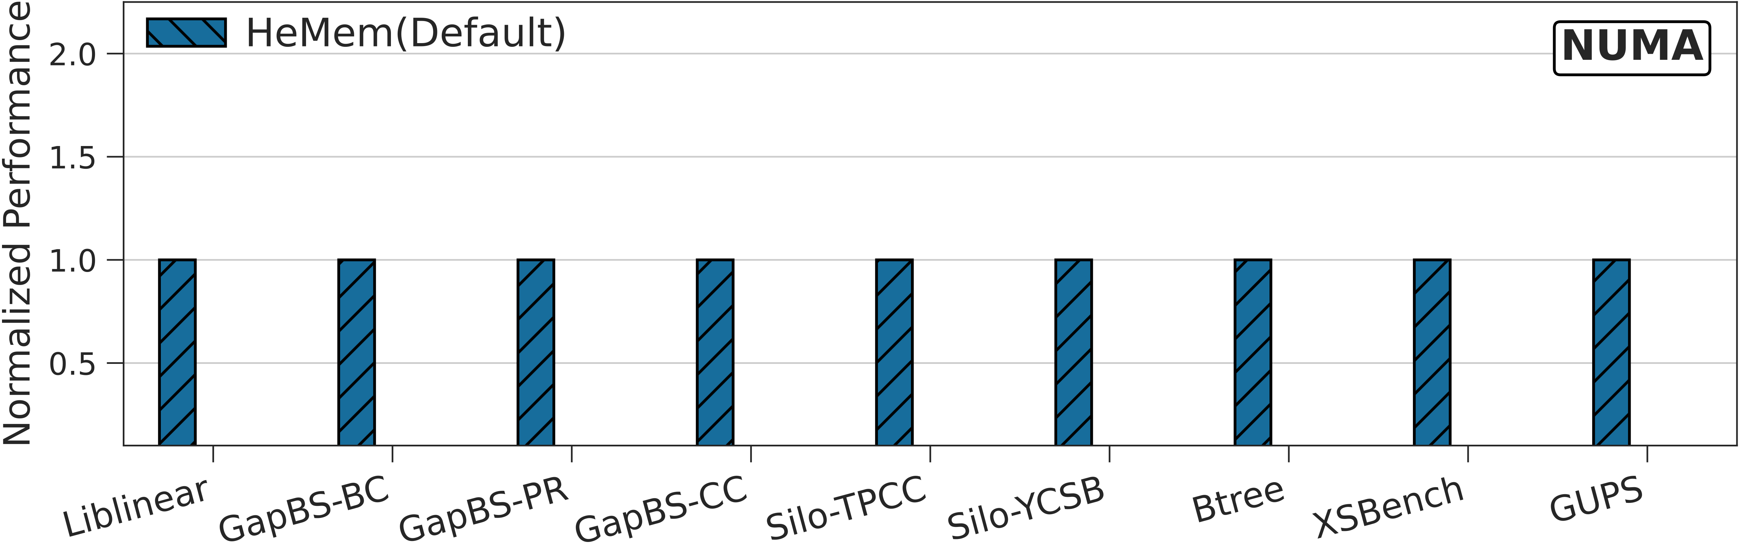
Performance benefits
[1] Raybuck A., et al. "Hemem: Scalable tiered memory management for big data applications and real NVM“ at SOSP 2021.
[2] T. Lee, et.al. ”Memtis: Efficient memory tiering with dynamic page classification and page size determination at SOSP 2023.
[3] K. Lee, et.al. “Improving Key-Value Cache Performance With Heterogeneous Memory Tiering” at IEEE Micro 2024.
Tuning results

Slide 19
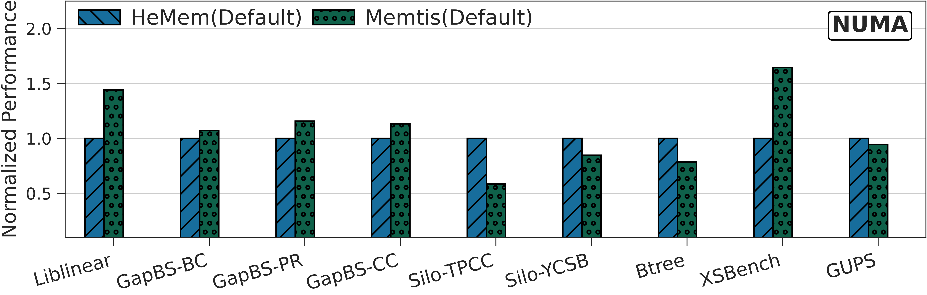
Performance benefits
[1] Raybuck A., et al. "Hemem: Scalable tiered memory management for big data applications and real NVM“ at SOSP 2021.
[2] T. Lee, et.al. ”Memtis: Efficient memory tiering with dynamic page classification and page size determination at SOSP 2023.
[3] K. Lee, et.al. “Improving Key-Value Cache Performance With Heterogeneous Memory Tiering” at IEEE Micro 2024.
Tuning results

Slide 20
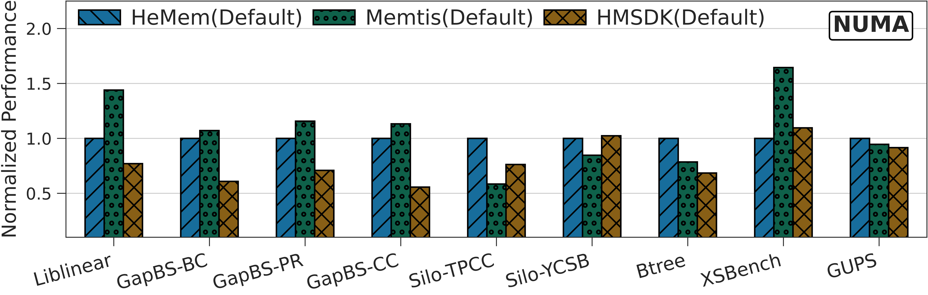
Performance benefits
[1] Raybuck A., et al. "Hemem: Scalable tiered memory management for big data applications and real NVM“ at SOSP 2021.
[2] T. Lee, et.al. ”Memtis: Efficient memory tiering with dynamic page classification and page size determination at SOSP 2023.
[3] K. Lee, et.al. “Improving Key-Value Cache Performance With Heterogeneous Memory Tiering” at IEEE Micro 2024.
Tuning results

Slide 21
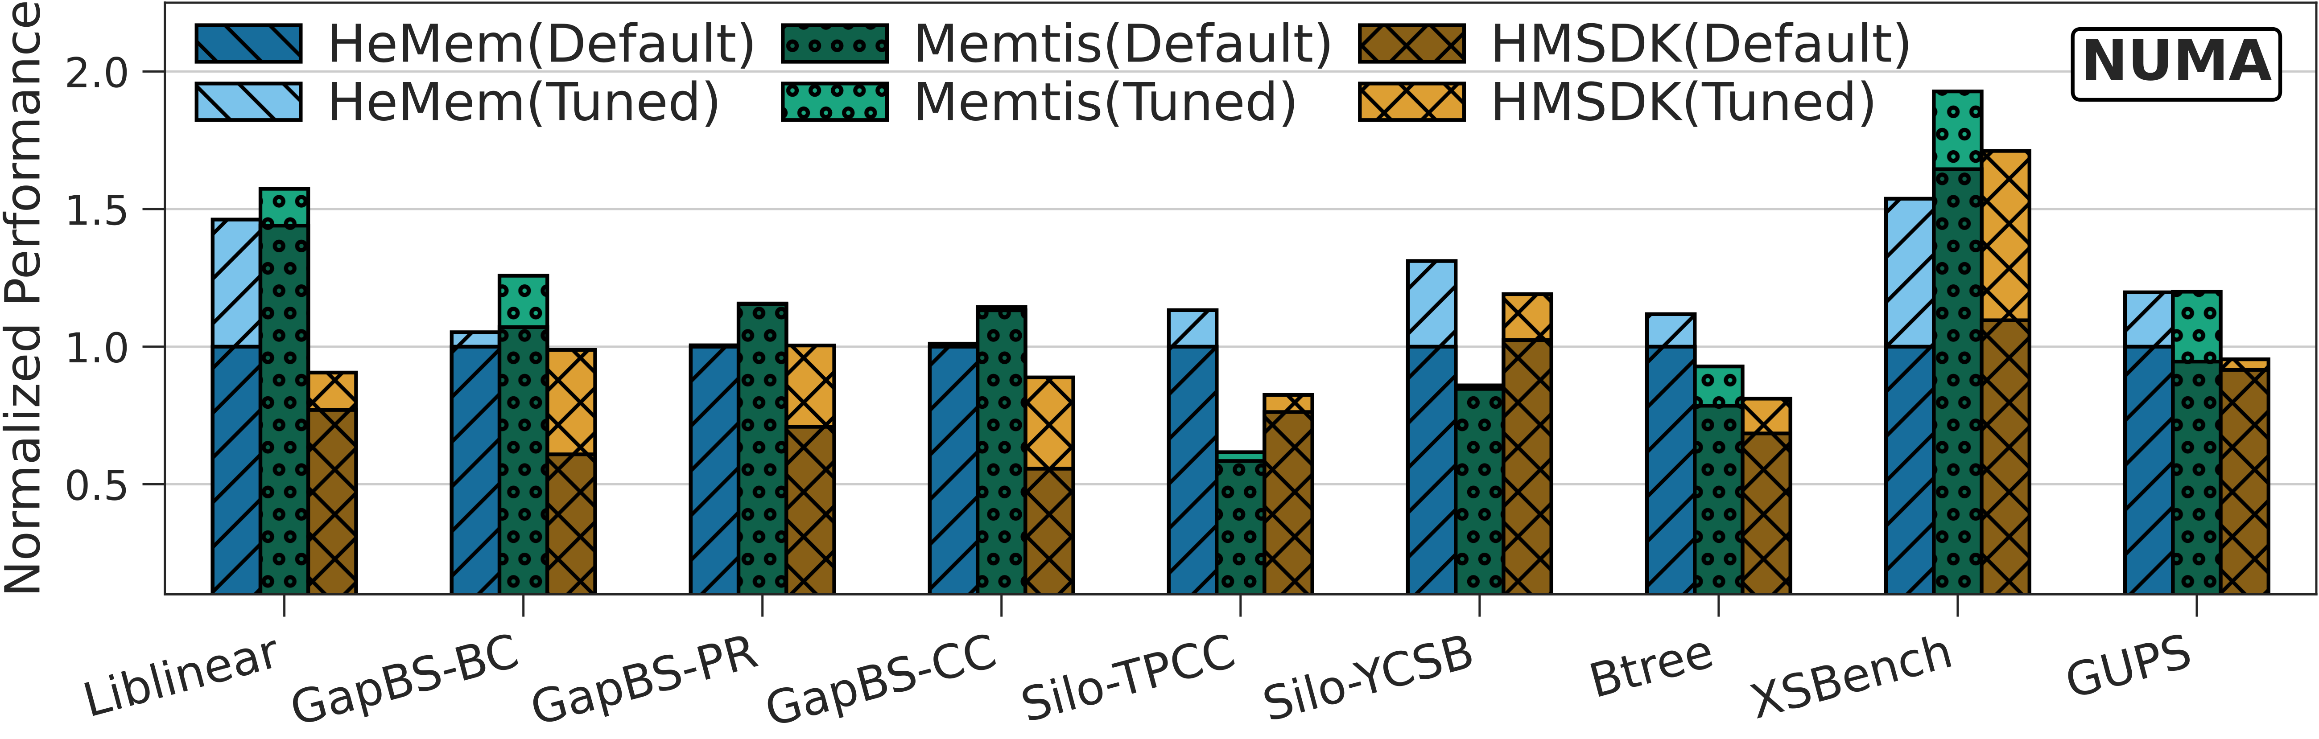
Performance benefits
Tuning can improve performance by 1.7x!
[1] Raybuck A., et al. "Hemem: Scalable tiered memory management for big data applications and real NVM“ at SOSP 2021.
[2] T. Lee, et.al. ”Memtis: Efficient memory tiering with dynamic page classification and page size determination at SOSP 2023.
[3] K. Lee, et.al. “Improving Key-Value Cache Performance With Heterogeneous Memory Tiering” at IEEE Micro 2024.
Tuning results
Notes:
Existing policies and mechanisms have the potential but are held back by inaccurate thresholds

Slide 22
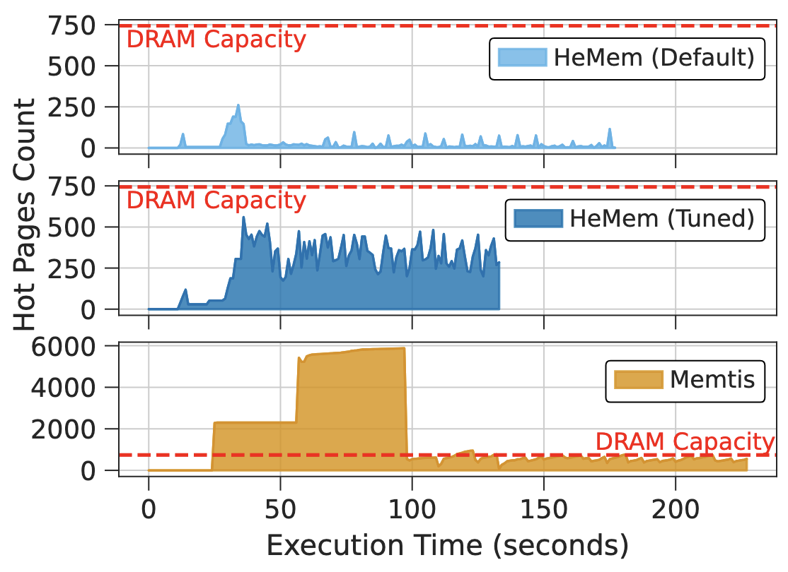
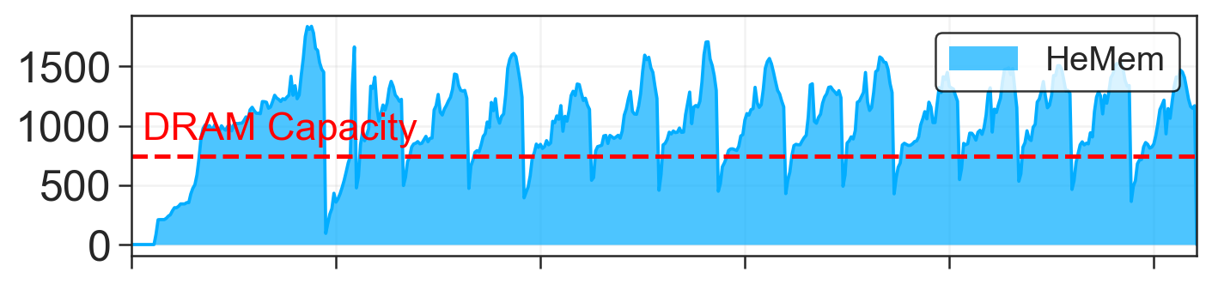
Reasons for improvement
Large hot threshold = few hot pages
Small hot threshold = excess hot pages
Hot Page Count
Hot Page Count
Program execution
Program execution
Hot Page Count
Program execution
Tuning improves accuracy of hot page classification
Tuning results

Slide 23
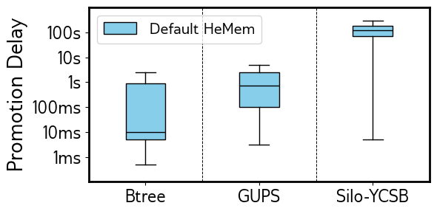
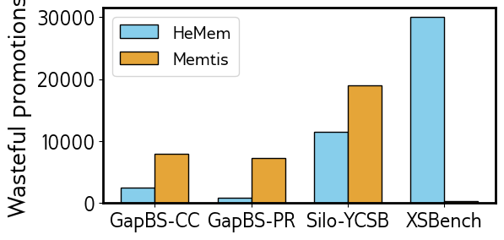
Reasons for improvement
High “cooling threshold” = Not reactive
Delayed promotion
Low “cooling threshold” = Highly reactive
Wasteful migrations
Promotion delay: time between identification and promotion
Tuning reduces promotion delay and eliminates wasteful migrations
Tuning results

Slide 24
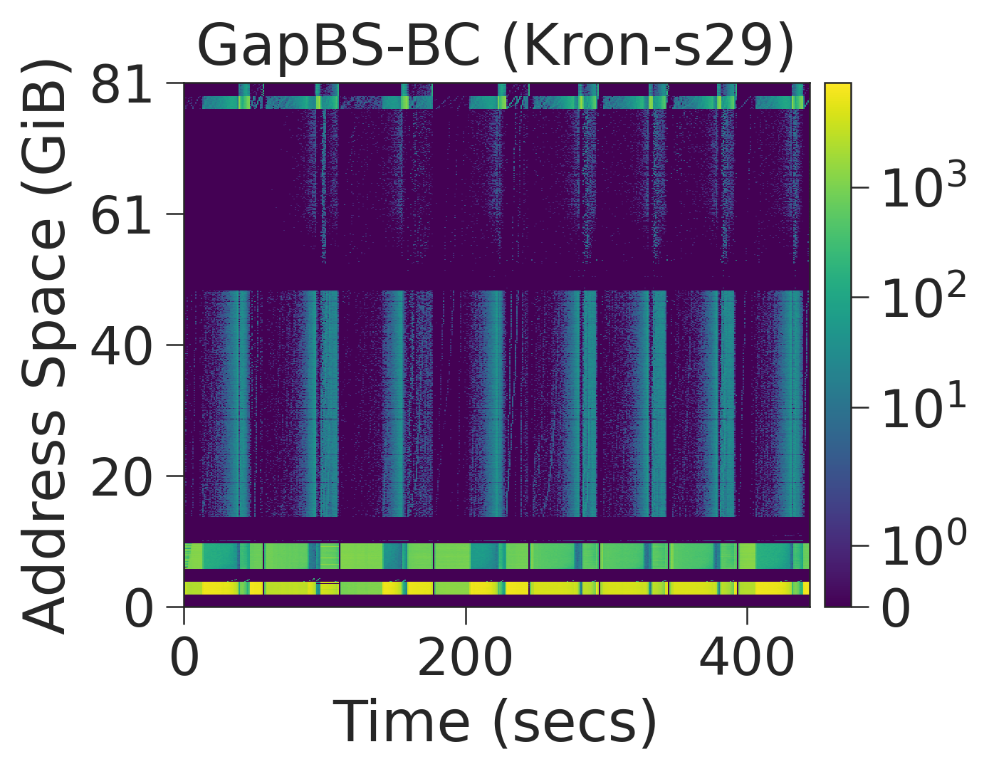
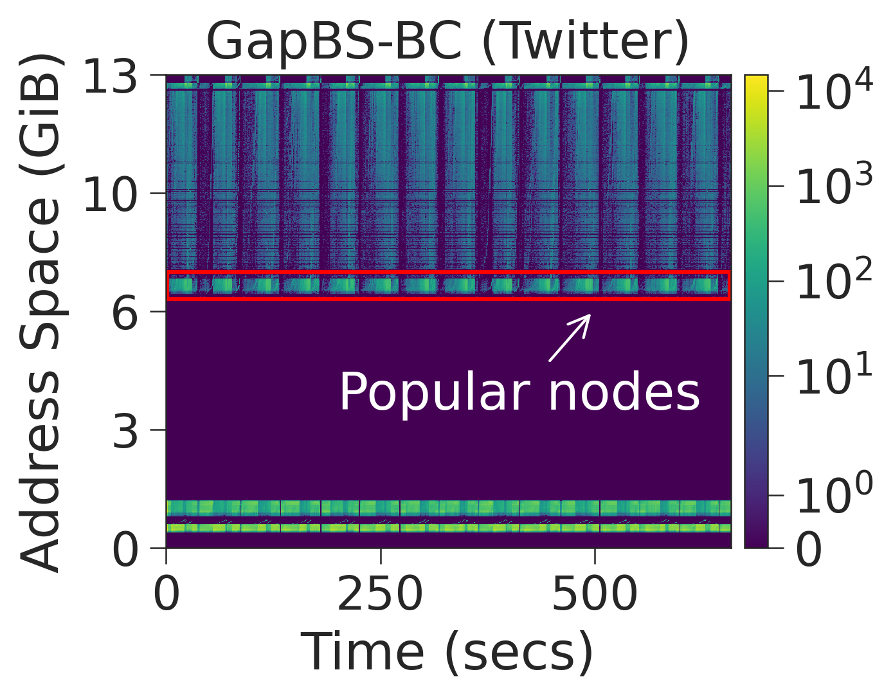
Factors affecting tuned values
Input parameters (e.g. graph, number of threads)
Subtle difference: small set of pages (popular nodes) frequently accessed
Tuning results
24

Slide 25
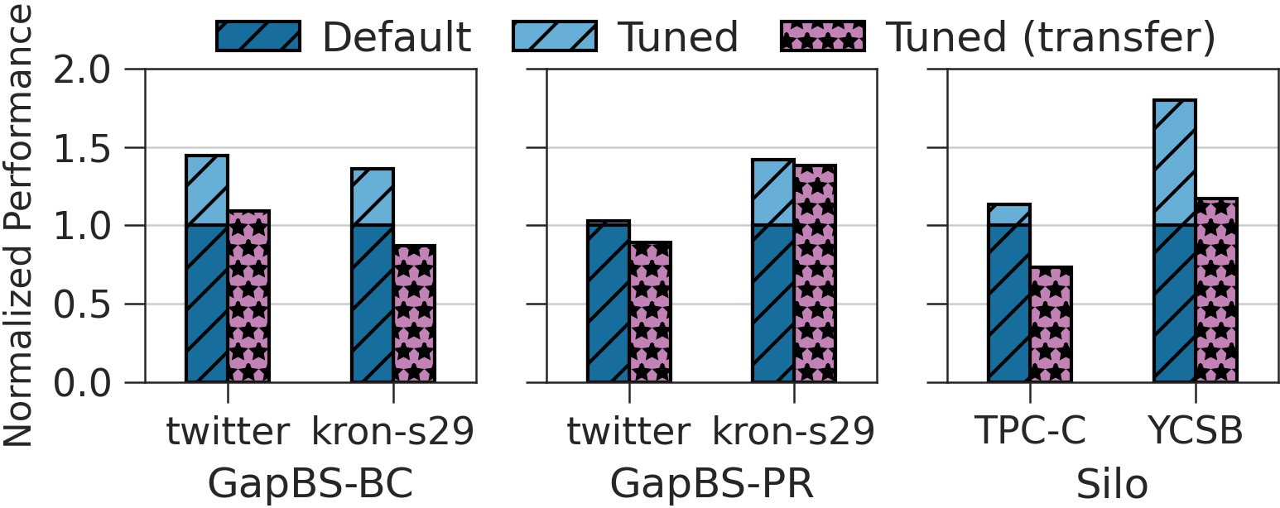
Factors affecting tuned values
Input parameters (e.g. graph, number of threads)
Tuning results
25

Slide 26
Factors affecting tuned values
Input parameters (e.g. graph, number of threads)
Tuning results
26

Slide 27
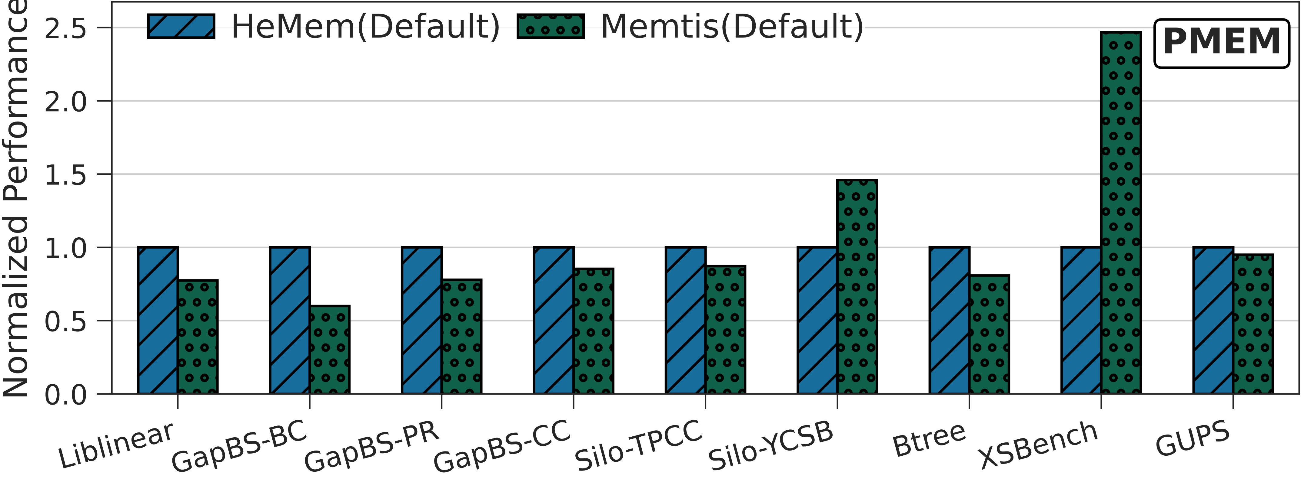
Factors affecting tuned values
Parameters depend on input
Hardware
Tuning results
27

Slide 28
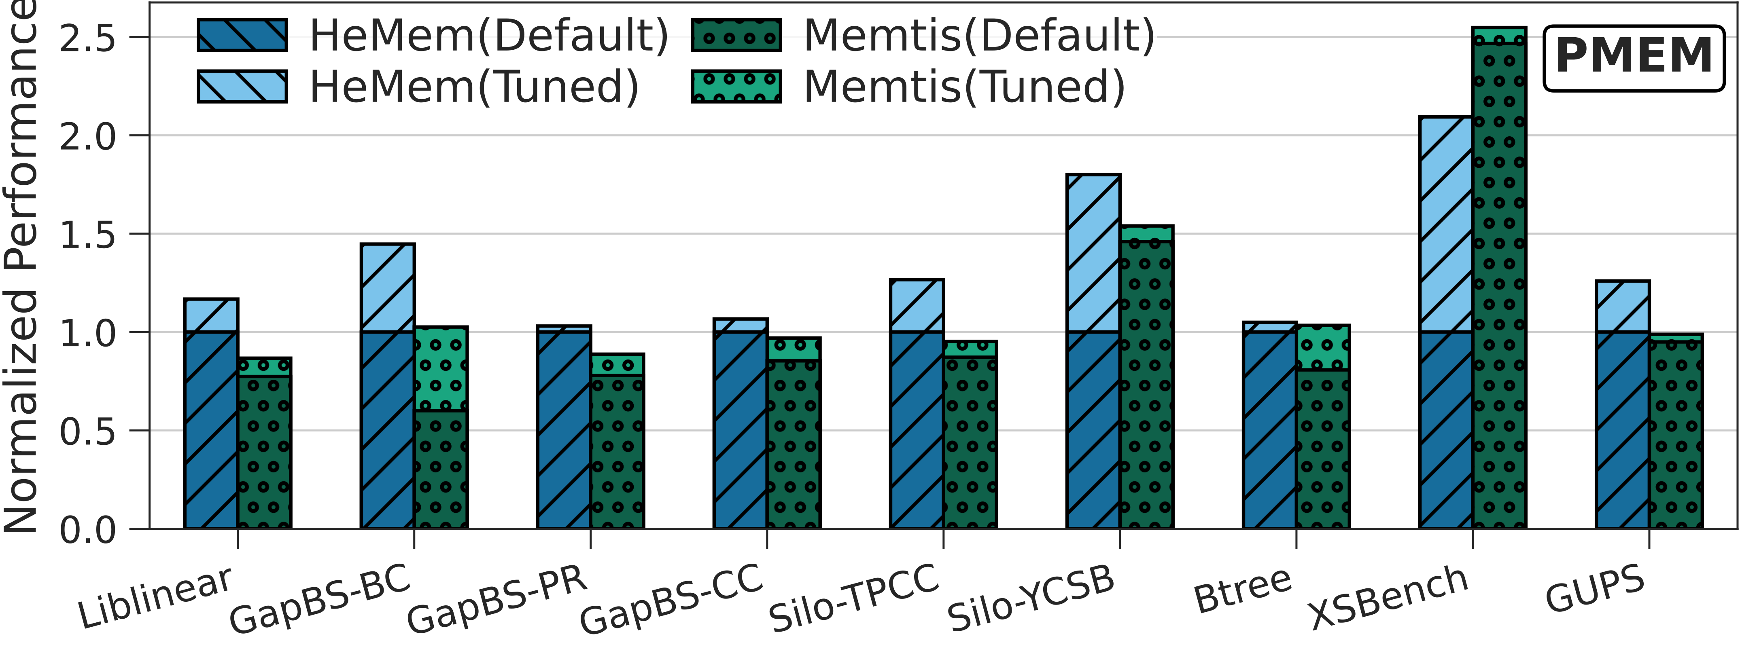
Factors affecting tuned values
Parameters depend on input
Hardware
Tuning results
28

Slide 29
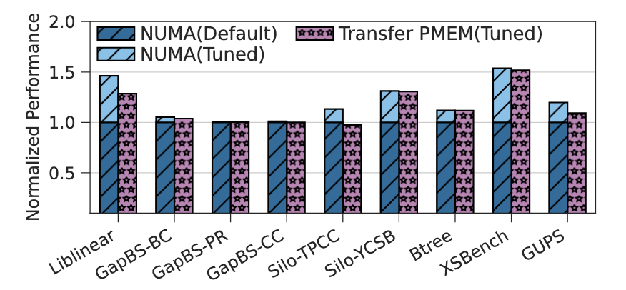
Factors affecting tuned values
Parameters depend on input
Hardware
Tuned configurations can be transferred across different hardware
Tuning results
29

Slide 30
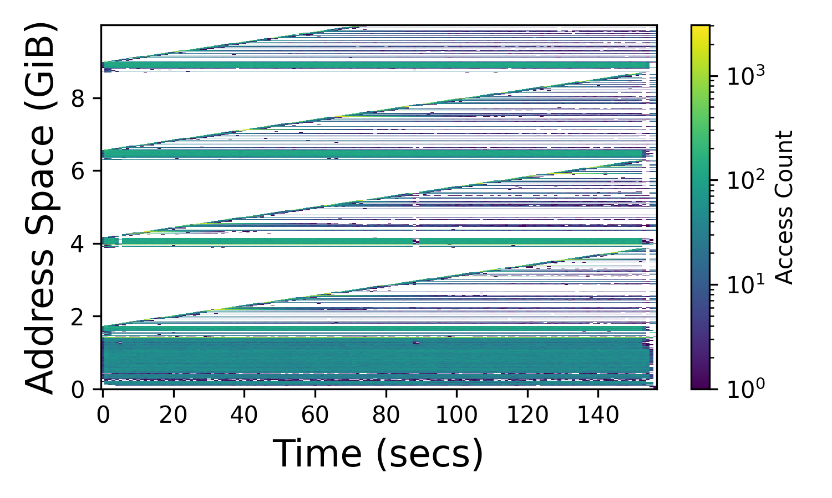
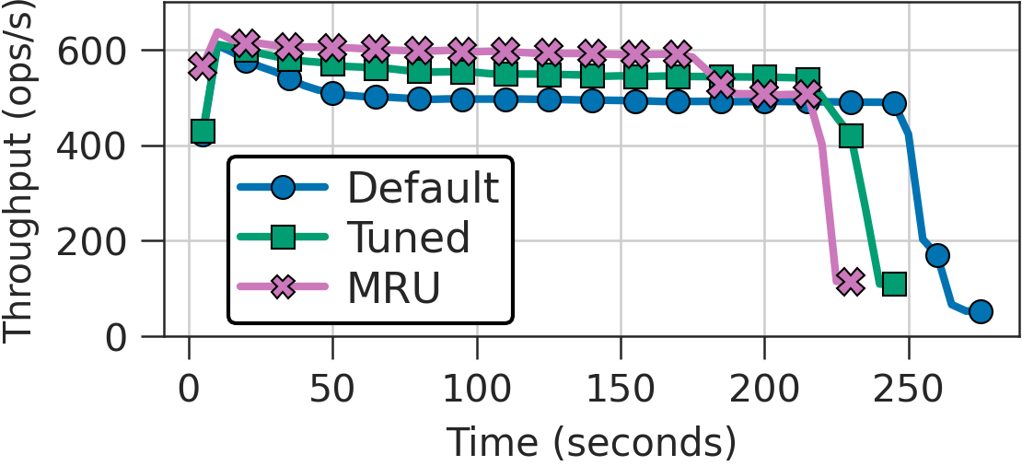
Tuning necessary but not sufficient
Heuristic selection is important
Latest distribution
Silo with TPC-C client
Using an appropriate heuristic provides ~15% perf improvement.
Discussion
30

Slide 31
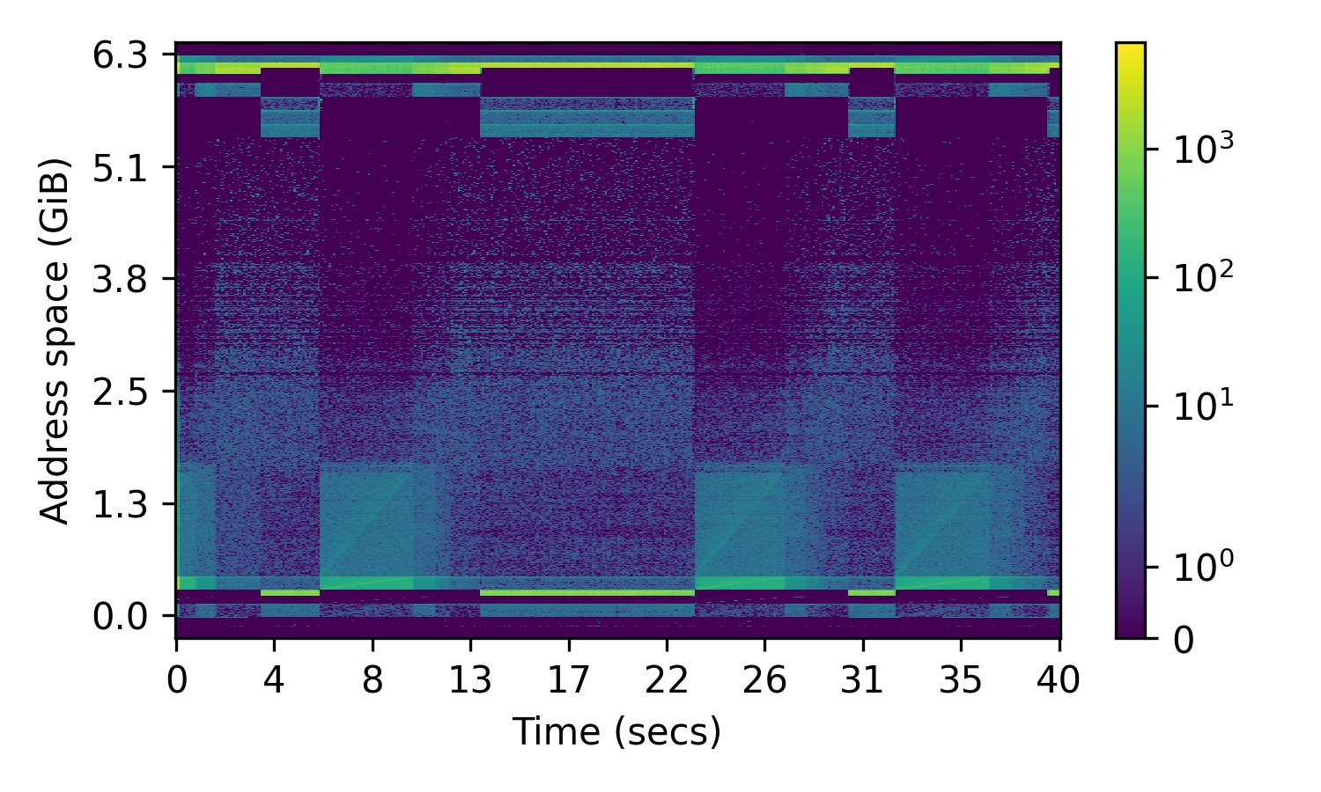
Tuning necessary but not sufficient
Heuristic selection is important
Need dynamic thresholds to adapt to phases
Different phases have different best parameter values
Liblinear
Discussion
31

Slide 32
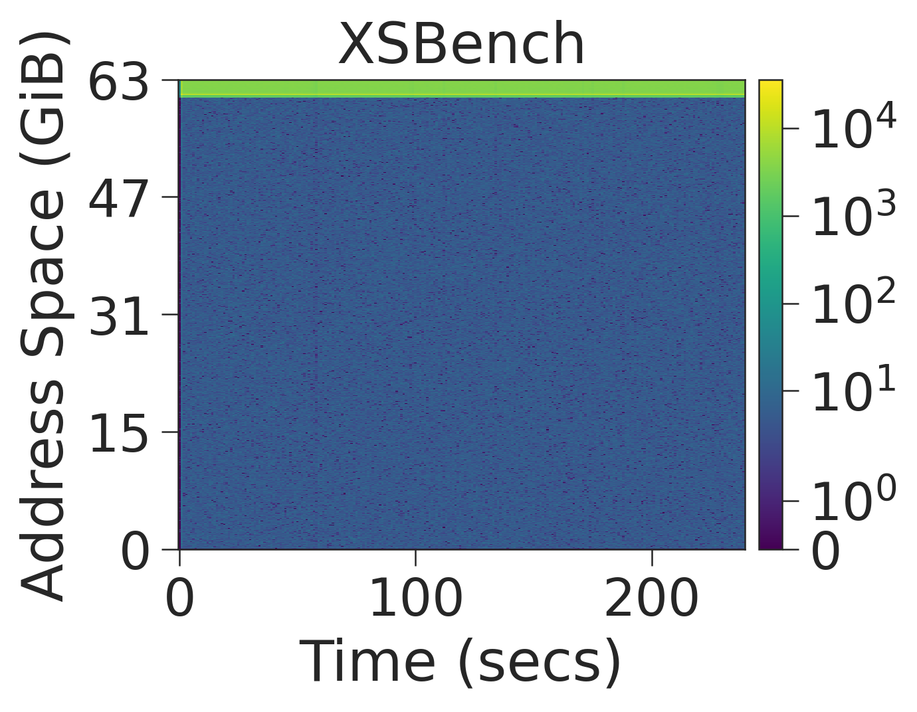
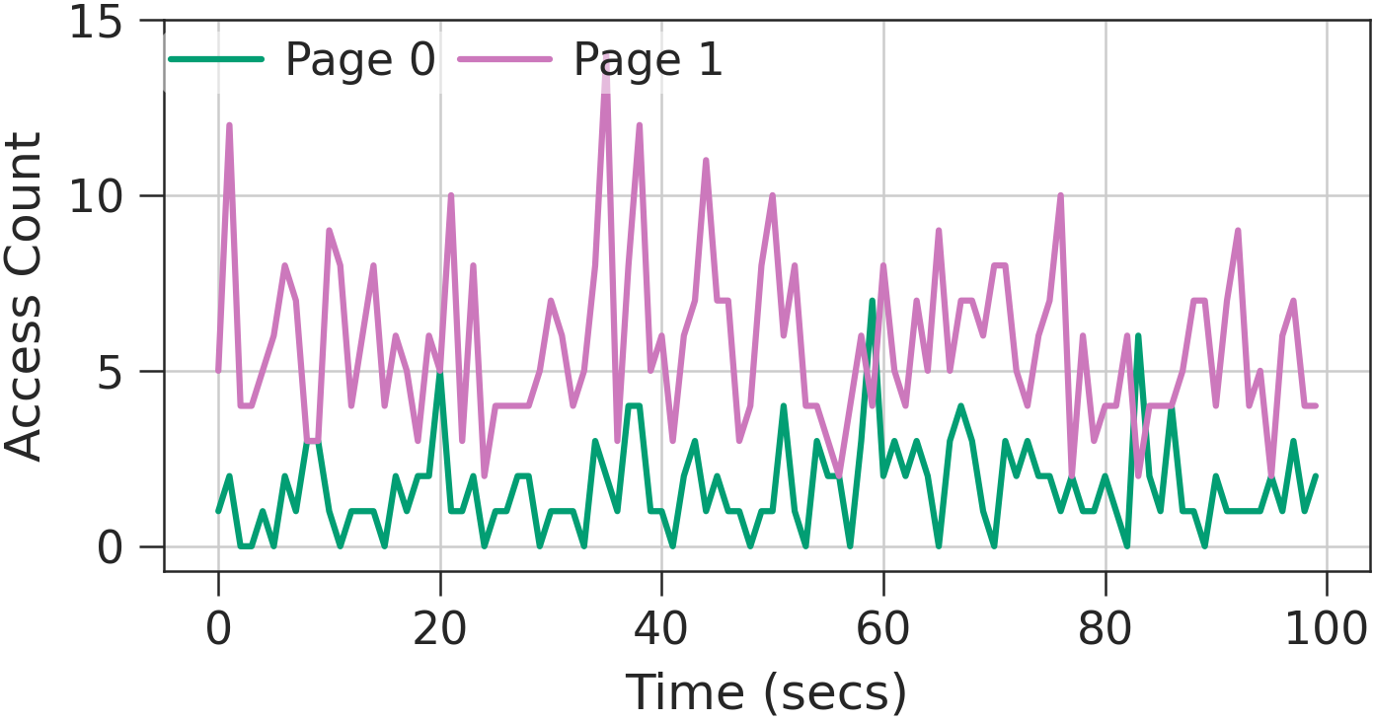
Tuning necessary but not sufficient
Heuristic selection is important
Need dynamic thresholds to adapt to phases
Robust mechanisms to handle input noise
One page might appear hotter than another
Discussion
32

Slide 33
Conclusion
Tiering systems rely on static thresholds to make decisions
Applications are sensitive to these values
Different applications prefer different parameter values
Tuning can yield up to 2x improvement
Future tiering systems should be adaptive and robust
33

Slide 34
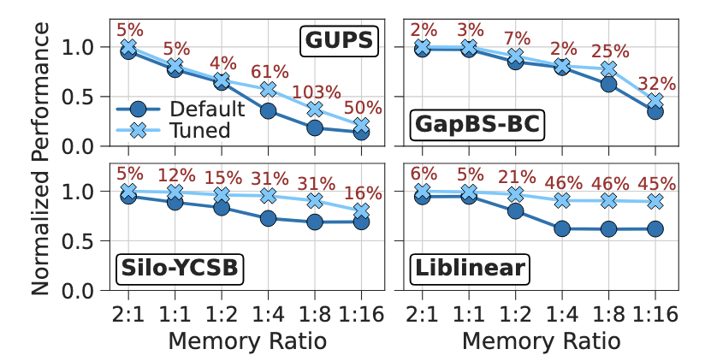
Tuning at different memory ratios
Tuning results

