Slide 1


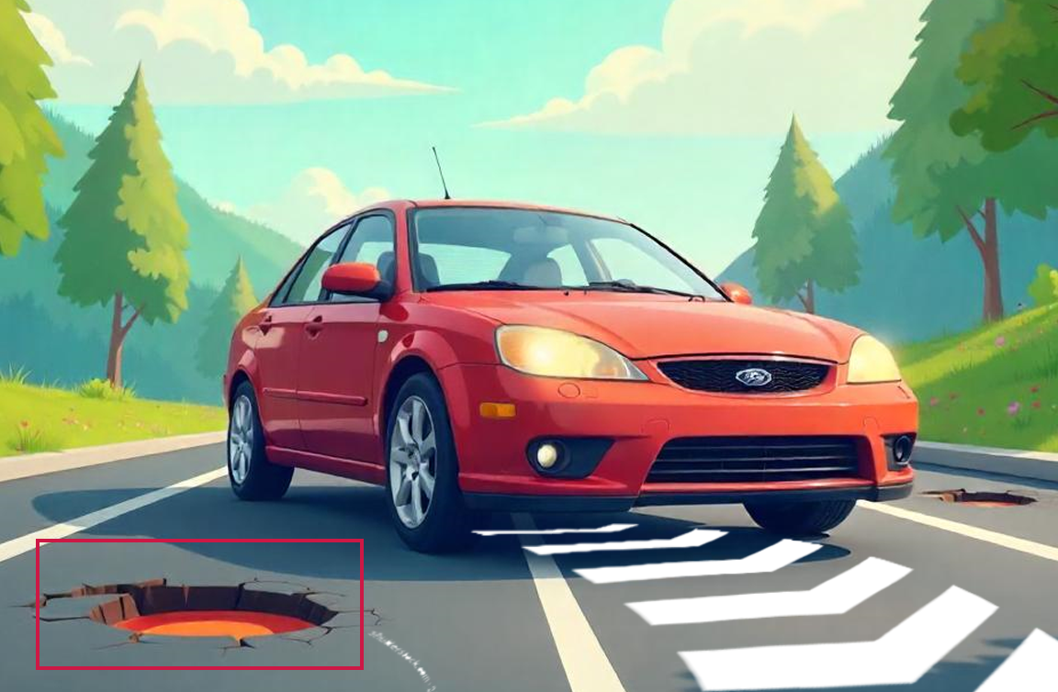



Designing an Advanced Pothole Detection and Mitigation System
Context:
Potholes are increasingly becoming a significant road hazard, leading to fatalities. There is a need for an economical solution that can pre-emptively identify these road hazards and warn drivers in time to maneuver accordingly. Such a method would not only enhance road safety but also potentially save lives by reducing the risk of accidents caused by potholes.
Deployment and Validation
Problem Statement:
Design an innovative and advanced pothole detection system to identify potential road hazards and avoid them.
Data Fusion and
Learning-based Processing for Object Detection
Deliverables:
Develop a pipelined framework for real-time pothole detection using multi-modal data.
A reliable assistance system for executing safe driving maneuvers in real time.
Implement dynamic map updates by marking pothole geo-coordinates.
Detected Pothole
Timeline
Training / Pre-Requisites:
Understanding of Python, MATLAB, Microcontrollers.
Data Fusion and ML algorithms.
Starter Reference Material:
The Use of Lidar and Artificial Intelligence Algorithms for Detection and Size Estimation of Potholes - Sk Abu Talha, Dmitry Manasreh, Munir D. Nazzal.
Review of Recent Automated Pothole-Detection Methods - Young-Mok Kim 1, Young-Gil Kim 1, Seung-Yong Son 2, Soo-Yeon Lim 3, Bong-Yeol Choi 4 and Doo-Hyun Choi 4.
Pothole Detection Using Computer Vision and Learning - Amita Dhiman and Reinhard Klette.
Month 1 Hands on learning with sensors and architectures Dataset Preparation | Month 2 Designing and developing the base framework Training and initial testing | Months 3 & 4 Real-time testing and validation on a vehicle in a live environment Documentation and applying for contests

